Slide 1



Stable usage of modes for wavefront representation without truncation
WFS Workshop Porto 2022
Andreas Obereder, AAO Team

Slide 2

The Scheme (Baseline)
WF Estimation
  VDM - Discretization of the WF fitting the P-WFS pixel
  using Regularization:
  Laplace on regular VDM grid
  Presented at the 2020 WFS online Workshop
Stable Projection on Control Modes
  this talk...
Temporal Control (PI Control)
Sending Modes (or actuator commands) to CCS
  M4/M5

Slide 3
Main Challenges
Stable and high quality WF estimation/reconstruction
  compare with Houdini
Choice of Modes
  M4 mechanical modes
  C. Verinaud force aware KL (aka THE modes)
  OG (still don‘t like the name…), condition numbers,
Choice of Projection method
  Pseudoinverse, then modal truncation
  Truncated SVD
  Pseudoinverse w. regularization (using statistics or proporties)
Choice of Regularization

Slide 4
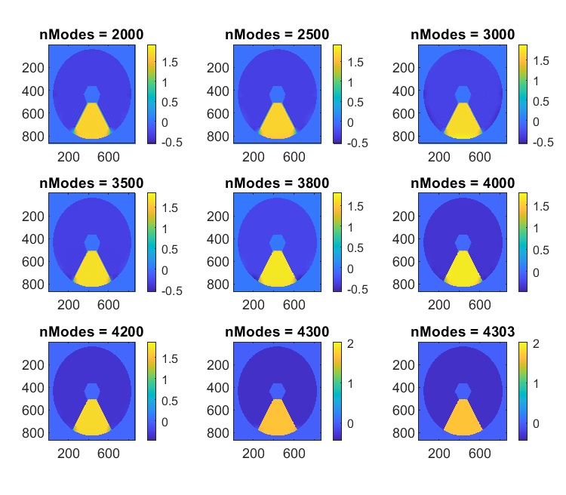
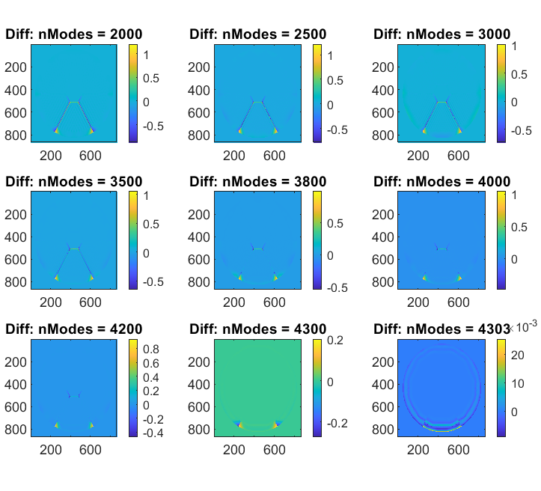
Motivation – Effects of Modal truncation
As Jeff said: understand your AO…including the modes

Slide 5
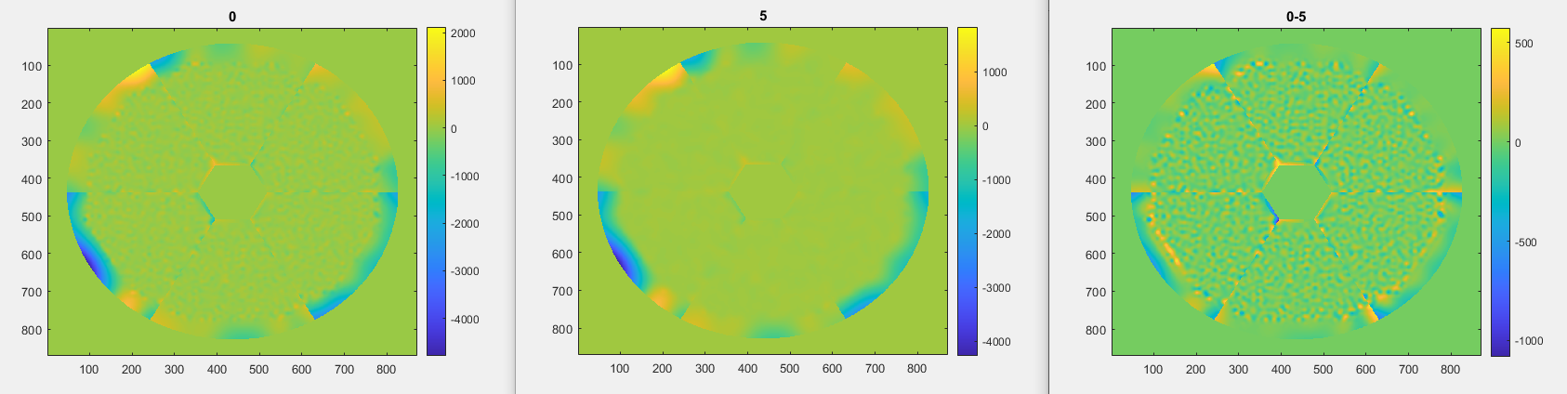
Effect of Smoothing on Modal coeffs
Testphase: all modal coefficients are one
Apply different regularization strength in the projection
Yes, obviously….but what about the coefficients?

Slide 6
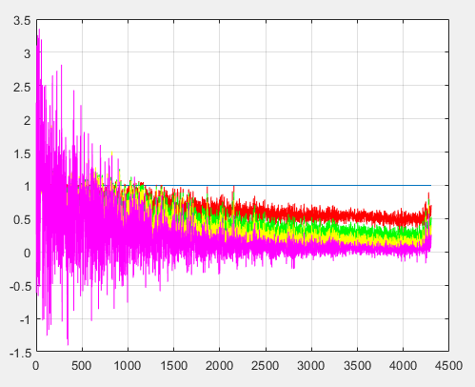
Effect of Smoothing on Modal coeffs

Slide 7
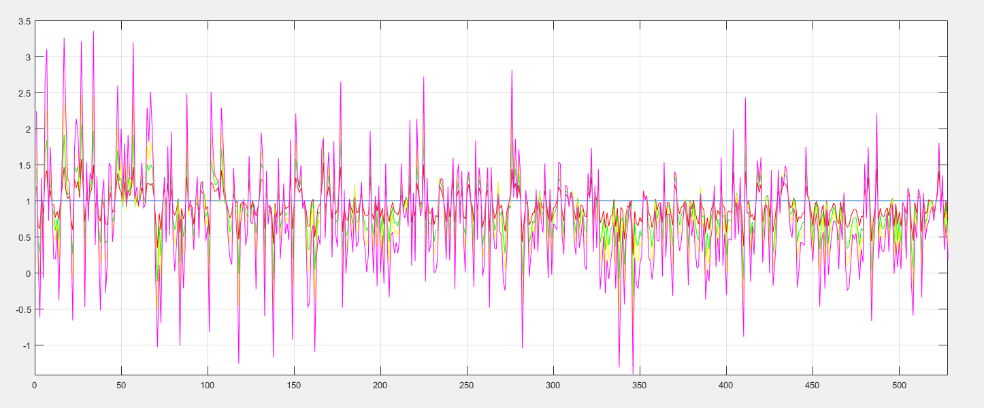
Effect of Smoothing on Modal coeffs

Slide 8
Different test phases on VDM
Sinus waves
Random white noise
Open loop phases
Closed loop residual phases
  For different seeing conditions

Slide 9
Implementation
Derive Laplace for the M4 actuators
  Regularized projection on M4 (using all actuators)
  Sparse!
Utilize the c2m and m2c matrices
  Condition number: 158.699
  Stable transformation from M4 commands to modal coefficients (and vice versa)
VDM → M4 → Modes
  (use sparse matrix multiplication in S-RTC)

Slide 10
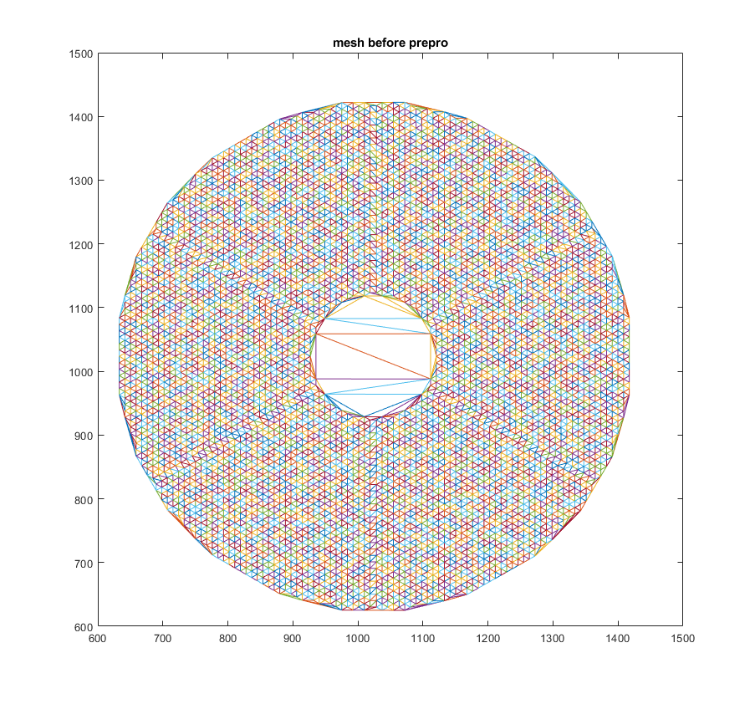
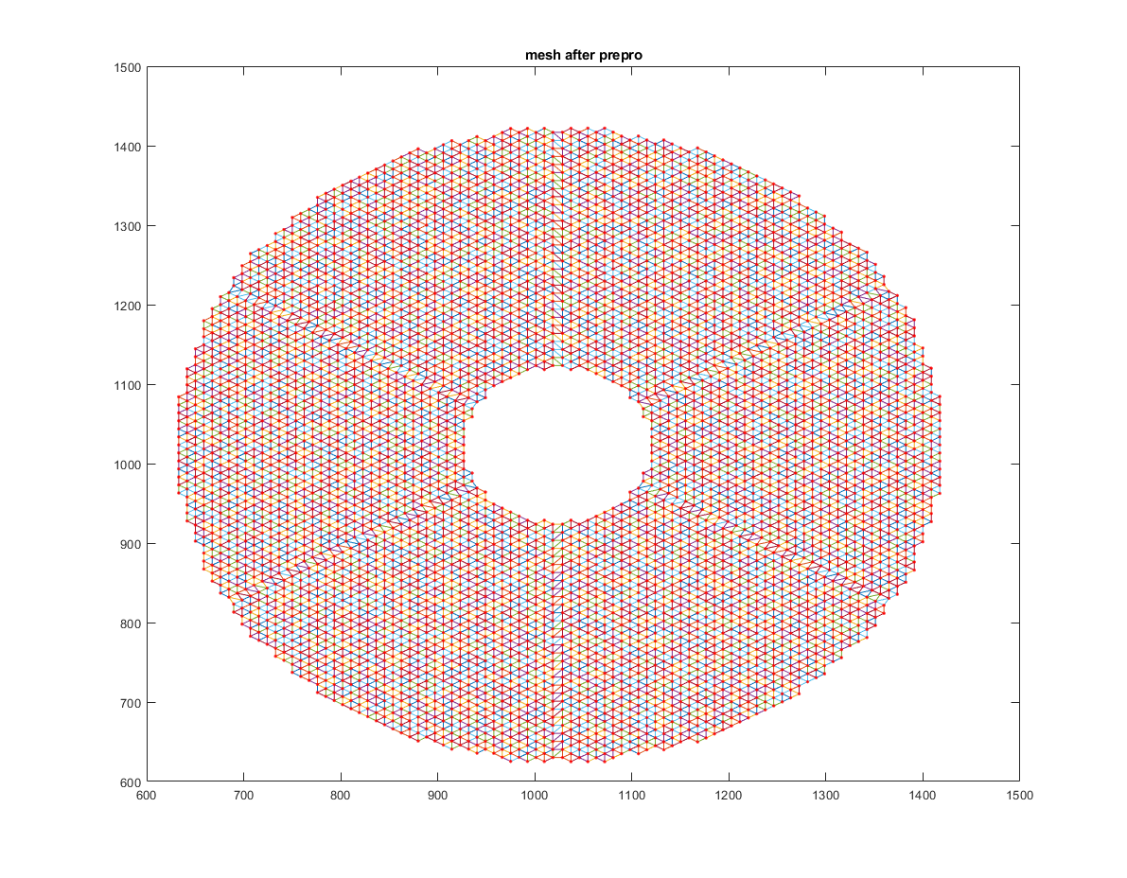
The used „M4-grid“
Proper triangulation on actuators as nodes
FE derivation of Laplace assuming linear ansatzfunctions

Slide 11
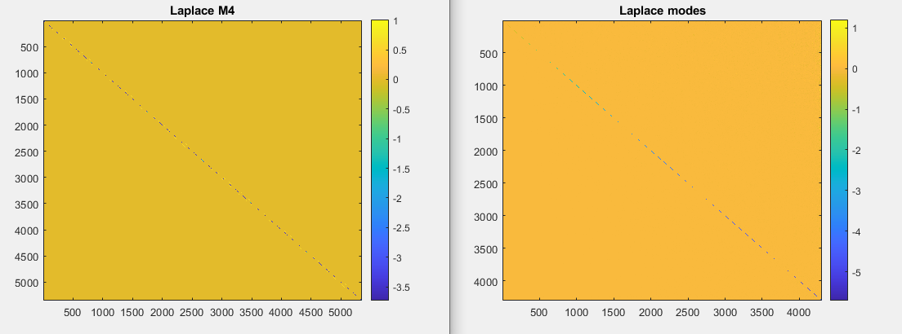
Laplace on M4 vs Laplace on Modes

Slide 12
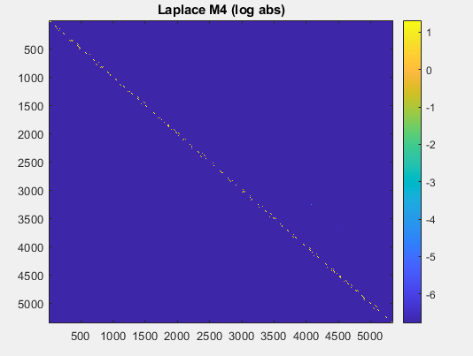
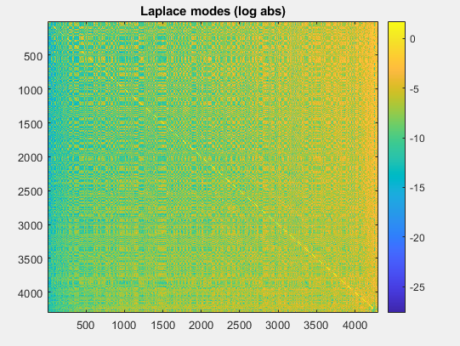
Laplace on M4 vs Laplace on Modes

Slide 13
METIS like simulations
Very good to very bad seeing
Zenith 0 – 60
GS brightness down to magnitude ~12 (K-Band)
→ with ONE set of parameters
  Regularisation parameter for WF estimation
  Regularisation parameter for modal projection
  Loop gain
  Modulation radius
  Integration time (loop frequency)

Slide 14
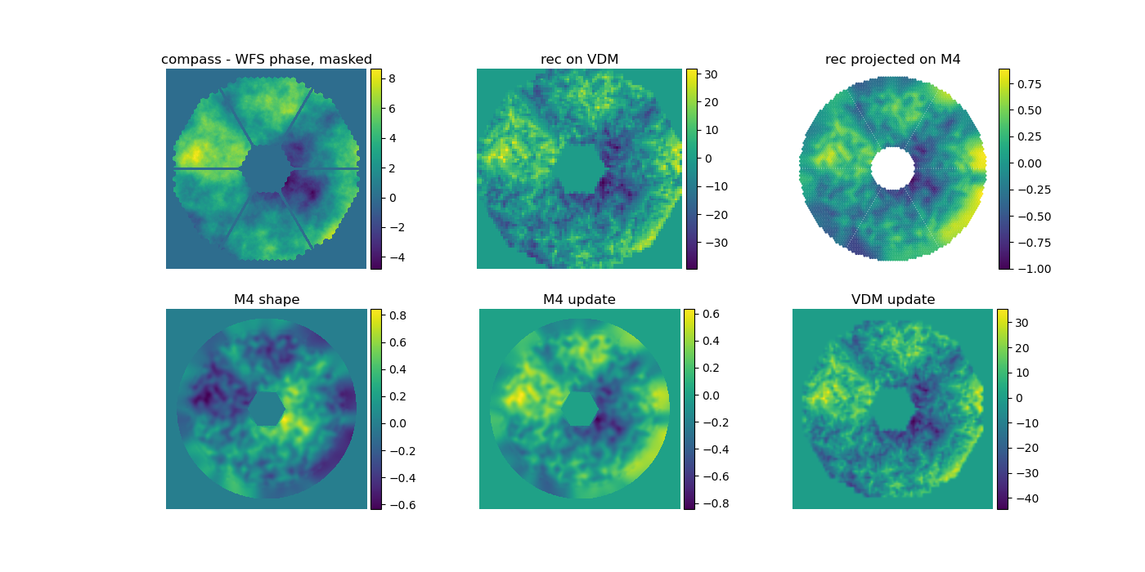
Incoming – WF Estimation on VDM –
M4 update (actuators and IFs) – DM shape
Closing the loop, iteration 2

Slide 15
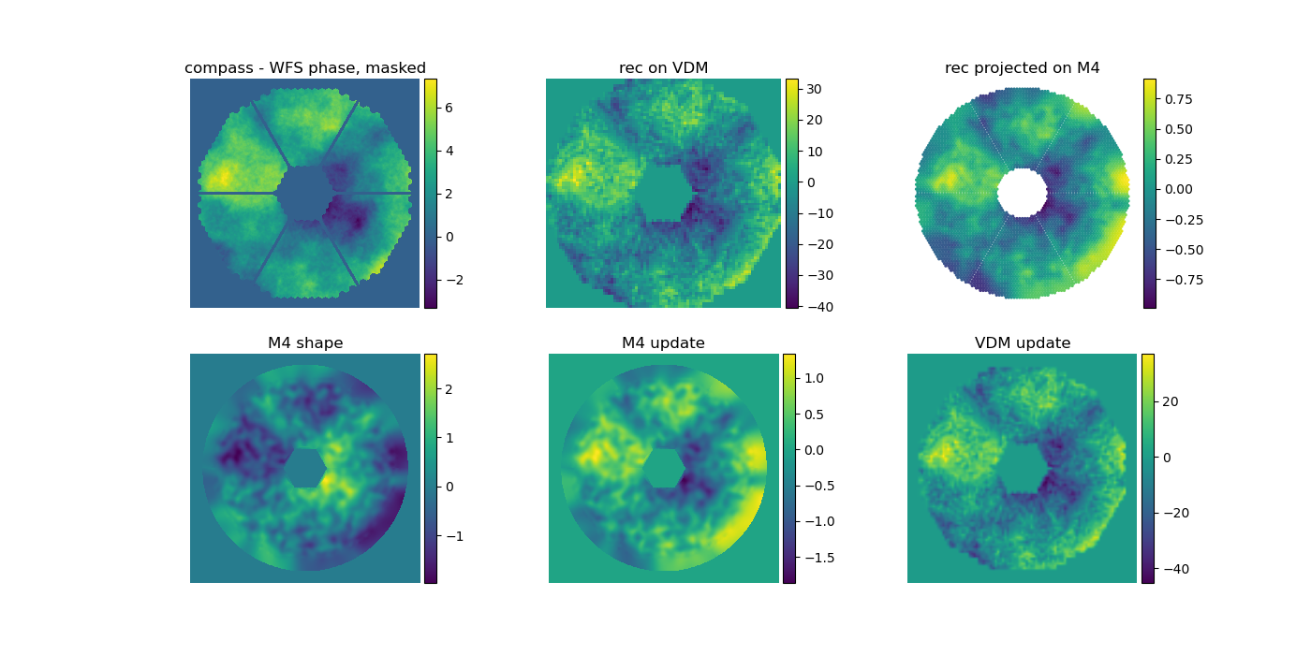
Incoming – WF Estimation on VDM –
M4 update (actuators and IFs) – DM shape
Closing the loop, iteration 4

Slide 16
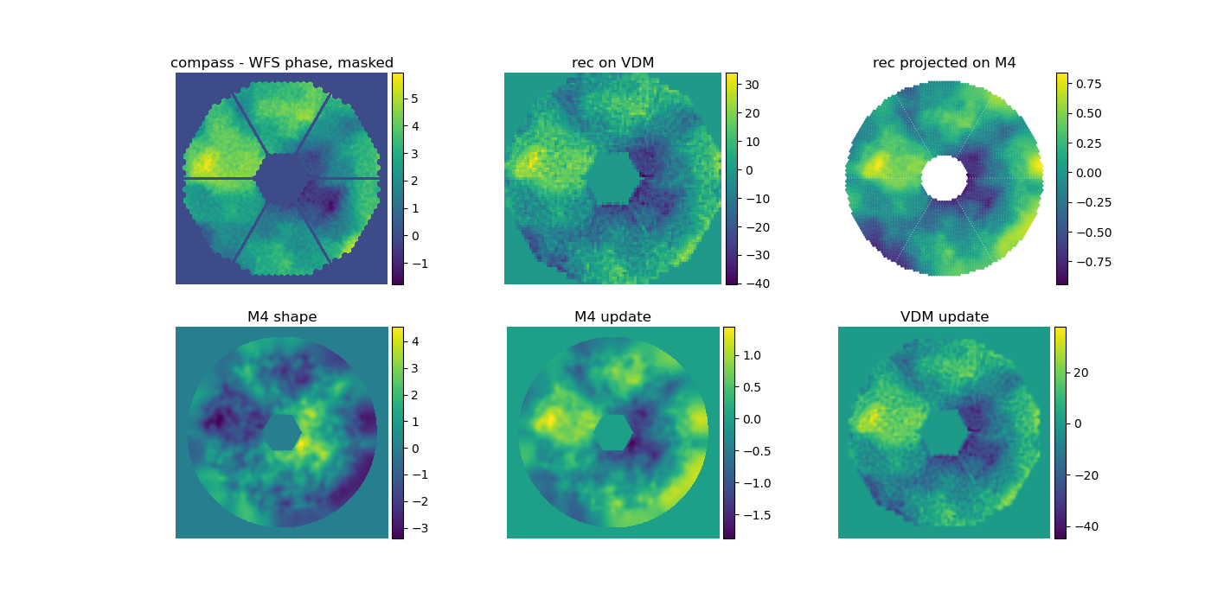
Incoming – WF Estimation on VDM –
M4 update (actuators and IFs) – DM shape
Closing the loop, iteration 6

Slide 17
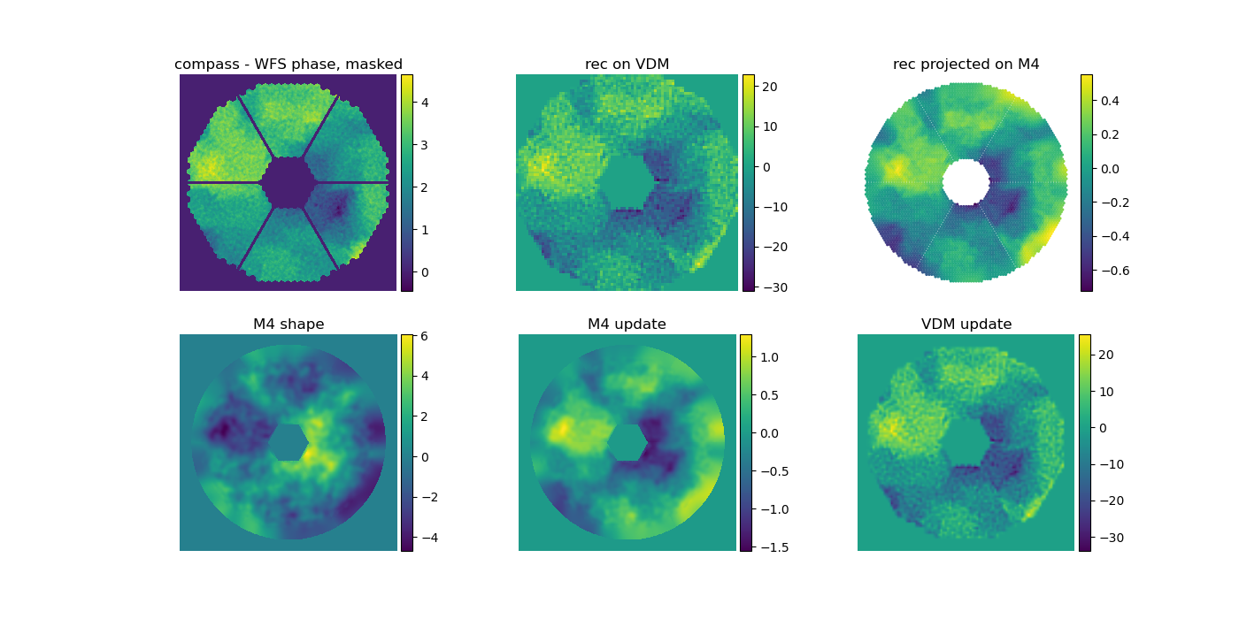
Incoming – WF Estimation on VDM –
M4 update (actuators and IFs) – DM shape
Closing the loop, iteration 8

Slide 18
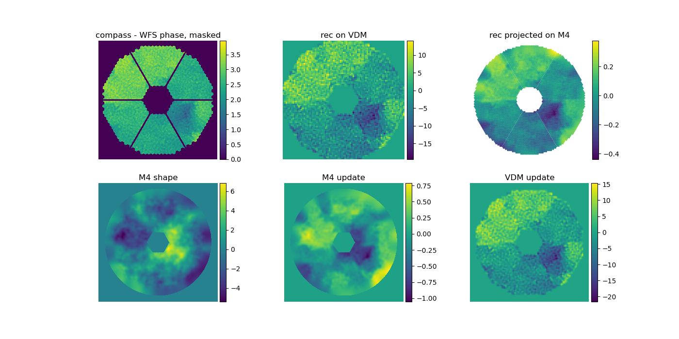
Incoming – WF Estimation on VDM –
M4 update (actuators and IFs) – DM shape
Closing the loop, iteration 10

Slide 19
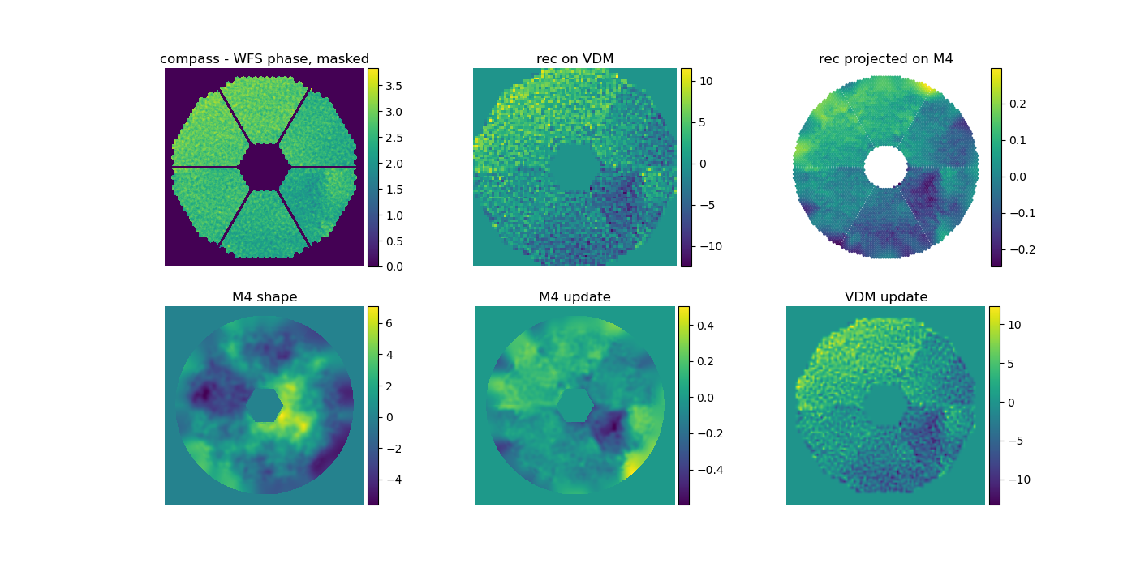
Incoming – WF Estimation on VDM –
M4 update (actuators and IFs) – DM shape
Closing the loop, iteration 12

Slide 20
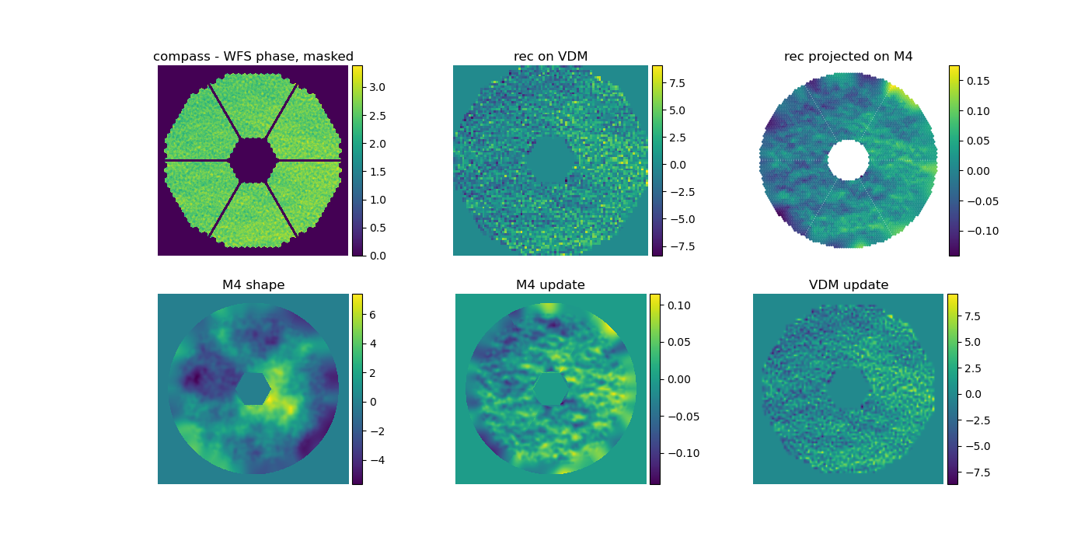
Incoming – WF Estimation on VDM –
M4 update (actuators and IFs) – DM shape
„steady state“, iteration 26

Slide 21
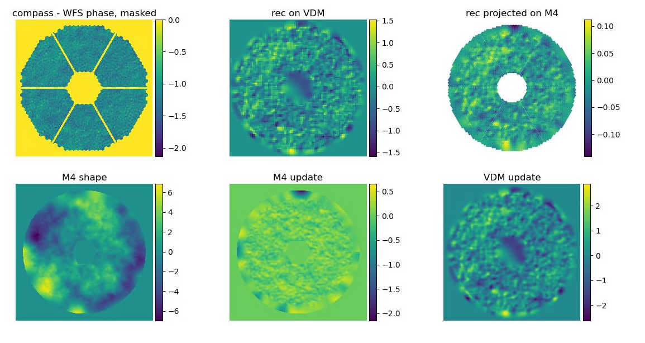
Showcase: use 6777 VDM actuators

Slide 22

Open Tasks
Large NCPAs
„real life“ testing:
  Bench
  On-sky
No funky abbreviation
available (yet)

Slide 23
Thanks to… (without ordering)
AAO Team
  Julia Shatokhina, Stefan Raffetseder, Cecilia Schwalsberger
METIS Team
  Markus Feldt, Horst Steuer, Carlos Correia
Christophe Verinaud, Miska Le Louarn
…you, the audience, for all the discussions and the input at this workshop!

Slide 24

Take Home Message
Why truncate modes?
  Easy
  Faster to change in closed loop
  Well known…well, often used.
Regularized projection

