Slide 1

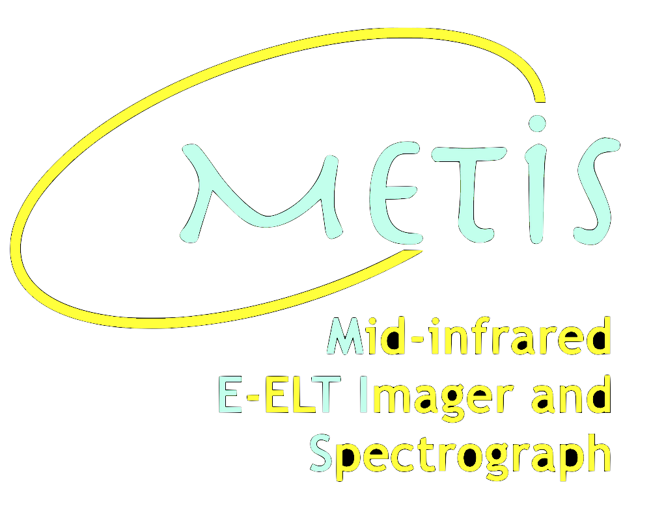


Non-Common Path Aberrations Strategy for the METIS High Contrast Imaging Modes
Gilles Orban de Xivry,
O. Absil, C. Delacroix, P. Pathak, M. Willson
Notes:
Non-common path aberrations (NCPAs) are widely recognized as one of the main limitations of current and future high-contrast imaging instruments. The slow variation of NCPAs generates quasi-static speckles (QSS) that are coherently modulated by the AO speckles. This increases speckle noise and reduces the achievable contrast, thus leading to a significant hit in HCI performance.
In METIS, NCPAs – due to optical imperfections – are kept to a minimum, and the gravity-invariant design should keep the time variation to a low level. Yet the short- and long-term variations, driven by chromatic beam wander, of the NCPA can lead to a significant hit in HCI performance and two algorithms are being developed to measure and correct for NCPAs: QACITS for tip-tilt sensing in the case of the vortex coronagraph, and Phase Sorting Interferometry (PSI) for higher-order aberrations.
In this contribution we will detail our NCPA modeling and control strategies for METIS, with an emphasis on our implementation and analyses of the PSI algorithm.
We will also shortly discuss the challenge posed by the water vapor turbulence, and the mitigation and limitation of our focal-plane wavefront sensing algorithms in measuring and correcting these dynamical aberrations.
illustrate the algorithm of PSI (each step with images)
Illustrate the probe field and subject beam and their temporal behaviour (-> try to explain why WV sensing cannot work) ?
Kernel video?( Illustration of lifting the ambiguity?)
PSI : video showing convergence for static NCPA for img.
A video for the kernel wavefront sensor…
- a video with phasor (sinus and showing how the field rotate ?)
TODO:
- QS NCPA : details & strategy + contrast curve ?
improve explanation of QACITS principle
PSI explanation: improve (phasors ??)
+ add slides (see also my METIS doc)
PSI implementation & results :
Package and simulation inputs
video + plots
Normal imaging & RAVC
WV seeing:
PSI breaks down in N-band
Explain why PSI is not appropriate for WV seeing
Asymmetric mask :
Breaking down degeneracy (illustration like in Bos et al.)
Kernel WFS for classical imaging -> showing it works for WV
Prospect for coronagraphs
- contrast curves with WV and with correction
<-> emphasise the importance of that
+ show ‘all effect’ curve

Slide 2

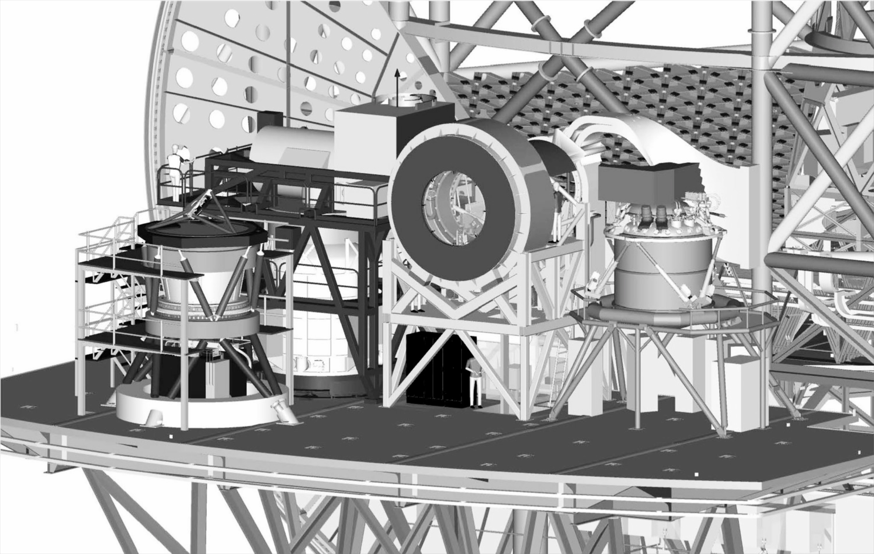




First Generation Instruments @ ELT
pre-focal station
Harmoni
METIS
Soon to Nasmyth B ??
Micado
(+MORFEO,
not shown)

Slide 3




METIS instrument baseline
All modes work at diffraction limit of 38-m ELT using single-conjugate AO
= coronagraphic capabilities
[IFS]
10⁵
LMS
0.90’’
10⁴
10³
IMG-LM
[long slit
spectro]
0.58’’
resolution
IMG-N
10²
10
IMG-LM
[imaging]
IMG-N
1
3
5
7
9
11
13
wavelength [µm]
Notes:
- NCPA correction (PSI) essentially plan for IMG not for LMS (there is a mode were a small fraction of the light would be diverted to the IMG, for QACITS control but most likely not for higher-order

Slide 4
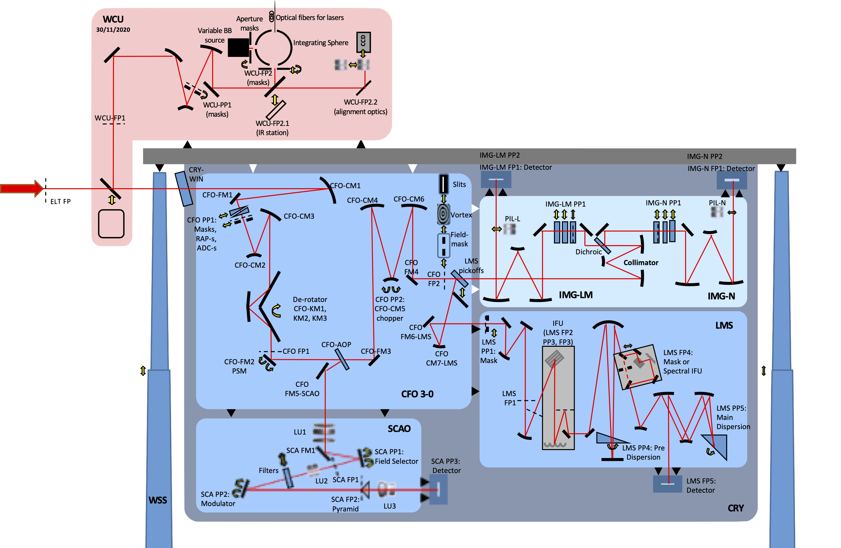
Optical sytem overview
light from ELT
Notes:
SCAO is in cryogenic conditions

Slide 5
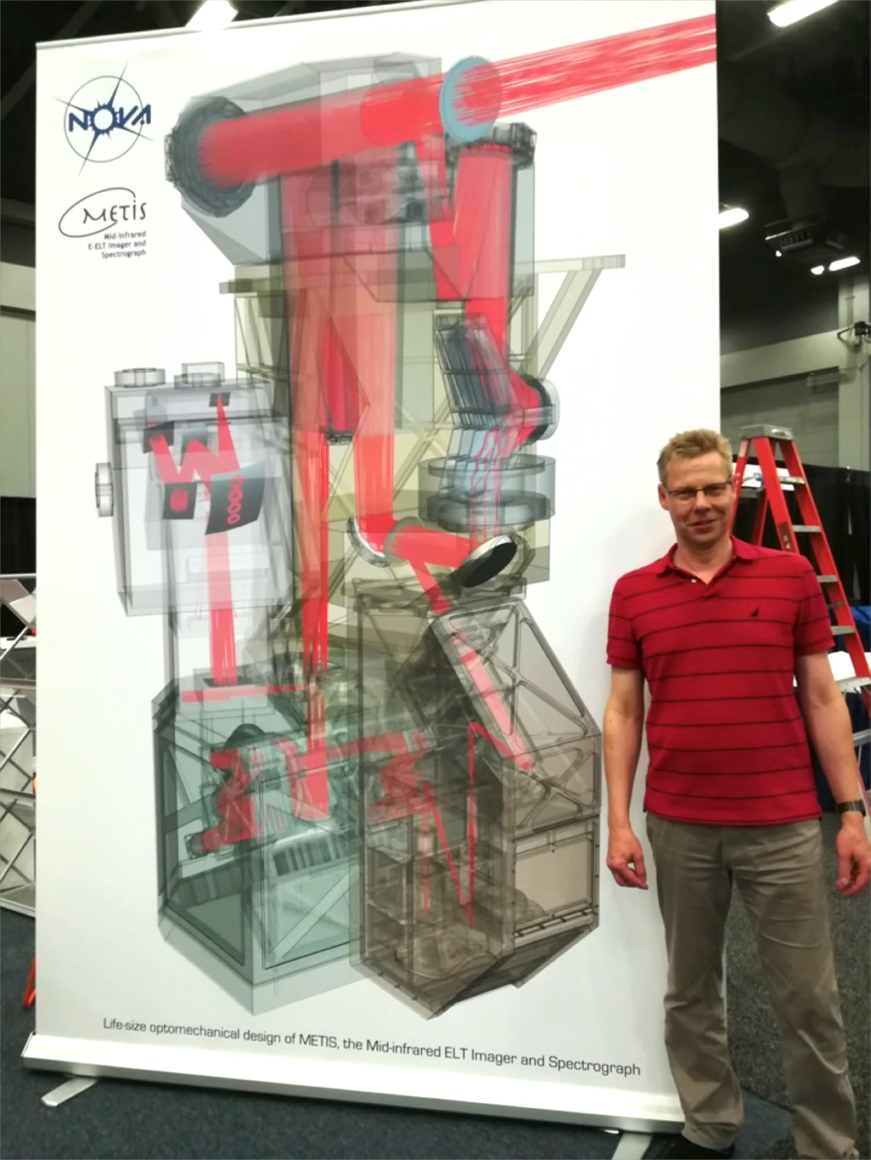
It’s got to be big!
(and cold)
1:1 scale model
METIS PI

Slide 6
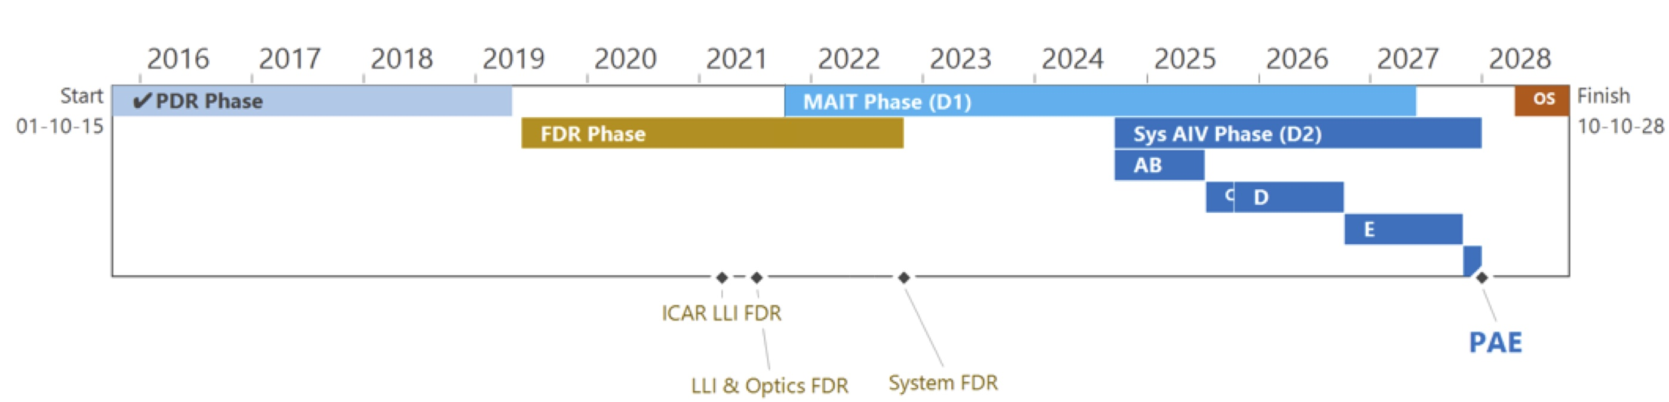
METIS Timeline
~ 670 FTE & 20 M€ hardware budget over 13 yrs
first light: end of 2028
today

Slide 7
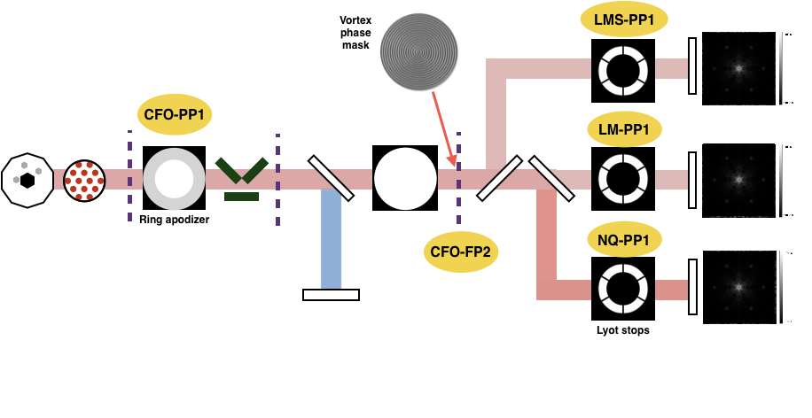
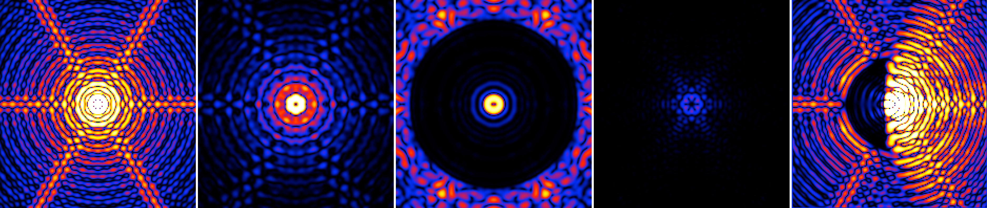
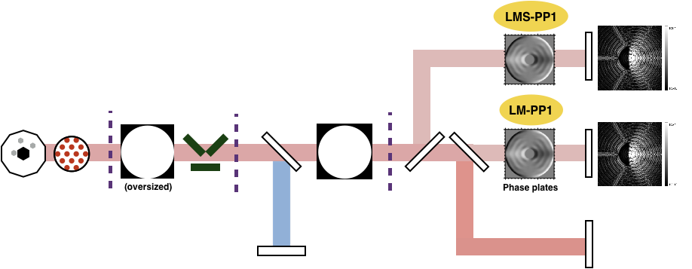
High-Contrast Imaging Modes
ELT
(Ring-Apodized)
Vortex Coronagraph
IMG (ELT)
CVC
RAVC
APP
Apodizing
Phase Plate
Notes:
Dash lines : focal planes
At CFO-PP2 : chopping (upstream of FP2)

Slide 8
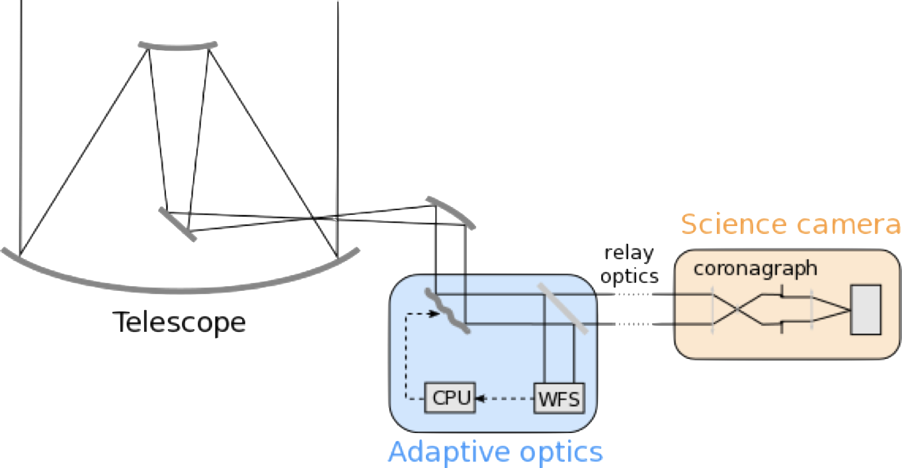
Wavefront Control Strategy
Dry air +
WV seeing
SCAO provides > 90% Strehl at LMN bands
NCPA minimised by design + focal-plane WFS
adaptive optics
non-common path aberrations
focal-plane
wavefront
sensing
wavefront matters here
wavefront measured here

Slide 9
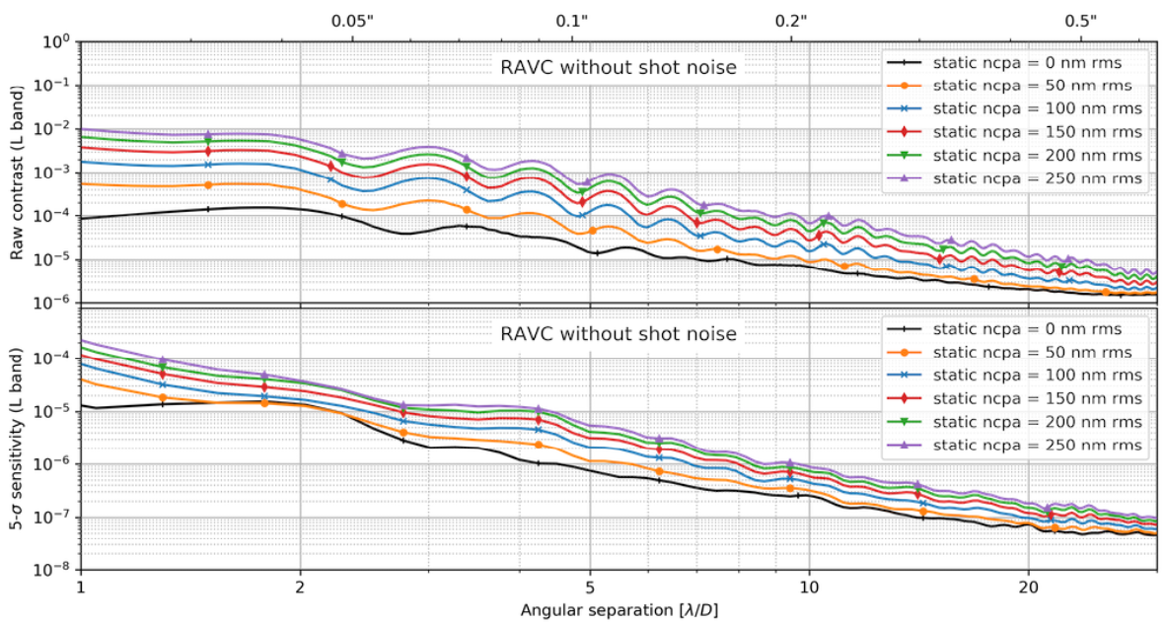
Static NCPA in METIS
Impact on contrast
Video with the QS NCPA
Impact on contrast if uncorrected
Decomposition in different dynamics (see NCPA strategy)
Notes:
Influence on post-processed contrast is somewhat lower thanks to the absence of time variability. Still remains important (coupling with SCAO residuals).
Could have a much larger effect if not correct but coupling to other effect (incl. variable NCPA)
Most of the static NCPA should be measured during AIV. But having the possibility to measure it afterwards - at least the low order - is planned.
Main contributor of variability: variability of NCPA is expected to be related to the changing position of the beam footprint on the METIS optical train
However, refraction in the Earth atmosphere applies a differential tilt to the beam as a function of wavelength. The net effect is that, as the target of interest is tracked along its trajectory in the sky, the relative position of the beam will change at LMN bands compared to the fixed K-band beam. The variability of the beam position leads to temporal variations of the aberrations picked up by the beam along its propagation through the METIS optics. This concerns optics located both in the common and in the non-common path.
AIV measurements of NCPA but would not be sufficient
Upstream vs downstream WFE allocations…
Modeling NCPA:
- top-down subsystem WEF allocation
- Bottom-up Monte-Carlo simulations
Talbot effect also taken into account
tolerancing
surface error

Slide 10
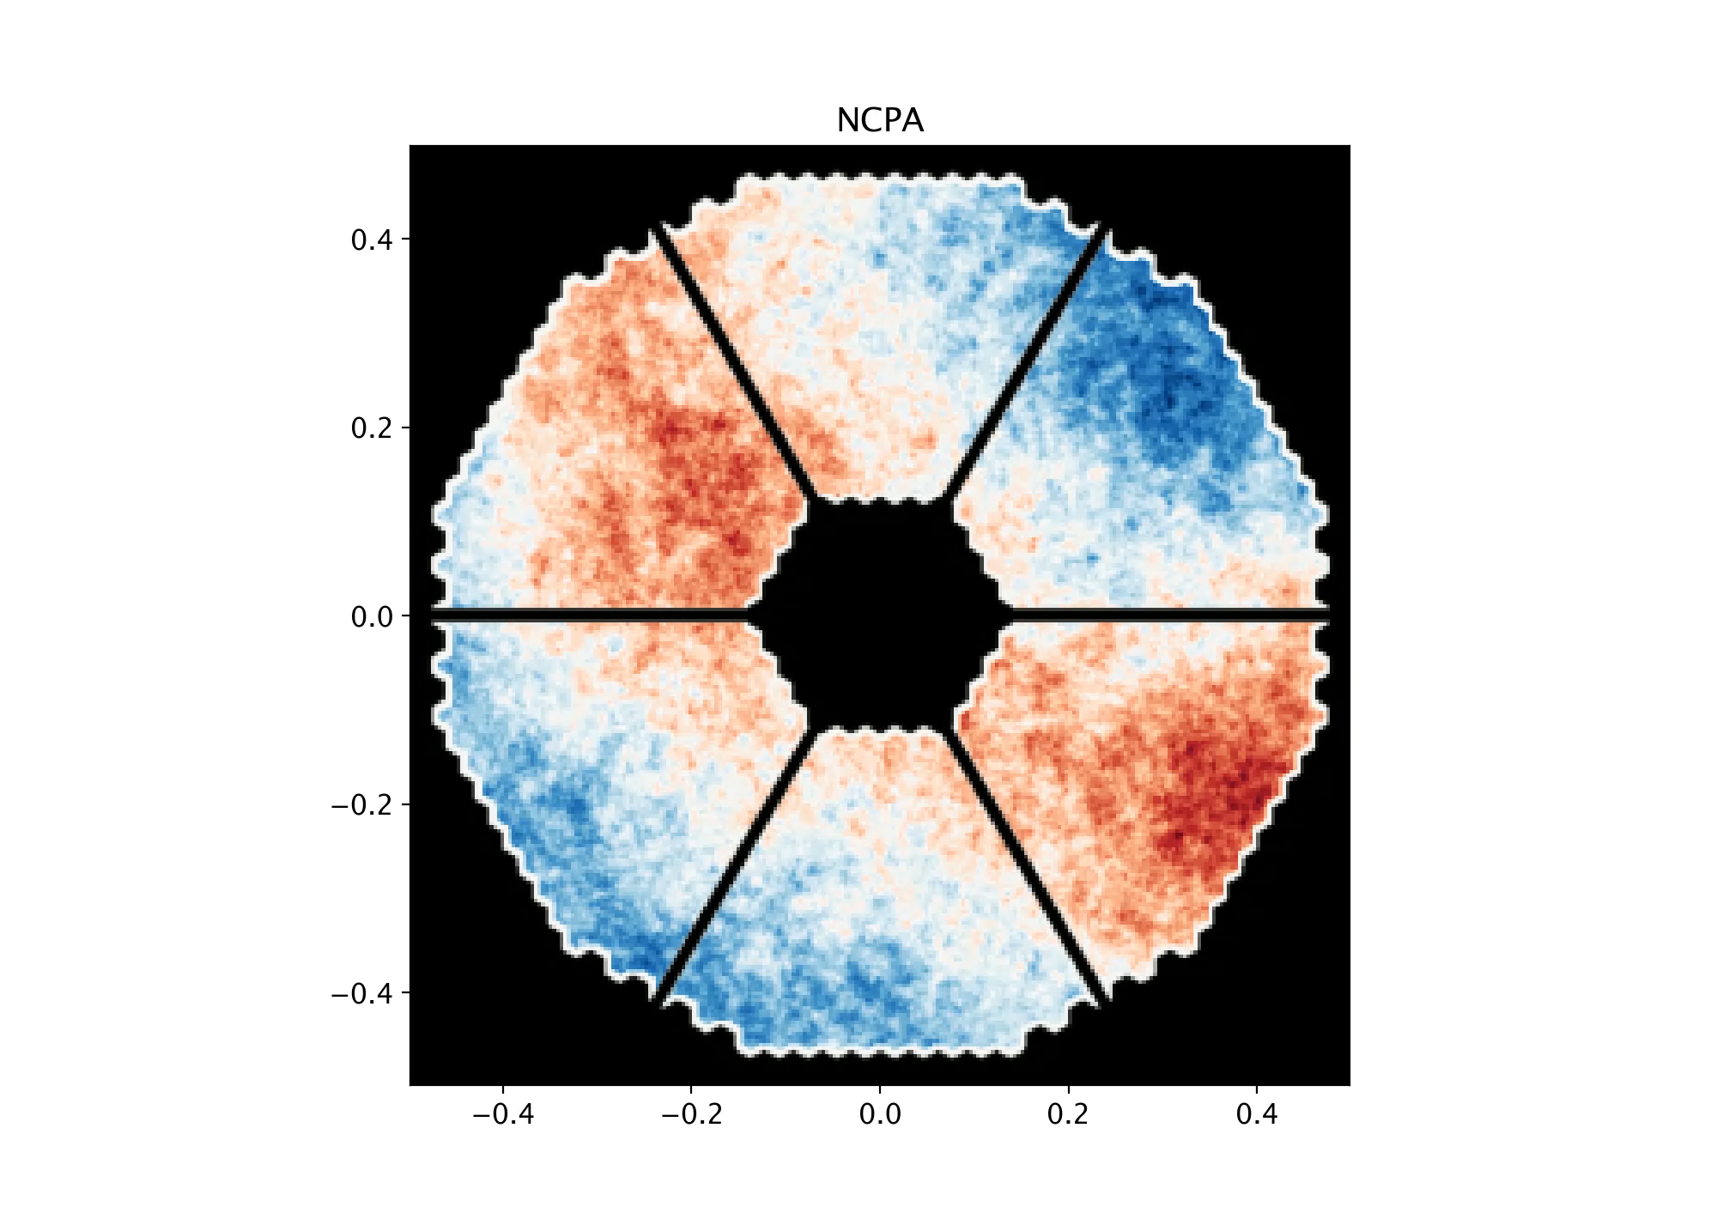
Quasi-static NCPA
Static NCPA is ~100 nm rms
 | LSF | HSF
Static | - | <40nm rms
Quasi-static (<0.01Hz) | 20nm rms | 20nm rms
Dynamic (>0.01Hz) | 40nm
Boné et al., in prep
Notes:
Modelling the NCPA is done by the Optics Team via Monte Carlo analysis playing on the tolerance and allocating surface errors.
variation of the beam footprint on the optics during the observation
QS HSF : temporal rms
QS <0.01Hz initially, then become 0.1Hz with water vapour
variability of NCPA is expected to be related to the changing position of the beam footprint on the METIS optical train
However, refraction in the Earth atmosphere applies a differential tilt to the beam as a function of wavelength. The net effect is that, as the target of interest is tracked along its trajectory in the sky, the relative position of the beam will change at LMN bands compared to the fixed K-band beam. The variability of the beam position leads to temporal variations of the aberrations picked up by the beam along its propagation through the METIS optics. This concerns optics located both in the common and in the non-common path.

Slide 11
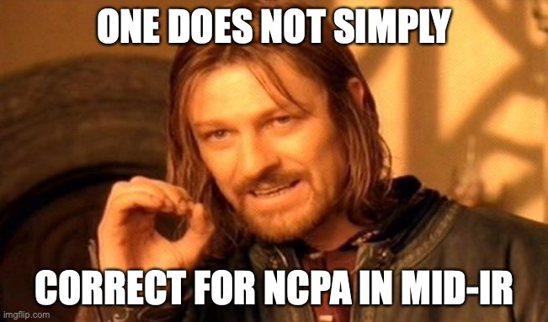

Slide 12
Water vapor seeing
WV column density is variable
Expected to follow Kolmogorov - von Karman spectrum
Highly chromatic, especially in mid-IR
  AO correction at K band not valid at L/N bands
wind
wind

Slide 13
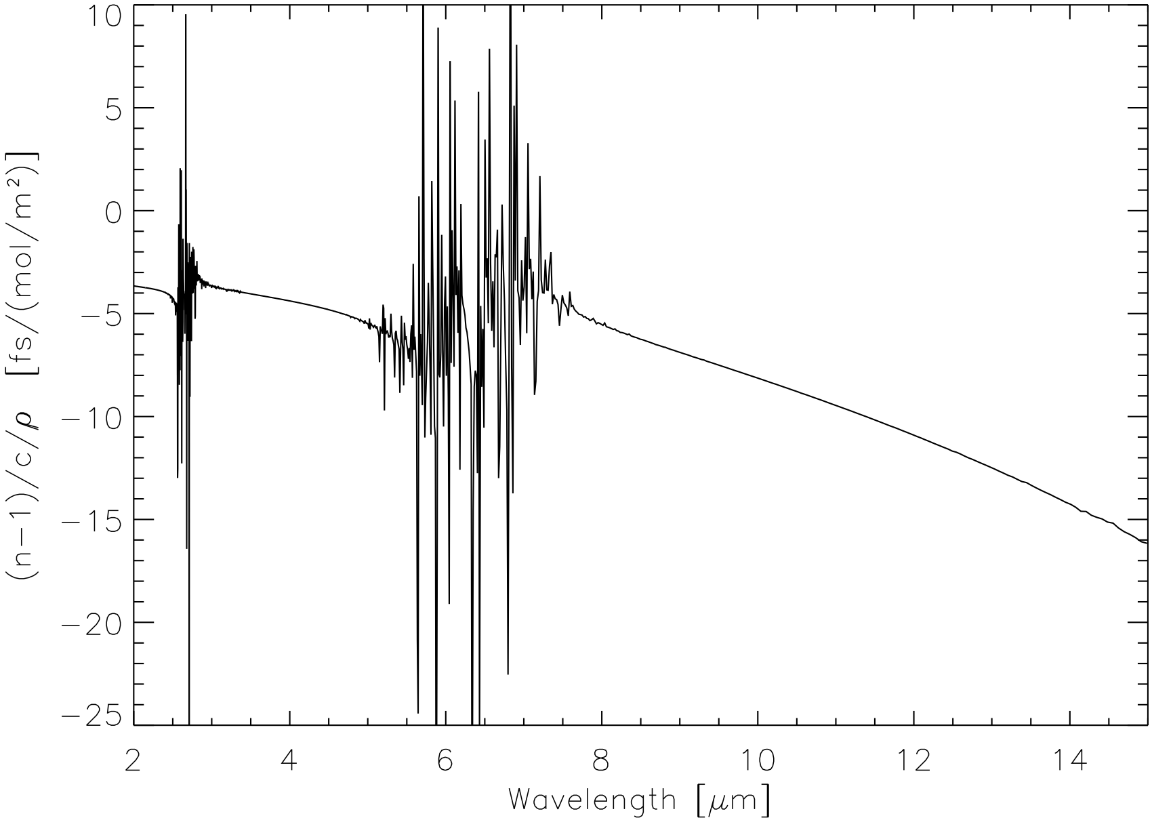
Additional path length: ‘water displacing air’
Holding P (and T) constant,
    added humidity reduces dry air
n̂WDA = n̂WV − n̂air
  n̂WDA(L − K) = 0.5 fs / (mol/m²)
  n̂WDA(N − K) = 6 fs / (mol/m²)
K band
L band
N band
Notes:
- If you have several spectral channel, you can actually predicted the phase chromaticity
- demonstrated with GRAVITY K-band fringe tracker -> MATISSE
- inferring differential WV column
- (power spectrum of the diff WV column is not Kolmogorov…)

Slide 14
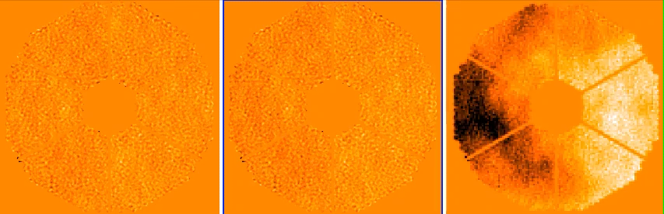
Adding WV to adaptive optics residuals
AO only
AO + WV (L band)
AO + WV (N band)
~140 nm RMS WFE
~25 nm RMS additional WFE
~300 nm RMS additional WFE
Strongly dominated by low spatial frequencies (Kolmogorov - von Karman)
See Absil et al. 2022, SPIE paper for a full discussion

Slide 15
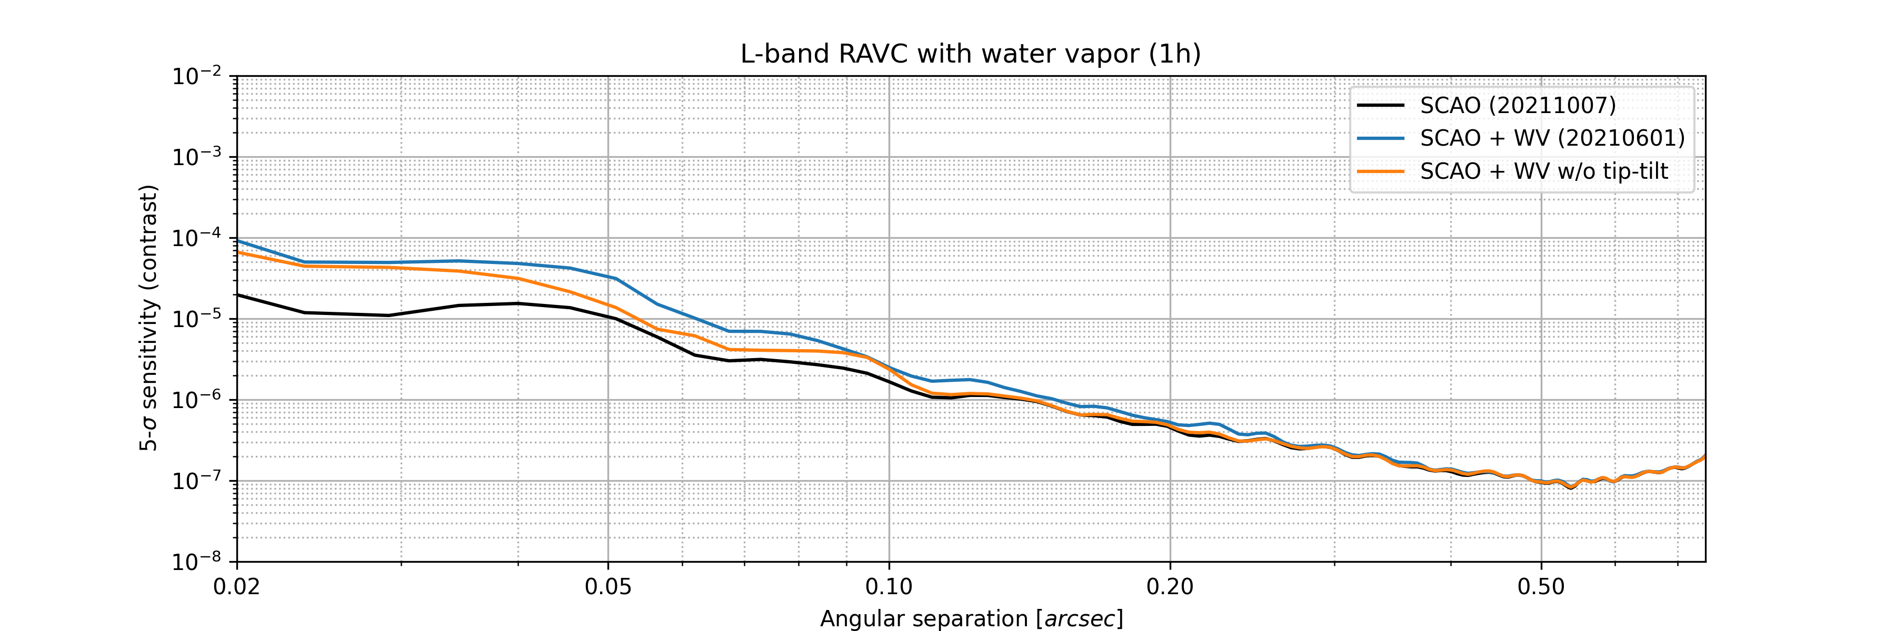
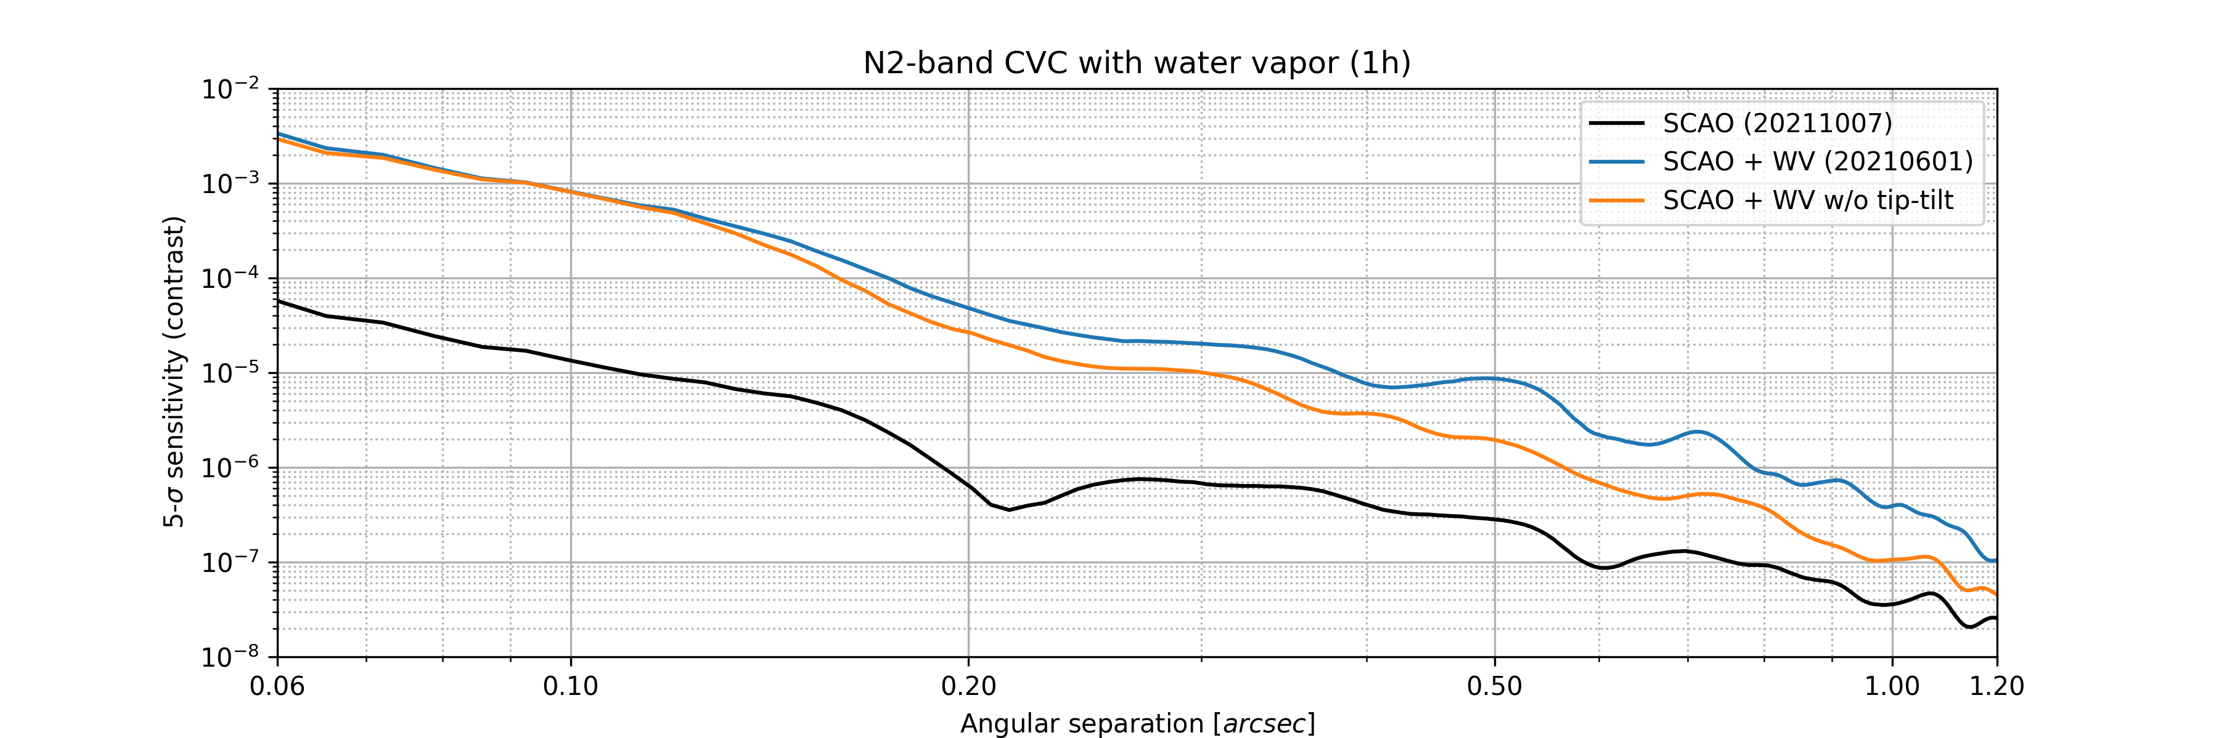
Effect on HCI Performance
AO + WV
Removed tip-tilt from WV
L band
AO only
N band

Slide 16
Mitigation plan for METIS
Science images fed back to AO system for focal-plane wavefront sensing @ 1 Hz
Pointing errors: QACITS
  uses asymmetry in coronagraphic PSF
Next ~100 Zernike modes: Phase Sorting Interferometry
  uses phase diversity introduced by AO residuals
  PSI output introduced as slope offsets in Pyramid WFS

Slide 17
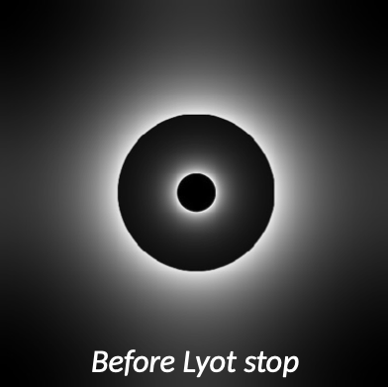
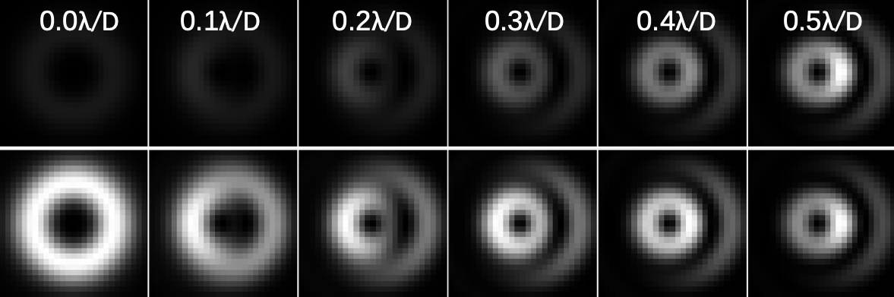
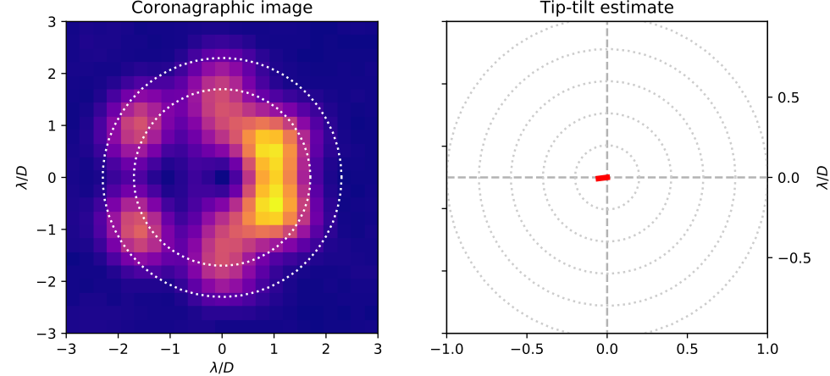
Pointing Control with QACITS
Tailored to vortex coronagraph
Reconstruct pointing error with nonlinear model
Demonstrated accuracy ~0.01 λ/D On-sky : Keck, VISIR/NEAR, and soon on ERIS
Huby et al. 2015, Maire et al. 2020
Notes:
Improve illustration of how QACITS works
Mention / illustrate ERIS/QACITS
0.01 lbda/D -> 0.2 mas on sky

Slide 18
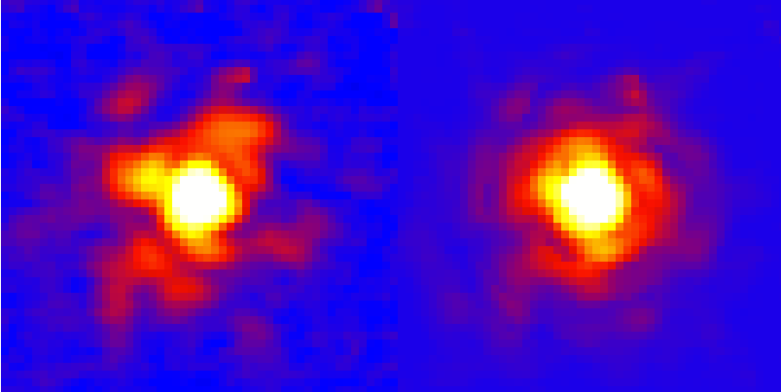
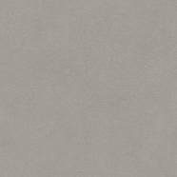

NCPA Control with PSI
reconstruction of the Efield
in the focal plane
WFS
short exposure
Science
camera
100% duty cycle
Reference beam or ‘probes' are the known AO residual speckles
Use SCAO residuals as source of diversity to infer pixel-wise amplitude and phase of NCPA
Codona & Kenworthy 2013
Notes:
Concept demonstrated by Codona & Kenworthy 2013, with a SH-WFS and normal imaging
100% duty cycle
It uses focal plane science images and simultaneous WFS telemetry to measure the NCPA phase. The principle is based on the common interferometry technique using a phase- shifted reference beam to probe an unknown subject beam. The key difference being here that the reference beam is “random” instead of being “controlled”. Indeed, in our context, the reference beam or “probes” are the residual AO speckles which are beyond our control but for which we have a known (albeit approximative) phase measurement provided by the WFS telemetry.

Slide 19
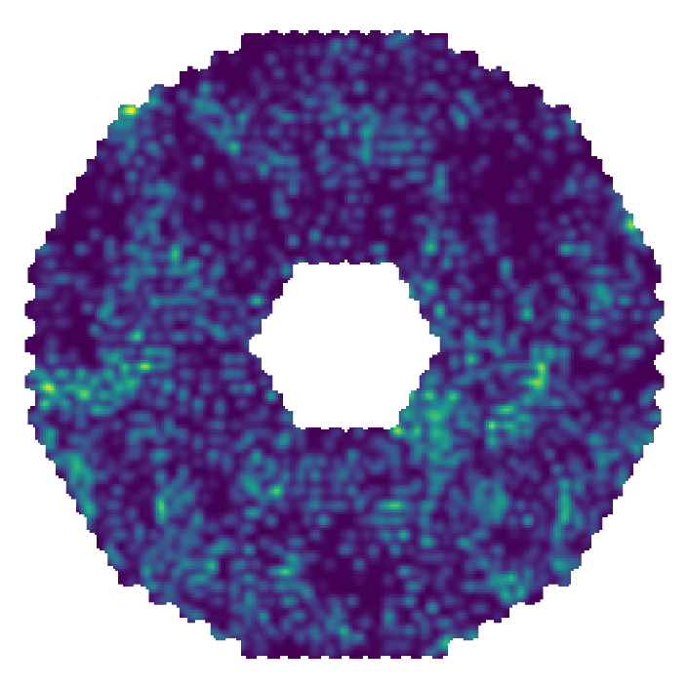
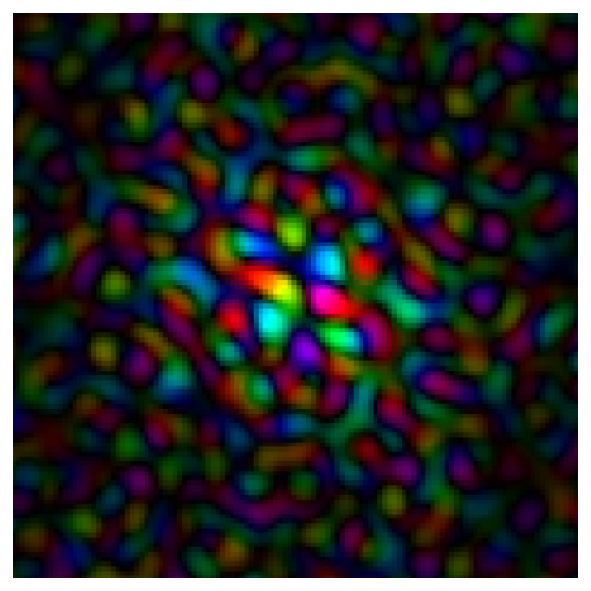

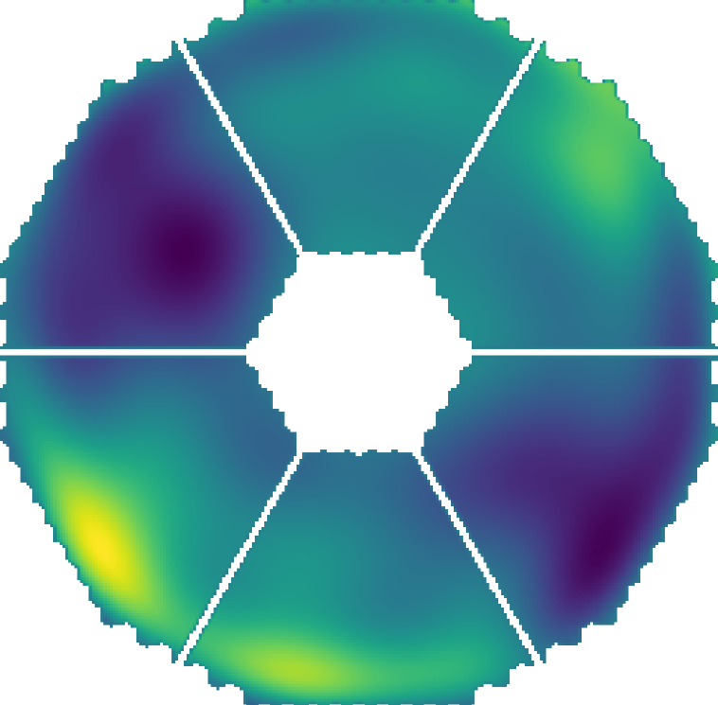
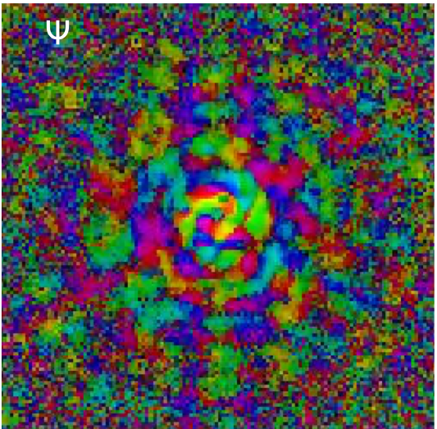


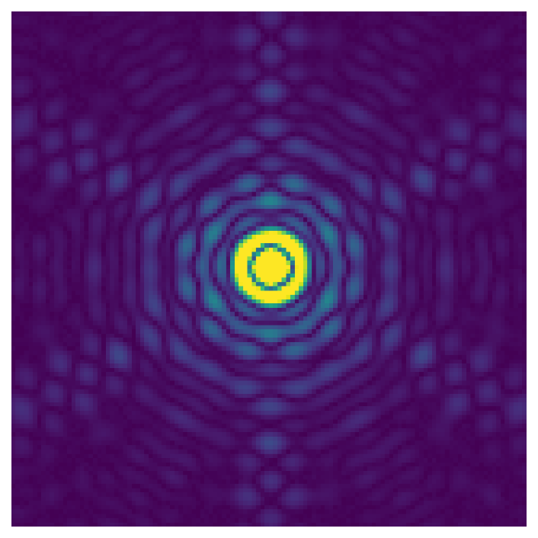
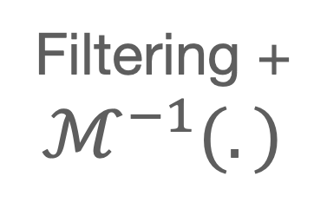
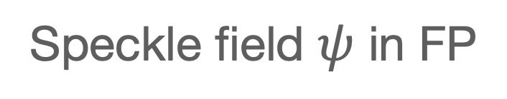
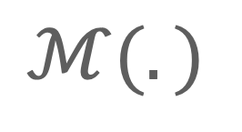
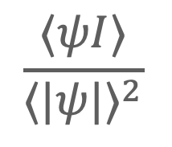
PSI algorithm in a nutshell
AO telemetry
Speckle field $ψ$ in FP
$$ℳ(.)$$
Calculated
Subject field in FP
NCPA estimate
Filtering +
$ℳ^{−1}(.)$
Science images
$$\frac{⟨ψI⟩}{⟨|ψ|⟩^{2}}$$
Typical numbers for METIS
PSI rate | 1Hz
AO rate & telemetry | 1kHz, 100Hz
Science DIT | 100ms

Slide 20



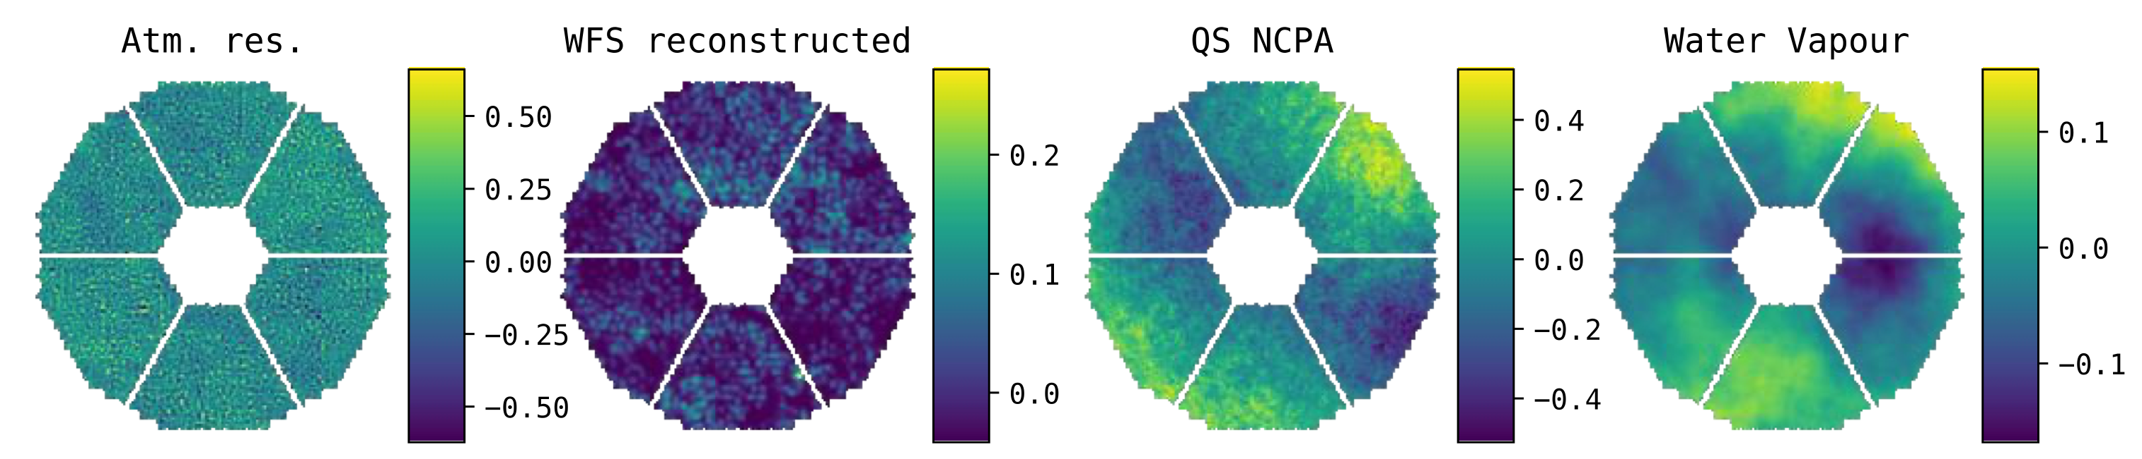
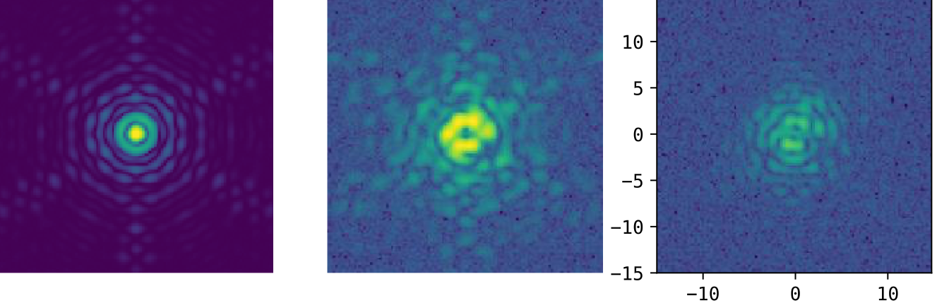
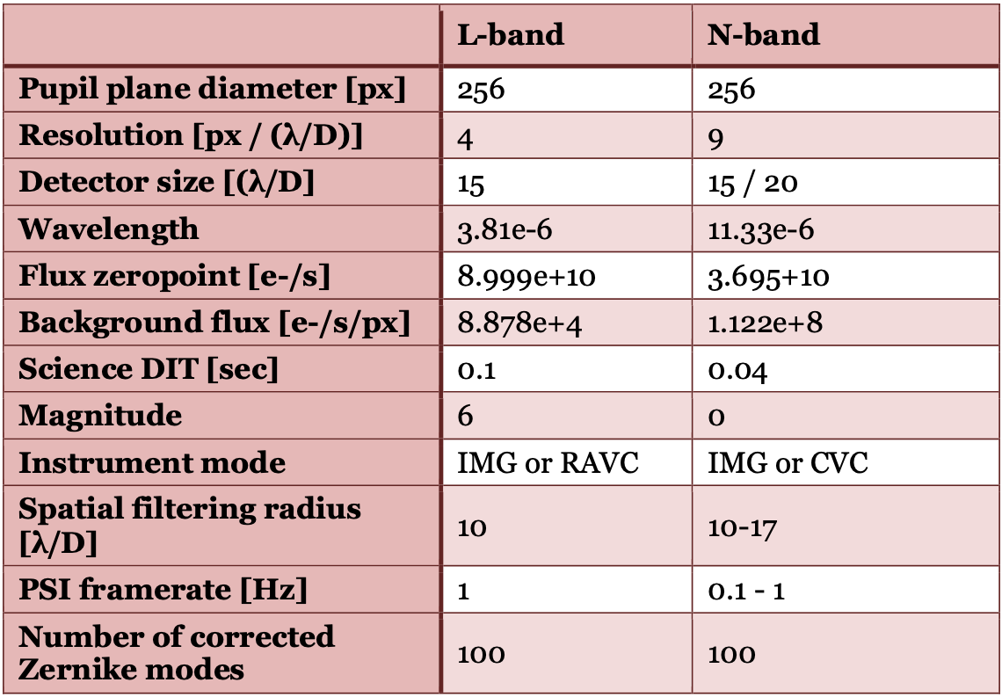
METIS PSI simulation setup
Run SCAO METIS COMPASS
- Save residual wavefront
- Save WF telemetry
Add variable "NCPA"
- Phase map provided by Optics Team
- Water vapour seeing (Kolmogorv phase screens
Simulate instrument mode and run PSI simulation
IMG
CVC
RAVC

Slide 21
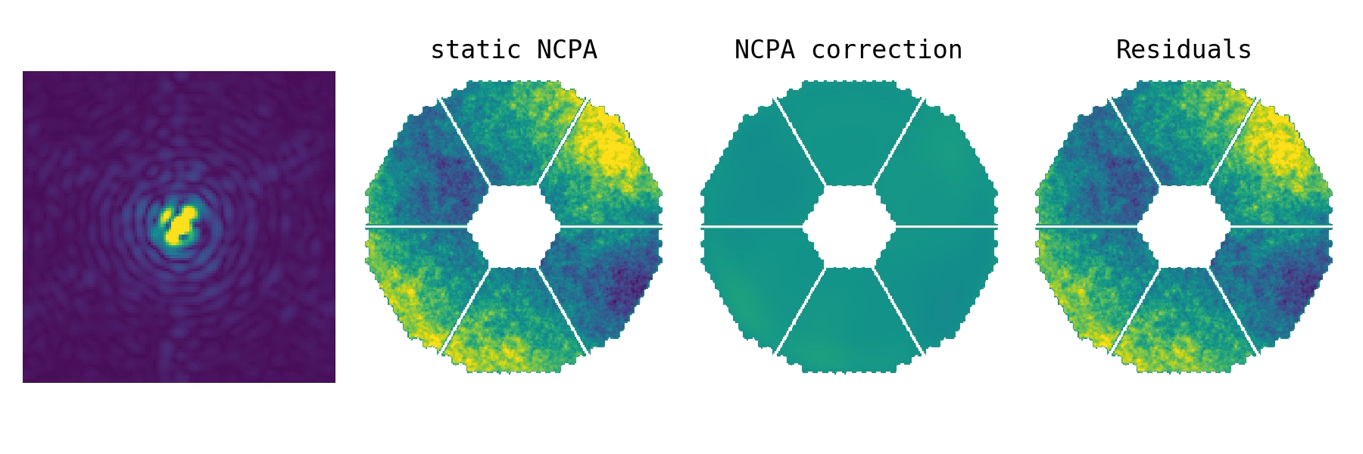
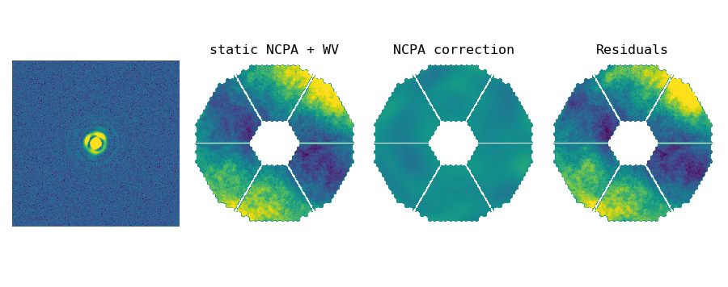
Results
Illustrations
Level of aberrations exaggerated
Static NCPA
Static NCPA
+ Water vapour seeing

Slide 22
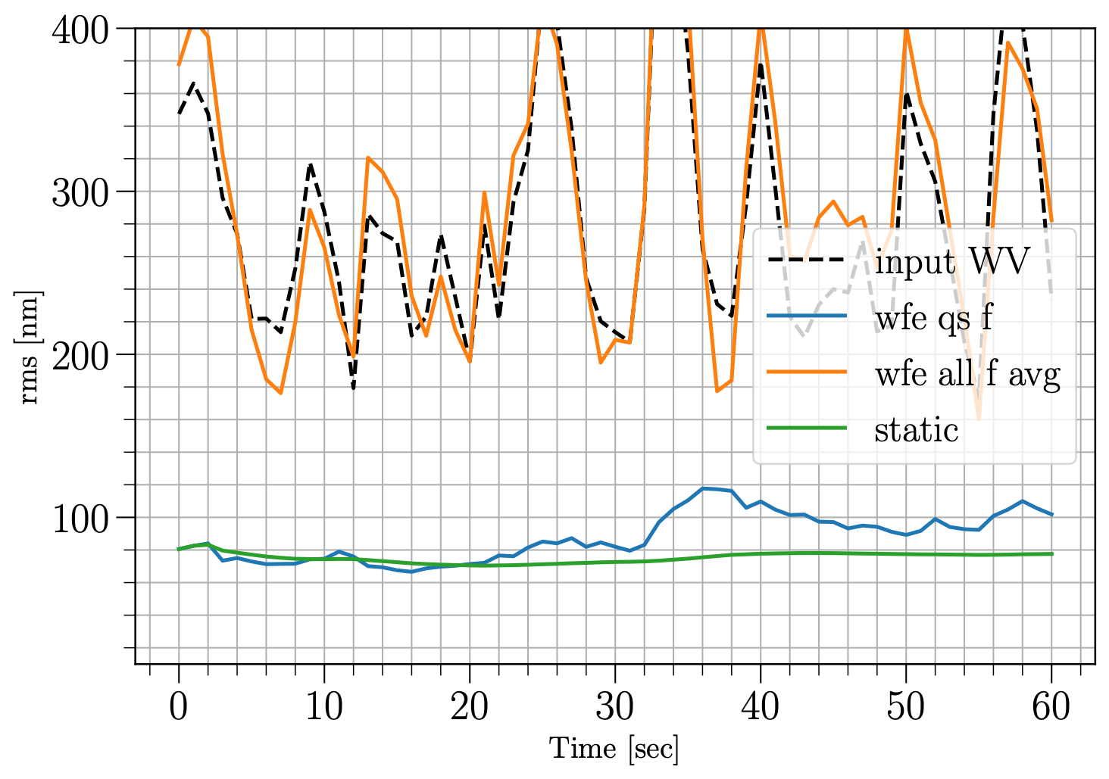
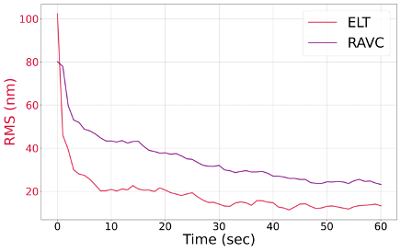
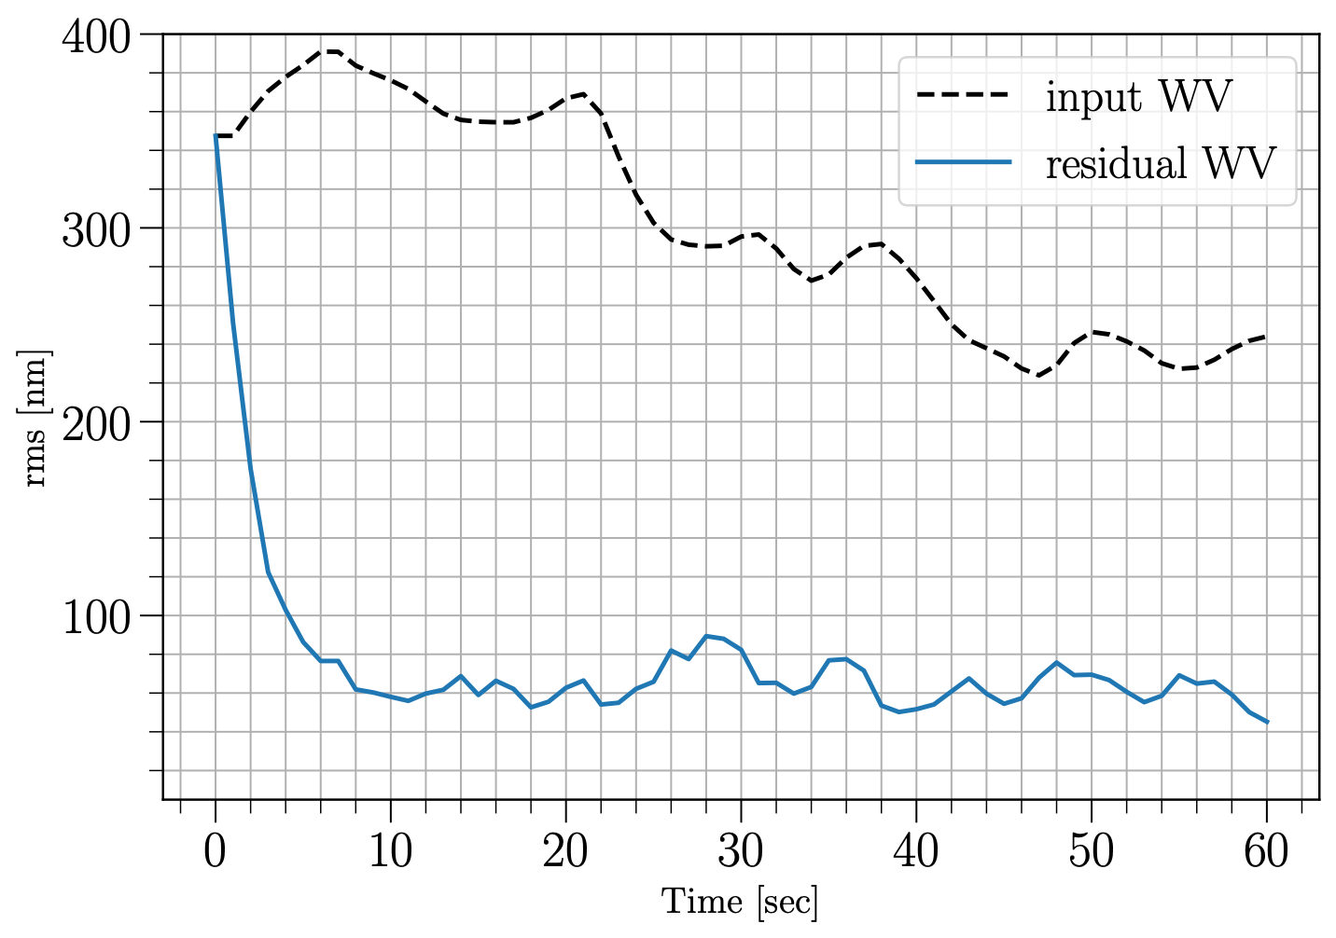
Results
RMS Plots
Static NCPA in L-band
  N-band with “slow” (10x) water vapour
Reaching <~20nm rms
for both IMG and RAVC
Reaching <~60nm rms
Probe field and subject beam cannot have the same temporal behaviour
Notes:
Subject beam need to be frozen during at least every single PSI iteration

Slide 23
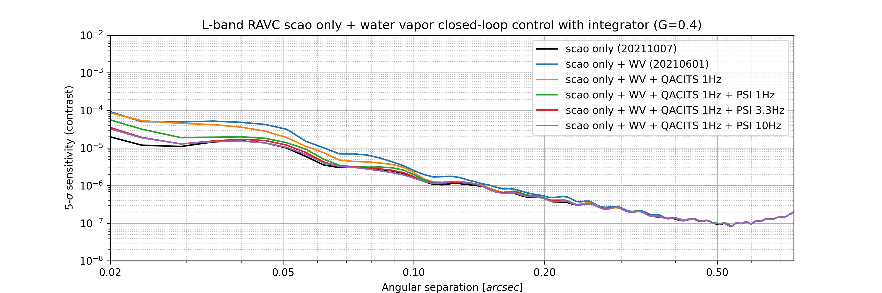
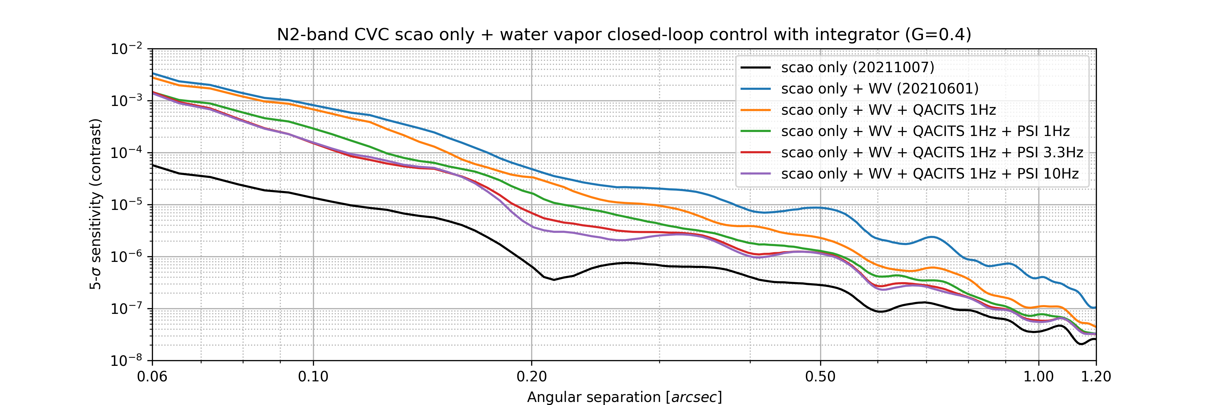
Expected performance improvement
L band
N band
Notes:
N-band:
Despite the challenges associated to water vapor seeing, we want also to highlight that correcting even partly WV seeing at N-band would be very beneficial scientifically, and could potentially open up a discovery space in terms of cold planet, down to temperate rocky planets.

Slide 24
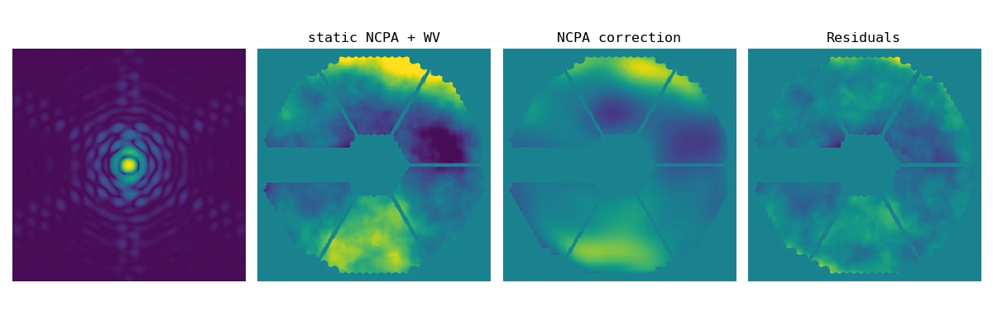
An Alternative to PSI in N-band ?
Asymmetric mask (pupil or Lyot) to lift phase ambiguity
On-going work: using the Asymmetric Pupil Fourier Wavefront Sensor (Martinache 2013)
Using XARA together with HCIPy and our METIS simulation products
Key questions:
Sensitivity limit (size of asymmetric arm, temporal aspect / WV rejection)
Asymmetric Lyot stop + Vortex coronagraph
Notes:
what is the sensitivity limit: magnitude vs temporal aspect and asymmetric arm
How well could it work with an asymmetric Lyot stop, + vortex coronagraph ?

Slide 25
Expect the Unexpected!
(and let’s keep our fingers crossed until then)
Notes:
"NCPA" is critical for METIS-HCI performance
Because of water vapour seeing, we do not have yet a solid solution
PSI, despite being elegant, is not demonstrated on-sky. ERIS ??
Using an asymmetric pupil mask has been demonstrated on-sky (Martinache, Bos+ with the APP) — but significant dev to make it a real-time sensor for the vortex coronagraph…

