Slide 1
A rotational shearing interferometer to sense across-the-spider phase discontinuity at ELT
Lorenzo Busoni, Simone Esposito, Giulia Carlà, Guido Agapito, Cedric Plantet, Marco Bonaglia
Osservatorio Astrofisico di Arcetri - INAF

Slide 2
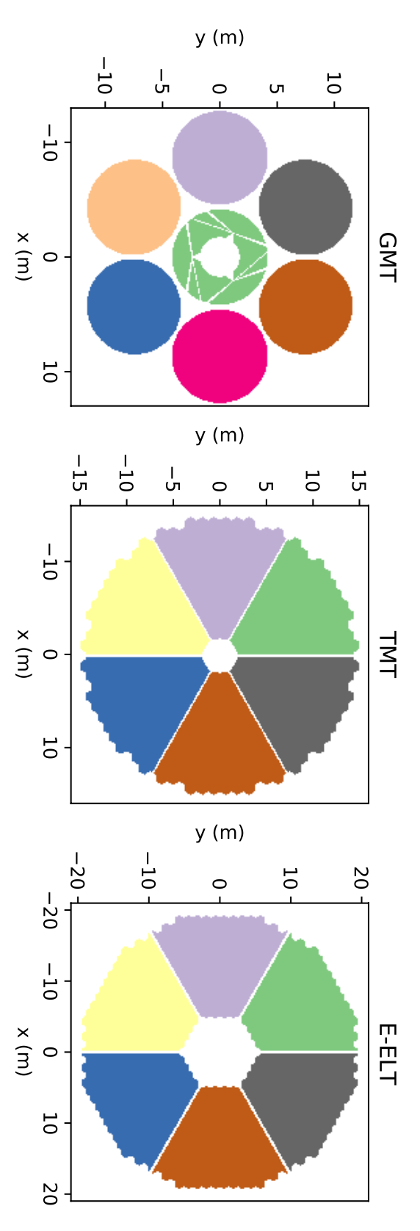
Why Yet Another Petalometer
ELT/GMT have segmented pupil with thick spider shadows or gaps
WFSs can’t «easily» reconstruct the WF under the gaps
Acting on DM control (slaving, POLC, …) may reduce unwanted petal pistons
But is it what we want? Real phase jumps do exist across the spider – pistoning petals is not evil
What we lack is the capacity to measure the wavefront jumps across the spider.

Slide 3
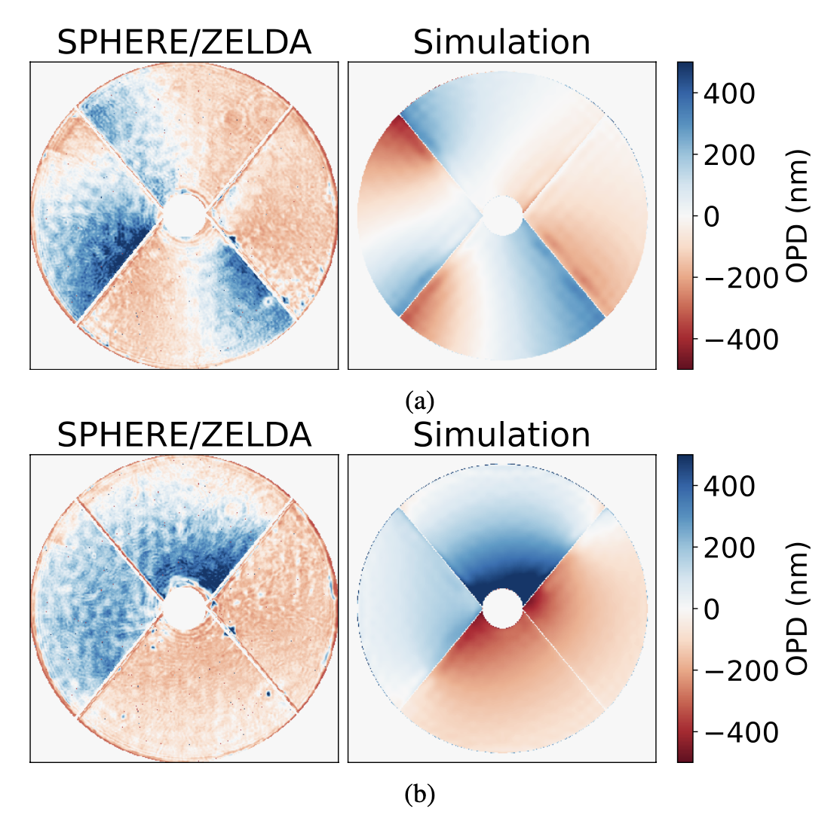
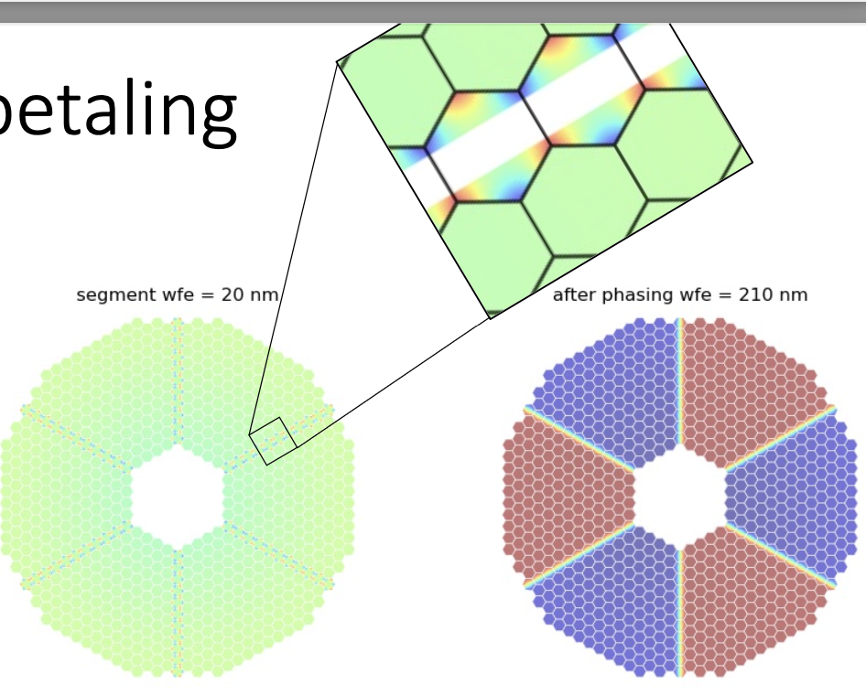
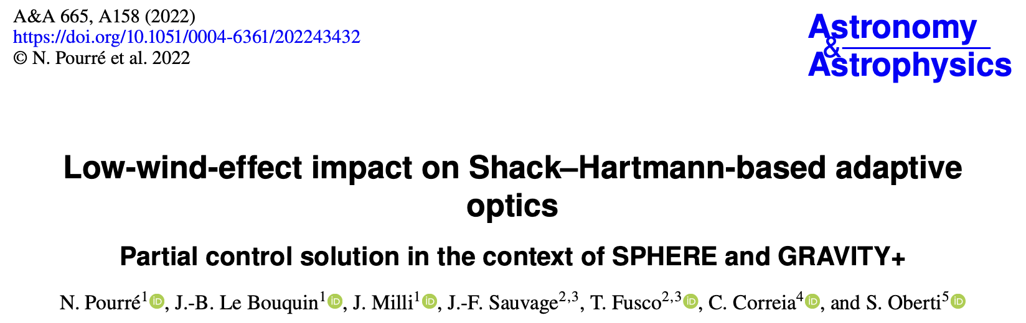
Wavefront jumps across the spider
Not only atmospheric turbulence, but Low Wind Effect, M1 footprint, …
The Nuke wavefront
H. Bonnet, Petal day – Mar 22

Slide 4
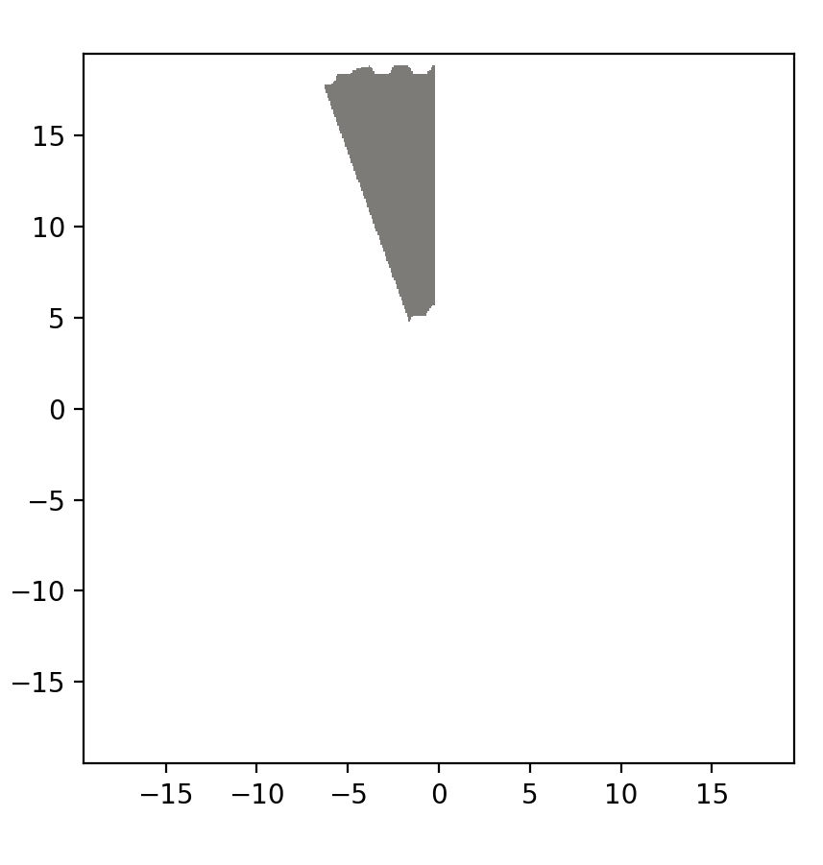
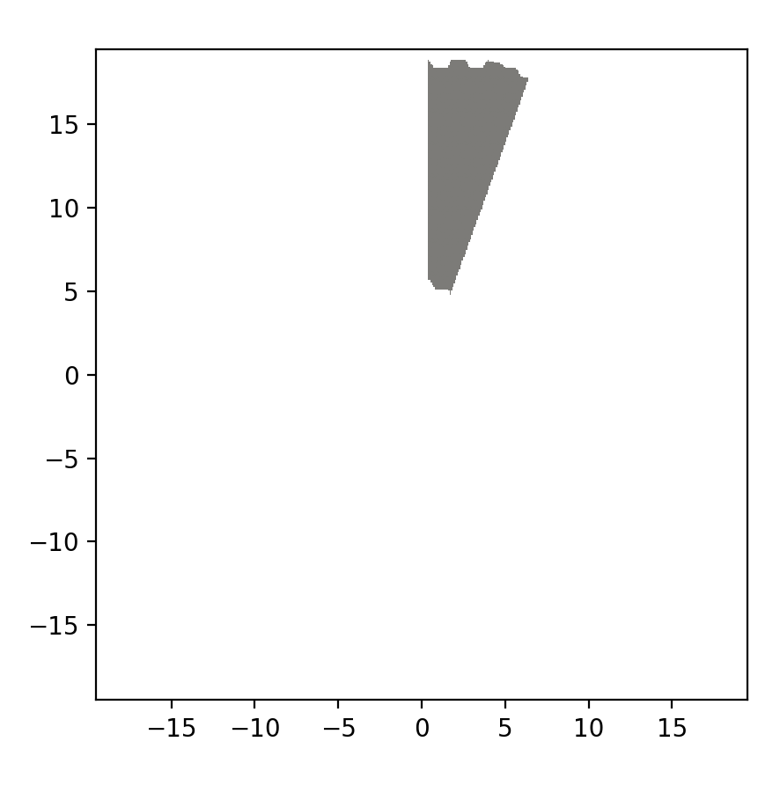

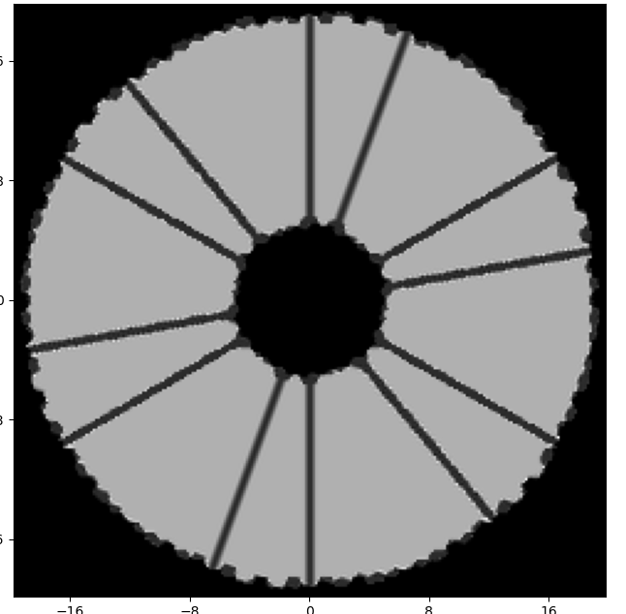
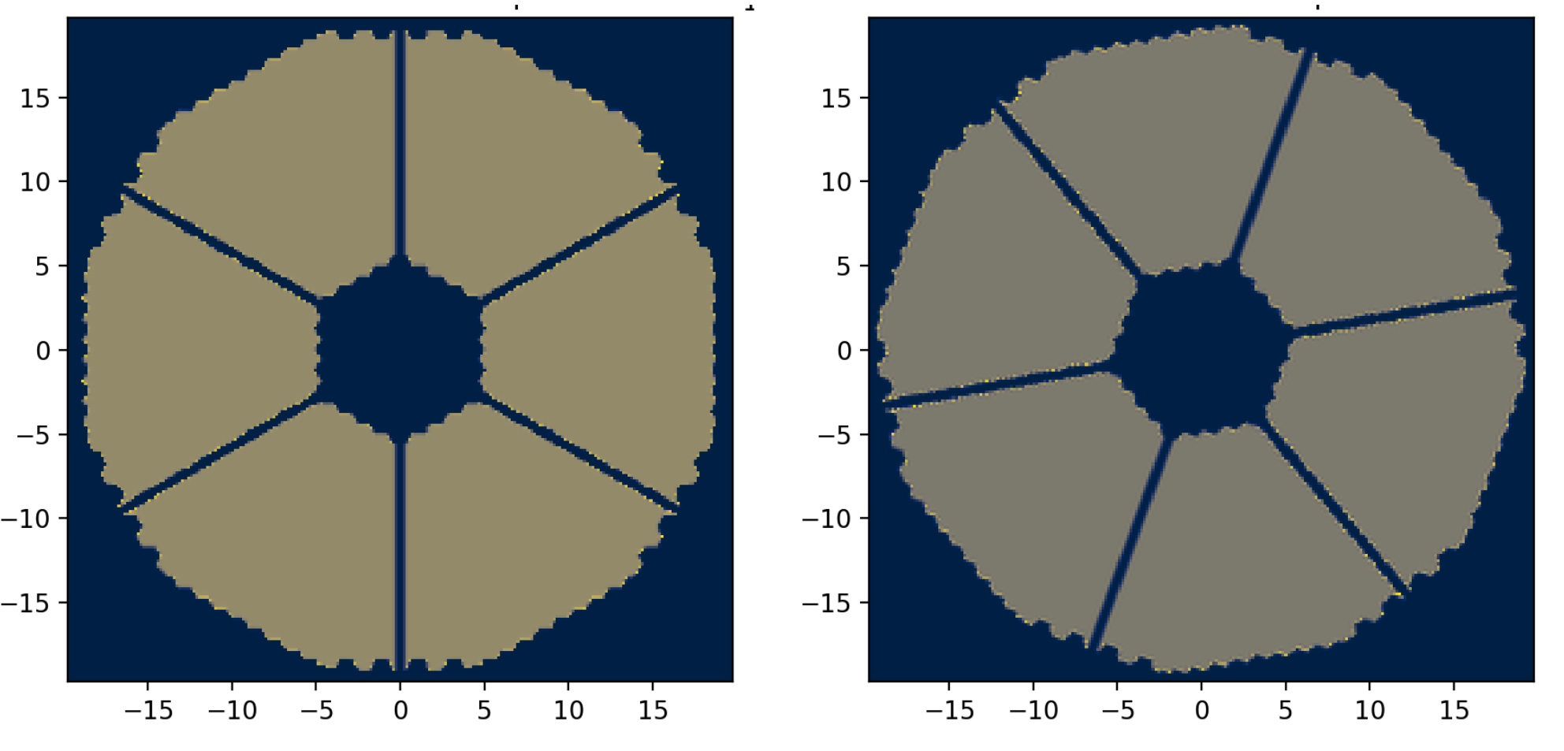

WFS concept
A shearing interferometer with rotational symmetry to overlap sectors of pupil across the spider
1-2
1
2
1
2
2-2
2-3
3
3
Recombine and
make interference
The Ciao Ciao WFS
Overlap this with this and make interference here
3-4
A pupil image
The pupil image rotated by $α=20°$
Notes:
Il WFS concept is simple: a rotational shearing interferometer that allows to interfere two pupil sectors separated by spider
Beam split, pupil rotator, recombine
Phase shifting o anche no.
The intensity in the overlapped sectors is function of dphi = dp + dres
Very similar to https://www.sait.it/node/470

Slide 5
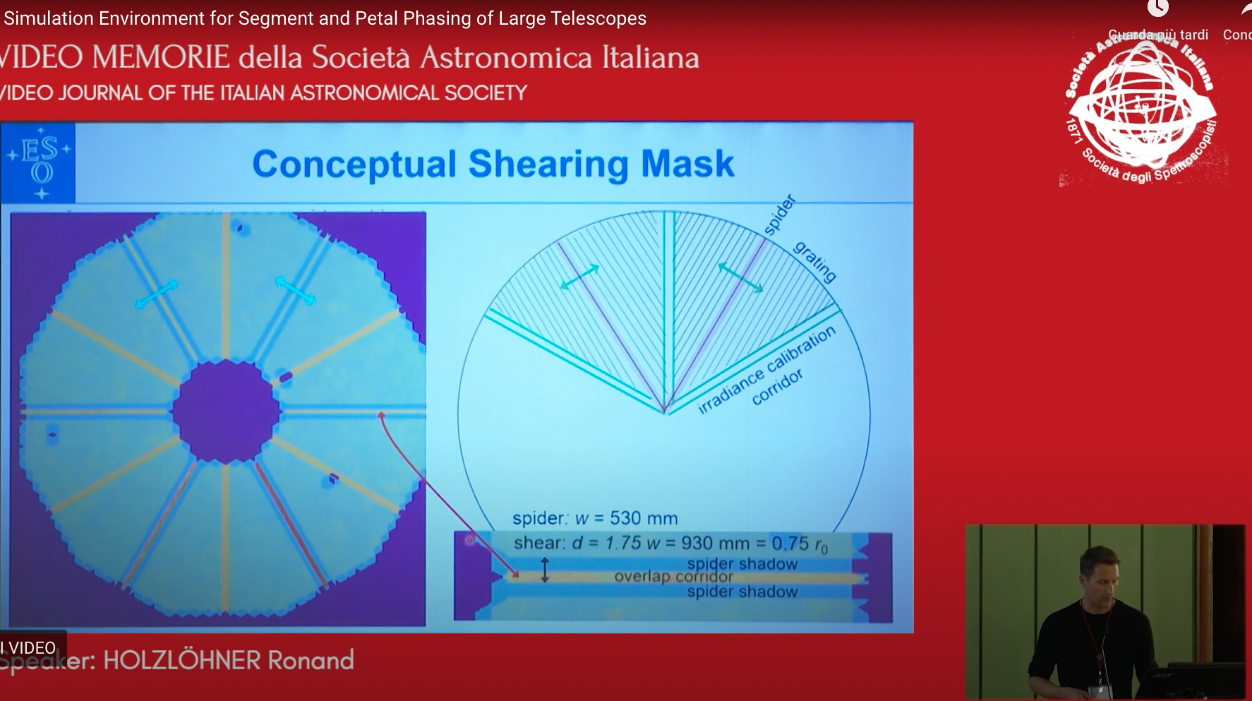
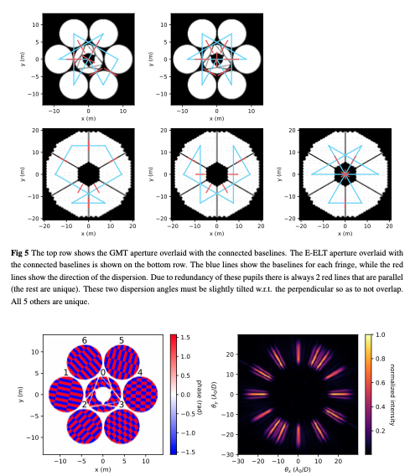
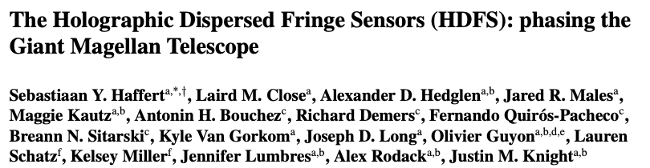
Other interferometric petalometers
Ron Holzloehner - WFS workshop Firenze https://www.sait.it/node/470

Slide 6
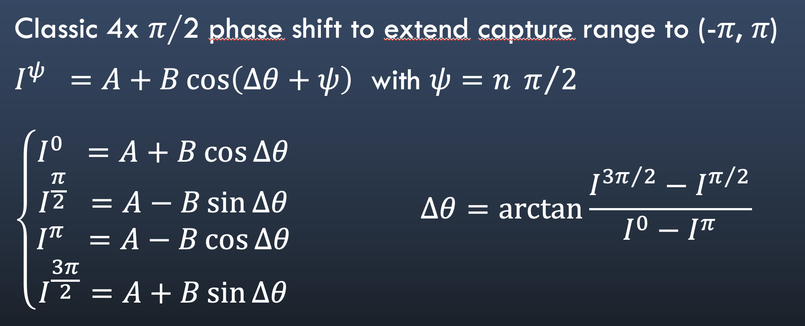




Phase difference reconstruction
$$E_{1}=A_{1} cos⁡(ω_{o}t+ θ_{1})$$
$${\left\langle I_{1,2}\right\rangle }_{T}={\left\langle {\left|E_{1}+E_{2}\right|}^{2}\right\rangle }_{T}=A^{2} \left[1+{\left\langle cos⁡(θ_{1}−θ_{2})\right\rangle }_{T}\right]$$
Assuming $A_{1}=A_{2}=A$
$$E_{2}=A_{2} cos⁡(ω_{o}t+ θ_{2})$$
The phase difference across the spider $∆θ= θ_{1}−θ_{2}$ can be retrieved from the interferogram
$$∆θ=\arccos\left(\frac{{\left\langle I_{1,2}\right\rangle }_{T}}{A^{2}}−1\right)$$
It requires monochromatic beams – we assume narrowband at 2200nm
Phase-shifting techniques can be used to extend the capture range to $λ$. More exposures - slower – needs piston mirror
Multi-lambda is possible to extend beyond $λ$ - even slower
Notes:
Non misura phase, but «phase jumps». The range –pi, pi is in the jump, not in the phase itself. +0.6 lambda and -0.6 lambda makes a jump of 1.2 that doesn’t work

Slide 7
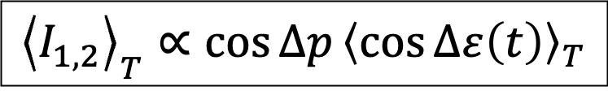

Impact of residual turbulence
Splitting $∆θ$ in
static phase jump $j=∆p= p_{1}−p_{2}$ and
turbulence $∆ε(t)= ε_{1}(t)−ε_{2}(t)$ evolving during T
$$\frac{{\left\langle I_{1,2}\right\rangle }_{T}}{A^{2}}−1= {\left\langle \cos\left(θ_{1}−θ_{2}\right)\right\rangle }_{T}={\left\langle \cos\left(∆p+∆ε\left(t\right)\right)\right\rangle }_{T}=\cos{∆p}{\left\langle \cos{∆ε\left(t\right)}\right\rangle }_{T}−\sin{∆p}{\left\langle \sin{∆ε\left(t\right)}\right\rangle }_{T}$$
where ${\left\langle \sin{∆ε\left(t\right)}\right\rangle }_{T}=0$ assuming ${\left\langle ∆ε\left(t\right)\right\rangle }_{T}=0$ and skewness $∆ε\left(t\right)=0$
➜ the spatial decorrelation of the turbulence biases the measurement of $∆p$with a factor < 1
Q: Can be estimated from the non-overlapping sectors (for large T)? Or calibrated?
$${\left\langle I_{1,2}\right\rangle }_{T}∝\cos{∆p}{\left\langle \cos{∆ε\left(t\right)}\right\rangle }_{T}$$

Slide 8
Optical concept
Highly inefficient conceptual idea
Pupil rotator
BS1
From AO
A 6x lenslet to collect all the sector flux onto 6 APD
Recombination in pupil conjugated plane
Phase n𝜆/2 shifter
(optional)
BS2

Slide 9
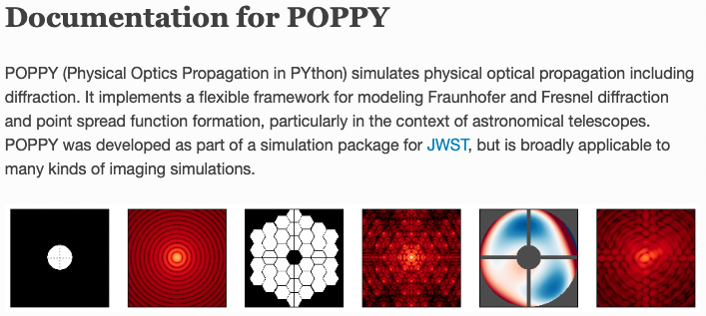
Optical simulations
Based on poppy
Optical model consists of a stack of pupil layers
  Residual turbulence from MORFEO simulations
  Low Order Zernike
  ELT Pupil Aperture
  Petaled M4
  Global Piston for phase shifting
  Rotator
2 identical models are instantiated with different rotation. Output wavefronts are recombined

Slide 10
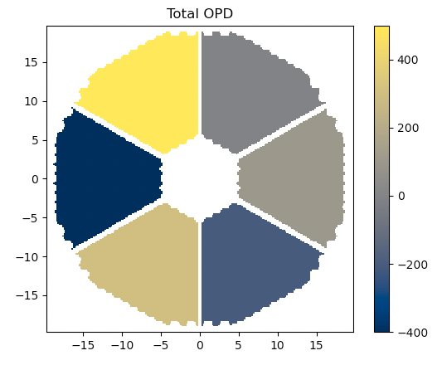
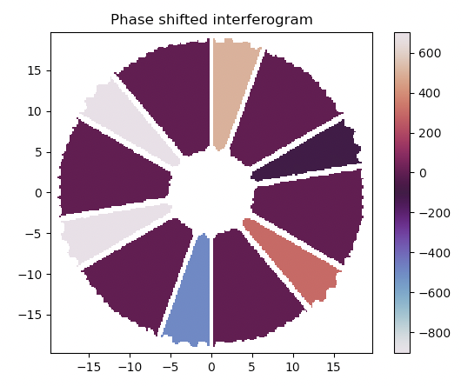

No turbulence case
500
500
500
0
-900
-900
-100
-100
-400
100
700
700
300
300
-200
300
-500
-500
Measured jumps $\vec{j}=\left[500, −100, 300, −500, 700, −900\right] nm$
Estimated petals $\vec{p}=−cumsum \vec{j} =\left[−500, −400, −700, −200, −900, 0\right] nm$
that is correct up to a global piston of -500nm
Notes:
Mettere freccine per capire come si fa

Slide 11
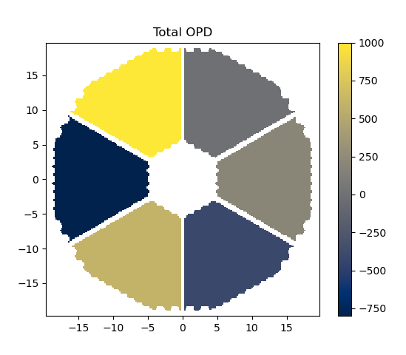
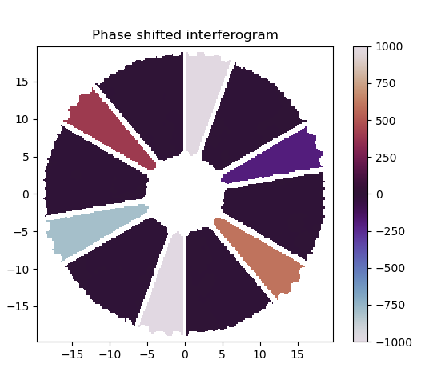

Too large phase steps
Petals are within (-λ/2 , λ/2 )
1000
1000
1000
0
400
-1800
-200
-200
-800
200
-800
1400
600
600
600
-400
-1000
But jumps exceed (-λ/2 , λ/2 )
-1000
Expected jumps $\left[+1000, −200, +600, −1000, +1400, −1800\right] nm$
Measured jumps $\left[+1000, −200, +600, −1000, −800, 400\right] nm$
Estimated petals $\left[0, 200, −400, 600, 1400, 1000\right] nm$
Wrong by 2𝜋 ambiguity

Slide 12

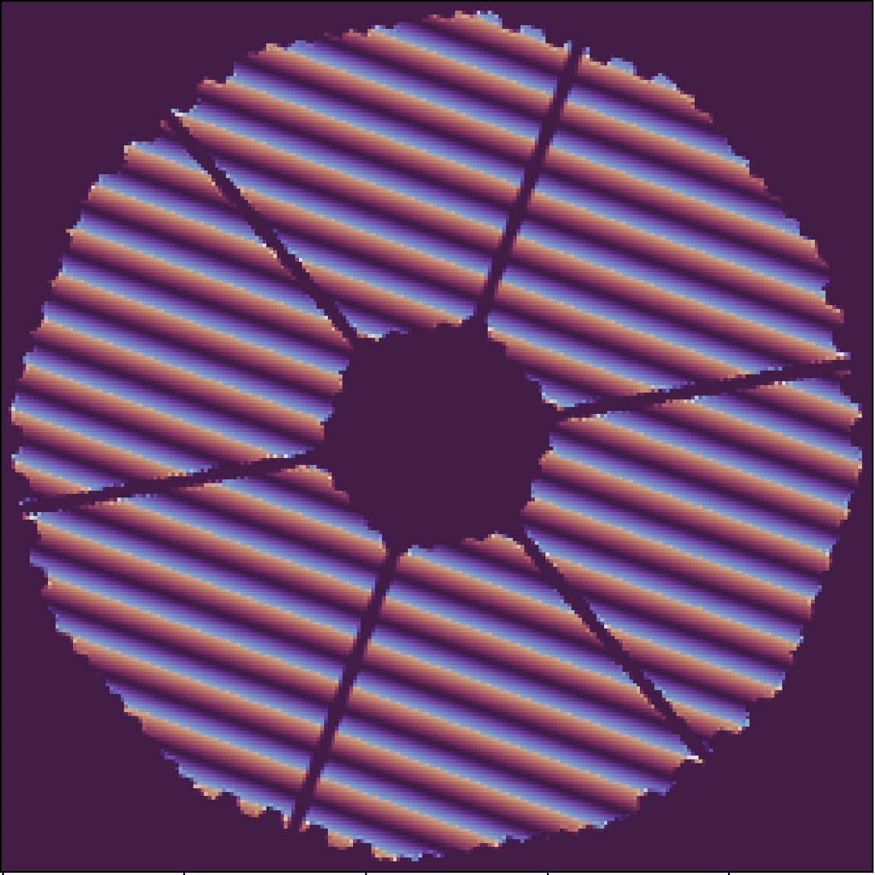
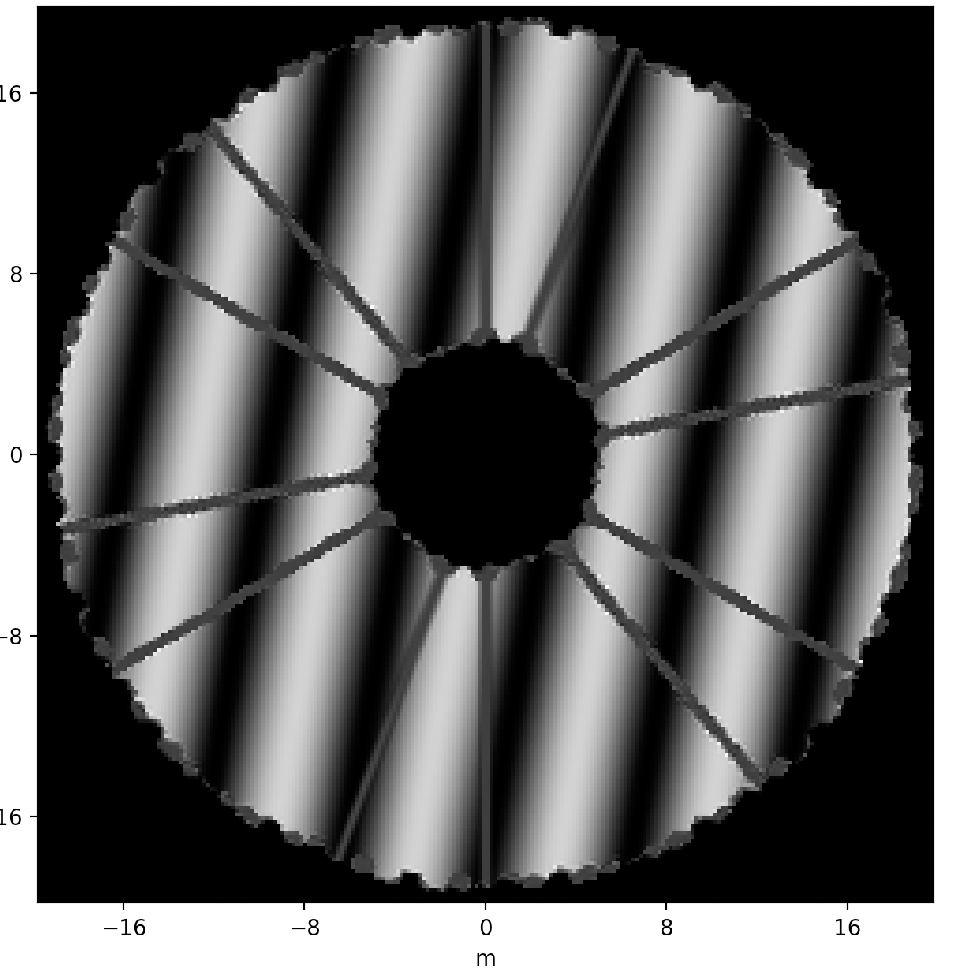
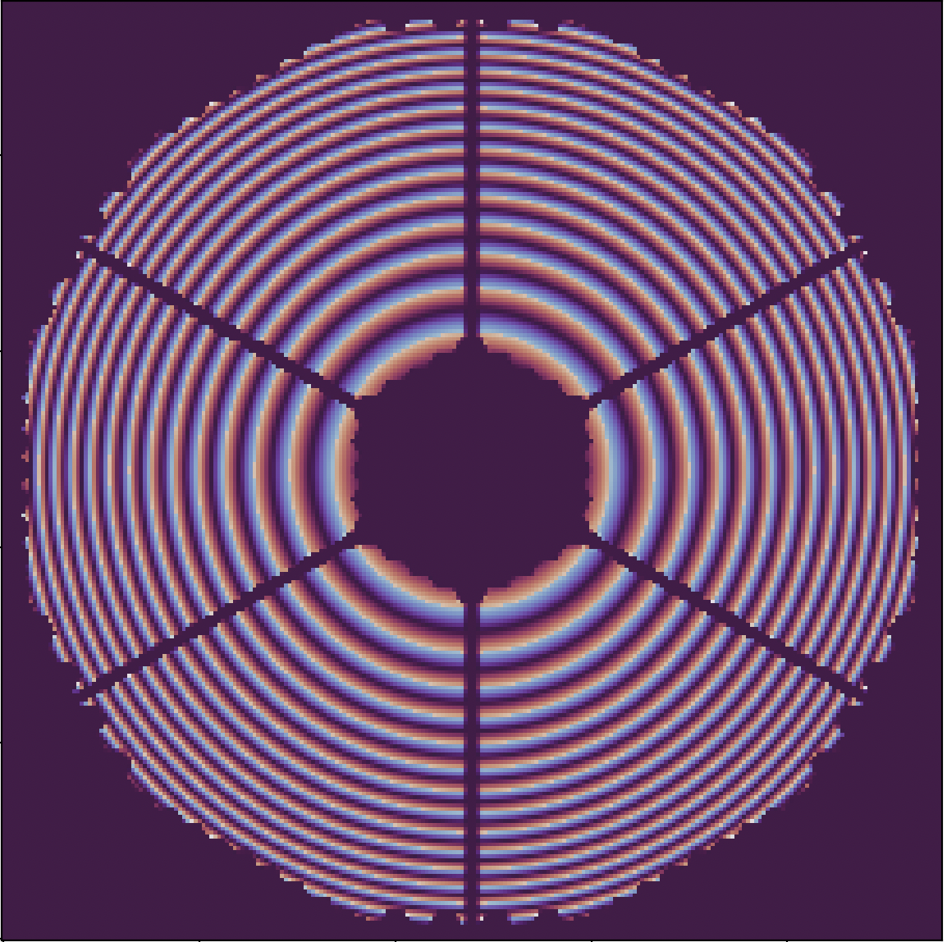
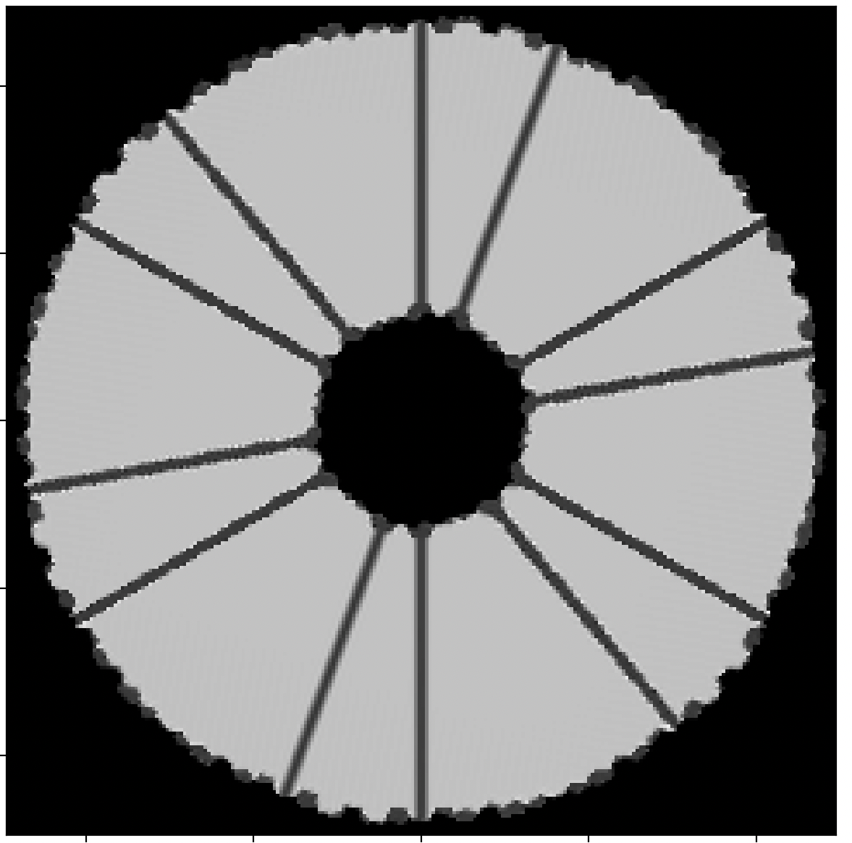

Rejection of low order aberrations
Residual tilt doesn’t cancel out: it is seen as a rotated tilt of smaller amplitude:
$$Z_{2}−R_{α}Z_{2}= \left(1 − \cos{α}\right)Z_{2}− \sin{α}Z_{3}$$
where $R_{α}$ is the rotation matrix of the pupil image by $α=20°$
Focus Z4

Slide 13
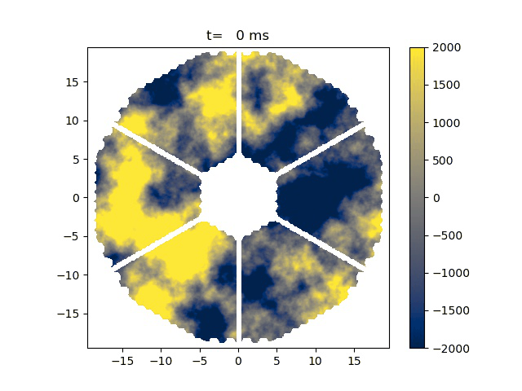
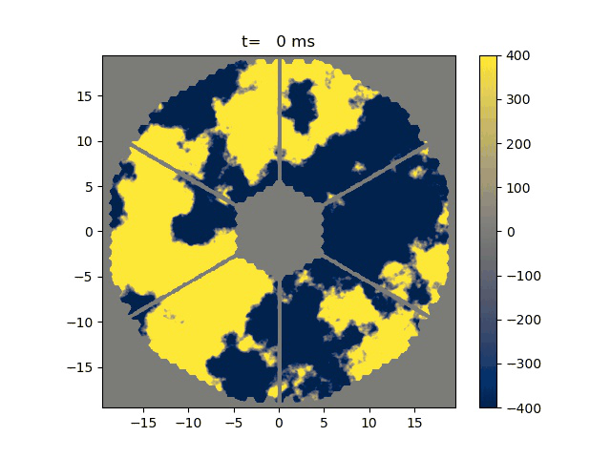
Residual turbulence of MORFEO
MCAO residual turbulence simulated with PASSATA
r0=0.128m, 6 LGS + 3 NGS, M4+1pfDM, POLC-MMSE
Residuals along 45 arcsec off-axis, 2s at 500fps
Cumulative average
Notes:
Residuo atmosferico dopo la correzione MCAO nella direzione off axis di un sensore LO (quanto off axis?)
Come è fatto il controllo, in termini del pistone atmosferico, base modale etc?
Ce la stiamo giocando con POLC/MMSE? Nel senso che abbiamo una turbolenza esattamente come quella messa nell’apriori e quindi ci funziona tutto?

Slide 14
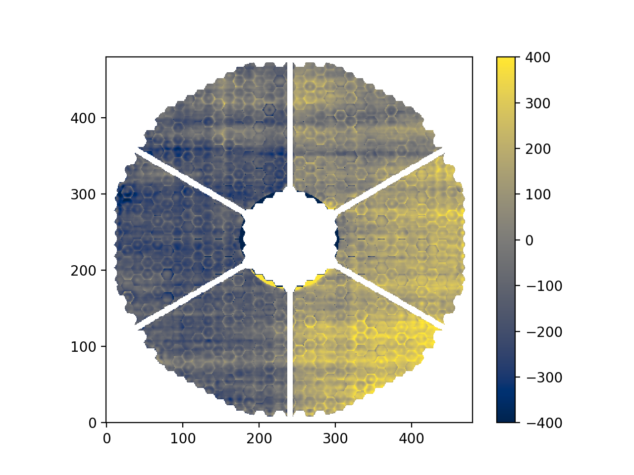
Long exposure (2s) residual phase map.
spatial variance = 220nm rms
We can compute the phase jumps across the spiders
Jumps = [-179, -96, -50, 153, 7, 70] nm

Slide 15
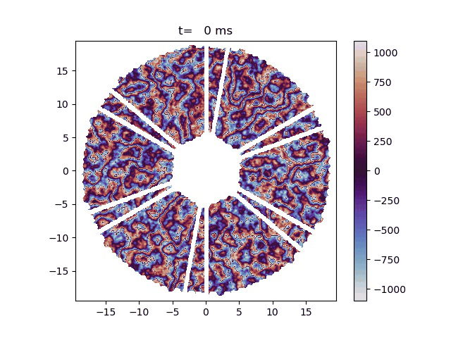
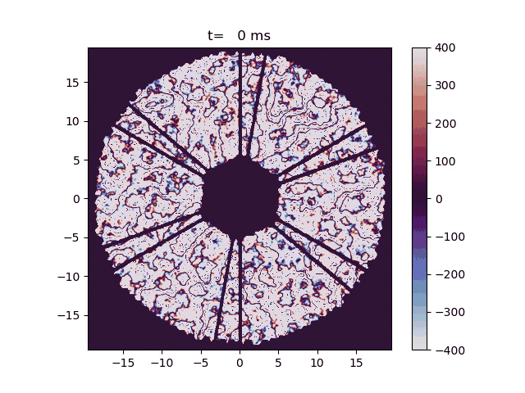
Interferograms of the residual turbulence of MORFEO
Cumulative average

Slide 16
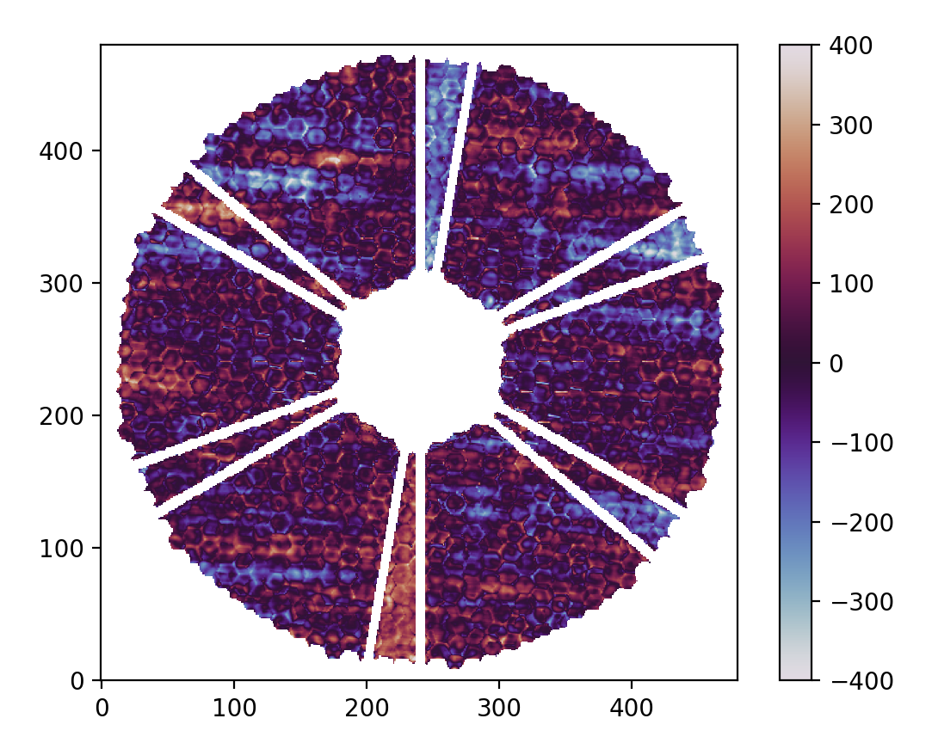
Jumps estimation on residual turbulence
«Real» phase jumps = [-179, -96, -50, 153, 7, 70] nm
Estimated jumps = [-168, -107, -64, 161, 21, 63] nm
Stdev jumps error = 11nm - Not bad!
Reconstructed petals = [-33, 74, 138, -24, -45, -108] nm
Exposure time=2s
Overlapping 𝛼=10°

Slide 17
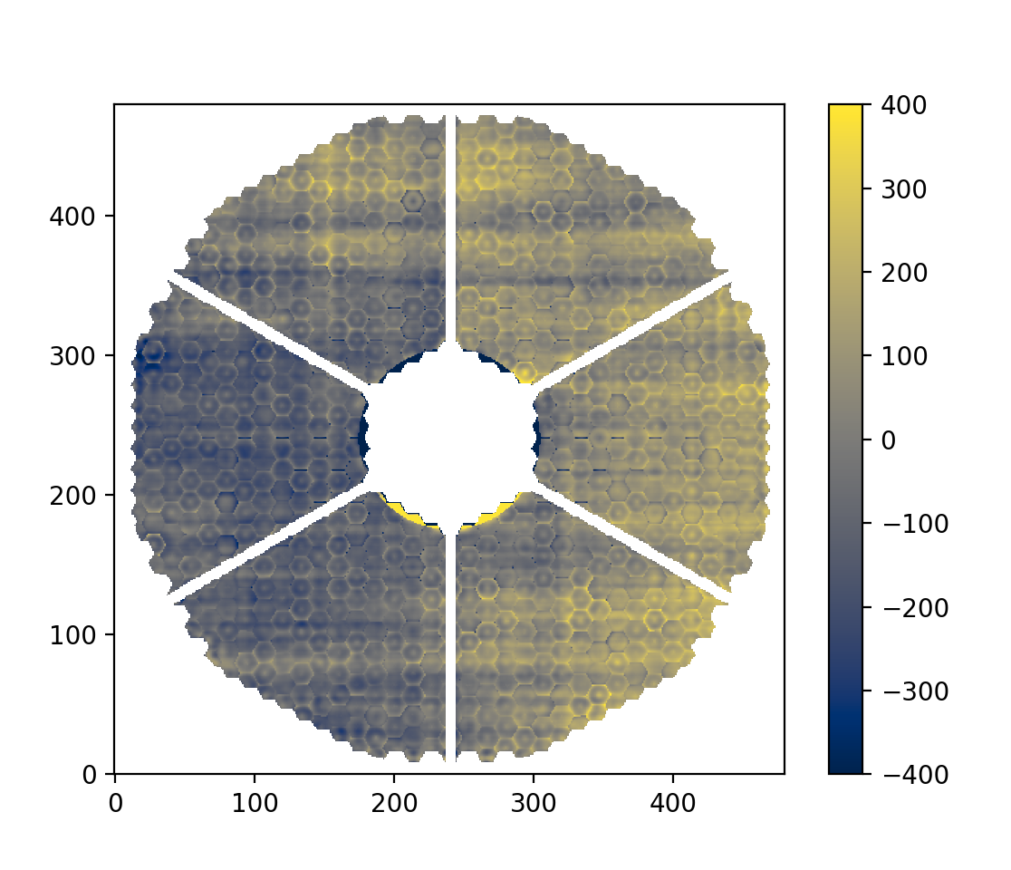
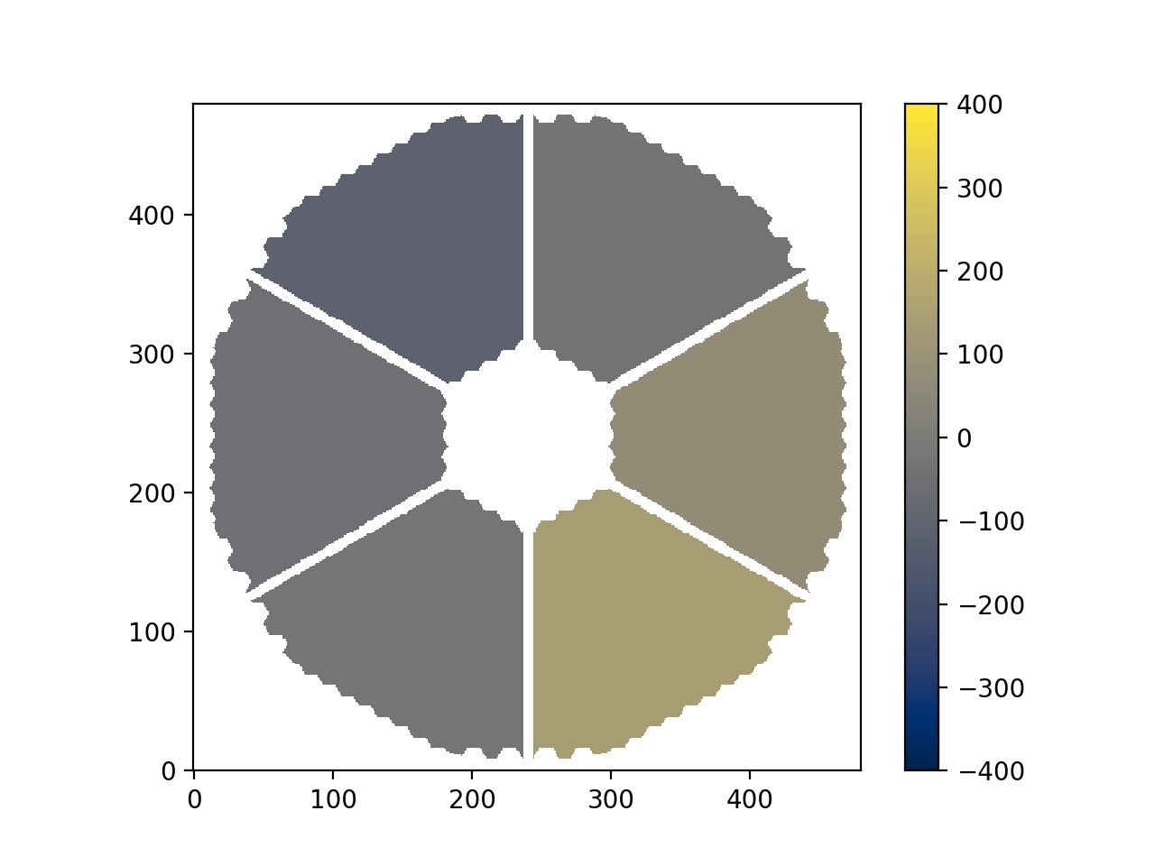
Mimicking petals correction
Before correction – 221nm rms
Petal corrected – 185nm rms
Petals estimated by petalometer

Slide 18
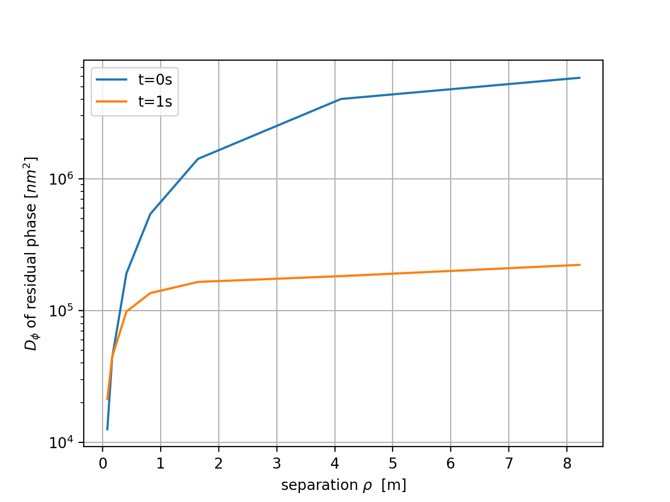
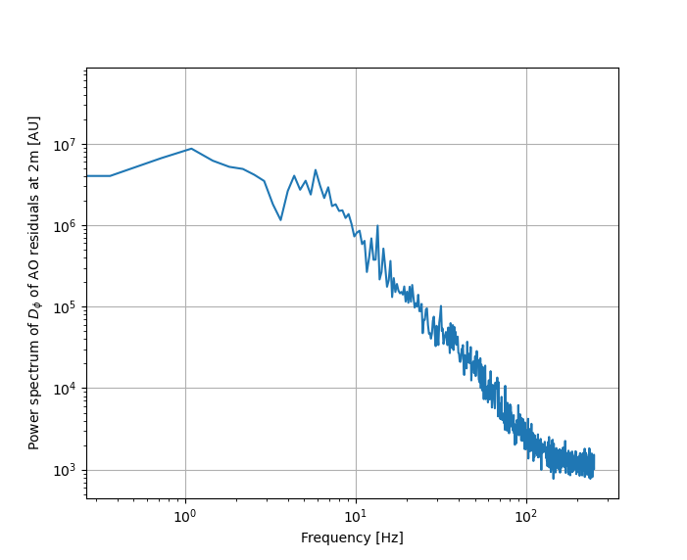


Spectral properties of the residual turbulence of MORFEO
Structure function
$$D_{ε}\left(ρ\right)= {\left\langle {\left|ε\left(r+ρ\right)− ε(r)\right|}^{2}\right\rangle }_{S}$$
reaches plateau of about 350nm already at $ρ=1 m$
Residual turbulence $∆ε(t)= ε_{1}(t)−ε_{2}\left(t\right)$ with $ρ=2m$ has a $1/f^{2}$ power spectrum
Notes:
Residuo atmosferico dopo la correzione MCAO nella direzione off axis di un sensore LO (quanto off axis?)
Come è fatto il controllo, in termini del pistone atmosferico, base modale etc?
Ce la stiamo giocando con POLC/MMSE? Nel senso che abbiamo una turbolenza esattamente come quella messa nell’apriori e quindi ci funziona tutto?

Slide 19

Trying to improve SNR
The residual turbulence is too large to measure the phase difference $∆p$ with good SNR
We are interested in a pseudo-static $∆p$ and the temporal power spectrum of the residual is decreasing fast, so…
we can apply homodyne detection (like in push-pull IM, lock-in amplifier, …)

Slide 20
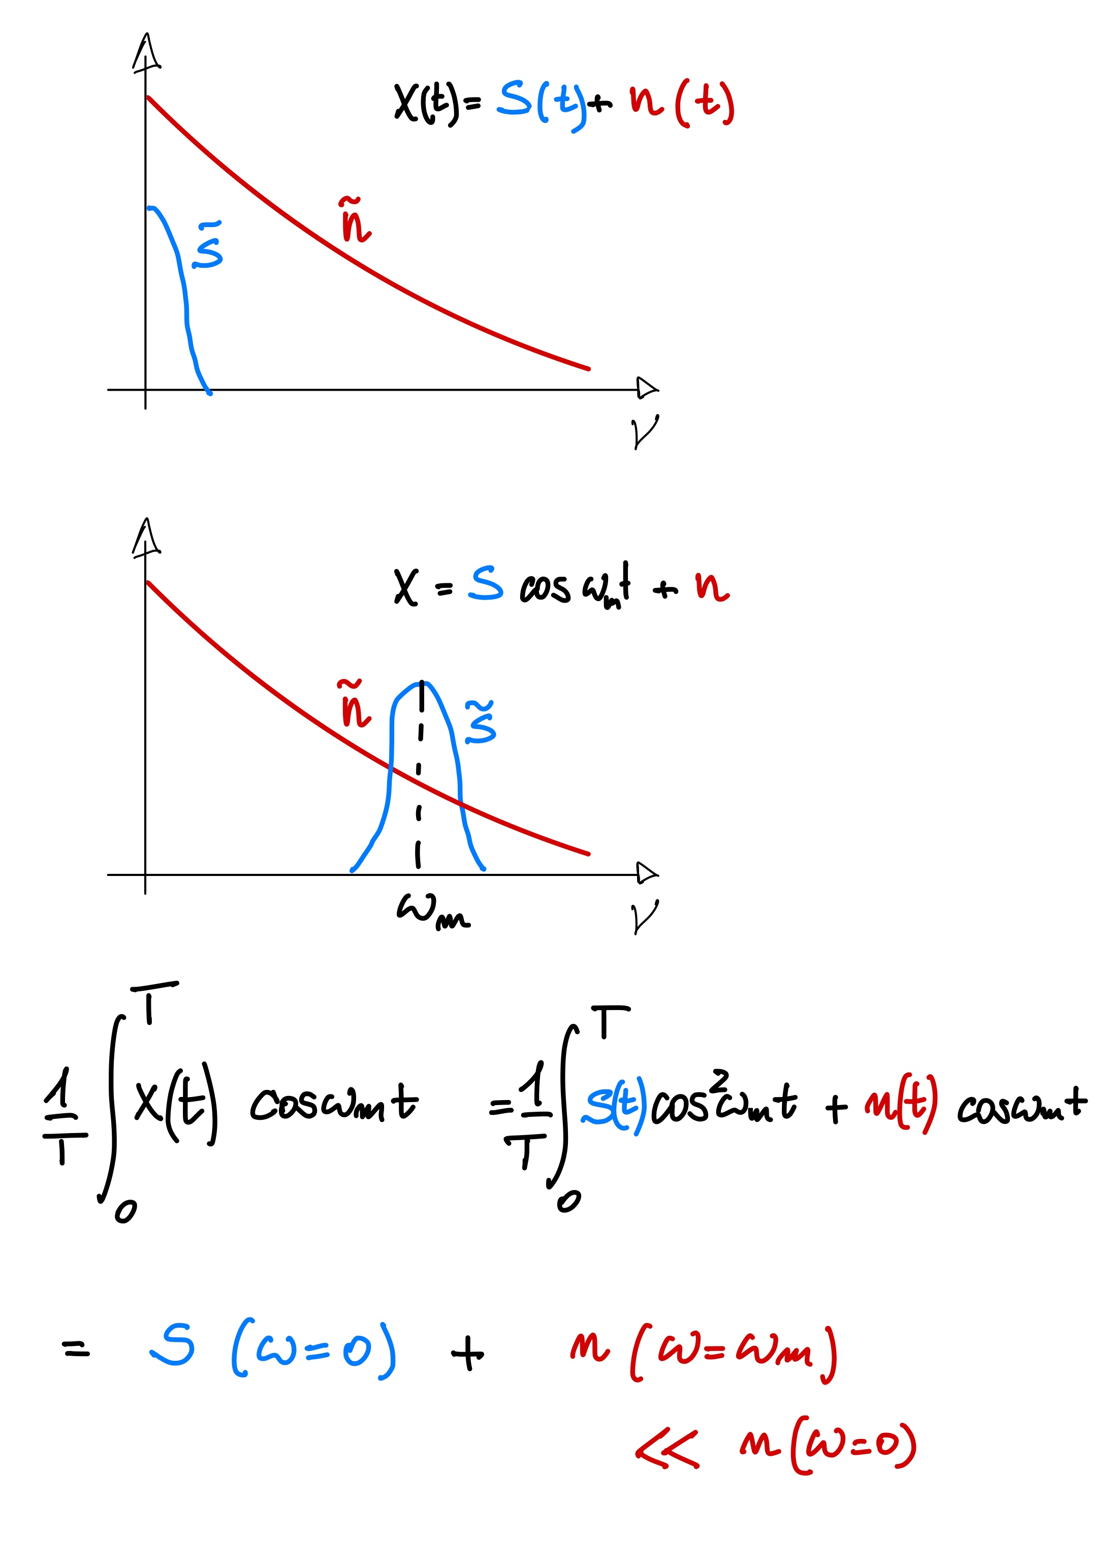
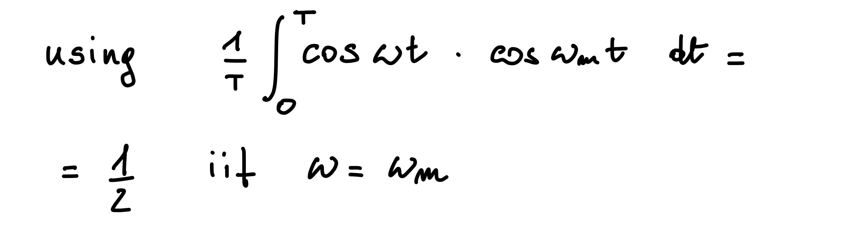



Homodyne detection
Demodulation: multiply by $\cos{ω_{m}}t$ and average
Original signal overwhelmend by noise
Modulated signal: spectrum shifted at $ω_{m}$
$$\tilde{x}$$

Slide 21
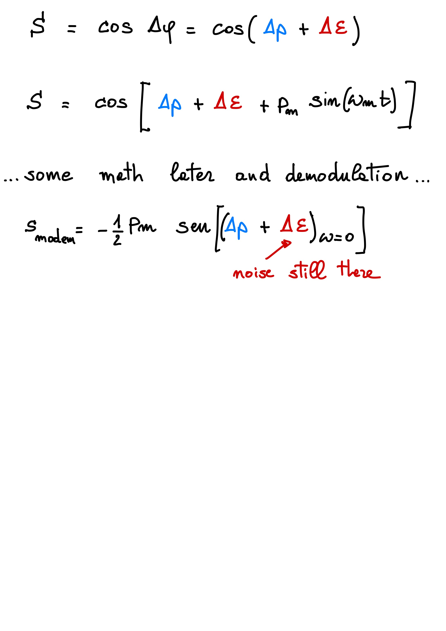

How to modulate interferograms?
Non modulated signal
Small modulation of $∆p$
$p_{m}$ must be small λ/100 to preserve PSF
The modulation above is not discriminating among signal and noise: the restored signal is still affected by large noise

Slide 22
Conclusions
Yet another petalometer to sense phase jumps across the spider
Interferometer based on overlapping of 2 rotated pupil images
Decent jumps retrieval with 2s exposure time also with MORFEO’s good seeing residuals
Attempt to improve SNR with homodyne detection is left as an exercise to the reader

Slide 24
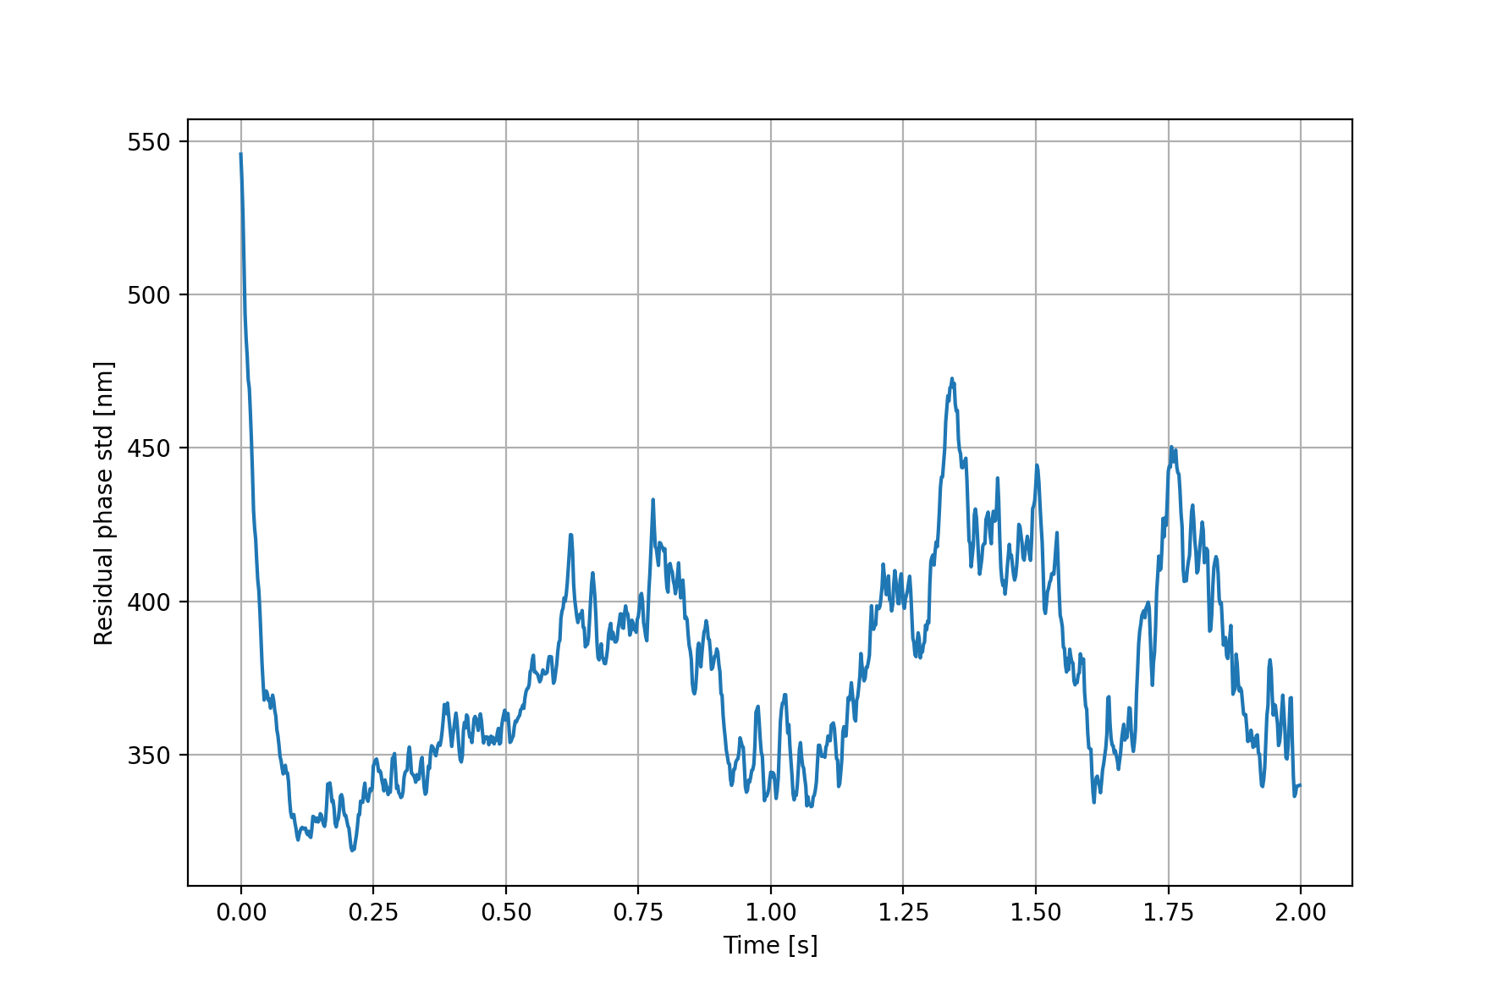
Average std of short exposure residual is 376nm

Slide 25



Phase Shifting to extend the range
Classic 𝜋/2 phase shift to extend capture range to (-𝜋, 𝜋)
$I^{ψ} =A+B\cos\left(∆θ+ψ\right)$ with $ψ=n π/2$
$$\left\{\begin{aligned}\begin{aligned}I^{0} =A+B\cos{∆θ} \\ I^{\frac{π}{2}} =A−B\sin{∆θ} \\ I^{π} =A−B\cos{∆θ}\end{aligned} \\ I^{\frac{3π}{2}}=A+B\sin{∆θ}\end{aligned}\right.$$
$$∆θ=\arctan{\frac{I^{{3π}/2}−I^{π/2}}{I^{0}−I^{π}}}$$

Slide 26
Phase jump on phase map using sectors of X° around the spider
In [73]: np.round(jj5[0::3] - jj5[1::3])
Out[73]: array([-179., -96., -50., 153., 7., 70.])
In [74]: np.round(jj10[0::3] - jj10[1::3])
Out[74]: array([-169., -90., -57., 198., 20., 41.])
In [75]: np.round(jj20[0::3] - jj20[1::3])
Out[75]: array([-145., -112., -63., 245., 17., -12.])
Phase jumps estimated by the petalometer for 5, 10 ,20° of rotation angle
In [81]: np.round(ej5[::2])
Out[81]: <Quantity [-168., -122., -46., 171., 15., 51.] nm>
In [82]: np.round(ej10[::2])
Out[82]: <Quantity [-168., -107., -64., 161., 21., 63.] nm>
In [83]: np.round(ej20[::2])
Out[83]: <Quantity [-66., -50., -11., 102., 12., 0.] nm>

Slide 27
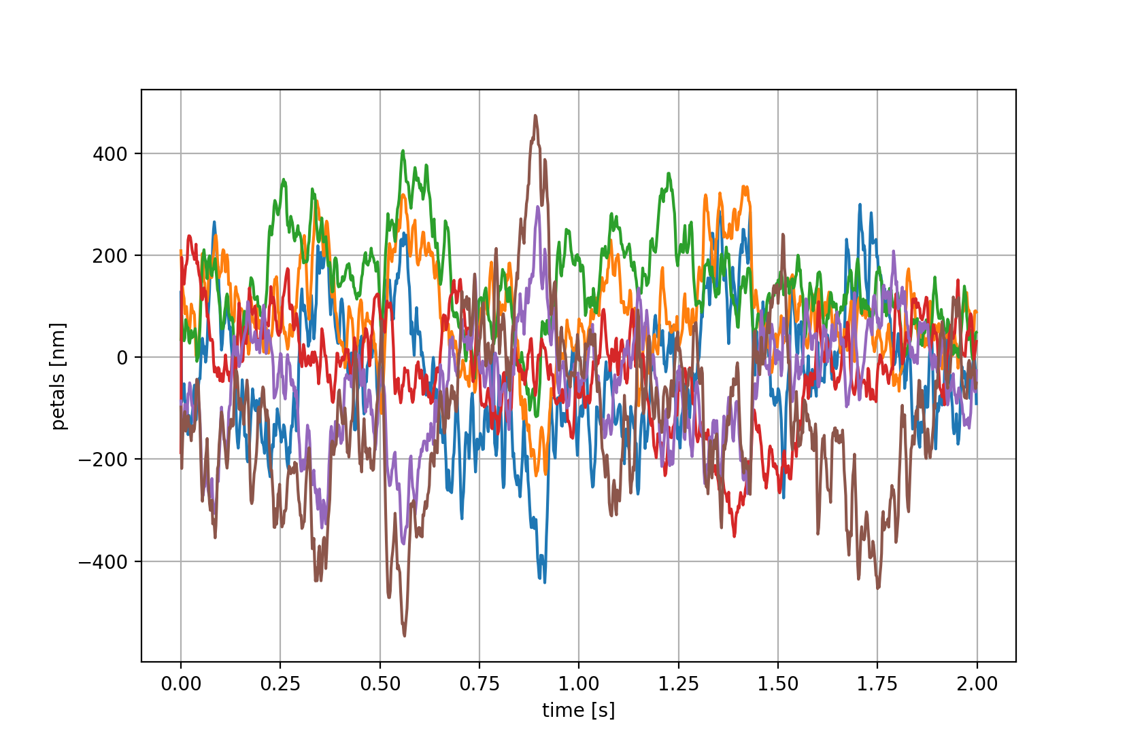

With an exposure time of 2s, the petal error is $σ_{{\left\langle ∆p\right\rangle }_{2s}}=90 nm$

Slide 28
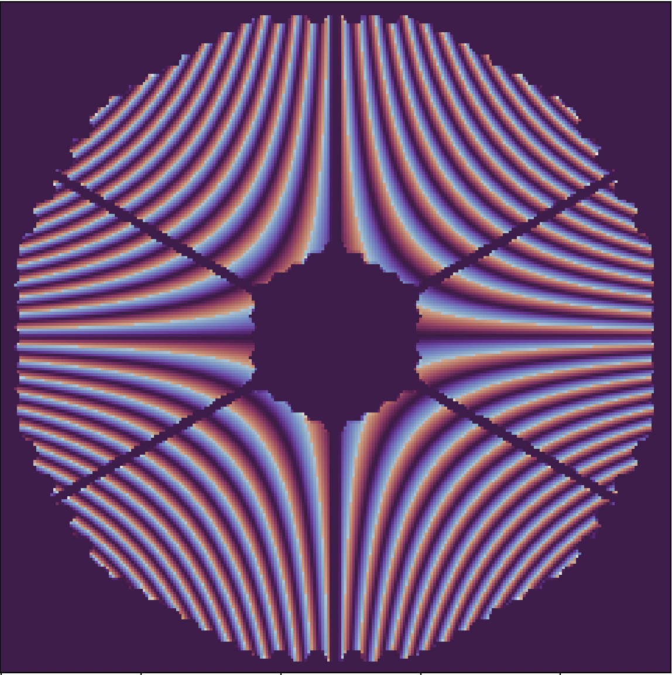
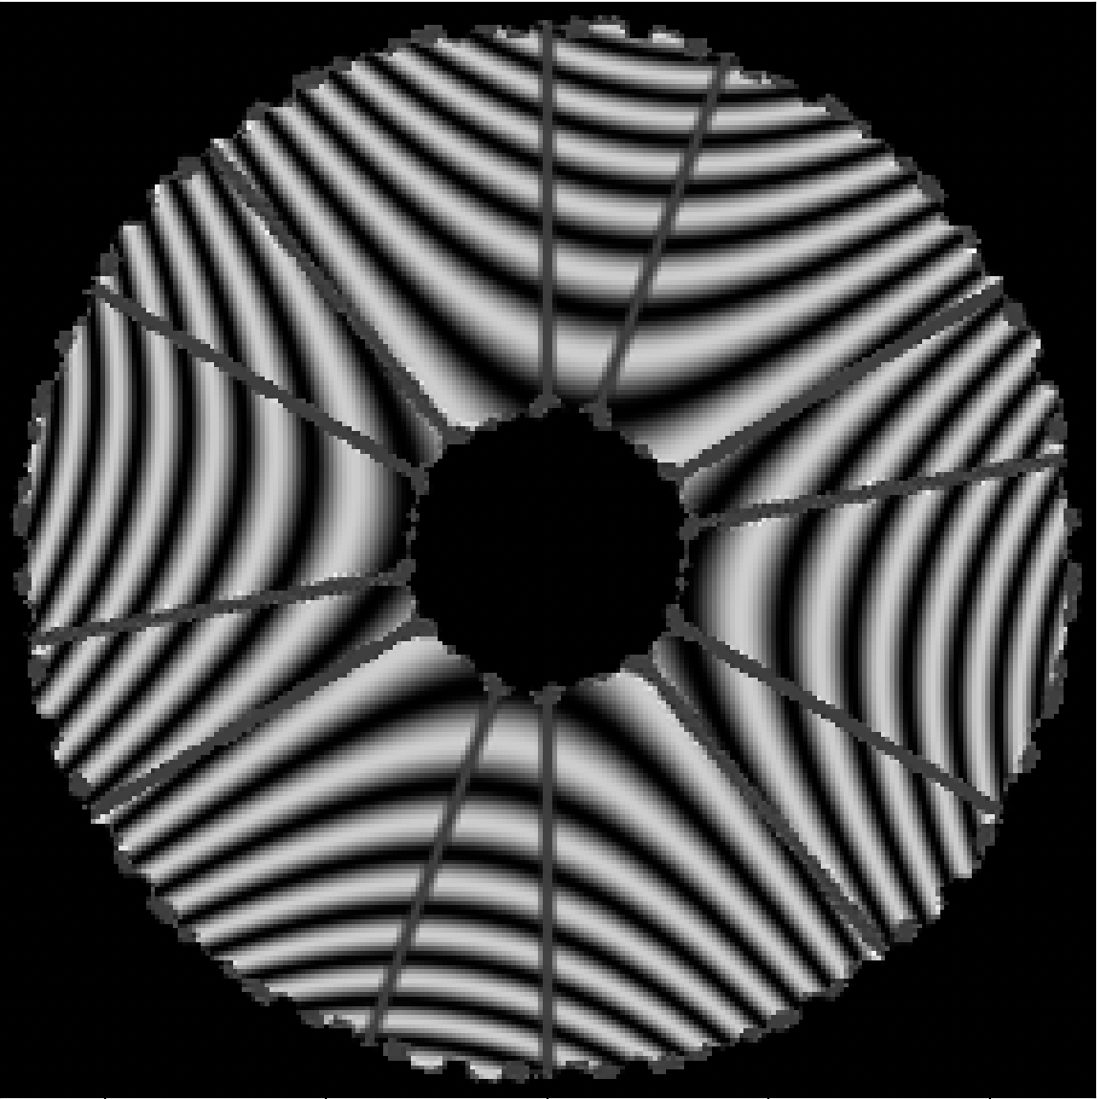
Axisymmetric aberrations cancel out completely
Astigmatism Z5
Focus Z4

