Slide 1





Deep Learning Wavefront Reconstruction With Collimated Lasers Using Experimental Data from the PPPP Bench
Nazim Ali Bharmal ¹,
Carlos González-Gutiérrez ²,
Huizhe Yang ^{1,3},
Jorge Rodríguez Muro ²,
Tim Morris ¹,
Francisco Javier de Cos Juez ²
¹ Centre for Advanced Instrumentation, Durham University, UK
² Instituto Universitario de Ciencias y Tecnologías Espaciales de Asturias, University of Oviedo, Spain
³ College of Advanced Interdisciplinary Studies, National University of Defense Technology, China

Slide 2
Outline
Alternative laser-based wavefront sensing, our technique
The PPPP bench, our source of experimental data
Results from ML, our analysis of the data
Next steps, our plans

Slide 3
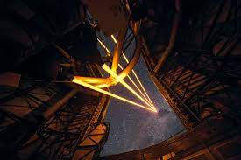
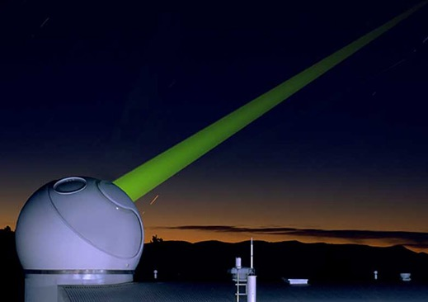


1. A non-LGS method of wavefront sensing:

Slide 4
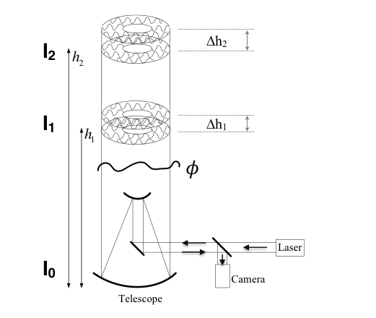
Mathematical model
Transport of Intensity Equation (TIE),
I₀
I₁
I₂
4

Slide 5
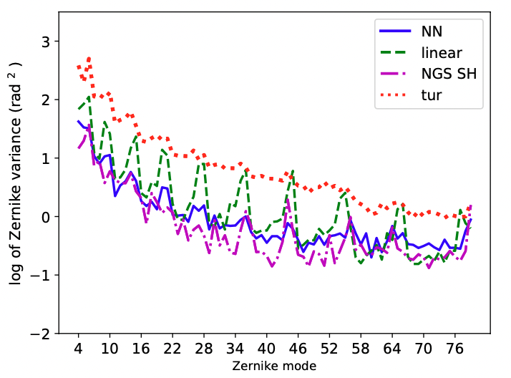
Example of simulation, low-resolution

Slide 6
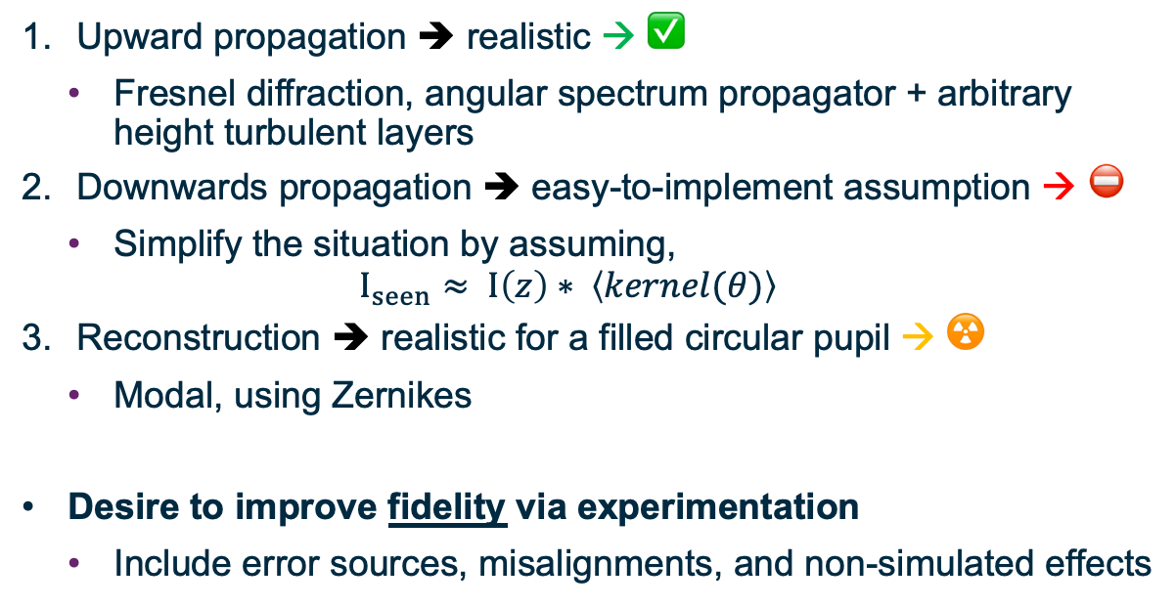
Simulation approach
Upward propagation ➔ realistic → ✅
  Fresnel diffraction, angular spectrum propagator + arbitrary height turbulent layers
Downwards propagation ➔ easy-to-implement assumption → ⛔️
  Simplify the situation by assuming,
  $I_{seen}≈ I\left(z\right)∗ \left\langle kernel(θ)\right\rangle$
Reconstruction ➔ realistic for a filled circular pupil → ☢️
  Modal, using Zernikes
Desire to improve fidelity via experimentation
  Include error sources, misalignments, and non-simulated effects

Slide 7
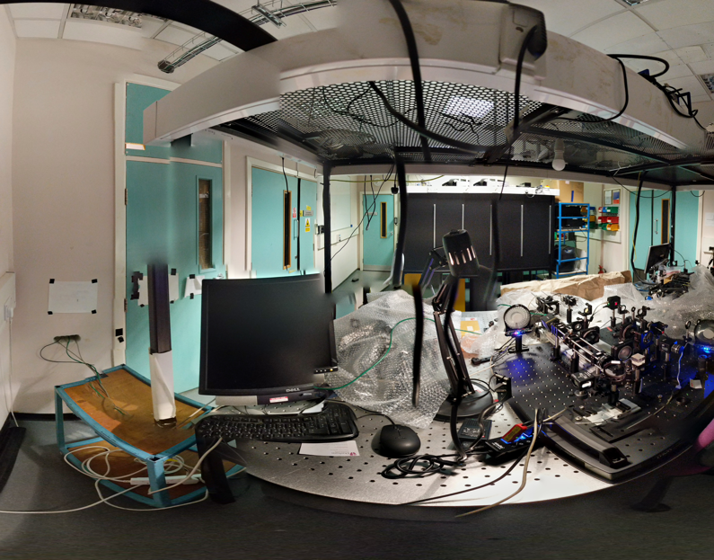
2. The PPPP bench
20th March 2020

Slide 8
Schematic
z₁
M_{3b}
D
B/S
B/S
B/S
M₂
M_{3a}
z₂
f₃
f₄
f₈
f₈
Laser
f₂
f₅
f₉
f₉
MLA
f₁
f₆
f₁₀
f₁₀
Cam 1
Cam 2
f₇
detector conjugate to z₁
detector conjugate to z₂
WFS
SH WFS
8×8
M₁
Deformable
Mirror

Slide 9
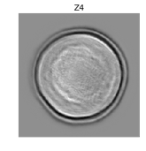
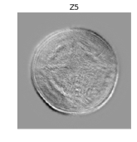
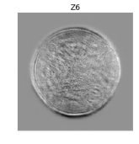
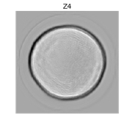
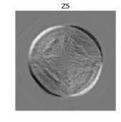
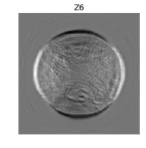
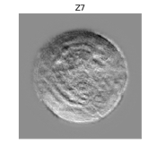
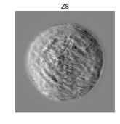
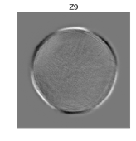
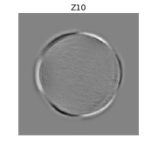
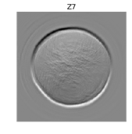
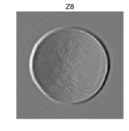
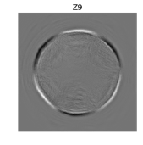
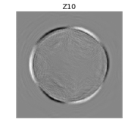
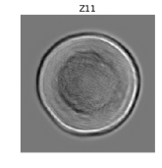
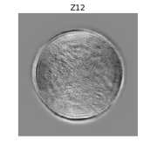
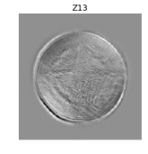
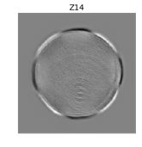
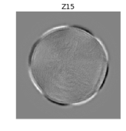
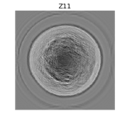
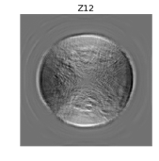
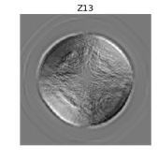
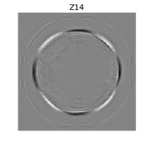
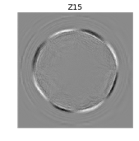
Modal DM response
SH
P4
Choice to use:
  measured IM and its inverse
  forward model
Both work well → linear algebra

Slide 10
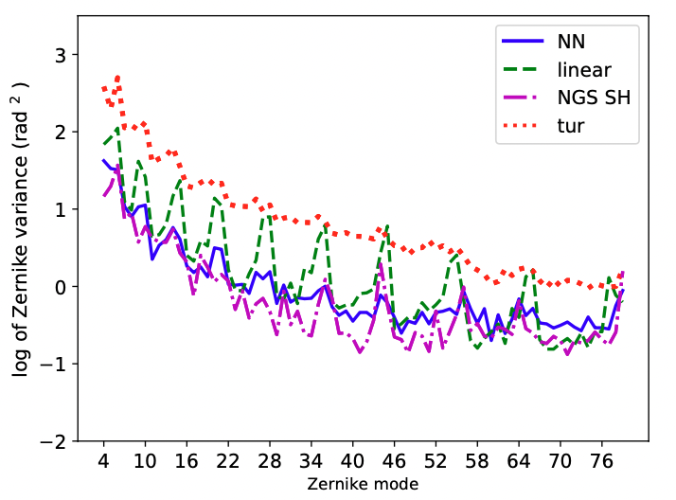
Neural networks for higher SNR

Slide 11
3. Neural Network architecture for Machine Learning
Already demonstrated in simulation that a neural network architecture is superior to the linear solution,
  (Except for unrealistic laser powers.)
Can use existing image-based processing
Wanted to confirm that NN-based ML algorithm works with hardware.

Slide 12
Limitations
Only one source of aberrations, low-order modal DM
Fixed propagation distances & zero turbulence altitude
Slow to operate, and need ca.10⁵ frames
Ignoring return propagation aberrations

Slide 13
Comparison of data inputs and outputs
Shack
Hartmann
WFS
Zernikes
slopes
wavefront
Cam 1
PPPP
ML
Zernikes
Cam 2

Slide 14
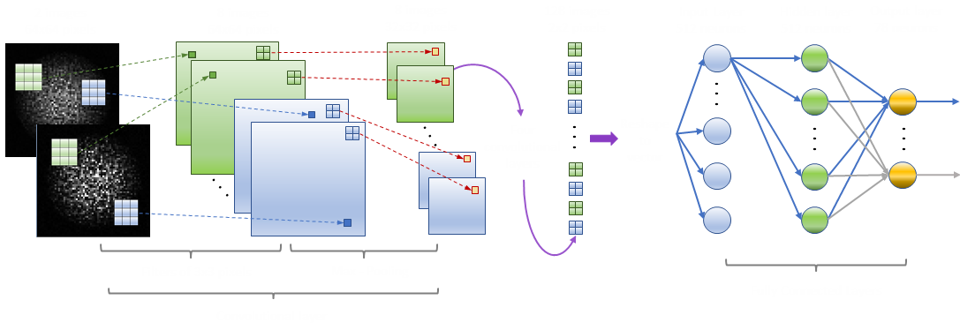
Neural Network architecture
Input
images
Input
layer
Hidden
layer
Output
layer
2×300×300
pixels
8×150×150
pixels
8×75×75
pixels
128
neurons
128
neurons
72
neurons
Four
convolutional
layers
Variable Filter Size
Variable Stride
Fully connected
layers
Convolutional
layers
1st layer: Filter size and stride: 2
2nd layer: Filter size and stride: 2
3th layer: Filter size and stride: 3
4th layer: Filter size and stride: 5
5th layer: Filter size and stride: 5

Slide 15
Results
Images subset |  | Output residual relative WFE
Training | Testing | Two images | One image, closer | One image + WFE back propagation | Difference of images
Complete | Complete ≡ training | 32.8% | 30.0% | 12.4% | 14.6%
Random | Random ∉ training |  |  | 12.4%
Estimated noise component |  |  |  | 14.1%

Slide 16
4. Future experiments with WIVERN
The PPPP bench reached its natural lifetime and has been dismantled
Future experiments will use WIVERN, a novel concepts experiment† which has:
  1 arcminute FoV,
  Laser projection through turbulence (two way) as far as ≲ 100km,
  Phase screens between surface and 20km,
  Built-in DM—AO experiments such as pre-compensation, and
  Well-defined software-based RTC.
† emulating a 4m telescope

Slide 17
Future goals
Recreate PPPP for investigating tomographic sensing.
  Currently at design stage for WIVERN.
Determine performance limits with ML wavefront retrieval.
  Enabled by faster (×100) and more accurate data from WIVERN.
Integrate tip/tilt sensing (or not).

