Slide 1
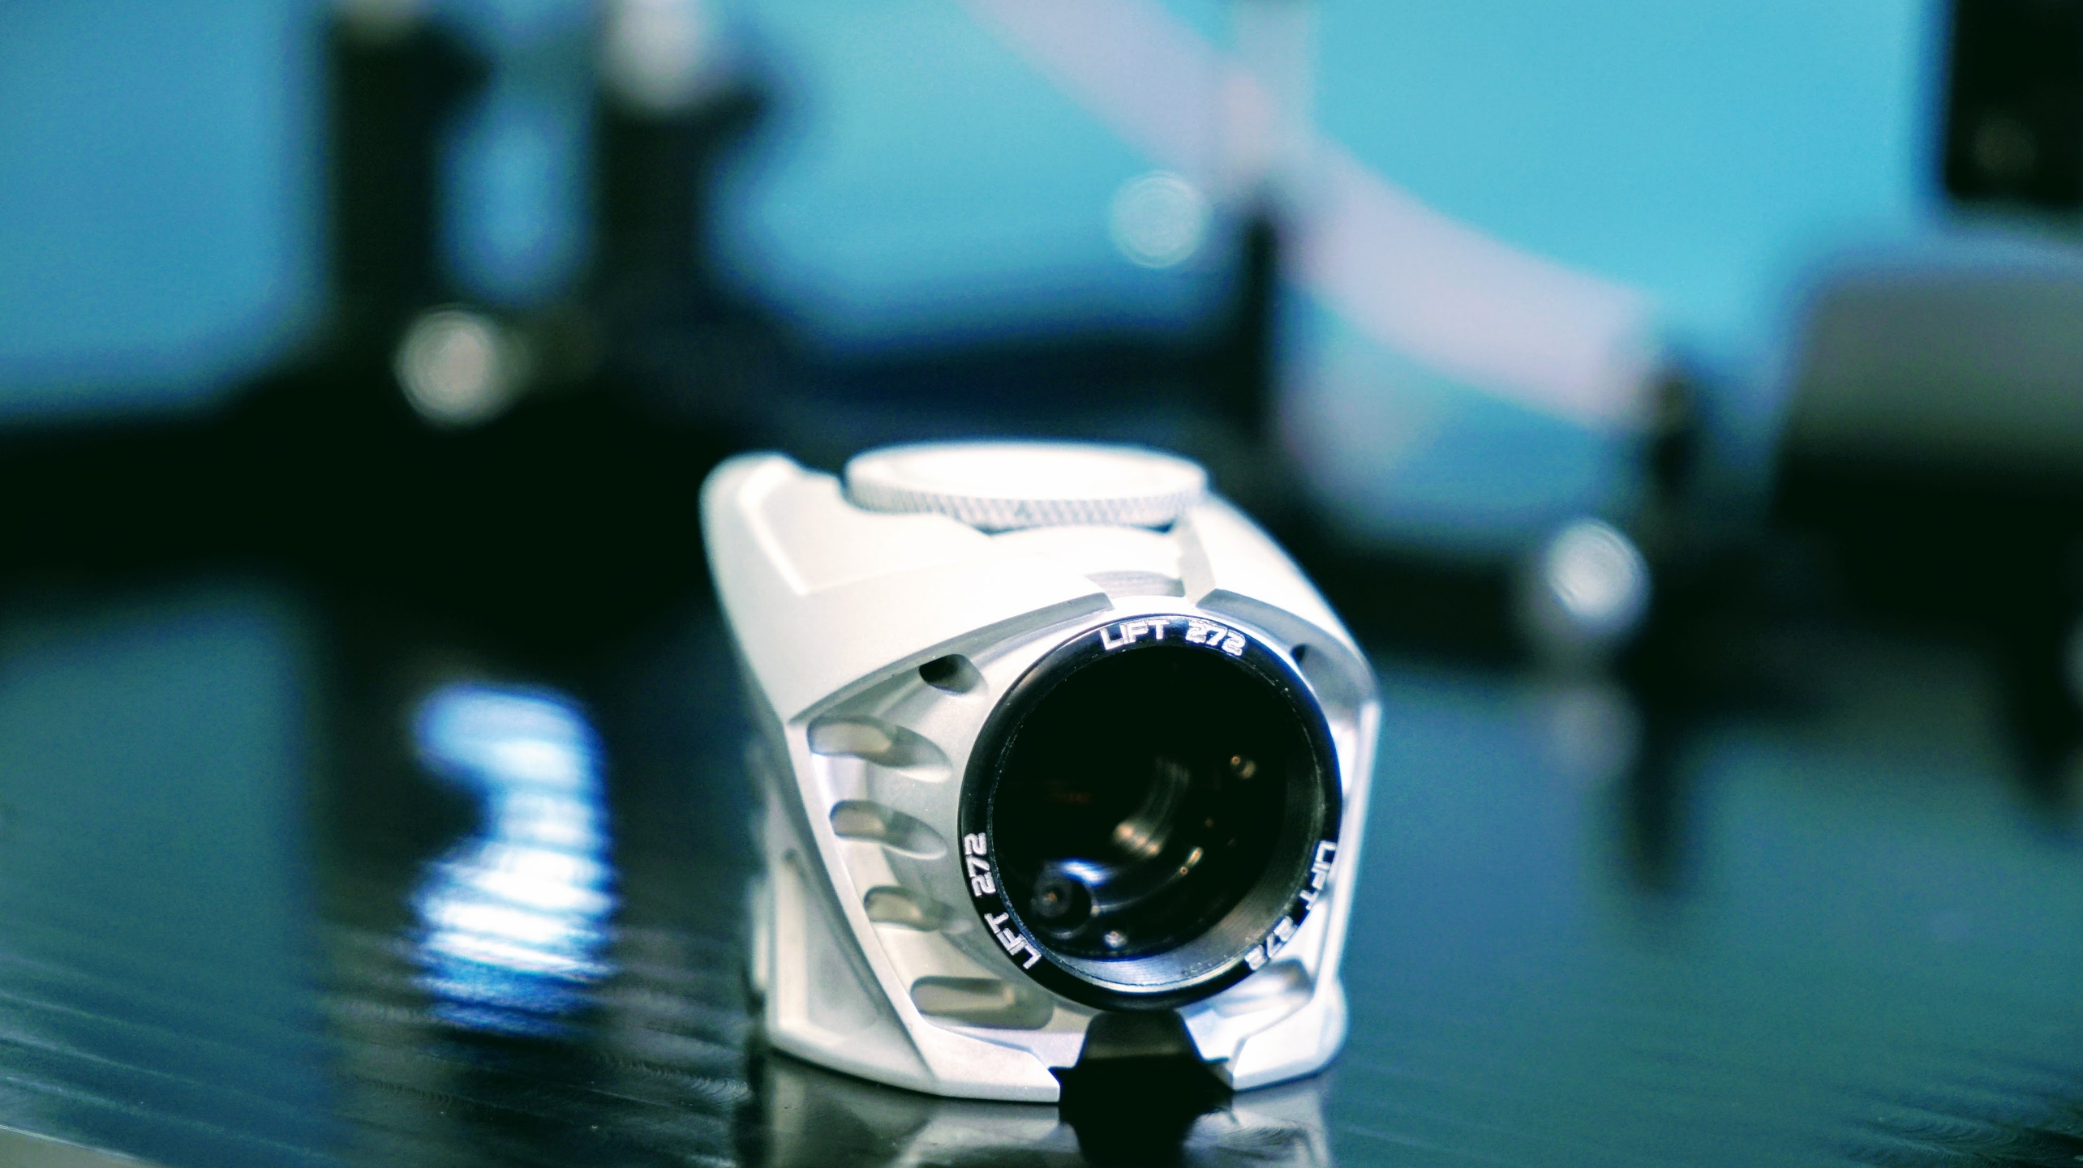
HASO LIFT
Imagine optic
Guillaume Dovillaire
wfs2022 Porto
October 20th 2022

Slide 2

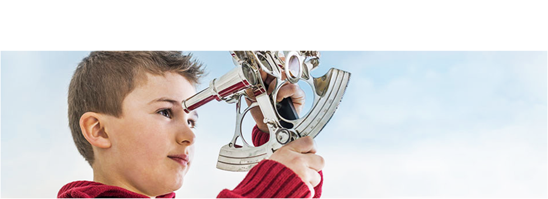
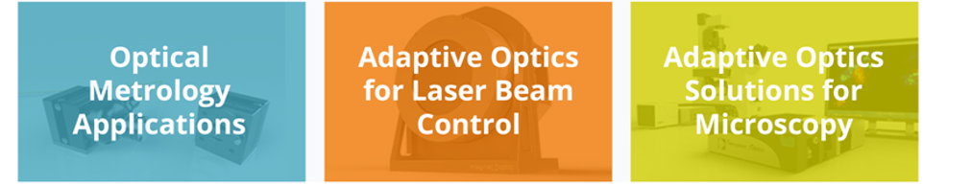
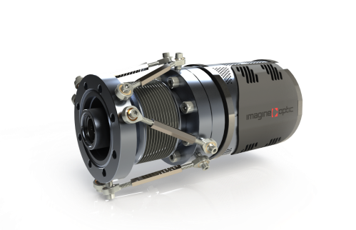
Wavefront sensors and adaptive optics for
optical metrology, lasers and microscopy
Optical metrology
& adaptive optics
for X-EUV

Slide 3
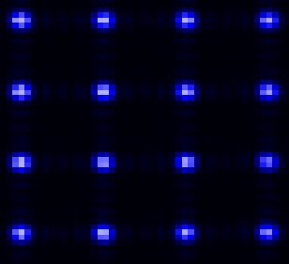
Standard Shack-Hartmann
Association of a microlenses array and a detector
Spot positions are proportional to the local wavefront slopes

Slide 4

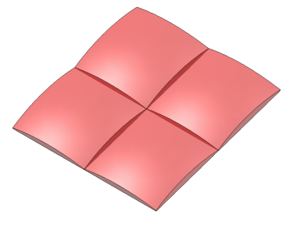
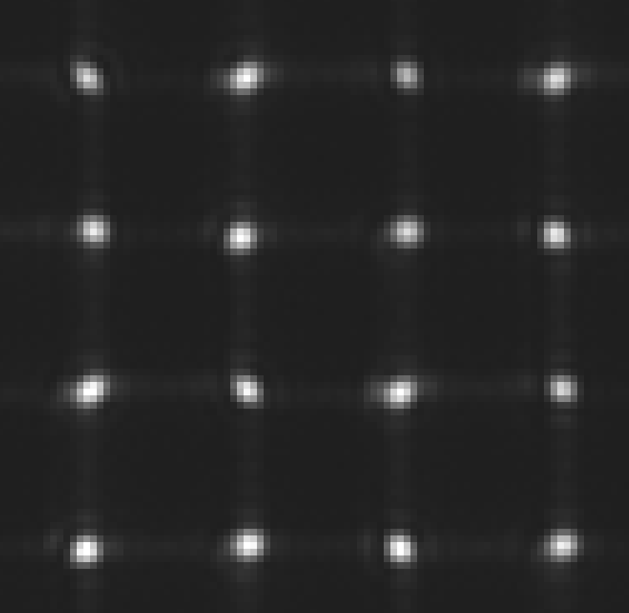

Shack-Hartmann hartmanngram
Square microlenses
focale length f, Size D
On the detector : Sinc² function

Slide 5

Concept : phase retrieval at microlens scale
1 single microlens
Standard
Shack Hartmann
Centroid
Incident
wavefront
Enhanced spatial
Resolution with LIFT
PSF shape analysis
Phase retrieval

Slide 6
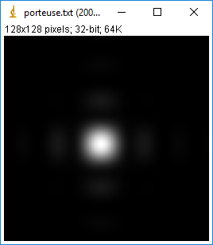
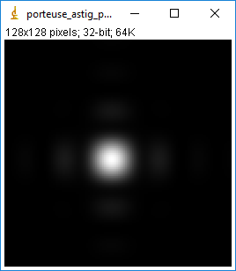
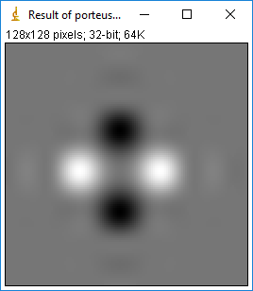
Spot shape vs local aberrations
For example
Without aberration
With astigmatism :10 nm PV
Difference

Slide 7
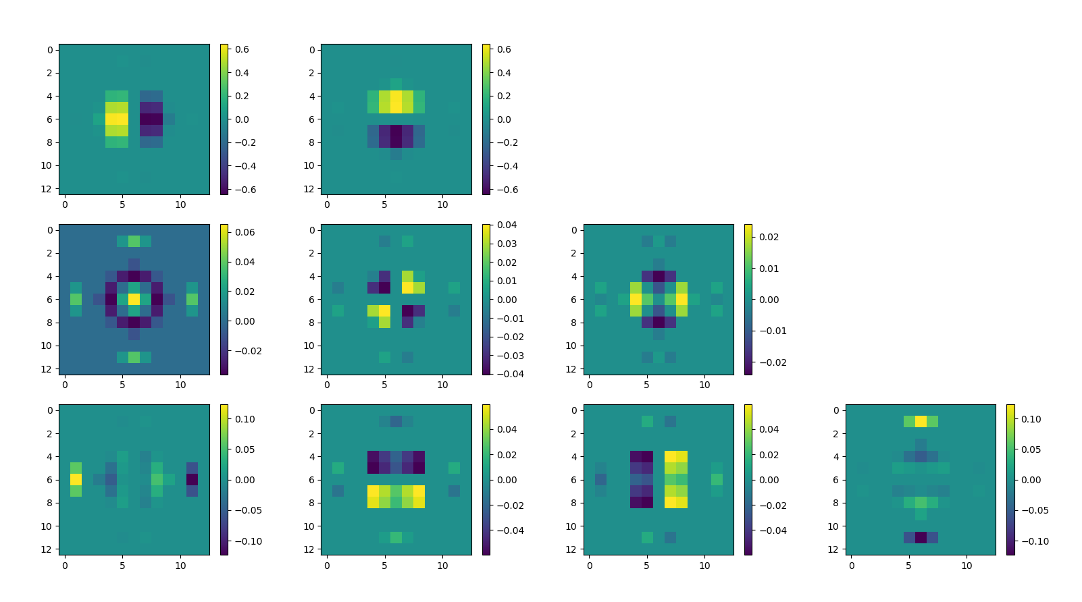
Spot differences for the 9 first Legendre
Tilt X and tilt Y influences
Focus, 45° astigmatism and 0° astigmatism influences
3rd order influences
Problem : the focus signature is the same for a positive or a negative value
The solution : change the shape of the microlenses to create an offset in the transmitted aberration
for instance, if the microlens itself contains pure astigmatism, a positive and a negative focus will have a different influence

Slide 8
To learn more about LIFT
LIFT is « Linearized Focal plane Technique »
Sensing more modes with fewer sub-apertures: the LIFTed Shack–Hartmann wavefront sensor
Serge Meimon and al ONERA, May 15, 2014 / Vol. 39, No. 10 / OPTICS LETTERS
Experimental validation of LIFT for estimation of low-order modes in low-flux wavefront sensing
C. Plantet, S.Meimon, J.-M. Conan and T. Fusco, 15 July 2013 | Vol. 21, No. 14, OSA
Small-phase solution to the phase-retrieval problem
R. Gonsalves, Opt. Lett., Vol. 26, No 10, pp. 684-685 (2001)

Slide 9
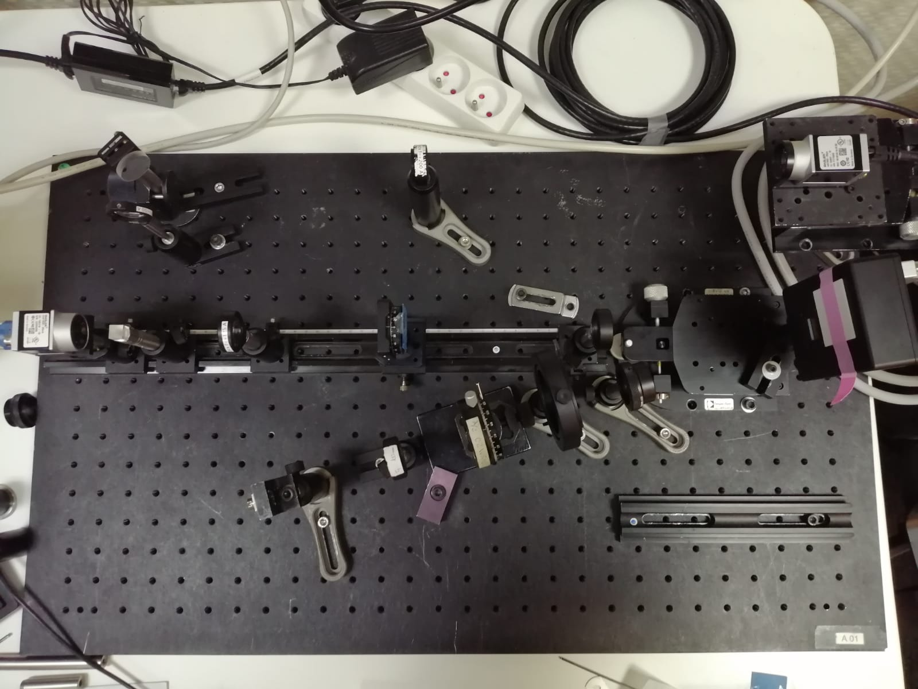
Optical setup
x4 Zoom pathway
HASO4 BROADBAND
SLM
HASO LIFT 272
Normal mode
or Lift mode
Source @520 nm

Slide 10

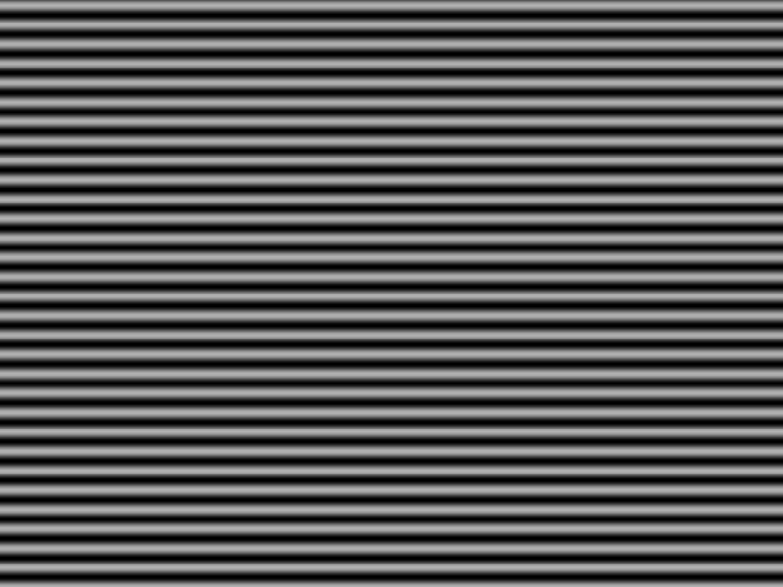

Transfer function : Wavefront amplitude/spatial frequency
HASO4 BROADBAND
Phase patterns sent to SLM
SLM
HASO LIFT 272
Normal mode
or Lift mode
Source

Slide 11
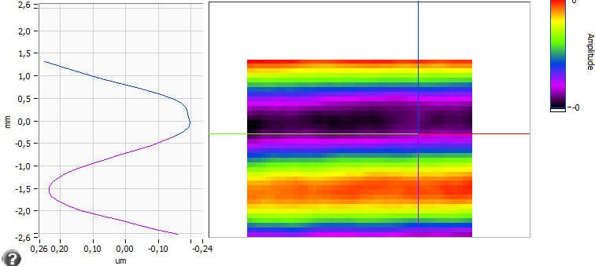
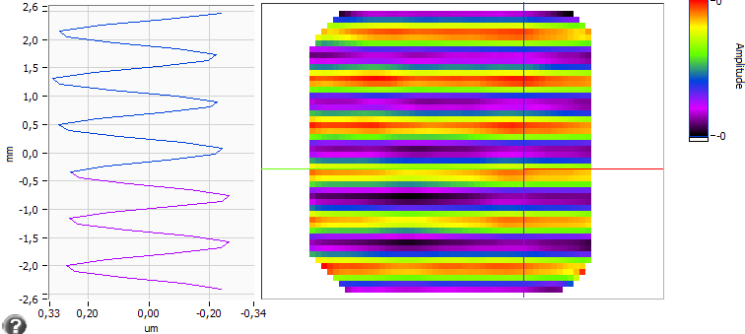
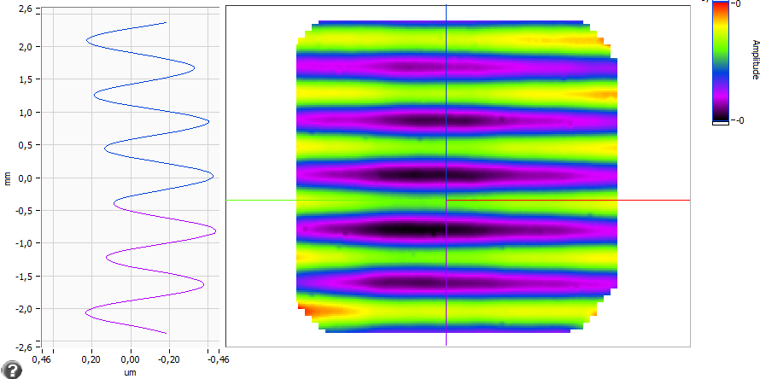
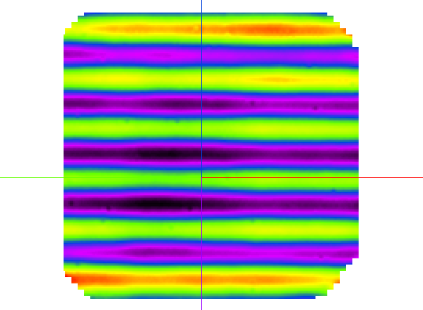
Transfer function : examples for 0.125 cycles/µlens
HASO4 BROADBAND
HASO LIFT 272 wo LIFT
HASO LIFT 272
Standard HASO
8 µlenses per cycle
Enhanced resolution
but still
8 µlenses per cycle
Zoom x4 : reference
32 µlenses per cycle
550 nm
550 nm
550 nm

Slide 12
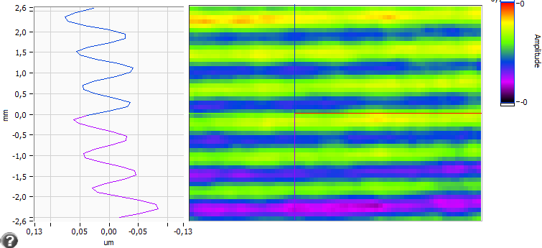
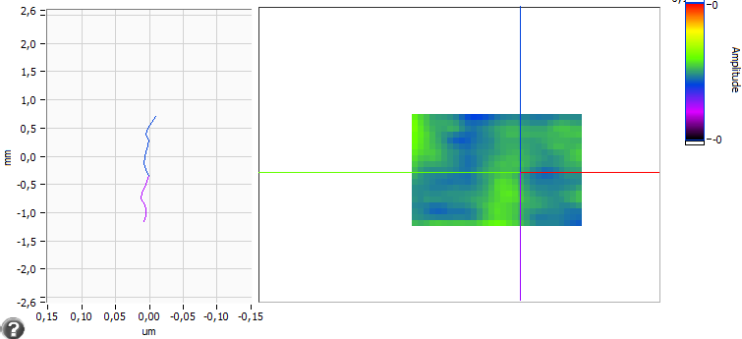
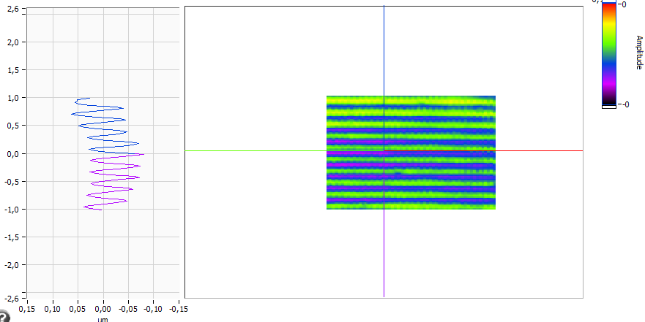
Transfer function : examples for 0.5 cycles/µlens
HASO4 BROADBAND
HASO LIFT 272 wo LIFT
HASO LIFT 272
Zoom x4 : reference
8 µlenses per cycle
2 µlenses per cycle
2 µlenses per cycle
100 nm
Enhanced resolution
100 nm
The oscilaltion in the wavefront is not measured
No centroid displacement but PSF shape modification
No centroid displacement

Slide 13
HASO and HASO LIFT Transfer function
0.2
0.3
0.5
Twice Nyquist frequency
for HASO LIFT
Twice Nyquist frequency
for HASO
Resolution improvement : x4

Slide 14

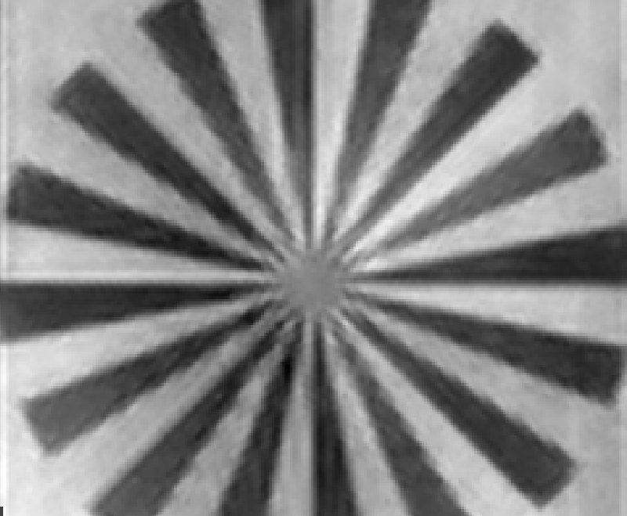
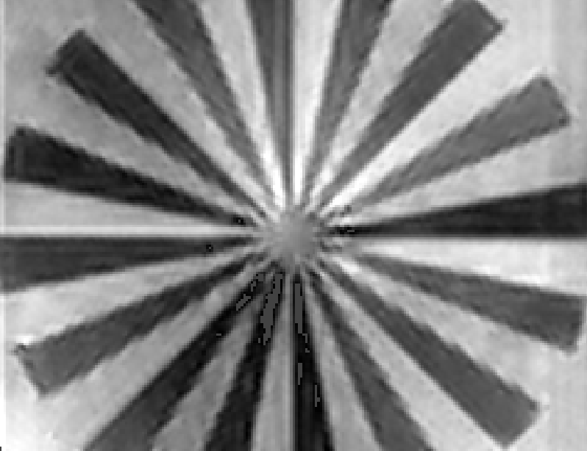
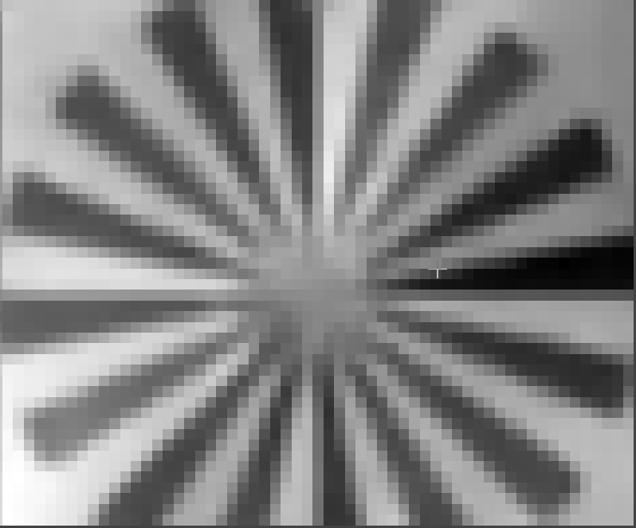
HASO LIFT 272
Phase reconstruction with standard
Shack-Hartmann algorithm
Phase hologram sent to SLM
Black is 0
White is 2π
Phase reconstruction with
LIFT algorithm

Slide 15




HASO LIFT 272
Spatial Frequency
standard
Shack-Hartmann
LIFT algorithm
Phase hologram sent to SLM

Slide 16
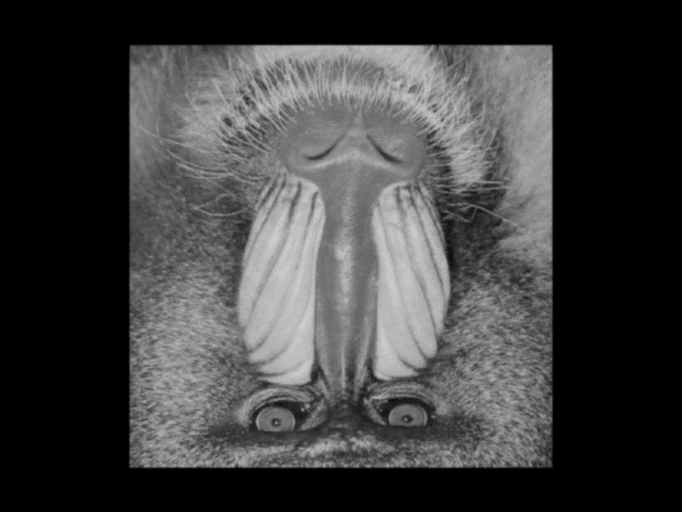
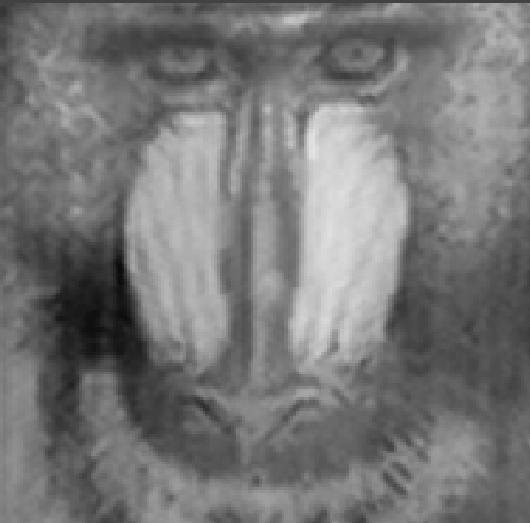
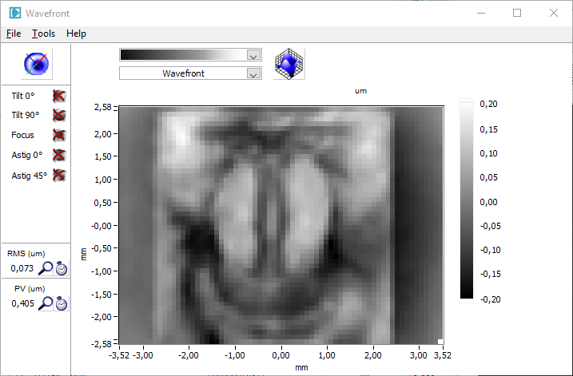
HASO LIFT 272
Phase reconstruction with standard
Shack-Hartmann algorithm
Phase hologram sent to SLM
Phase reconstruction with
LIFT algorithm

Slide 17
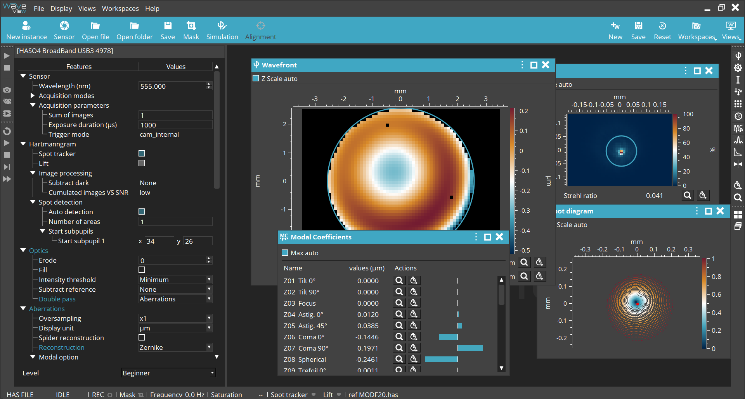
Implementation in Waview4

Slide 18
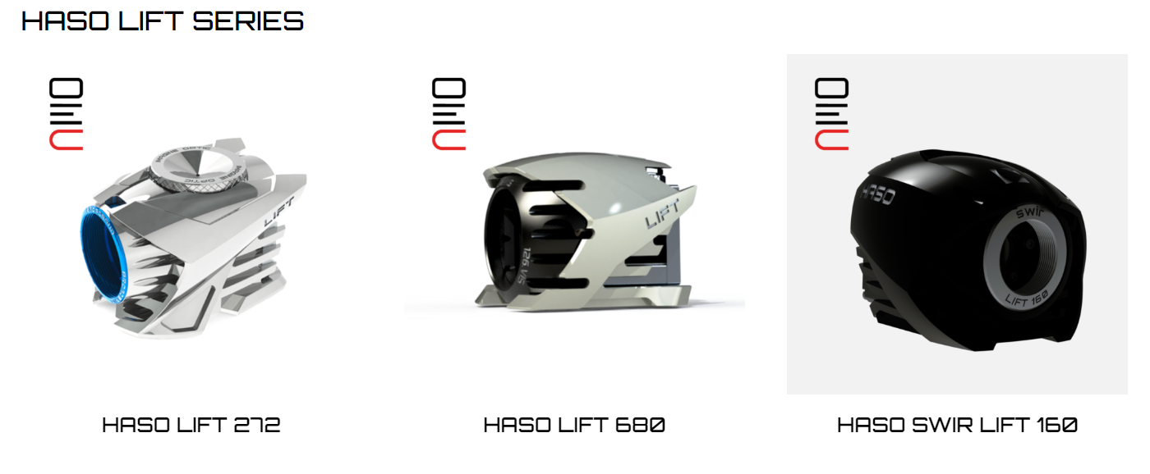
Our HASO LIFT
400-800nm
5.2 x 7 mm²
λ/100 RMS absolute accuracy
400-800nm
10.2 x 13.8 mm²
λ/100 RMS absolute accuracy
1050-1700nm
7.4 x 9.3 mm²
λ/100 RMS absolute accuracy

Slide 19
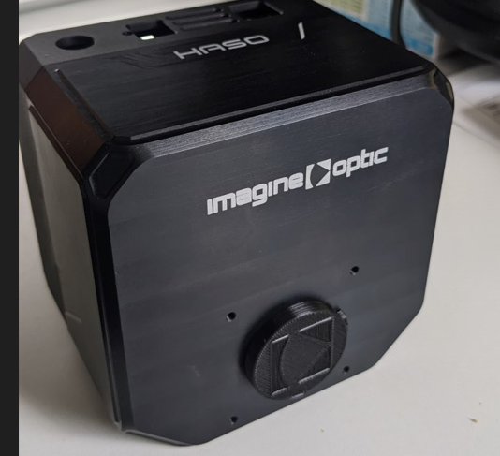
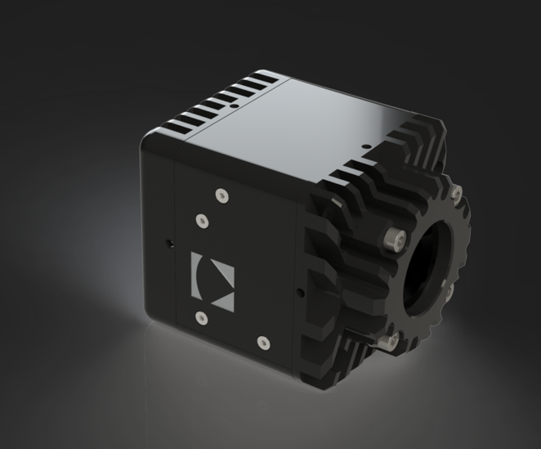
Some other newly released HASO
The ultra-low light
The SWIR FAST
7.12 x 5.33 mm²
14 microlenses on 3.6mm diameter
Optimized for 637nm
Accuracy (systematic errors) : 5 nm RMS
Repeatability at saturation : 5 nm RMS
10nm RMS of repeatability at 1000ph/s in the pupil
USB3.0
7.12 x 5.33 mm²
14x14 microlenses
0.9 to 1.7µm
Accuracy (systematic errors) : 12 nm RMS
Repeatability at max speed : 30 nm RMS
1.7kHz
USB3.0

Slide 20
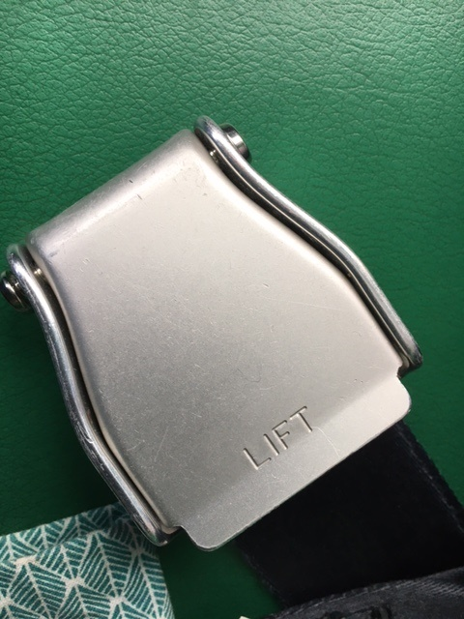

Thank you
or
??

Slide 21
BACK-UP SLIDES

Slide 22
Shack-Hartmann transfer function

Slide 23


Slide 24
Conclusions
HASO LIFT = The best of Shack-Hartmann technology + High sampling density
High accuracy : λ/100 RMS
Huge dynamic range
Insensitive to vibrations
And now high spatial resolution
HASO LIFT 272 : 200x272 phase points
HASO LIFT 680 : 504x680 phase points
HASO LIFT opens the door to new applications and, together with R-Flex LA, allows for multispectral interferometry applications.

Slide 25
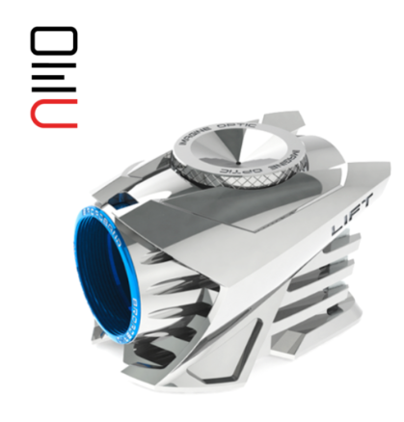

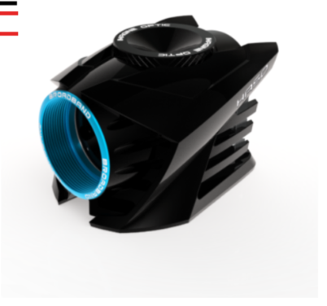
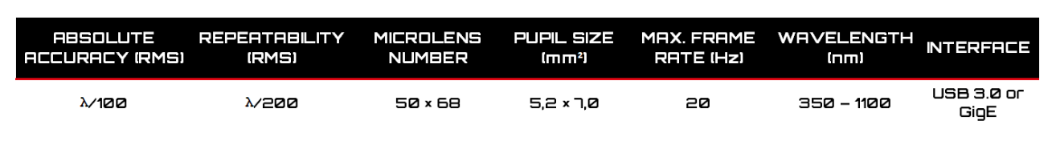
HASO LIFT 272 and HASO4 BROADBAND
HASO LIFT 272
HASO4 BROADBAND

Slide 26
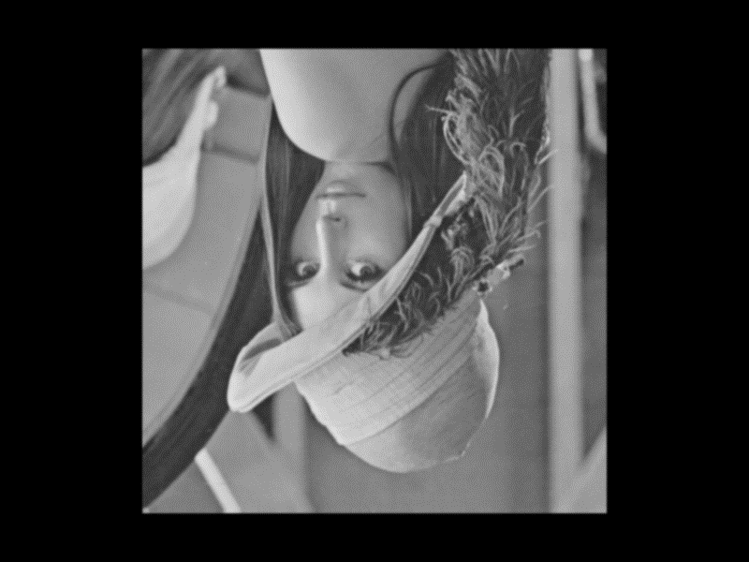
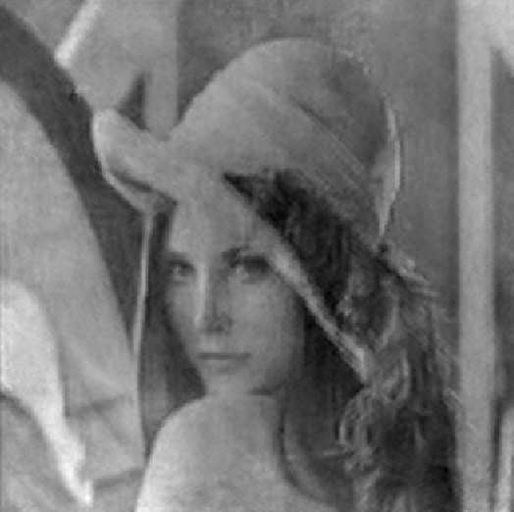
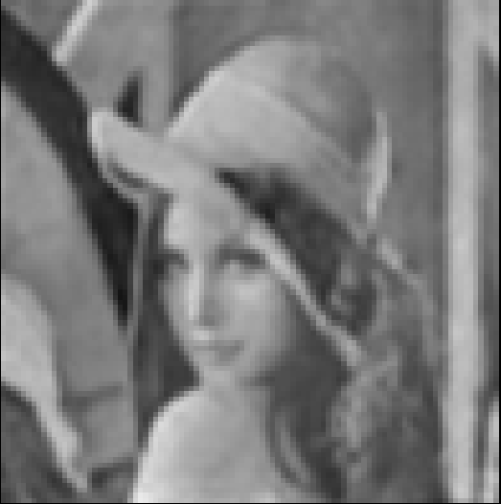
HASO LIFT 680
Phase reconstruction with standard
Shack-Hartmann algorithm
Phase hologram sent to SLM
Phase reconstruction with
LIFT algorithm

Slide 27
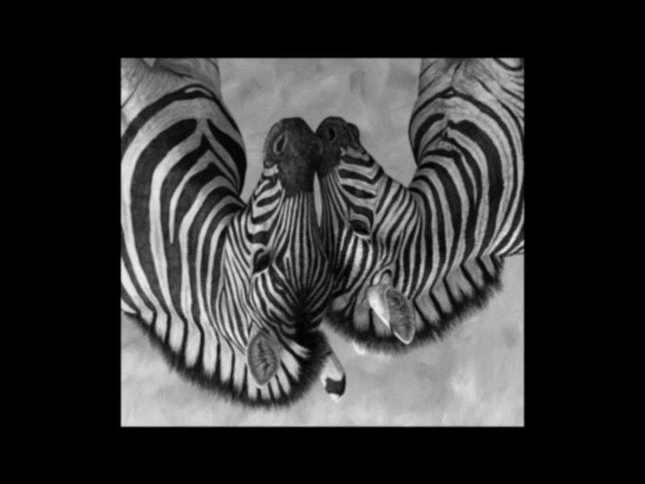
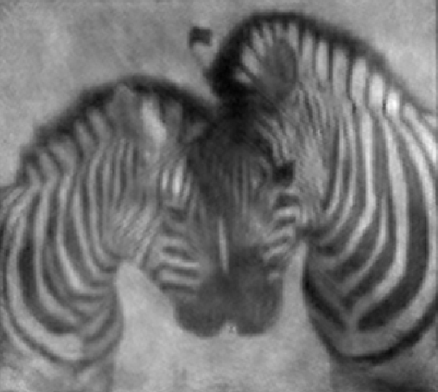

HASO LIFT 680
Phase reconstruction with standard
Shack-Hartmann algorithm
Phase hologram sent to SLM
Phase reconstruction with
LIFT algorithm

Slide 28
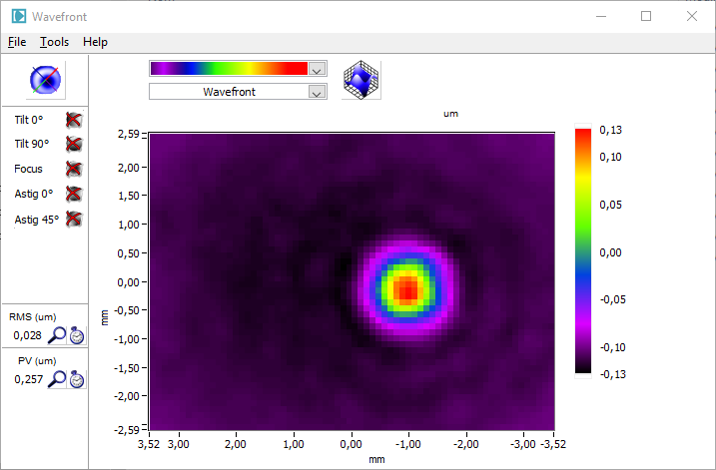
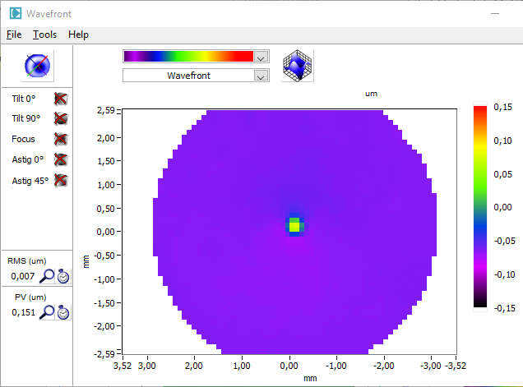
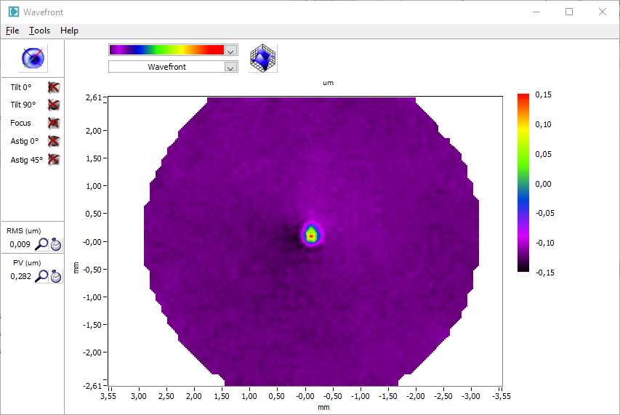
Example : small diameter phase gaussian defect (FWHM = 2 µlens)
Zoom x4 : reference
FWHM = 8 µlens
Standard HASO
FWHM = 2 µlens
Enhanced resolution
FWHM = 2 µlens
PV = 260 nm
PV = 150 nm
PV = 280 nm
Detectable but wrong amplitude
Enhanced resolution = refrence resolution

Slide 29
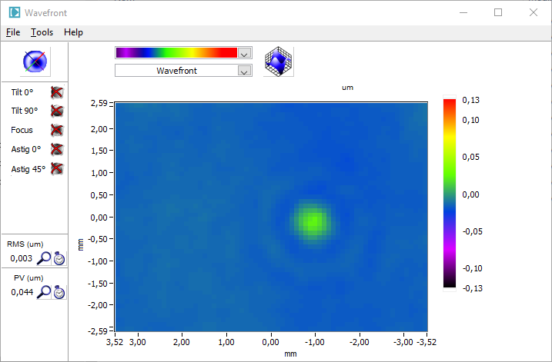
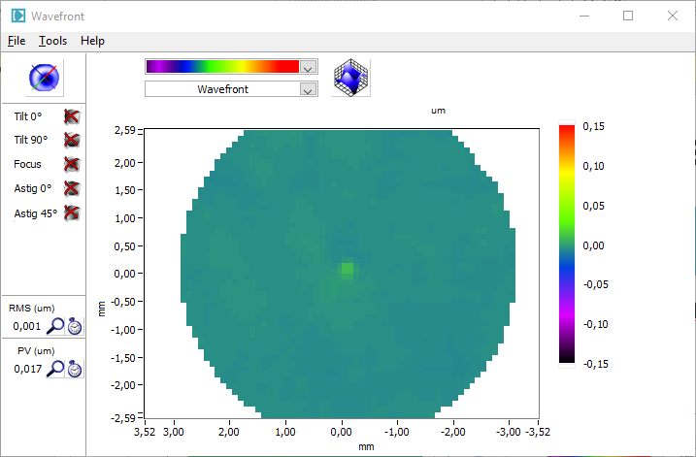
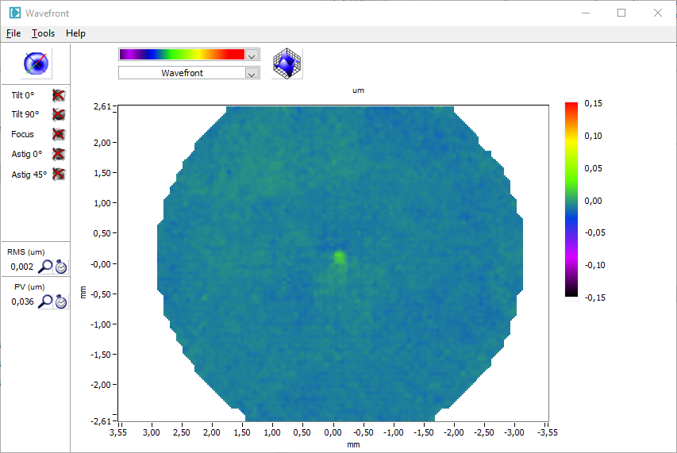
Example : small diameter phase gaussian defect (FWHM = 1 µlens)
Zoom x4 : reference
FWHM = 4 µlens
Standard HASO
FWHM = 1 µlens
Enhanced resolution
FWHM = 1 µlens
PV = 44 nm
PV = 17 nm
PV = 36 nm
Hardly detectable, wrong amplitude
Enhanced resolution = refrence resolution

Slide 30
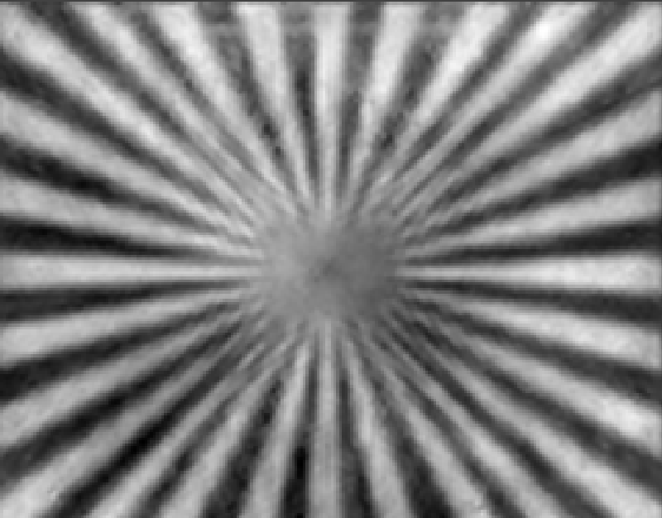

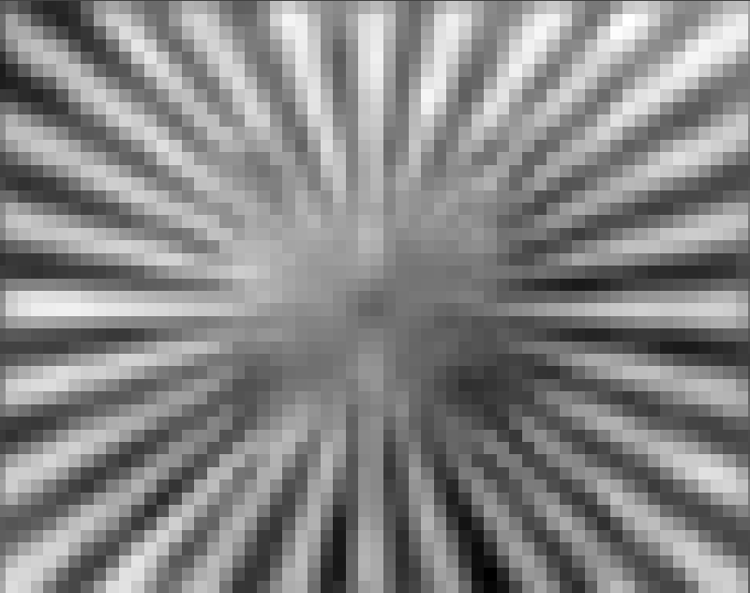
HASO LIFT 272
Phase reconstruction with standard
Shack-Hartmann algorithm
Phase hologram sent to SLM
Phase reconstruction with
LIFT algorithm

Slide 31
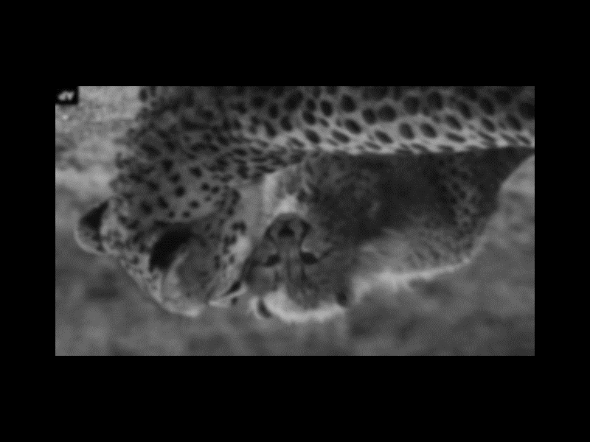
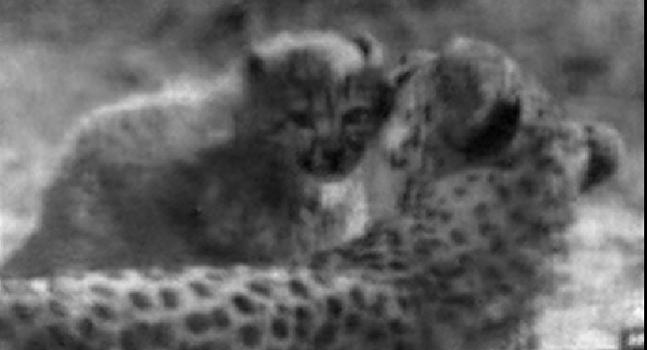
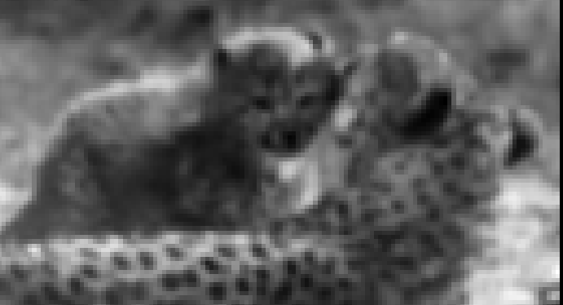
HASO LIFT 680
Phase reconstruction with standard
Shack-Hartmann algorithm
Phase hologram sent to SLM
Phase reconstruction with
LIFT algorithm

Slide 32

Spot differences for the 9 first Legendre @ 650 nm
Tilt X and tilt Y influences
Focus, 45° astigmatism and 0° astigmatism influences
3rd order influences

Slide 33


HASO LIFT 272
Phase reconstruction with standard
Shack-Hartmann algorithm
Phase hologram sent to SLM
Phase reconstruction with
LIFT algorithm

