Slide 1

MAVIS update: WFSing and control
Preliminary Design Status
MAVIS Team, including: Jesse Cranney, Cédric Plantet, Guido Agapito, Hao Zhang, Francois Rigaut, et al.
Notes:
We present a brief update on some interesting aspects of MAVIS WFSing and Control

Slide 2
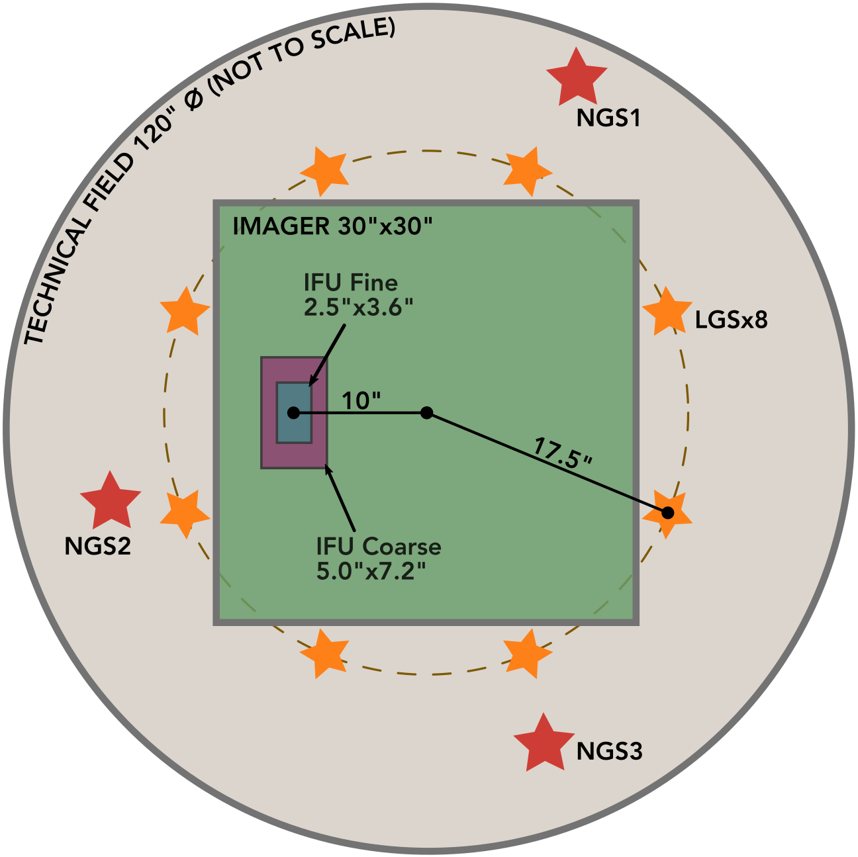
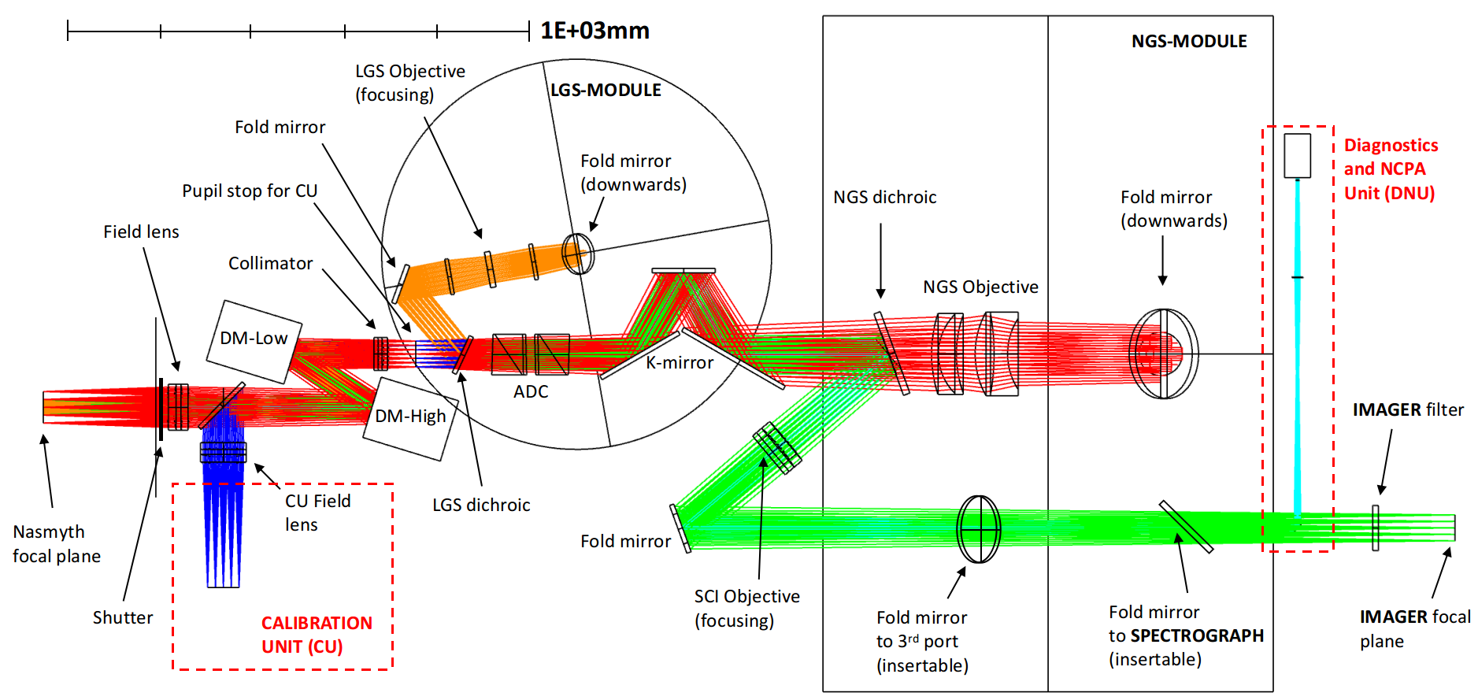
MAVIS (AO) Overview
MAVIS WFSing and Control
MCAO Assisted Visible Imager and Spectrograph
8 LGS 40x40 SHWFS,
Up to 3 NGS: 1x1 or 2x2 SHWFS
3 DMs:
VLT UT4 DSM @ 0 km,
ALPAO DM3228 @ 6.5 km,
ALPAO DM3228 @ 13 km.
Figure 1: MAVIS optical path
Figure 2: MAVIS field of view
Notes:
High level overview of the MAVIS AO system, eight laser guide stars, three natural guide stars, three deformable mirrors. Together these provide a high correction over a wide field, feeding an imager and integral field spectrograph.

Slide 3
MAVIS fun* stuff:
MAVIS WFSing and Control
Super-resolution LGS WFSing optimisation,
Tomographic NCPA calibration,
Real-time atmospheric profiling,
1x1/2x2 switchable NGS WFSing,
Control schemes:
Predictive Learn & Apply (PL&A),
Minimum Mean Square Error (MMSE),
Linear Quadratic Gaussian (LQG).
LGS jitter control,
And more…
*subjective
Notes:
There are a lot of fun aspects to speak about, but today we only have time for the first three (in bold), but I’m happy to discuss the rest with you over coffee

Slide 4
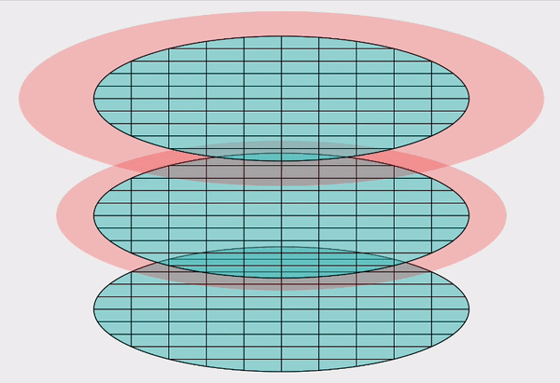
Super-resolution WFSing
MAVIS WFSing and Control
Diversity in WFSs improves AO performance,
Automatically achieved for most layers, but not for ground layer,
Rotating WFSs allows super-resolution on ground layer.
Altitude
Figure 3: 2 SH-WFS in super-resolution
Notes:
The idea of super-resolution is very fashionable at the moment. Basically, as a rule of thumb, diversity in WFS alignment tends to improve AO performance by reducing redundancy in measurements.
In tomographic systems, most layers of turbulence get this automatically, but the ground layer is seen identically by all WFSs,
But by shifting or rotating the WFS micro-lens arrays with respect to each other, we can improve diversity of measurements on the ground layer (so long as those misalignments are known accurately)

Slide 5
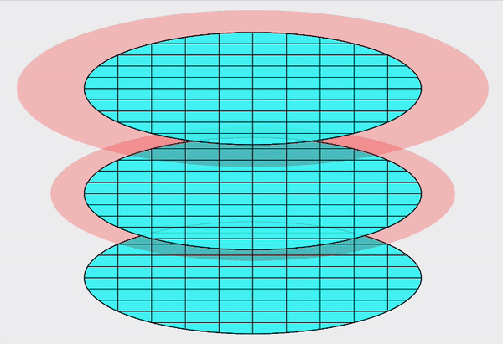
Super-resolution LGS WFSing
MAVIS WFSing and Control
MAVIS has 8 high order WFSs,
Note: if it looks like a mess, it can sense well
Altitude
Figure 4: 8 SH-WFS in super-resolution
Notes:
In the case of MAVIS, where we have eight wavefront sensors, the picture is much messier. But, it appears to be a rule in super-resolution, that the messier things looks, the better they will sense.

Slide 6
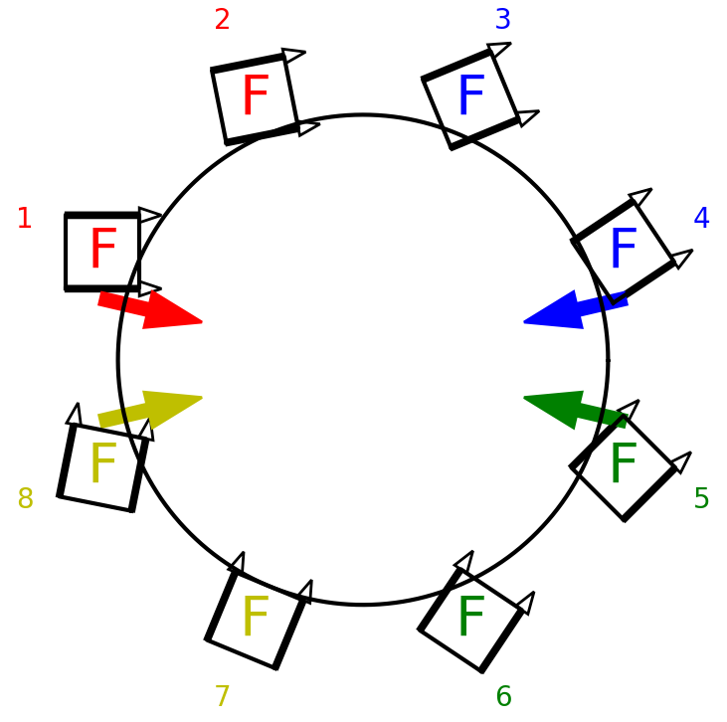
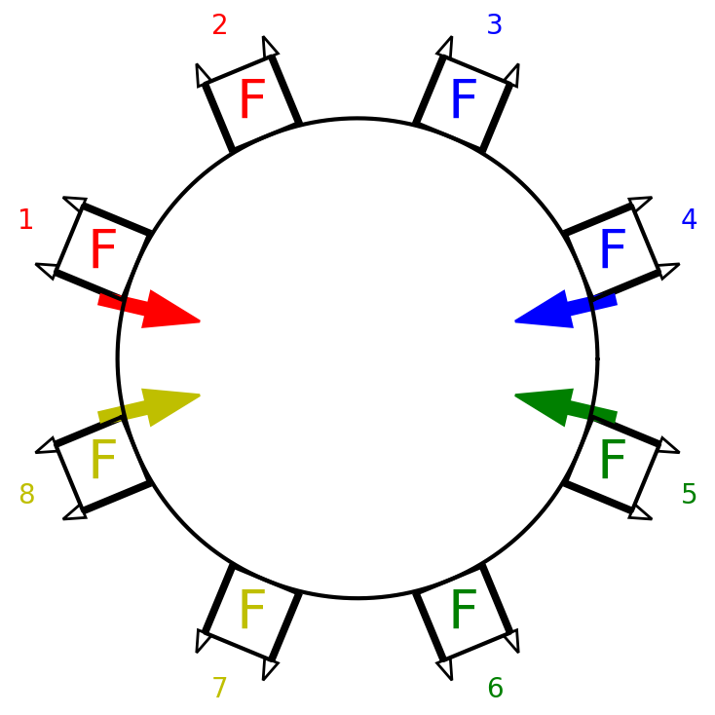
Super-resolution LGS WFSing
MAVIS WFSing and Control
Maximum rotational diversity 😁 -> difficult to do mechanically 🤬
Figure 5: Ideal super-resolution alignment. Maximum rotational diversity (modulo pi/2)
Figure 6: Ideal mechanical alignment.
WFS cameras mounted radially, reduces volume of enclosure and simplifies cable routing.
Notes:
There is an issue though. It turns out that the rotational freedom we wanted for the WFSs is very annoying to the mechanical engineers, so they asked if we could make a compromise.

Slide 7
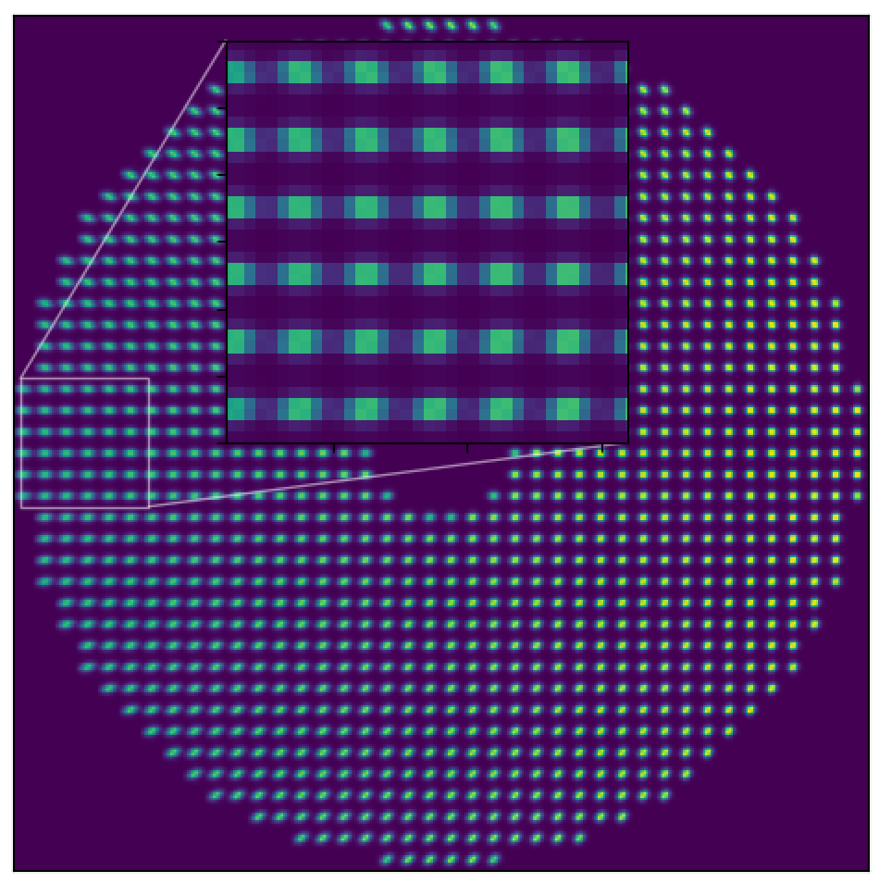
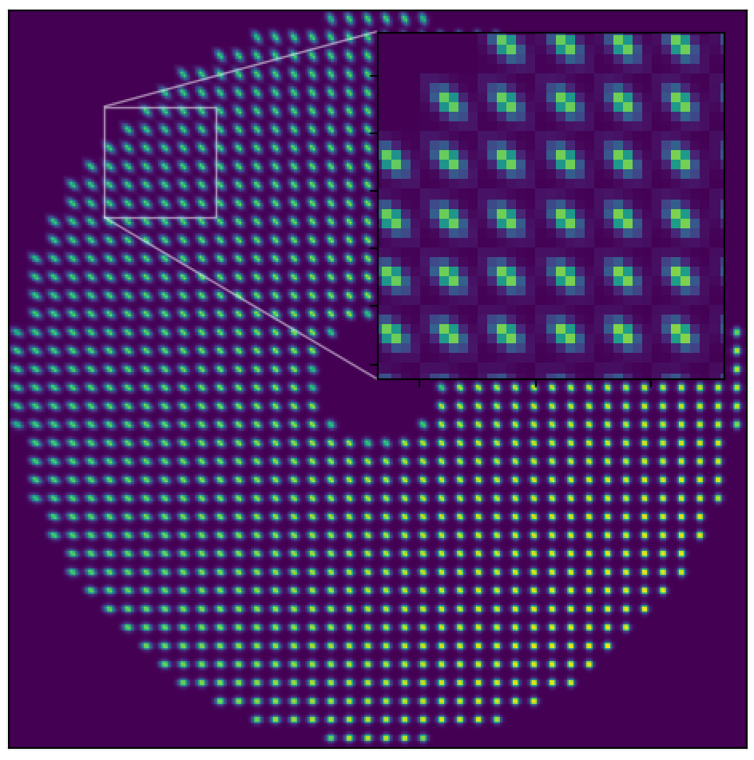
Super-resolution LGS WFSing
MAVIS WFSing and Control
But wait, there’s more! We can also minimise LGS spot truncation by rotating:
Figure 7: LGS elongation axis aligned with short-axis of SH spot array
Figure 8: LGS elongation axis aligned with long-axis of SH spot array
Notes:
And there is one more thing to consider. The truncation of the elongated LGS spots can be reduced by rotating the WFSs to be at 45 degrees to the elongation axis. The elongation effect is not so bad on the VLT compared to ELT, but still makes a difference when the error budget is so tight.

Slide 8
Super-resolution LGS WFSing
MAVIS WFSing and Control
So… we want to simultaneously optimise for:
Maximum diversity,
Simplest mechanical implementation,
Minimal LGS spot truncation.
Notes:
So, we have three different considerations to optimise for.
We want the maximum diversity in our angles for super resolution,
We want to simplify the mechanical implementation to keep our engineers happy,
And we want to minimise the LGS spot truncation to reduce the elongation effect.

Slide 9

Super-resolution LGS WFSing
MAVIS WFSing and Control
So we want to simultaneously optimise for:
Maximum diversity, ✅
Simplest mechanical implementation, ✅
Minimal LGS spot truncation. ✅
Feeding these into a numerical optimiser gives:
Wide field LE SR jumps from
24.7% -> 27.2% in V-band
(equiv: -27 nm RSS)
Figure 9: Final selection of LGS clocking angles to optimise all 3 criterion. Coloured arrows indicate LGS elongation axes.
Notes:
And by numerically optimising the rotations with respect to these three criterion, we end up with a WFS arrangement that looks something like this.
Plugging these values into a simulator shows a boost of about 2.5% strehl ratio over the FoV, which is significant in terms of MAVIS’s error sources. (note you might get a question about “how much comes from super-res vs lgs truncation” and the answer is we don’t know precisely yet, but it looks around 2% from super-res and 1% mechanical. Note that a little bit of misalignment does almost all of the required super-resolution performance boost, so we are free to target the other terms more aggressively.)

Slide 10
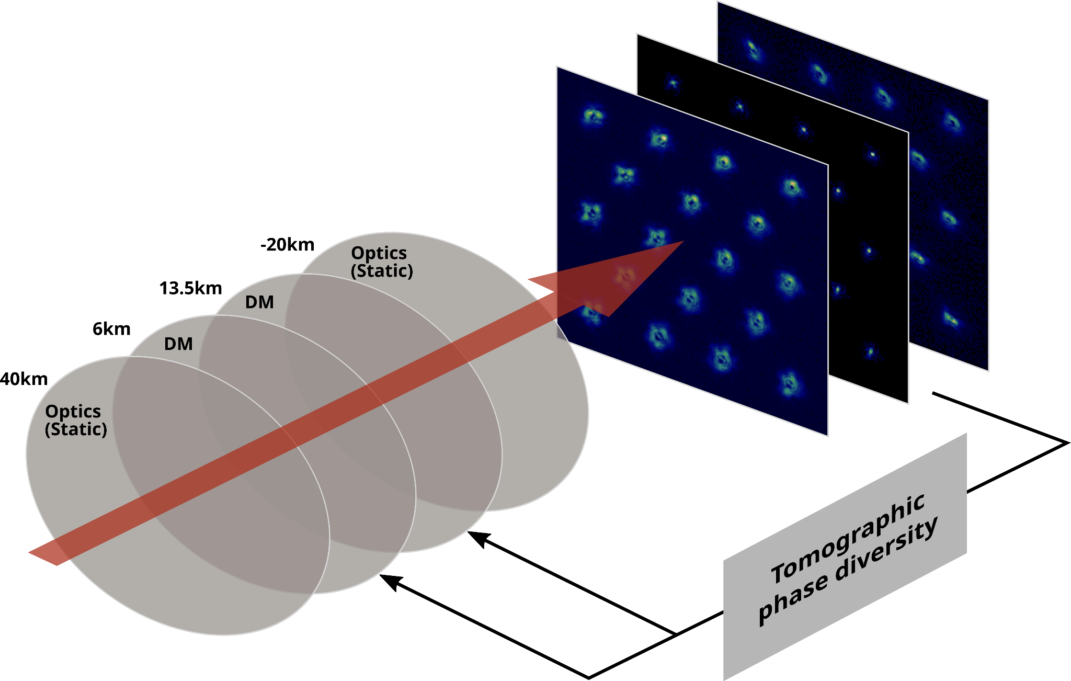
NCPAs in MAVIS
MAVIS WFSing and Control
Wide-field instrument + many surfaces -> field-varying static NCPAs
Field-varying NCPAs + tight error budget -> tomographic phase diversity
Method based on PRAy - Gratadour et al (2011)
Figure 10: Tomographic phase diversity principle
Notes:
Now, with a wide-field instrument with plenty of optical surfaces, one is bound to get field-varying non-common path aberrations.
Combining that with a tight error budget means we need a way to identify and compensate for field-varying NCPAs, and for this we will use “tomographic phase diversity”
This approach is based on classical phase diversity, where images are taken in and out of focus to infer the phase aberrations along the optical path, though in the wide-field case, those optical paths are significantly different depending on the direction of the source, so one has to perform a tomographic phase diversity.

Slide 11
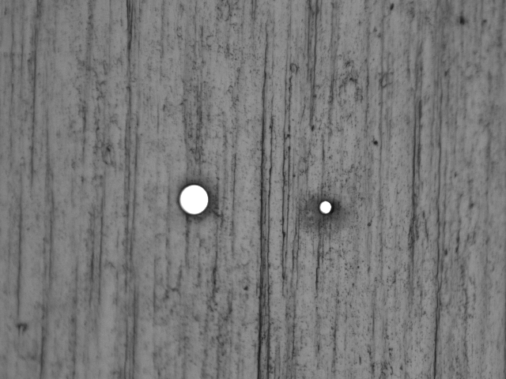
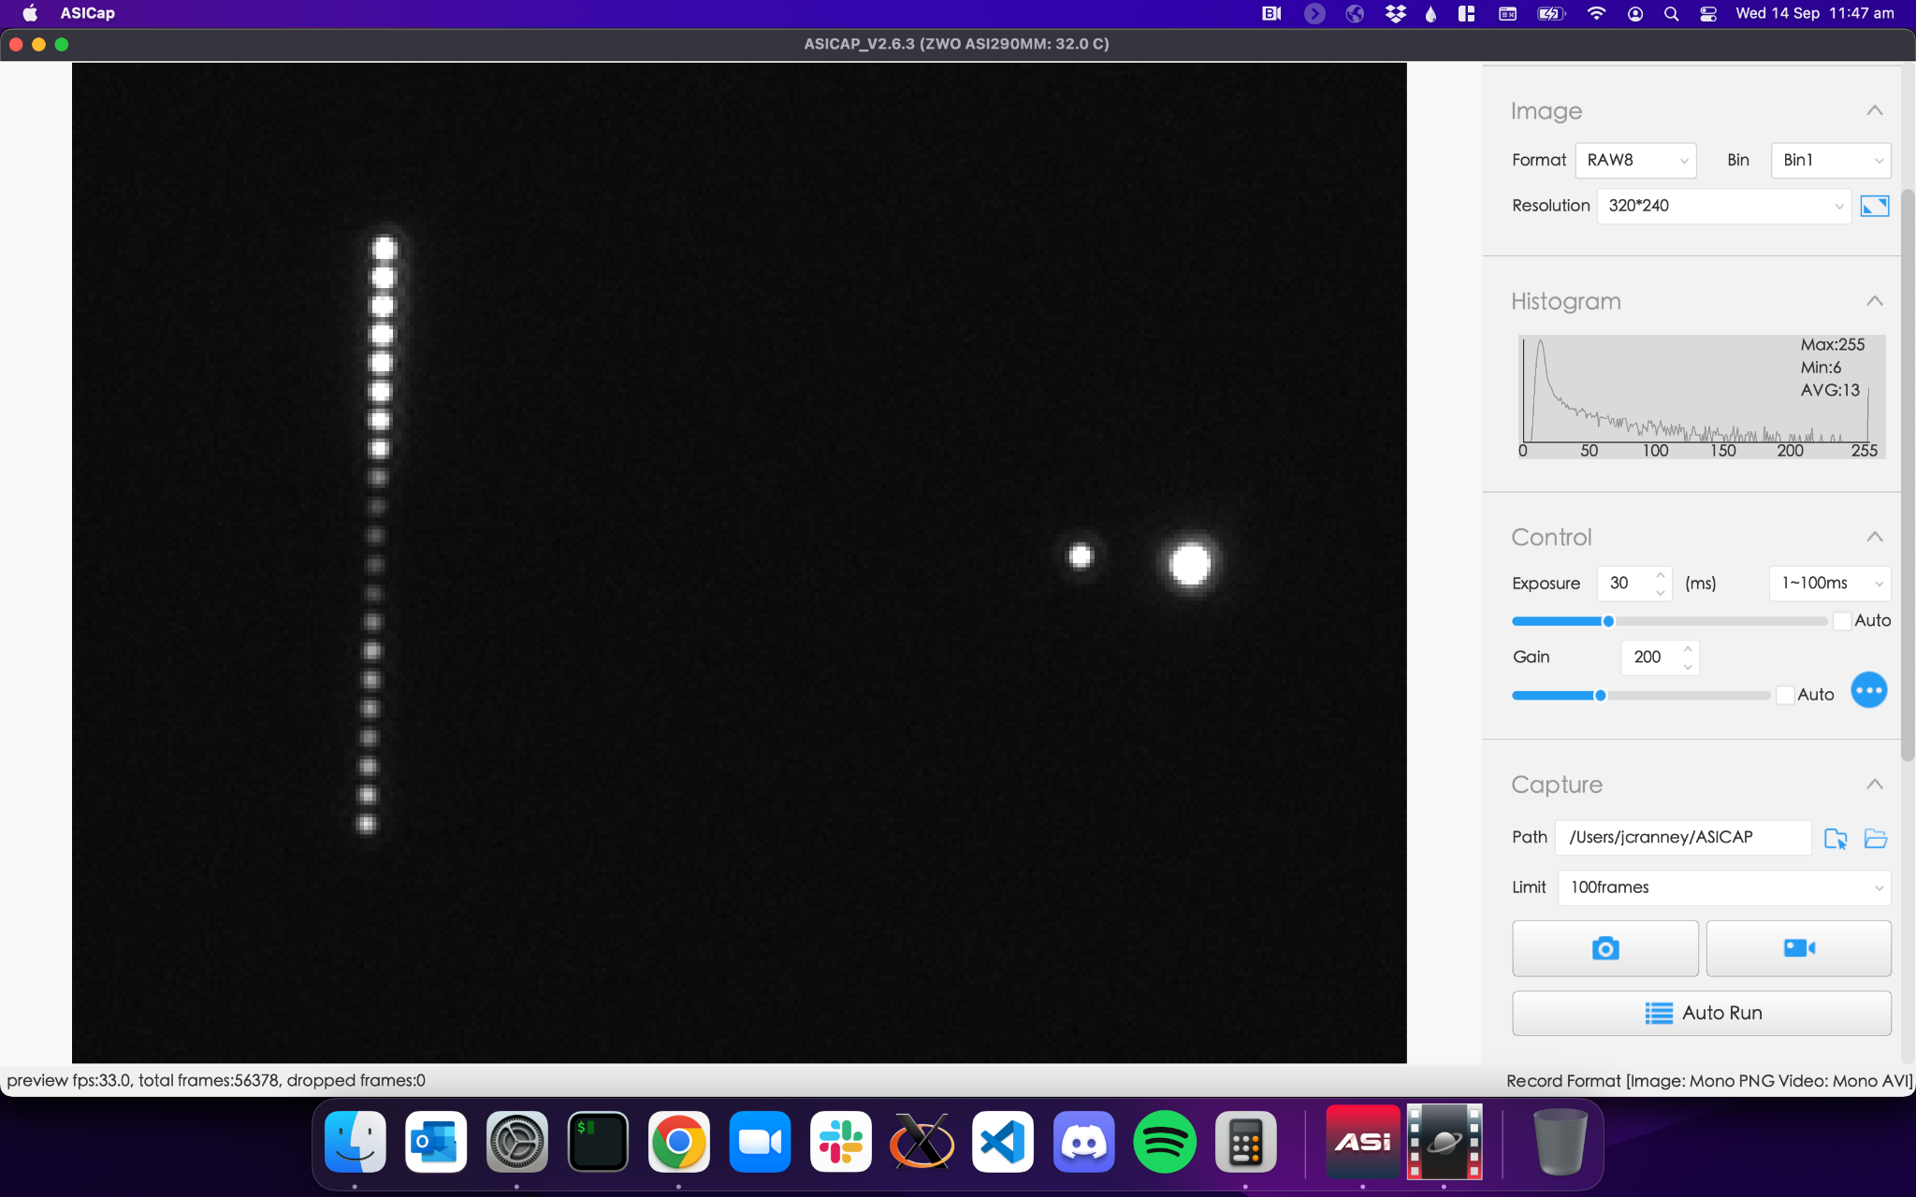
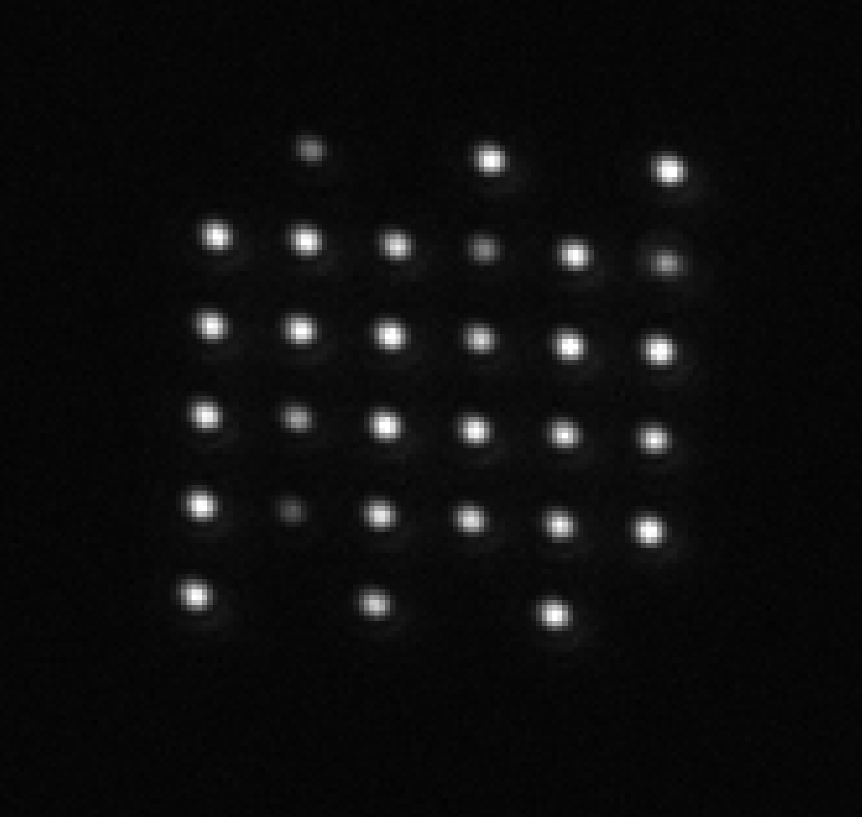
NCPAs in MAVIS
MAVIS WFSing and Control
Requires many small sources over the science FoV (100 holes, each 5 um ø),
Test masks produced by Optofab in Sydney provide sufficient accuracy and throughput tested at Stromlo.
15 um ø
5 um ø
Figure 12: Pinholes under microscope
Figure 11: Image taken of 5 um pinhole grid on the bench, pinholes are 40 um apart.
Figure 13: Imaged pinholes on the bench. (left) varying focus of cutting laser, (right) 5 um and 15 um pinholes.
Notes:
The images require many diffraction size pinhole sources over the field-of-view, and we have procured some test masks from Optofab in Sydney which seem to meet the spec at a very reasonable price. The technology uses laser cutters to carve out holes to a very fine tolerance. We require a grid of around 100 pinholes, each 5 microns in diameter.

Slide 12
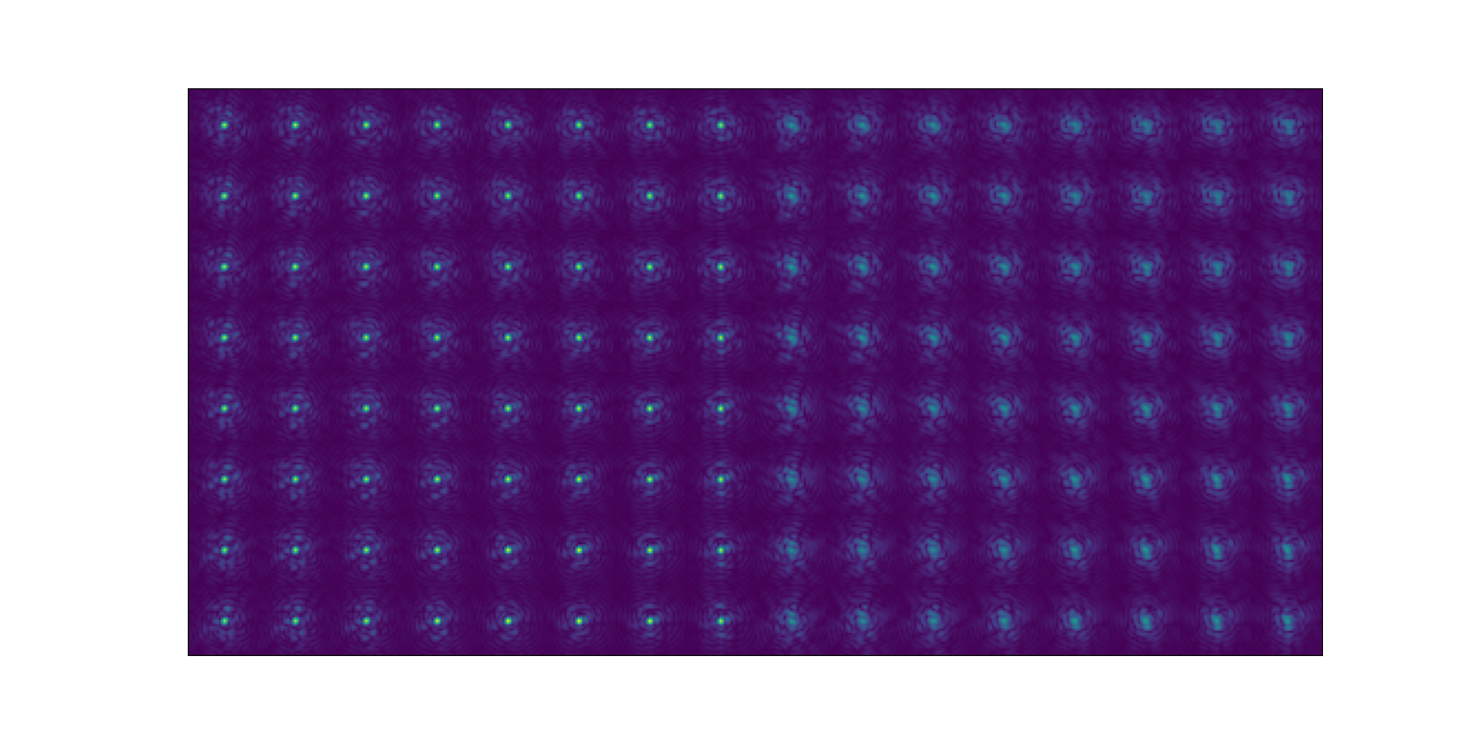
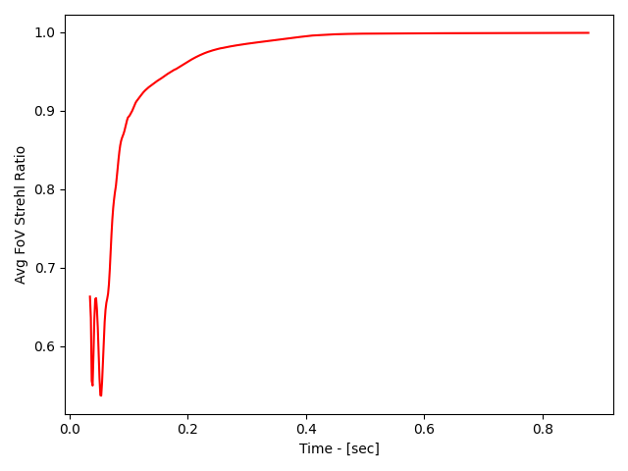
NCPAs in MAVIS
MAVIS WFSing and Control
Simulations show we can converge on NCPA calibration with 64 sources simultaneously in less than 1 second on GPU,
Prototyping in the lab for MAVIS commencing Q1 2023.
Figure 15: Tomographic phase diversity convergence vs time.
Figure 14: Simulated NCPA pinhole images
Notes:
We’ve simulated the tomographic NCPA process and are developing a GPU tool to do the tomographic phase diversity. Currently it looks like we can converge on the perfect solution in less than 1 second. The software is written in pytorch.

Slide 13
Thanks!
MAVIS WFSing and Control
Questions?
Further correspondence: jesse.cranney@anu.edu.au

Slide 14
Real Time Turbulence Profiling
MAVIS WFSing and Control
Tomographic predictive control requires real-time Cn2 and wind profiling,
“Predictive Learn and Apply” provides this, and is optimised for GPU.
Some results in end-to-end simulation:
Hao Zhang to include results here, otherwise this slide to be skipped (and content slide to be modified)

Slide 15
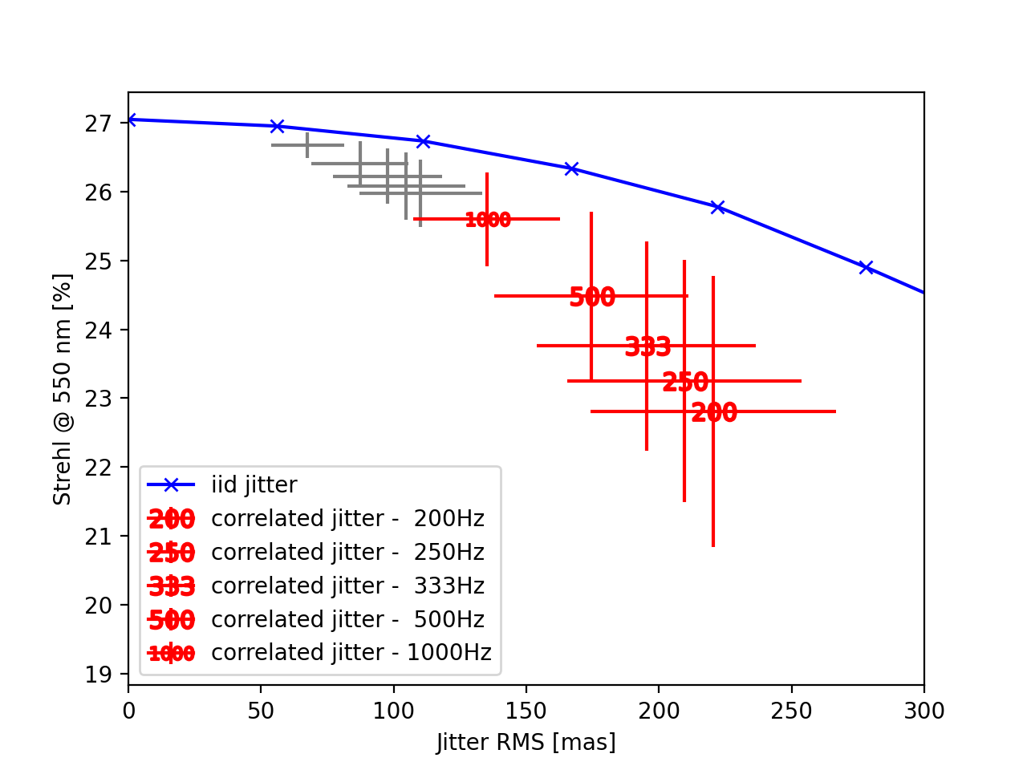
LGS jitter
MAVIS WFSing and Control
Notes:
Skip, unless you have some text/figures to add

Slide 16
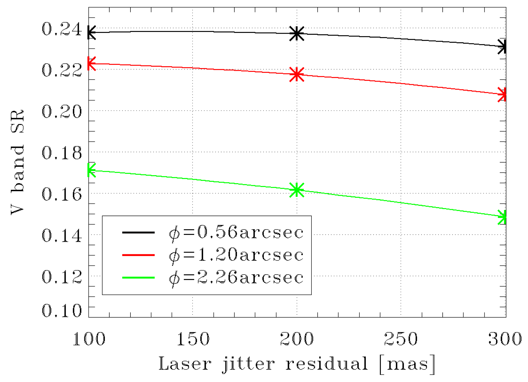
LGS jitter
MAVIS WFSing and Control
𝜙: Small axis of LGS spot on sky
Seeing = 0.87”
1 kHz jitter loop
100 Hz jitter loop
Notes:
Skip, unless you have some text/figures to add

