Slide 1


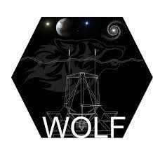
Dynamic, optical gain compensation and phase unwrapping
for the Zernike Wave-Front Sensor
Mahawa CISSE, Vincent CHAMBOULEYRON, Olivier FAUVARQUE, Charlotte BOND, Nicolas LEVRAUD, Jean-François SAUVAGE, Benoît NEICHEL, Thierry FUSCO
Notes:
Hello everyone, I am Mahawa Cissé a 2nd year PhD Student between LAM and ONERA. My field of research is adaptive optics and wave-front sensing for Extremely Large Telescope. I am going to talk about the dynamic, the OG compensation and the phase unwrapping for the ZWFS.

Slide 2
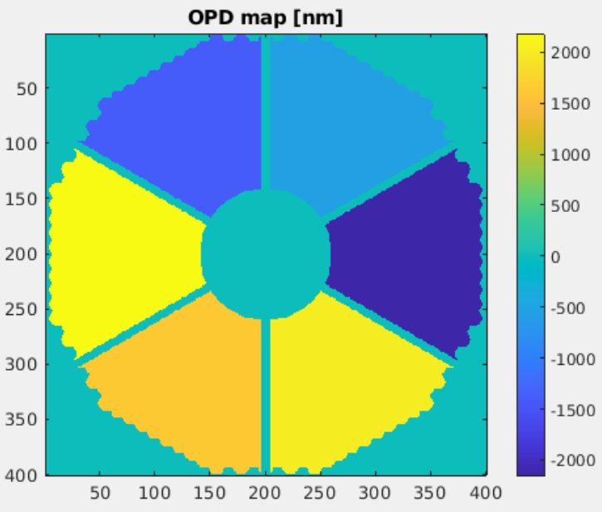
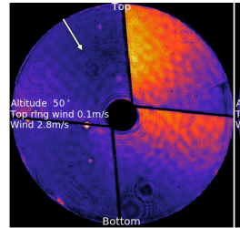
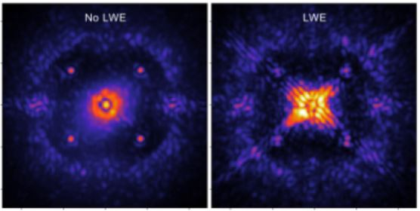
Context : High angular resolution with the ELTs
Differential piston
Low-Wind Effect (LWE)
High contrast imaging
New challenges for Wave-Front Sensing (WFS) for Adaptive Optics (AO) systems
to achieve high angular resolution
Reference :
Milli, J., et al 2018
Notes:
To goal of the next generation of telescopes is to provide high angular resolution. However, the telescope itself bring new aberrations that we need to correct in order to achieve high angular resolution.
The big spiders of the telescope will bring differential piston problems made a all session yesterday.
There is also LWE created by the spider.
And if you want to do high contrast imaging we really need to correct these aberration.
→ New challenges for AO and especially for WFS.

Slide 3
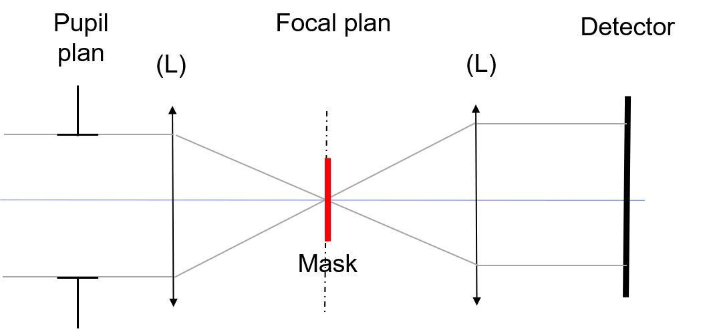

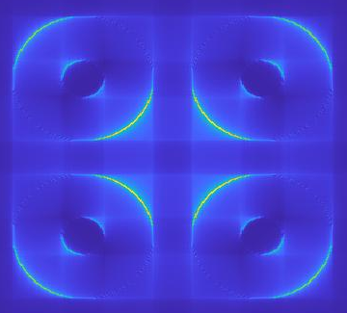
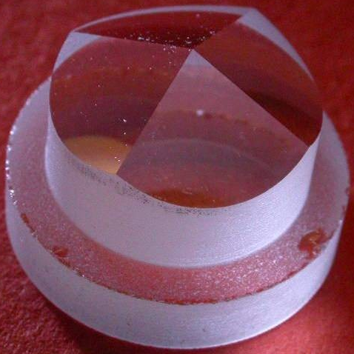
Adaptive Optics and Wave-Front Sensing
Pyramid (PWFS) [1]
More sensitive than the Shack-Hartmann (SH)
But highly non-linear sensor
Atmosphere
Pupil plane
Focal plane
Detector
→ modulation
LWE
« Gradient sensor »
Modulated PWFS and SH are not sensitive to the petal mode or LWE
Telescope
LWE measured by the ZELDA for the VLT as a 2nd stage correction cf Milli et al 2018
SCIENCE
CAMERA
DM
Need to analyse the Zernike WFS to measure aberrations
Small phase → 2nd stage WFS, petalometer etc
Large phase → AO WFS
RTC
WFS
References :
[1] : Ragazzoni, R. (1996). Pupil plane wavefront sensing with an oscillating prism. Journal of modern optics, 43(2), 289-293.
Notes:
As you all know AO equipped ground telescope to correct in real time atmospheric turbulence.
The WFS that will equipped the next generation of telescope is the pyramide. Because it’s more sensitive than the SH even though it’s a highly non-linear sensor. to deal with the non-linearity we add modulation. but once it’s done the pyramid acts like a gradient sensor which means it will no longer be sensitive to phase discontinuities.
As an example, the LWE was measure by a Zernike mask not the by the SH on the VLT.
So now you are going to focuse on the Zelda WFS.
First as 2nd stage AO and then as a 1st stage AO.

Slide 4
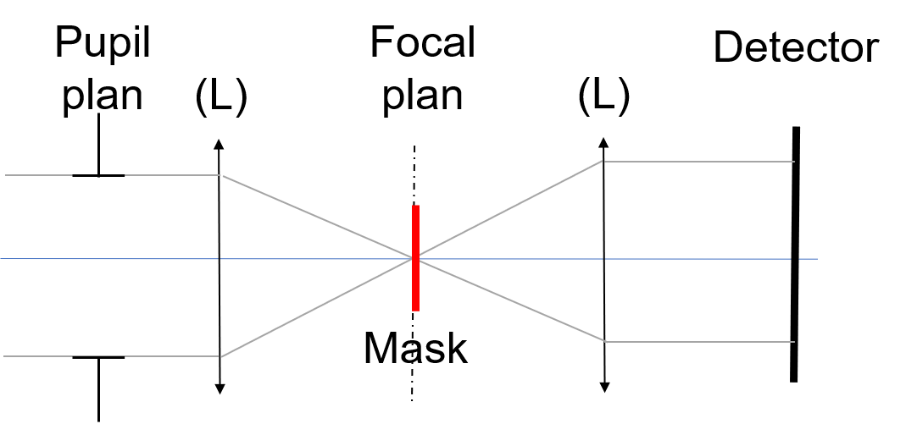
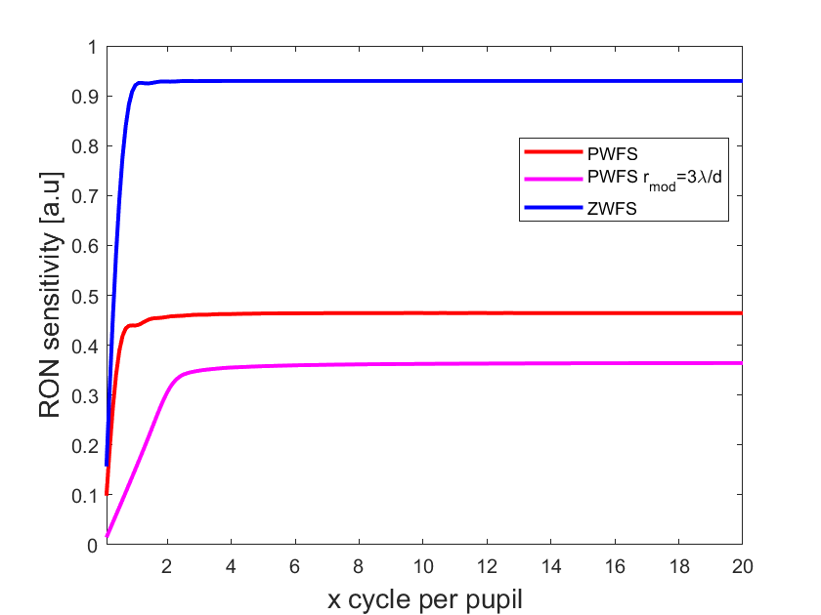
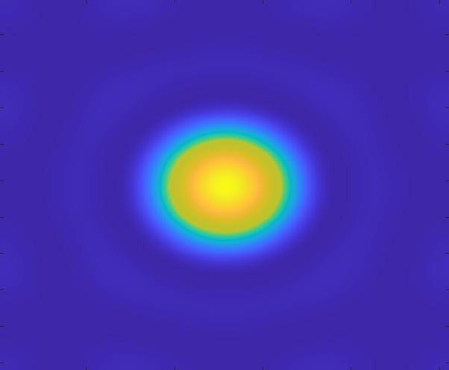
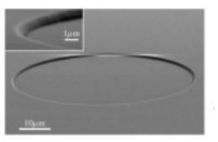
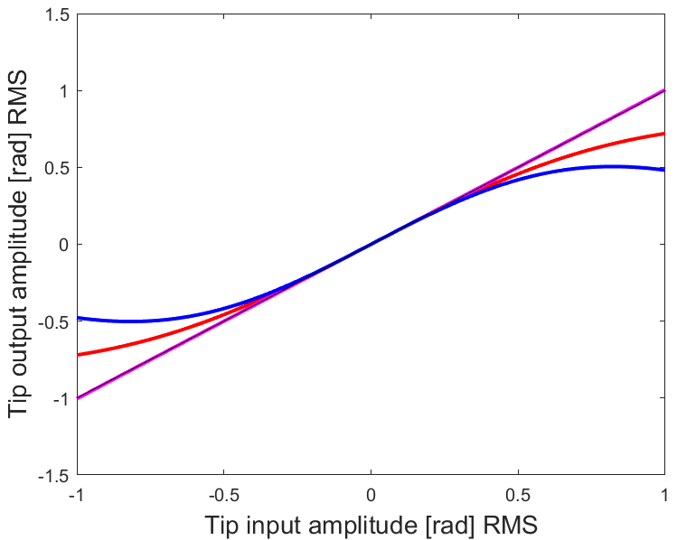
Zernike Wave-Front Sensor (ZWFS)
Pupil plane
Focal plane
Detector
Linearity curves of FFWFS
Source [1]
More sensitive than the PWFS
Phase sensor
Less linear than the PWFS
References :
[1]: N'Diaye et al 2016
Notes:
The ZWFS is a FFWFS. It’s means that we encode the phase information into intensity on the detector.
Why the Zernike WFS is more interesting than the pyramide?
First because it’s more sensitive than the PWFS.
Then it’s also because in first approximation it’s a phase sensor.
The problem with the ZWFS it’s its dynamic. It’s dynamic range is smaller than the one on the PWFS without modulation.

Slide 5
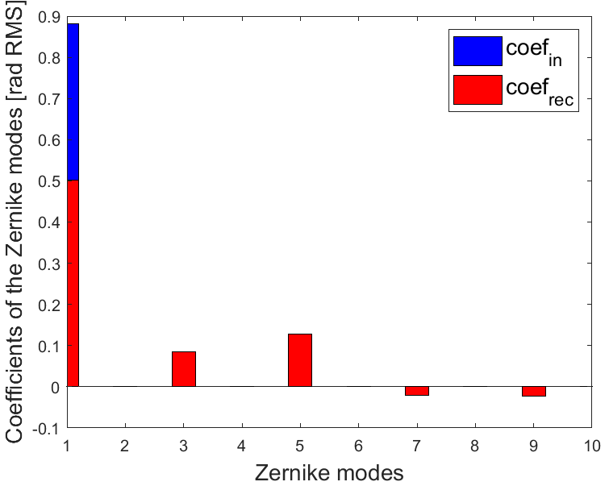
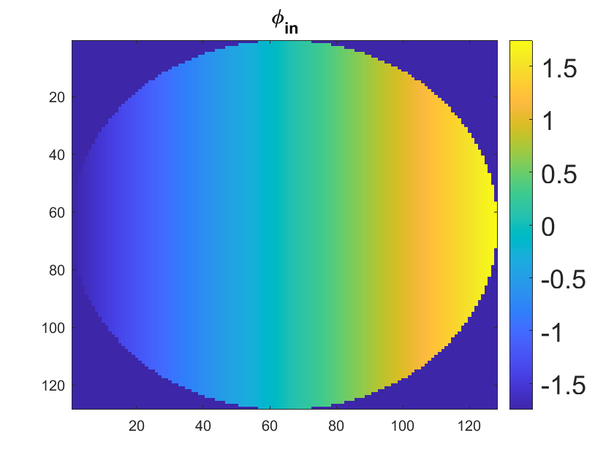
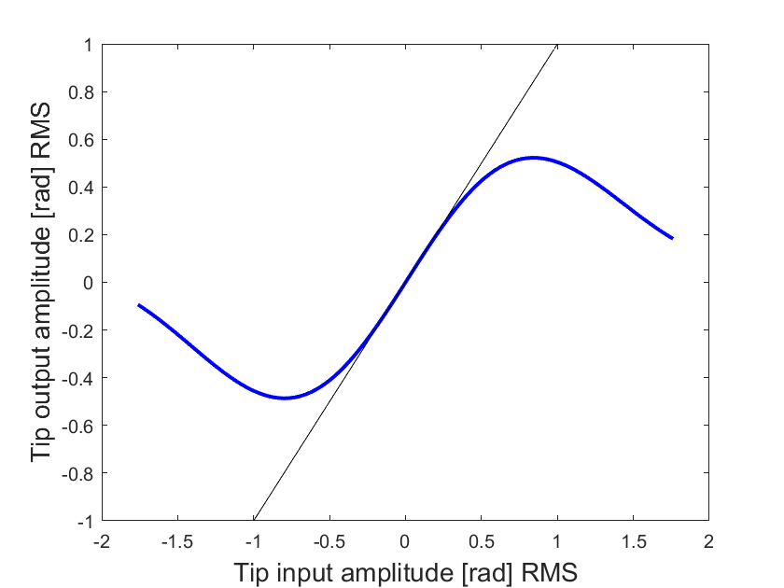
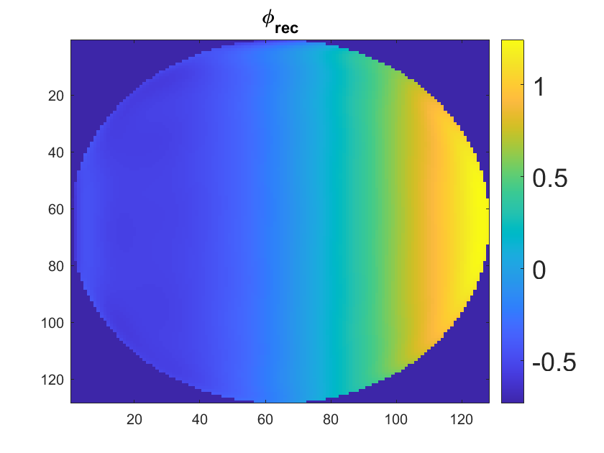
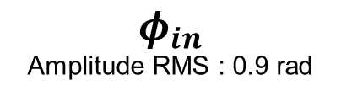

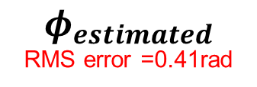
Non-linearities of the ZFWFS : Example with a Tip
$$φ_{in}$$
Amplitude RMS : 0.9 rad
$$1−g_{i}$$
$$φ_{estimated}$$
RMS error =0.41rad
Optical gain
Modal confusion
Necessary to deal with the non-linear effects of the sensor
Notes:
To highlight the non-linearities of the ZWFS I studied the reconstruction of a Zernike mode the tip. The curve here gives the output intensity of a tip after the propagation with respect to the input amplitude. We can see that for phase amplitude higher than 0.5 radian, the response of the sensor is no longer linear. this difference between the signal and the linear regime is what is call optical gains.
If I take a tip of 0.9rad amplitude for example, the phase is estimated with 0.4 radian RMS of error. And if I project the phase on the Zernike mode. First we notice that the output amplitude of the tip is lower than the input amplitude. This is due to the optical gain. We also notice that others modes appear after the propagation. Mode that where not in the input phase. This modal confusion will bias our phase estimation.
to improve the phase estimation of the ZWFS we need to have a better understanding of this non-linear effects that will damage our phase estimation.

Slide 6
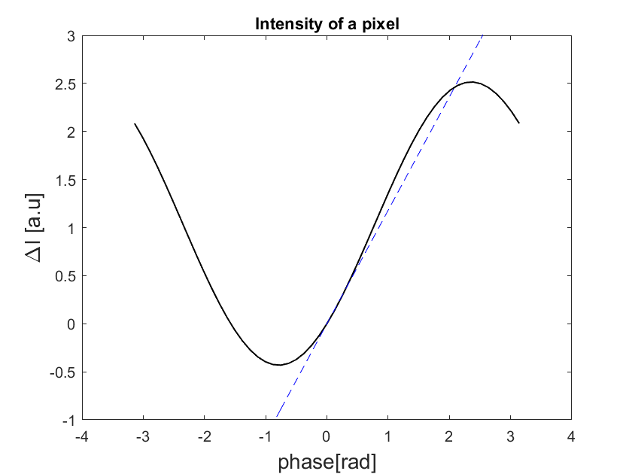
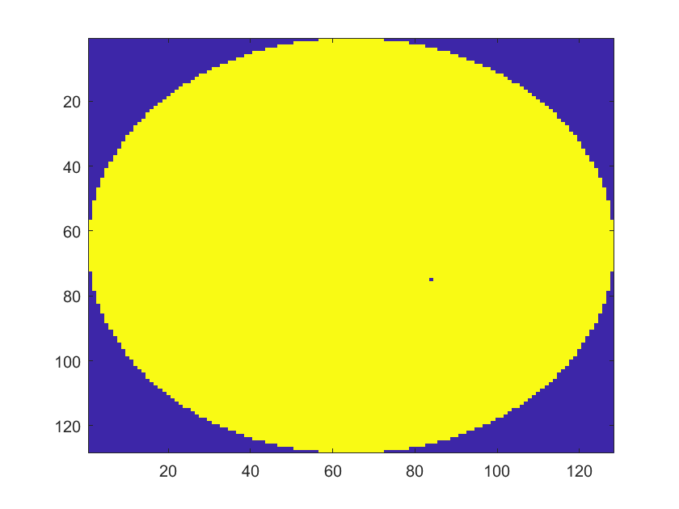
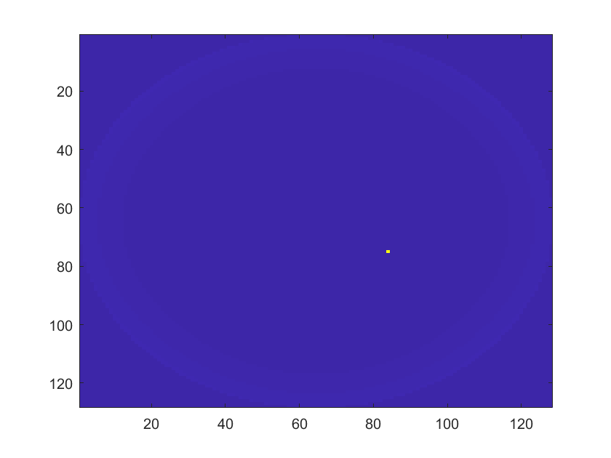
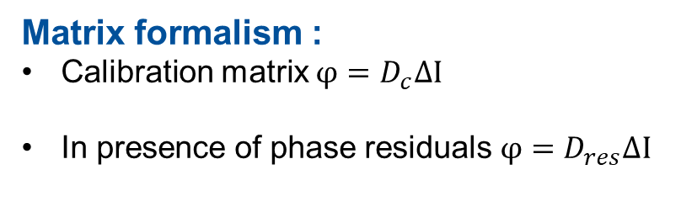
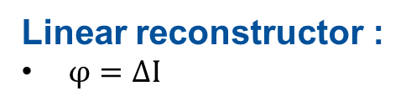
Phase reconstructors
Intensity response of one pixel
Pupil plane
Focal plane
Detector
Z
Linear reconstructor :
$φ=∆I$
Matrix formalism :
Calibration matrix ${φ=D}_{c}∆I$
In presence of phase residuals ${φ=D}_{res}∆I$
$D_{res}=\left(\begin{matrix}{δI}_{res}\left(Z_{1}\right), & … & {δI}_{res}(Z_{N})\end{matrix}\right)$ with ${δI}_{res}(Z_{i})=\frac{∆I\left(Φ_{res}+{εZ}_{i}\right)−∆I\left(Φ_{res}−{εZ}_{i}\right)}{2ε}$
Notes:
First let’s focuse on the phase reconstructors that we can use.
Another way to understand properly the dynamic range of the Z mask is to look at one pixel. We have a flat wave-front in the pupil plane and we are going to modify the phase of one pixel and then plot the intensity of this pixel with respect to its input amplitude. We can see in the plot that the intensity response is a sin wave which means that the signal delivered by the Z mask will wrapped. Problem that will be address in few slides.
If the amplitude if small enough we can use a linear approximation to estimate the phase from the intensity measurement.
Another solution will be to calibrate our system and make the interaction matrix of our sensor.
We rapidly understand that the calibration matrix will perform well around the flat wave-front. However, in presence of phase residual we can try another approach that consists in building an interaction matrix around the operating point.

Slide 7
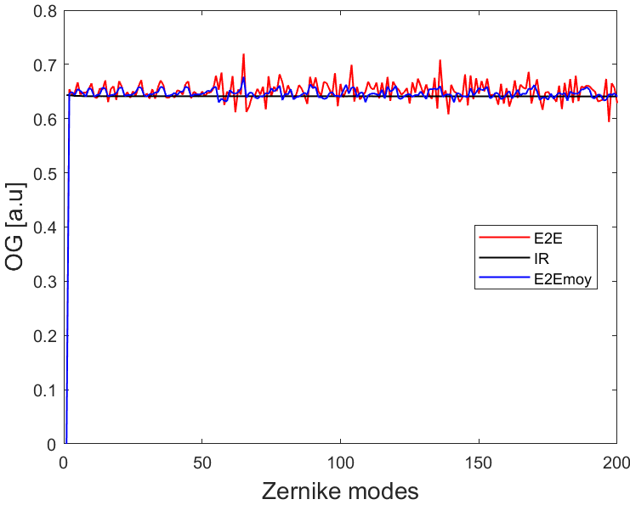
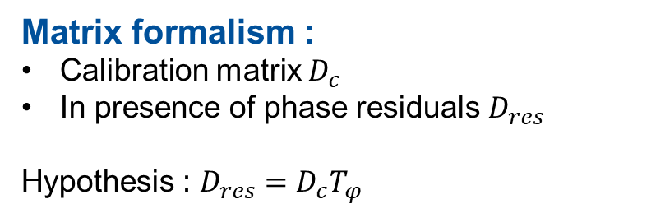

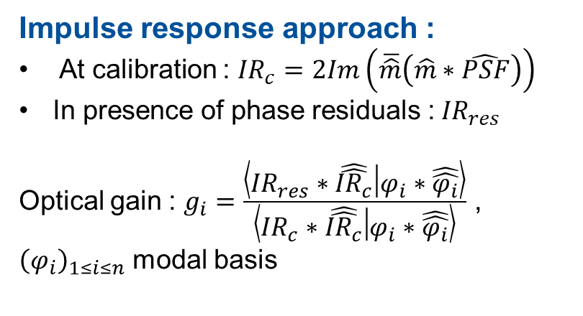
Optical gains computation
Matrix formalism :
Calibration matrix $D_{c}$
In presence of phase residuals $D_{res}$
Hypothesis : $D_{res}=D_{c}T_{φ}$
Impulse response approach :
At calibration : ${IR}_{c}=2Im\left(\overline{\hat{m}}\left(\hat{m}∗\hat{PSF}\right)\right)$
In presence of phase residuals :${IR}_{res}$
Optical gain : $g_{i}=\frac{\left\langle {IR}_{res}∗\hat{\hat{{IR}_{c}}} | φ_{i}∗\hat{\hat{φ_{i}}}\right\rangle }{\left\langle {IR}_{c}∗\hat{\hat{{IR}_{c}}} | φ_{i}∗\hat{\hat{φ_{i}}}\right\rangle }$ ,
${\left(φ_{i}\right)}_{1≤i≤n}$ modal basis
Simulation parameters :
1m telescope
Resolution 64 pixels
Modal DM
(200 Zernike modes)
SR=65%
References :
[1] : Chambouleyron, V. (2021). PhD Thesis
[2] : Chambouleyron, V et al 2021
E2E & IR approach give the same OG
OG independant of the modes → $D_{res}={OG.D}_{c}$
Notes:
So another approach is to find the link between the matrix around the phase residual and the calibration matrix.
The hypothesis is to say the matrix around the residual is equal to the calibration matrix times a matrix that take into acount the non-linear effect. I am going to name this matrix Tphi. We have 2 information in this matrix first what we call the OG the diagonal on Tphi and the non-diagonal terme will give the coupling between the modes. Using the all Tphi matrix doesn’t solve our problem of speed computation. That’s why we are going to focuse only on the OG and forget about modal confusion.
The other approach to compute the gain is the impulse response approach with the gain scheduling camera. By using the impulse response of our mask which depends on the PSF we can have access to the modal gain.
To compare the 2 approaches I simulated a PSFres obtained with a perfect AO system limited by the fitting error.
Now if I compare the 2 approach we see that the results match. The gains obtain with the IR approach and the one obtain with the E2E simulation are almost the same. And this plot also show that the OG is a scalar. Which means that our reconstruction is the calibration matrix times a scalar. Scalar that we can compute with the PSFres and like this the computation will be much faster.

Slide 8
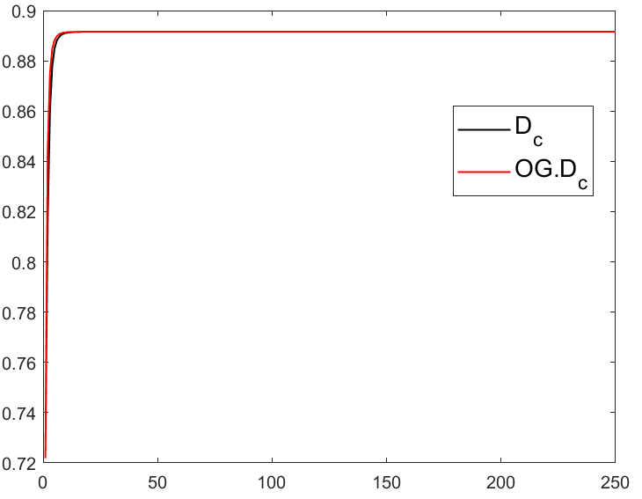
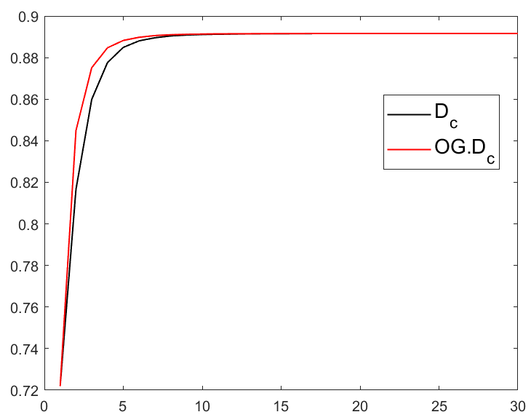
Close Loop test on phase residuals
Simulation parameters :
1m telescope
Resolution 64 pixels
Modal DM
(200 Zernike modes)
SR=72%
SR
SR
Iterations
Iterations

Slide 9
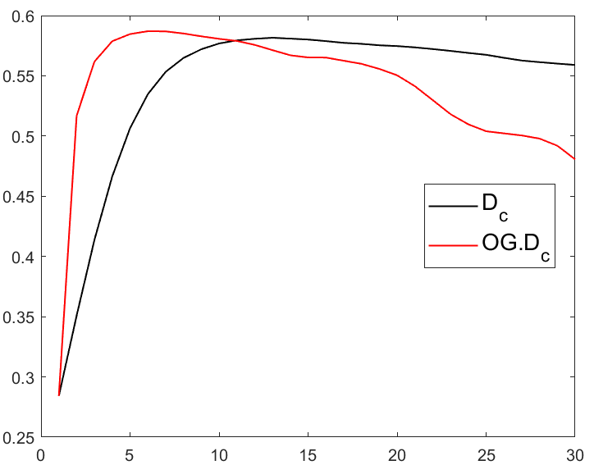
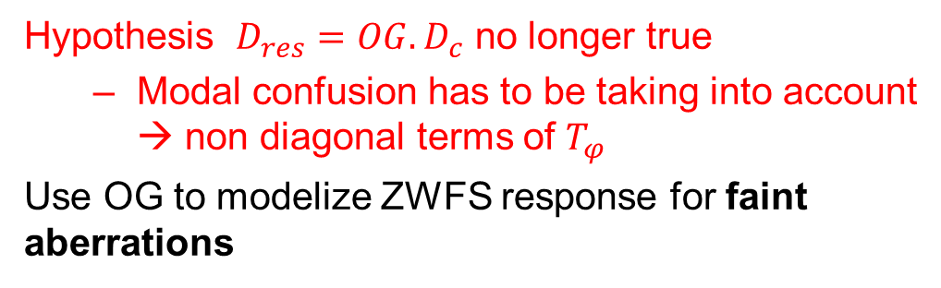
Close Loop test : stronger turbulence
Simulation parameters :
1m telescope
Resolution 64 pixels
Modal DM
(200 Zernike modes)
SR=29%
Hypothesis $D_{res}={OG.D}_{c}$ no longer true
  Modal confusion has to be taking into account → non diagonal terms of $T_{φ}$
Use OG to modelize ZWFS response for faint aberrations
SR
What about increasing the dynamic of the ZWFS
Iterations

Slide 10
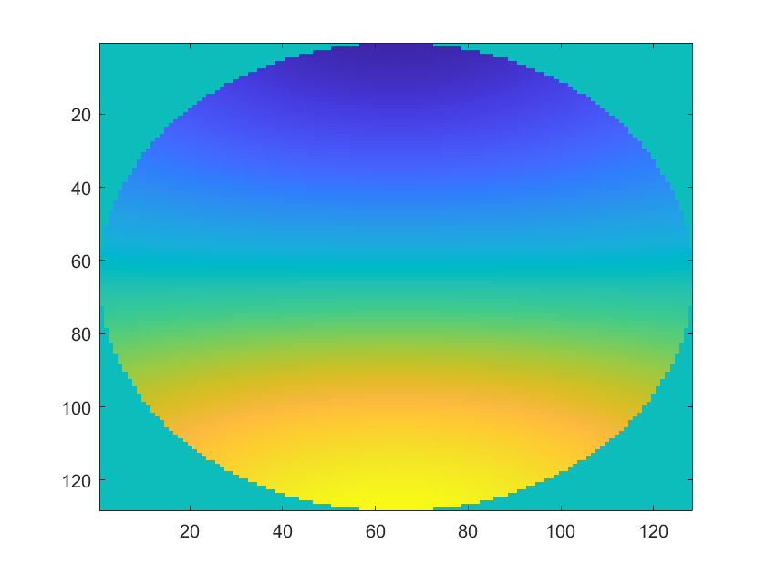
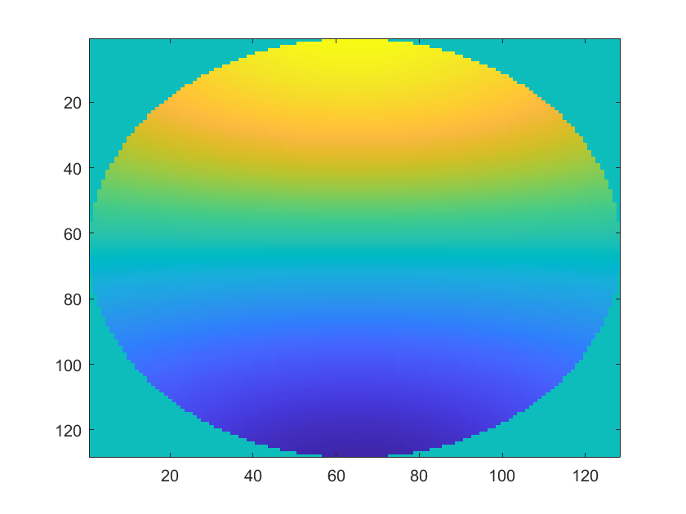







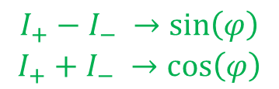


The Phase-Shifted ZWFS
Detector
Detector
Detector
Pupil plane
Detector
Pupil plane
Pupil plane
Pupil plane
Focal plane
Focal plane
Focal plane
Focal plane
δ =λ/4
δ =λ/4
$$Z_{+}$$
δ =λ/4
$$Z_{−}$$
δ =-λ/4
$$Z_{+}$$
$$Z_{+}$$
$$Z_{+}$$
$$Z_{+}$$
$$Z_{+}$$
P=1.06λ /d
P=1.06λ /d
P=1.06λ /d
P=1.06λ /d
$$Z_{−}$$
Dynamic range of $π$
Focal plane
$$I_{+}$$
$$I_{+}$$
Dynamic range of $2π$
Detector
$$\begin{matrix}I_{+}−I_{−} →sin\left(φ\right) \\ I_{+}+I_{−} →cos\left(φ\right)\end{matrix}$$
$$I_{−}$$
Reference:
David S. Doelman et al (2019)
Increased dynamic
Notes:
The idea is called the phase-shifted ZWFS. which is the combination of 2 Z masks.
First, an other way to understand properly the dynamic range of the Z mask is to look at one pixel. We have a flat wave-front in the pupil plane and we are going to modify the phase of one pixel and then plot the intensity of this pixel with respect to its input amplitude.
If the amplitude if small enough we can use a linear approximation to estimate the phase from the intensity measurement.
But because we have a sine curve, we can also use the arcsin function to estimate the phase within a pi range.
To improve this dynamic range what we do is to use a second Z mask which I call Z- which is the transconjucated mask of the first one. Then by doing linear combination of the 2 intensities I+ and I- obtained on the detector we have access to the sine and the cosine of the phase. From this we can estimated the phase within a 2pi range.
This way we multiple by 2 the dynamic of the sensor on one pixel.

Slide 11
Review : ZWFS non-linearities & dynamic
Use of OG limited by the phase residuals regime
Modal confusion has to be taken into account
Phase-Shifted ZWFS :
  Increase the dynamic range
  Less constraints on the phase residuals regime
On going work
Can we bootstrap with the ZWFS?

Slide 12
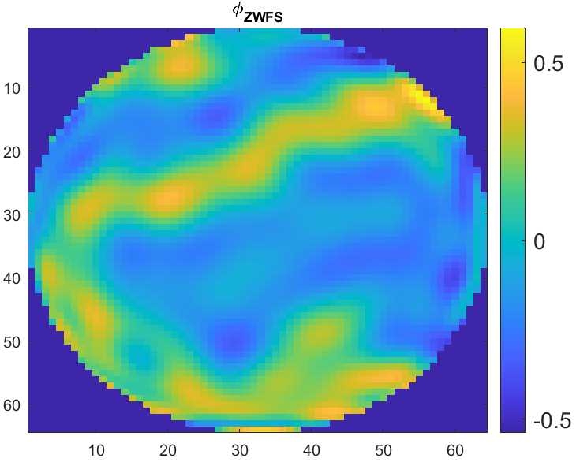
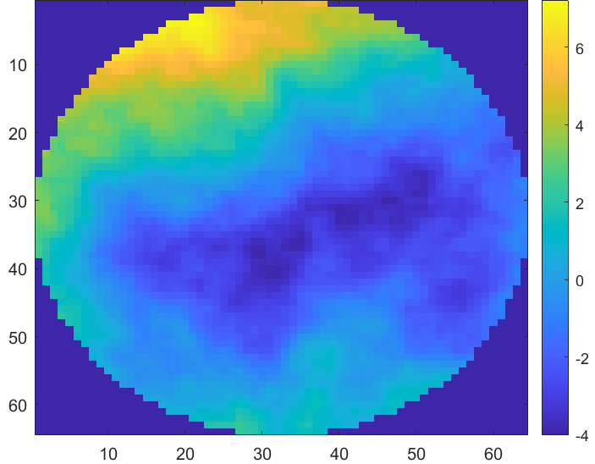
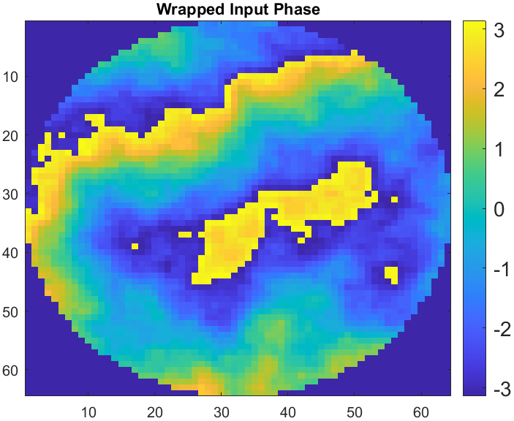
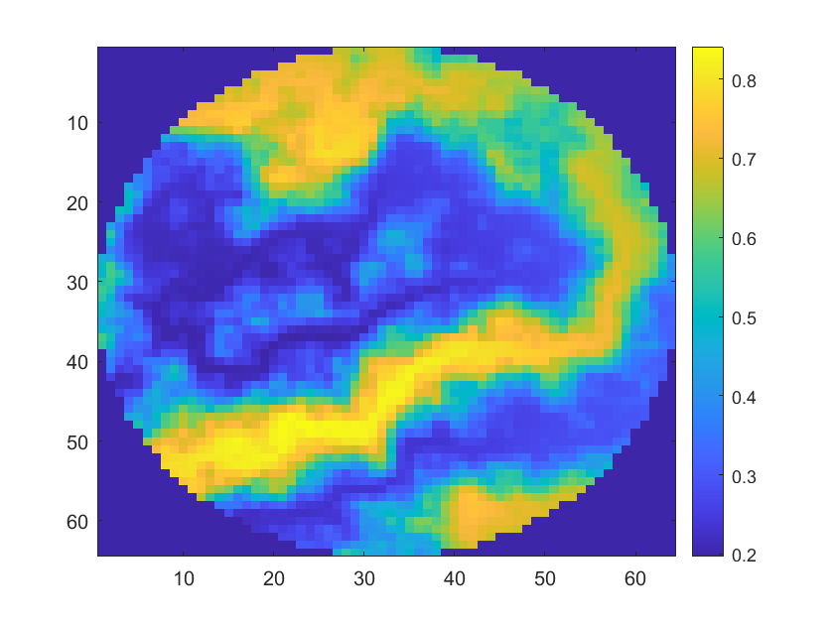
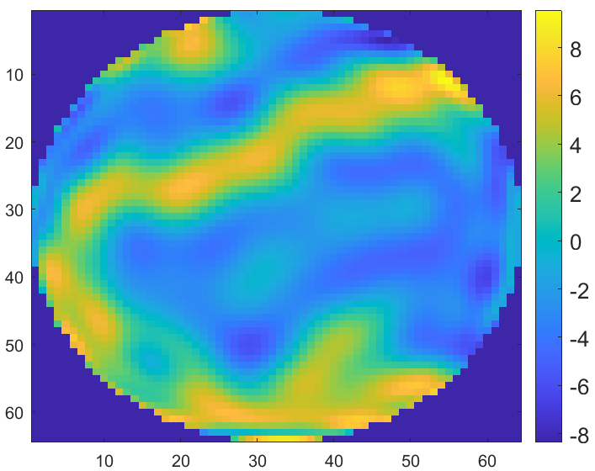

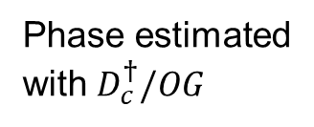

ZWFS 1st stage AO: phase wrapping issues
Easy part
What we want
Phase estimated with $D_{c}^{†}$
Input phase
Phase seen by ZWFS
ΔI
DM response
Phase estimated
with $D_{c}^{†}/OG$
Modulo 2pi
ZWFS response
Notes:
Wrapped phase seeing by the ZWFS due to the propagation.
In the reduced intensity we see the phase shape but it’s smooth by the Z response which is a sine wave.
Then the phase estimation given by the calibration matrix has 2 problems : first it’s amplitude which is much smaller than the input phase amplitude due the non-linearity of the sensor. Then it’s also smooth by the DM response. Which means that it won’t be easy to unwrap with the classical unwrapping algorithme.
If we try to compensate with the OG it will make the loop diverge because it will multiple by a strong factor our estimated phase and above all this formalism does not change our smoothing issues.
So what we would like to do is to have a way to make our phase estimation as close as possible to the wrap input phase so recreate the phase jump. Then unwrapping the phase estimation and applying it to the DM.

Slide 13
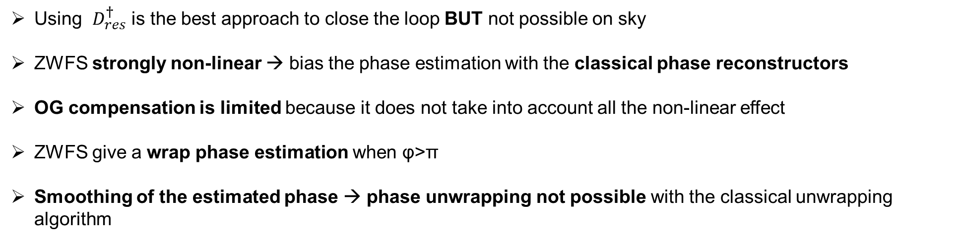


Conclusion
To have a better understanding of the non-linear behavior of the ZWFS to improve the phase estimation
Using $D_{res}^{†}$ is the best approach to close the loop BUT not possible on sky
ZWFS strongly non-linear → bias the phase estimation with the classical phase reconstructors
OG compensation is limited because it does not take into account all the non-linear effect
ZWFS give a wrap phase estimation when φ>π
Smoothing of the estimated phase → phase unwrapping not possible with the classical unwrapping algorithm
Science path
Detector
Perspectives :
Improve the dynamic range of the ZWFS → Phase-Shifted ZWFS
Non-linear phase reconstructors
Wollaston
$$Z_{+}$$
DM2
Dichroic beamsplitter
$$Z_{−}$$

Slide 14
Thank you for listening

Slide 15




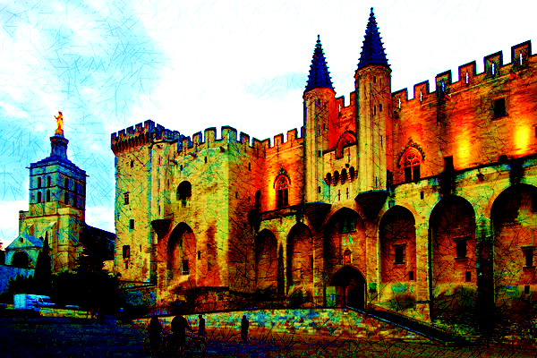



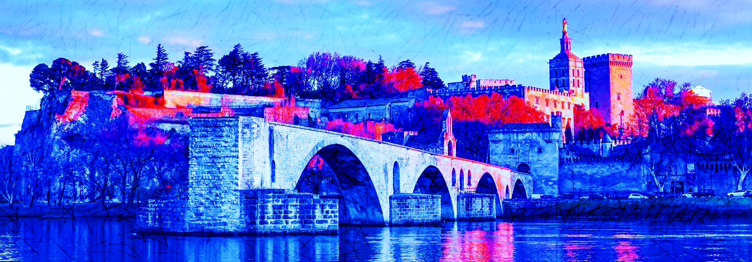


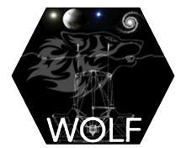

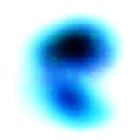
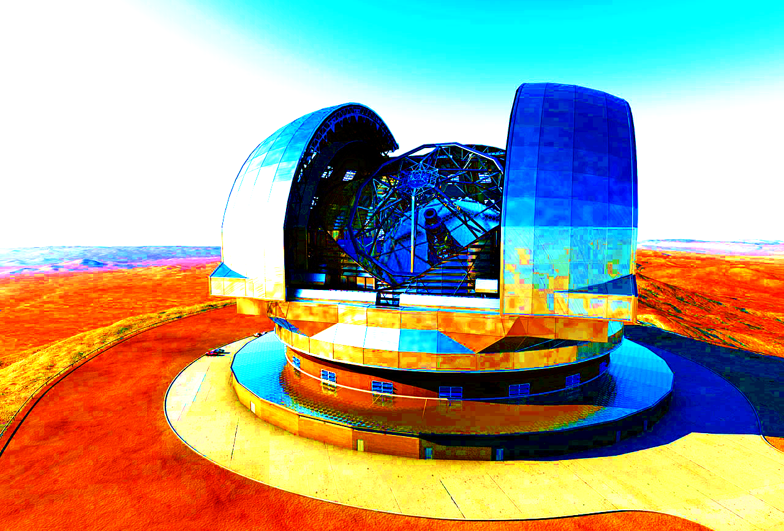
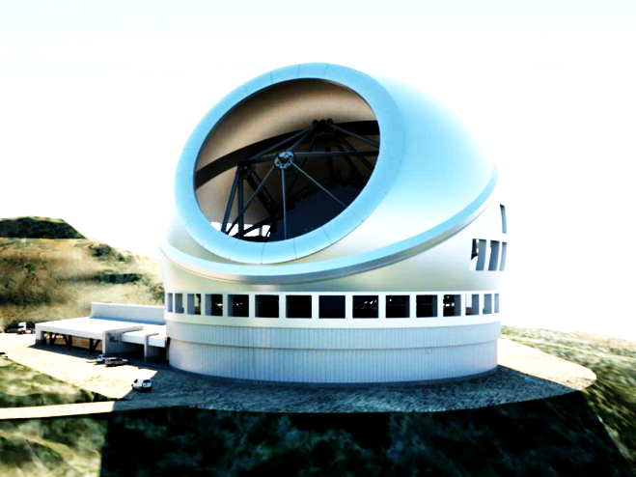
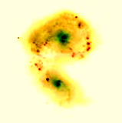
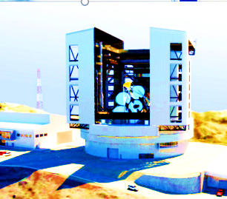
AO 4 ELT - 7th Edition
25 to 30 ^{th} June 2023
Palais des Papes, Avignon, France
Web site : ao4elt7.sciencesconf.org
More information: Thierry.Fusco@onera.fr, Benoit.Neichel@lam.fr

Slide 16
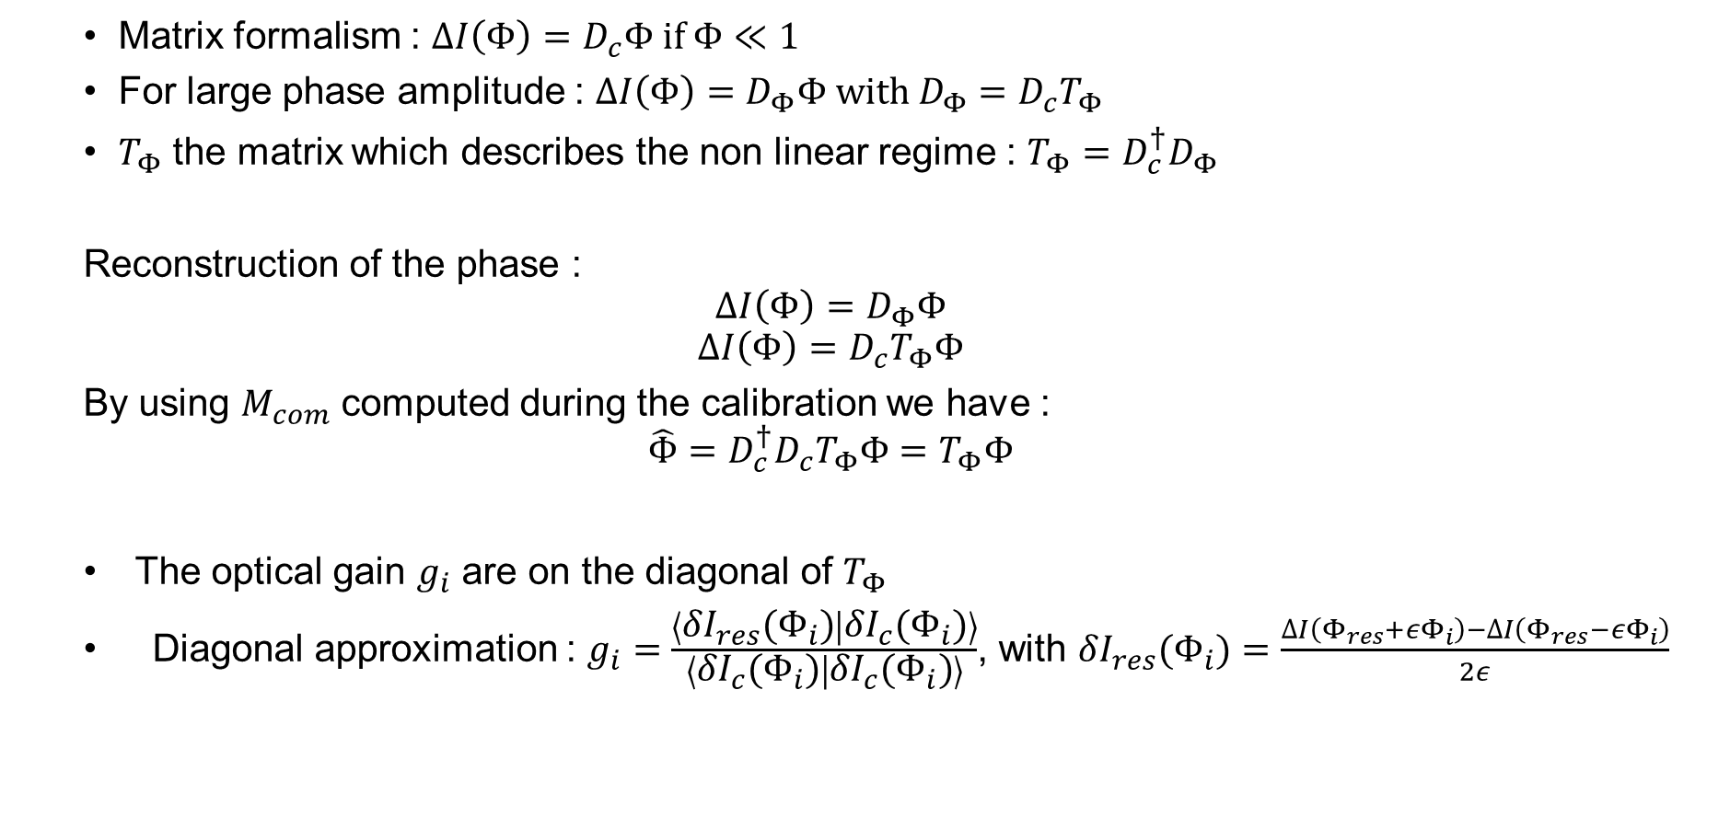
Annexe 1 : Optical gains (OG)
  Matrix formalism : $∆I\left(Φ\right)=D_{c}Φ if Φ≪1$
  For large phase amplitude : $∆I\left(Φ\right)=D_{Φ}Φ with D_{Φ}=D_{c}T_{Φ}$
  $T_{Φ}$ the matrix which describes the non linear regime : $T_{Φ}={D_{c}^{†}D}_{Φ}$
  Reconstruction of the phase :
  $$∆I\left(Φ\right)=D_{Φ}Φ$$
  $$∆I\left(Φ\right)=D_{c}T_{Φ}Φ$$
  By using $M_{com}$ computed during the calibration we have :
  $$\hat{Φ}=D_{c}^{†}D_{c}T_{Φ}Φ=T_{Φ}Φ$$
  The optical gain $g_{i}$ are on the diagonal of $T_{Φ}$
  Diagonal approximation : $g_{i}=\frac{\left\langle {δI}_{res}(Φ_{i}) | {δI}_{c}(Φ_{i})\right\rangle }{\left\langle {δI}_{c}(Φ_{i}) | {δI}_{c}(Φ_{i})\right\rangle }$, with ${δI}_{res}(Φ_{i})=\frac{∆I\left(Φ_{res}+{εΦ}_{i}\right)−∆I\left(Φ_{res}−{εΦ}_{i}\right)}{2ε}$

Slide 17
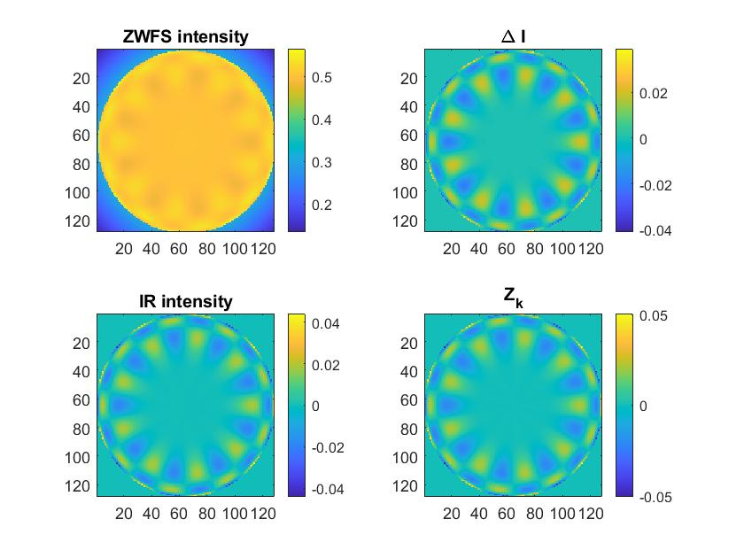






Annexe 2 : impulse response of a FFWFS
Impulse response of a FFWFS $IR=2Im\left(\tilde{\overline{m}}\left(\tilde{m{\left|\tilde{𝕀_{p}}\right|}^{2}}\right)\right)$ with $m$ the phase mask and $FT\left(m\right)=\tilde{m}$
Linear intensity expression : $∆I_{lin}=𝕀_{p}Φ∗IR$
ZWFS impulse response :
$${ΔI}_{E2E}$$
Intensity cut
$$Z_{30}$$
2d
$$I_{IR}$$

