Slide 1

Study of wavefront sensing strategies for the future EST based on laboratory results.
Luzma Montoya, , Jose Manuel González, Yolanda Martín, Noelia Feijoo,
Haresh Chulani, Francisco González, Jorge Quintero
Instituto Astrofísica de Canarias

Slide 2
CONTEXT
The EST is a 4-metre solar telescope optimised for studies of the magnetic coupling between deep photosphere and upper chromosphere.
High spatial resolution.
High temporal resolution.
FOV 60” (500nm - 2200nm)
MCAO: Multi-conjugate adaptive optics.
Strong turbulences concentrated in a few prominent layers, specially in the low altitudes.

Slide 3
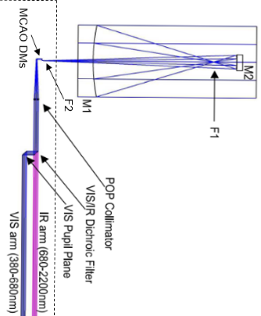
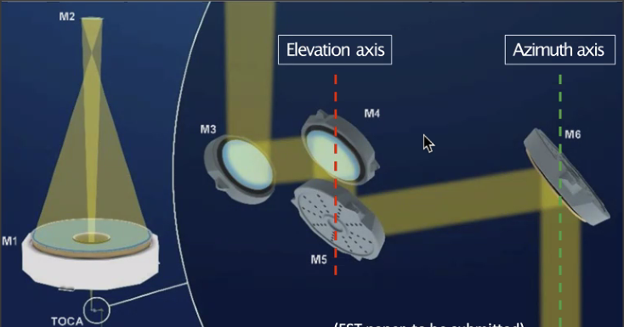
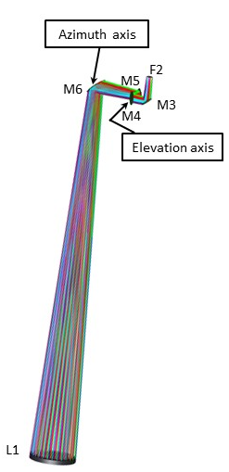
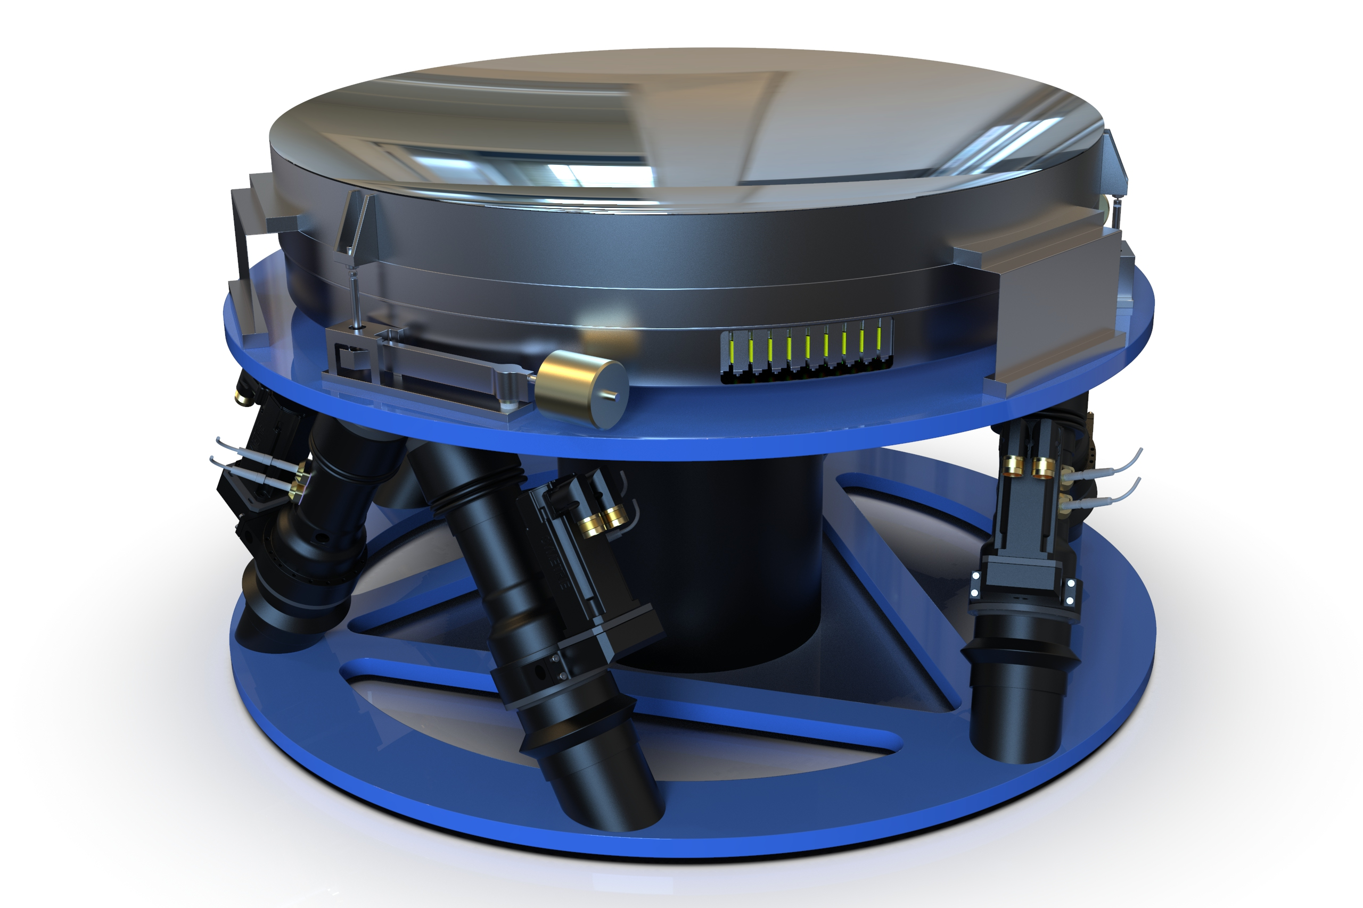
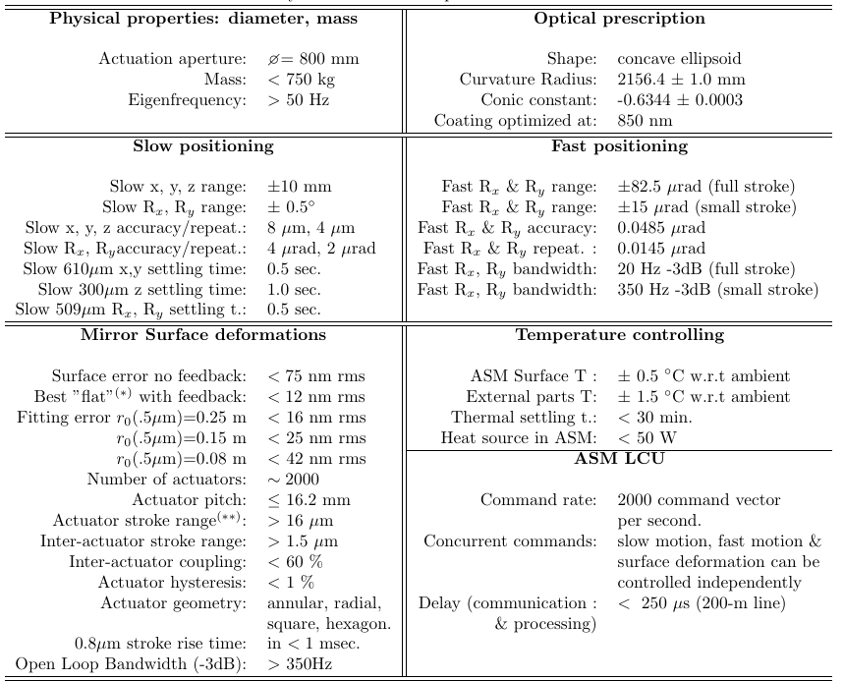
Optical Design EST: MCAO
Number of actuator 2000, pitch 16.2mm
Slow positioning ± 10mm
Fast positioning ± 85µm

Slide 4
Test-bed EST: Objectives
Select the optimal configuration for solar MCAO based on the performance results obtained in a realistic environment.
Study the effect of the order of the deformable mirrors in the MCAO performance.
Study the feasibility and performance improvements achieved using DMs with adjustable conjugate heights.
Study the impact of using DM oriented at 45º on the MCAO system, including the variation of the conjugated height in the DM surface and the anisotropic actuator distribution.
Study the pupil misregistration effects caused by using intermediate DM between a DM a WFS.
Study the impact of the pupil rotation and spider footprint on the wavefront sensing and reconstructor.
Implement Artificial Neuronal Network (ANN) in the reconstruction and control of the MCAO system and study their suitability and performance.
Define, implement and validate different calibration procedures that can be used with a deformable secondary mirror in order to select the optimal procedure for the EST.

Slide 5
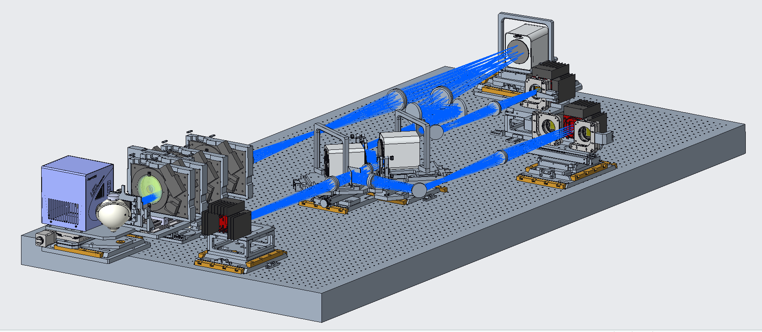
Test-bed EST:MCAO concept
r0 > 10cm & FoV ≤ 30” SR ≥ 0.25
r0 > 10cm & 30” ≤ FoV ≤ 60” SR ≥ 0.15
r0 > 20cm & FoV ≤30” SR ≥ 0.4
r0 > 20cm & 30” ≤ FoV ≤ 60” SR ≥ 0.3
Aperture EST: 4 m → Aperture TB = 26 mm
FoV EST = 70 arcsec → FoV TB = 3°

Slide 6
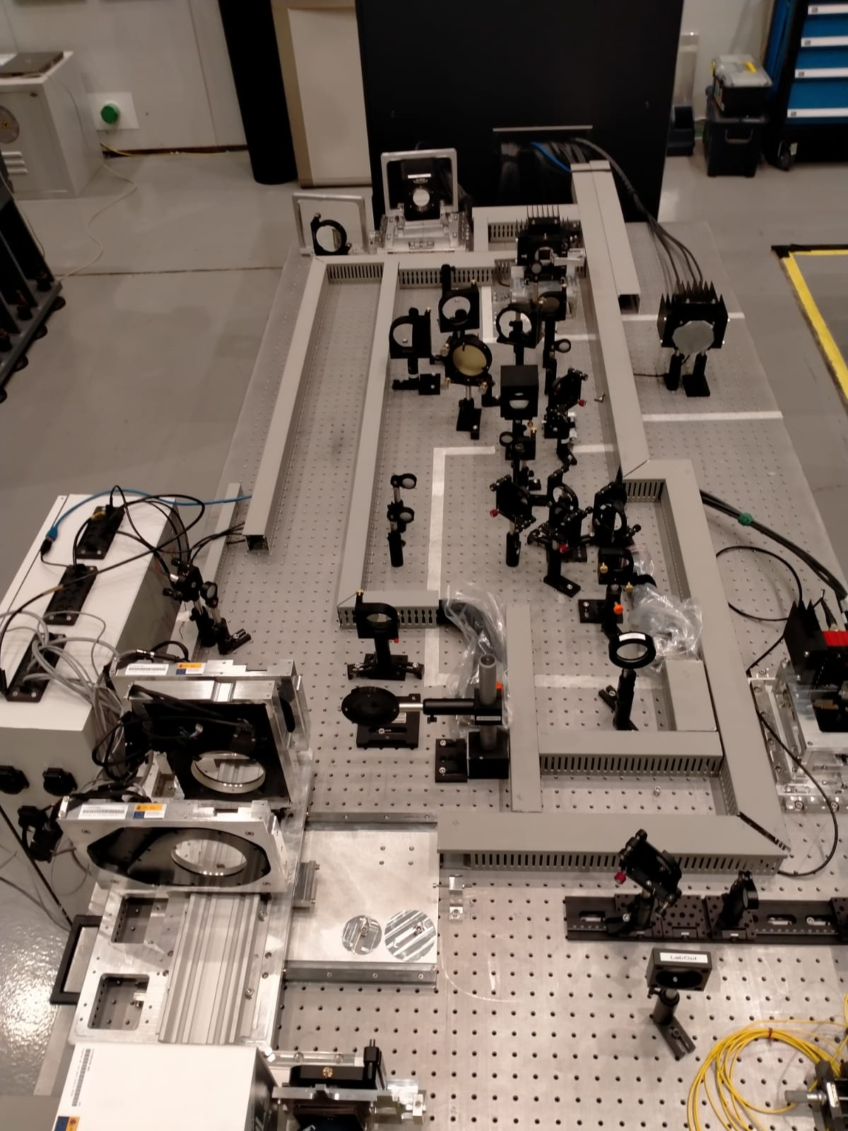
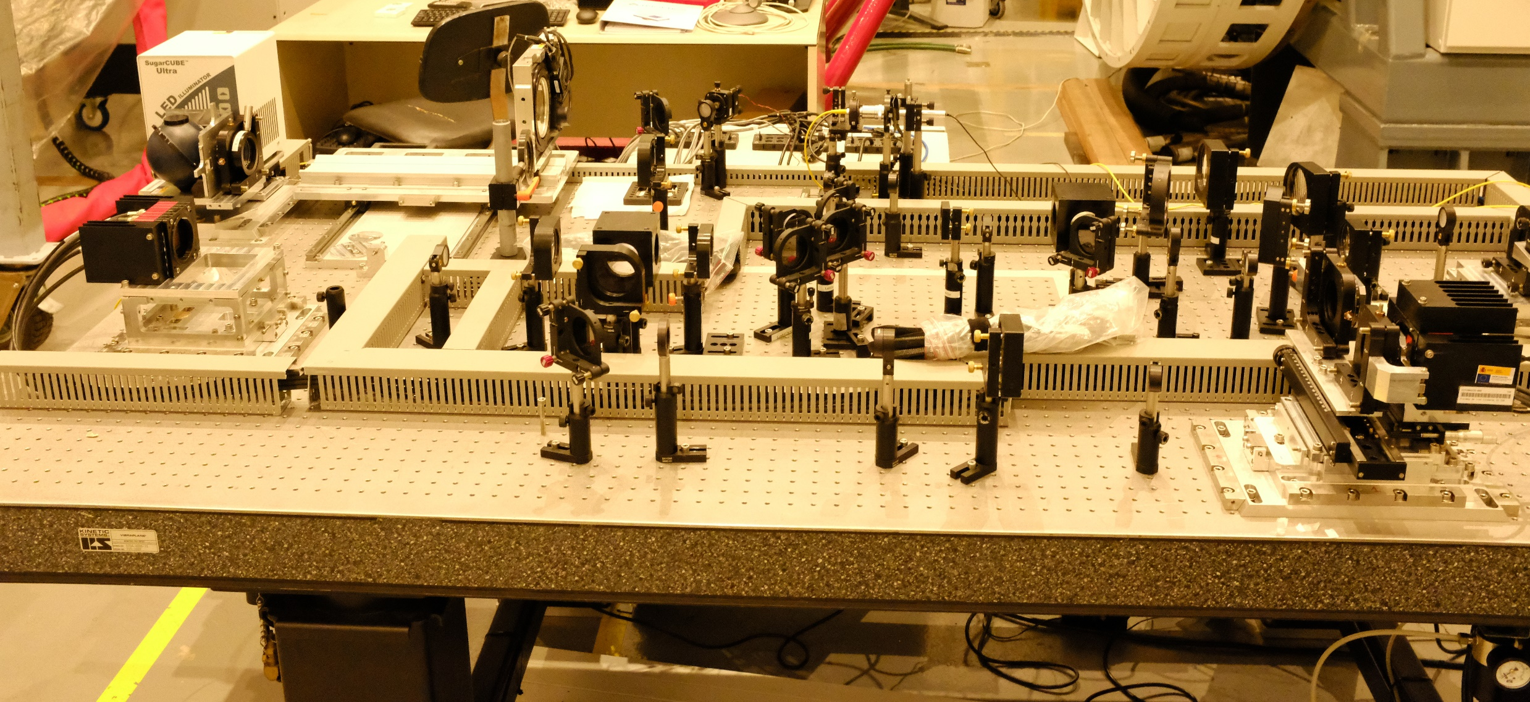
Test-bed:Optical setup
Illumination system
DM0
HO-WFS
PS
Sci cam
MD - WFS

Slide 7
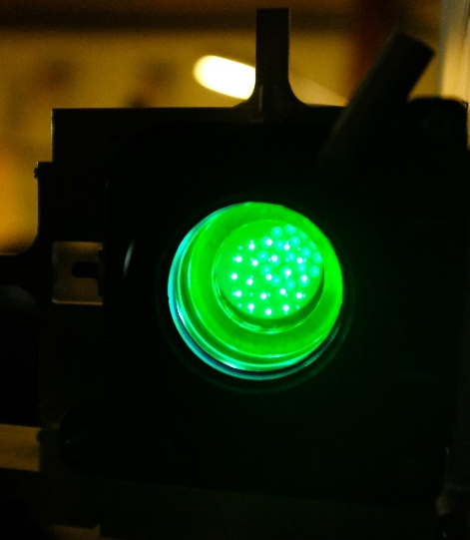
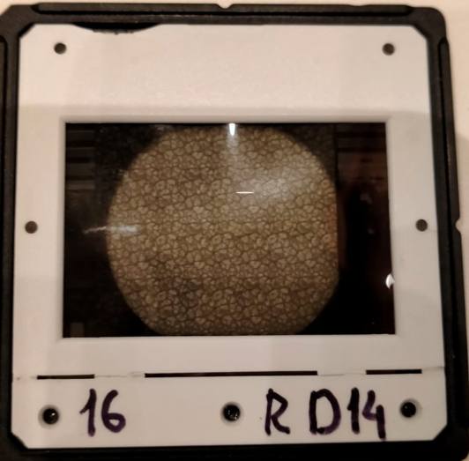
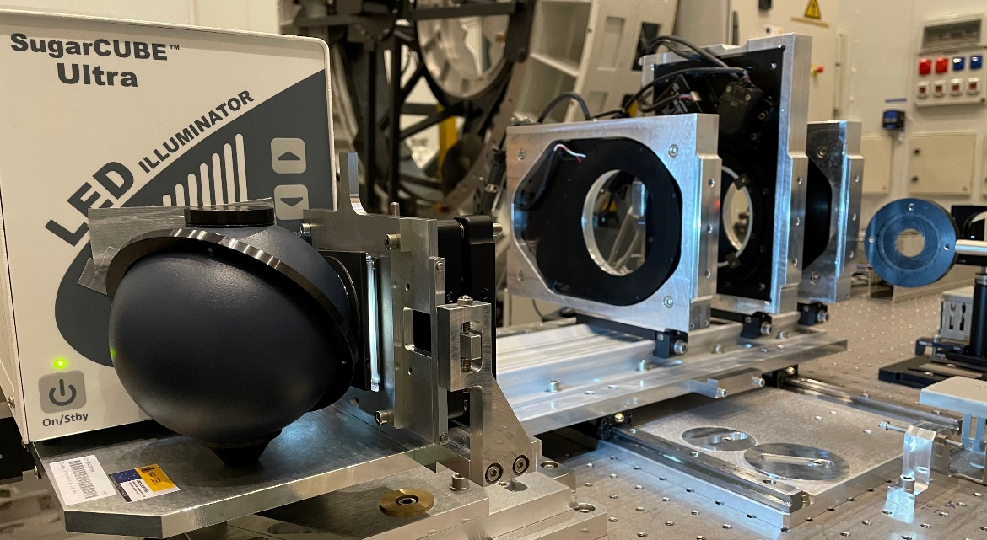
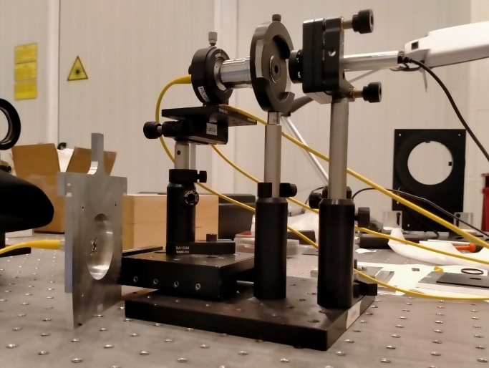
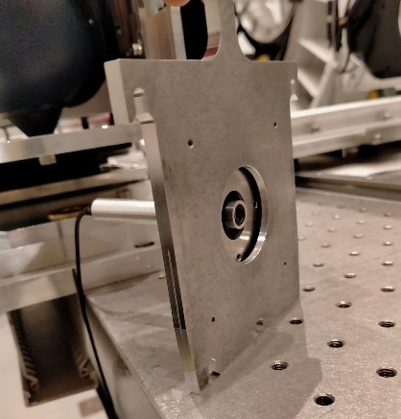
Test-bed:Illumination System
19 Pinholes 0.4’’(150 µm) WFS
25 Pinholes 0.026’’ (10 µm) ) Science camera
Sun object:
granulation and sun spot
Pinholes Array
Illumination Sytem
Turbulence Simulator
Fiber (532nm)
Aligment laser

Slide 8
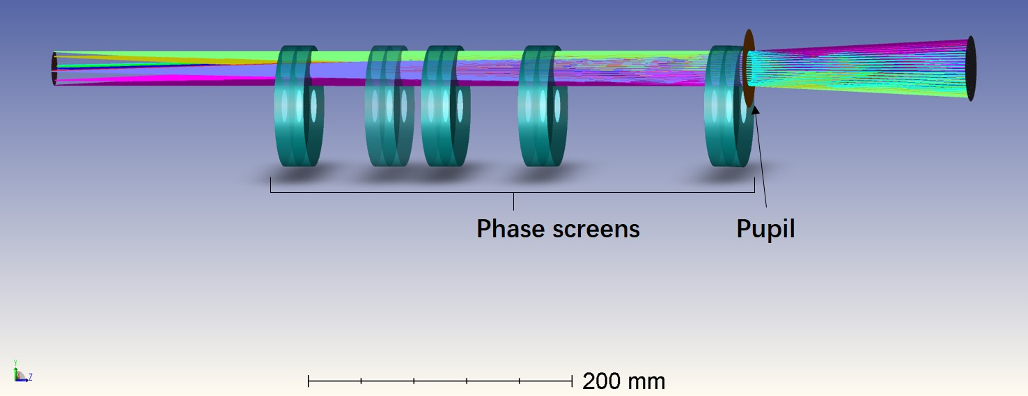
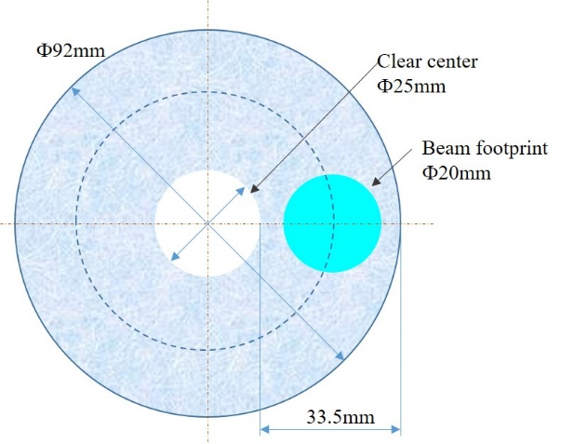
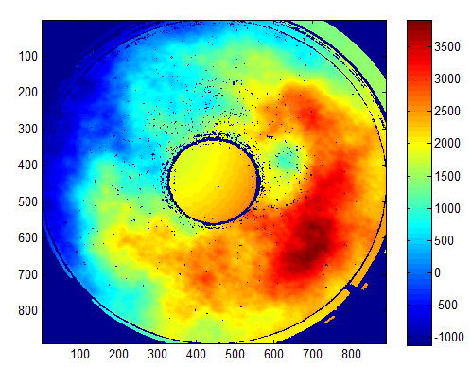
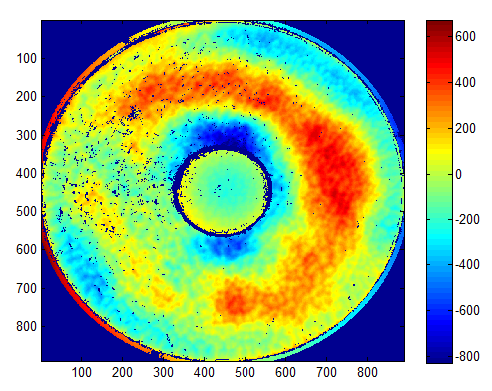
Test-bed:Turbulence Simulator
9
H (Km):
20
12
5
0
Measurements PS with Zygo interferometer
Measurement PS with GTCAO
R0 = 20 cm
R0 = 90 cm

Slide 9
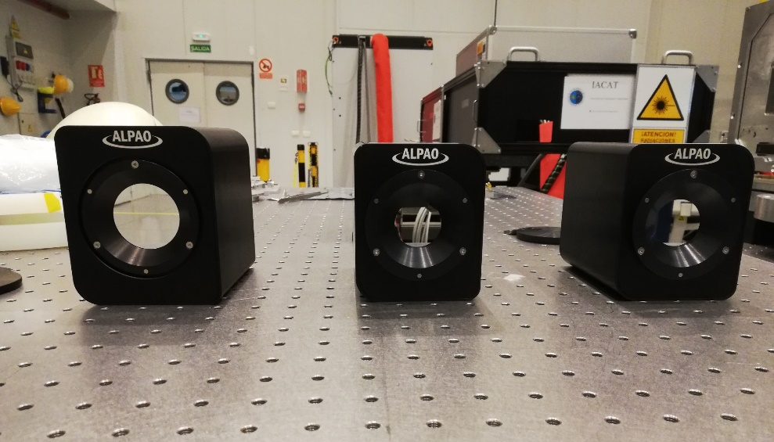
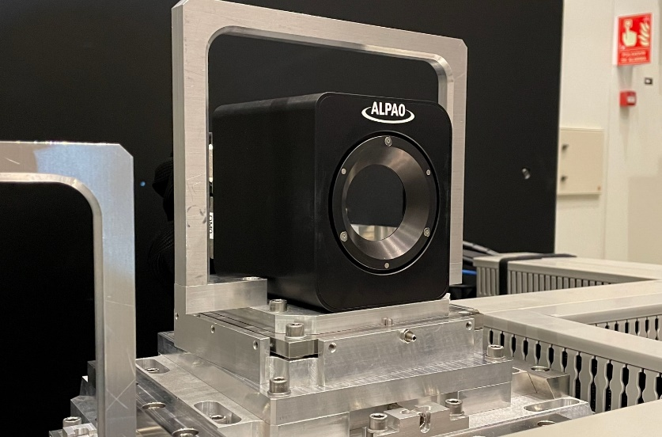
Test-bed:DMs
DM0
DM0
DM1
DM2
DM0
SIZING | Number of actuators | 820
 | Pupil diameter (mm) | 45
 | Pitch (mm) | 1.5
 | Number of actuators across the diameter | 32
QUALITY | Active best flat (nm RMS, mechanical) | < 7
STROKE | Tilp/TilT strolke (μm P-V, wavefront) | 12
 | Defocus Astis. stroke(μm P-V, wavefront) | 10
 | 3x3 stroke(μm P-V, wavefront) | 10
DM1 & DM2
SIZING | Number of actuators | 468
 | Pupil diameter (mm) | 33
 | Pitch (mm) | 1.5
 | Number of actuators across the diameter | 24
QUALITY | Active best flat (nm RMS, mechanical) | <7
STROKE | Tilp/TilT strolke (um P-V, wavefront) | 12
 | Defocus Astis. stroke(μm P-V, wavefront) | 10
 | 3x3 stroke(μm P-V, wavefront) | 10

Slide 10
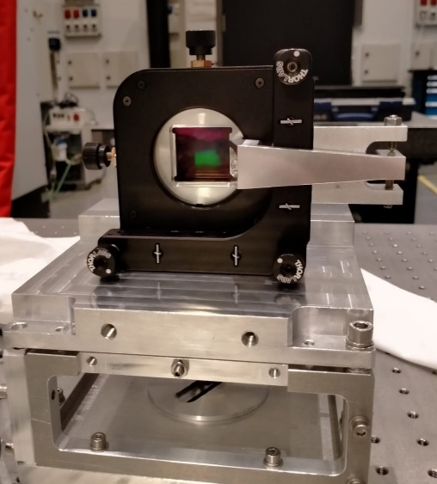
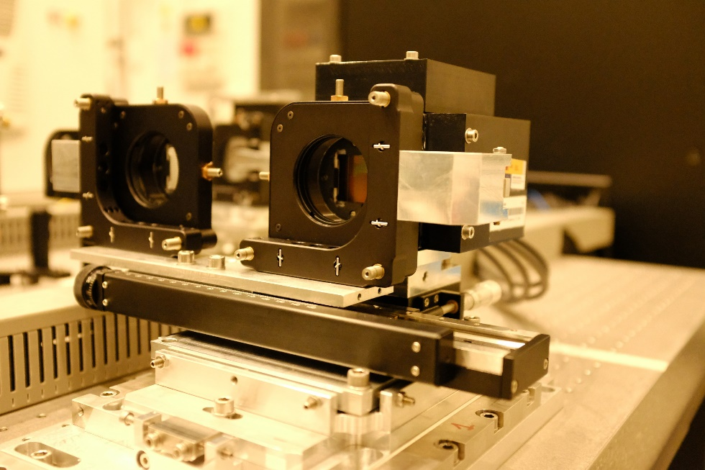
Test-bed:WFSs
HO –WFS
Substrate Material | UV Fused Silica
Square Lens Array | spherical lens / square aperture
HO - WFS
Optic Total Clear Aperture | 13.695mm x 13.695mm
Lenslet EFL | 26.03mm
Lenslet array | 33 x 33// 0.25”/px
FoV | 10 ‘’— 40 px
HO – MD –WFS
Optic Total Clear Aperture | 27.291mm x 27.291m
Lenslet EFL | 16.17mm
Lenslet array | 33 x 33 // 0.4”/px
FoV | 70 ’’—175px
HO – MD –WFS & MD - WFS
MD –WFS
Optic Total Clear Aperture | 27.302mm x 27.302m
Lenslet EFL | 21.53mm
Lenslet array | 17 x 17 // 0.3”/px
FoV | 70 ‘’—233px

Slide 11
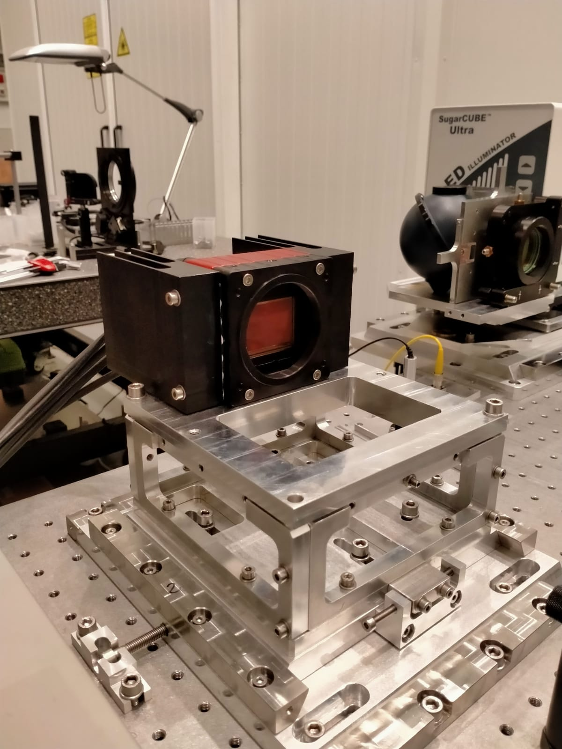
Test-bed: Science Camera
Flare 48M CXP
Sensor | CMOSIS CMV50000
Effective Pixels | 7920 x 6004
Optical Format | 35mm full frame
Pixel Pitch | 4.6 x 4.6 μm²
Full Well Charge | 14.5 ke- normal mode 58 ke- binning mode
Conversion | Gain 0.27 DN/e- normal mode 0.068 DN/e- binning mode
Responsivity | 0.16 DN/ph
Temporal Noise | 8.8 e- Normal mode 8.8 e- Normal mode
Quantum Efficiency | > 55% @ 510nm (with micro lenses)

Slide 12
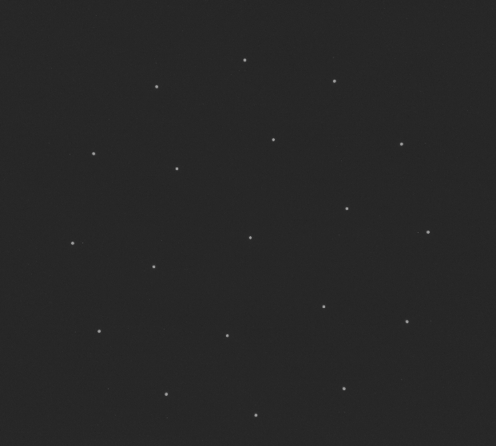
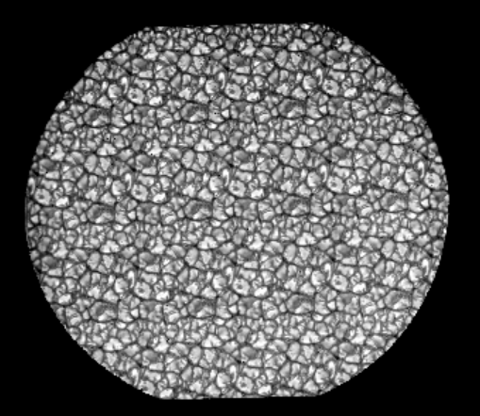
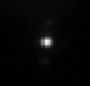
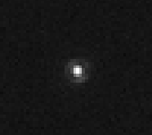
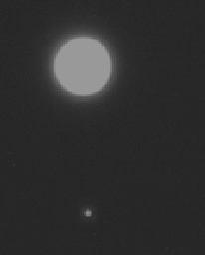
Test-bed: Science Camera
Pinholes Array
Sun granulatio Image
PSF close loop SCAO 525nm±50nm SR ≈ 0.70
Ø: 0.4’’ 150 µm
Ø: 0.026’’ 10 µm
C = 21 %
PSF fiber 532nm. SR≈0.85

Slide 13
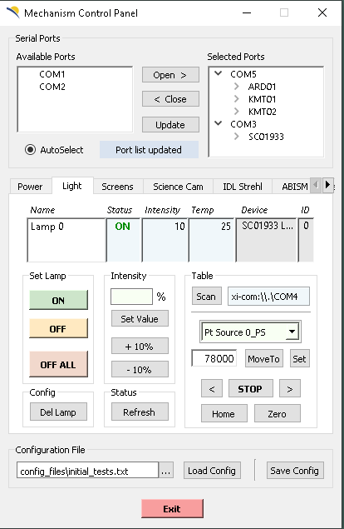
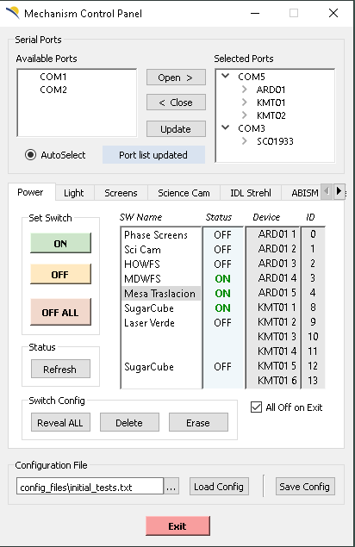
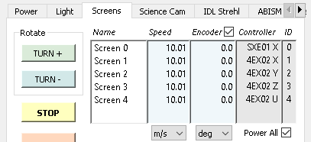
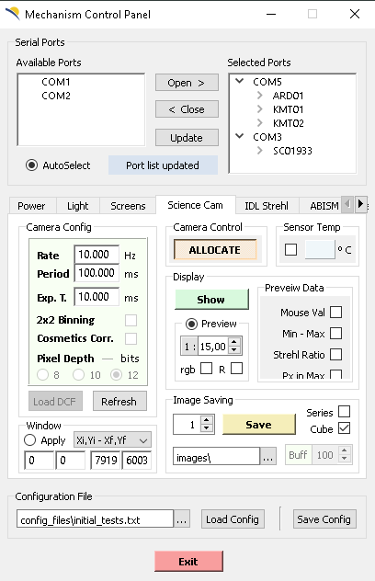

Test-bed: Control software

Slide 14
AO Configurations
SCAO | DM0 / HO-WFS
GLAO1 | DM0 / HO-WFS & MD-WFS
GLAO2 | DM0 / HO-MD-WFS
MCAO 1 | DM0 / HO-WFS & DM1/MD-WFS
MCAO 2 | DM0 / HO-WFS & DM1+DM2/MD-WFS
MCAO 3 | DM0 +DM1/ HO-MD-WFS
MCAO 4 | DM0 +DM1+DM2/ HO-MD-WFS
Control:
DARC (RTC).
Frequency rate: 30Hz (limited by the WFS).

Slide 15
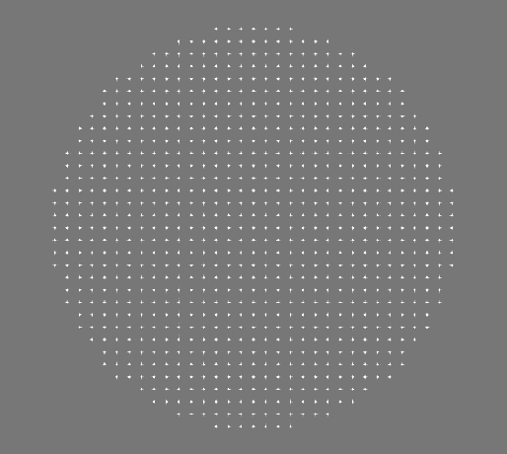
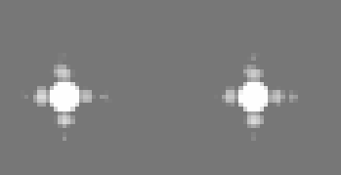
Test-bed: HO WFS - SCAO
Interaction matrix (pmx)
2 zonal alternatives:
Basic poke.
Sine poke.
2 modal alternatives:
Zernike basic poke (819).
KL basic poke (527 best).
Reconstruction matrix (rmx)
Pseudo-inverse of the pmx by SVD.
Zonal (‘rcond’ value).
Modal (‘rcond’ value).
Control strategy
PI controller
POLC

Slide 16
Test-bed: HO WFS - SCAO
Evaluation of the results
WFS image:
Temporal RMS of each centroid.
Comparison of homogeneity.
Science image:
Strehl ratio.
FWHM in x and y axes.

Slide 17
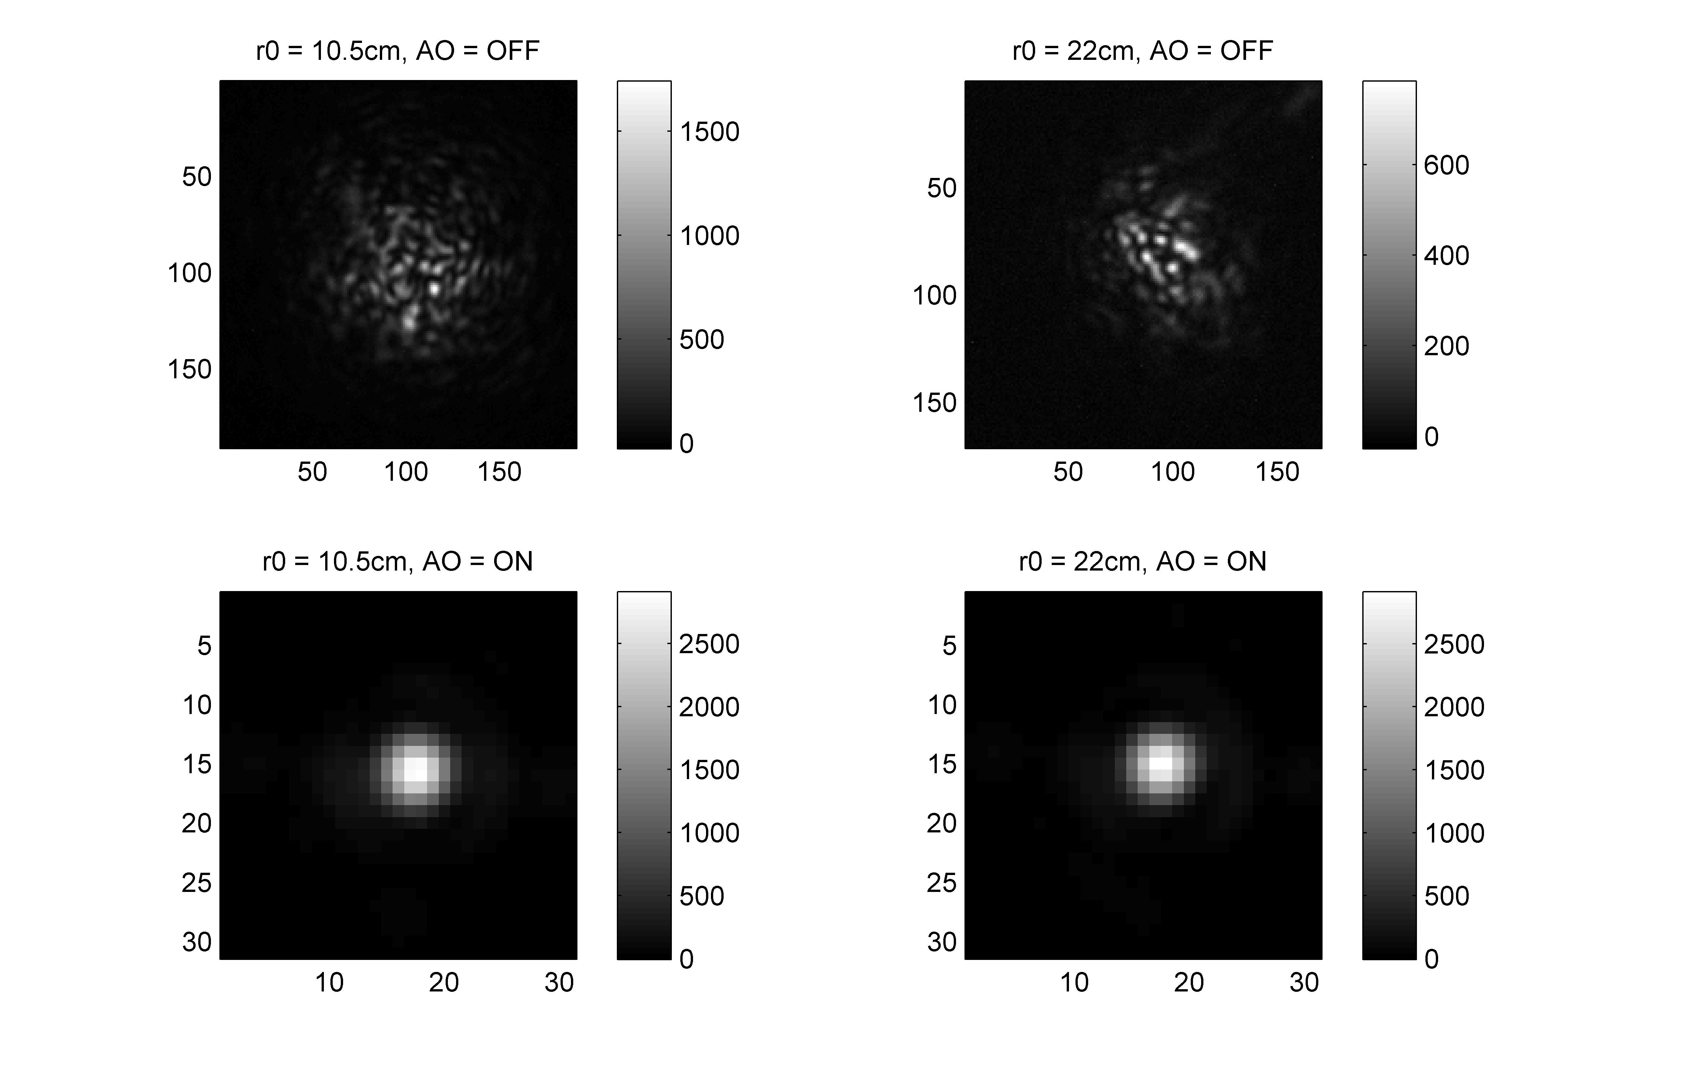
Test-bed: HO WFS - SCAO
r₀ = 22cm
WFS image
Zonal slightly better than modal methods.
Poke sine and regular zonal shows
best performance.
Zernike modes slightly better than KL.
POLC seems not offering any advantage.
Science image
Slighlty better results when using zonal approaches (regular, SR: 0.60).
Zernike and KL reported very similar results (SR: 0.57).

Slide 18
Test-bed: HO WFS - SCAO
r₀ = 10 cm
WFS image
Similar conclusions can be drawn.
Basic poke shows a poor performance.
Science image
Slightly better results when using zonal approaches
(poke sine, SR: 0.48).
Zernike (SR:0.45) slightly better than KL (SR: 0.42 ).
Degradation in basic poke performance (SR: 0.36).

Slide 19
Test-bed: HO WFS - SCAO
J.Manuel Gonzalez et al SPIE 2022
“Laboratory results of SCAO: getting ready for the EST MCAO”
Zonal strategies outperformed the modal strategies in both scenarios.
POLC seems to not have introduced any relevant benefit.
Slight divergencies between SR and WFS could be due to:
Science image processing.
NCPA.
Are we using the optimal tuning of each algorithm?

Slide 20
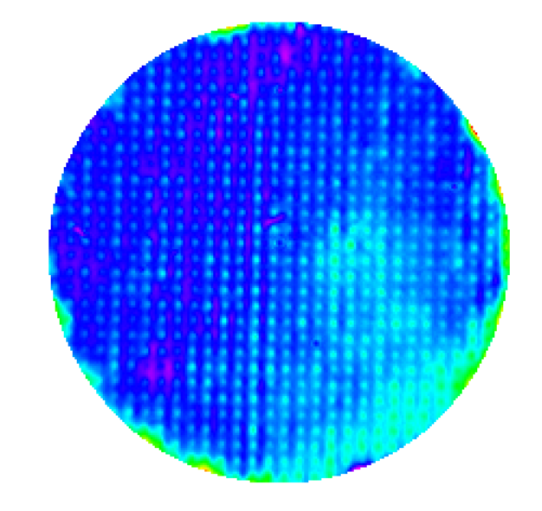
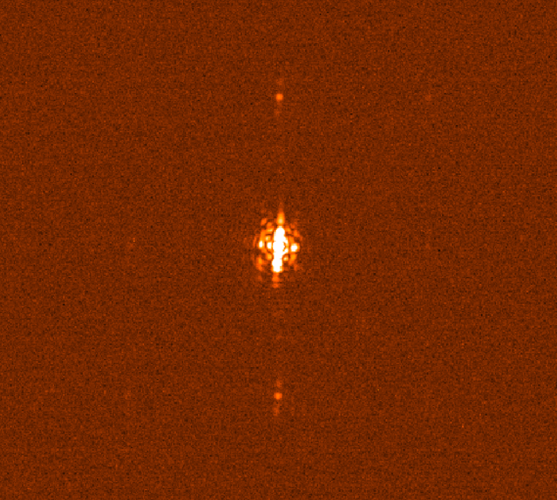
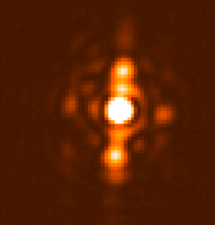
Test-bed: HO WFS - SCAO
PSF
Flatten DM
10% Central Peak
Subpixel precision

Slide 21
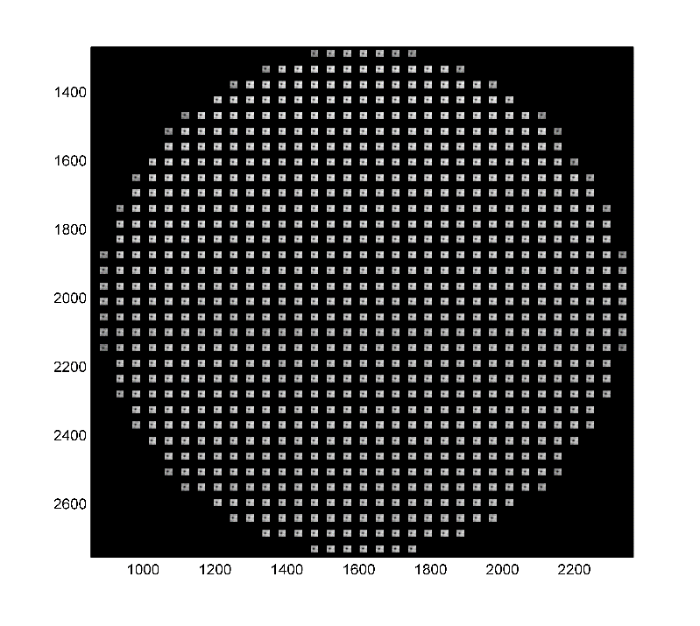
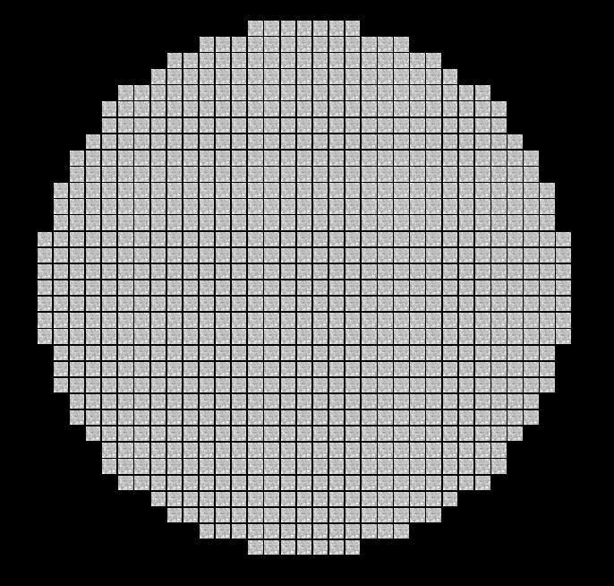
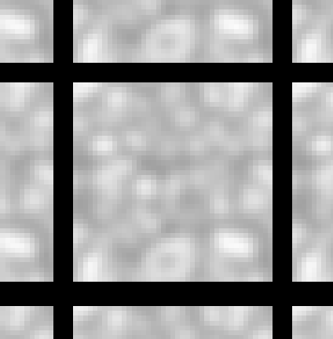
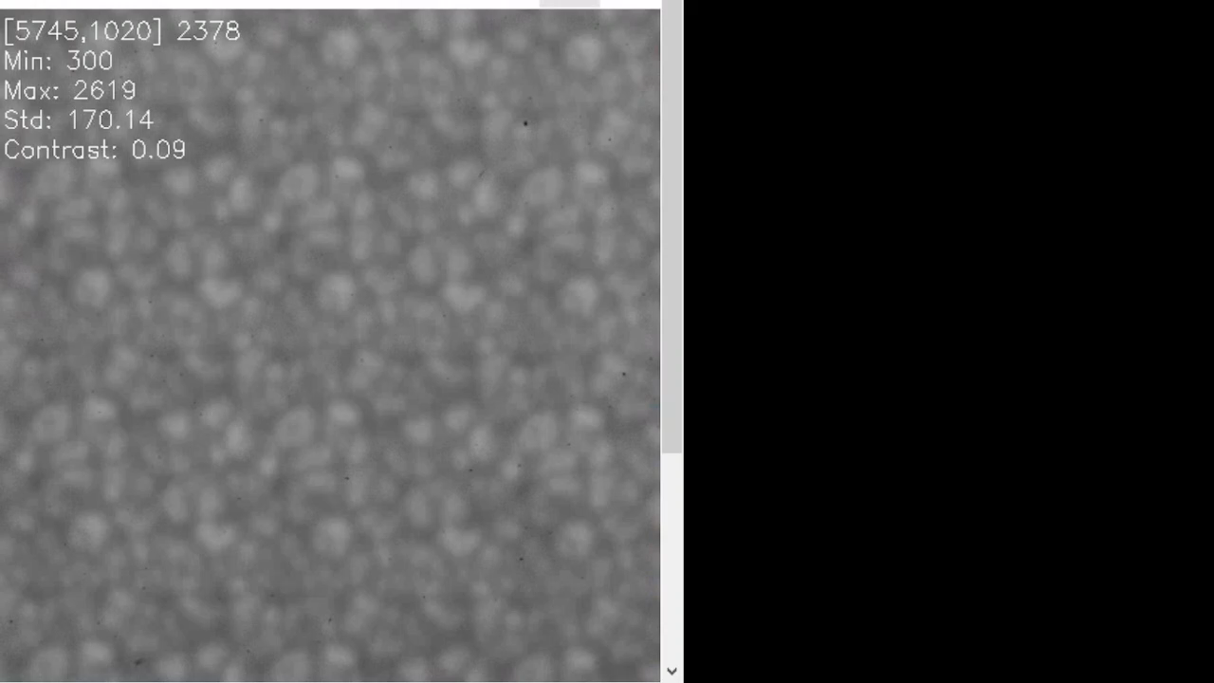
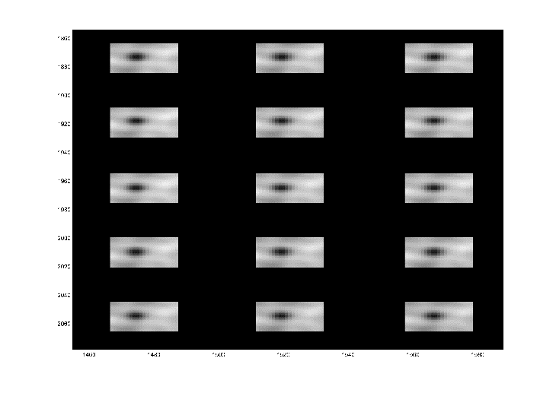
Test-bed: HO WFS - SCAO
Correlation image: Square difference.
Sub-pixel precision: Parabolic fitting (3x3).
Interaction matrix: Poke Sine method.
Reconstruction matrix:
Pseudoinverse matrix (SVD)
Zonal control: PI controller.
10”
r₀=10cm

Slide 22
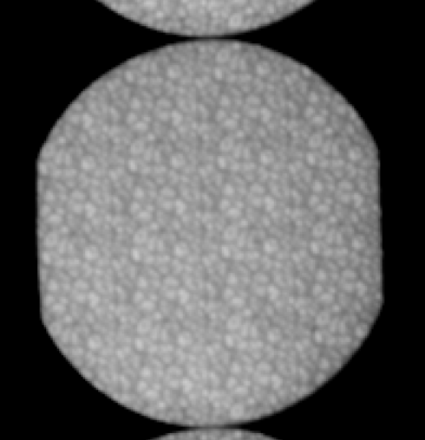
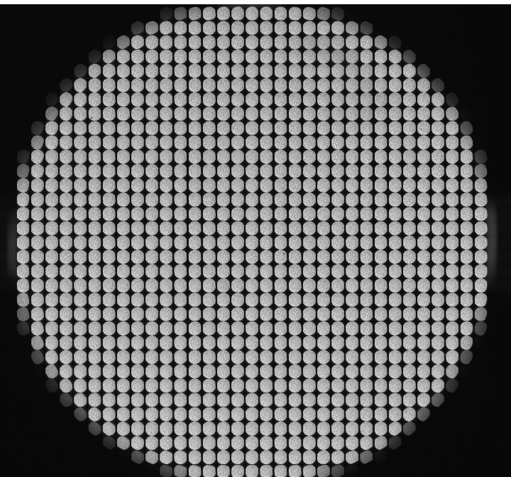
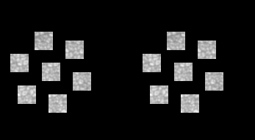
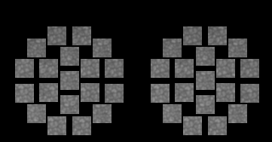
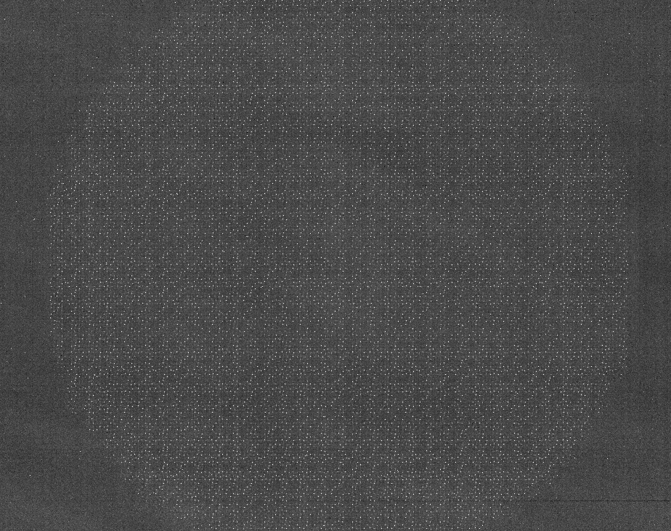
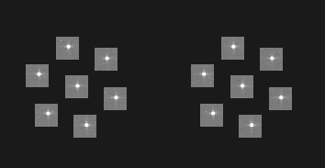
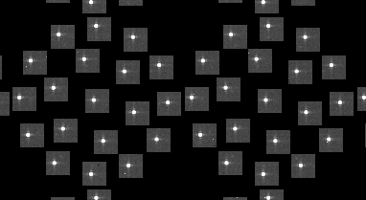

Test-bed: HOMD WFS - GLAO
SUN
70”
7 dir
19 dir
Array Pinholes
“This project has received funding from the European Union’s Horizon 2020 research and innovation programme under grant agreement No 739500”

Slide 23
Test-bed: HOMD WFS - GLAO
Interaction matrix (pmx)
Sine poke
Reconstruction matrix (rmx)
Pseudo-inverse of the pmx by SVD.
Zonal (‘rcond’ value).
7 directions
Control:
PI controller: adjusting decay factor and gain

Slide 24
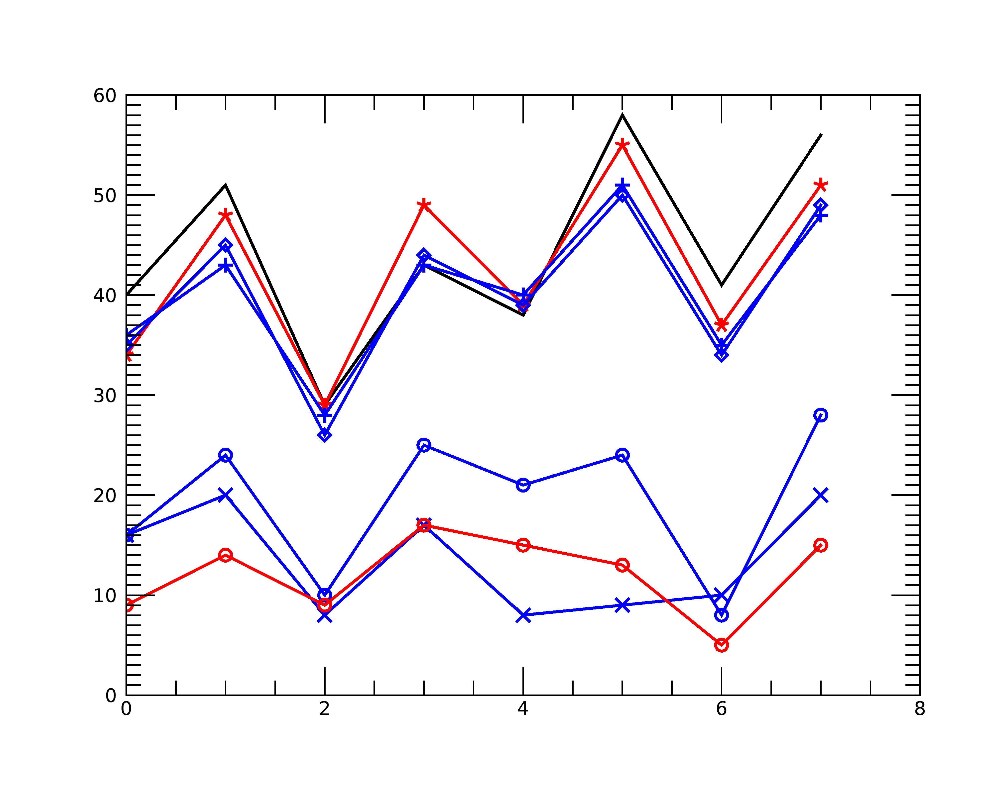

Test-bed: HOMD WFS - GLAO
PSF
SCAO 10cm 0km
GLAO 10cm 0km 1dir
GLAO 10cm 0km 7dir
SCAO 30cm 4km
GLAO 30cm 4km
GLAO 30cm 10km
*
◊
+
Strehl
o
o
x
1
2
3
15”
0
4
15”
FOV
5
7
6

Slide 25
Perspectives
Improve bench aligment to increase image quality.
Improve correlation algorithms.
Complete GLAO configurations:19 dirs, sun, MD-WFS.
Implement MCAO with altitude DMs.
OBRIGADA !!!!!!

