Slide 1
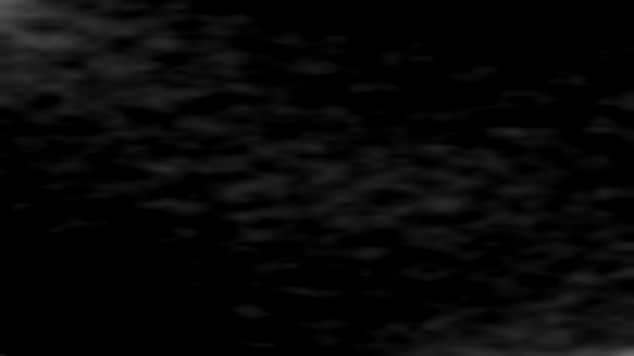




Fourier filter LGS wavefront sensing for ELT sized telescopes: comparison of Pyramid and Ingot
Francisco Oyarzún¹, Vincent Chambouleyron², Benoit Neichel², Thierry Fusco², Andrés Guesalaga¹ ¹Departamento de Ingeniería Eléctrica, Pontificia Universidad Católica de Chile, Santiago, Chile
²Aix Marseille Univ, CNRS, CNES, LAM, Marseille, France

Slide 2
Pyramid + LGS
Introduction
NGS
LGS
Glass pyramid
Light beam
Spot image

Slide 3
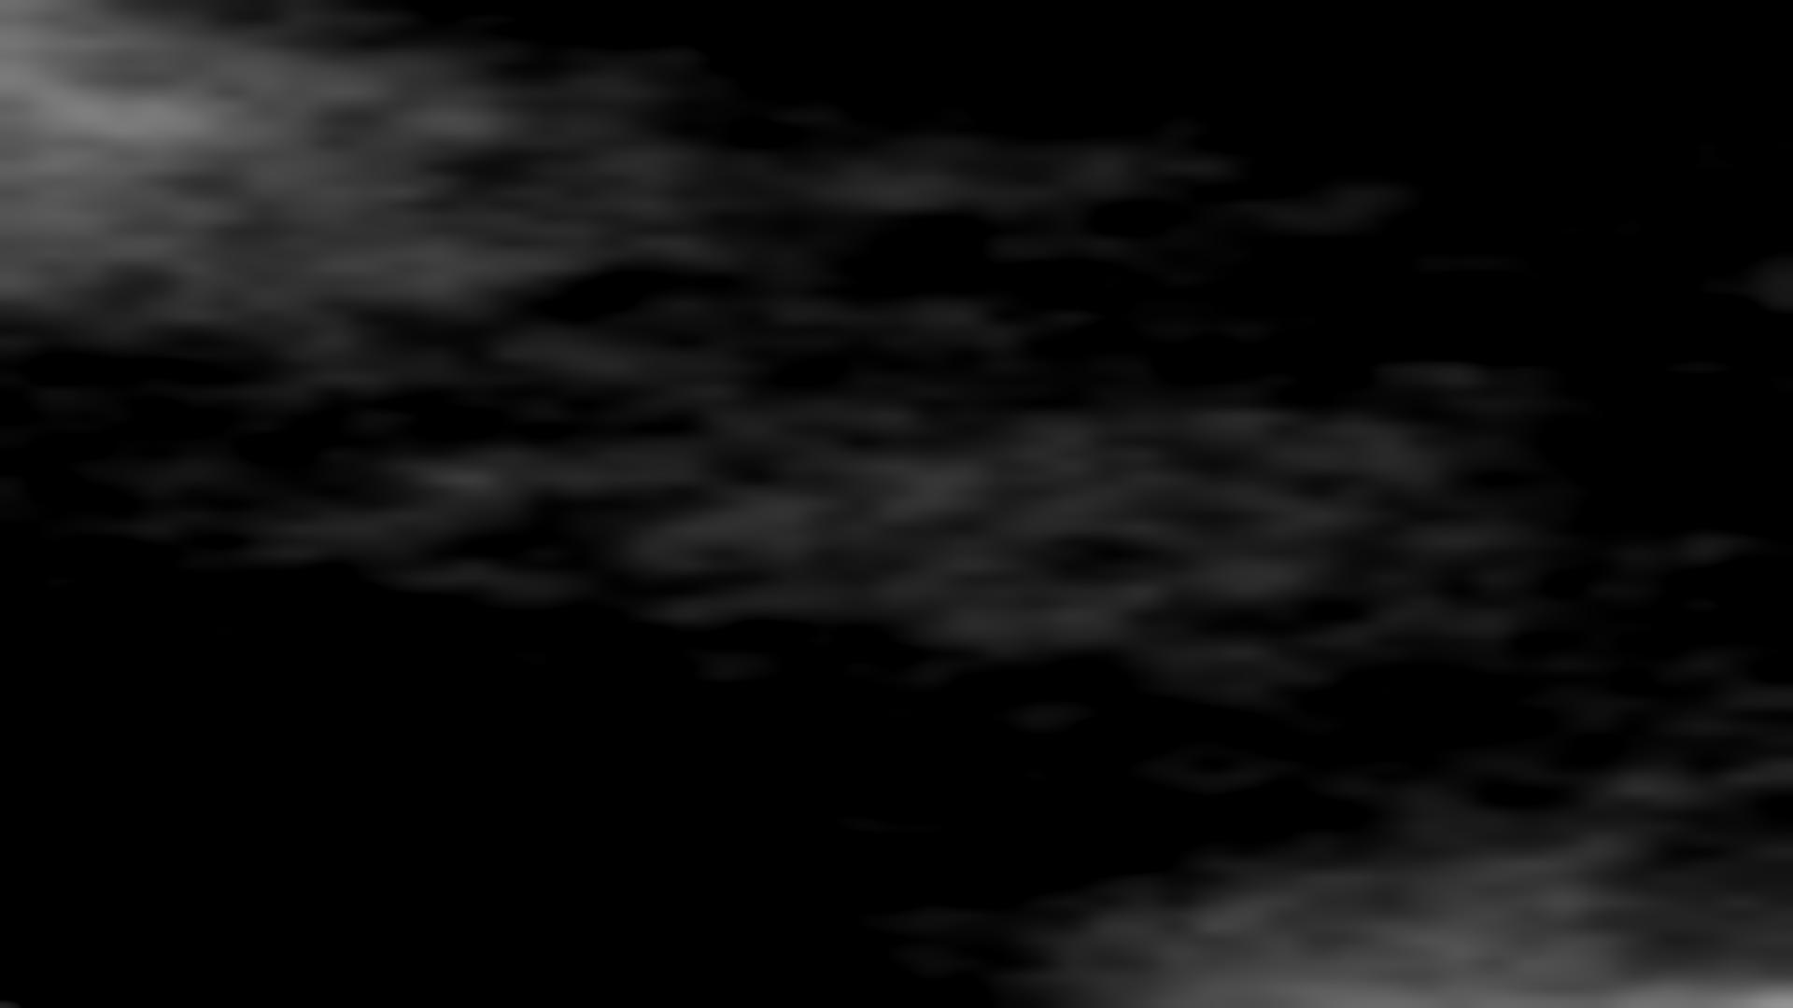
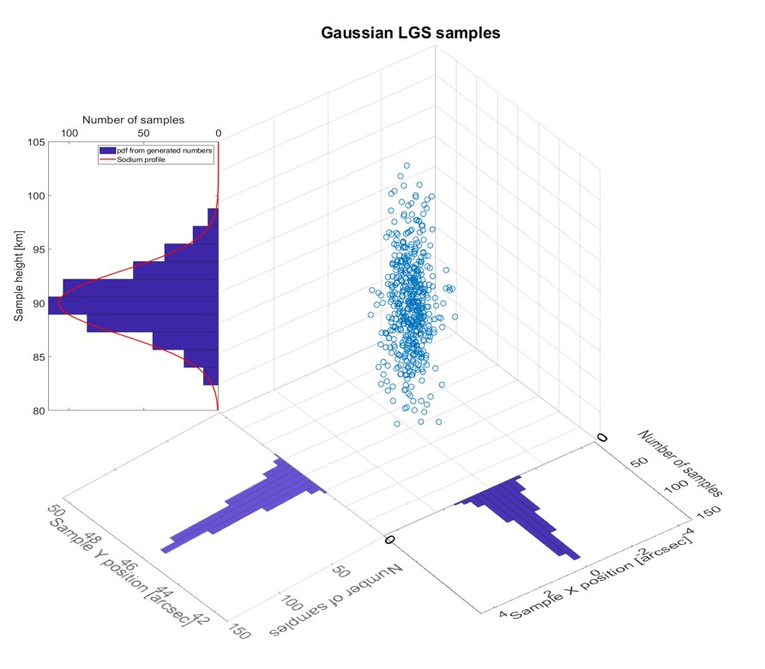
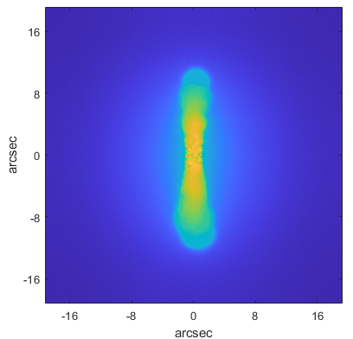
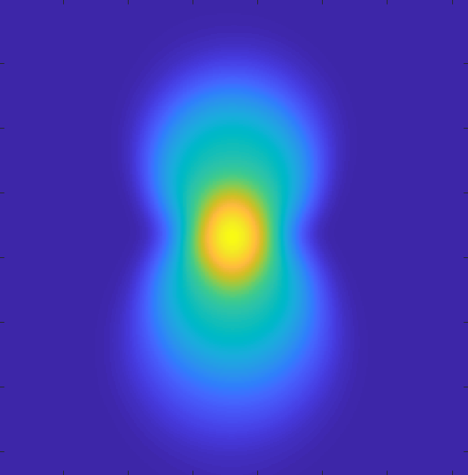
LGS modeling
Modeling
LGS modelation: point source sampling
LGS image as seen through the telescope

Slide 4
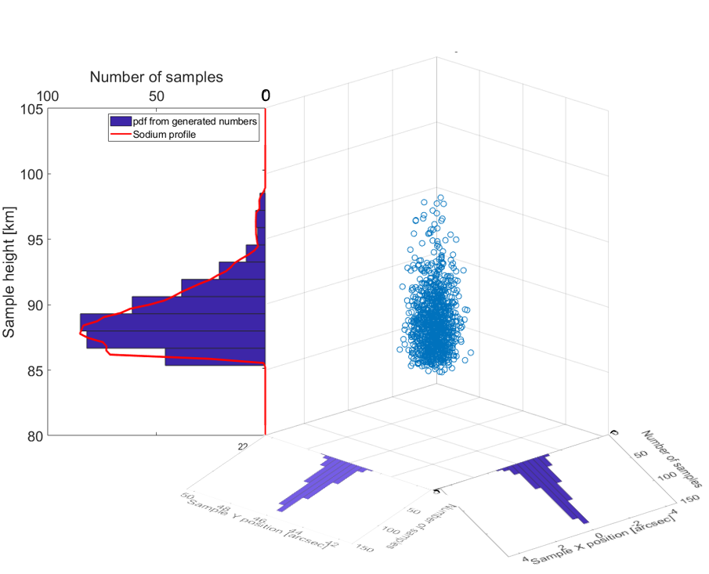
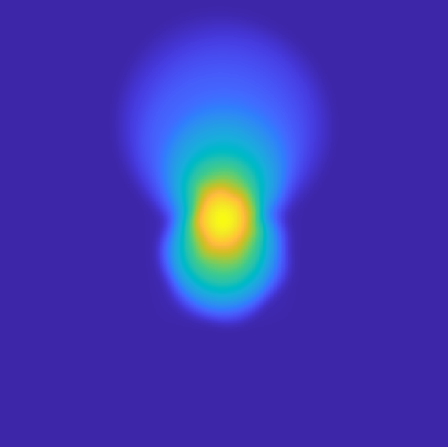
LGS modeling
Modeling
LGS modelation: point source sampling
LGS image as seen through the telescope

Slide 5
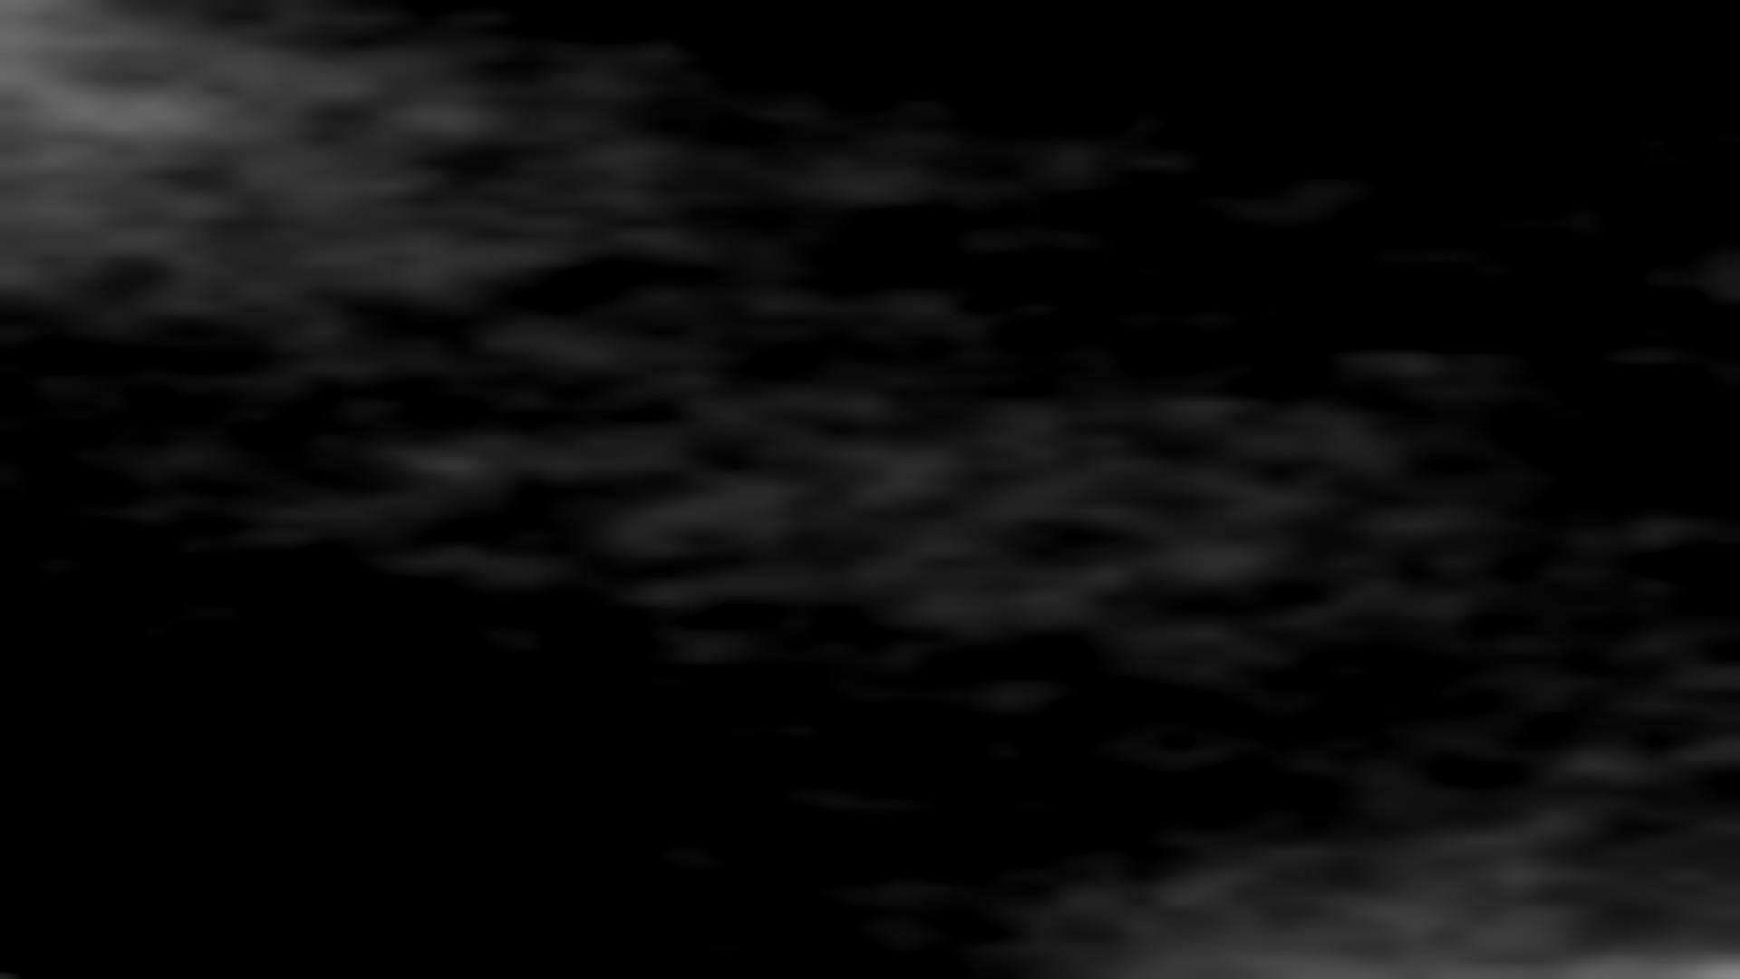
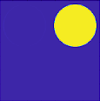


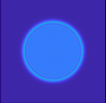
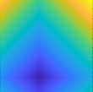
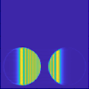
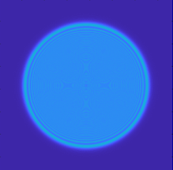
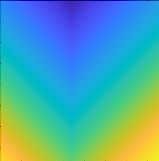
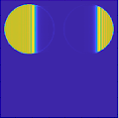
>60x faster!
5

Slide 6
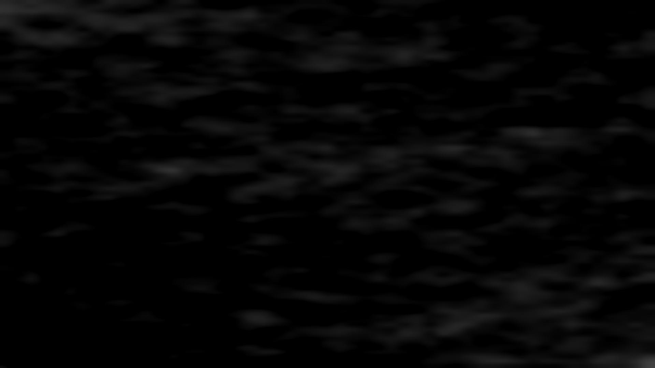
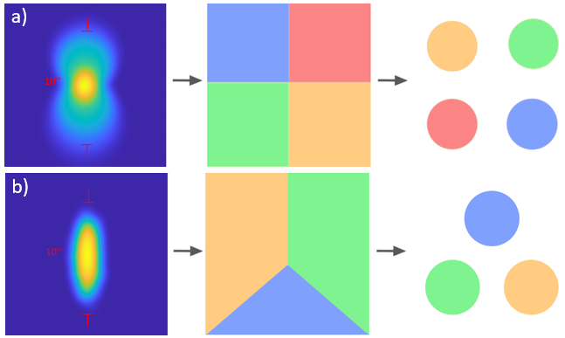
Tested FFWFS for 40 m telescope
Modeling
Affected by DoF
Pyramid
Not affected by DoF
Ingot
LGS as seen by the WFS
Phase mask
Pupil images
DoF : Depth of Focus

Slide 7
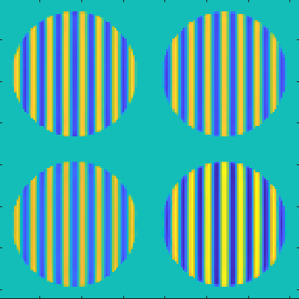
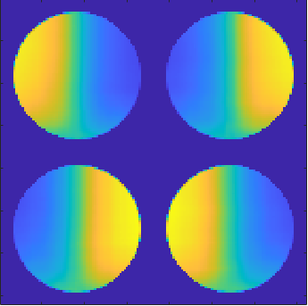


Photon noise sensitivity computation
Modeling
$$s_{φ_{i} γ}=$$
$$2$$

Slide 8
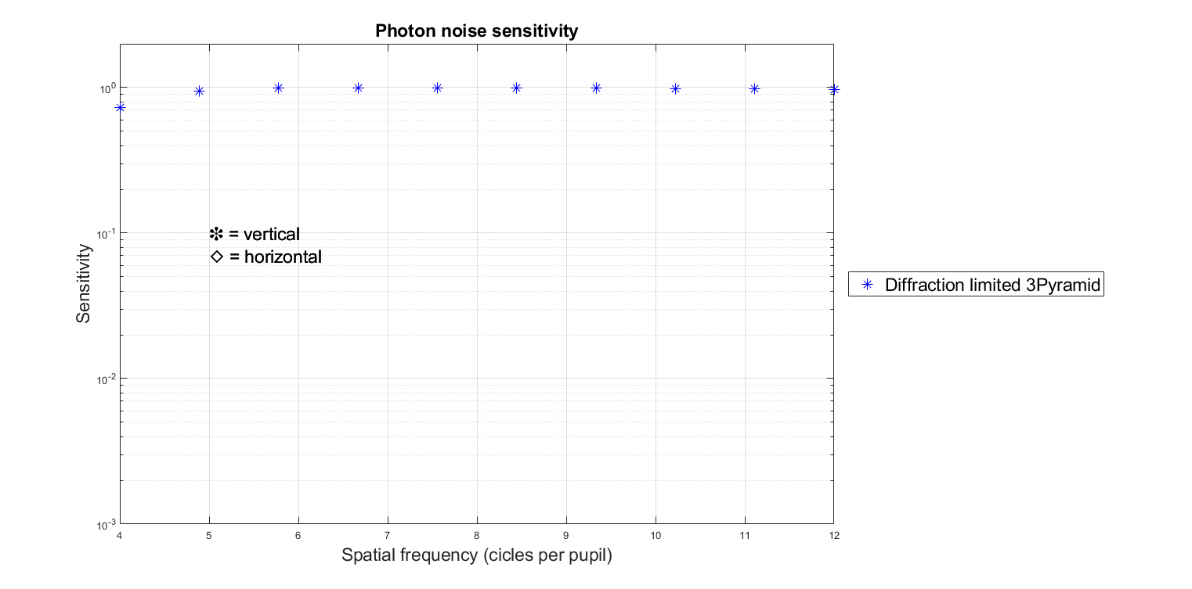
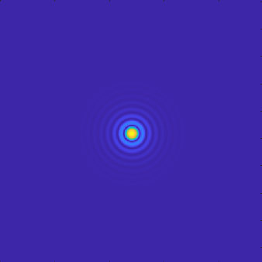
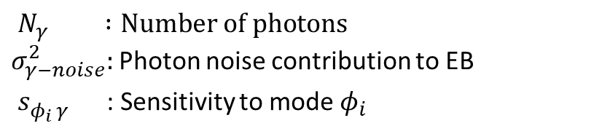
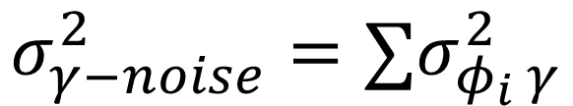

Photon noise & Sensitivity
Performance evaluation
$$σ_{φ_{i} γ}^{2}= \frac{1}{s_{φ_{i} γ}^{2} N_{γ}}$$
$$σ_{γ−noise}^{2}=∑σ_{φ_{i} γ}^{2}$$
Diffraction limited
3 mas spot
(zoom x300)
$N_{γ} :Number of photons$
$σ_{γ−noise}^{2}:$Photon noise contribution to EB
$s_{φ_{i} γ}^{}$ : Sensitivity to mode $φ_{i}$

Slide 9
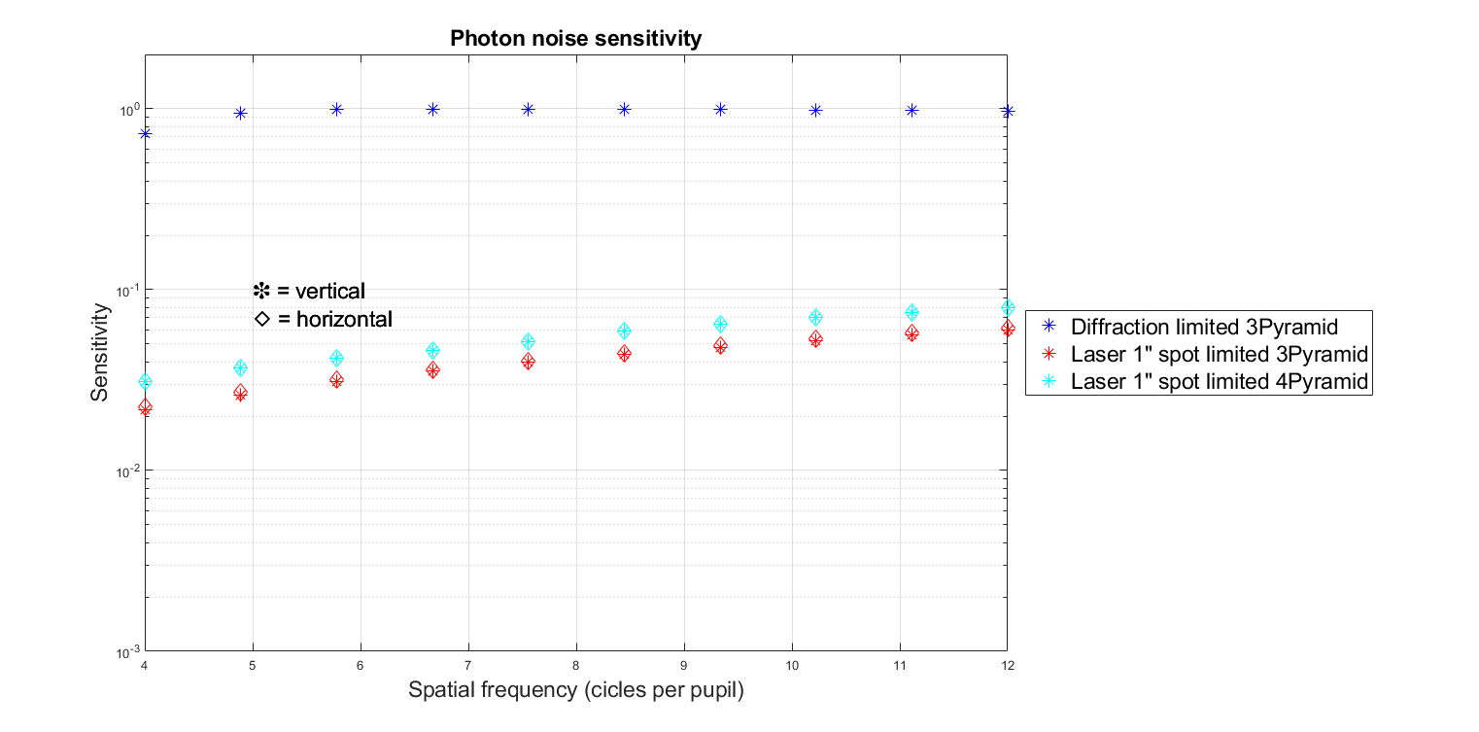
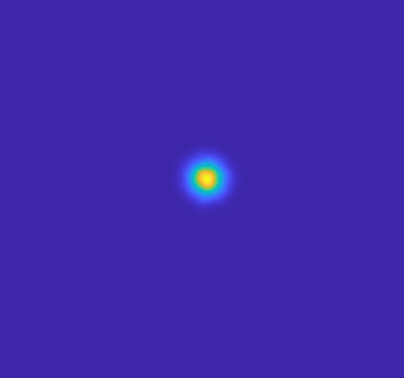
Photon noise & Sensitivity
Performance evaluation
$$σ_{φ_{i} γ}^{2}= \frac{1}{s_{φ_{i} γ}^{2} N_{γ}}$$
20x drop
~ 6.5 mag
$$σ_{γ−noise}^{2}=∑σ_{φ_{i} γ}^{2}$$
Diffraction limited
3 mas spot
(zoom x300)
Laser launch telescope limited
1” spot
$N_{γ} :Number of photons$
$σ_{γ−noise}^{2}:$Photon noise contribution to EB
$s_{φ_{i} γ}^{}$ : Sensitivity to mode $φ_{i}$

Slide 10
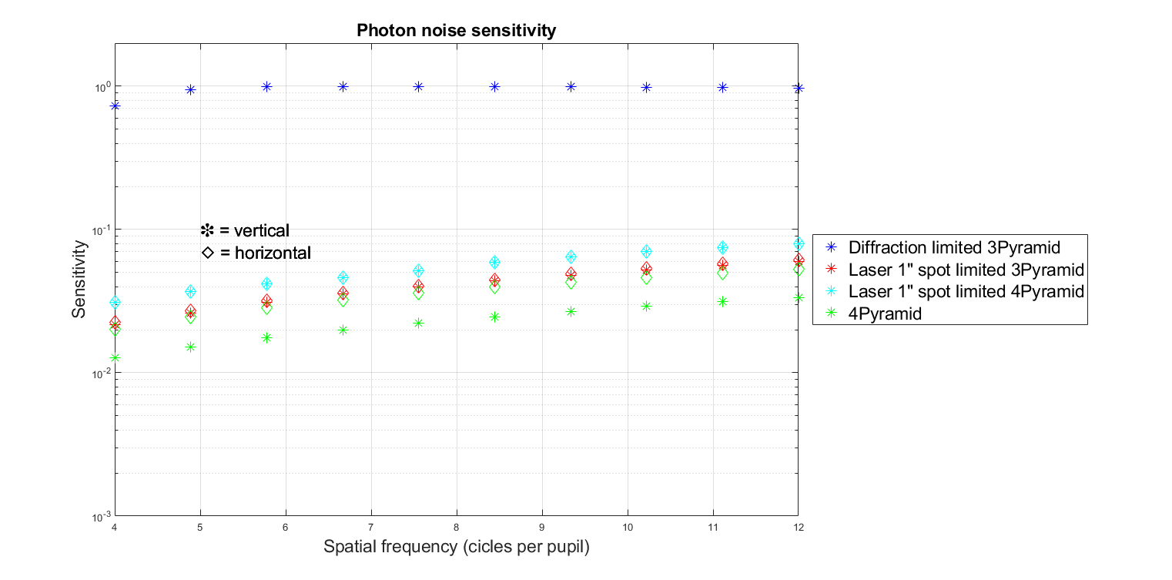
Photon noise & Sensitivity
Performance evaluation
$$σ_{φ_{i} γ}^{2}= \frac{1}{s_{φ_{i} γ}^{2} N_{γ}}$$
$$σ_{γ−noise}^{2}=∑σ_{φ_{i} γ}^{2}$$
Diffraction limited
3 mas spot
(zoom x300)
Laser launch telescope limited
1” spot
$N_{γ} :Number of photons$
$σ_{γ−noise}^{2}:$Photon noise contribution to EB
$s_{φ_{i} γ}^{}$ : Sensitivity to mode $φ_{i}$

Slide 11
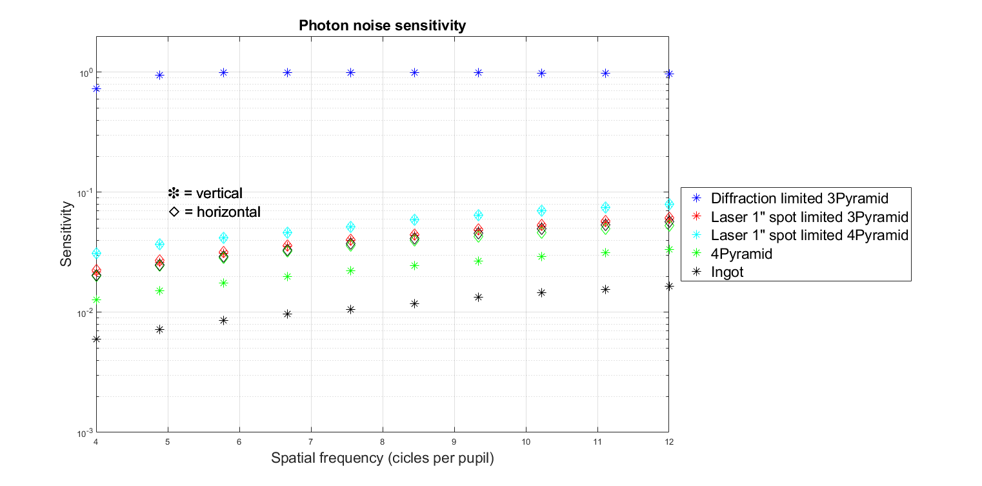
Photon noise & Sensitivity
Performance evaluation
$$σ_{φ_{i} γ}^{2}= \frac{1}{s_{φ_{i} γ}^{2} N_{γ}}$$
2x drop
~ 1.5 mag
$$σ_{γ−noise}^{2}=∑σ_{φ_{i} γ}^{2}$$
Diffraction limited
3 mas spot
(zoom x300)
Laser launch telescope limited
1” spot
$N_{γ} :Number of photons$
$σ_{γ−noise}^{2}:$Photon noise contribution to EB
$s_{φ_{i} γ}^{}$ : Sensitivity to mode $φ_{i}$

Slide 12
Photon noise Sensitivity
Performance evaluation
Diffraction limited
3 mas spot
(zoom x300)
Laser launch telescope limited
1” spot
Full 3D LGS structure
20x drop
~2x drop

Slide 13
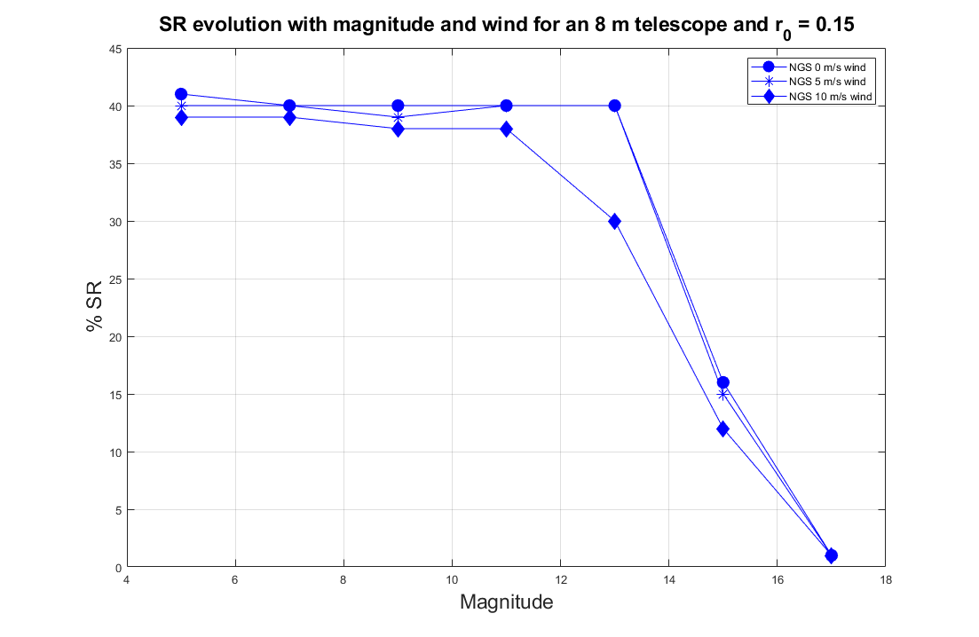
Closed loop verification on 8 m telescope
Performance evaluation
400 KL modes
Expected SR = 42 %
@ 8m the sensitivity analysis predicts 4.6 mag drop when using pyramid+LGS

Slide 14
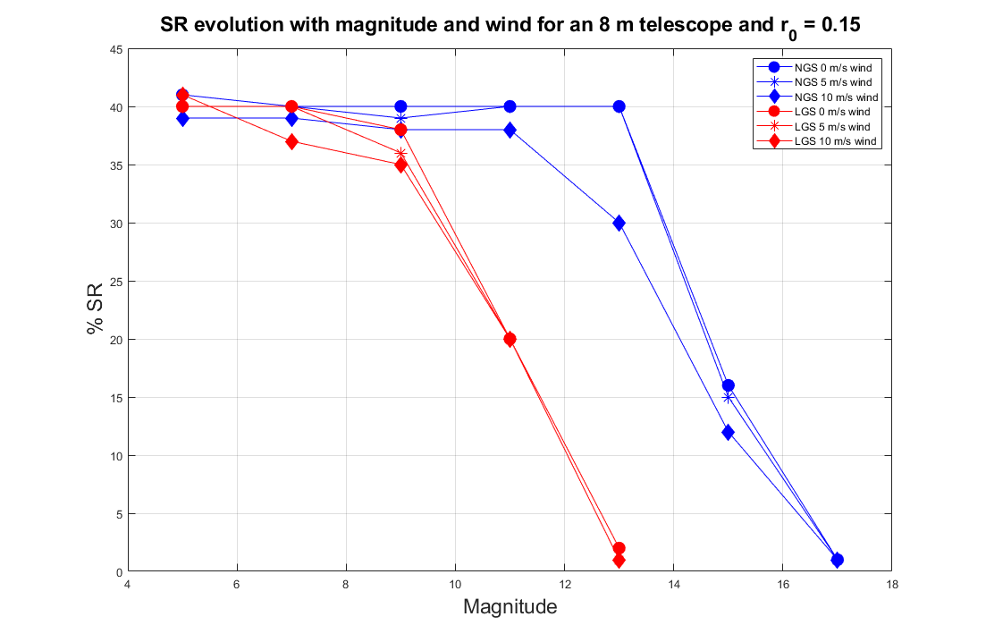
Closed loop verification on 8 m telescope
Performance evaluation
400 KL modes
Expected SR = 42 %
@ 8m the sensitivity analysis predicts 4.6 mag drop when using pyramid+LGS
4 magnitude drop

Slide 15
Conclusion
Performance evaluation
Successfully developed a method 60+ times faster than traditional ways of simulating LGS.
Pyramid and Ingot have similar sensitivities.
The main source of lost sensitivity might be the width of the LASER.

Slide 16
Future work
Performance evaluation
Laboratory demonstration with PULPOS @ PUCV

Slide 17
Thank you!
Performance evaluation
Questions?

