Slide 1
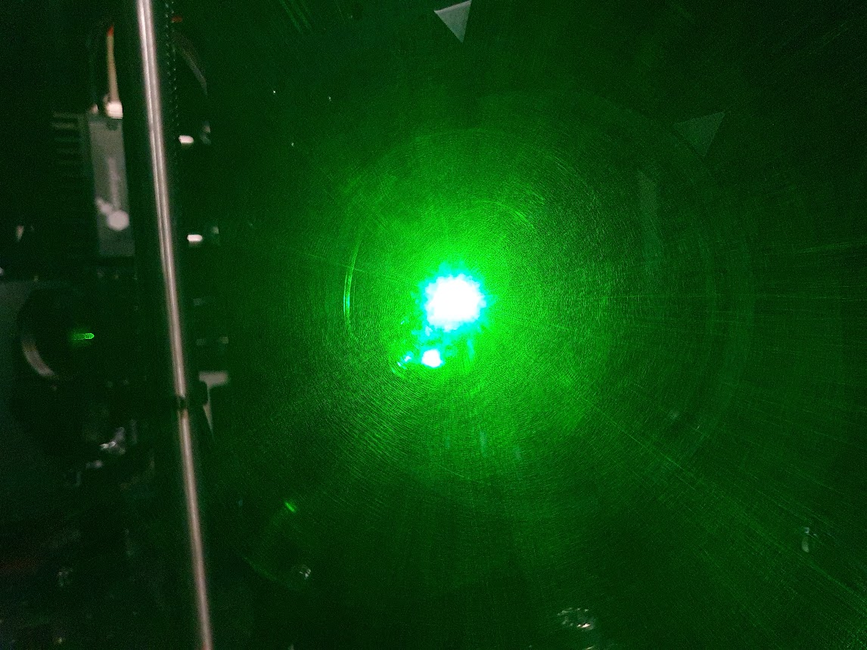

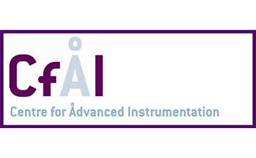
First results from a bench demonstrator of a novel Wide Field of View Wavefront Sensor
Lazar Staykov, Nazim Ali Bharmal, Timothy Morris, Lisa Bardou, Matthew Townson, David Bramall, Ariadna Calcines-Rosario

Slide 2
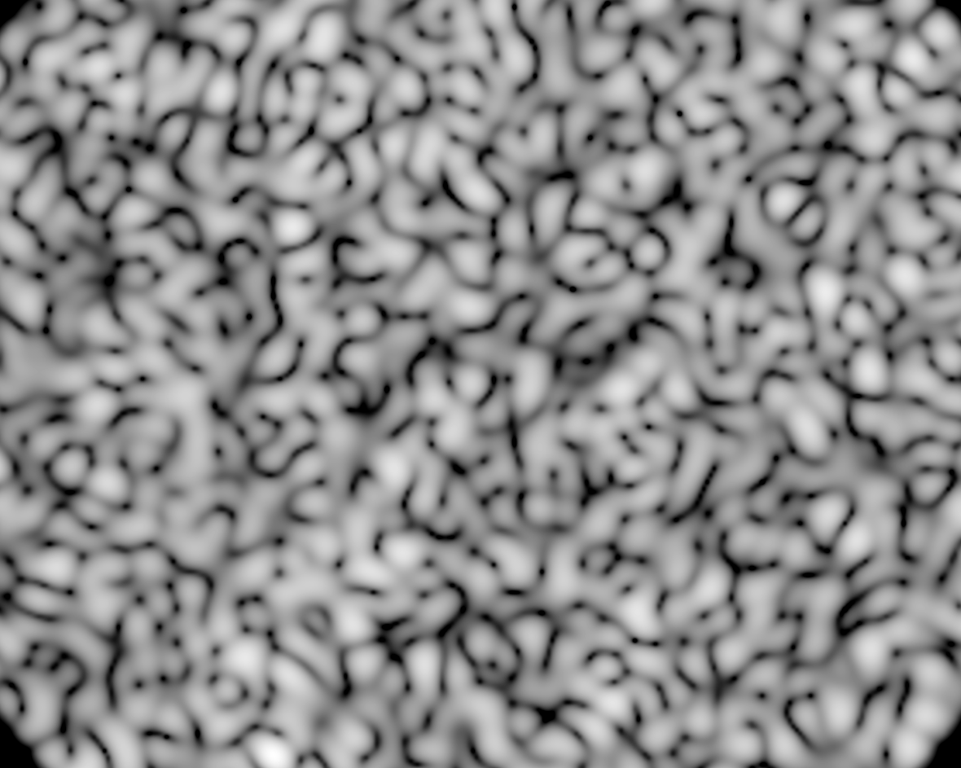
Outline
Wide Field Wavefront Sensing, short intro
Our approach
The bench
The results
Discussion

Slide 3
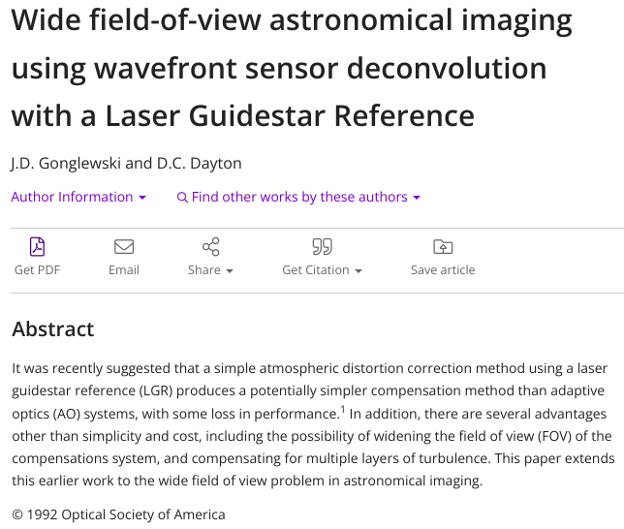
Wide Field of View WFS
It all begins with a dream:
improve performance
lower the cost
widen the corrected area
Notable applications:
Solar AO, from way back when
MAVIS – Cedric’s talk yesterday
MORFEO – ELT’s FL WFoV WFS

Slide 4
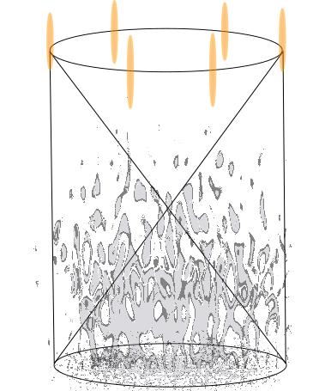
Wide Field of View WFS – concept
classic case
Laser light propagated in multiple directions around the target. Provides different projections of the turbulent volume.
Each LGS is observed by a dedicated WFS.
The information from the different WFS is then cross-correlated to reconstruct the 3D shape of the turbulence.
Problem is:
not all of the volume is sampled simultaneously.
need multiple lasers and WFS, MORFEO 6, MAVIS 8

Slide 5
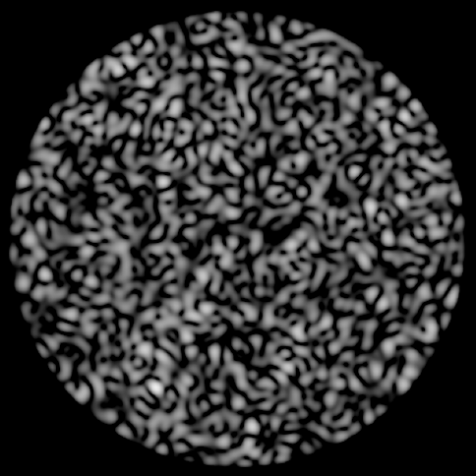
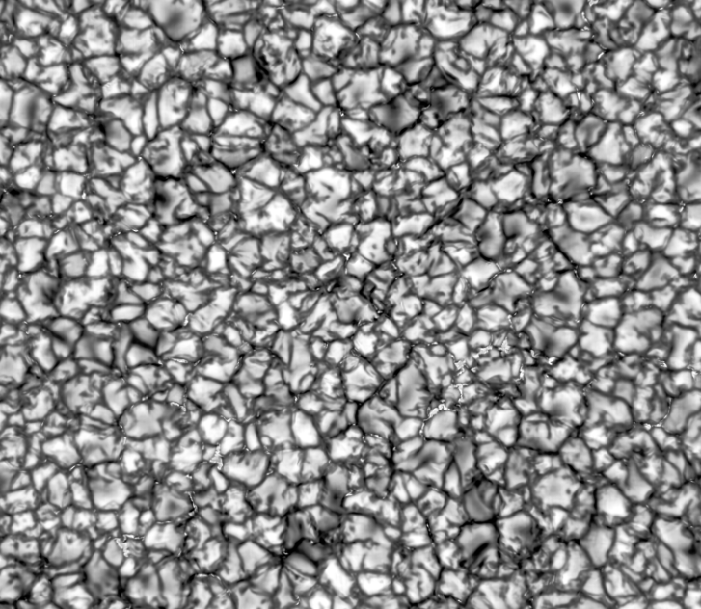
WF WFS – Solar AO

Slide 6
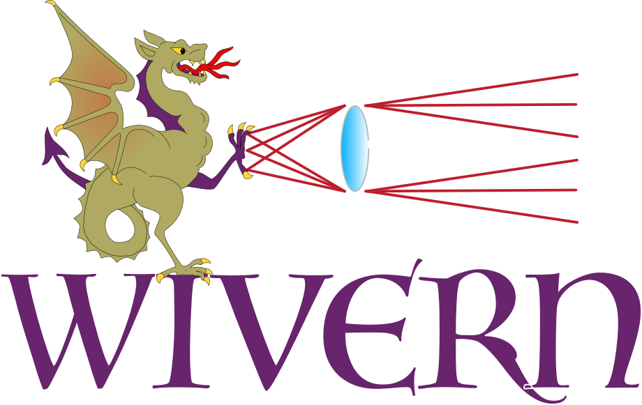
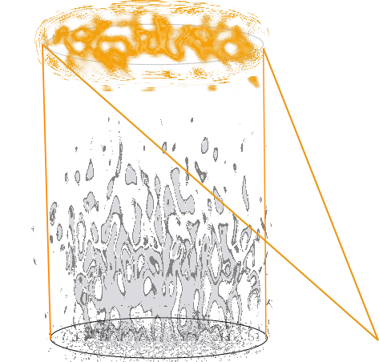
Short form
Create a structured illumination using a single laser
Sense it with a single correlating WFoV WFS
Improve tomography errors

Slide 7
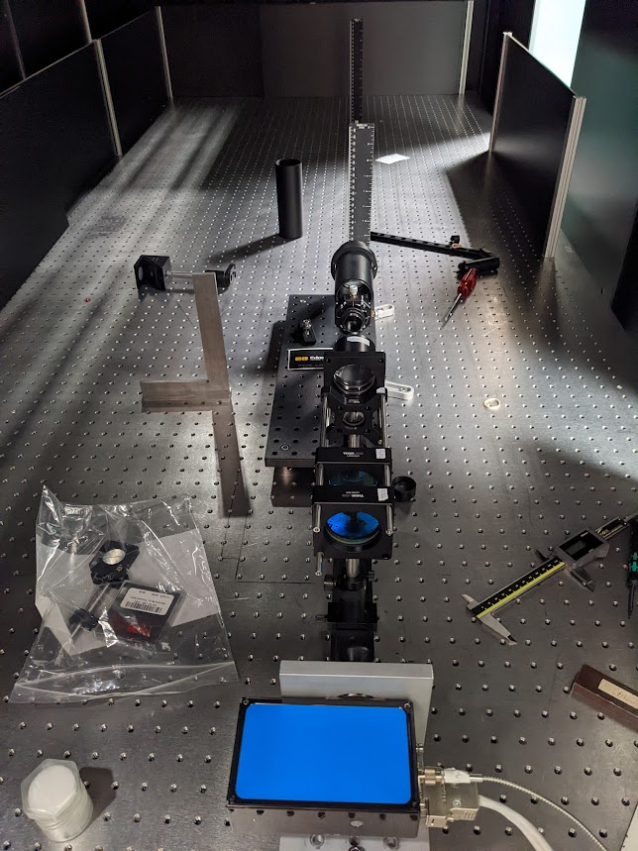
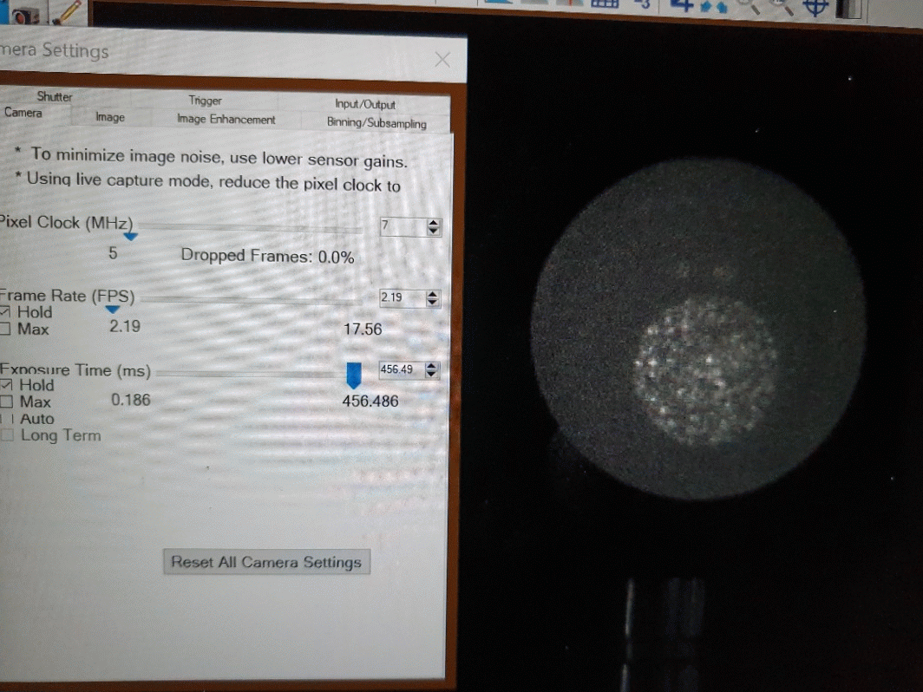
July’22
Basics
Laboratory bench aiming to test two novel WFWFS techniques – correlating Shack-Hartmann (SH) using structured illumination and P⁴
Simulate 4/8 m telescope with a FoV of 1 to 2’
Pupil conjugated DM with ~52 actuators operating at up to 500 Hz
Atmospheric simulator consisting of 2x rotating phase wheels by Lexitek
fixed ‘ground layer’
movable high-altitude layer, 2+ km conjugate
532nm Laser to illuminate a diffuse reflective screen or a dye cell
455x455 OLED 78 μm/pxl (approx 4 x DL of optics)
C-BLUE One^{(!)} with 10x10 Shack-Hartmann WFS with ~100 pxl/subap
Sep 9th

Slide 8
Pattern transportation
8m telescope
Single layer of turbulence at the ground (r₀ of 0.12m)
Pessimistic case
532nm laser projected to 20km
Uses angular spectrum propagator
Full aperture monostatic launch of collimated beam
Not the best/easiest way to implement in reality
Definitely the easiest to simulate
Uplink/Downlink paths not fully reciprocal

Slide 9



Pattern transportation
Launch intensity
Intensity @ 20km
150 modes
550 modes
1550 modes

Slide 10
Pattern transportation
Sub-aperture images
5”
28 arcseconds
150 modes
550 modes
1550 modes

Slide 11
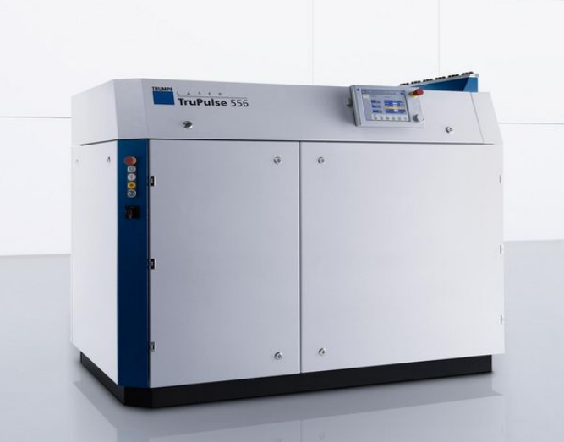
Pattern transportation
subaperture flux
100 independent turbulence realisations
Investigate flux and contrast within every 5” subaperture
Predicted photon return from 265W pulsed 532nm laser
50cm subapertures, 800 Hz frame rate
Values are photons/subaperture/frame
 |  | 150 modes | 550 modes | 1550 modes
Flux | Mean Max Std | 648 3050 422 | 617 2121 267 | 593 1488 198
Contrast | Min | 0.981 | 0.984 | 0.993

Slide 12
Pattern transportation
Laser feasibility
Photon return and contrast pattern appears suitable for correlation based wavefront sensing
Fibre modes (i.e. fibre core diameter) gives some flexibility to tune flux vs number/distribution of guide regions
Modal structure broadly preserved on propagation
High-power pulsed multimode fibre lasers are commercially available
Not completed a full market survey however

Slide 13
Optical layout, designed
OLED
DM (flat mirror)
WFWFS
Free space scattering
Laser launch
Atmospheric simulator

Slide 14
Optical layout, current
Laser launch
OLED
DM (flat mirror)
WFWFS
Atmospheric simulator
Free space scattering

Slide 15
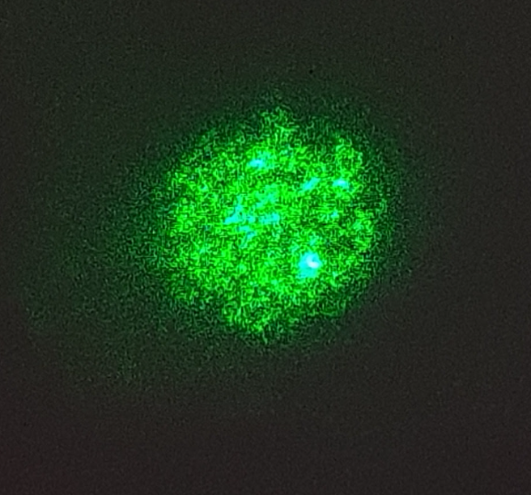
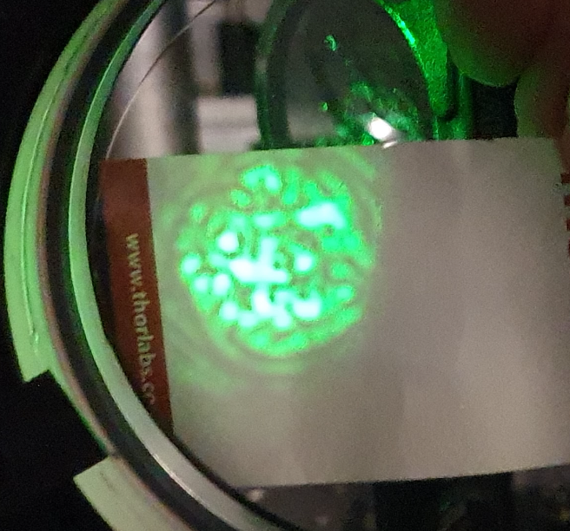
Pattern transportation
With phase screen@ pupil
Without phase screen

Slide 16
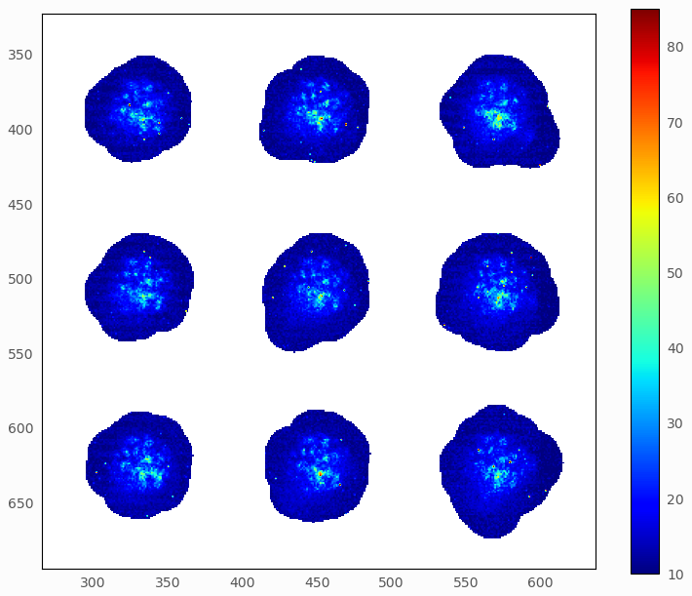

Pattern on WFS
Post phase screen
Pre phase screen

Slide 17
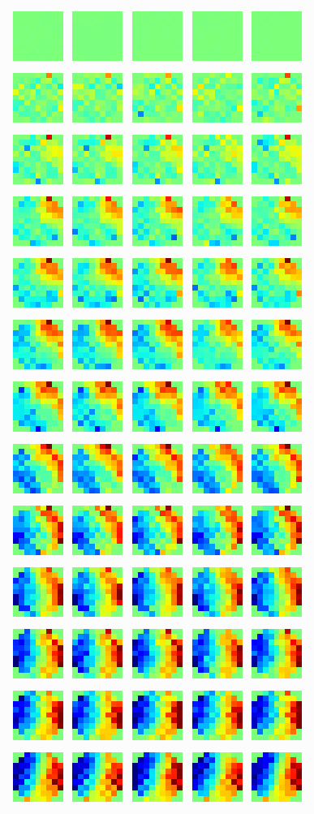
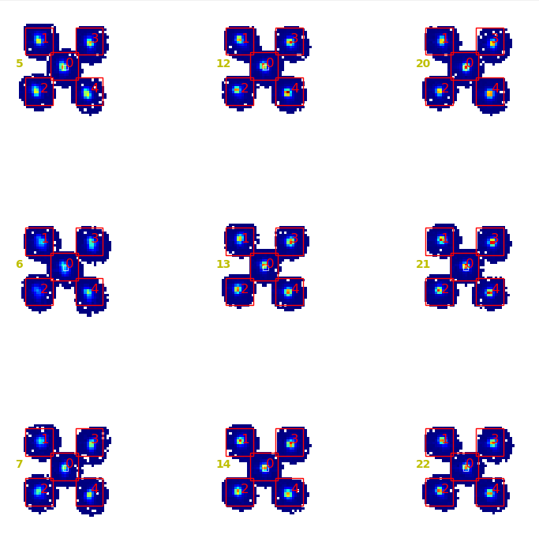
Pattern on WFS
Five dots generated using the OLED
Same type of analysis performed
The ‘turbulence’ is applied downlink only
The screen is rotated 1.5° between each data grab
The distance between the centre dot and the off-axii is ~13’’

Slide 18
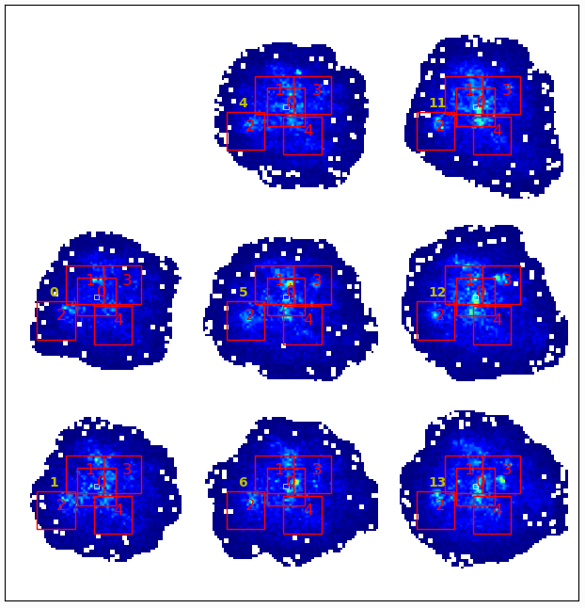
Pattern on WFS
Speckle pattern in each subaperture is subdivided to various areas of interest (AoI)
Cross correlation is then performed on each one of them
However:

Slide 19
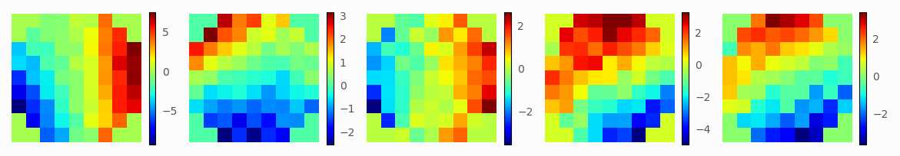
Pattern on WFS
Speckle pattern in each subaperture is subdivided to various areas of interest (AoI)
Cross correlation is then performed on each one of them
However:
resulting WF disagree
possibly due to:
low SNR
centre identification

Slide 20

Conclusion
Can we improve wide-field wavefront sensing using a LGS
LGS = Laser Guide Sun
Simulations show it’s feasible using current technology
High-powered laser coupled into multi-mode fibre
Creates high contrast speckle pattern
Optical bench setup that simulates two-way LGS propagation
Started in July, very first results presented here
Wide-field correlating WFS works on calibration OLED
Issues with SNR degrading 2-way LGS sensing
Side-launch and modifications to optical path should help here
Thank You!

Slide 21
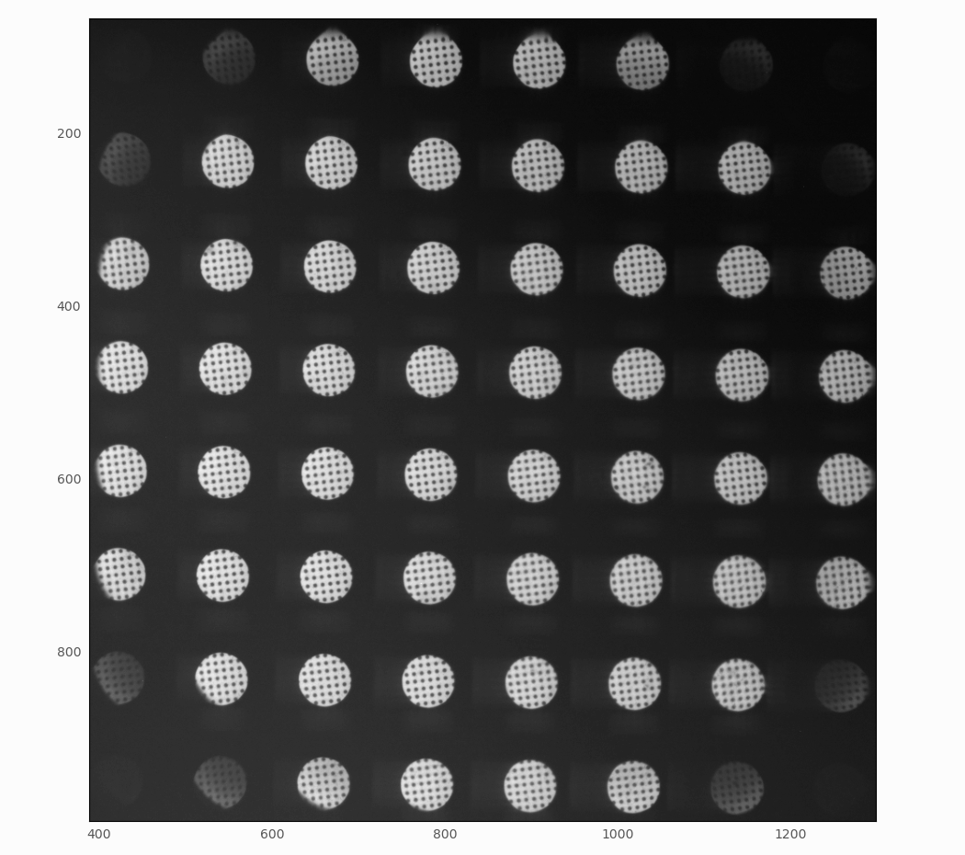
Calibration dots:

Slide 22


