Slide 1


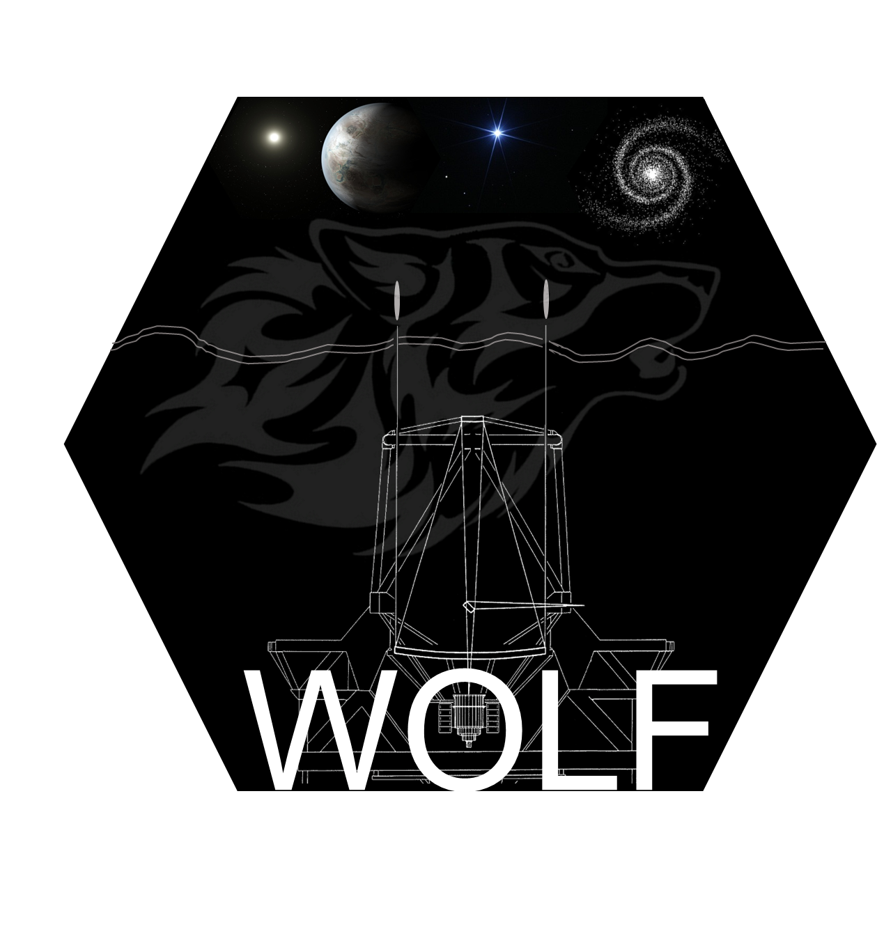
Strategy for sensing petal mode in presence of AO residual turbulence
Authors :
Nicolas Levraud, Vincent Chambouleyron, Mahawa Cisse, Anne Laure Cheffot, Jean François Sauvage, Benoit Neichel , Thierry Fusco, Cedric Plantet, Guido Agapito, Enrico Pinna, Simone Esposito

Slide 2
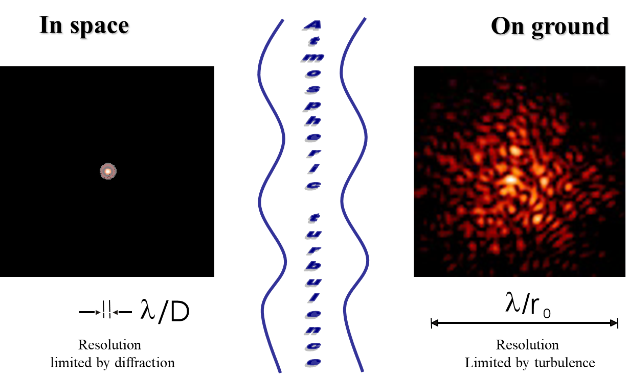
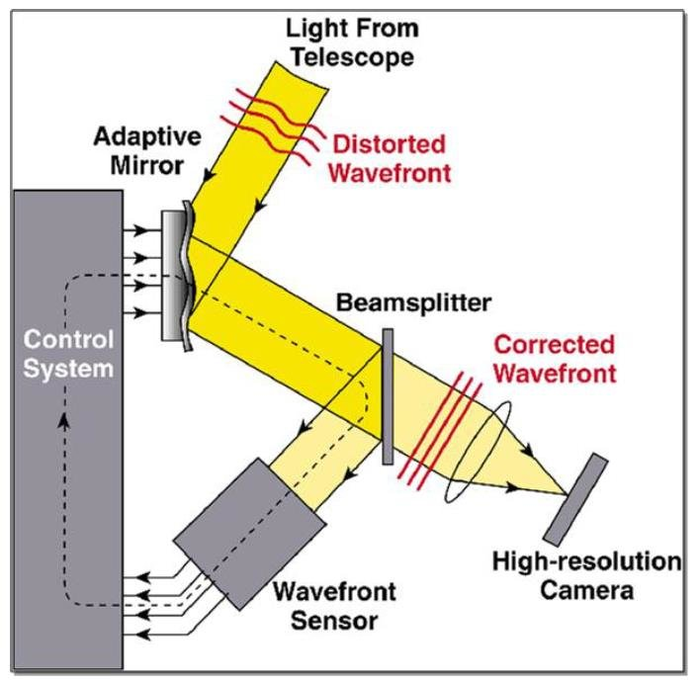
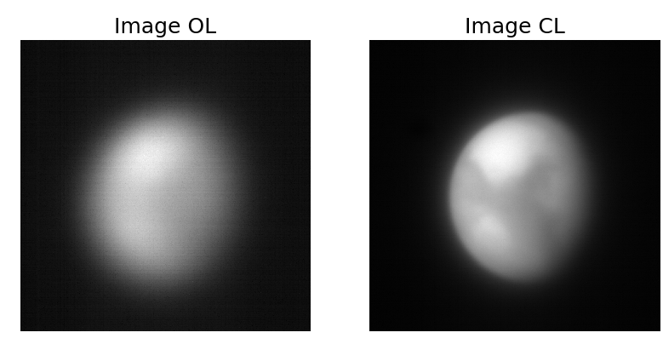
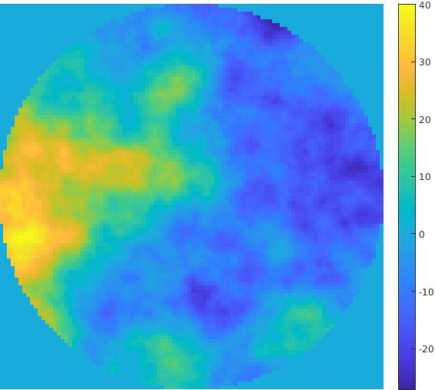
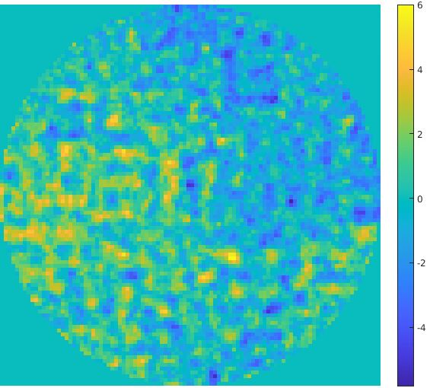
Adaptive Optics :
Ajouter le passage ‘on a besoin de l’OA pour controler l’atmosphère plus le télescope est grand’
3 Main components
Wavefront sensor
Control system (real time computer)
Deformable mirror
Limited by :
- number of DM actuator
- Control loop speed
- Wavefront sensor reconstruction
Classical OA simulation
Credit : Romain Fétick → PAPYRUS bench presentation Friday at 11:00

Slide 3
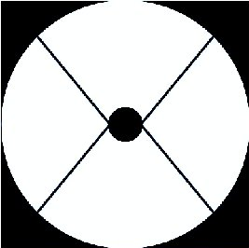
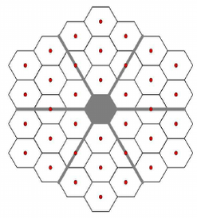
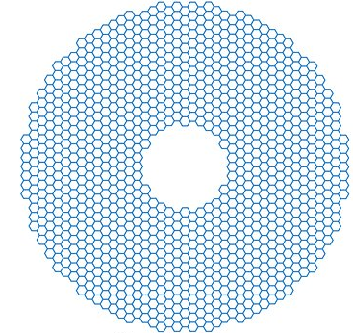
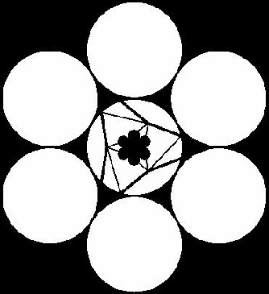
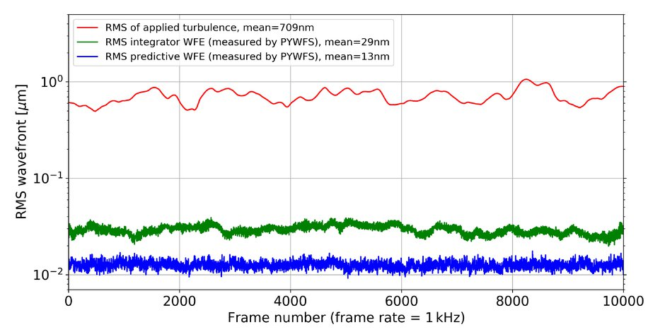
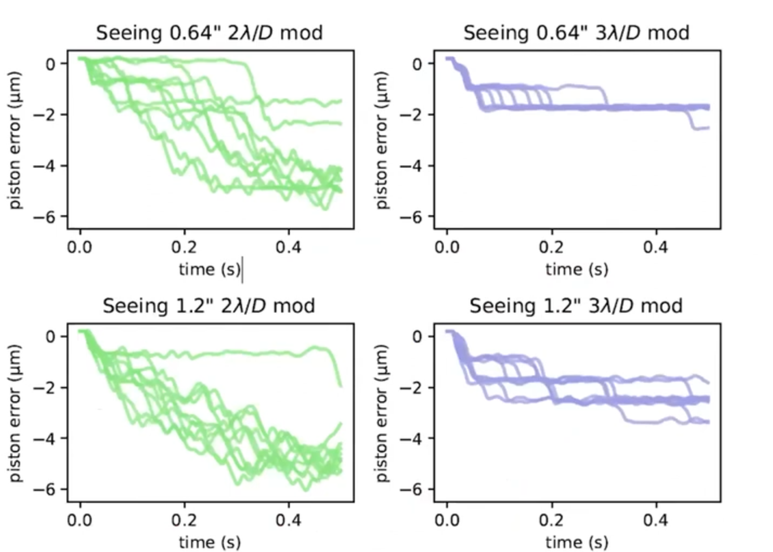
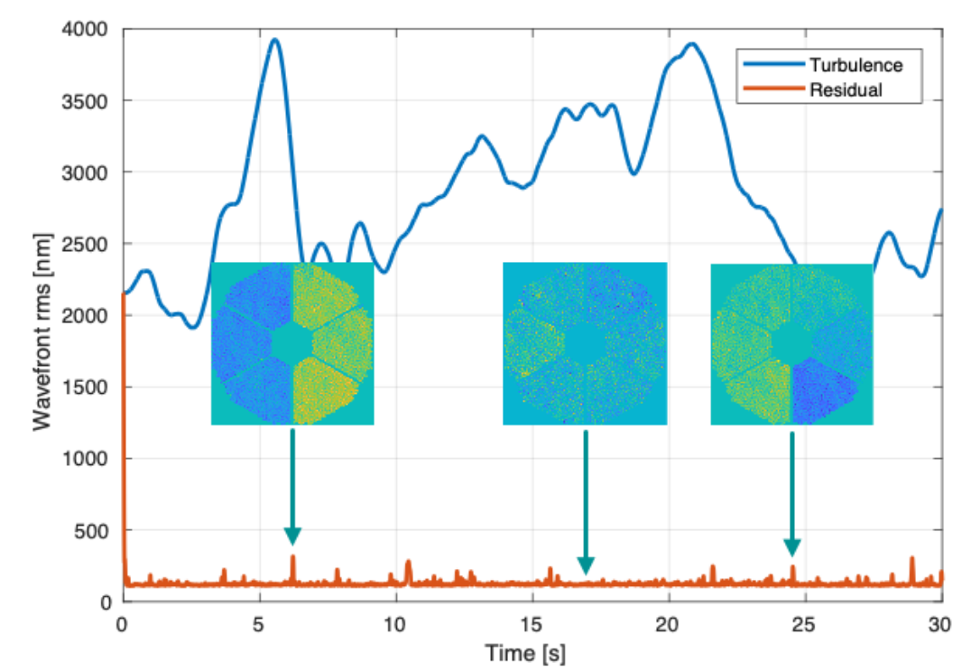
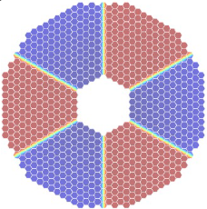

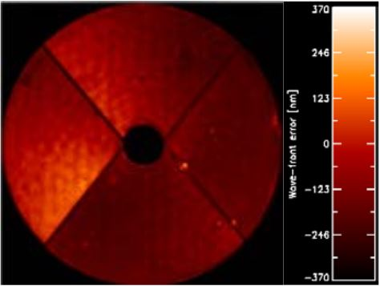
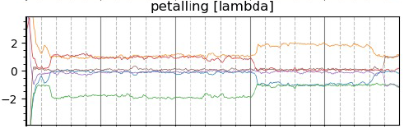
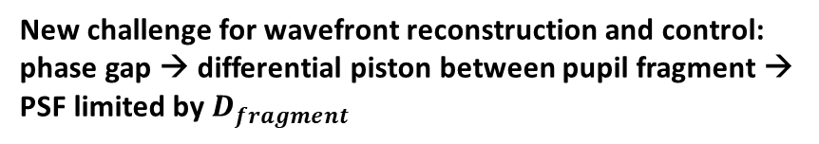
Adaptive Optics for giant telescope
Télescope : jusqu’à la classe des 10m le télecope n’était (presque) pas un problème, sur la clase des 30 m ça en devient un majeur
Vise a atteindre le diffraction limit sensing dans le visible
30m class →telescopes becomes a major problem
Pupil GMT
Spider >40cm
Pupil VLT spider=5cm
Pupil Keck spider=2,5cm
Pupil ELT
Spider = 50cm
Credit : Rebecca Jensen-Clem
Credit : Sebastian Haffert
10m telescope (almost) not a problem for AO
New challenge for wavefront reconstruction and control: phase gap → differential piston between pupil fragment → PSF limited by $D_{fragment}$
Our aim : reaching diffraction limit with a visible wavefront sensor
Credit : Jean François Sauvage
Credit : Charlotte Bond
Notes:
A gauche VLT et kck, puis bloque ELT et bloque GMT avec les même infos pupille, puis résidu d’OA puis petaling

Slide 4


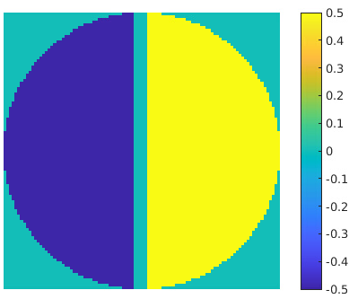
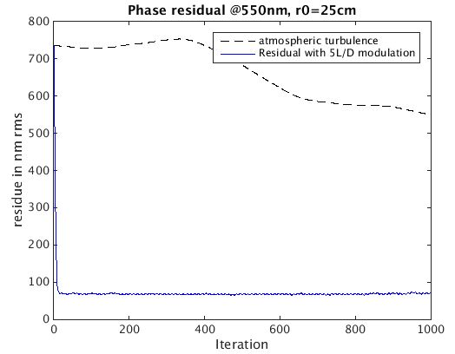
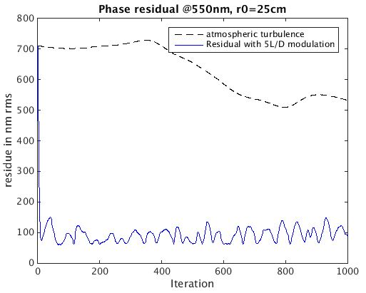
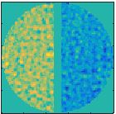
Modelisation of the problem : the toymodel
Conditions :
20*20 DM
D=10m
r₀=25cm @550nm
Wind speed=5m/s
No detector noise,
No sensor noise,
Sensing at λ = 550nm
F=500Hz
Spider size= 50cm
5λ/D pyramid for control
Only 2 fragment, 1 petal mode
Test setting : ELT size spider (50cm) on a VLT-class telescope(10m)
Spider represents 5% of pupil diameter
AO end to end loop with fullpupil :
AO end to end loop with spider in the pupil :
Toymodel pupil
Phasescreens at iteration 132
Petal mode
Residuals are dominated by fitting error
Residuals are fitting error + petal mode

Slide 5

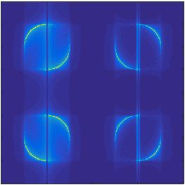
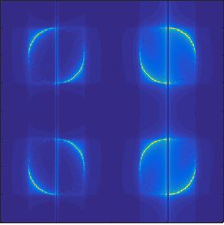
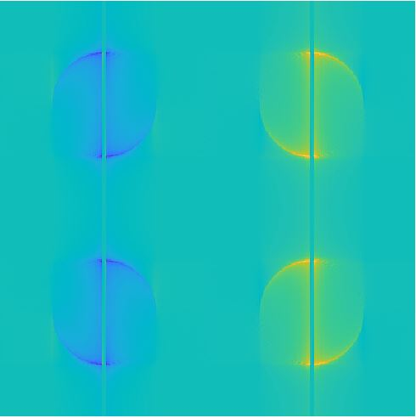
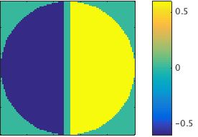


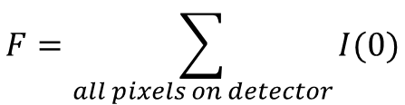
Pyramid wavefront sensor
Pupil plane
focal plane
Detector in pupil plane
Petal mode 1*P
Flux
Ref : R. Ragazzoni 1996 ‘Pupil plane wavefront sensing with an oscillating prism’

Slide 6

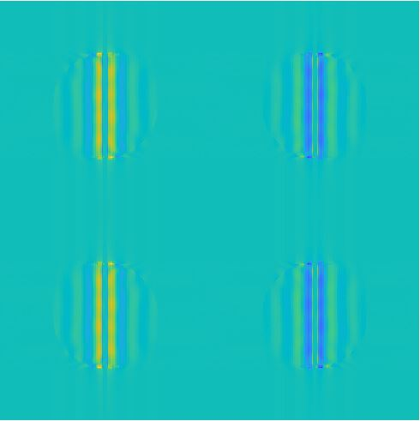
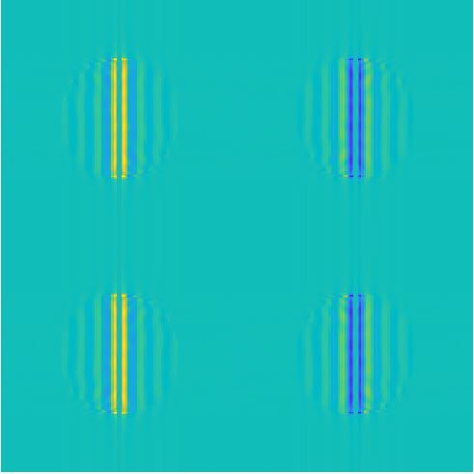
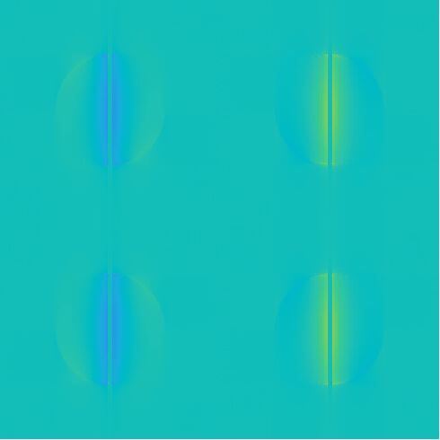

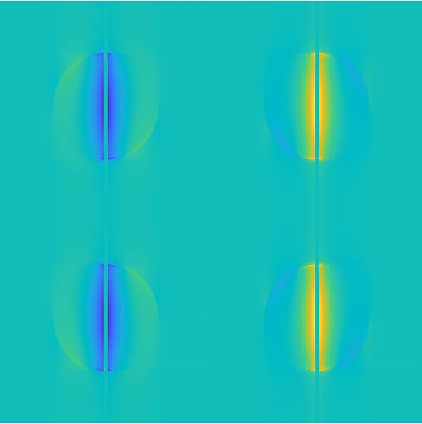

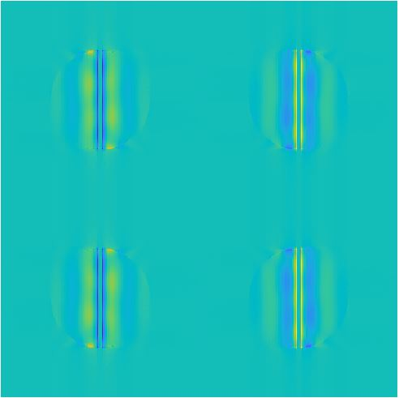

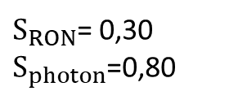
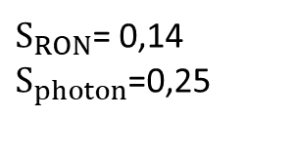
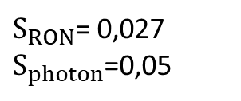
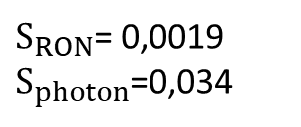
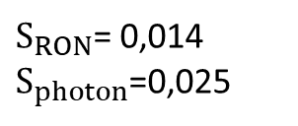
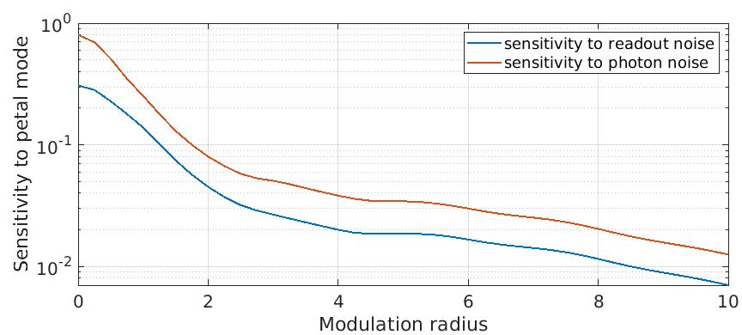
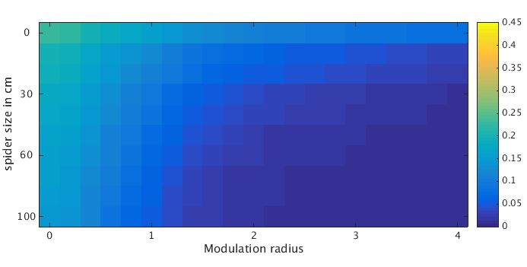
Pyramid response to petal mode
Modulation = 0λ/D
Modulation = 1λ/D
Modulation = 3λ/D
Modulation = 5λ/D
Modulation = 7λ/D
S as a function of modulation radius
$S_{RON}$ depending on modulation and spider size
measure petal = unmodulated pyramid
VLT
ELT
HARMONI
Ref : V.Chambouleyron 2022 ‘Optimizing Fourier-Filtering WFS to reach sensitivity close to the fundamental limit’

Slide 7
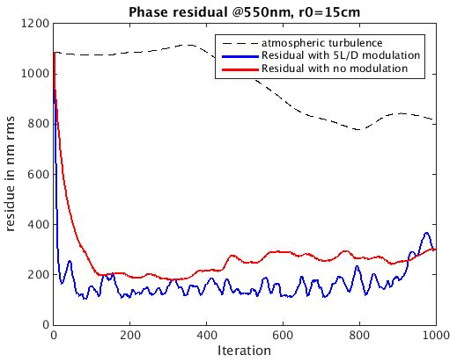
Pyramid control without modulation
strong turbulence → need modulation → not sensitive to piston
Conditions :
20*20 DM
D=10m
r₀ =15cm @550nm
Wind speed=5m/s
No detector noise,
No sensor noise,
Sensing at λ = 550nm
F=500Hz
Spider size= 50cm
Petal when modulating better than no modulation
Need two sensors,
1 for atmosphere
1 Petalometer

Slide 8
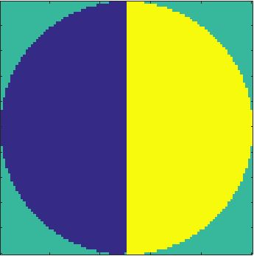
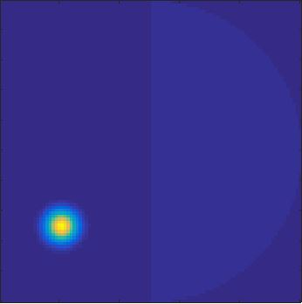
2 Path wavefront sensor
Equivalent to woofer-twitter AO system but for the sensing
Controls petal only
Non modulated pyr
Telescope with spider
Petalometer
Modulated pyr
Can the pyramid in second path measure petal ?
Petal free DM modes
Atmosphere control

Slide 9
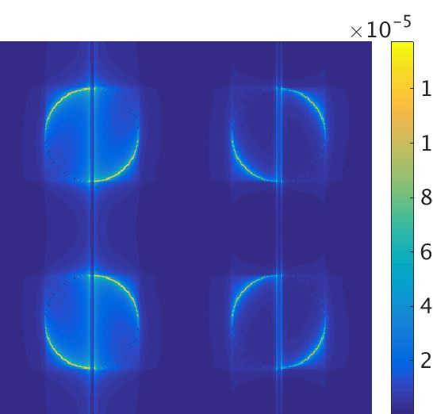
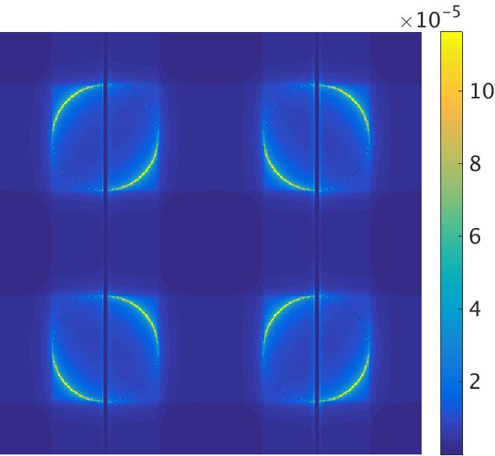
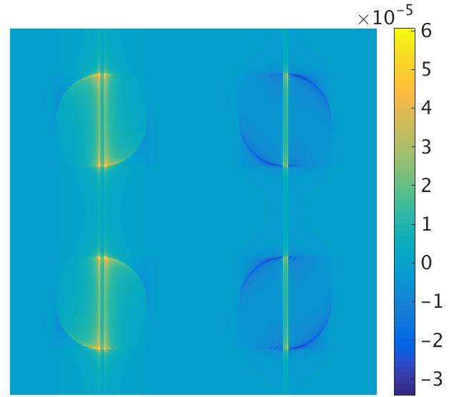
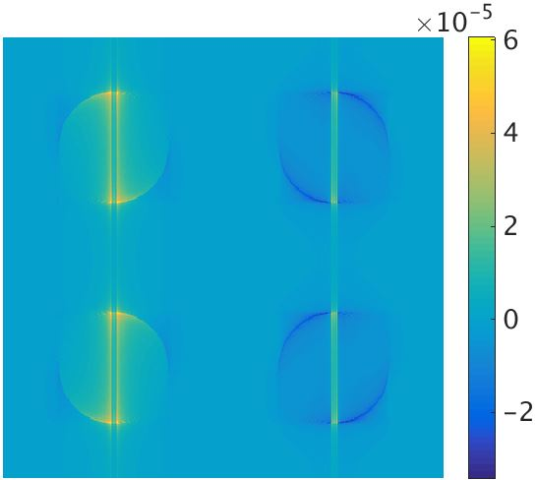



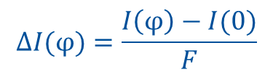





Petal estimation
$$D=[δI\left(φ_{1}\right);δI\left(φ_{2}\right);δI\left(φ_{3}\right) …]$$
Intensity
Intensity
Intensity
[$φ_{1}$, $φ_{2}, …]=Petal+29 first Zernike$
$D$ : interaction matrix
$D^{†}$ : Reconstruction or control matrix
I(ϕ)/F
I(0)/F
$$ΔI(φ)$$
$$ΔI(φ)=\frac{I\left(φ\right)−I(0)}{F}$$
$\hat{p}(φ)=D^{†} ×ΔI$($φ$)
$\hat{p} R$econstructed petal
Goal : test $\hat{p}$ VS p in presence of residuals
Introduced
p = - 0.1 rad
$\hat{p}$ = - 0.1 rad
Reconstructed

Slide 10
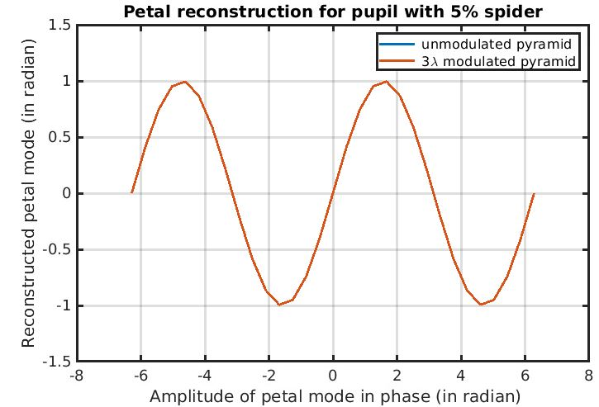
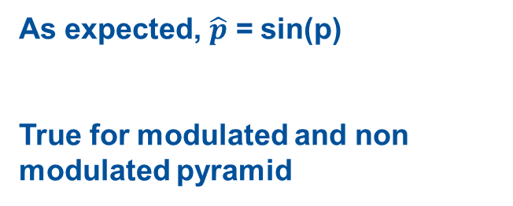
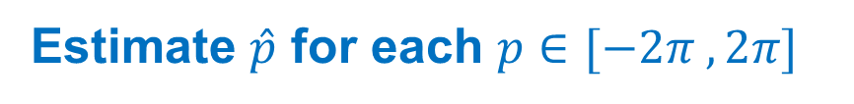
Petal reconstruction : with no atmosphere
Estimate $\hat{p}$ for each $p∈[−2π , 2π]$
Pas justifié le p^= sin(p)
As expected, $\hat{p}$ = sin(p)
True for modulated and non modulated pyramid
Linearity curve in absence of noise or atmosphere

Slide 11
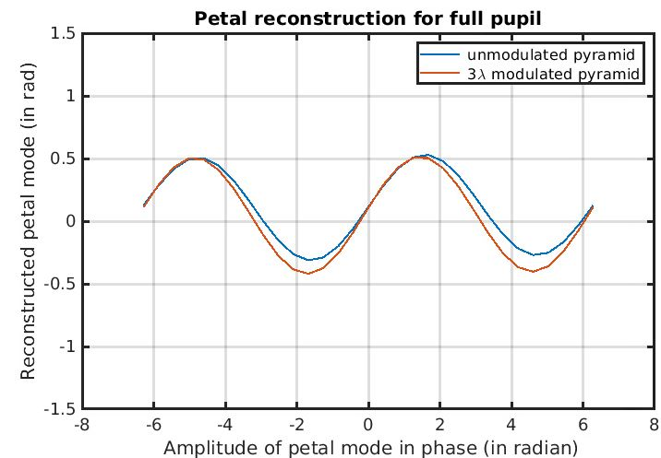


Petal reconstruction with 20x20 first stage residuals
Residuals phase screen used :
Conditions :
20*20 DM
D=10m
r₀=15cm @550nm
Wind speed=5m/s
No detector noise,
No sensor noise,
Sensing at λ = 550nm
F=500Hz
Spider size= 50cm
Residual piston substracted from phasescreen
fullpupil
Pourquoi gain optiques si différents ?
Bias > min of reconstruction → cannot reconstruct 0
Petal reconstruction is biased in presence of residuals and spider
5% spider
Bias no modulation = 0.45 rad
Bias modulation = 0.42 rad

Slide 12


Petal reconstruction with variable residuals
Reconstruction made for 10 independant residuals
Bias not repeatable
100 consecutive residual phasescreens
Highly depedant on phase residuals
Fast evolving

Slide 13




Petal reconstruction with variable residuals
Residuals scaled by 0.5
Residuals scaled by 0.1
$s∈[−1 1]$
Petal bias for diferent scaling of residualphase
Bias no modulation = 0.62 rad
Bias no modulation = 0.18 rad
Bias modulation = 0.26 rad
Bias modulation = 0.20 rad
Bias is residual dependant → can’t be controlled
Notes:
Changer orga ici

Slide 14



Reduce impact of residuals
Reduce the phase to be sensed → go to longer wavelength
Reduce impact of residuals → spatial filter in the focal plane
Pupil plane
focal plane with spatial filter
Detector in pupil plane
Spatial Filter Radius
Residual dominates
Petal dominates
5 λ/D seems best compromise here

Slide 15


After spatial filtering linearity plots
fullpupil
Spatially filtered reconstruction is the same with or without spider →Bias greatly reduced
5% spider
Notes:
Bigger fontsize !

Slide 16
Conclusion
2 sensor-system necessary to measure petal
Residuals bias the petal measurement
Spatial filter reduces this bias

Slide 17
Perspectives
Understanding origin of the bias → what creates bias in the residuals ?
Closed loop simulation → loss of light ? Size of spatial filter ? Best sensor ?
Simulation of ELT case
Spatial filter interest for other Fourrier Filtering WFS
Test on PAPYRUS ?
Thank you for listening !

Slide 18


Annex : Spatial filter effect on pyramid signal
1 λ/D
3 λ/D
5 λ/D
10 λ/D
15 λ/D
Petal phase
I(0)
5 λ/D seems best compromise here

Slide 19







Annex Origin of the bias
$D^{†}$ of petal
Signal of petal reconstruction very close to spider
→ Residual next to spider causing bias ?
Look at $D^{†} →$ what signal is used for petal reconstruction
Blunt test : zero phase next to spider
Origin of bias not understood
Comes from phase residuals
Phase a la limite VS biais ?
Phase =0 sur 20 cm autour du spider pour voir si ça enlève le biais ?
Phase screen
As if Spider = 70cm
As if Spider = 90cm
No effect on bias !
Reduced bias !

Slide 20





Annex : Improving sensitivity to petal
Toymodel pupil
No Spider
Spider
No modulation
3 λ/D modulation
No modulation
3 λ/D modulation
I ref
I piston

Slide 21

II Improving sensitivity to Petal :
Loss with spider when modulating
Toymodel pupil (D=10m)
classic 4 sided
pyramid
Asymetric pyramid
Sensitivity
Sensitivity
ELT
ELT

