Slide 1




$$N_{2}O NCPA∗$$ A new low order Wavefront Sensor and its first experimental results.
Alessandro Terreri
Collaborators:
Dr. Fernando Pedichini
Dr. Markus Kasper
Dr. B.Engler
Dr. T. Heritier
Prof. Dario Del Moro
Terreri Alessandro
1 /25
Wavefront Sensing in the VLT/ELT era VII - Porto
Notes:
Userei lo stesso font per tutte le scritte mi piace molto quello del titolo

Slide 2
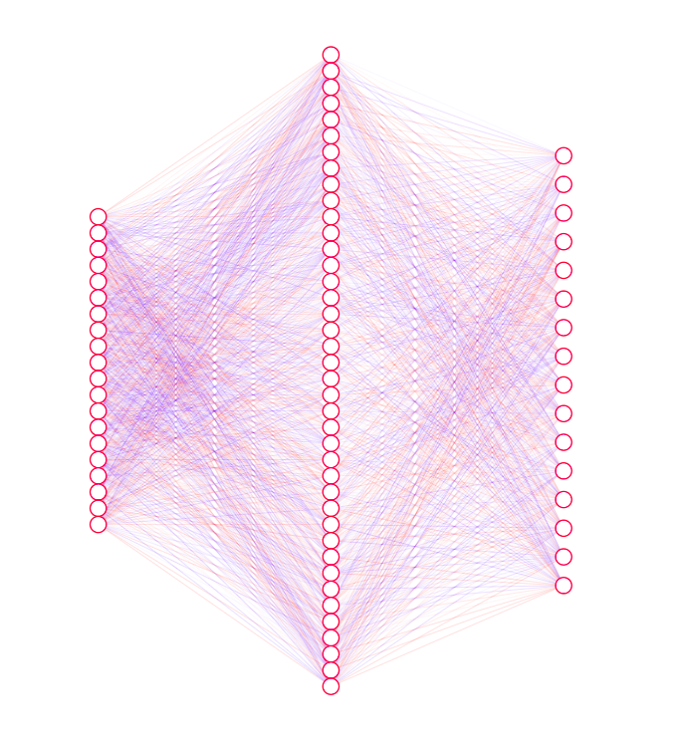
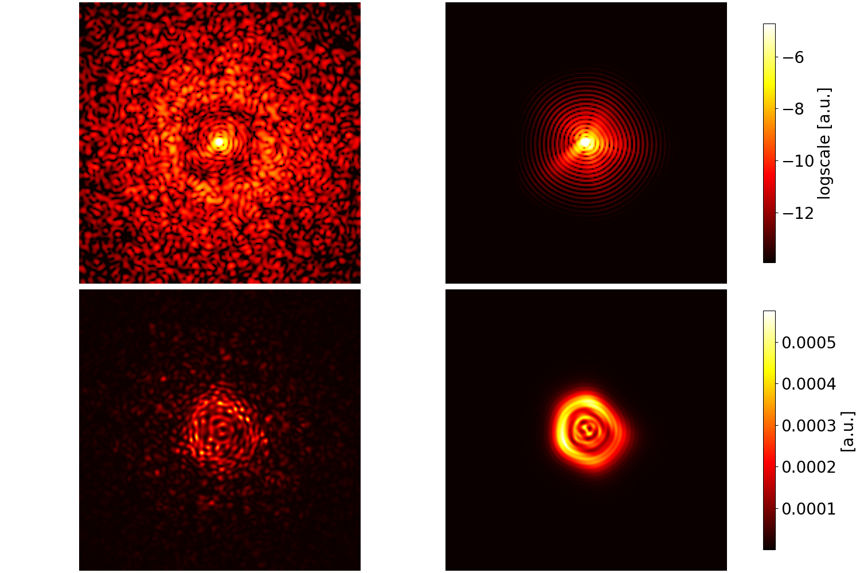
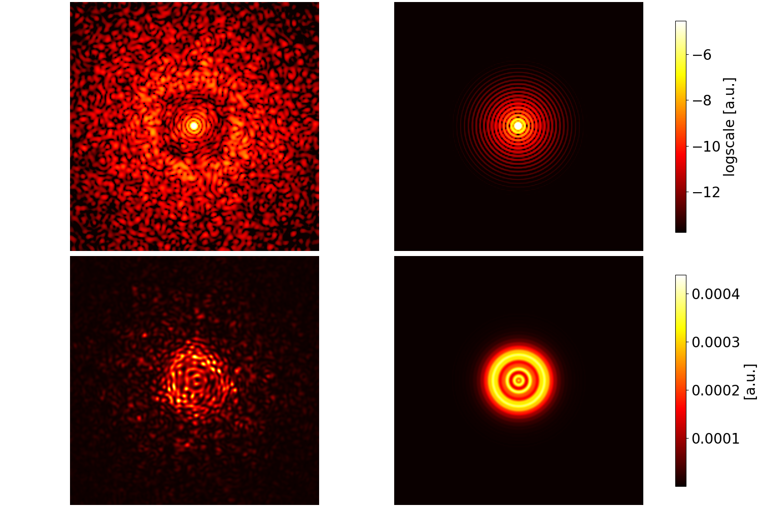
Short Summary
NN
STARTING FROM THIS..
WE WANT TO OBTAIN THIS…
On Sky
PCA
In Laboratory
Use of extrafocal images
Terreri Alessandro
2 /25
Wavefront Sensing in the VLT/ELT era VII - Porto
Notes:
EVENTUALMENTE togliere l animazione col blocco dell AO che entra

Slide 3
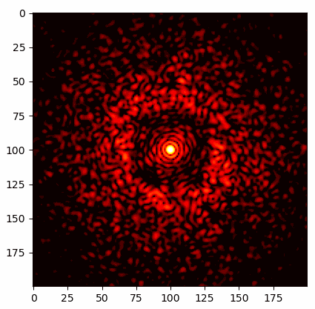
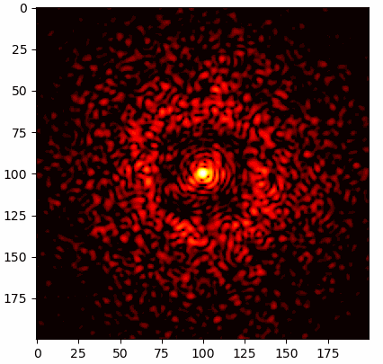

AO residual and NCPA
$$WFE≈\frac{λ}{6}+NCPA$$
Simulated using the ESO library PO4AO by T.C.Heritier 2020
Terreri Alessandro
3 /25
Wavefront Sensing in the VLT/ELT era VII - Porto
Notes:
EVENTUALMENTE togliere l animazione col blocco dell AO che entra

Slide 4
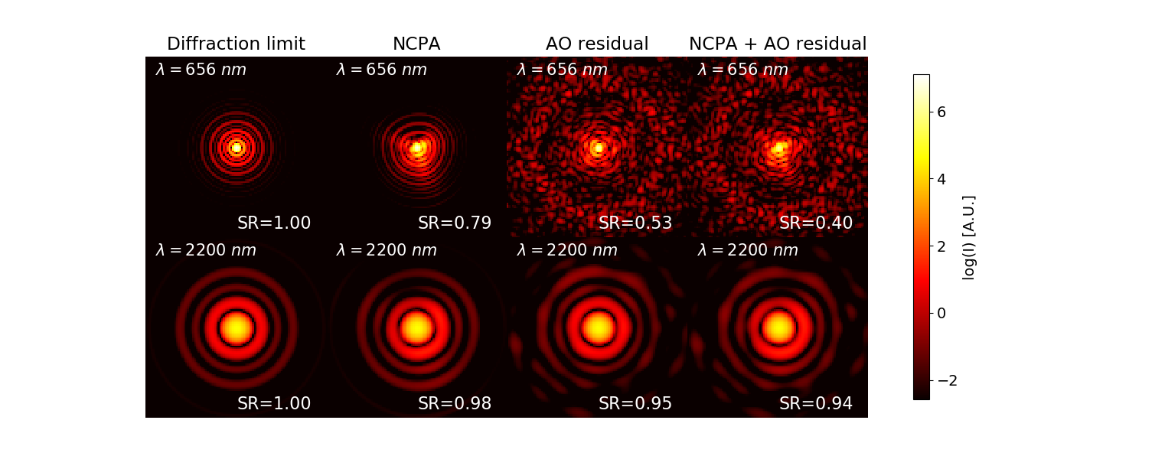



NCPA is critical in the visible$λ<1 μm$
TYPICAL BEST SCENARIO @LBT$AO residual≈80 nm RMS$
Example: $NCPA≈50 nm RMS$
||-------No AO residual-----||-----With AO residual-----||
Strehl vs NCPA
$$∆S=−1\%$$
$$∆S=−20\%$$
Terreri Alessandro
4 /25
Wavefront Sensing in the VLT/ELT era VII - Porto
Notes:
Sintetizzare

Slide 5

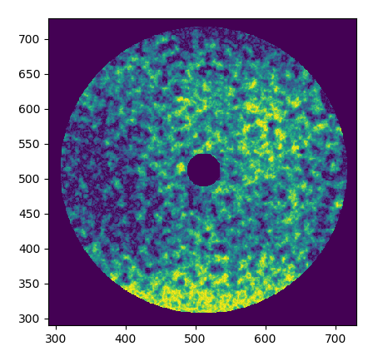
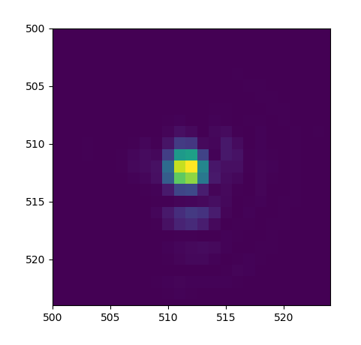
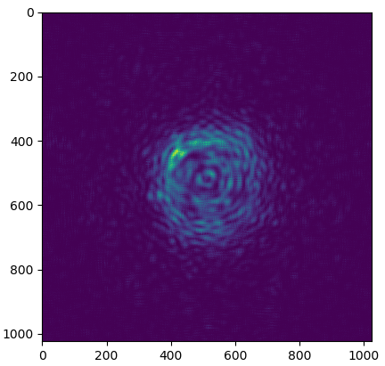


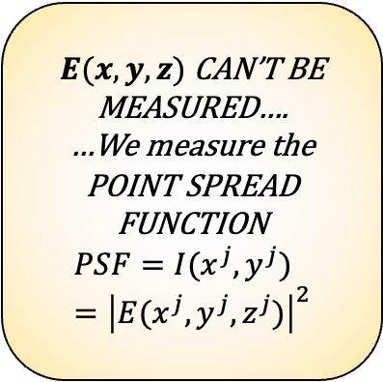



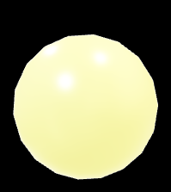

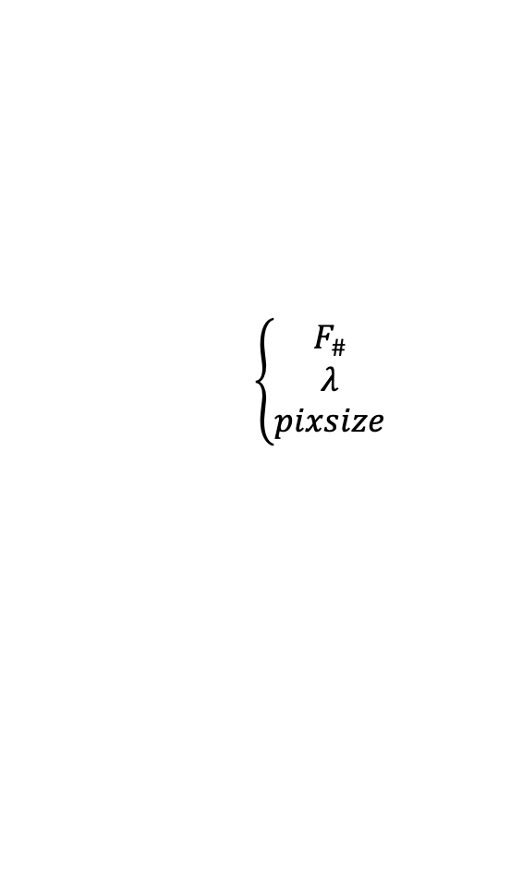






Optical Propagation Simulations
$$\left\{\begin{aligned}F_{\#}\#\# \\ λ \\ pixsize\end{aligned}\right.$$
Equivalent system with just 3 features needed:
$$E\left(x,y,0\right)=A\left(x,y\right)e^{iφ(x,y)}$$
$$E\left(x^{′},y^{′},z^{′}\right)=FT\{E\left(x,y,0\right)\}$$
$E\left(x^{′′},{y′}^{′},z^{′′}\right)=FT\{E\left(x,y,0\right)\}$ $∗exp⁡(−iz^{′′})$
STOP
PUPIL
PLANE
FOCAL
PLANE
EXTRAFOCAL
PLANE
PUPIL
PLANE
LENS
$$y$$
$$y^{′}$$
$$y^{′′}$$
$E(x,y,z)$CAN’T BE MEASURED….
…We measure the
POINT SPREAD FUNCTION
$$PSF=I(x^{j},y^{j})={\left|E(x^{j},y^{j},z^{j})\right|}^{2}$$
$$A$$
$$\left(A\right)$$
$$x$$
$$x^{′}$$
$$x^{′′}$$
Terreri Alessandro
5 /25
Wavefront Sensing in the VLT/ELT era VII - Porto

Slide 6
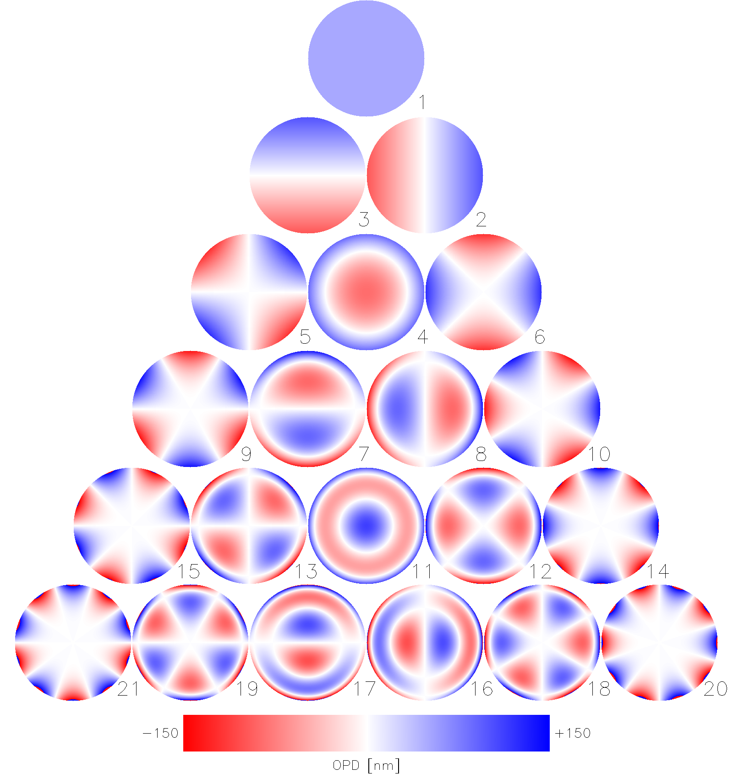
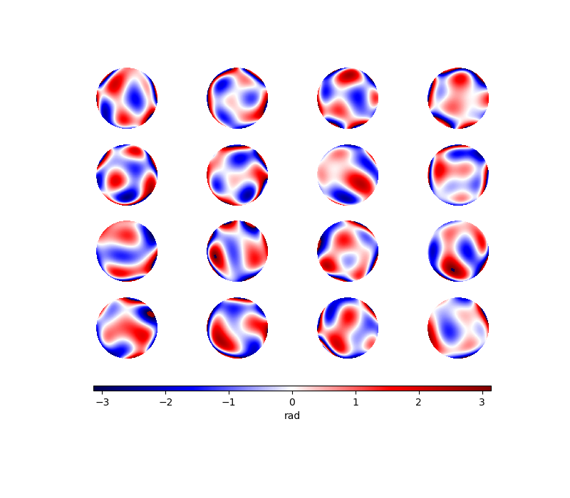

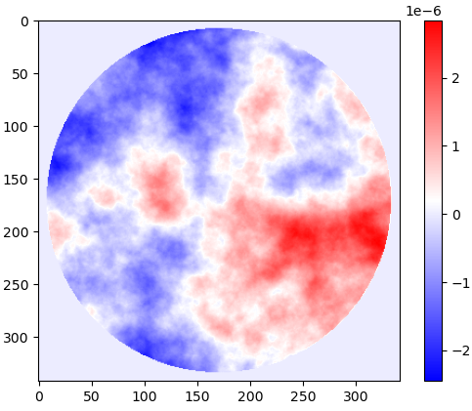

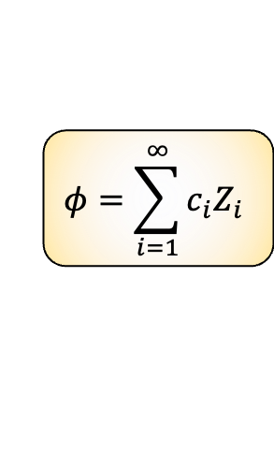
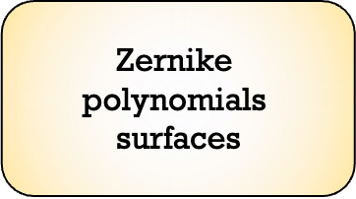
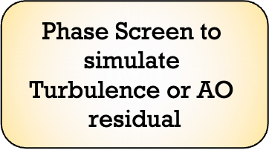
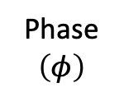
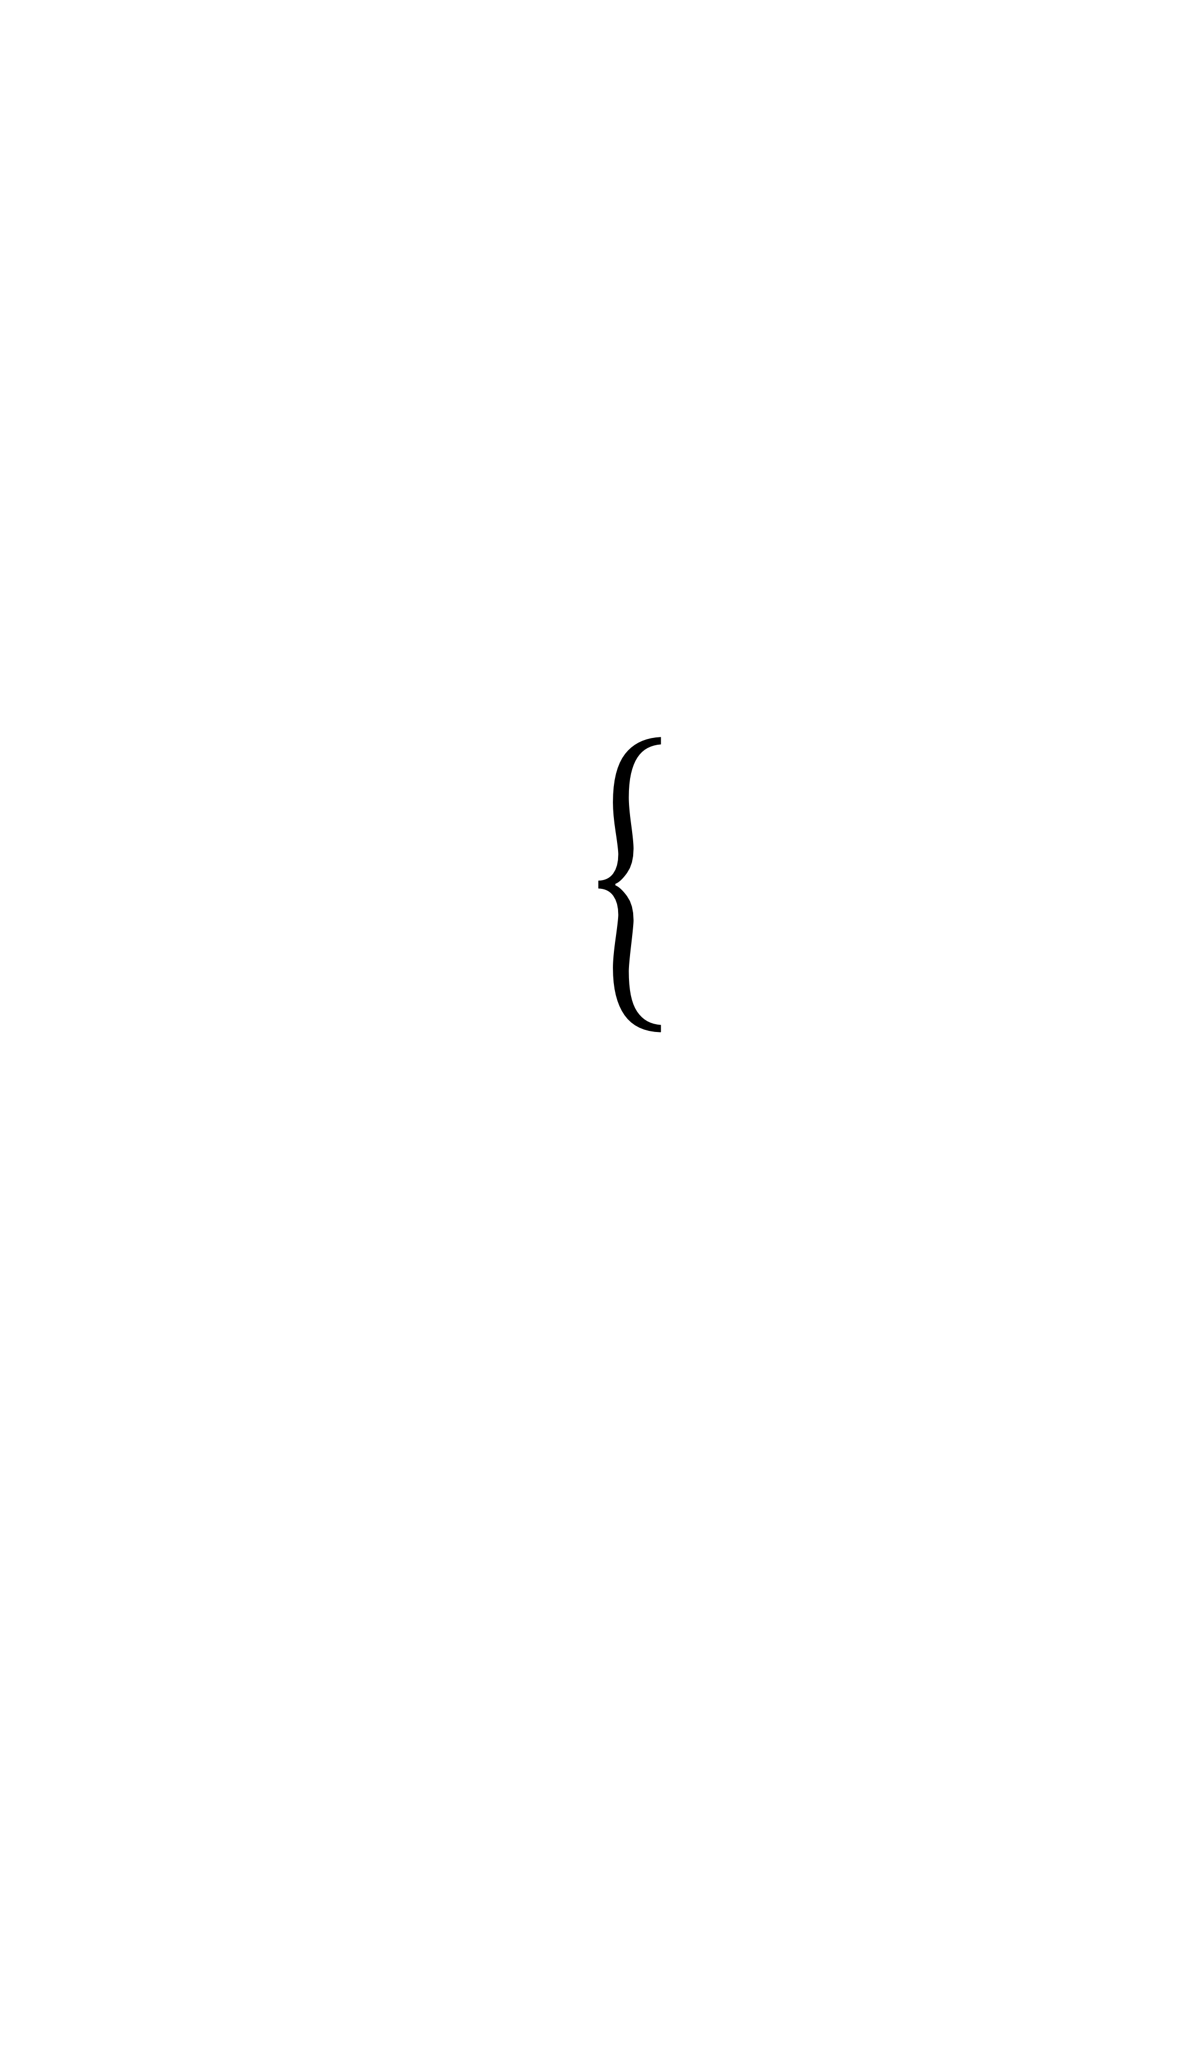
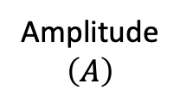



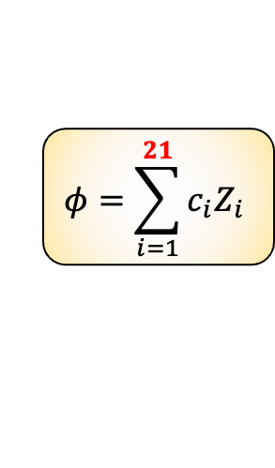
Phase: Zernike Polynomials or phase screen
$$y$$
$$y^{′}$$
$$y^{′′}$$
$$φ=\sum_{i=1}^{∞}{c_{i}Z_{i}}$$
$$φ=\sum_{i=1}^{21}{c_{i}Z_{i}}$$
$$\left(A\right)$$
$$x$$
$$x^{′}$$
$$x^{′′}$$
$$E\left(x,y,0\right)=A\exp\left(iφ\right)$$
$$\text{Zernike} \text{polynomials} \text{surfaces}$$
Amplitude $\left(A\right)$
Phase
$$\left(φ\right)$$
NCPA is encoded in the first Zernikes
$$\text{Phase} \text{Screen} \text{to} \text{simulate} \text{Turbulence} \text{or} \text{AO} \text{residual}$$
$$Constant$$
$$Variable$$
Terreri Alessandro
6 /25
Wavefront Sensing in the VLT/ELT era VII - Porto
Notes:
Sintentizzare

Slide 7
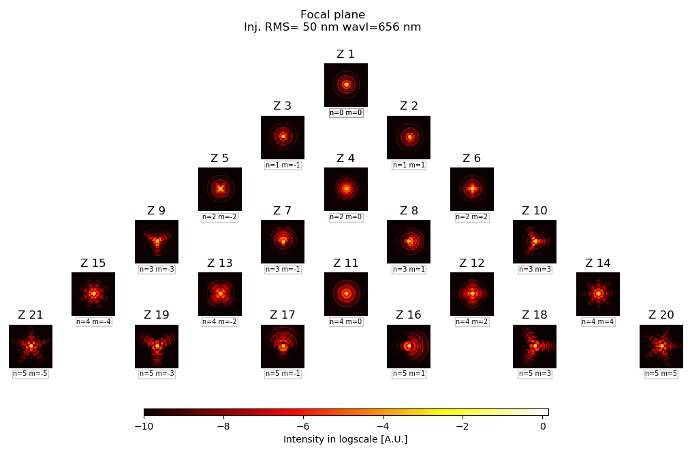

Can we use focal plane images to recognize aberrations?
$$y$$
$$y^{′}$$
$$y^{′′}$$
$$\left(A\right)$$
$$x$$
$$x^{′}$$
$$x^{′′}$$
Even
PROPAGATION
Odd
Even
Odd
Even
Terreri Alessandro
7 /25
Wavefront Sensing in the VLT/ELT era VII - Porto
Notes:
Va aggiunto il valore della NCPA e impaginare meglio

Slide 8
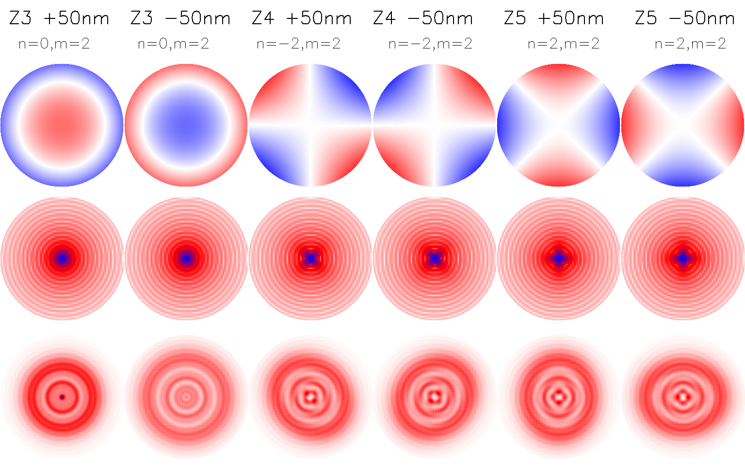
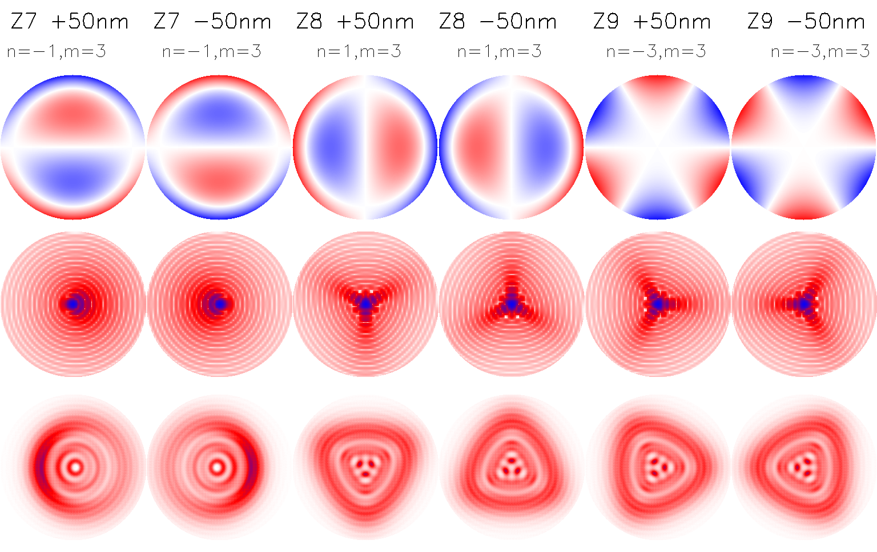
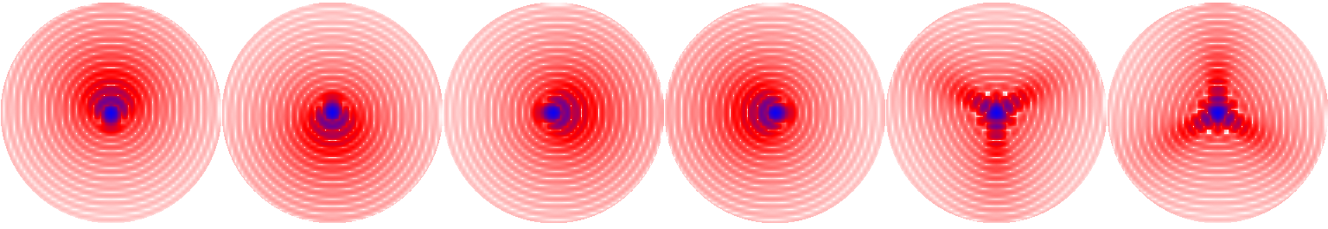






Degeneration or non degeneration? That’s the problem
Odd Radial order
DEGENERATION
Even radial order
NO DEGENERATION
Spherical ${(Z}_{4})$
Astigmatism${(Z}_{5})$
Astigmatism${(Z}_{6})$
Coma Y ${(Z}_{7})$
Coma X${(Z}_{8})$
Trefoil 45°${(Z}_{9})$
+50nm
-50nm
+50nm
-50nm
+50nm
-50nm
+50nm
-50nm
+50nm
-50nm
+50nm
-50nm
Pupil
plane
Focal plane
Extra-focal plane
Terreri Alessandro
8 /25
Wavefront Sensing in the VLT/ELT era VII - Porto

Slide 9
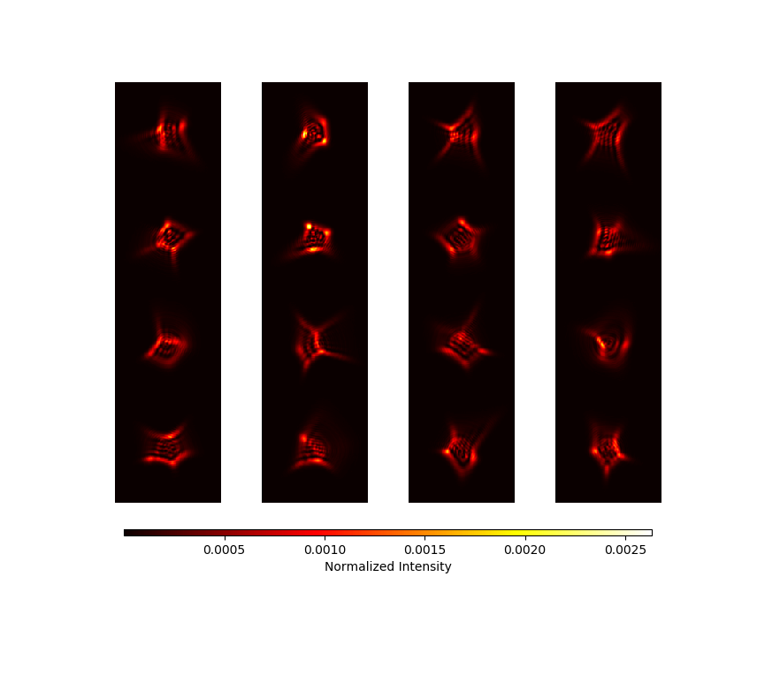
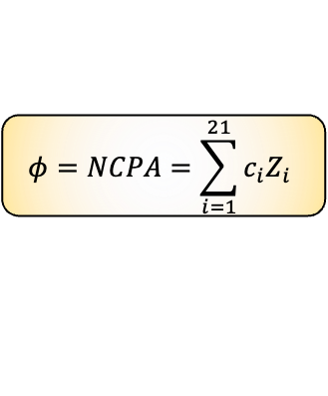
Simulated dataset (10 000 images)
Simulations of 10000 Extrafocal plane images starting from the injection of different combination of 21 Zernike with $±50 nm$ UNIFORMLY RANDOM DISTRIBUTED
PUPIL PLANE→PHASE
EXTRA-FOCAL PLANE→ INTENSITY
Propagation
Each one is a linear combination:
$$φ=NCPA=\sum_{i=1}^{21}{c_{i}Z_{i}}$$
DEFOCUS = 10 mm
Terreri Alessandro
9 /25
Wavefront Sensing in the VLT/ELT era VII - Porto

Slide 10
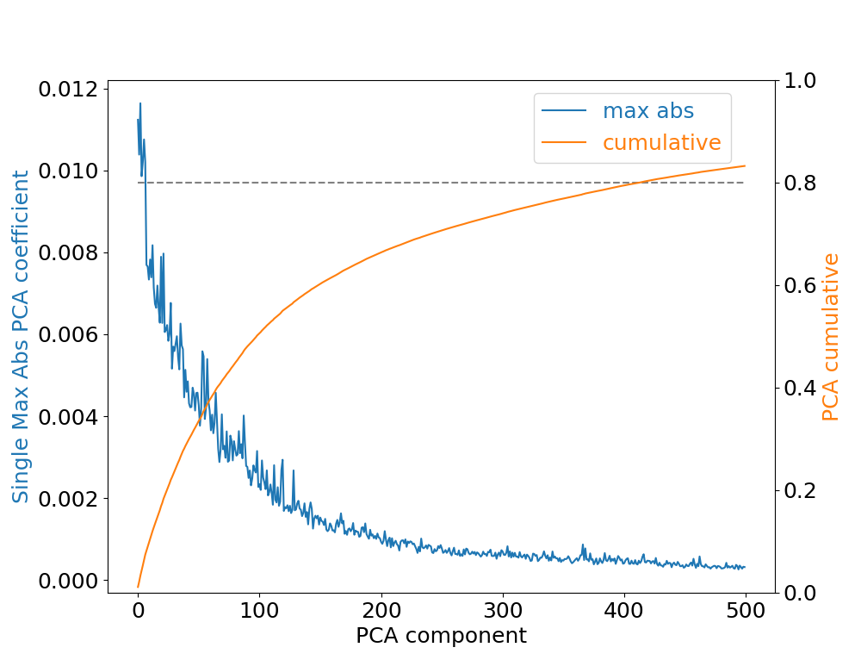
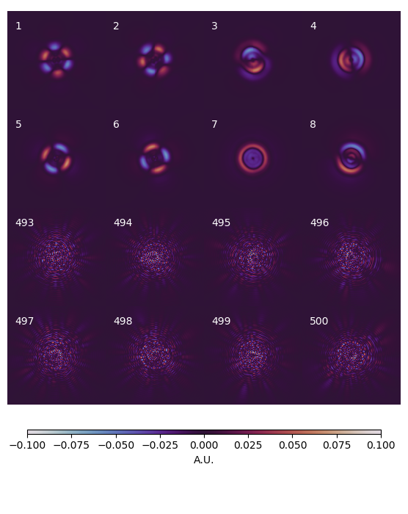
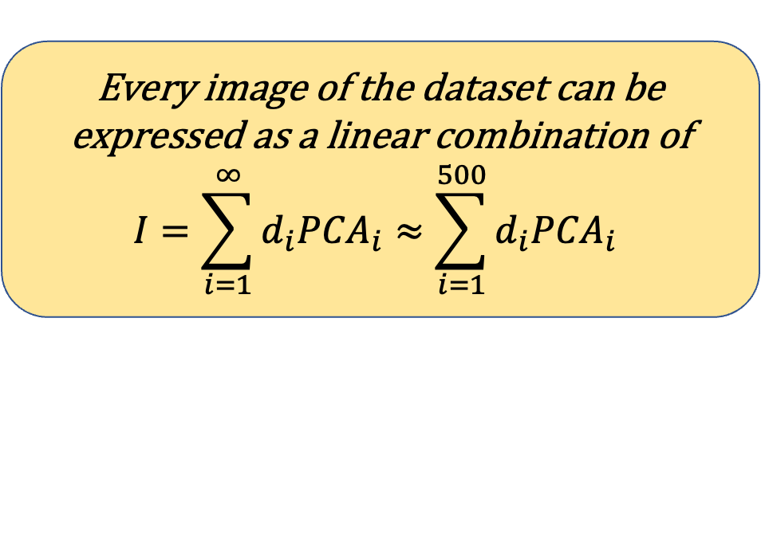
Principal Component Analysis (PCA)
Returns basis of eigenimages that comes from the diagonalization of the covariance matrix for the defocused images dataset
Thousands of pixels are now substituted with few hundreds coefficients
Images can be projected on this basis
Every image of the dataset can be expressed as a linear combination of
$$I=\sum_{i=1}^{∞}{d_{i}{PCA}_{i}}≈\sum_{i=1}^{500}{d_{i}{PCA}_{i} }$$
Terreri Alessandro
10 /25
Wavefront Sensing in the VLT/ELT era VII - Porto
Notes:
Accorciare se possibile le frasi scritte

Slide 11
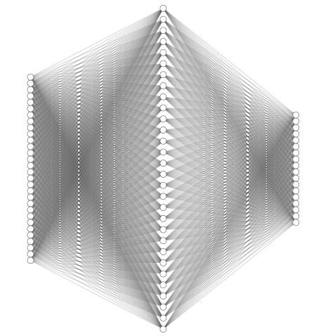



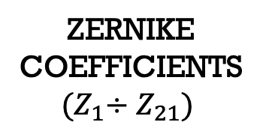







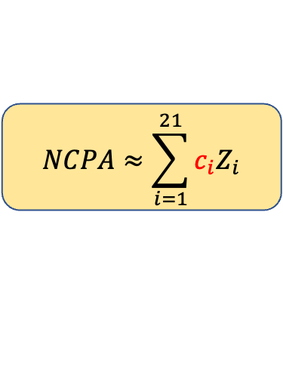





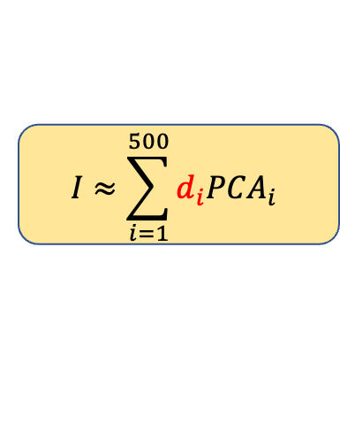




Neural Network
$$I≈\sum_{i=1}^{500}{d_{i}{PCA}_{i} }$$
PCA
COEFFICIENTS
$$NCPA≈\sum_{i=1}^{21}{c_{i}Z_{i}}$$
ZERNIKE COEFFICIENTS
$${(Z}_{1}÷Z_{21})$$
$$d_{1}∙$$
$$+$$
$$c_{1}∙$$
$$+$$
$$d_{2}∙$$
$$+$$
$$c_{2}∙$$
$$+$$
$$d_{3}∙$$
$$+$$
Intensity
Phase
$$c_{3}∙$$
$$+$$
……
$$c_{4}∙$$
$$+$$
$$d_{498}∙$$
$$+$$
……
$$d_{499}∙$$
$$+$$
HIDDEN LAYER
$$c_{20}∙$$
$$+$$
INPUT LAYER
OUTPUT LAYER
$$c_{21}∙$$
$$+$$
$$d_{500}∙$$
Terreri Alessandro
11 /25
Wavefront Sensing in the VLT/ELT era VII - Porto

Slide 12
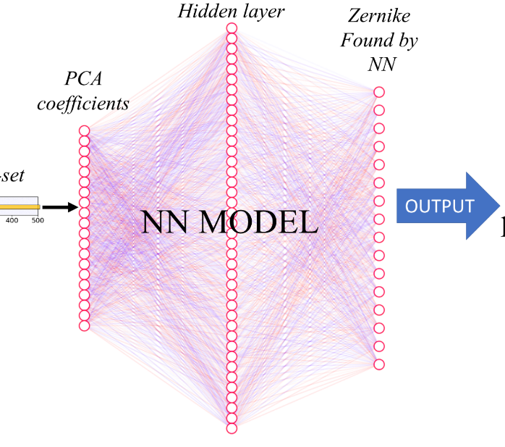
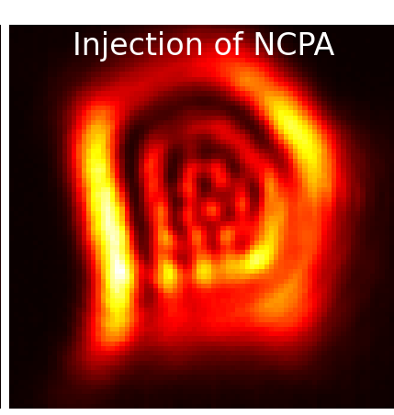
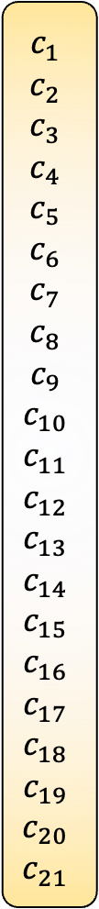
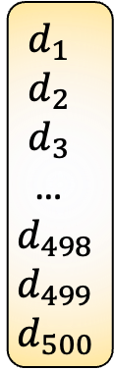
NN usage on 1 image
$$c_{1}$$
$$c_{2}$$
$$c_{3}$$
$$c_{4}$$
$$c_{5}$$
$$c_{6}$$
$$c_{7}$$
$$c_{8}$$
$$c_{9}$$
$$c_{10}$$
$$c_{11}$$
$$c_{12}$$
$$c_{13}$$
$$c_{14}$$
$$c_{15}$$
$$c_{16}$$
$$c_{17}$$
$$c_{18}$$
$$c_{19}$$
$$c_{20}$$
$$c_{21}$$
$$d_{1}$$
$$d_{2}$$
$$d_{3}$$
…
$$d_{498}$$
$$d_{499}$$
$$d_{500}$$
PROJECTION
INPUT
……
SIMULATED
OR
EXPERIMENTAL
Terreri Alessandro
12 /25
Wavefront Sensing in the VLT/ELT era VII - Porto

Slide 13
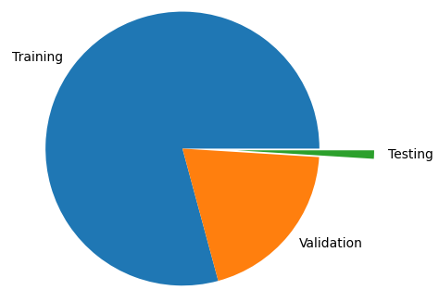
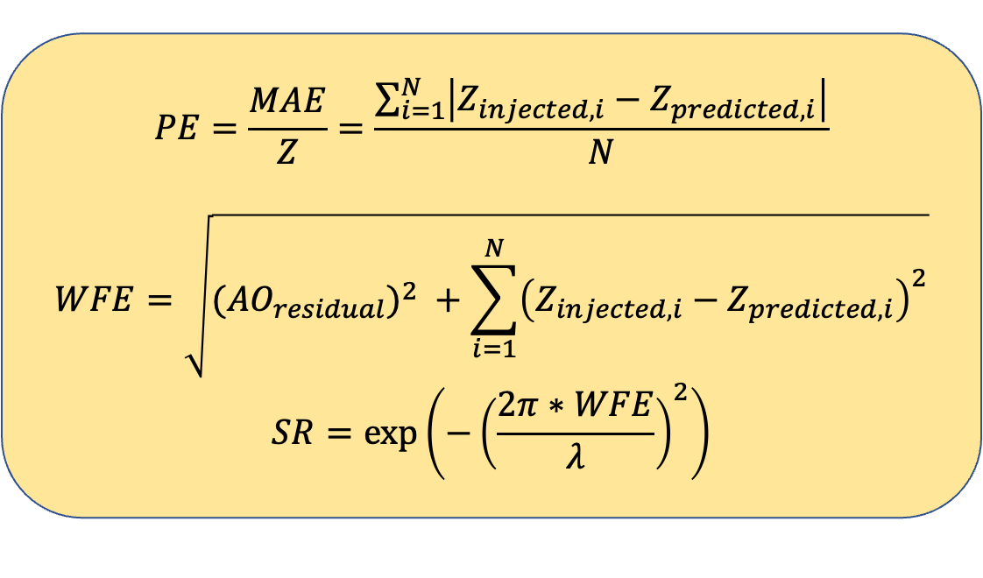
Training, Testing and merit figures
Results come from simulated images:
Train-set 10 000 images
Test-set 100 images (different conditions)
We need merit factors to evaluate the efficiency of the NN reconstruction:
$$PE=\frac{MAE}{Z}=\frac{\sum_{i=1}^{N}{\left|Z_{injected, i}−Z_{predicted,i}\right|}}{N}$$
$$WFE=\sqrt{{{(AO}_{residual})}^{2} +\sum_{i=1}^{N}{{\left(Z_{injected,i}−Z_{predicted,i}\right)}^{2}}}$$
$$SR=\exp\left(−{\left(\frac{2π∗WFE}{λ}\right)}^{2}\right)$$
Terreri Alessandro
13 /25
Wavefront Sensing in the VLT/ELT era VII - Porto

Slide 14
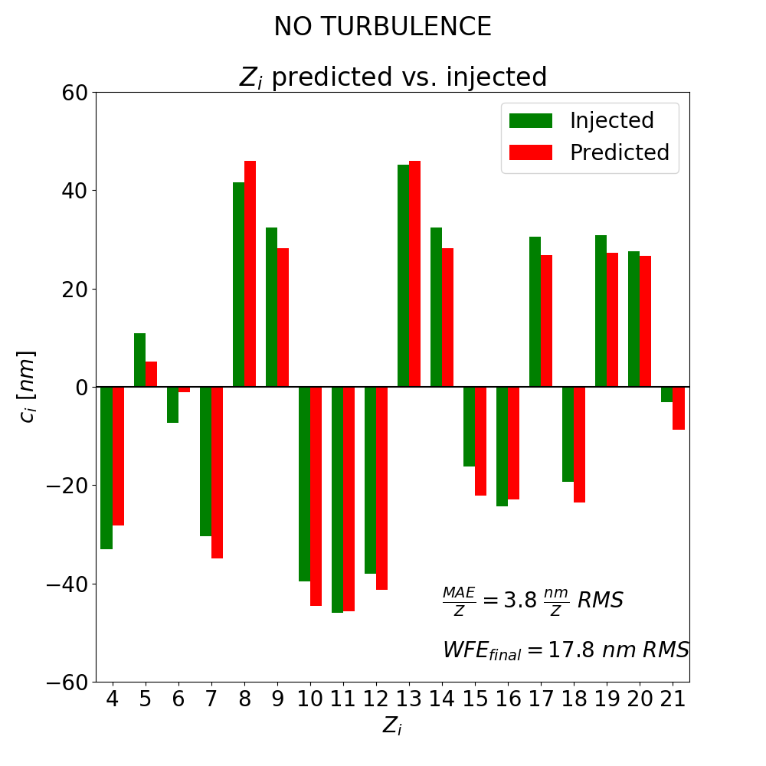
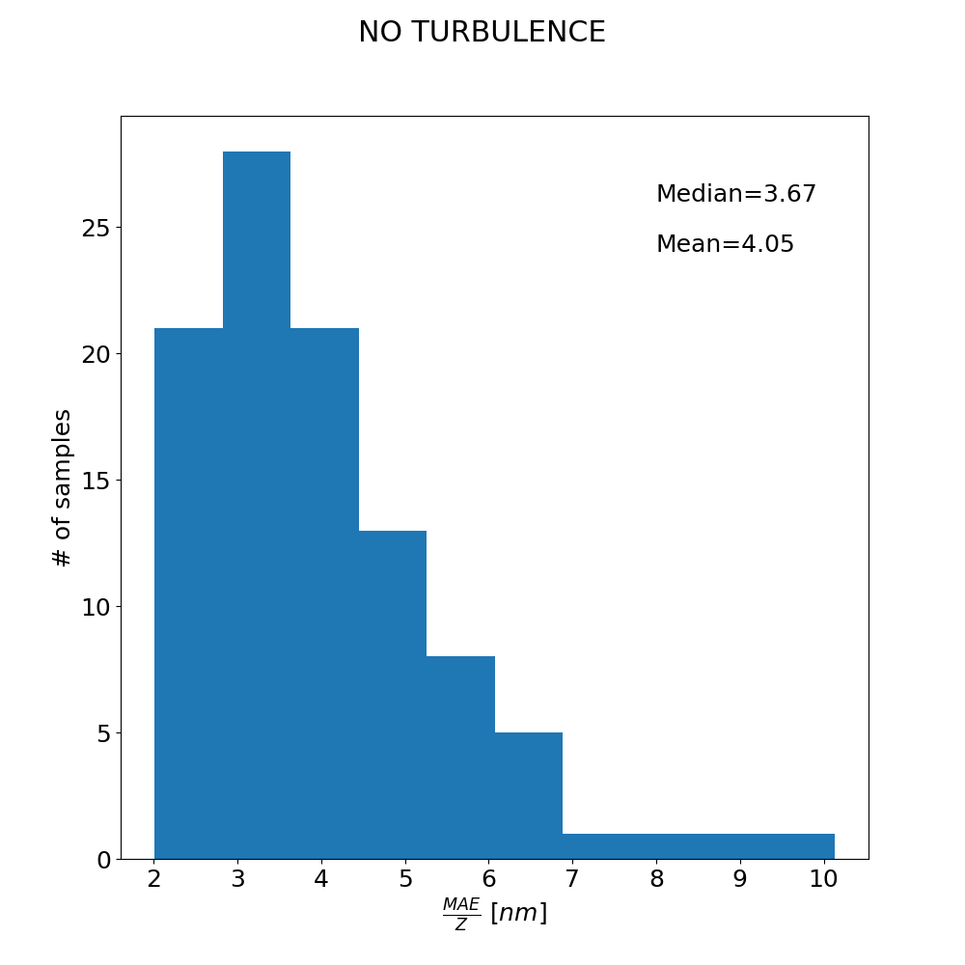

Ideal case: ONLY NCPA
SIMULATIONS
TESTSET: distribution
of prediction error for 100 images
Single image: $Z_{i}$ predicted vs. injected
Median=3.7 nm
nm
Mean=4.1 nm
Example
on 1 image
Terreri Alessandro
14 /25
Wavefront Sensing in the VLT/ELT era VII - Porto

Slide 15
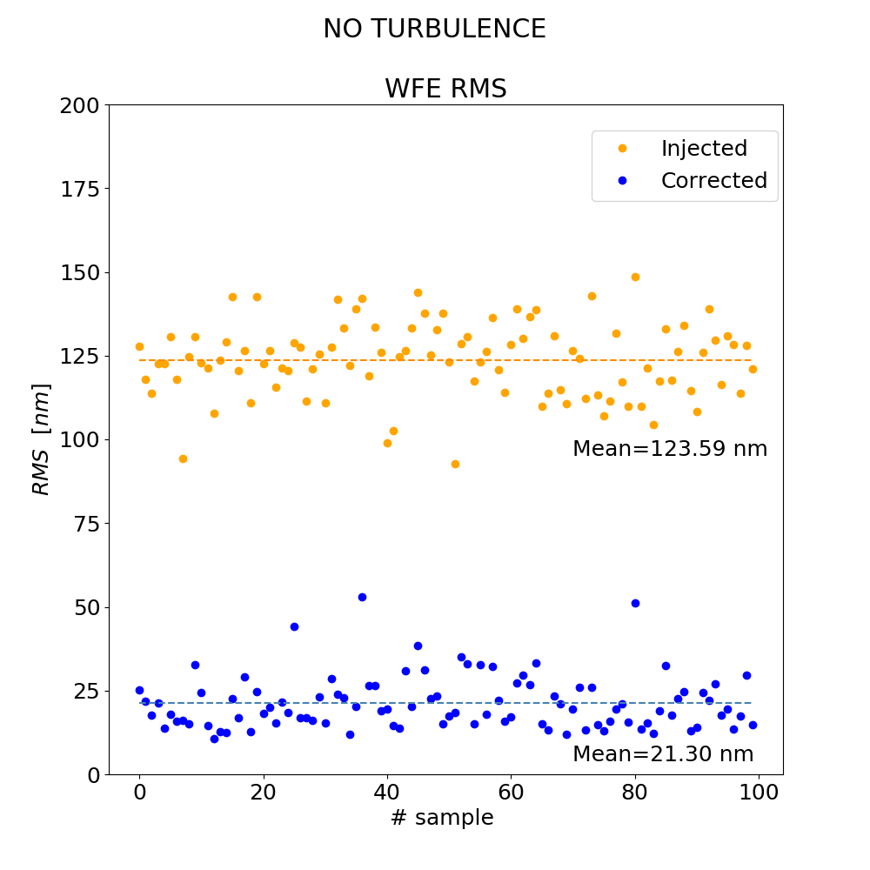
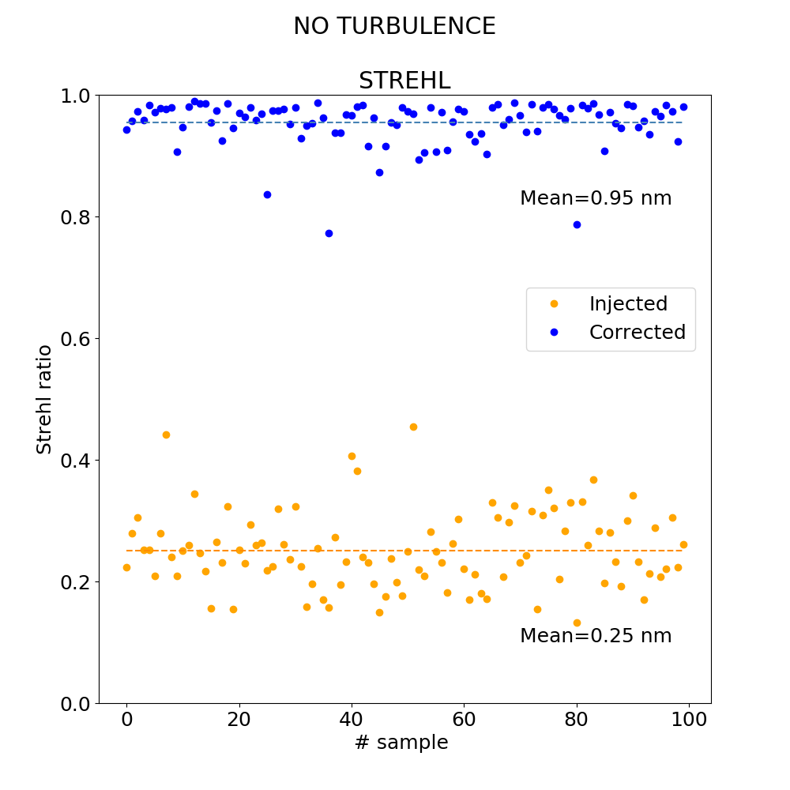
Simulation of correction: from 123 to 21 nm WFE
SIMULATIONS
Mean=0.95
Mean=0.25
Terreri Alessandro
15 /25
Wavefront Sensing in the VLT/ELT era VII - Porto

Slide 16
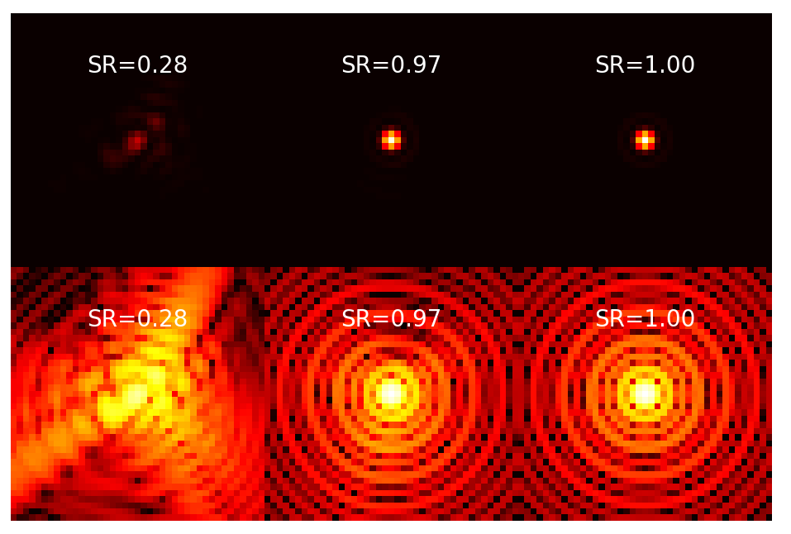
Effects in the focal plane
SIMULATIONS
Example:
1 image of the TEST-SET
After NN Prediction/Correction
Diffraction Limit
Linear scale
Log scale
Terreri Alessandro
16 /25
Wavefront Sensing in the VLT/ELT era VII - Porto
Notes:
Toglierei quell fattore moltiplicativo della scala log

Slide 17
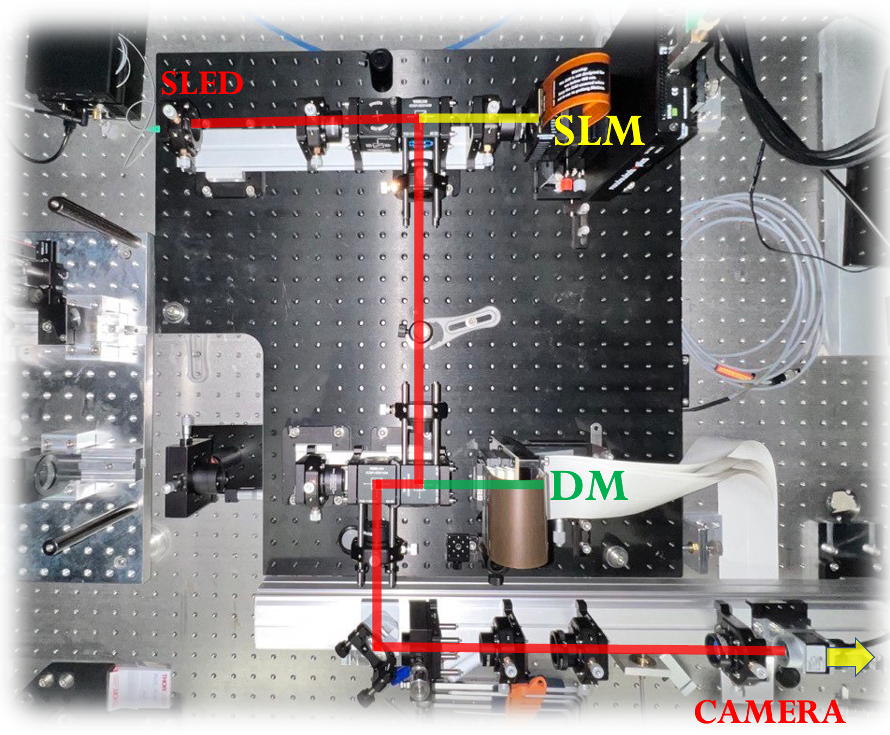
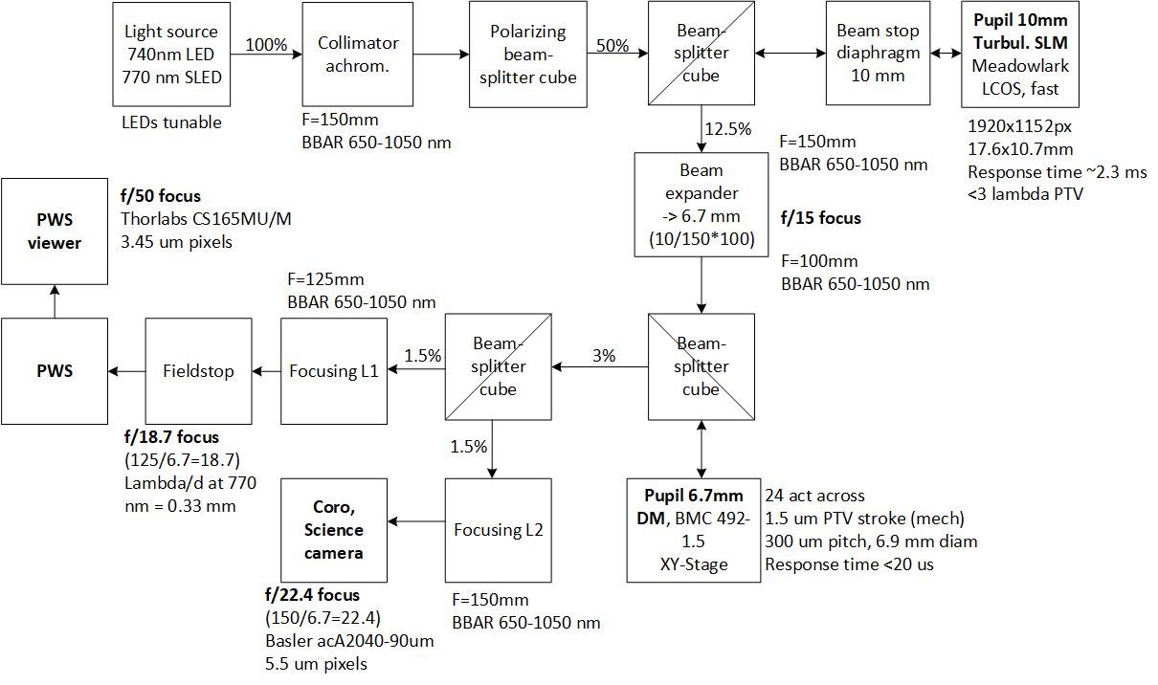
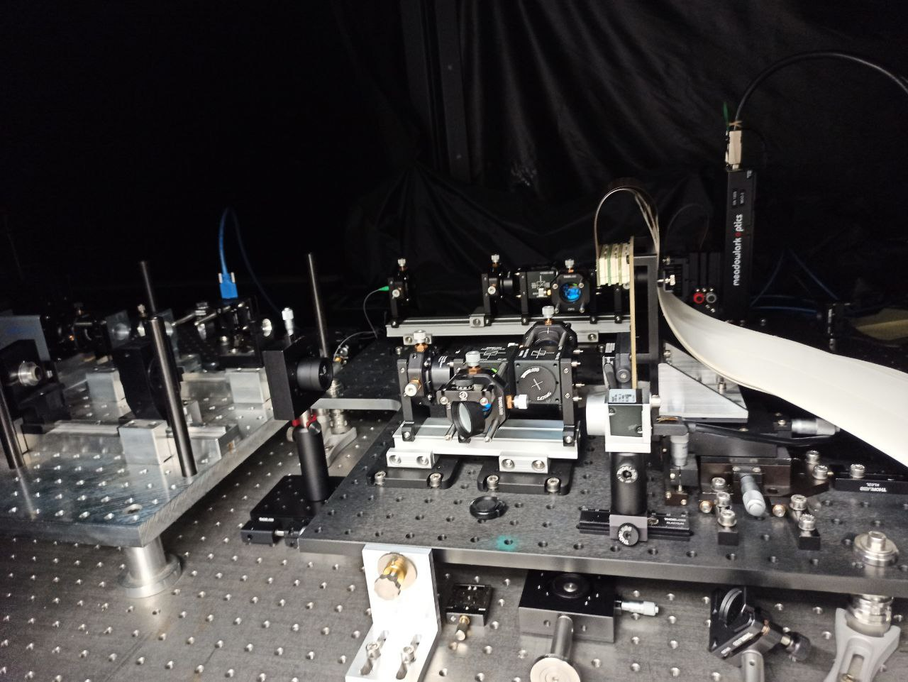
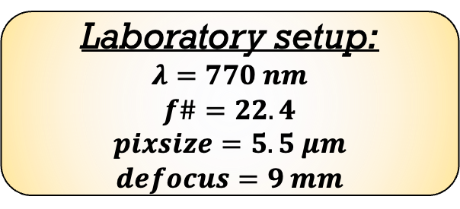

EXPERIMENTAL: GHOST bench
EXPERIMENTAL
Laboratory setup:
$$λ=770 nm$$
$$f\#=22.4$$
$$pixsize=5.5 μm$$
$$defocus=9 mm$$
I used the Spatial Light Modulator (SLM) to inject:
Aberrations
AO residual
(still working)
Experimental work to control bench and train the new NN
Move manually the camera out of focus and test the NN
CAMERA SHIFT $≈9 mm$
Use of iterative process
of correction
Terreri Alessandro
17 /25
Wavefront Sensing in the VLT/ELT era VII - Porto

Slide 18



Results on the GHOST bench with Iterative process
EXPERIMENTAL
I chose a set of coefficients randomly in the range [-50,+50] nm for the 21 Zernike polynomials and then:
NCPA is injected through the SLM
We perform a measurement with NN
We can inject back in the SLM the values measured by NN
WFE [nm] RMS
# Iteration step
WE PERFORM BETTER AND FASTER THAN HUMAN
Terreri Alessandro
18 /25
Wavefront Sensing in the VLT/ELT era VII - Porto

Slide 19
With AO closed loop residual turbulence
Three possible approaches to mitigate NCPA using NN:
AO Residual + random NCPA
AO residual + Fixed NCPA
Iterative correction using the AO loop
Terreri Alessandro
19 /25
Wavefront Sensing in the VLT/ELT era VII - Porto

Slide 20




1. AO Residual + random NCPA
SIMULATIONS
TESTSET: prediction error distribution for 100 images
Single image: $Z_{i}$ predicted vs. injected
Median=4.9 nm
nm
Mean=5.4 nm
Example
on 1 image
Terreri Alessandro
20 /25
Wavefront Sensing in the VLT/ELT era VII - Porto

Slide 21


1. AO Residual + random NCPA
From 133 nm to 58 nm WFE RMS
SIMULATIONS
AO limits for WFE and SR
Terreri Alessandro
21 /25
Wavefront Sensing in the VLT/ELT era VII - Porto

Slide 22


2. AO residual + Fixed NCPA
#100 fast exposures with fixed NCPA…. From 139 to 57 nm WFE RMS
SIMULATIONS
Take home message:
We can infer the NCPA as the average of the predicted aberrations
From initial value of $WFE=139 nm$ to $57 nm$ (AO residual limit 50 nm)
Terreri Alessandro
22 /25
Wavefront Sensing in the VLT/ELT era VII - Porto

Slide 23

3. Iterative correction using the AO loop
From 184 nm to 50.5 nm WFE RMS
SIMULATIONS
(AO residual limit 50 nm)
Terreri Alessandro
23 /25
Wavefront Sensing in the VLT/ELT era VII - Porto

Slide 24
Experimental Results
EXPERIMENTAL
ON-GOING ???
let’s see
Terreri Alessandro
24 /25
Wavefront Sensing in the VLT/ELT era VII - Porto

Slide 25
CONCLUSIONS
This new proposed algorithm based on NN and PCA coefficients WORKS….. correctly identify relations between defocused images and wavefront phase at the pupil plane.
It is possible to use it to mitigate completely all the static/quasi static aberrations in CONTROLLED conditions (such as Laboratory condition, the instrument has a calibration/reference source, characterizing optical elements or the entire optical path)
Compared to MANUAL trial-and-error approach:
FASTER …< 1 minute → NN prediction on one image < 1 ms
BETTER… 7% more in terms of maximum in the peak compared to values found MANUALLY by an EXPERT in optics.
It is possible to use this algorithm to minimize NCPA using the NN on:
A single image
Series of images in frozen flow condition with the same NCPA (FAST IMAGING APPROACH)
Single or series of images but with the real time correction thanks to some Active Optical Elements (such as DM,DL or SLM …. typically on AO system)
IDEAL CONDITION
TURBULENCE CONDITION
Terreri Alessandro
25 /25
Wavefront Sensing in the VLT/ELT era VII - Porto
Notes:
I risultati li metterei in una tabella e prometterei meno per il prossimo anno da decider insieme cosa promettere

Slide 26



$∗N^{2}ONCPA$ stands for «Neural Network 2 Optimize NCPA»
But if you switch apex with pedic it probably brought to your mind $N_{2}O$ brute formula for Nitrous Oxide (NOS) used in cars to boost the output of the engine for a limited duration… BECAUSE WE WANT TO REMOVE THE NCPA FASTLY
Or the anesthetic used in surgery… BECAUSE WE WANT THE ABERRATIONS TO GO TO SLEEP
😜
Thank you for the attention
ORIGINAL IDEA:
Terreri et al 2022, A&A, Neural networks and PCA coefficients to identify and correct aberrations in adaptive optics, DOI:10.1051/0004-6361/202142881
EXPERIMENTAL RESULTS:
Terreri et al. 2022, SPIE Proceedings, Experimental verification of NN and PCA for NCPA mitigation

Slide 27
Published papers
A.Terreri et al.2022, A&A,Neural Networks and PCA coefficients to identify and correct aberrations in Adaptive Optics DOI: 10.1051/0004-6361/202142881
A.Terreri et al.2022, SPIE, Experimental verification of NN and PCA for NCPA mitigation DOI:10.1117/12.2629249
Papers as co-author
G.Viavattene et al. 2022, SPIE, DOI: 10.1117/12.2629400 , ELVIS: the exoplanets at LBT with a visible IFS for SHARK-VIS
F. Pedichini et al.2022, SPIE, SHARK-VIS ready for the stars: instrument description and final laboratory performance test, DOI: 10.1117/12.2629244
R.Briguglio et al 2022, SPIE, Demonstrating the sub-nanometer sensitivity of a pyramid WaveFrontSensor for active space telescopes, DOI: 10.1117/12.2599825
G.Viavattene et al. 2022, IBIS-TRE-01: Conceptual design of the IBIS 2.0 polarimentric unit, DOI:10.20371/INAF/TechRep/136
R.Briguglio et al.2022, SPIE, Laboratory characterization of a large format, contactless active mirror with intrinsic rejection of vibrations, DOI:10.1117/12.2628730
SUMMARY
of
PhD activities
Poster
A.Terreri et al.2022, Poster, DOI:10.1117/12.2629249, Experimental verification of NN and PCA for NCPA mitigation
Talks
Workshop «Wavefront sensing in the VLT/ELT era»,Firenze, 2019
Workshop «Network of Young Researcher in Instrumentation for Astronomy», 2021
ESA-ESO SCIOPS, 2022, DOI: 10.5281/zenodo.6568531, Neural Networks and PCA coefficients to identify and correct aberrations in Adaptive Optics
Workshop Ottica Adattiva Italiana «ADONI», Teramo, 2022
Conference «Machine Learning at Galileo Galilei Institute», Firenze, 2022
AO4ELT, Porto, 2022 (SCHEDULED)
Schools
INAF, «Deep Learning @INAF», Pula (Sardegna), 16-19 September 2019
International School of Space Science, L’Aquila, «Dynamical system and machine learning approaches to Sun-Earth relations», 1-5 February, 2021
Space Science Institute, «Applications of Statistical Methods and Machine Learning in the Space Sciences», May 17-21,2021
CFAO, University of California (Santa Cruz), «Summer school on Adaptive Optics», 16-20 August 2021
Internship
3 months Internship at the European Southern Observatory (ESO) in Garching Bei Munchen, Germany, 7 April – 8 July 2022

Slide 28








NN_0
NO Turbolenza
FLUSSO 1e6
FLUSSO 1e5
FLUSSO 1e4
FLUSSO 1e3
RMS= 0.8 nm
RMS= 1.2 nm
RMS= 0.8 nm
RMS= 13 nm

Slide 29








NN_0.5
Turbolenza 50nm RMS
FLUSSO 1e6
FLUSSO 1e5
FLUSSO 1e4
FLUSSO 1e3
RMS= 3.7 nm
RMS= 3.8 nm
RMS= 3.5 nm
RMS= 18.9 nm

Slide 30








NN_1
Turbolenza 100 nm RMS
FLUSSO 1e6
FLUSSO 1e5
FLUSSO 1e4
FLUSSO 1e3
RMS= 6.9 nm
RMS= 7.1 nm
RMS= 7.5 nm
RMS= 26 nm

Slide 31


HIGH CONTRAST
4m solar granulation simulation
Distinguish star in multiple system
Solar Granulation studies
Identification of exoplanets (2)
Better photometry estimation (AGN)
without correction
with correction (2000modes)
Fast imaging and CADI
31
2020 Workshop for PhD Program in Astronomy, Astrophysics and Space Science
Terreri Alessandro

Slide 32






Two sides of the same coin
ZERNIKE
Both encode the same out of focus image
PCA
$$φ=NCPA=\sum_{i=1}^{21}{c_{i}Z_{i}}$$
$$I≈\sum_{i=1}^{500}{d_{i}{PCA}_{i} }$$
Terreri Alessandro
32 /38
Machine Learning at Galileo Galilei Institute

Slide 33


TURBULENCE frozen flow by FAST IMAGING
Fixed NCPA
AO residual
AO residual+ Fixed NCPA
FAST IMAGING allows freezing of turbulence
AVERAGING
AVERAGING
Terreri Alessandro
33 /34
AASS PhD WORKSHOP 2022
Notes:
Animazioni confondono e fanno perdere tempo mi dispiace ma queste immagini non sono chiare

Slide 34
New results after improving image centering
EXPERIMENTAL
FLAT SLM
WFE [nm]
# Iteration step
100
STILL WORKING TO IMPROVE RECENTERING
EVEN IF IT IS NOT NECESSARY

Slide 35


When is the image good?
Aberrated image
Speckles
&
AO residual
Control
radius
NCPA EFFECT consists of static/quasi-static or slowly evolving intensity structures like these.
SR = $\frac{peak(aberratted image)}{peak(theoretical image)}$
Terreri Alessandro
35 /34
AASS PhD WORKSHOP 2022
Notes:
Mettere profilo radiale

Slide 36


AO residual model
Phase screen [4096x4096] pixel
LBT Pupil Ø 8200mm
[440x440]pixel
Sampling: 18mm
Kolmogorov spectrum
high pass filtered to match AO residual during calibration @LBT
BEWARE !
From now on, simulations will contain high order aberrations (from the phase screen) unknown to the neural network during the training…
$$WFE≈50 nm RMS$$
Terreri Alessandro
36 /34
AASS PhD WORKSHOP 2022

Slide 37


Good fit of AO residual vs experimental data!
SIMULATED
PSF RADIAL PROFILE
λ = 630nm
EXPERIMENTAL
mas
Terreri Alessandro
37 /34
AASS PhD WORKSHOP 2022
Notes:
Non si usa una freccia ma si scrive Texp.=….

