Slide 1
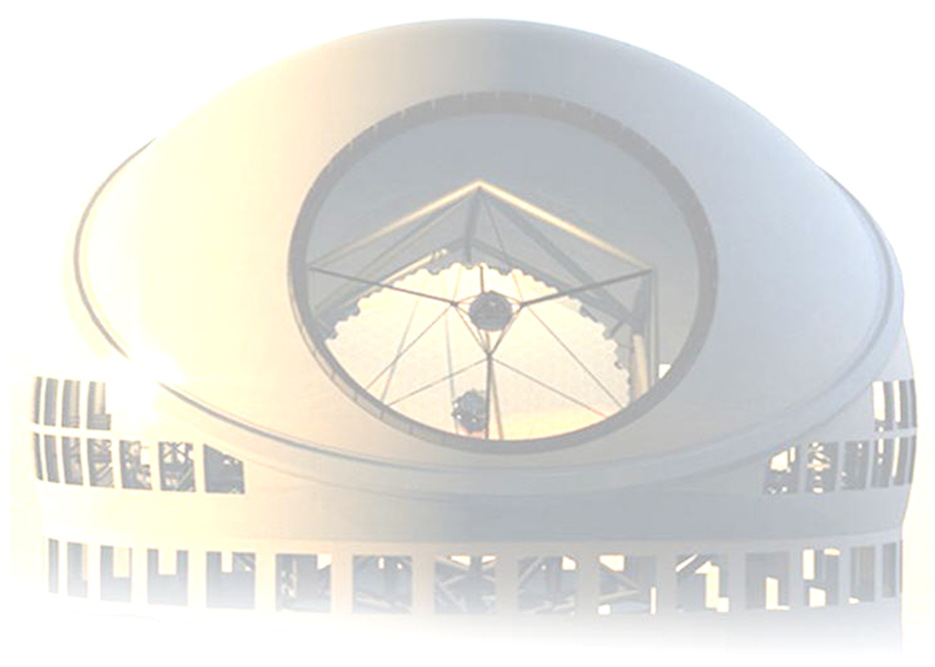
First on-sky demonstration of the C-BLUE One camera and the HEART RTC platform on REVOLT
Oct 21, 2022
Jean-Pierre Véran
National Research Council Canada
Herzberg Astronomy & Astrophysics, Victoria, BC
Presentation to the AO WFS Workshop in Porto (Oct 19-21, 2022)

Slide 2
REVOLT
Research, Experiment, and Validation of Adaptive Optics with a Legacy Telescope
REVOLT is an SCAO system for the HAA 1.2m McKellar telescope
Operates at the Coudé focus, just like VOLT in 2008
REVOLT is intended as a test bench to test new AO technologies developed by or critical to HAA on sky.
Complements HAA AO Lab
Two successful runs so far
Aug 2022 (one night)
Sep 2022 (two nights)
Site characteristics:
Seeing = 1.5” (best) / 2.1” (mean) / 2.5” (90%tile) / 4.2” (worst)

Slide 3
AO technologies to be tested
✓
First Light C-Blue One camera
NFIRAOS LGS WFS camera)
HEART RTC Platform
To be used in NFIRAOS, GNAO, GPI2, GIRMOS and possibly MORFEO and ANDES
Fiber-fed photonic spectral correlation sensor
Remote gas detection and identification technique
Developed by NRC-AEP and NRC-HAA, based on correlation spectroscopy with a piezoelectric tunable fiber-optic Fabry-Perot filter
Open-loop AO (GIRMOS), PWFS control, Advanced control algorithms
20x20 Low-voltage DM prototype (NRC-NanoTechnology)
512x512 Saphira NIR APD camera
✓

Slide 4
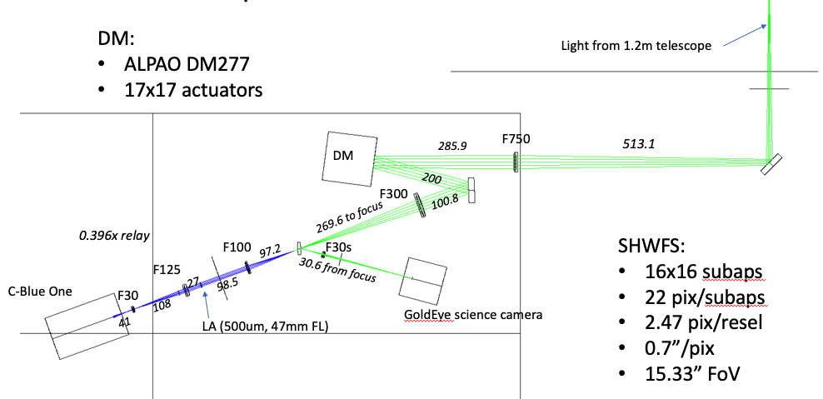
REVOLT with Alpao DM + C-Blue-One

Slide 5
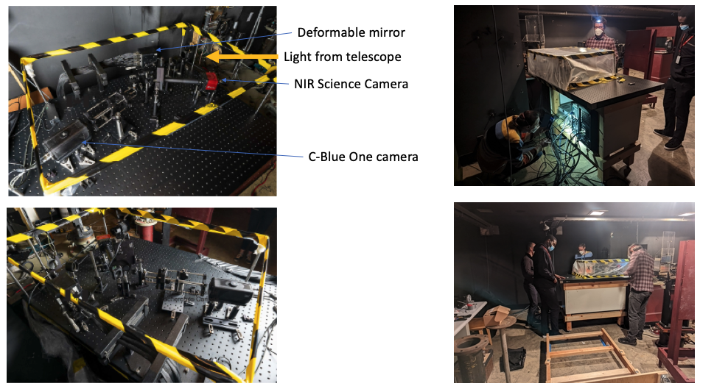
REVOLT in the Coudé room

Slide 6
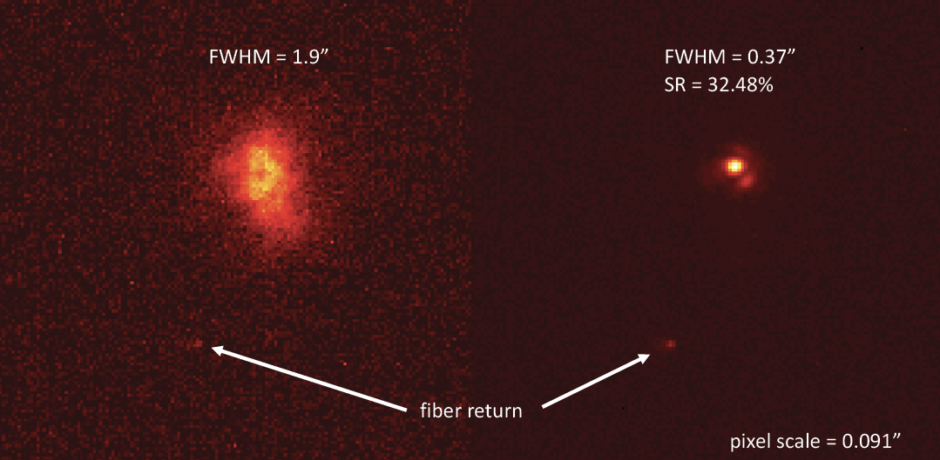
First results
Alpha Persei (Mirfak) Aug 12
“H-Band” (1600nm ± 50nm)
Frame rate = 1 kHz
Airy: FWHM = 0.28”
Uncorrected
AO corrected

Slide 7
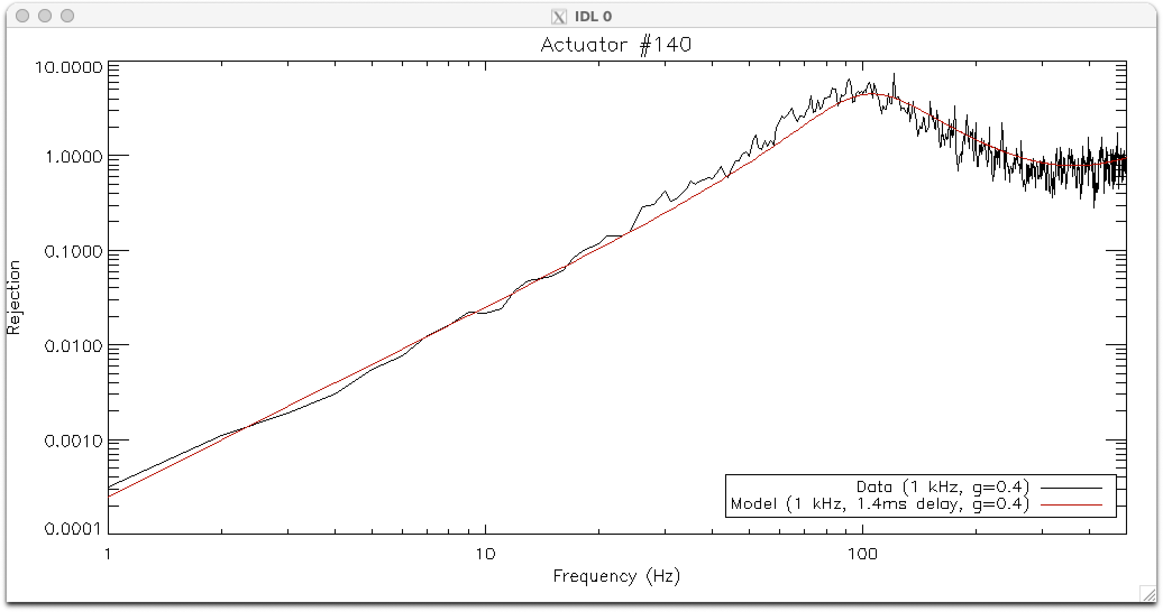
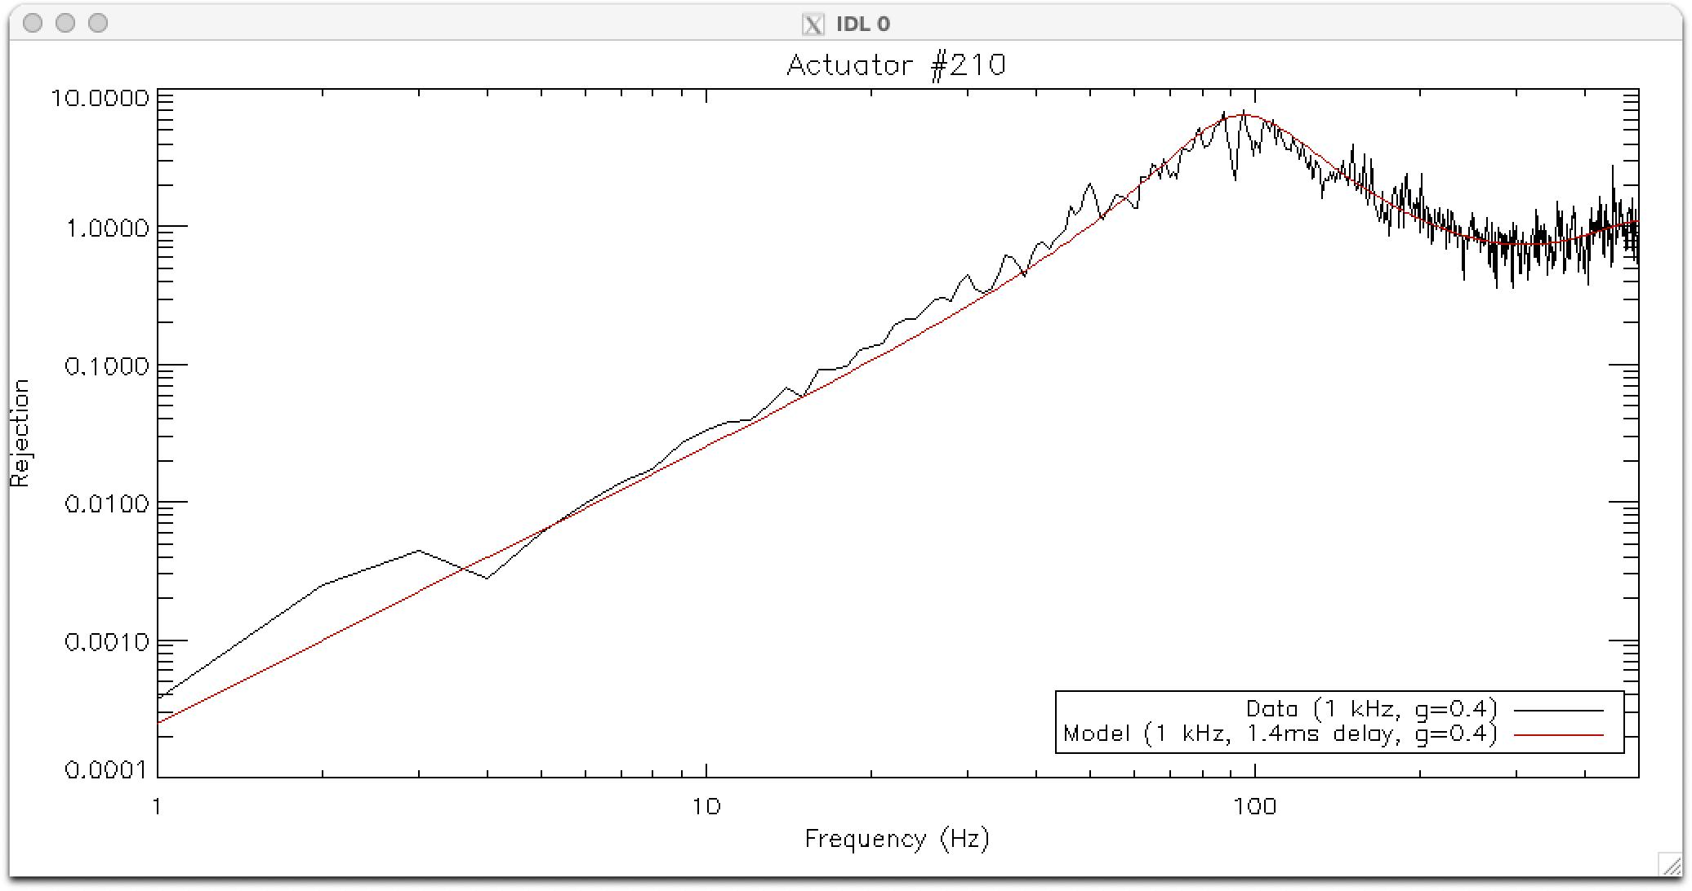
Rejection transfer functions
Using open-loop and closed loop data with r0=5cm disturbance
Very clean fit
Interface to C-Blue One is CoaXPress 2.0
No pixel streaming – frame must be complete to be available
ROI 352x352 pixels read from camera @ 1 kHz
Integration time = 891 us
Uncorrected
AO corrected

Slide 8
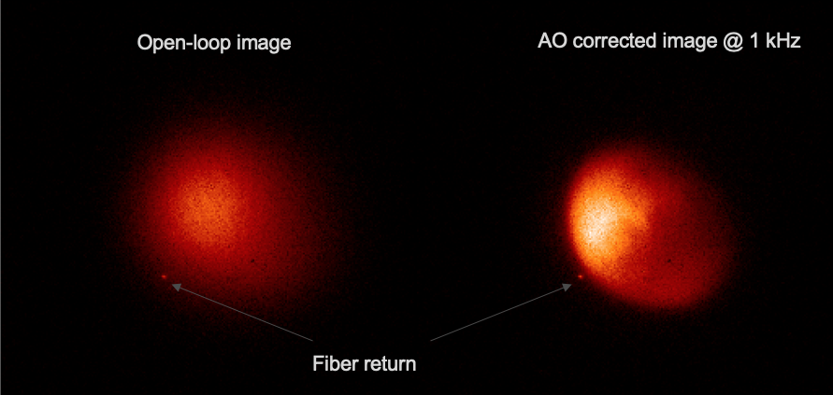
MARS !
Mars (10.29” diameter – Sep 9, 2:45am PDT)
Sub-aperture FOV: 15.3”
50 images, 0.75s per image H-band
Uncorrected
AO corrected

Slide 9
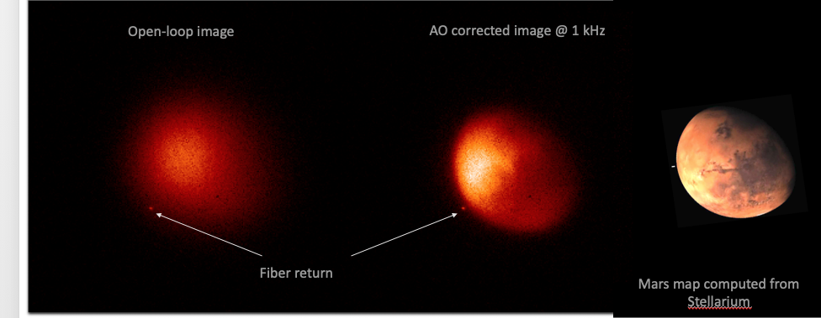
MARS !
Uncorrected
AO corrected

Slide 10
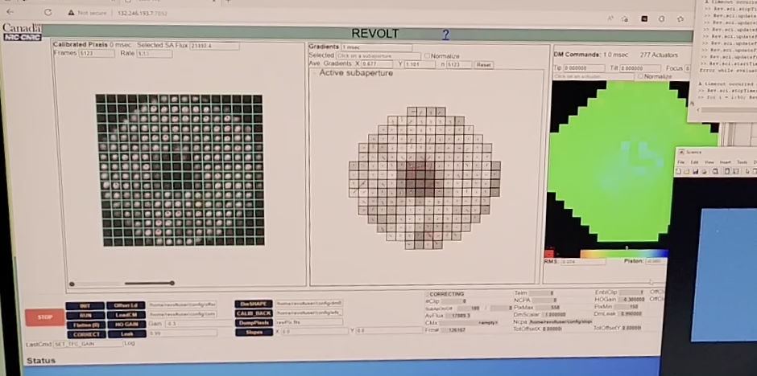
REVOLT GUI
Uncorrected
AO corrected

Slide 11
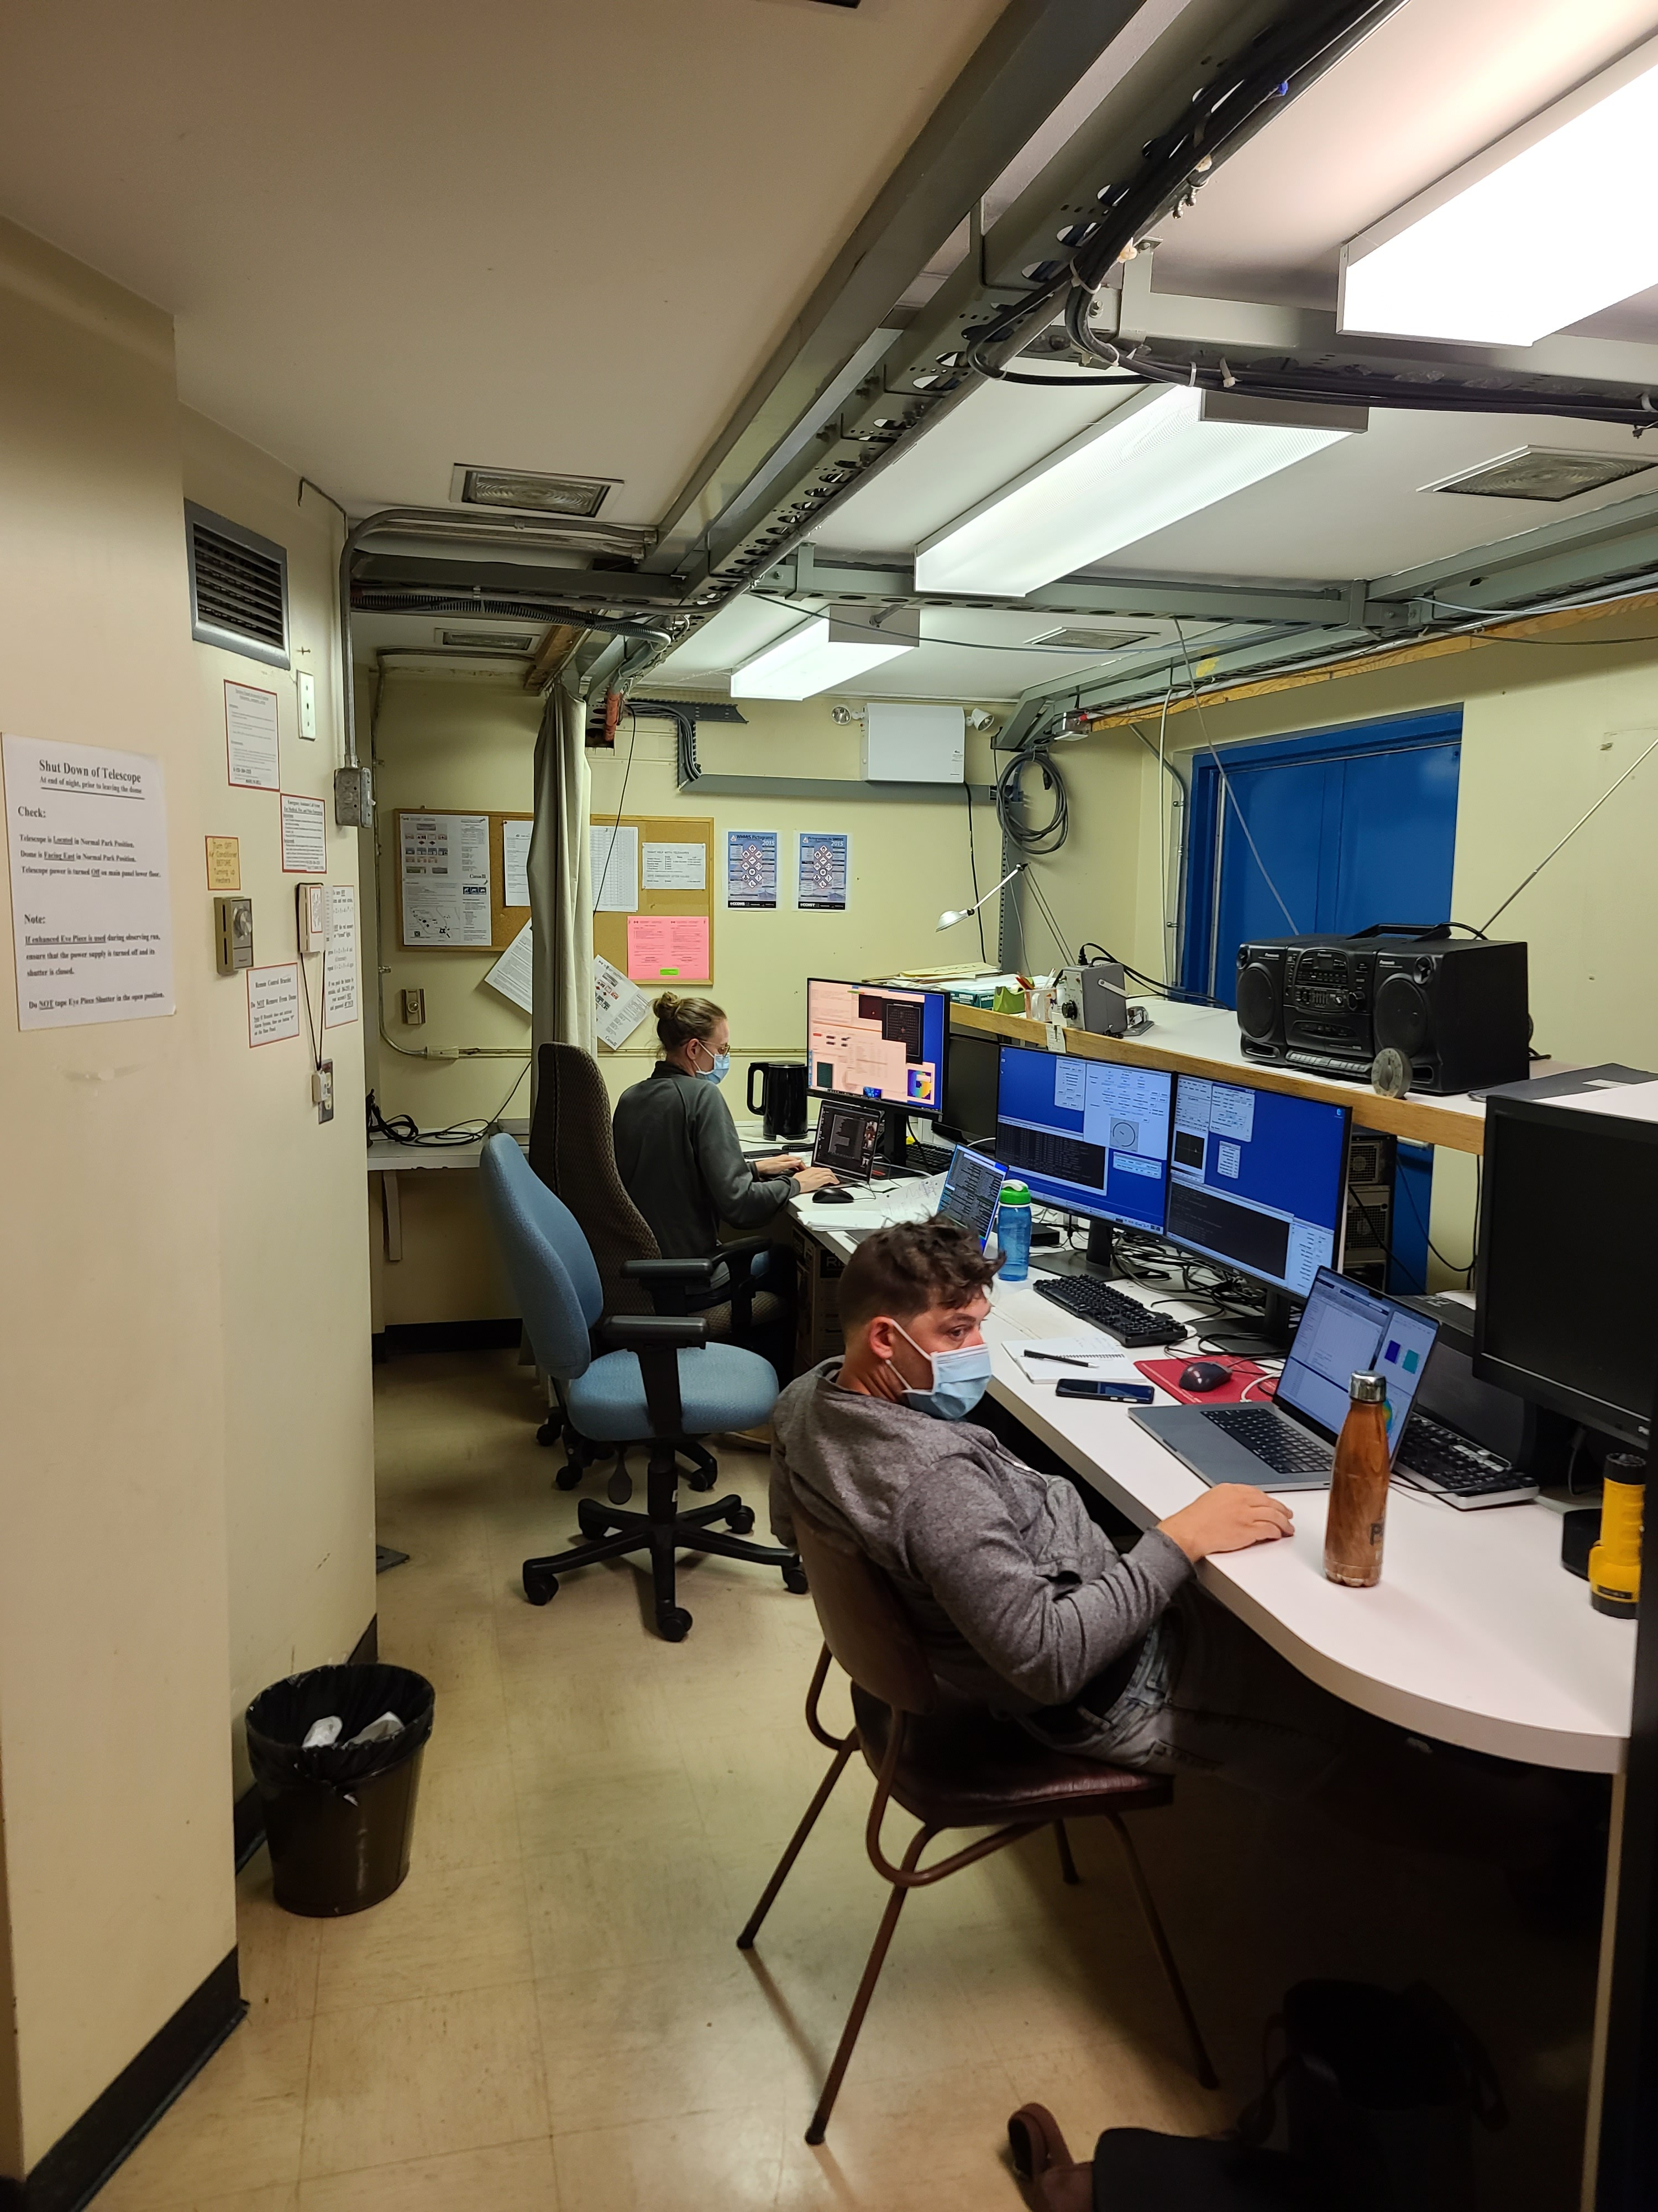
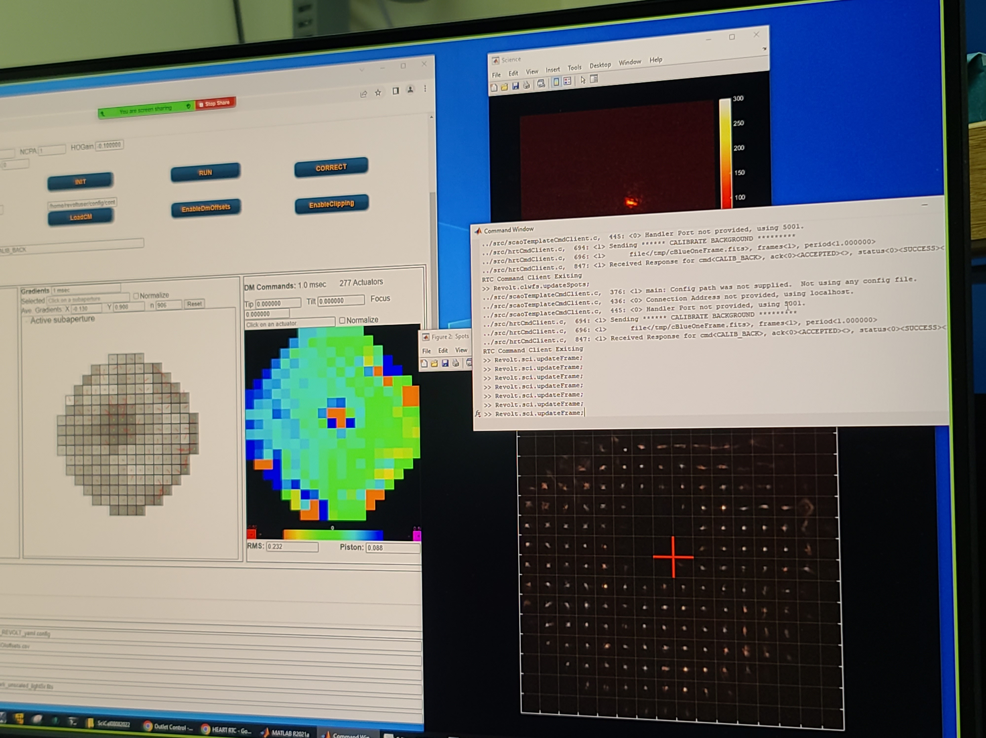
The REVOLT Team
AO Group
Kate Jackson
Dave Andersen
Tarun Kumar (PhD student)
Daniel Muhwezi (co-op student)
Jean-Pierre Véran
Optics Group
Olivier Lardière
Software Group
Jennifer Dunn
Darryl Gamroth
Dan Kerley
Lianne Mueller
Malcolm Smith
Ed Chapin
Jonathan Stocks
Telescope Group
Dmitry Monin
David Bohlender
1.2m telescope control room
Special thanks to Uriel Conod (foreground) for his help during the Aug 2022 run.

