Slide 1
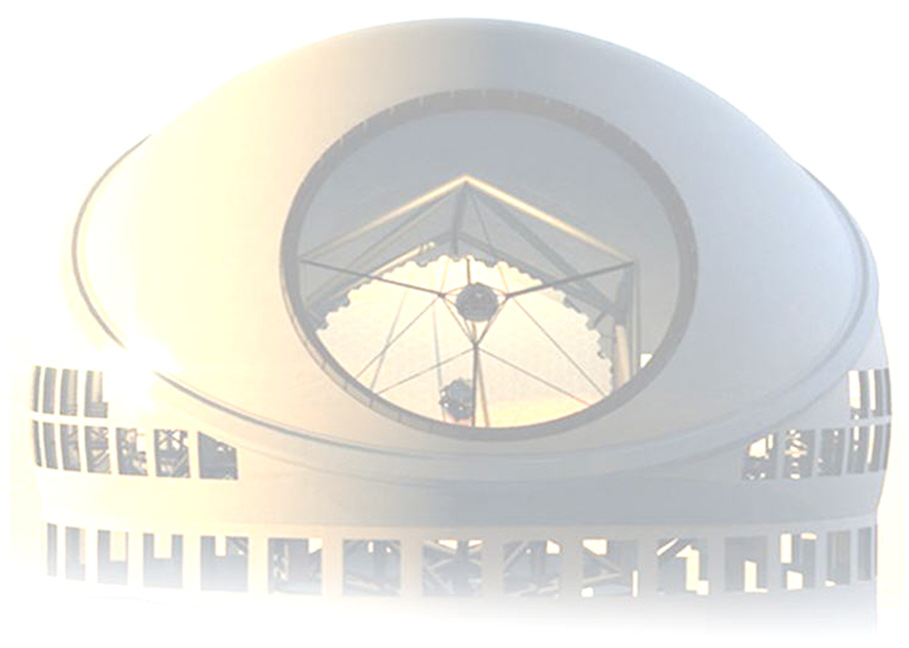
Time-Resolved Pyramid Wavefront Sensing using Photon-to-Digital Converters
Oct 21, 2022
Jean-Pierre Véran
NRC, Herzberg Astronomy & Astrophysics, Victoria, BC
Simon Carrier, Serge Charlebois, Jean-François Pratte
University of Sherbrooke
Presentation to the AO WFS Workshop in Porto (Oct 19-21, 2022)

Slide 2
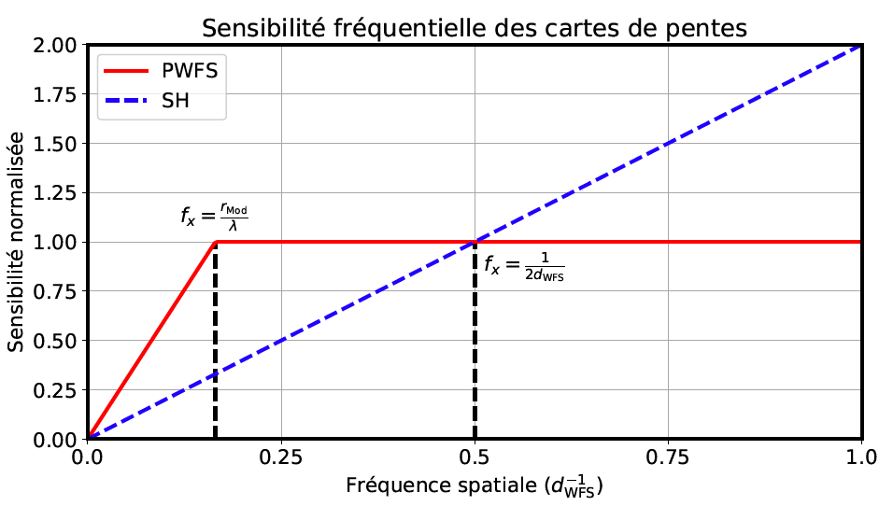
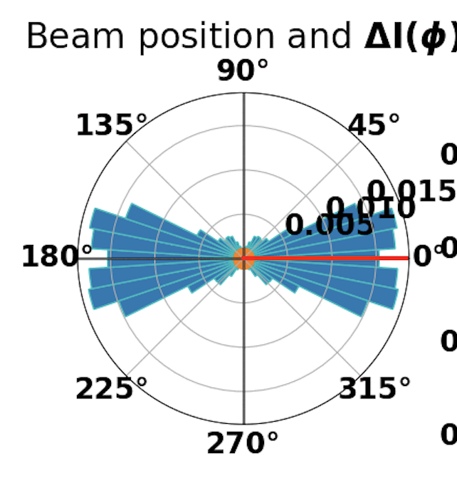
Sensitivity of PWFS
For a modulated PWFS, low spatial frequencies have reduced sensitivity
Some positions in the modulation cycle provide useful information
Some positions in the modulation cycle provide useless information
If the modulation cycle can be temporally resolved, then we could reject the photons providing useless information

Slide 3
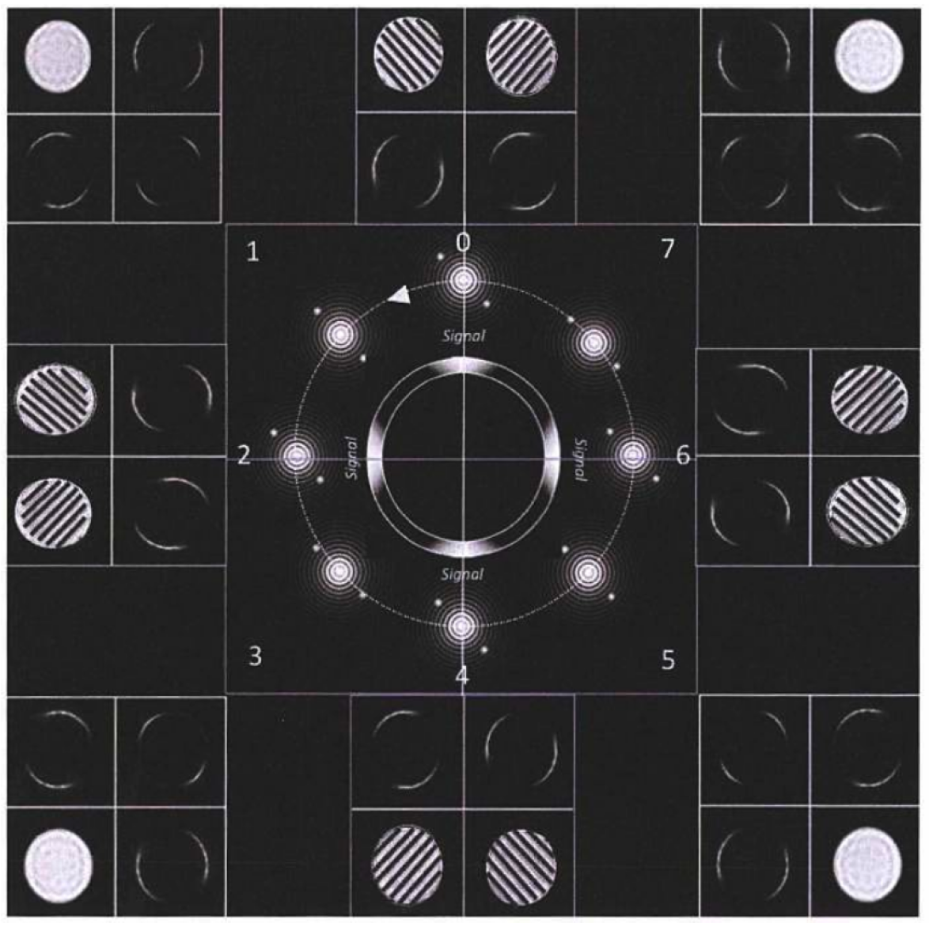
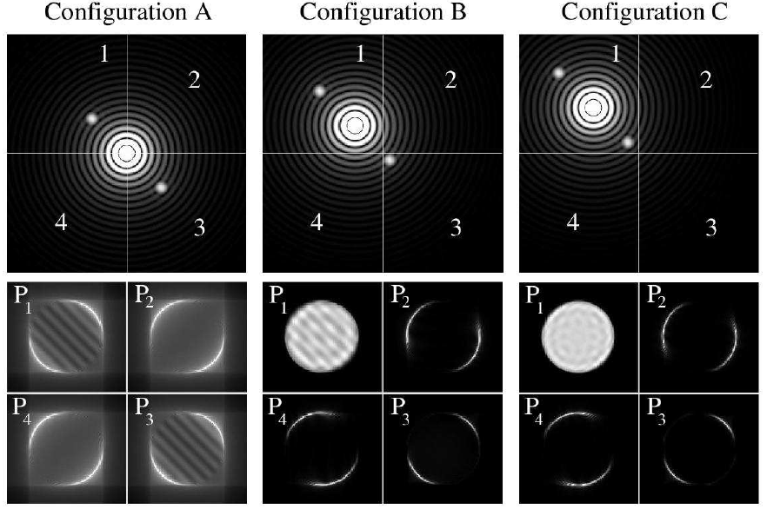
PWFS signal
A useful signal (fringes) is recorded only when the two speckles are on a different face of the pyramid
This is always the case when f>r_{mod}/𝝀 but when f < r_{mod}/𝝀 there is some time during the modulation cycle when photons are recorded (thus contributing to noise) but no useful signal (”desert crossing”). These photons should be ignored if possible to maximize the measurement SNR.
The size of the core of the Airy pattern and of the speckles is 𝝀/D (FWHM) where D is the telescope diameter
Typical modulation radius is r_{mod}=3-5𝝀/D
A larger modulation radius provide more dynamic range but reduces sensitivity.
Deo 2019, after Clergeon
Guyon, 2005

Slide 4
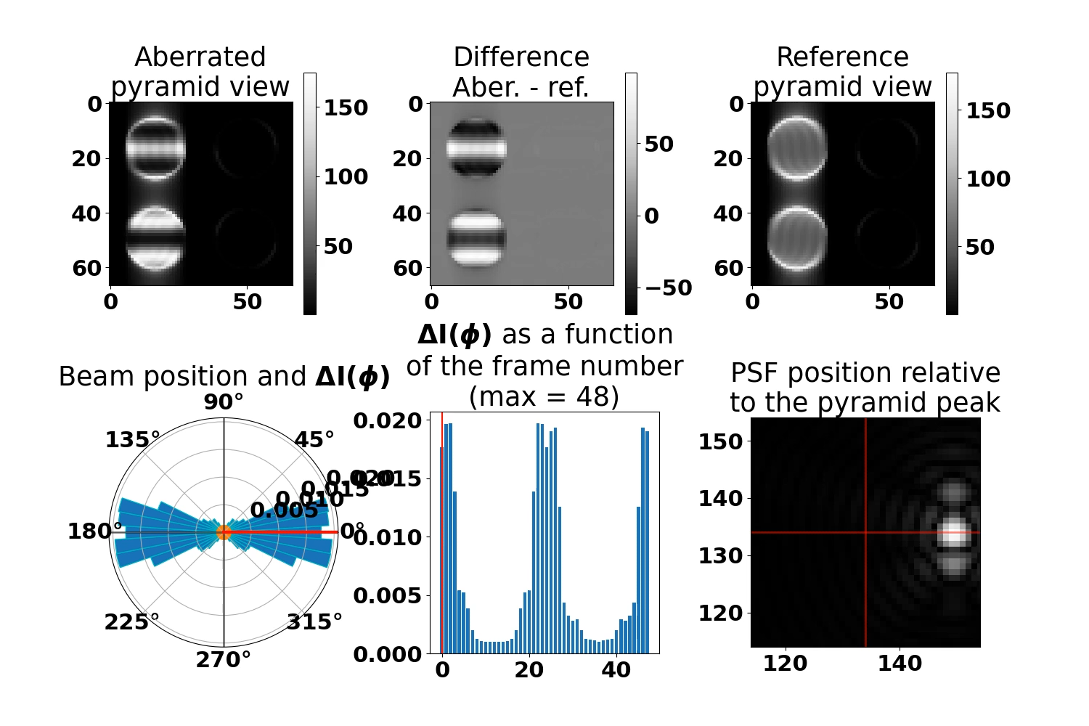
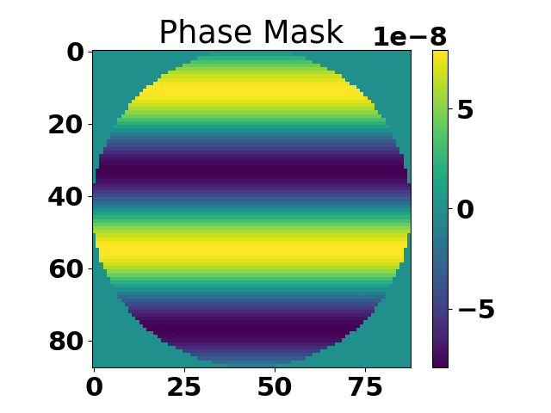
PWFS measurement
Low spatial frequency
Mode:
Modulation: 5𝜆/D
Measurement:
∆I(𝜑)=I/N-I_{ref}/N_{ref}
Only a few time slices are useful

Slide 5
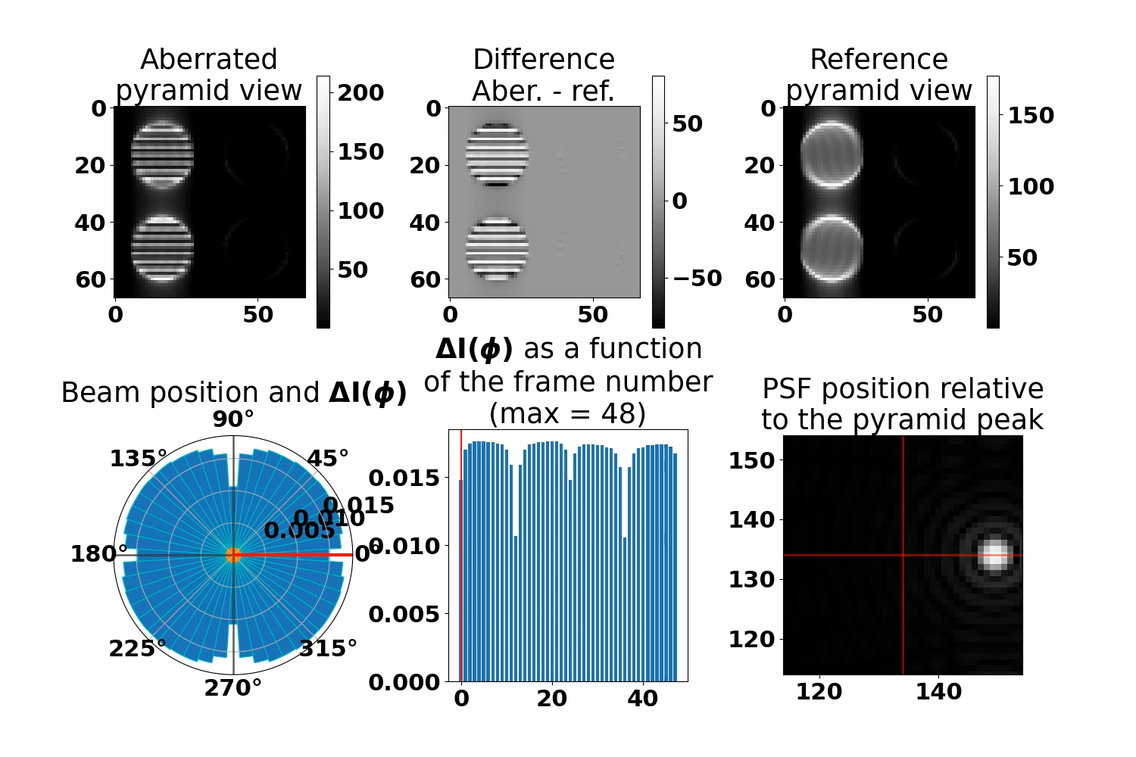
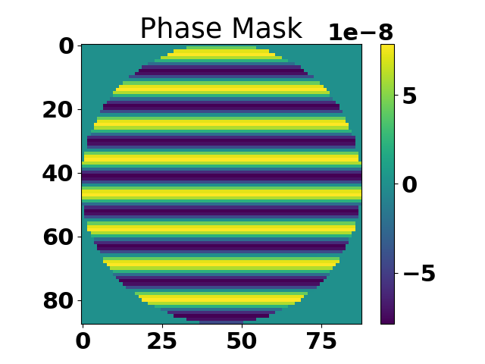
PWFS measurement
High spatial frequency
Mode:
Modulation: 5𝜆/D
Measurement:
∆I(𝜑)=I/N-I_{ref}/N_{ref}
All time slices are useful

Slide 6
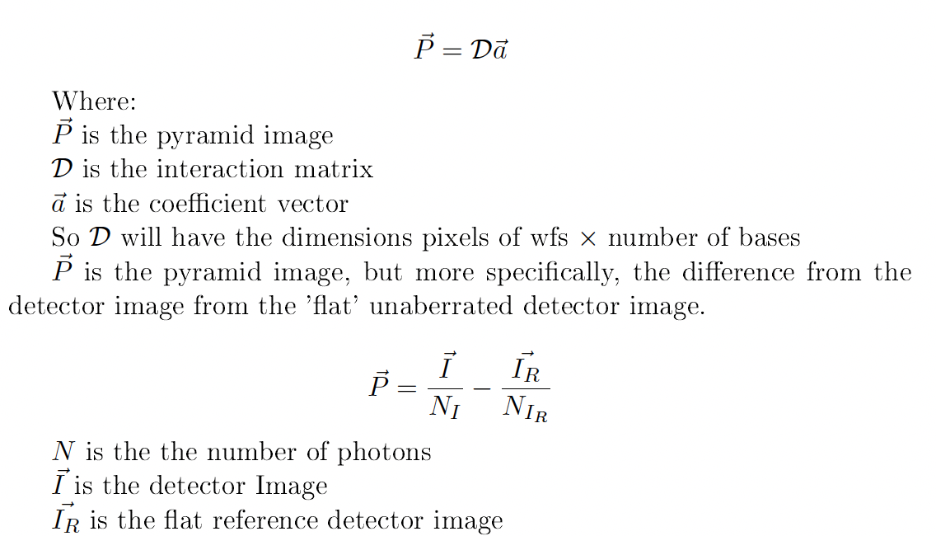
Noise propagation
Noise propagation coefficient
Noise variance
Propagated noise on mode #m
1/N_{I}
B_{m}/N_{Im}
Hopefully reduces when rejecting frames
Definitely reduces when rejecting frames

Slide 7
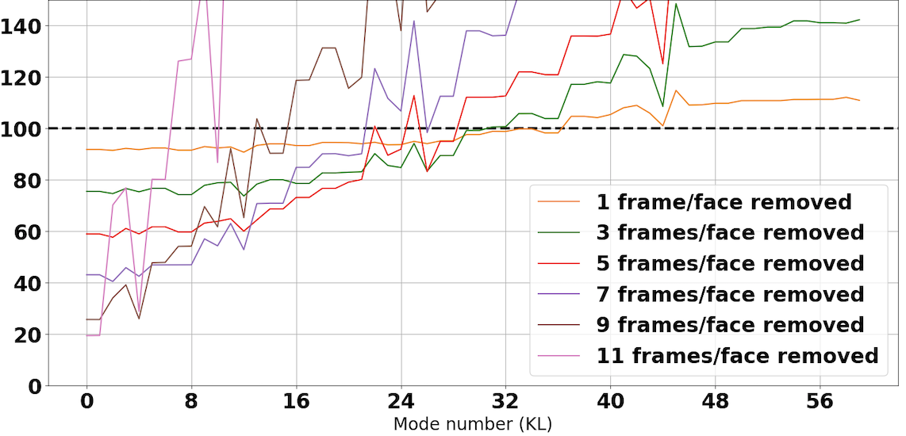
Noise propagation

Slide 8
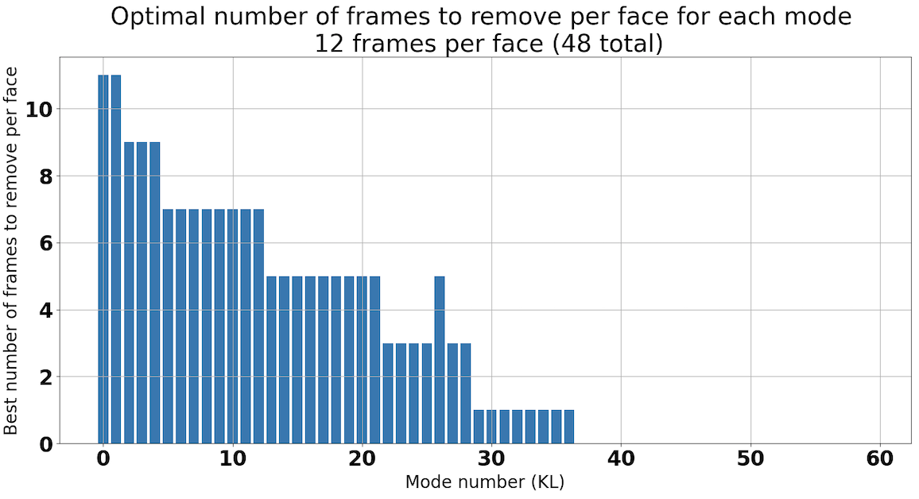
Optimal frame rejection

Slide 9
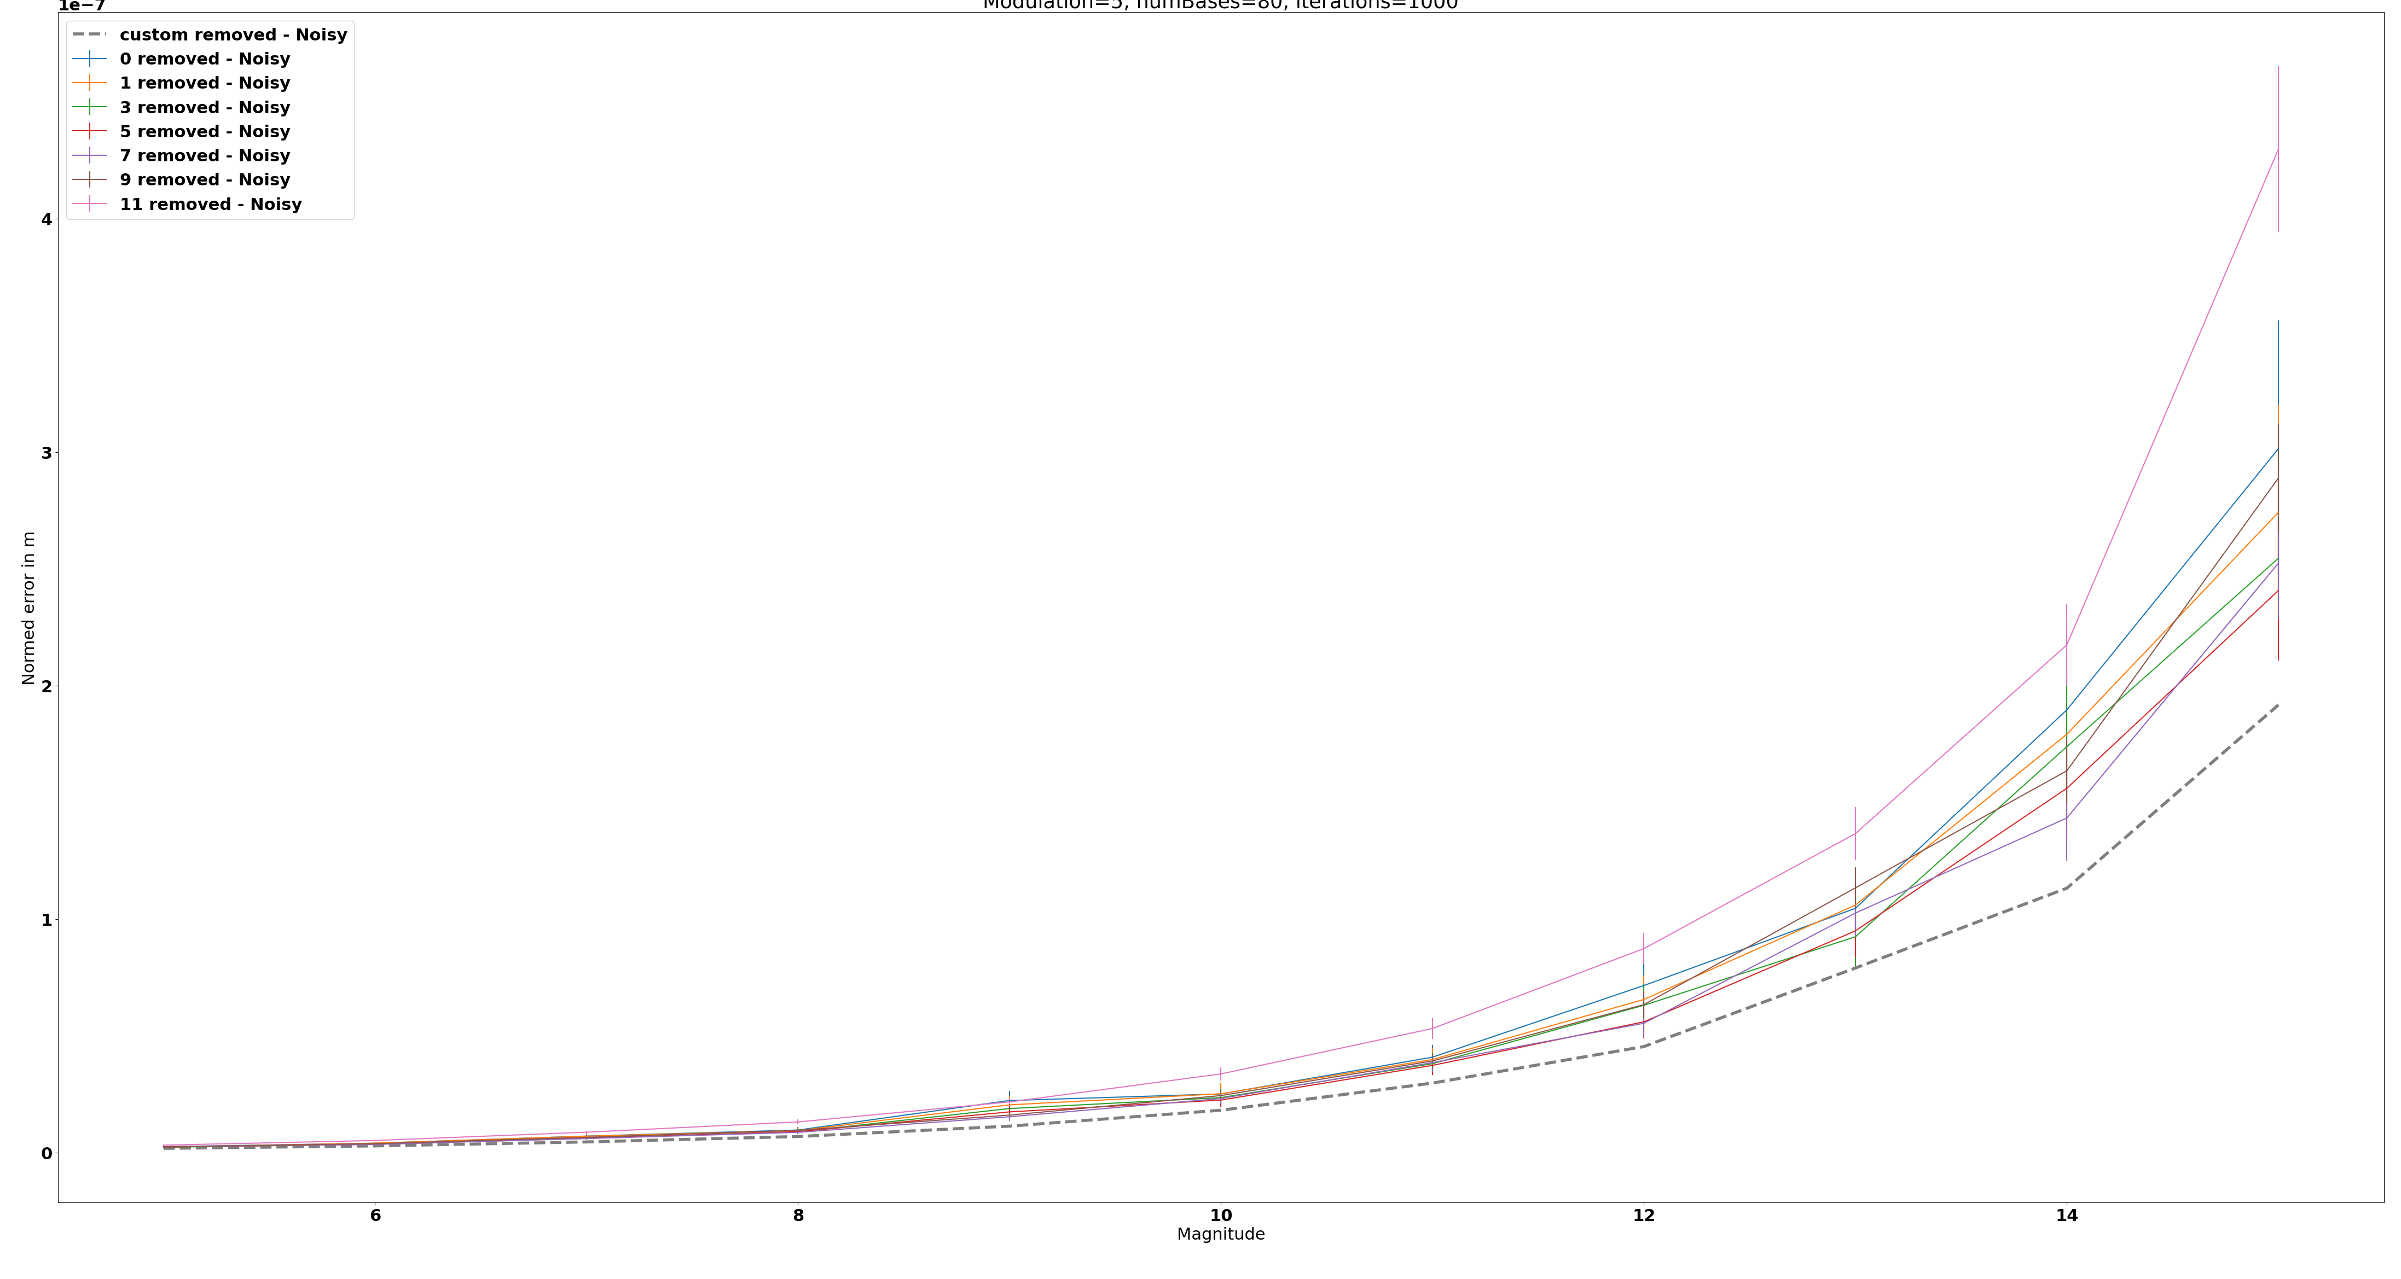
Reconstruction error
8-meter telescope, assumes 100% throughput in V band
Modulation circle decomposed in 48 time slices
100nm RMS wavefront maps with f⁻² power law (residual)

Slide 10
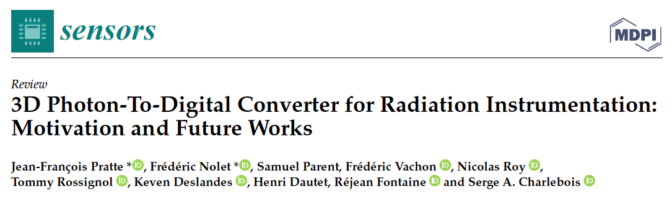
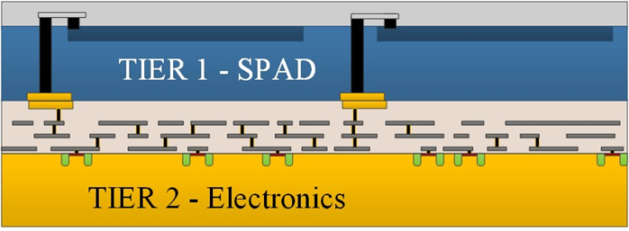
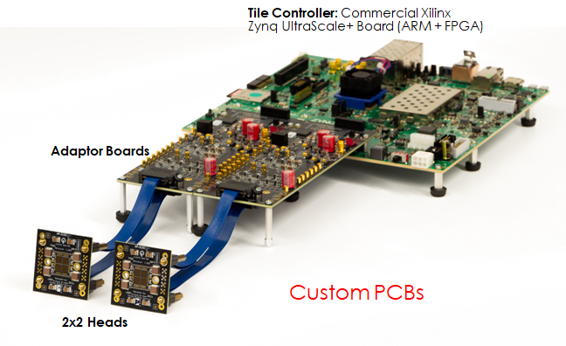
Photon-to-Digital Converter
Photon to bit conversion at the photodiode level
SPAD integrated on top of electronics in order to increase fill factor (QE 50-60%, up to 80% eventually)
< 70 ps FWHM single photon timing resolution
Embedded signal processing
<10 ps Time-to-Digital Converters (TDC)
Coincidence, dark count filters, etc.
Made in Canada:
Designed at U. de Sherbrooke
Photodiodes fabricated at Teledyne DALSA (Bromont, Qc)
Applications in radiation instrumentation
Large scale detection systems (>10 m²) for particle physics
Fast neutron imaging (Oak Ridge – NA22)
Medical imaging
Time-of-Flight Positron Emission Tomography
Time-of-Flight Computed Tomography
Quantum communications
DOI: 10.3390/s21020598

Slide 11
Conclusion
Time resolved WFS might improve the sensitivity of PWFS
Temporal super-resolution might be just as useful as spatial super-resolution for WFSing.
Photon-to-Digital Converters might enable this technology at a reasonable cost
Other WFSs might benefit to
Curvature sensing?
Non-linear Curvature WFS (Mateen, 2017)

