Slide 1



FEWHA for the MORFEO instrument Balancing between reconstruction quality and run-time
Bernadett Stadler, Daniel Jodlbauer, Andreas Obereder, Stefan Raffetseder, Ronny Ramlau
bernadett.stadler@indmath.uni-linz.ac.at
Wavefront Sensing in the VLT/ELT Era VII Porto, Portugal October 21st, 2022

Slide 2
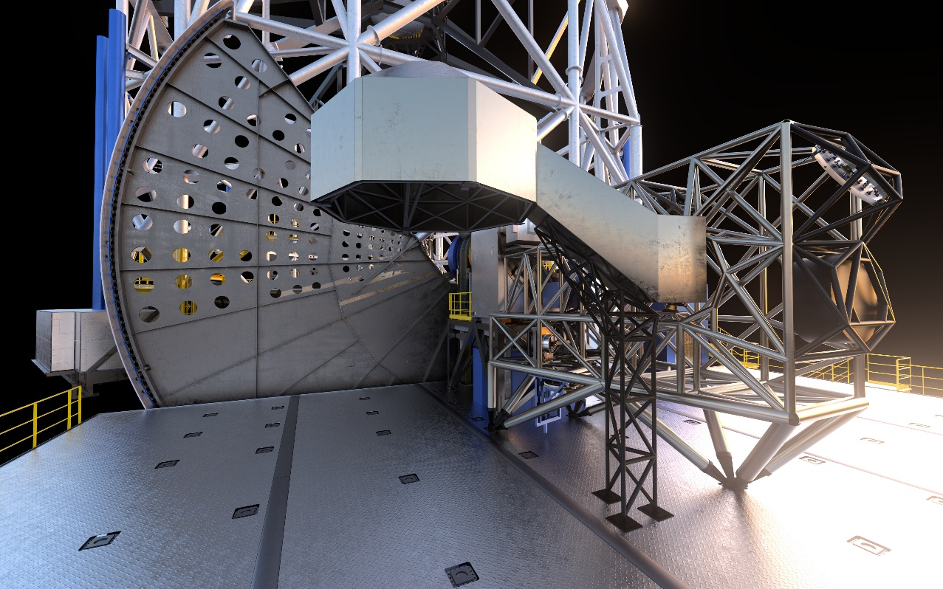
Multi Conjugate Adaptive Optics Relay (MORFEO)
Adaptive Optics module for ESO‘s Extremely Large Telescope (ELT)
Aim: Providing good wavefront correction over a large field of view
Requires tomographic estimation of 3D atmospheric wavefront disturbance
Credit: ESO
2

Slide 3
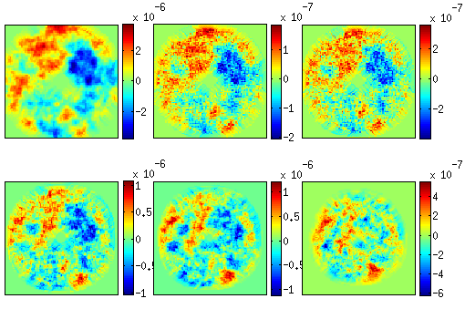
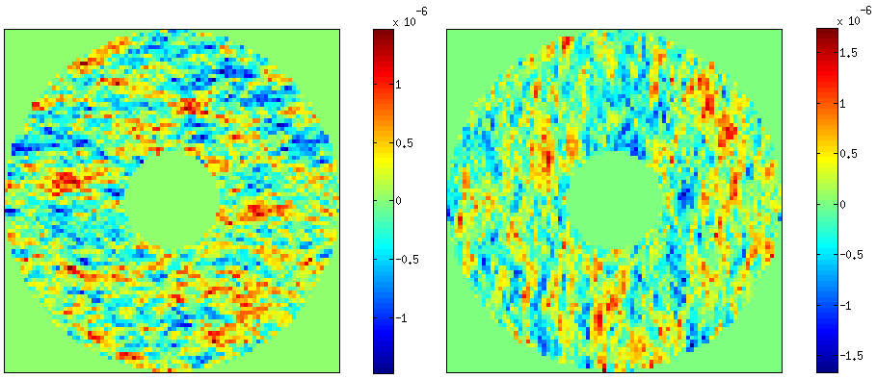
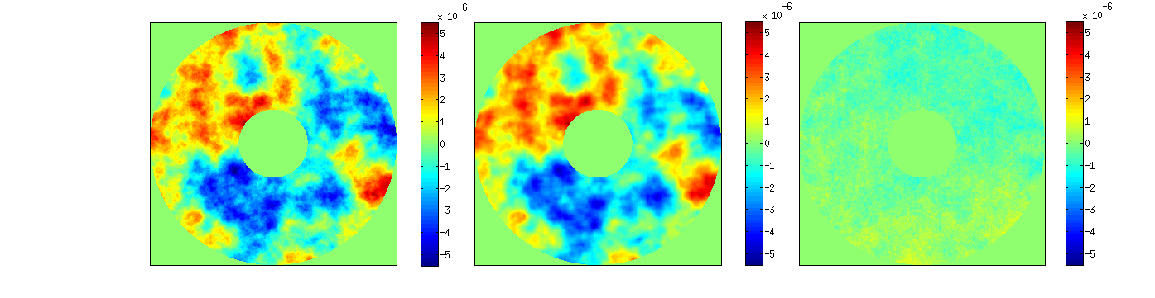
AO control
- 2 step approach
6 turbulent layers ϕ
WFS measurements s_{x} and s_{y}
Atmospheric
tomography
s = A ϕ
MVM method: a = Rs
R precomputed in soft-real time
Fitting / Projection step
a = F ϕ
Incoming screen DM shape Residual
3

Slide 4
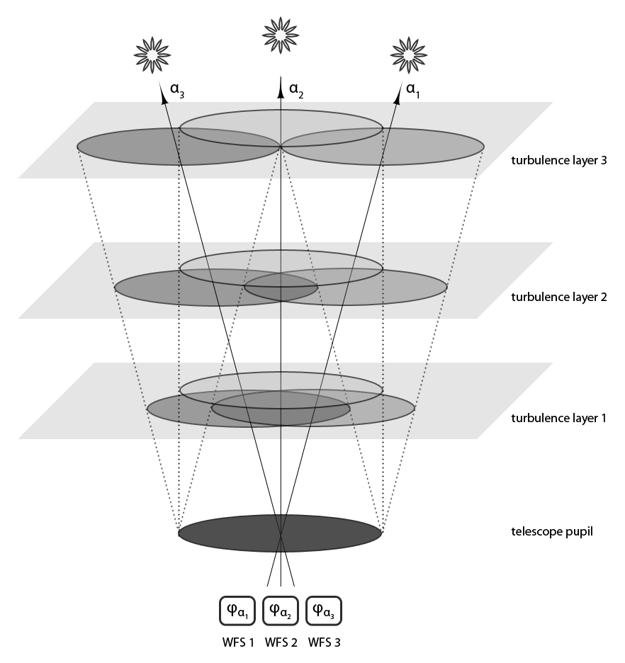
Finite Element Wavelet Hybrid Algorithm (FEWHA)
Atmospheric tomography
Reconstruct turbulent layers from sensor measurements
s = A ϕ
Regularization:
Bayesian framework + maximum a-posteriori estimate
(A*C_{η}⁻¹A + C_{ϕ}⁻¹)ϕ = A*C_{η}⁻¹s
Challenges:
demanding operations to be solved in real-time (500 Hz)
Sparse discretization + iterative solver
4
Notes:
C_eta: paper from Clementine in 2010:
sigma^2=1/nphotons
tuning alpha_eta
Full width at half maximum
Elongation vector: depending on height, laser launch position, midpoints of subaperture
Tip tilt directly removed in equation s=A*phi → for each LGS directions C_eta=(I-T)*C_eta*(I-T), where T is a orthonormal projection into the tip and tilt
measurement space.

Slide 5
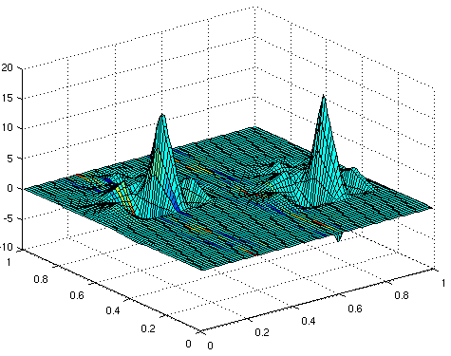

Finite Element Wavelet Hybrid Algorithm (FEWHA)
Wavelets for atmospheric tomography
Idea: Using a wavelet basis for representing the turbulence layers
Why wavelets?
    Approximative properties (less coefficients)
    Fast decay in the frequency domain
    → efficient turbulence statistics representation
    diagonal C_{ϕ}⁻¹ in wavelet basis
    Discrete Wavelet Transfrom is Ο(n)
Wavelets of choice: Daubechies 3
M. Yudytskiy and T. Helin and R. Ramlau. Finite element-wavelet hybrid algorithm for atmospheric tomography. J. Opt. Soc. Am. 2014.
5
Notes:
For sufficiently large N Daubechies wavelet 2 regular. However N=3 not enough but good in numerical simulations.
Diagonal C_phi: widely used penalty term from Ellerbroek + wavelet family that is 2-regular (2 vanishing moments and are 2 times continuously differentiable)
-> Bernstein Jackson inequality applicable -> diagonal approximation

Slide 6
Finite Element Wavelet Hybrid Algorithm (FEWHA)
Atmospheric tomography
Dual domain discretization: wavelet basis + bilinear basis
Iterative approach: Preconditioned Conjugate Gradient Method (PCG
+ Fast, because of sparse matrices
+ On the fly parameter updates (no soft real-time precomputation)
- More complex structure of the algorithm → harder to parallelize and pipeline
6

Slide 7
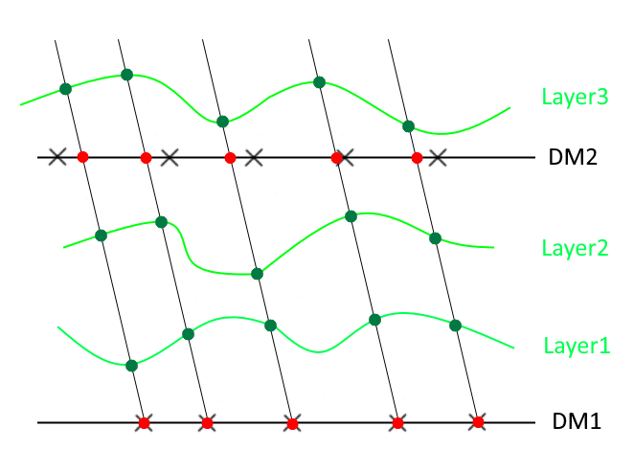
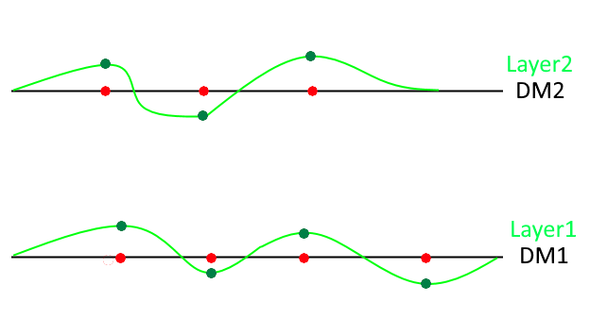
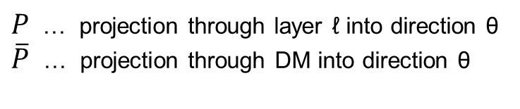
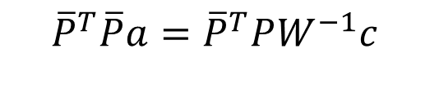
Finite Element Wavelet Hybrid Algorithm (FEWHA)
Mirror fitting for MCAO systems
Layers at altitudes of DMs: No mirror fitting necessary
More layers than DMs: Additional problem to be solved
$$a=W^{−1}c$$
$${\overline{P}}^{T}\overline{P}a={\overline{P}}^{T}PW^{−1}c$$
$P$ … projection through layer ℓ into direction θ
$\overline{P}$ … projection through DM into direction θ
7
Notes:
the mirror shapes are determined directly from the shapes of the turbulence layers
minimize the cost functional ||P*phi – P_quer*a||
we choose discrete directions of interest theta over FOV. For a bilinear representation of the mirrors and the wavelet representation of the layers, this leads to this equation here
For piecewise bilinear basis functions have sparse matrices -> choose again an iterative solver

Slide 8
Real-time performance
Reducing the PCG iterations for tomography and mirror fitting
Warm restart: Reusing the solution from previous time step as intial guess for the PCG method of the next time step
Preconditioning: (Modified) Jacobi preconditioner
M. Yudytskiy and T. Helin and R. Ramlau. A frequency dependent preconditioned wavelet method for atmospheric tomography. AO4ELT3 Conference. 2013.
Augmented Krylov Subspace Method: Reusing search directions of PCG from previous time step to speed up the PCG of the next time step
B. Stadler and R. Ramlau. An augmented wavelet reconstructor for atmospheric tomography. ETNA. 2021.
8

Slide 9
Numerical simulations in OCTOPUS
DMs (equidistant actuator spacing)
 | DM1 | DM2 | DM3
Actuators | 75 x 75 | 47 x 47 | 37 x 37
Altitude | 0 km | 4 km | 12.7 km
Spacing | 0.5 m | 1 m | 1 m
Wavefront Senors
 | LGS - WFS | NGS - WFS
Type | SH - WFS | SH - WFS
Number | 6 | 3
Geometry | 74 x 74 subap. | 2 x 2 subap.
Subap. size | 10 x 10 pixel | 6 x 6 pixel
GS asterism | 45 arcsec | 55 arcsec
Wavelength | 589 nm | 1650 nm
Flux | 500 photons/subap./frame | 500 photons/subap./frame
Detector RON | 3.0e⁻/pixel/frame | 3.0e⁻/pixel/frame
System parameters
Telescope | 37 m diameter
Obstruction | 11 %
Fried parameter | 12.9 cm
Turbulence layer | 35 layer, von Kármán, L0=25 m
Na-layer height | 90 km
Na-layer FWHM | 11.4 km
Delay | 2 frames
Evaluation wavelength | K band
Simulation duration | 1 s
9
Notes:
Noise in simulation??

Slide 10
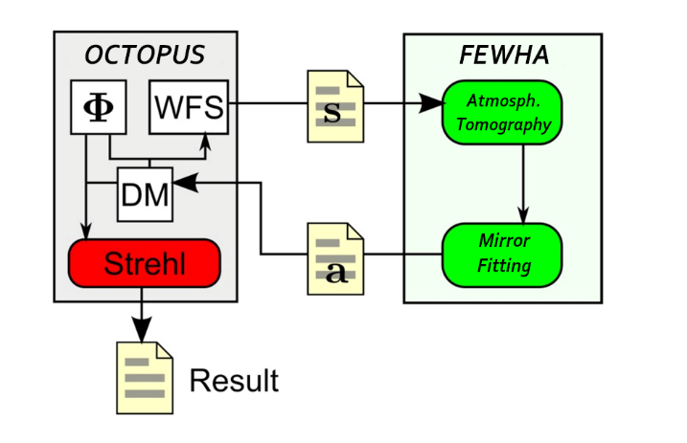
Parallel implementation on CPU
Global parallelization over number of layers or WFSs
→ block diagonal structure of matrices
Local parallelization inside the blocks
Parallel, matrix-free implementation in C++
FEWHA called as external library in OCTOPUS
Run-time measurements only for FEWHA
(no data movement)
10

Slide 11
Test settings
MORFEO with 2 post focal DMs
  Reconstructing 3 layers directly at the altitudes of the DMs (no mirror fitting)
  Reconstructing 9 layers with a mirror fitting step
MORFEO with 1 post focal DM
  Reconstructing 2 layers directly at the altitudes of the DMs (no mirror fitting)
  Reconstructing 9 layers with a mirror fitting step
11

Slide 12
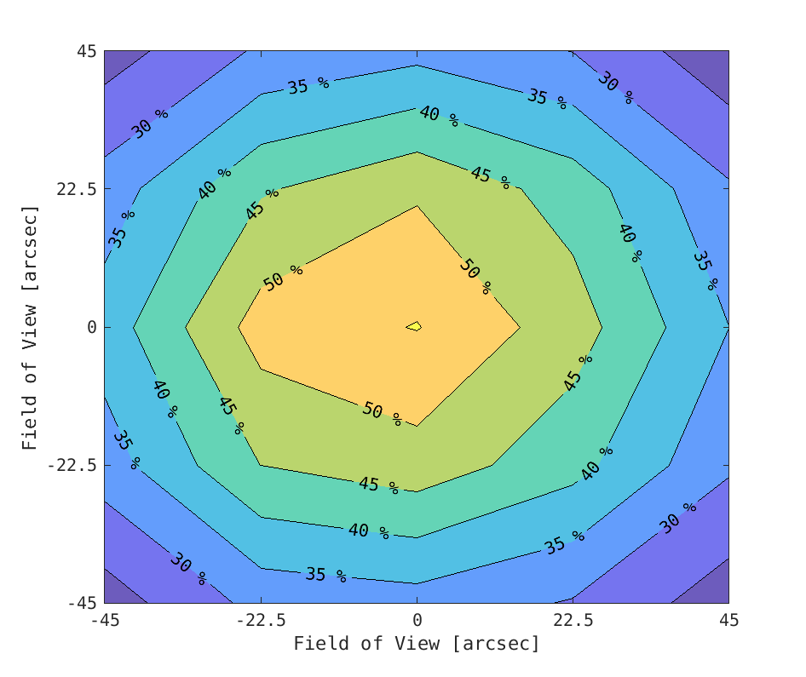
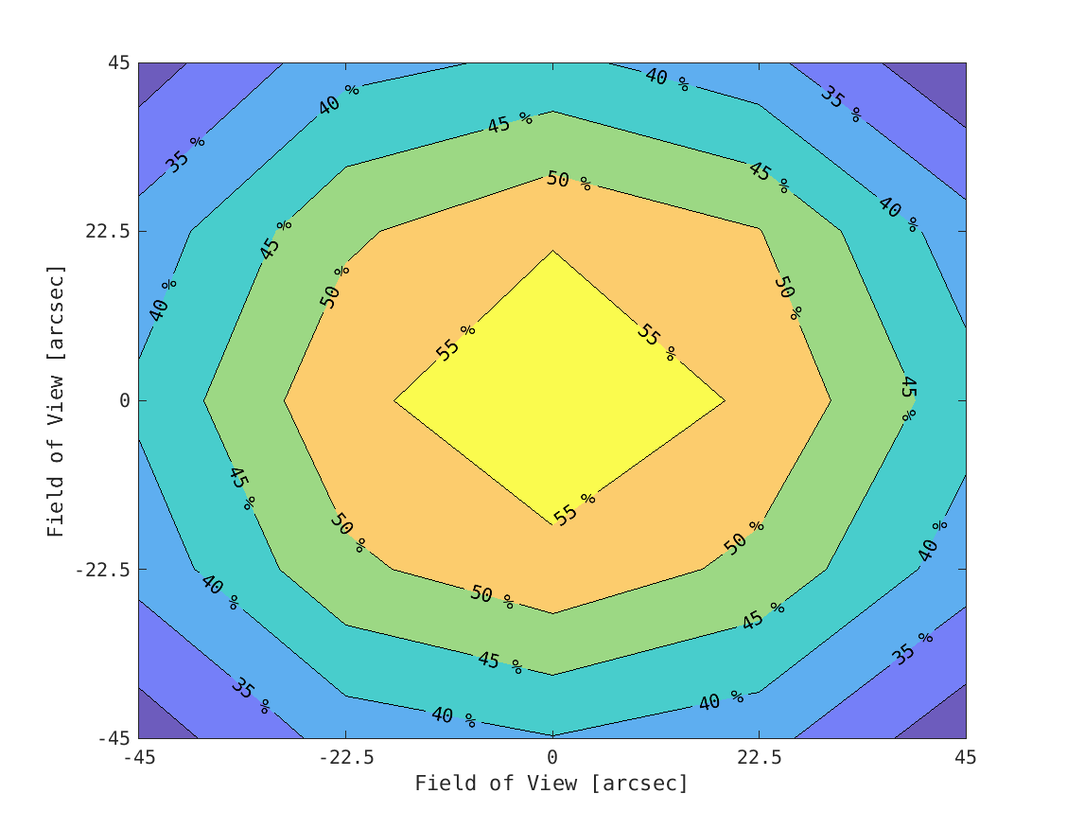
Strehl ratio in 5x5 directions over FoV
35 layer atmosphere, 3 DMs
3 rec. layer
9 rec. layer
Center Strehl Ratio: 55.22 %
Average Strehl Ratio: 36.07 %
Number of PCG iterations: [2, -]
Run-time: 1.5 ms
Center Strehl Ratio: 58.89 %
Average Strehl Ratio: 41.57 %
Number of PCG iterations: [4, 2]
Run-time: 8.1 ms
12

Slide 13
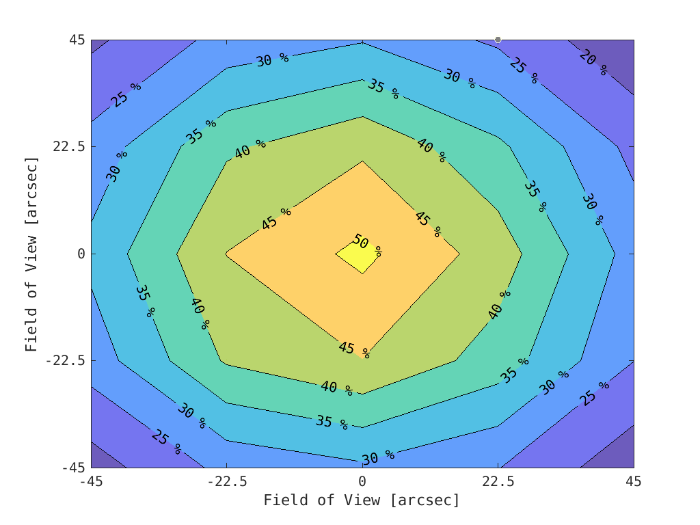
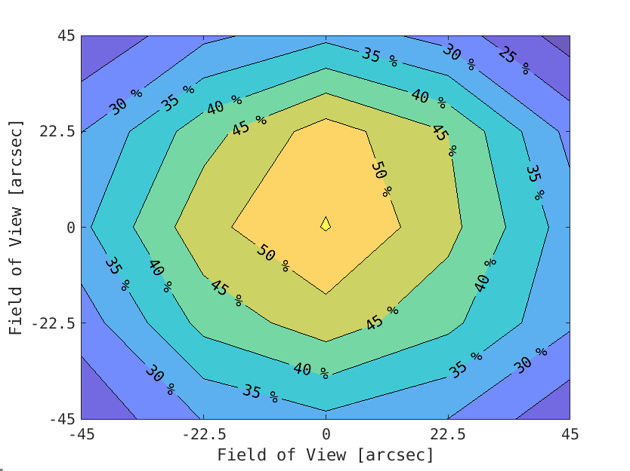
Strehl ratio in 5x5 directions over FoV
35 layer atmosphere, 2 DMs
2 rec. layer
9 rec. layer
Center Strehl Ratio: 51.21 %
Average Strehl Ratio: 30.95 %
Number of PCG iterations: [2, -]
Run-time: 1.4 ms
Center Strehl Ratio: 55.30 %
Average Strehl Ratio: 34.52 %
Number of PCG iterations: [4, 2]
Run-time: 7.9 ms
13

Slide 14
Summary
Wavelet based, iterative real-time reconstructor FEWHA
Fast + good reconstruction quality
  Sparse discretization with wavelet and bilinear basis
  Reduced number of PCG iterations
  Matrix-free, parallel implementation in C++
No soft-real time precomputation of the inverse
→ on the fly parameter updates
14

Slide 15
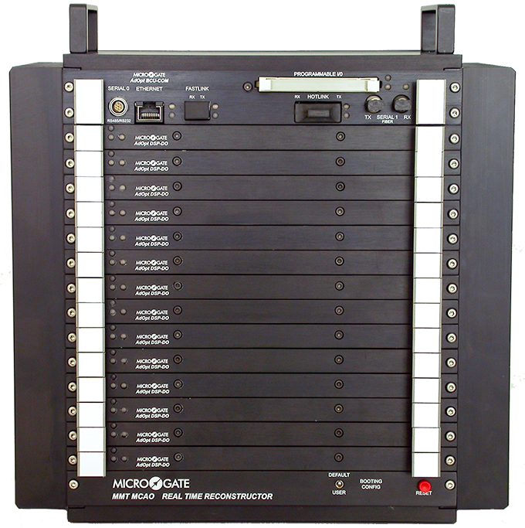
Ongoing and future work
Comparison with the Fractal Iterative Method (FrIM) in OCTOPUS
Interface to PASSATA simulator
→ compare with well-tuned MVM
Implementation on FPGAs
(together with Microgate)
Testing at bench and on-sky
Microgate’s Real Time Reconstructor
15

Slide 16
Thank you!
This research has received funding by the Austrian Research Promotion Agency (FFG) FO999888133 (Industrial methods for Adaptive Optics control systems).
Notes:
FEWHA for pyramid: linearized model because FEWHA is linear reconstructor – linearization of the roof sensor

Slide 17
Parameter tuning via simulation
 | 3 DMs 3 layers | 3 DMs 9 layers | 2 DMs 2 layers | 2 DMs 9 layers
Regularization | 8.0 | 8.0 | 8.0 | 16.0 | large influence on rec. quality changes with photons and r₀
Spot elongation | 0.2 | 0.2 | 0.2 | 0.2 | medium influence on rec. quality changes with photons and r₀
Loop gain | 0.4 | 0.4 | 0.4 | 0.4 | small influence on rec. quality
Number of iterations [tomography, fitting] | [2,-] | [4,2] | [2,-] | [4,2] | trade-off between quality and speed
17

