Slide 1


Study of the LIFT focal-plane wavefront sensor for GALACSI NFM
Arseniy Kuznetsov, Benoit Neichel, Sylvain Oberti, Cedric Heritier, Cédric Plantet, Thierry Fusco, Stefan Ströbele, Carlos Correia

Slide 2
Objectives
Re-analyze the on-sky data and potentially improve the accuracy of reconstruction
Try Machine Learning (ML) within the scope of LIFT
Prepare the background for future work with ML
It is the side project
It is a playground project
It is a work in progress
Notes:
Results are raw and open for the discussion

Slide 3
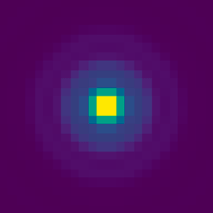
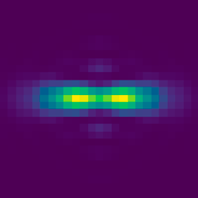
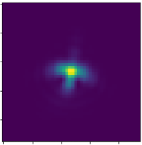
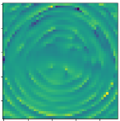
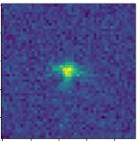
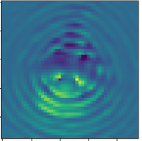
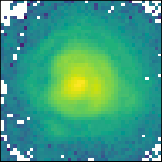
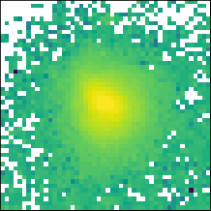
LIFT on IRLOS
Baseline was to use LIFT as a slow truth-sensor for tip/tilt, defocus (m.b. higher orders) in low-flux
LIFT is based on inserting known amount of astigmatic phase diversity into optical path
In IRLOS the cylindrical lens is inserted into the filter wheel
Therefore, acquired LIFTed PSFs are highly polychromatic
LIFT is model-based → an accurate and well-calibrated model of the focal-plane PSF in required for accurate reconstruction with LIFT
Astigmatic phase diversity
Defocus sign indetermination
LIFTed PSF resolves the sign of even modes
Input PSF
P_{ML}
→
By weighing with pixel variance, LIFT uses the vicinity of the PSF core in low-flux and the whole image in high-flux. In this work we consider high flux
Monochromatic full-pupil PSF
Chromatic J+H full-pupil PSF → challenging!
[S. Meimon, et al., 2010], [C. Plantet, et al., 2015]

Slide 4
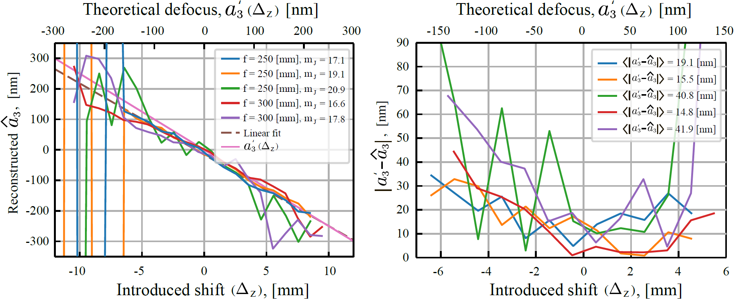
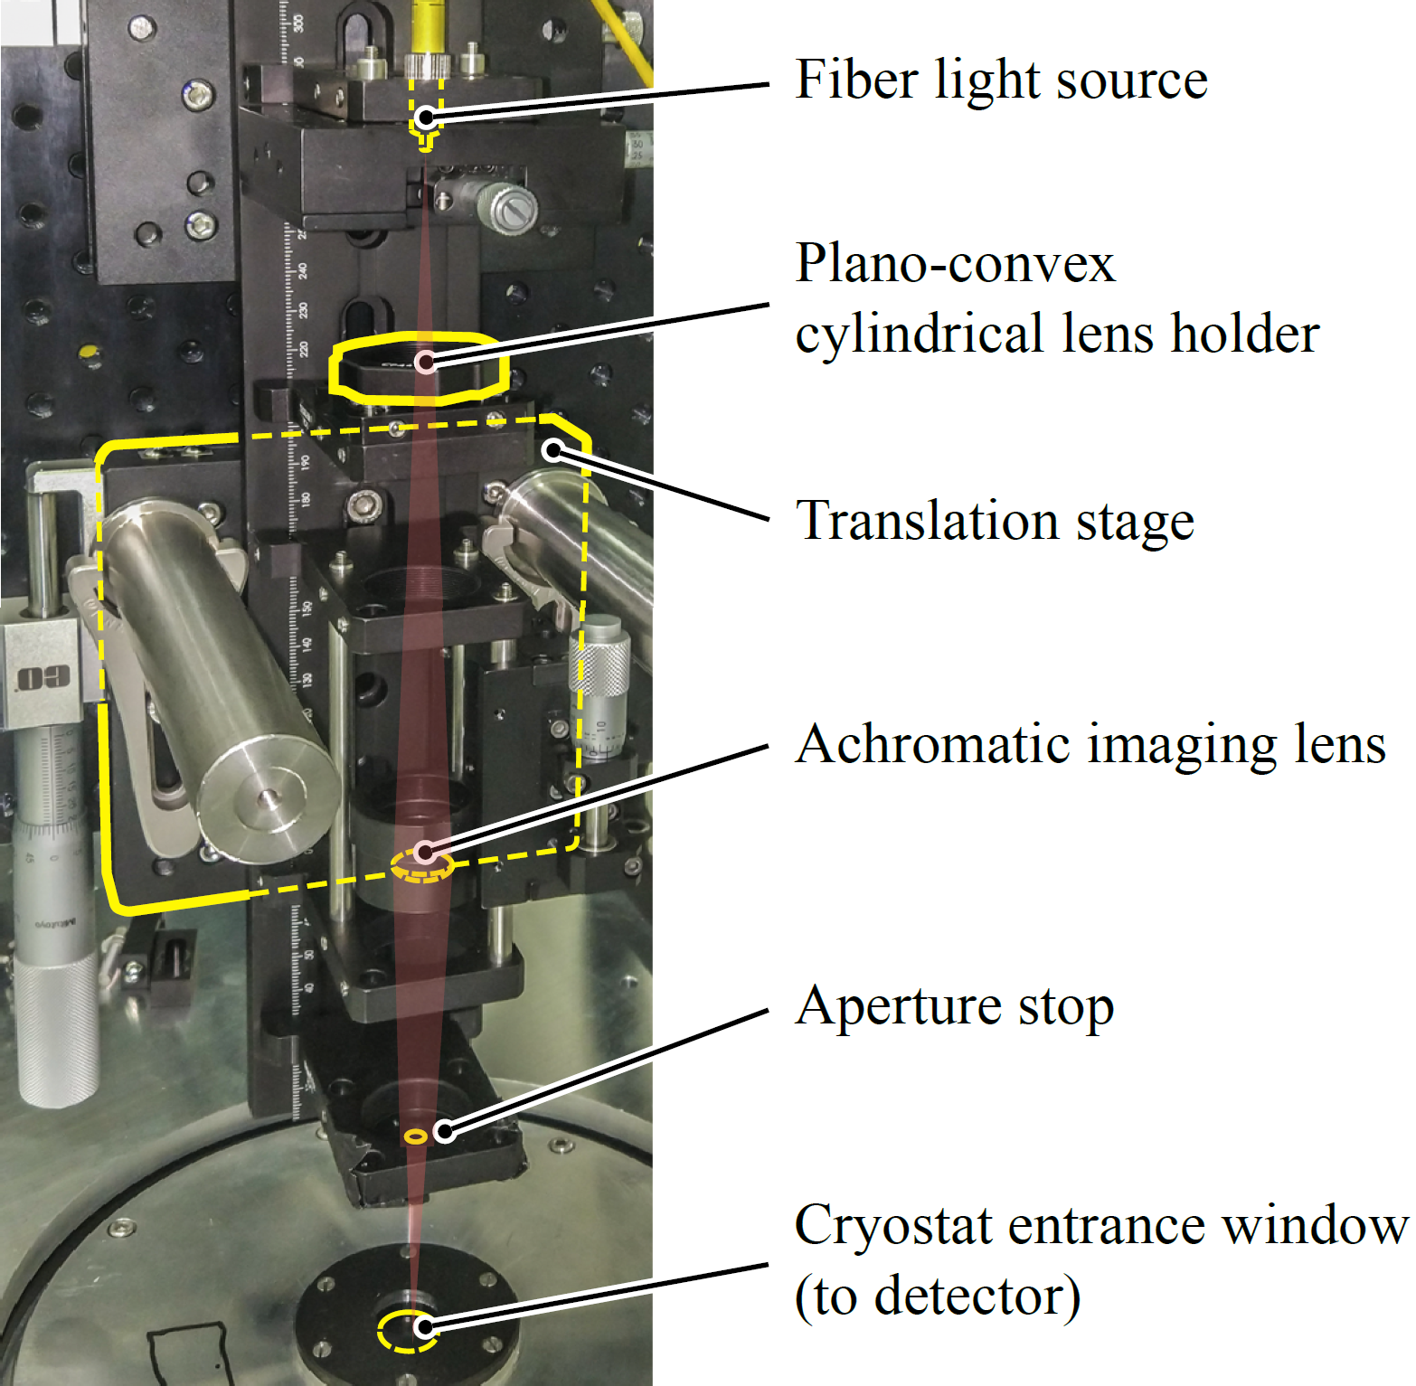
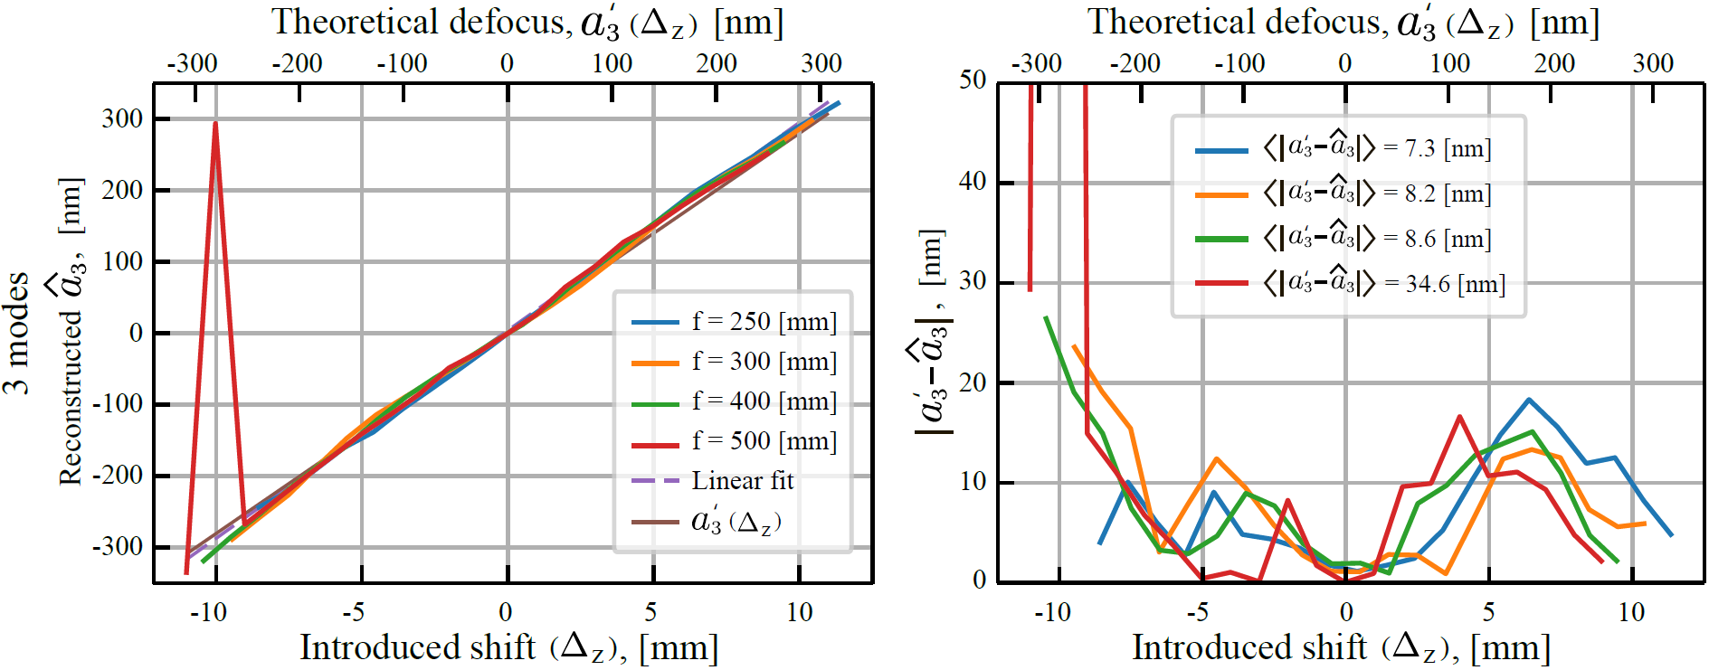
LIFT, verification in the lab
(f = 80 mm)
Low flux
High flux
Test setup very similar to IRLOS
Same SAPHIRA detector as on real IRLOS (RON < 1e⁻)
Varying defocus by translating the setup relative to the focal plane to scan linearity range
Fiber point source with λ ≈ 1.2…1.6 μm
→ LIFT performed well, even in very faint conditions
(⌀2 mm)

Slide 5
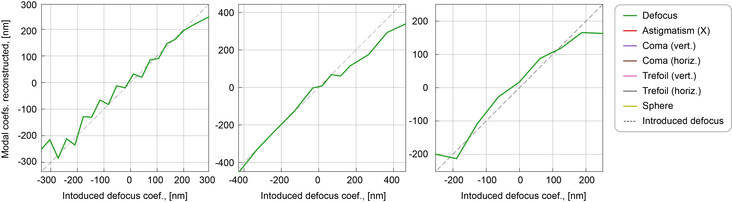
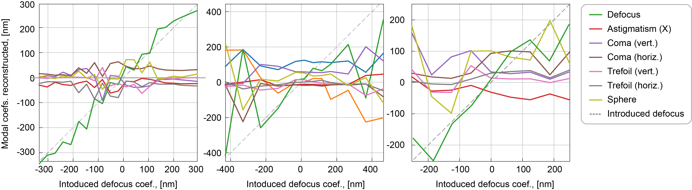
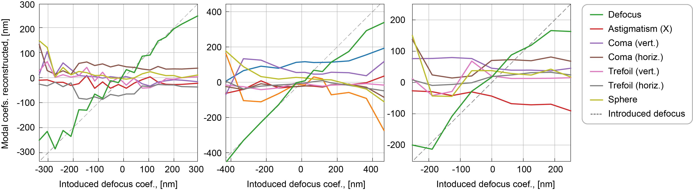
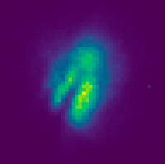
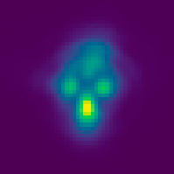
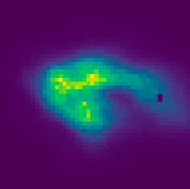
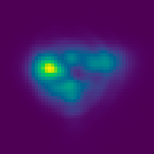
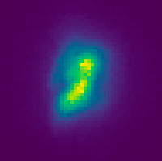
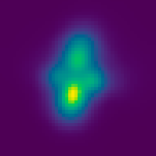
LIFT, verification on-sky
Target #1, J+H_{mag} ≈ 13
Target #2, J+H_{mag} ≈ 9
Target #3, J+H_{mag} ≈ 9
The assumption for the convolution kernel is turned off.
This kernel is a way to account for the uncharacterized effects
On-sky PSF
Reconstruction
On-sky PSF
Reconstruction
On-sky PSF
Reconstruction

Slide 6
So, on-sky PSFs…
Highly chromatic
Affected by NCPAs (possibly chromatic)
Affected by uncharacterized effects
Only one image is used for the reconstruction
Long exposure (several seconds)
Real PSFs have a complex morphology
Very challenging case!

Slide 7
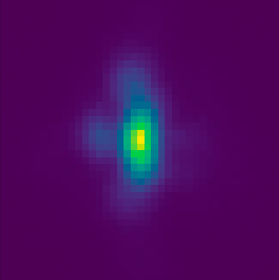
Simulated dataset
Question: can we do more with these data using Machine Learning?
Problem: only 41 samples of on-sky PSFs available → too few for training
Solution: simulate realistic synthetic dataset for pre-training
Simulated PSFs
J_{mag} = 12
AO residuals
Polychromatic (J+H)
20 Zernike modes as NCPAs
Convolution with a random kernel
Photon + electron noise

Slide 8
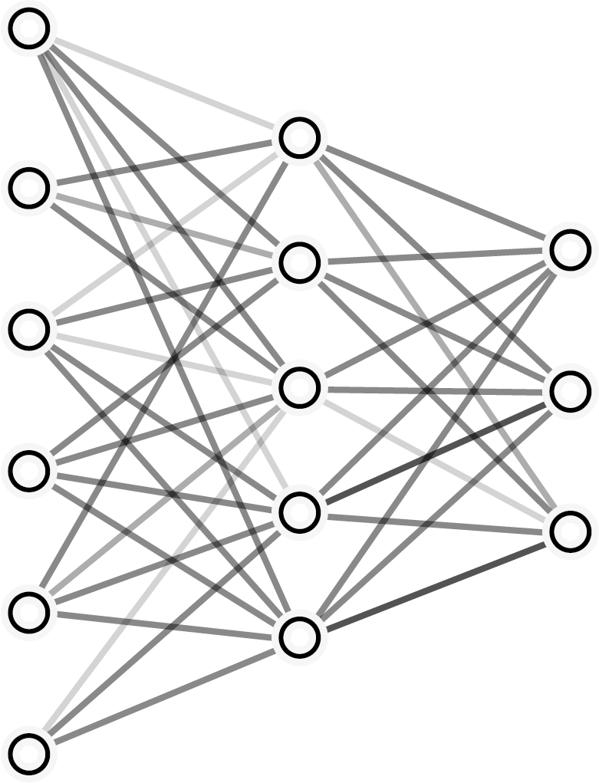
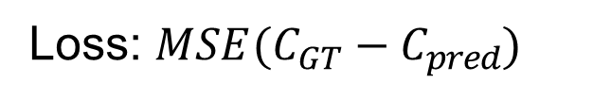

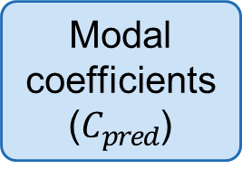
Proposed architecture
Naïve approach: simple MLP
Trained to correspond PSF images to modal coefficients directly
Trained on the synthetic dataset with the ground-truth (GT) modal coefficients available
Small model (~55K params) → very fast training/inference
Modal coefficients
($C_{pred}$)
Multilayer perceptron (MLP)
Input PSF
Loss: $MSE(C_{GT}−C_{pred})$

Slide 9
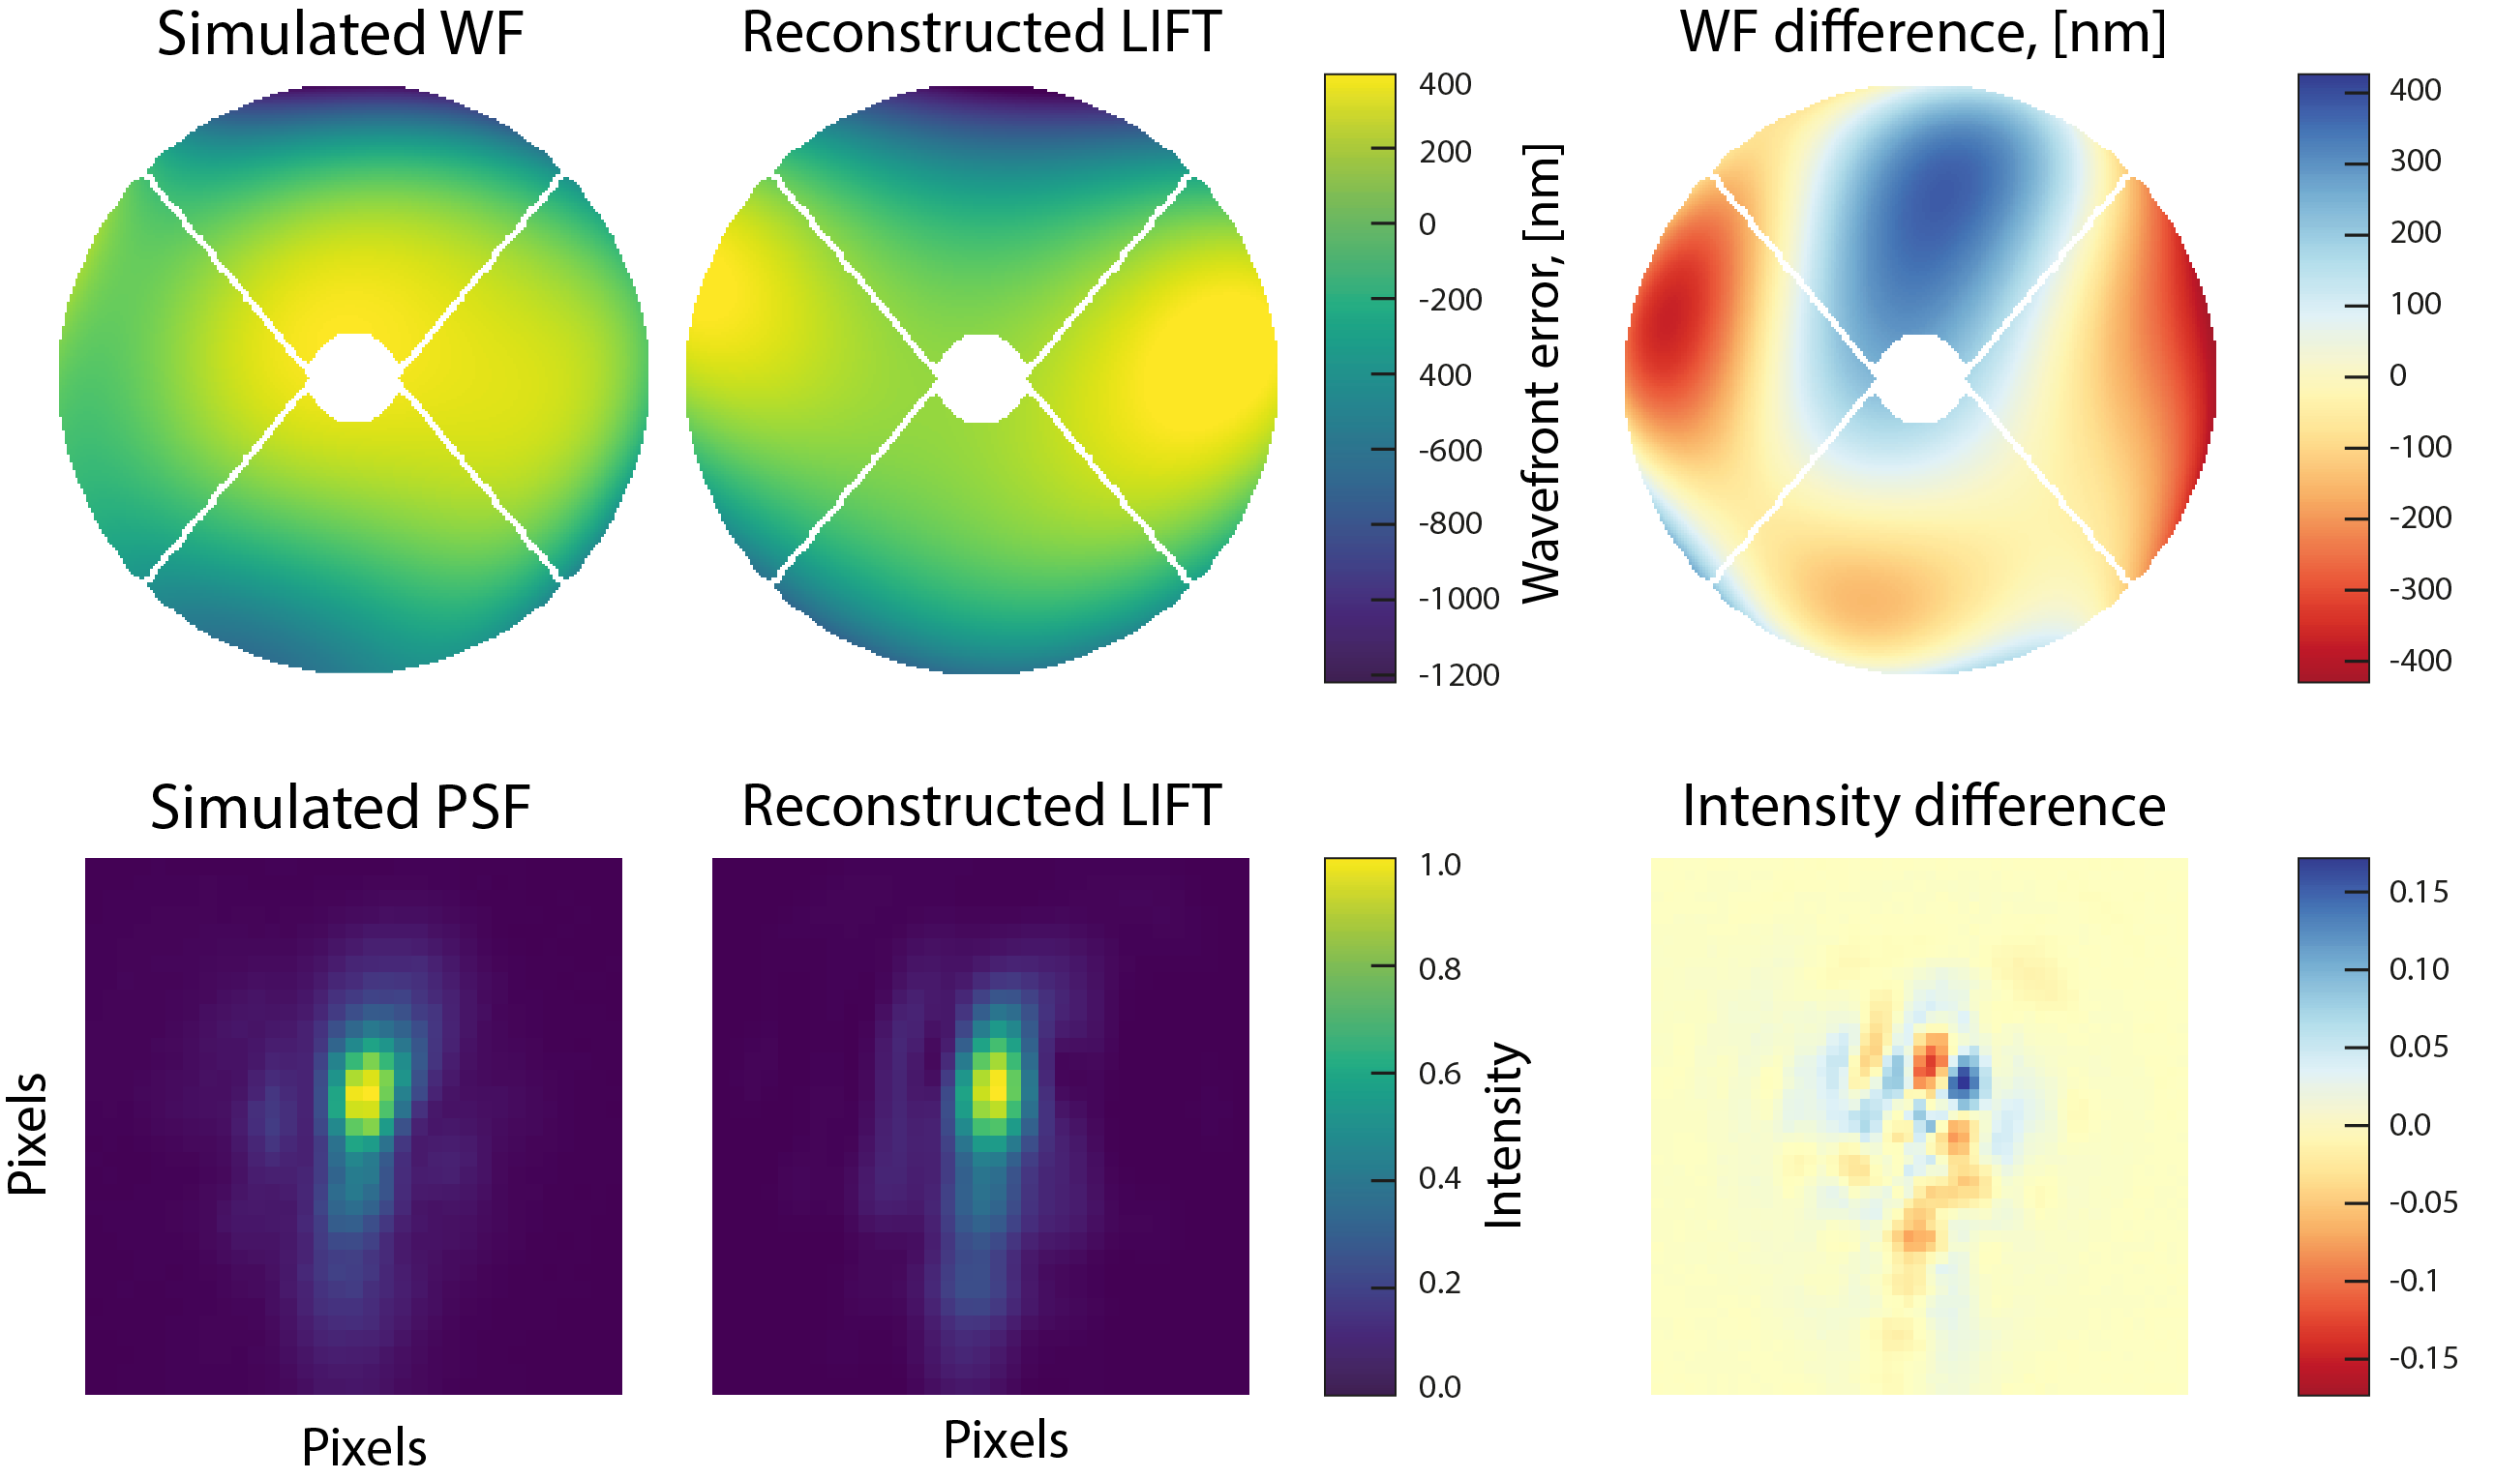
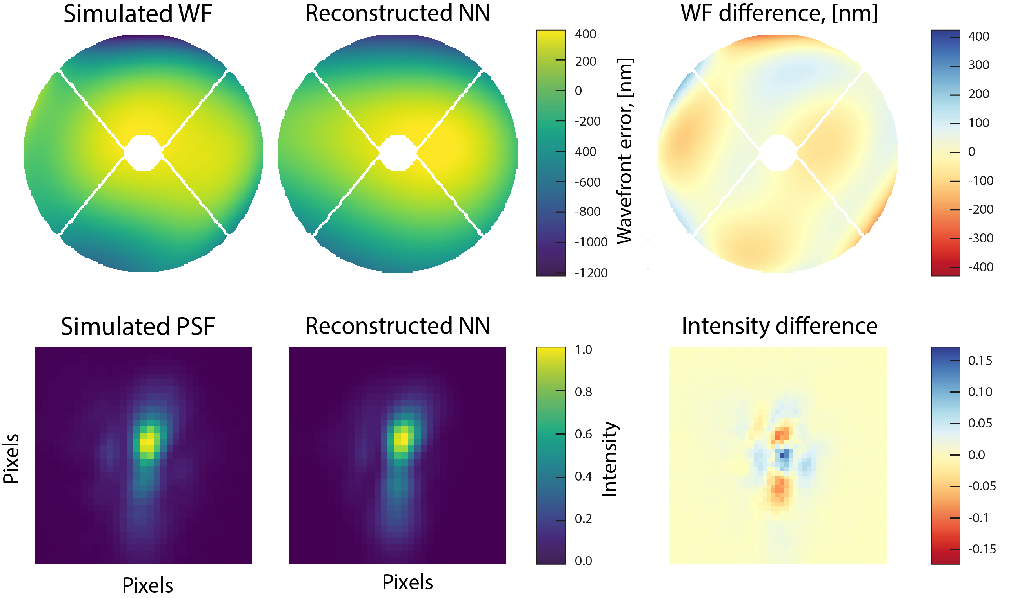
Reconstruction LIFT vs. NN
LIFT tries to reconstruct the PSF accurately, though the WF is not always accurate
But the Neural network (NN) reconstructs WF with higher accuracy
Makes sense: LIFT tries to fit to PSF image at any cost → modes can cross-couple, while the NN was trained to predict the coefficients

Slide 10
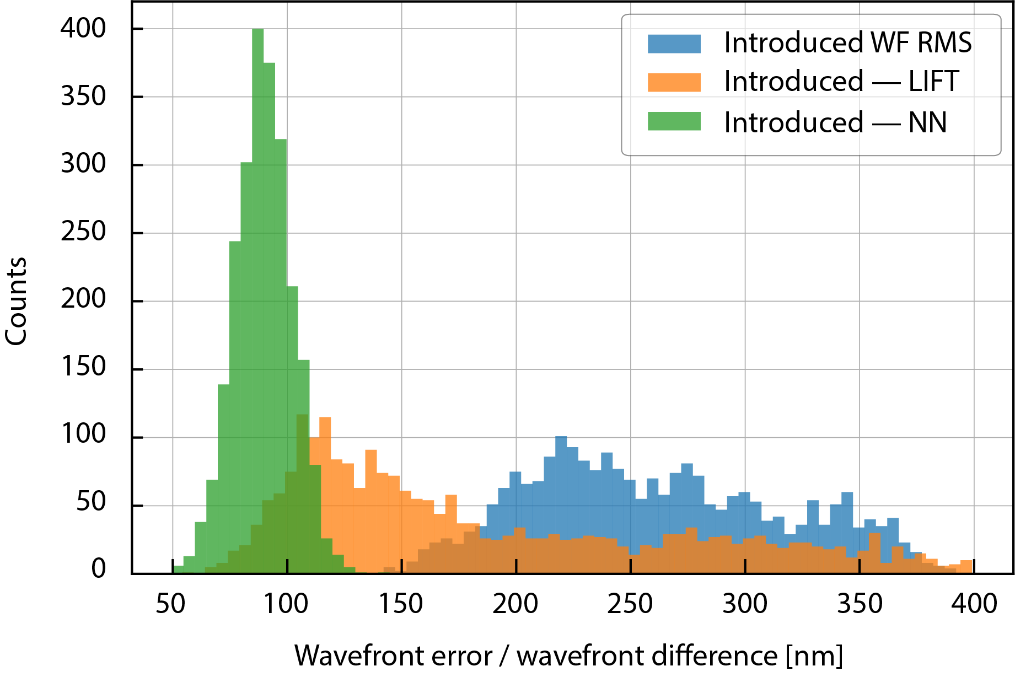
Results (synthetic data)
Median WFE, [nm]
Introduced WF RMS | 256
LIFT WF error | 160
NN WF error | 89
NN is better than LIFT
No convolution kernel prior is needed, unlike for LIFT
Very fast: direct inference of the modal coefficients
But these tests were made using the synthetic dataset. Will it perform as well with the real data?

Slide 11
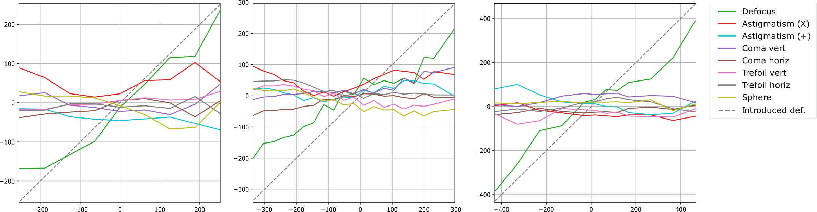
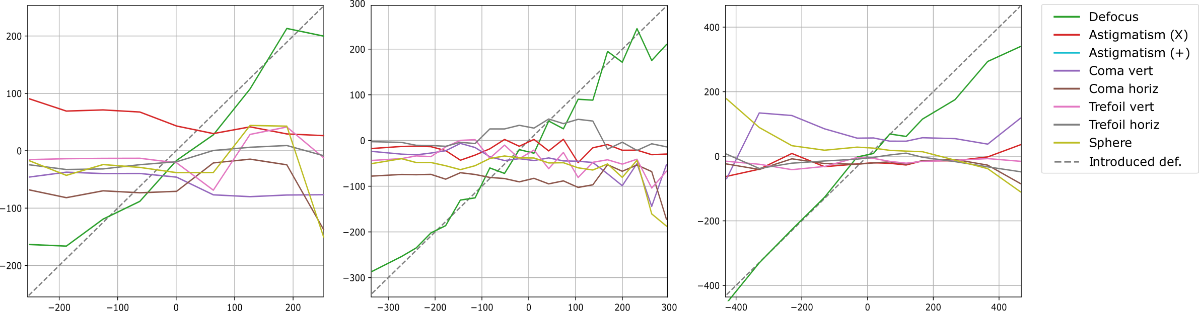
Tuning NN on real data
Scan #1
Scan #2
Scan #3
LIFT
NN
Trained on synthetic data only
The NN maybe shows smoother results, though accuracy is not so good
Can we do it better?

Slide 12
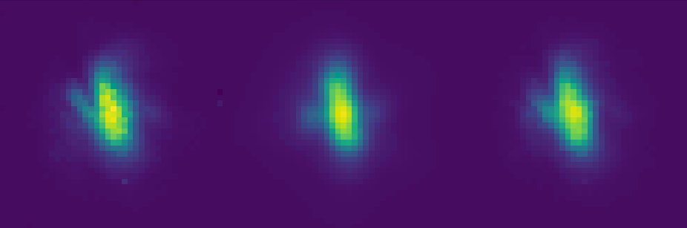



Tuning NN on real data
Modal coefficients
($C_{pred}$)
Analytical
PSF model
Multilayer perceptron (MLP)
Differentiable model
Input real PSF ($I_{GT}$)
Output PSF ($I_{pred}$)
Loss: $MAE\left(I_{GT}−I_{pred}\right)+ MSE\left(C_{GT}−C_{pred}\right)+ MSE\left({Defoc}_{GT}−{Defoc}_{pred}\right)$
Attach the analytical PSF model after the predicted coefficients
Now train NN PSF to PSF, feed with real data this time
Ground-truth coefs. are not accessible anymore (except for defocus)

Slide 13
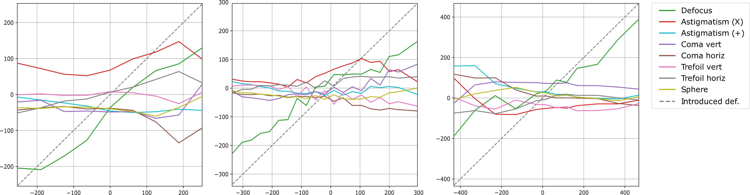
Tuning NN on real data
Scan #1
Scan #2
Scan #3
LIFT
NN
NN (tuned)
Tuning did not help much
The same problem as with LIFT → now NN is trained to accurately infer the intensity pattern, not the modal coefficients

Slide 14
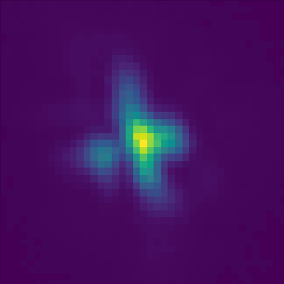
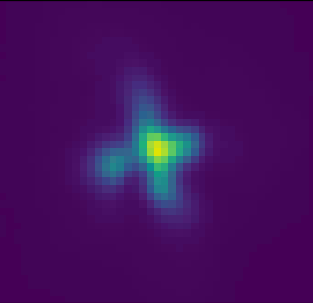


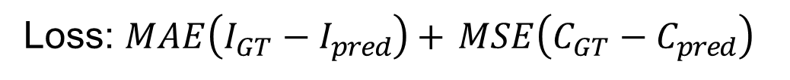

Non-analytical approach
Latent space$≈$ modal coefs.
($C_{pred}$)
Multilayer perceptron (MLP)
Multilayer perceptron (MLP)
Input PSF ($I_{GT}$)
Output PSF ($I_{pred}$)
Loss: $MAE\left(I_{GT}−I_{pred}\right)+ MSE\left(C_{GT}−C_{pred}\right)$
Pre-train variational autoencoder on simulations to tune it on real data later
Additionally, force latent space to be equal to Zernike modal coefficients (when trained on simulated data)

Slide 15
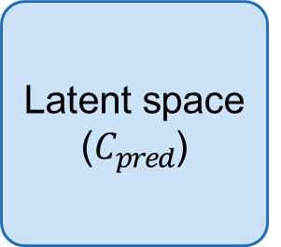

Non-analytical approach
Latent space ($C_{pred}$)
Multilayer perceptron (MLP)
Multilayer perceptron (MLP)
Input real PSF ($I_{GT}$)
Output PSF ($I_{pred}$)
Loss: $MAE\left(I_{GT}−I_{pred}\right)+ MSE\left(C_{GT}−C_{pred}\right)+ MSE\left({Defoc}_{GT}−{Defoc}_{pred}\right)$
Ground-truth coefs. are not accessible anymore (except for defocus)
VAE trained on synthetic data and tuned on real PSFs

Slide 16
Tuned VAE
On-sky PSF
VAE (synth. only)
VAE (tuned on real)
Tuned VAE absorbed an understanding of realistic PSF morphology
But what the decoder learned is a black box → it cannot be analytically expressed → opened the question how to interpret the decoder

Slide 17
Conclusion
Although LIFT is simple, it still performs well (provided an appropriate convolutional kernel is assumed)
Even though the simulated PSFs account for many realistic contributors, the bitter reality is still much more complex
Nevertheless, NN is capable of “absorbing” the morphological complexity from just a few real PSFs, provided it was pretrained on the synthetic model. But it cannot tell us what it learned
More on-sky samples are needed to tune the neural network adequately

Slide 18
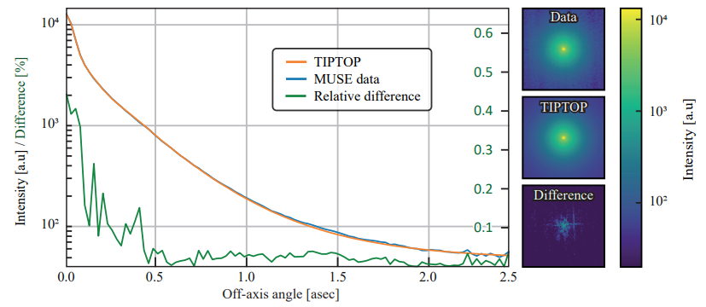
Future work
Train a PSF to wavefront predictor
Bench experiments?
Collect more on-sky data (heh, not likely for LIFT…)
Use more advanced PSF models to generate a dataset?
LIFT is a toy project. Meanwhile, I am
working on PSF reconstruction/
prediction using the more advanced
PSF models.
New results are coming, stay tuned!

