Slide 1





Seeing estimation from
Adaptive Optics Telemetry
Nuno Morujão (MEng Physics Student)
Collaborators: Paulo Garcia, Carlos Correia, Paulo Andrade, Johann Kolb, Julien Woillez

Slide 2
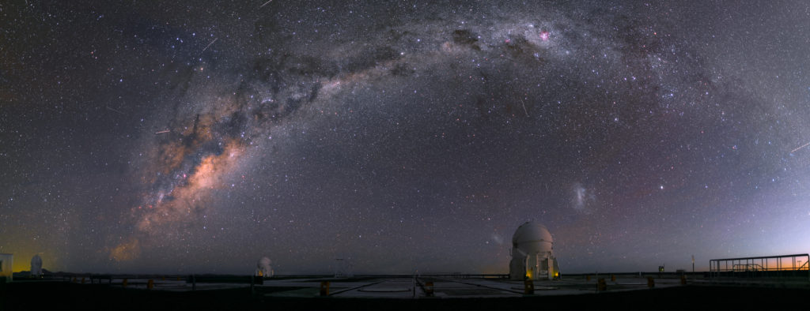
Motivation
R. Wesson/ESO
Site evaluation and characterization;
Non-consensual values for the turbulence parameters;
Optimization of the adaptive optics systems and fringe trackers;
Understand if and how climate change is affecting turbulence parameters (r0 and L0);
Use AO telemetry data for the estimation of turbulence parameters;
Operational adoption of the algorithm;

Slide 3

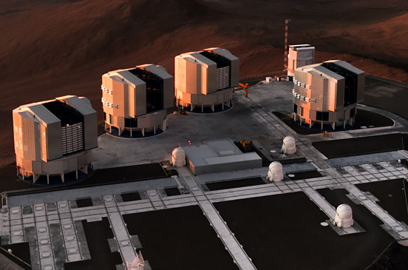
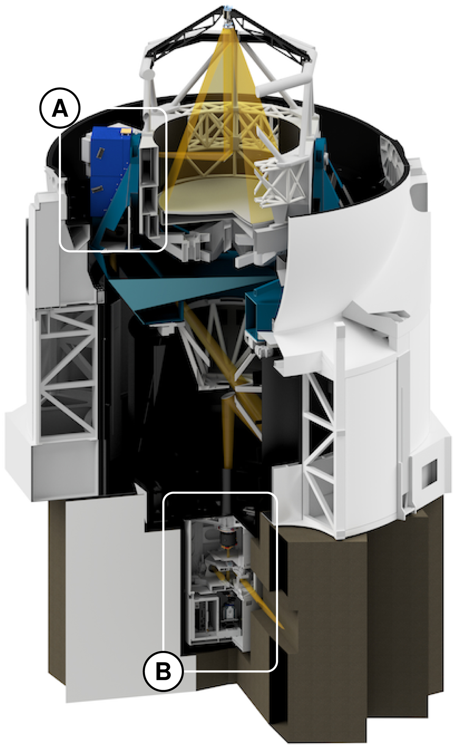
NAOMI - the new AO system of the VLTI
Advantages
Spatial resolution – 4 AT’s at Paranal;
Temporal coverage – near-continuous estimation of the seeing;
Source matching – Direct correspondence to the observing telescope;
Challenging scenario:
  VLTI/ATs – 4 NAOMIs;
  SH-WFS (4x4, visible);
  Diameter: 1.8 m
ESO/G.Hüdepohl
Woillez + 2019

Slide 4
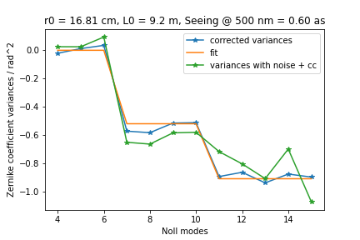
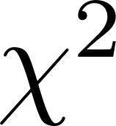
Methods: background
Andrade+ 2019 (“Estimation of atmospheric turbulence parameters from Shack–Hartmann wavefront sensor measurements”, MNRAS, 483, 1192):
Fit theoretical variances;
Include cross coupling effects (function of r0 + L0) in model;
Iteratively fit r0, L0 and noise;
Novel adaptations:
Conversion of the algorithm into a ;
Estimation of the uncertainty of the fit
through a Monte Carlo approach;

Slide 5
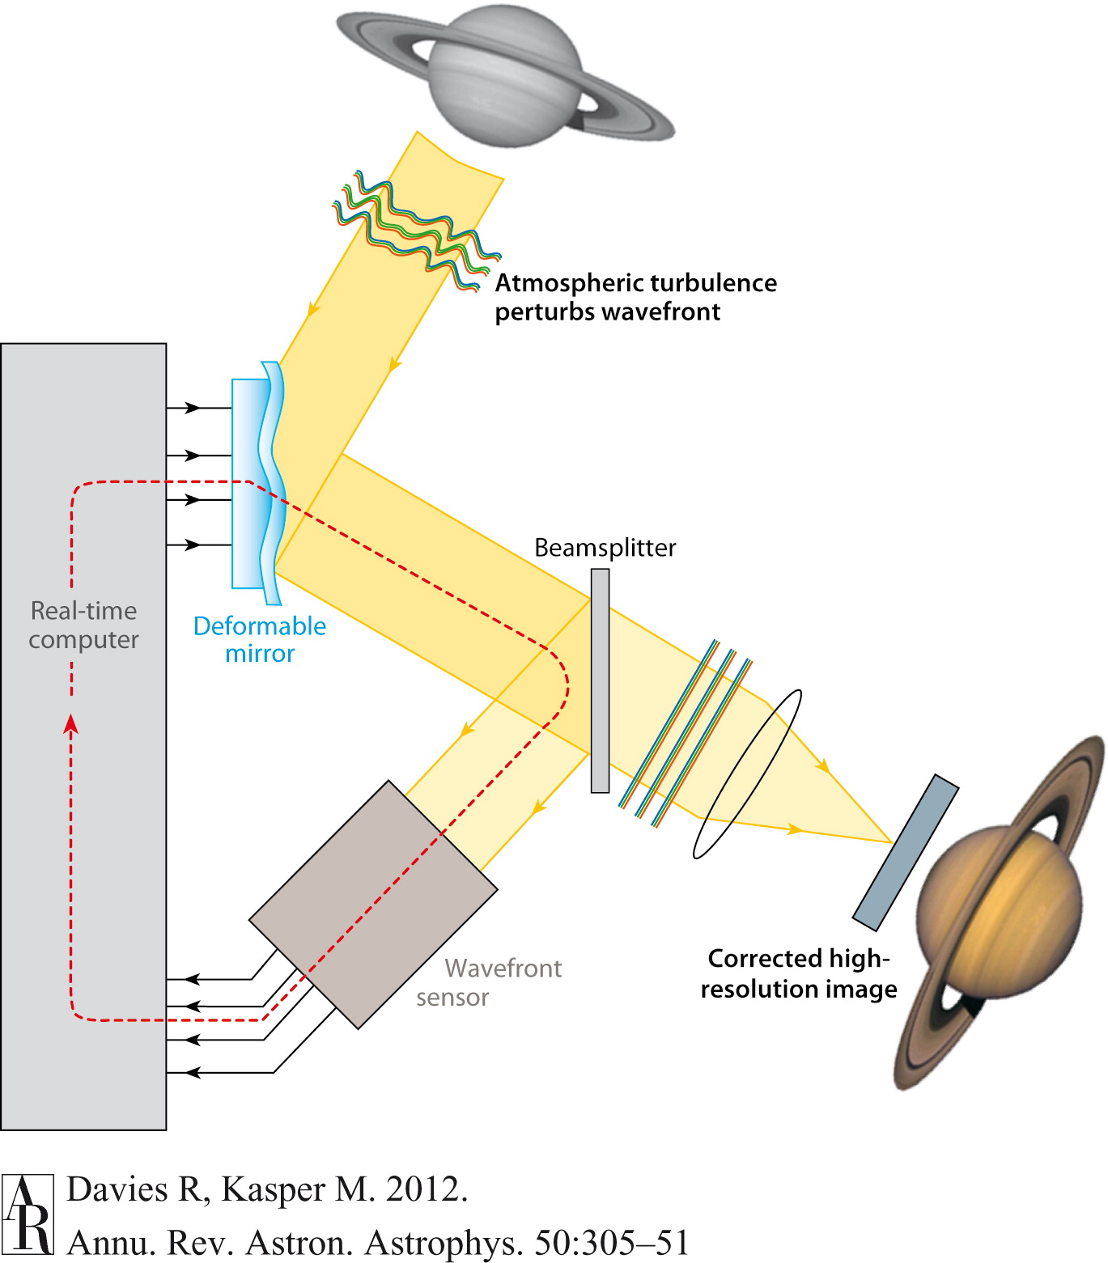
Methods: pipeline flow
Negative
feedback
control loop
Telemetry data
Pseudo-open slopes
Temporal variances
Turbulence parameters
(r₀, L₀)
Iterative
estimation algorithm

Slide 6
Methods: iterative algorithm
Initial measured variances are introduced in the model fit;
Result in an initial set of turbulence parameters (r0, L0, noise);
The estimated turbulence parameters are used to calculate the
cross-talk = f(r0,L0);
Cross-talk and noise are removed from the variances;
Fit of corrected variances (r0, L0, noise);

Slide 7

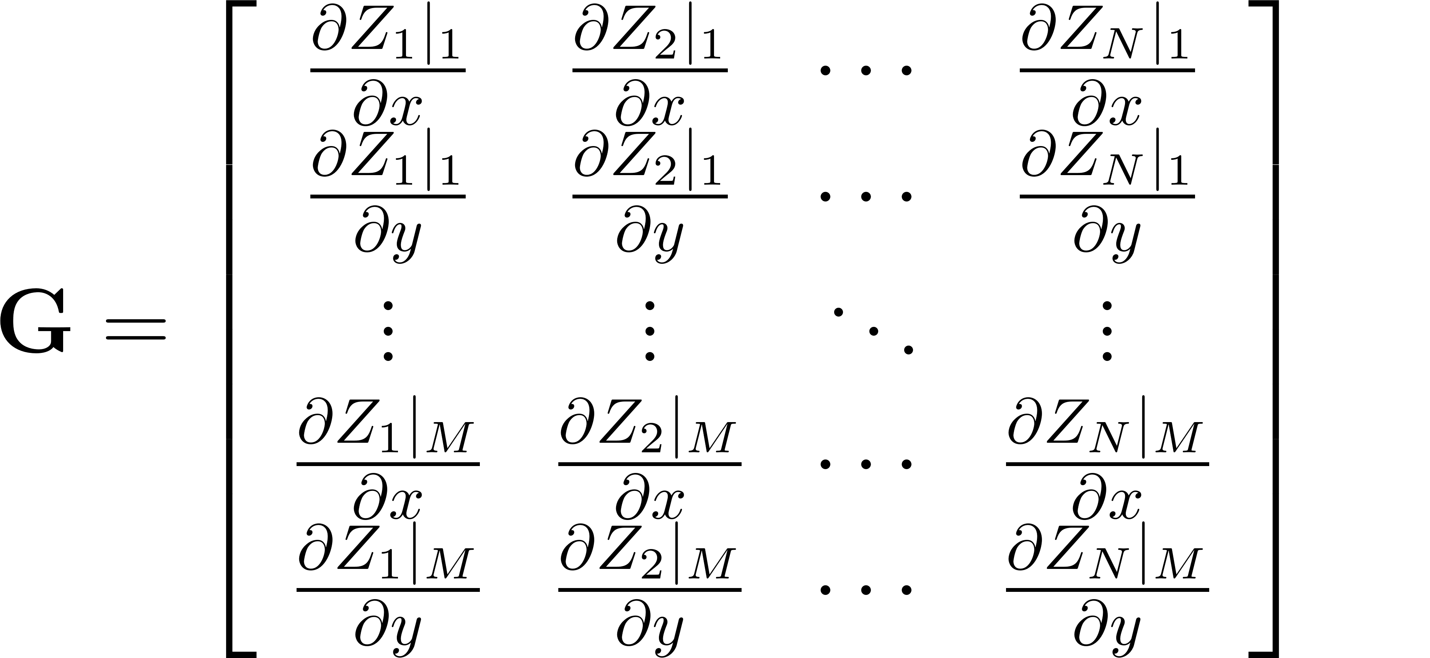
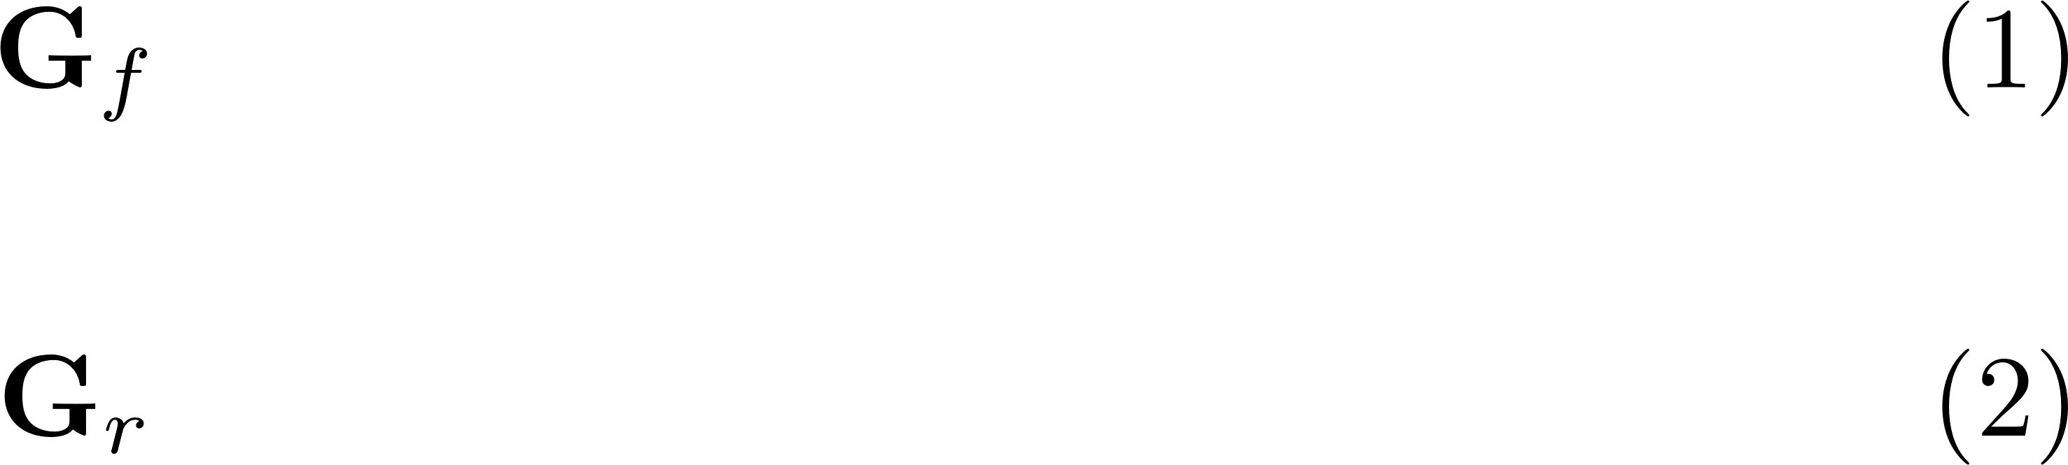
Shack Hartmann sensor
Measurement is done from derivatives of the used modal basis (Zernike polynomials)
s – measured slopes vector
G – derivative matrix
b – reconstructed Zernike coefficients
M – # of lenslets in the sensor
N – # of contemplated modes
– fitted modes
– remaining modes

Slide 8
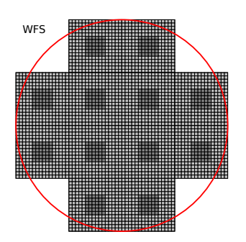
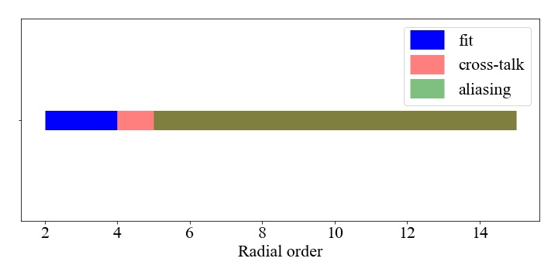
Error Sources
Features | Value
SH-WFS lenslet configuration | 4x4
# of active lenslets | 12
Diameter of telescope | 1.8 m
Central obstruction | 7.7 %
Fitted Zernike modes | 12
Woillez + 2019
Present problems in NAOMI:
Aliasing – Finite frequency of the sensor;
Measurement noise – Read-out noise, photon noise, ...
Cross-talk - Non-orthogonality of G columns;

Slide 9
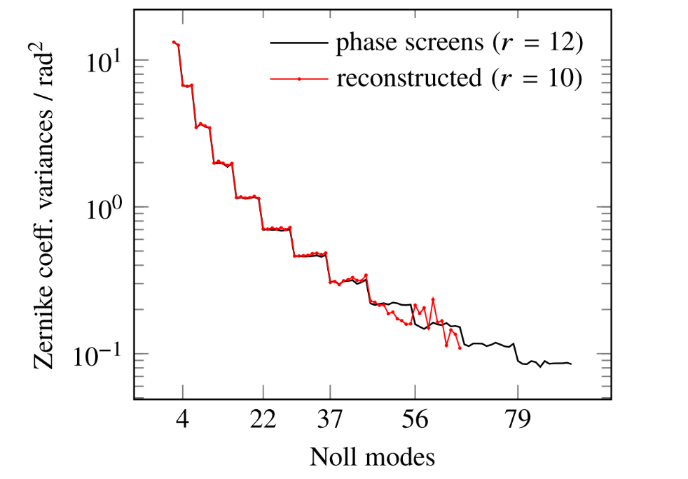
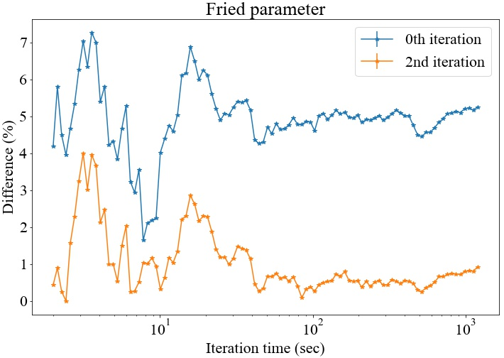
Cross-talk
Zernike polynomials don’t possess orthogonal derivatives
Columns of G are non-orthogonal
- Inverse matrix;
- Cross-talk matrix;
Result in:
No C correction
Andrade + 2019

Slide 10
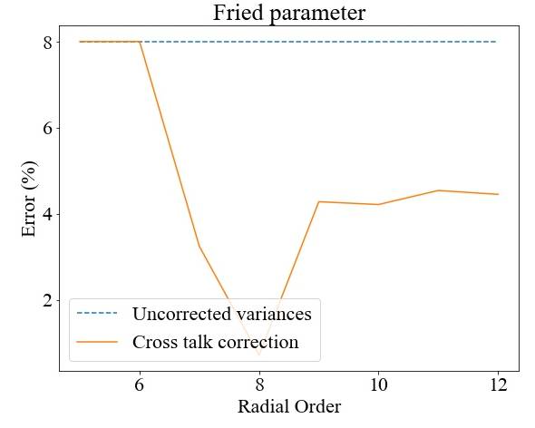
Cross-talk & aliasing mixing
Modes above the fifth radial order display aliasing.
Only one non aliased radial order.
We still see improvements to our correction if we include aliased modes.

Slide 11
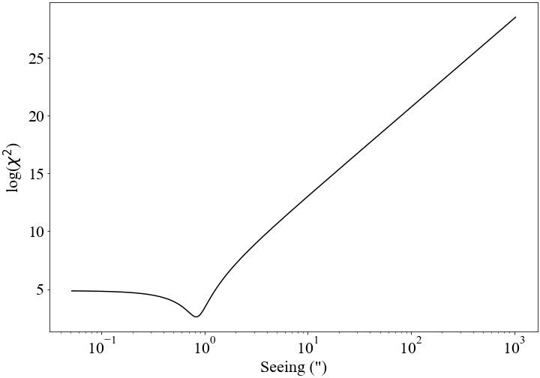
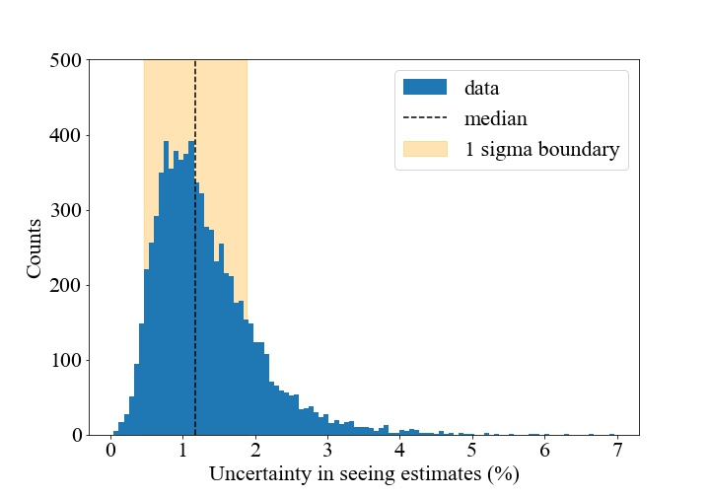
Results
Total data sample:
Date window - (11/2018 - 03/2020)
Total data size - 8170 data measurements
Loop frequency - 500 Hz
Minimum time horizon - 20 seconds
Internal consistency in the estimation algorithm was found.
Median uncertainty of 1.2%.
A single well-behaved minima was found in the map for the seeing.

Slide 12
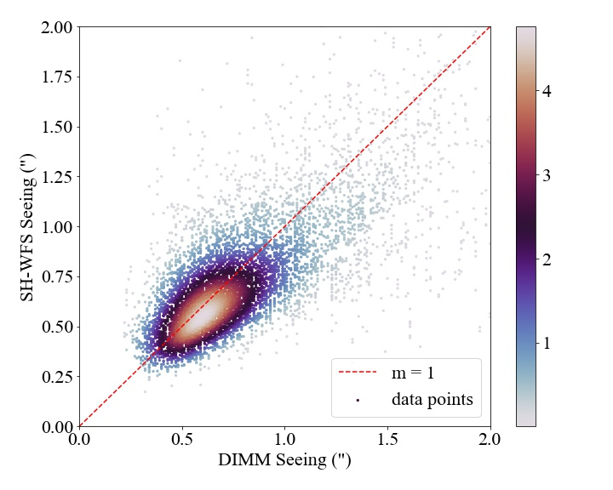
Seeing comparison: telemetry vs DIMM
Seeing estimates are available from the DIMM;
Excellent agreement between DIMM and AO telemetry based seeing;
% level differences;
Causes:
Different instrument locations;
Different dome turbulence in DIMM;
Noise estimation from fit;

Slide 13
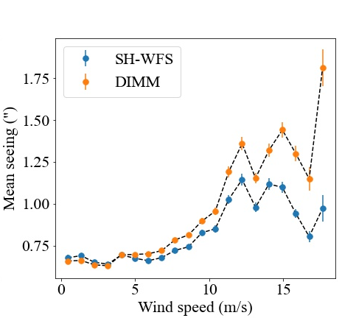
Seeing comparison: wind-speed
As the wind-speed increases the differences between DIMM and AO telemetry based seeing data estimates also increases.
The difference is caused by:
Vibrations in the defocus mode – Especially affected by wind-shake;

Slide 14
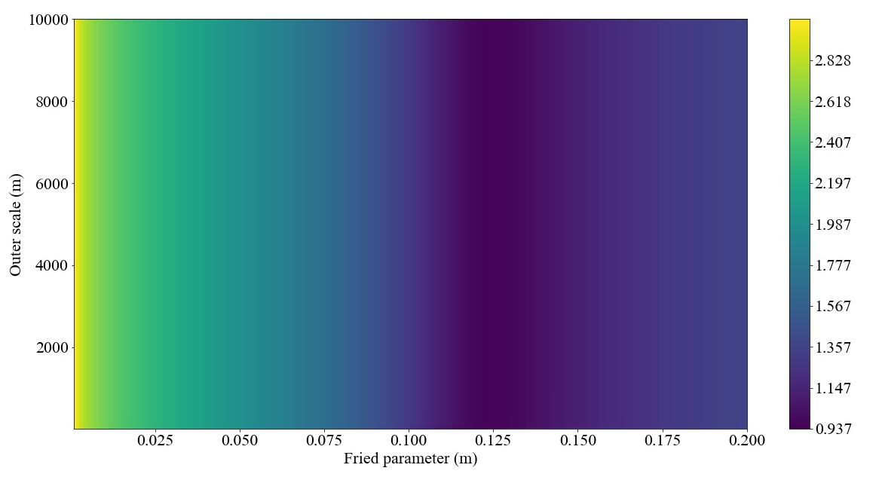
Outer scale estimation
Can’t be estimated with NAOMI telemetry data consistently;
Small telescope diameter leads to a minimum detectable frequency larger than the frequency associated with the outer scale (20 meters);
It’s translated in the map as a weak (absent) minima;

Slide 15
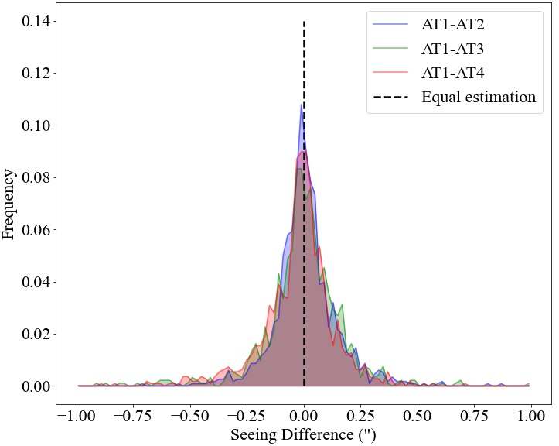
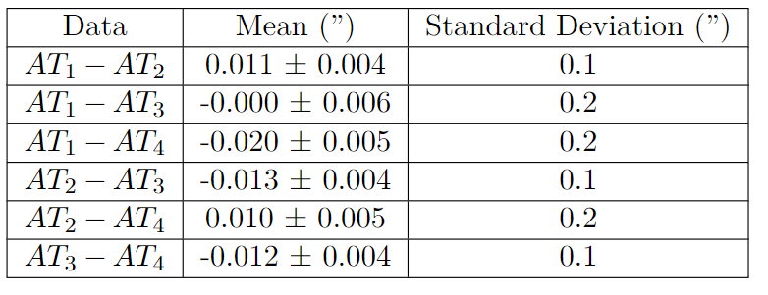
Consistency of estimates
The seeing is consistent across the ATs.

Slide 16


Status and Future Goals
Algorithm is operational;
Improves estimation to sub % error wrt DIMM;
Agreement across ATs;
Deployable to track seeing on 20 sec time scales;
Explain the remaining differences between NAOMI and DIMM;
Automatic removal of abnormal modes;
Improve noise estimation algorithm;
Improve estimation with data fusion of the four telescopes and fringe-tracking data;

Slide 17
Thank You !

