Slide 1




Improved Pyramid Wavefront Sensor using a Diffractive Optical Layer
Esteban Vera, Felipe Guzman, Jorge Bacca, Jorge Tapia, Camilo Weinberger, and Henry Arguello

Slide 2
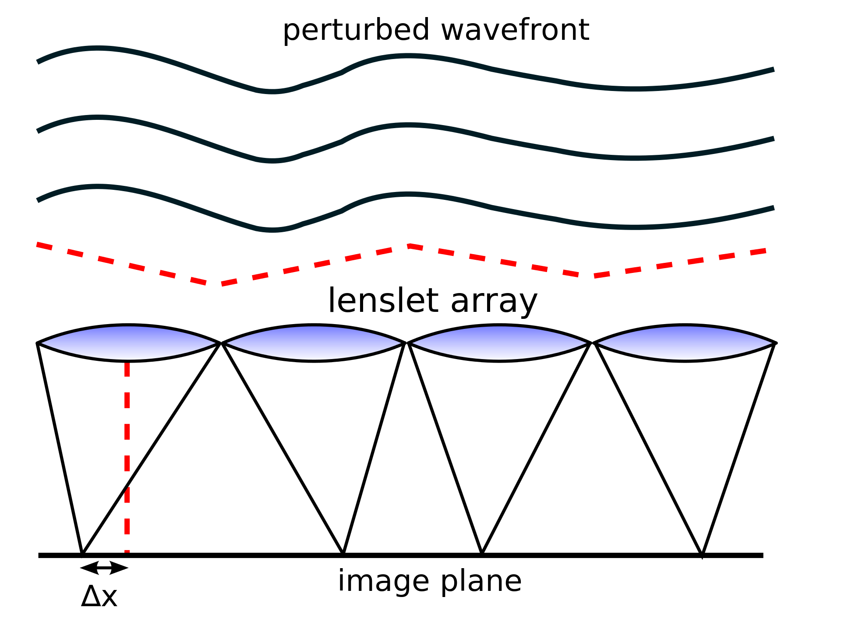
Shack-Hartmann wavefront sensor

Slide 3
Pyramid wavefront sensor
focusing lens
prism
relay lens

Slide 4
Wavefront sensing
Projection/Transformation
OPTICS
detector

Slide 5
Wavefront sensing
Projection/Transformation
OPTICS
detector

Slide 6
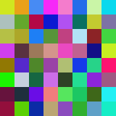

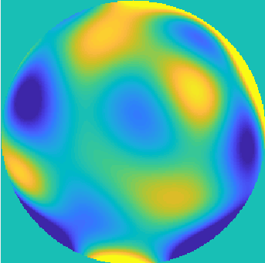
WAVEFRONT ESTIMATION
INVERSE PROBLEM
MODEL
WFS MEASUREMENT
ESTIMATION

Slide 7
WAVEFRONT ESTIMATION
WFS MEASUREMENT
ESTIMATION

Slide 8
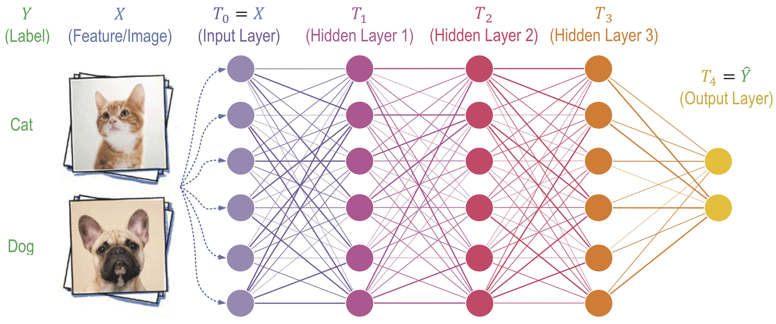
WAVEFRONT ESTIMATION
DEEP NEURAL NETWORK
WFS MEASUREMENT
ESTIMATION

Slide 9
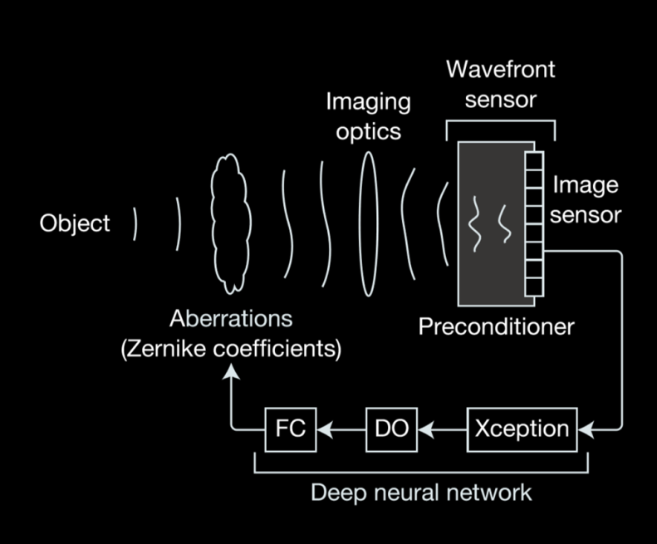
Deep learning wavefront sensor
Y. Nishizaki, M. Valdivia, R. Horisaki, K. Kitaguchi, M. Saito, J. Tanida, and E. Vera, "Deep learning wavefront sensing," Optics Express 27, 240-251 (2019).

Slide 10
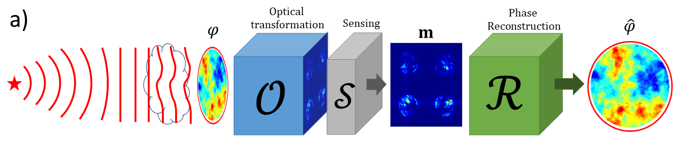
GENERALIZED WFS

Slide 11
GENERALIZED WFS
1
-

Slide 12
GENERALIZED WFS
2
-

Slide 13
GENERALIZED WFS
3
-

Slide 14
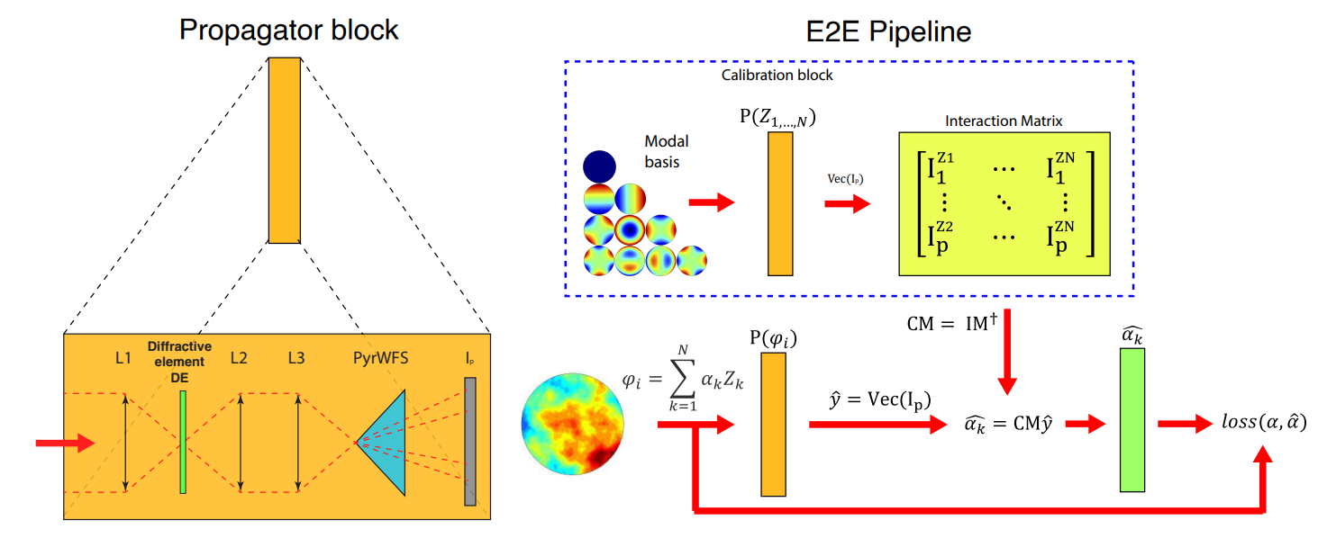
GENERALIZED PWFS
Linear Rec

Slide 15

End-to-End TRAINING FOR THE IMPROVED PWFS
Forward pass

Slide 16




End-to-End TRAINING FOR THE IMPROVED PWFS
Forward pass
Backward pass
Incoming wavefront
$$φ_{i}$$

Slide 17
End-to-End TRAINING FOR THE IMPROVED PWFS
Forward pass
Backward pass
Incoming wavefront
$$φ_{i}$$

Slide 18
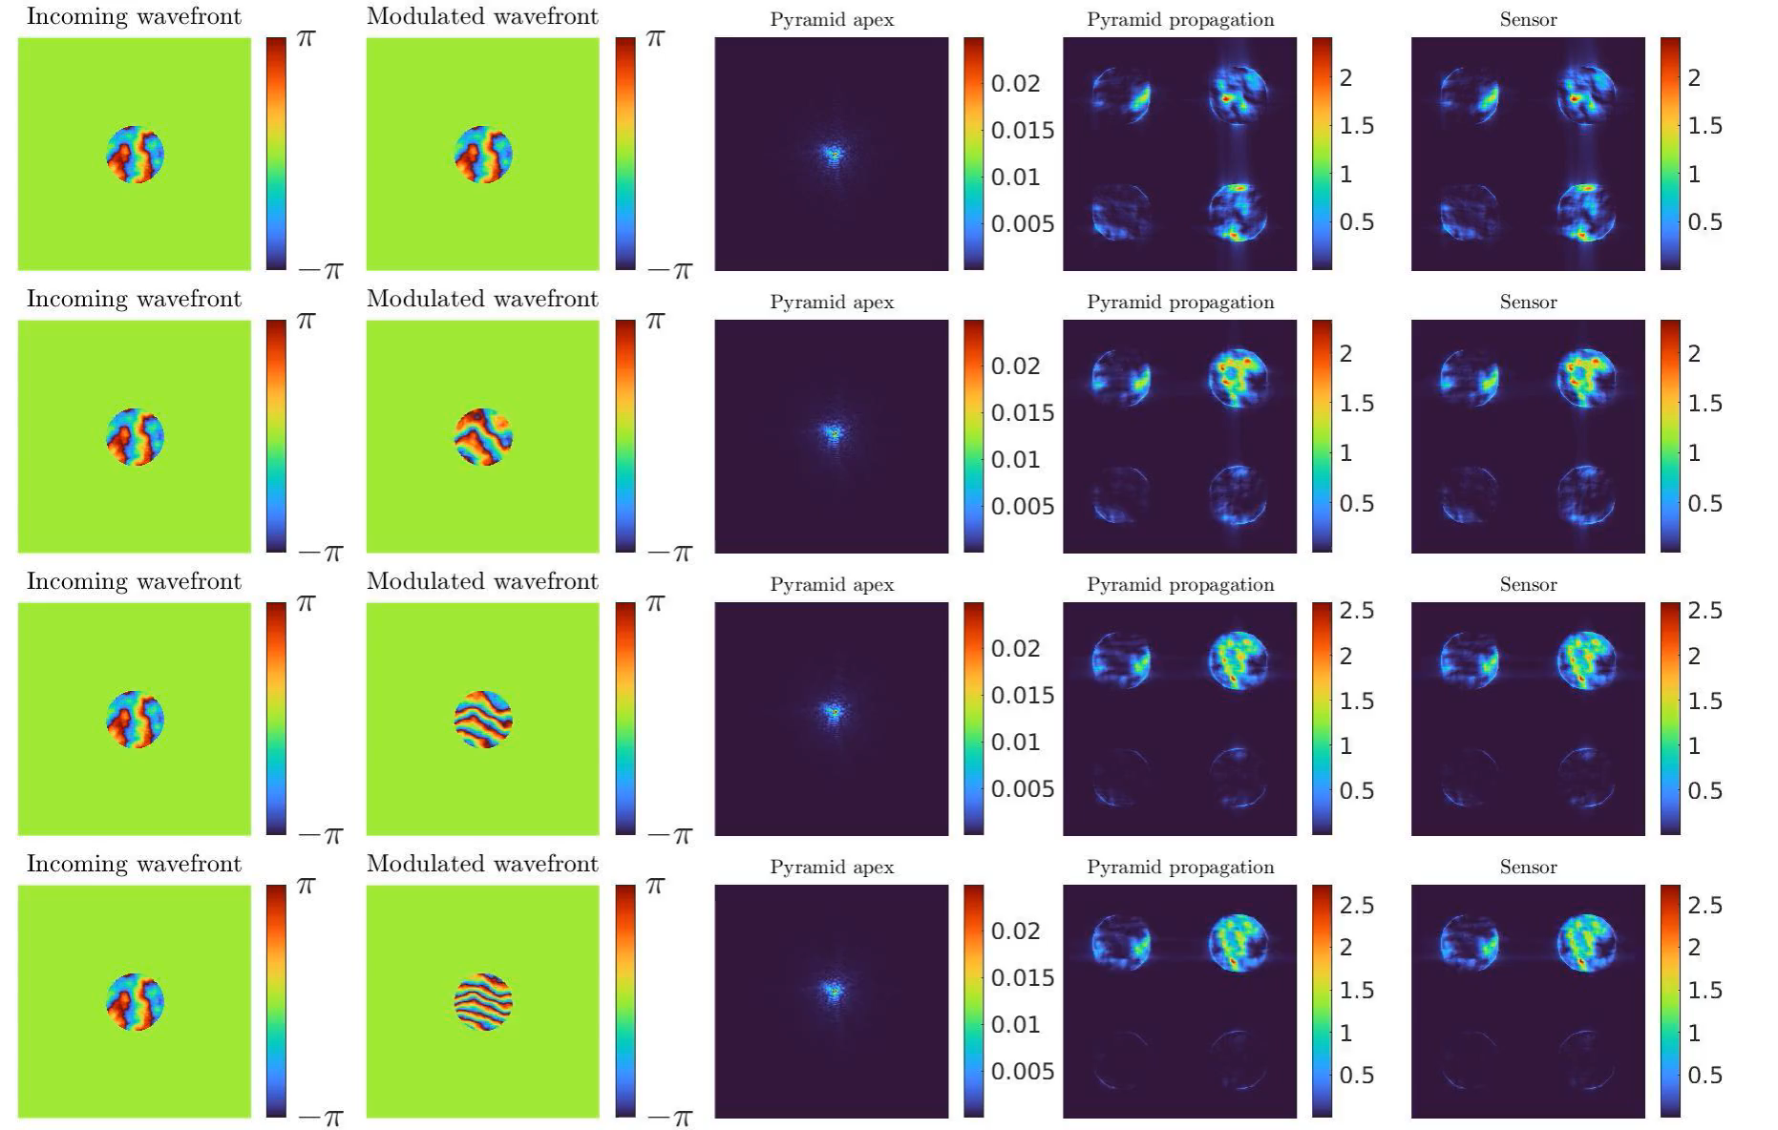
PWFS SIMULATION
Unmodulated
Notes:
Problems linarility and sensitivity

Slide 19
PWFS SIMULATION
Unmodulated
Mod = 2
Mod = 4
Mod = 6
Notes:
Problems linarility and sensitivity

Slide 20
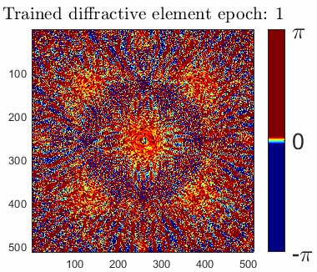
End-to-End TRAINING

Slide 21
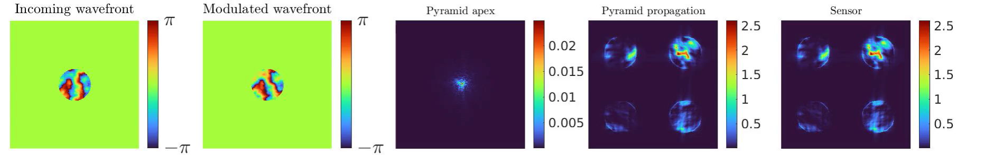
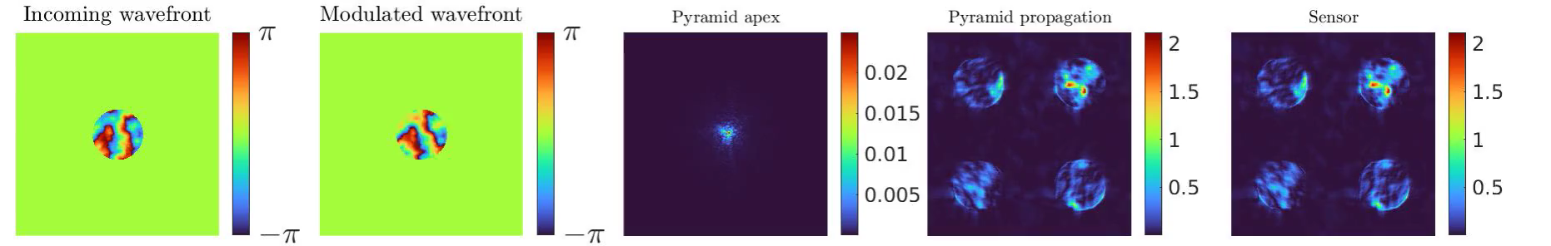
Traditional Pyramid wavefront sensor
Preconditioned Pyramid wavefront sensor

Slide 22
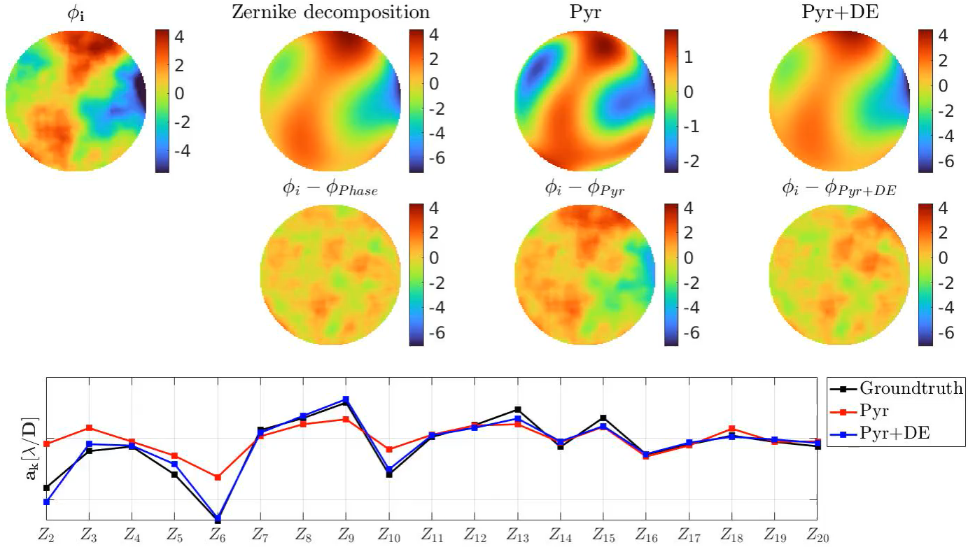
Simulation Results

Slide 23
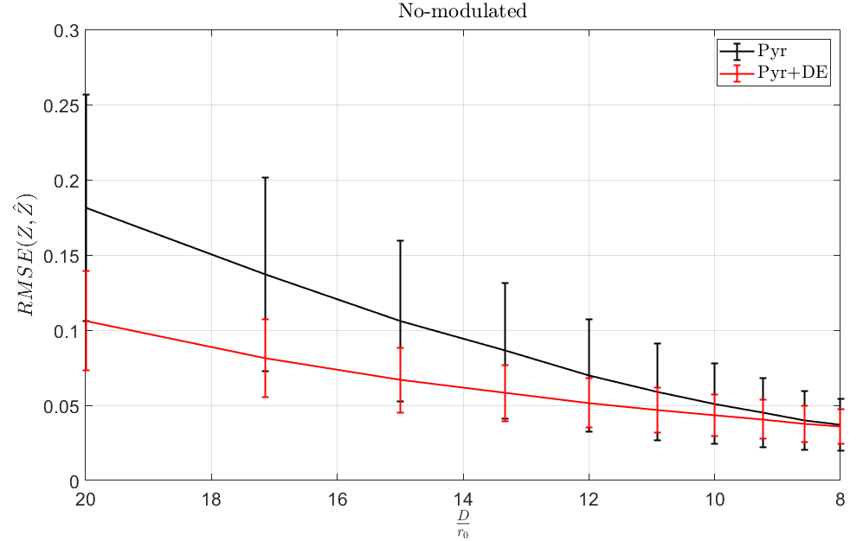
Simulation Results

Slide 24
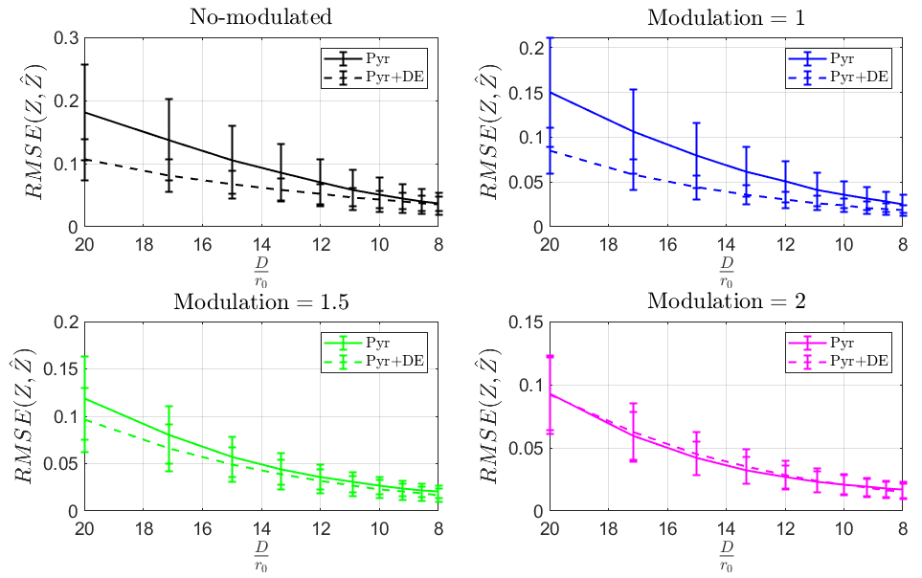
Simulation Results

Slide 25
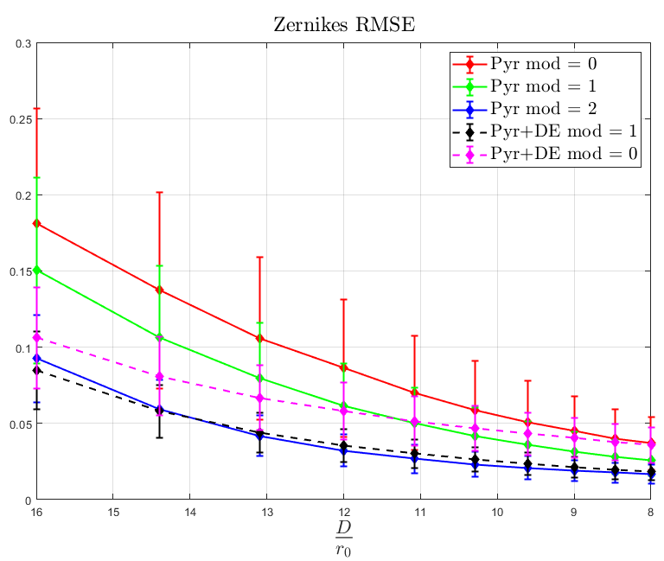
Simulation Results

Slide 26
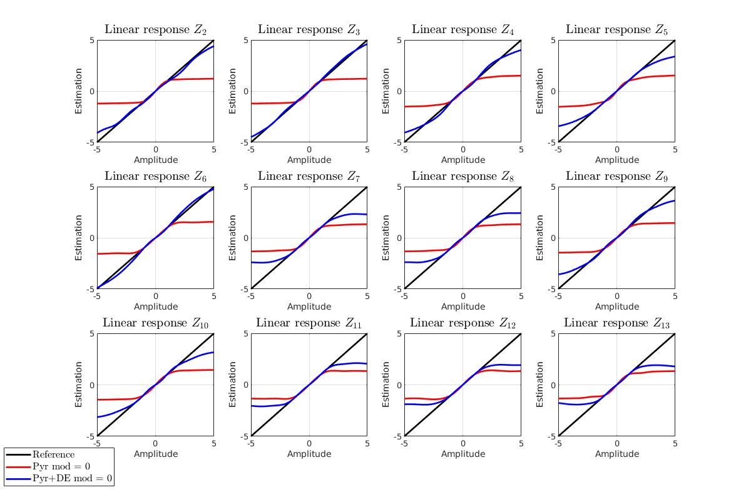
Simulation
Results without modulation

Slide 27
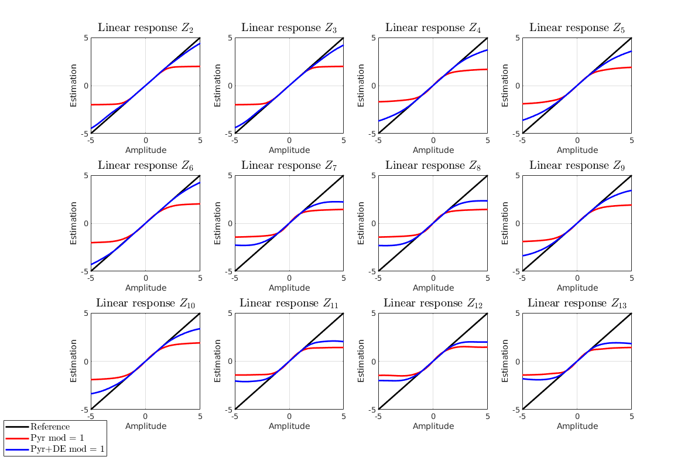
SIMULATION RESULTS WITH MODULATION

Slide 28

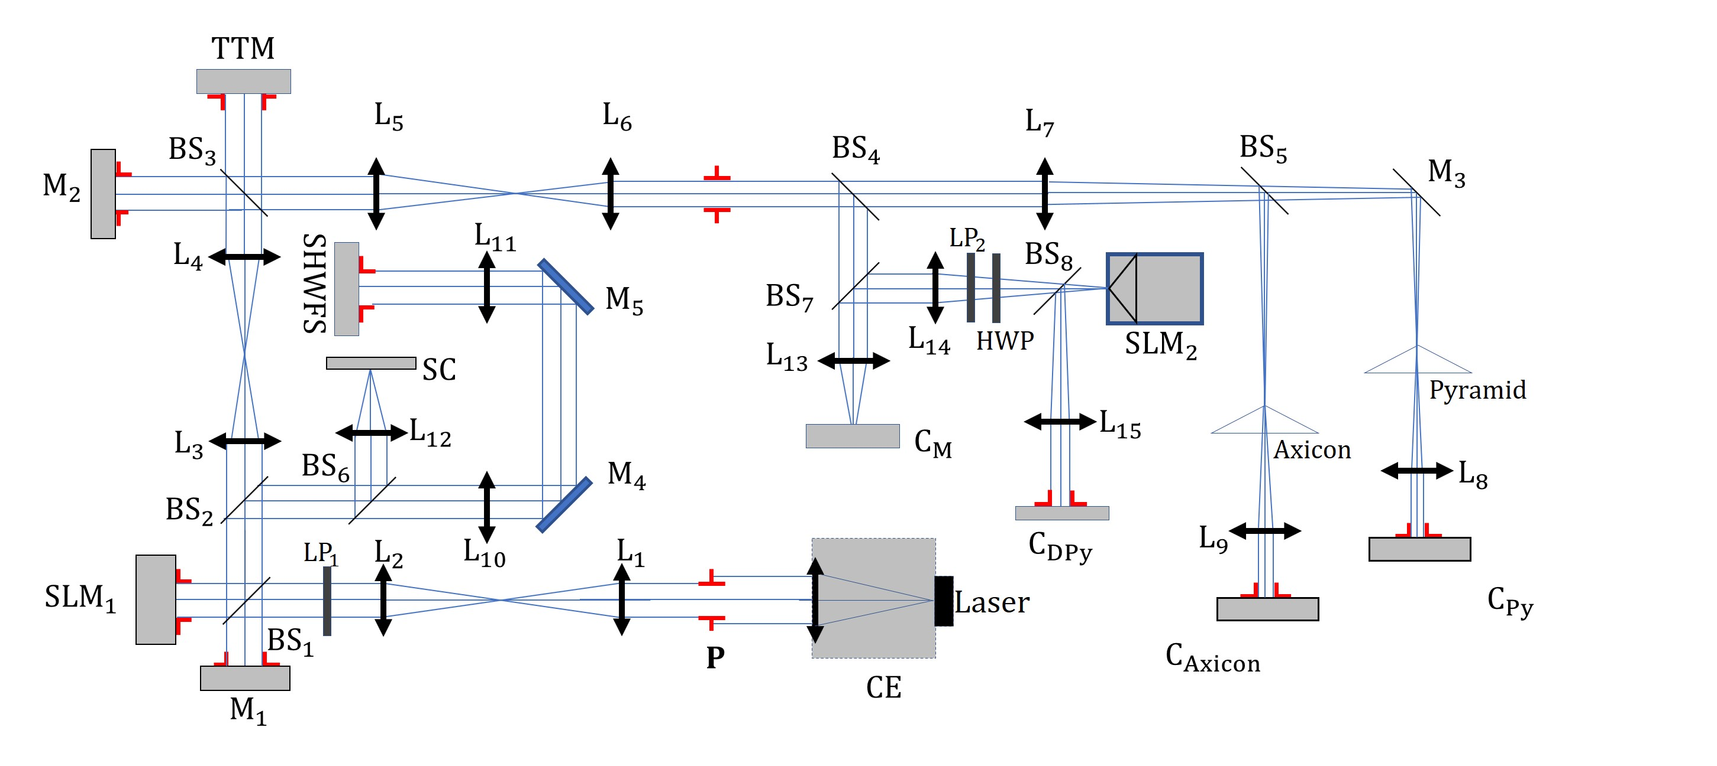
PULPOS AO BENCH
PULPOS
J Tapia, FP Bustos, C Weinberger, B Romero, E Vera , “PULPOS: a multi-purpose adaptive optics test bench in Chile”, Proc. SPIE Adaptive Optics Systems VIII, 2022

Slide 29
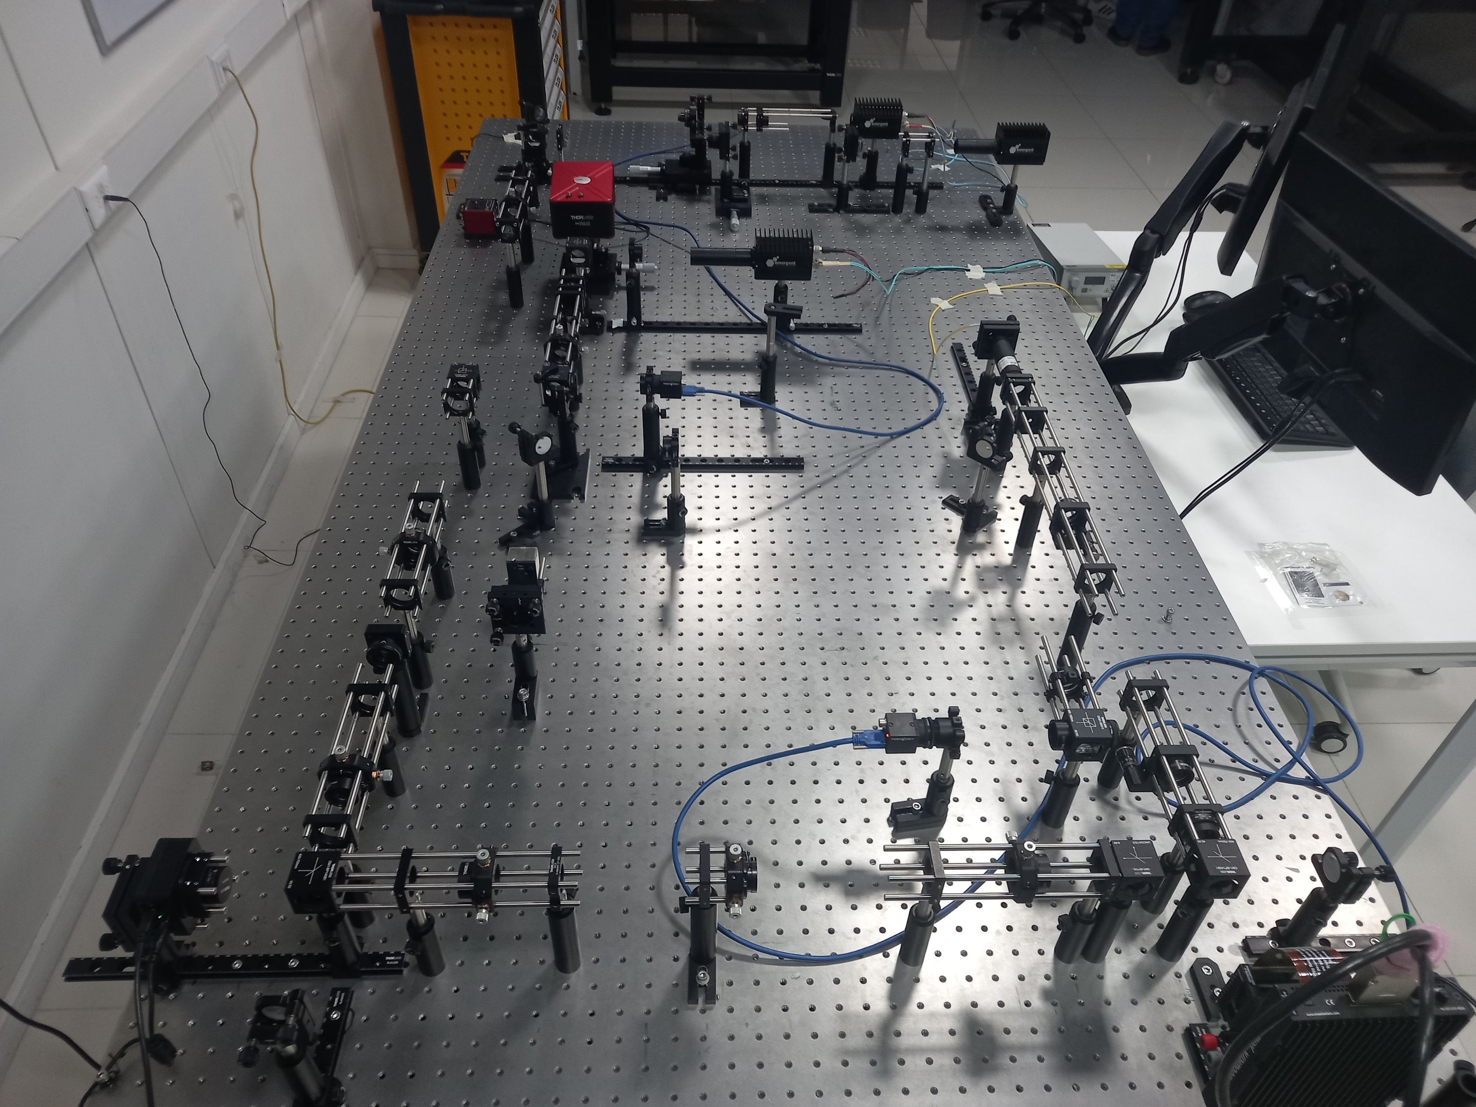
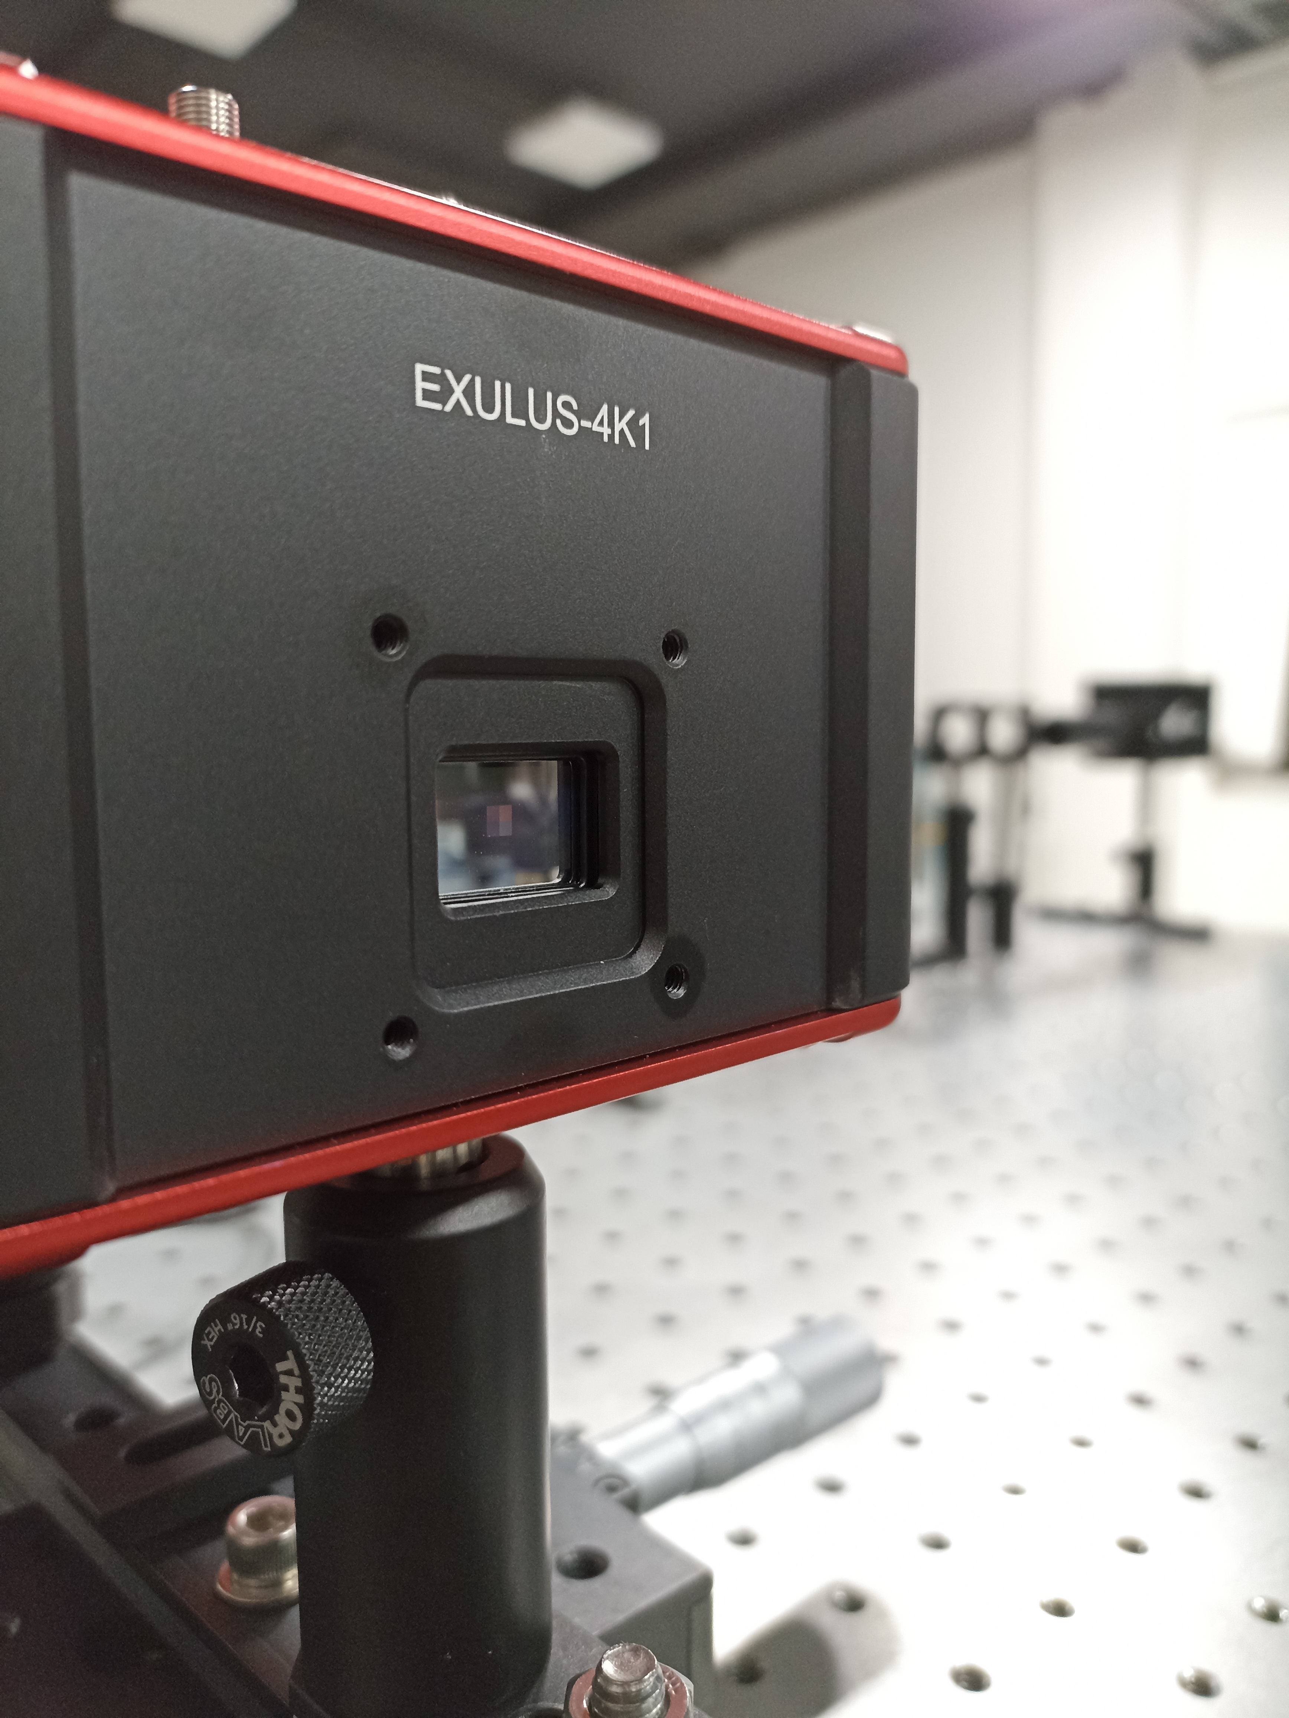
PULPOS

Slide 30
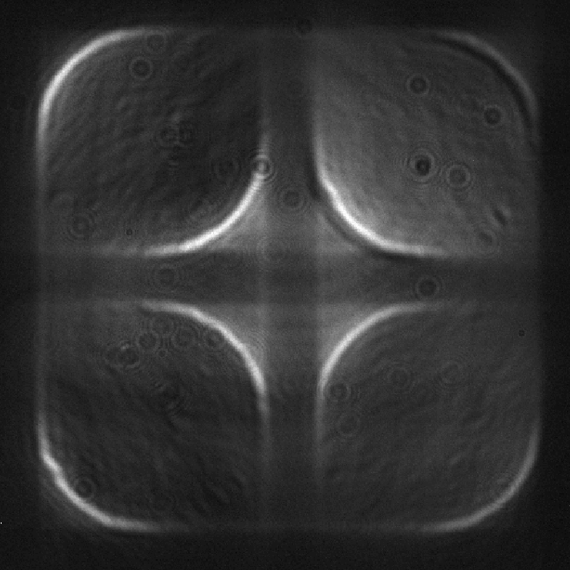
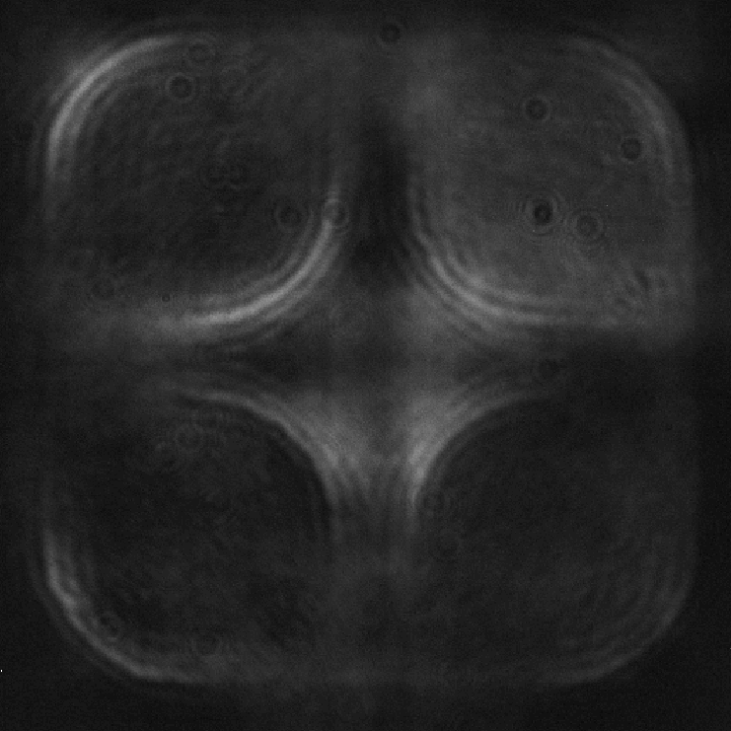
PULPOS FIRST LIGHT without modulation
DIGITAL PWFS + DIFFRACTIVE MASK
DIGITAL PYRAMID WFS

Slide 31
Conclusions
We know deep learning has opened the design space for wavefront sensors
Using a data-diven approach we can train for
better estimation given your WFS measurements
better measurements given your WFS estimations
both
We can add a diffractive optical layer to the optical path of a PWFS that can work as an optical preconditioner
Assuming the use of linear reconsruction, we can design the optical preconditioner using an End-2-End approach
Simulation results suggest that the modified PWFS may
extend the linearity range of the original PWFS
require less modulation to obtain similar results
We are currently working on the experimental demonstration using PULPOS

Slide 32
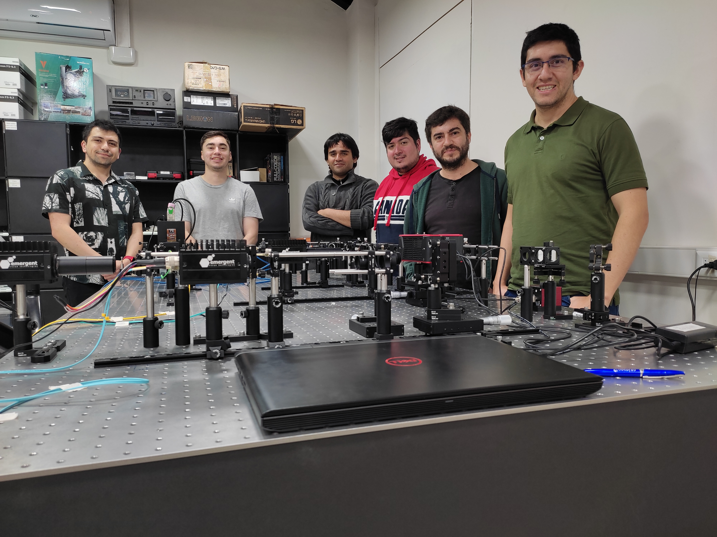
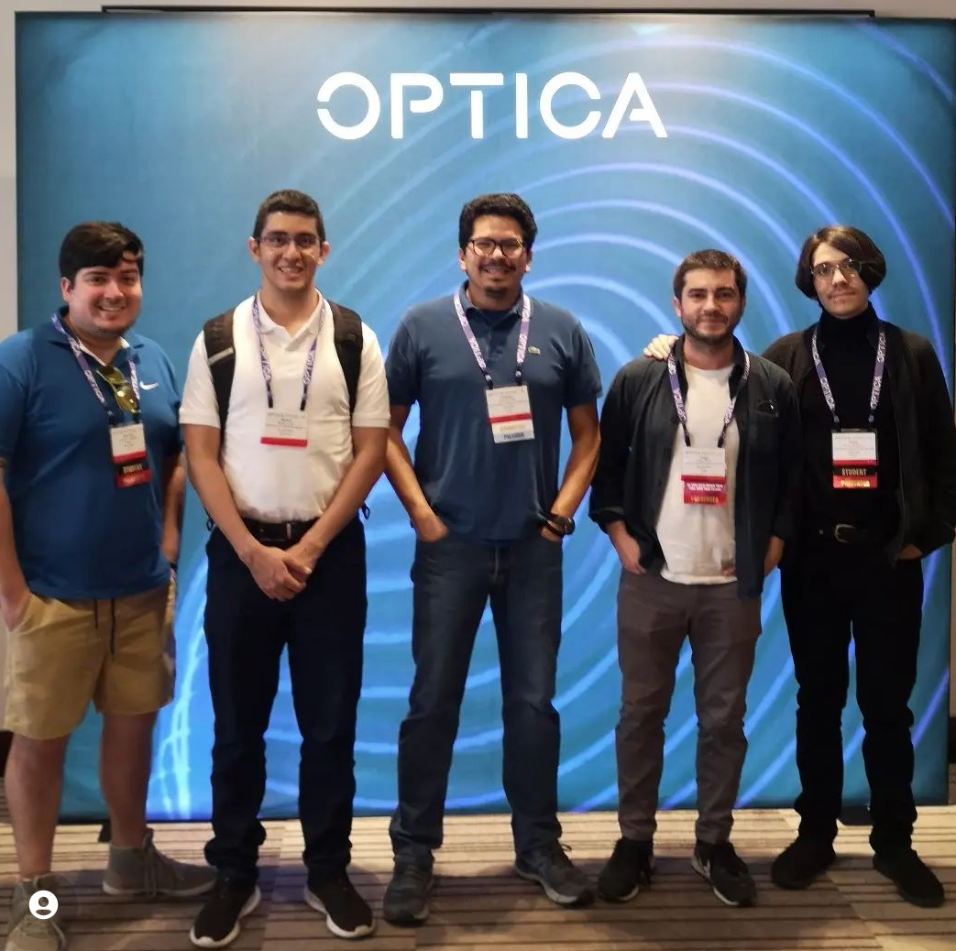
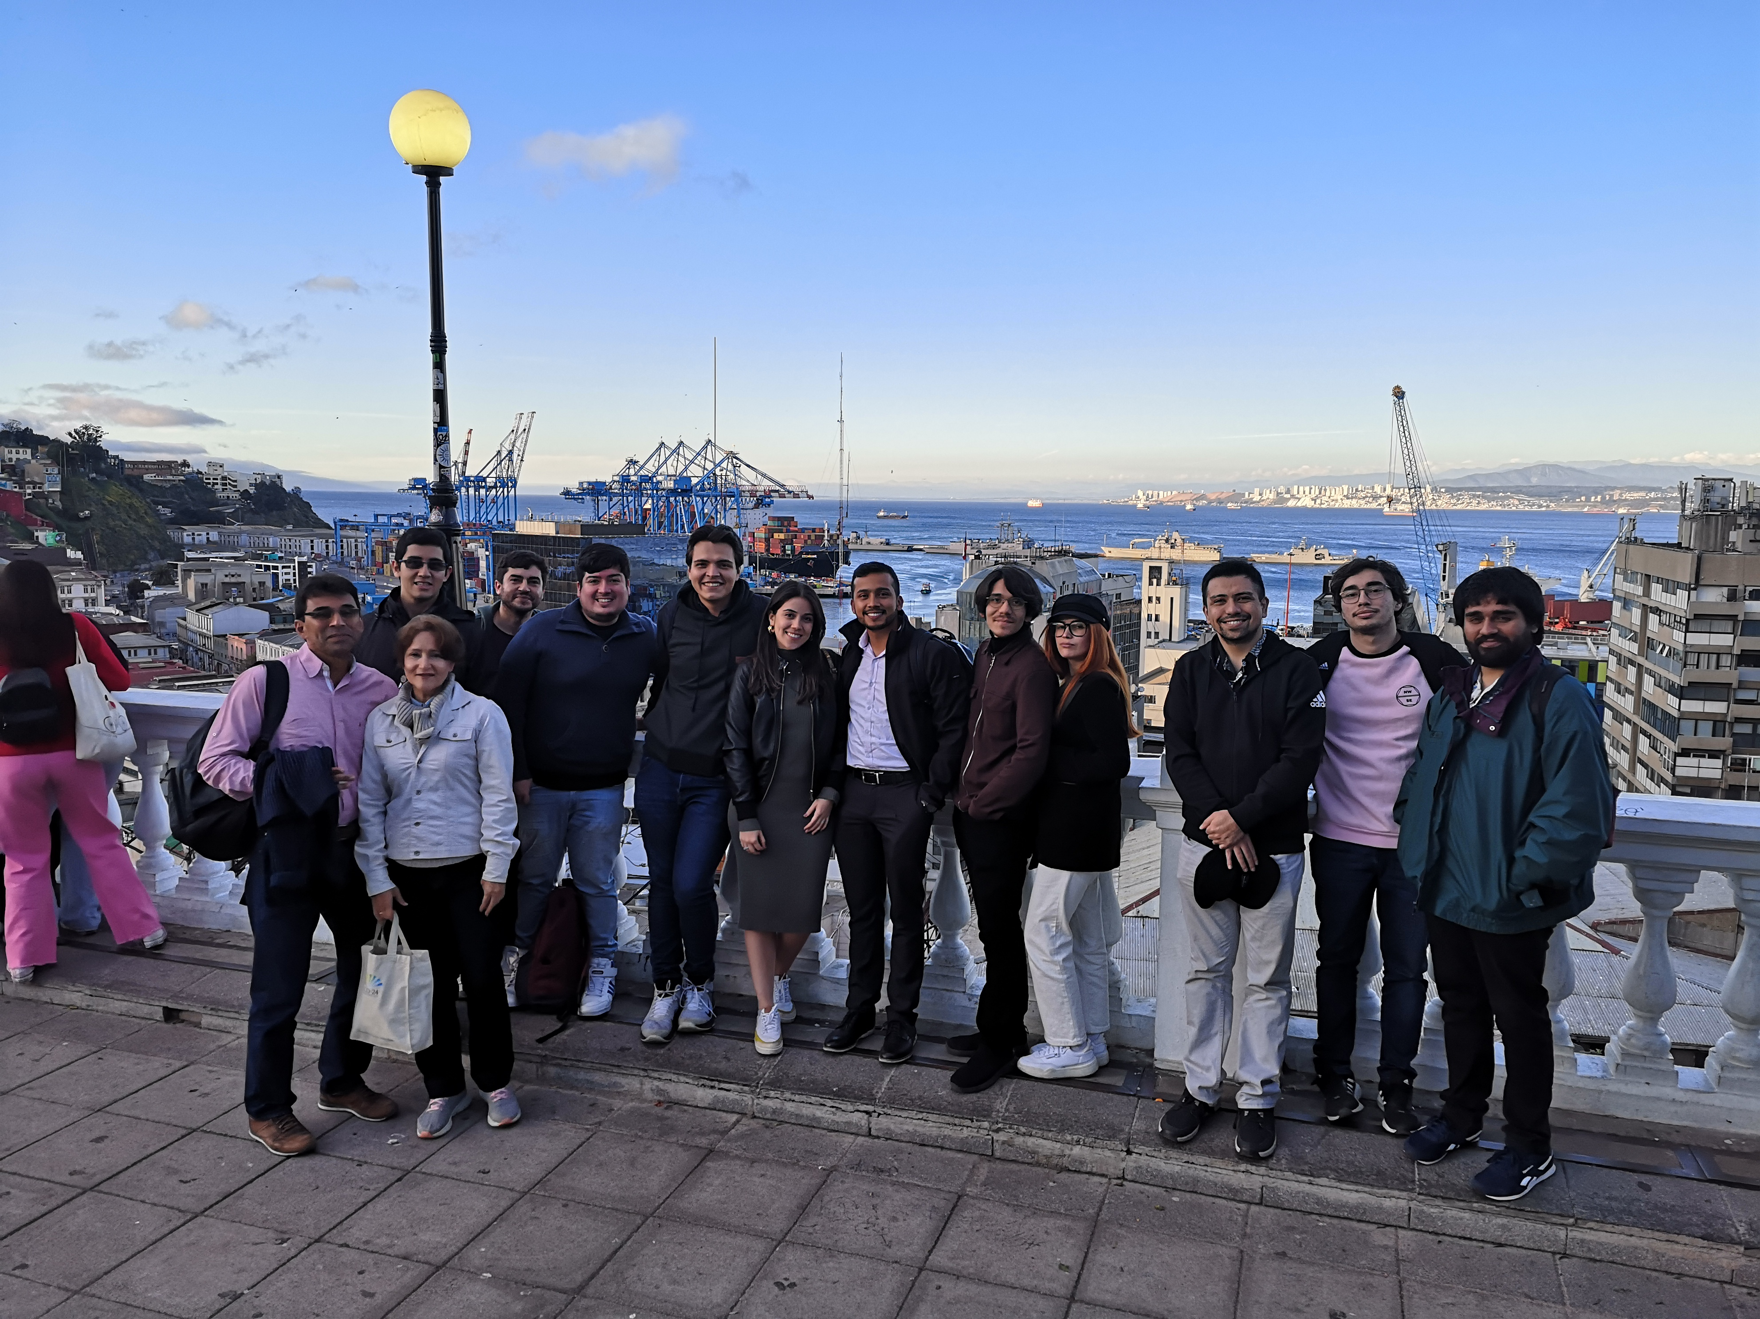
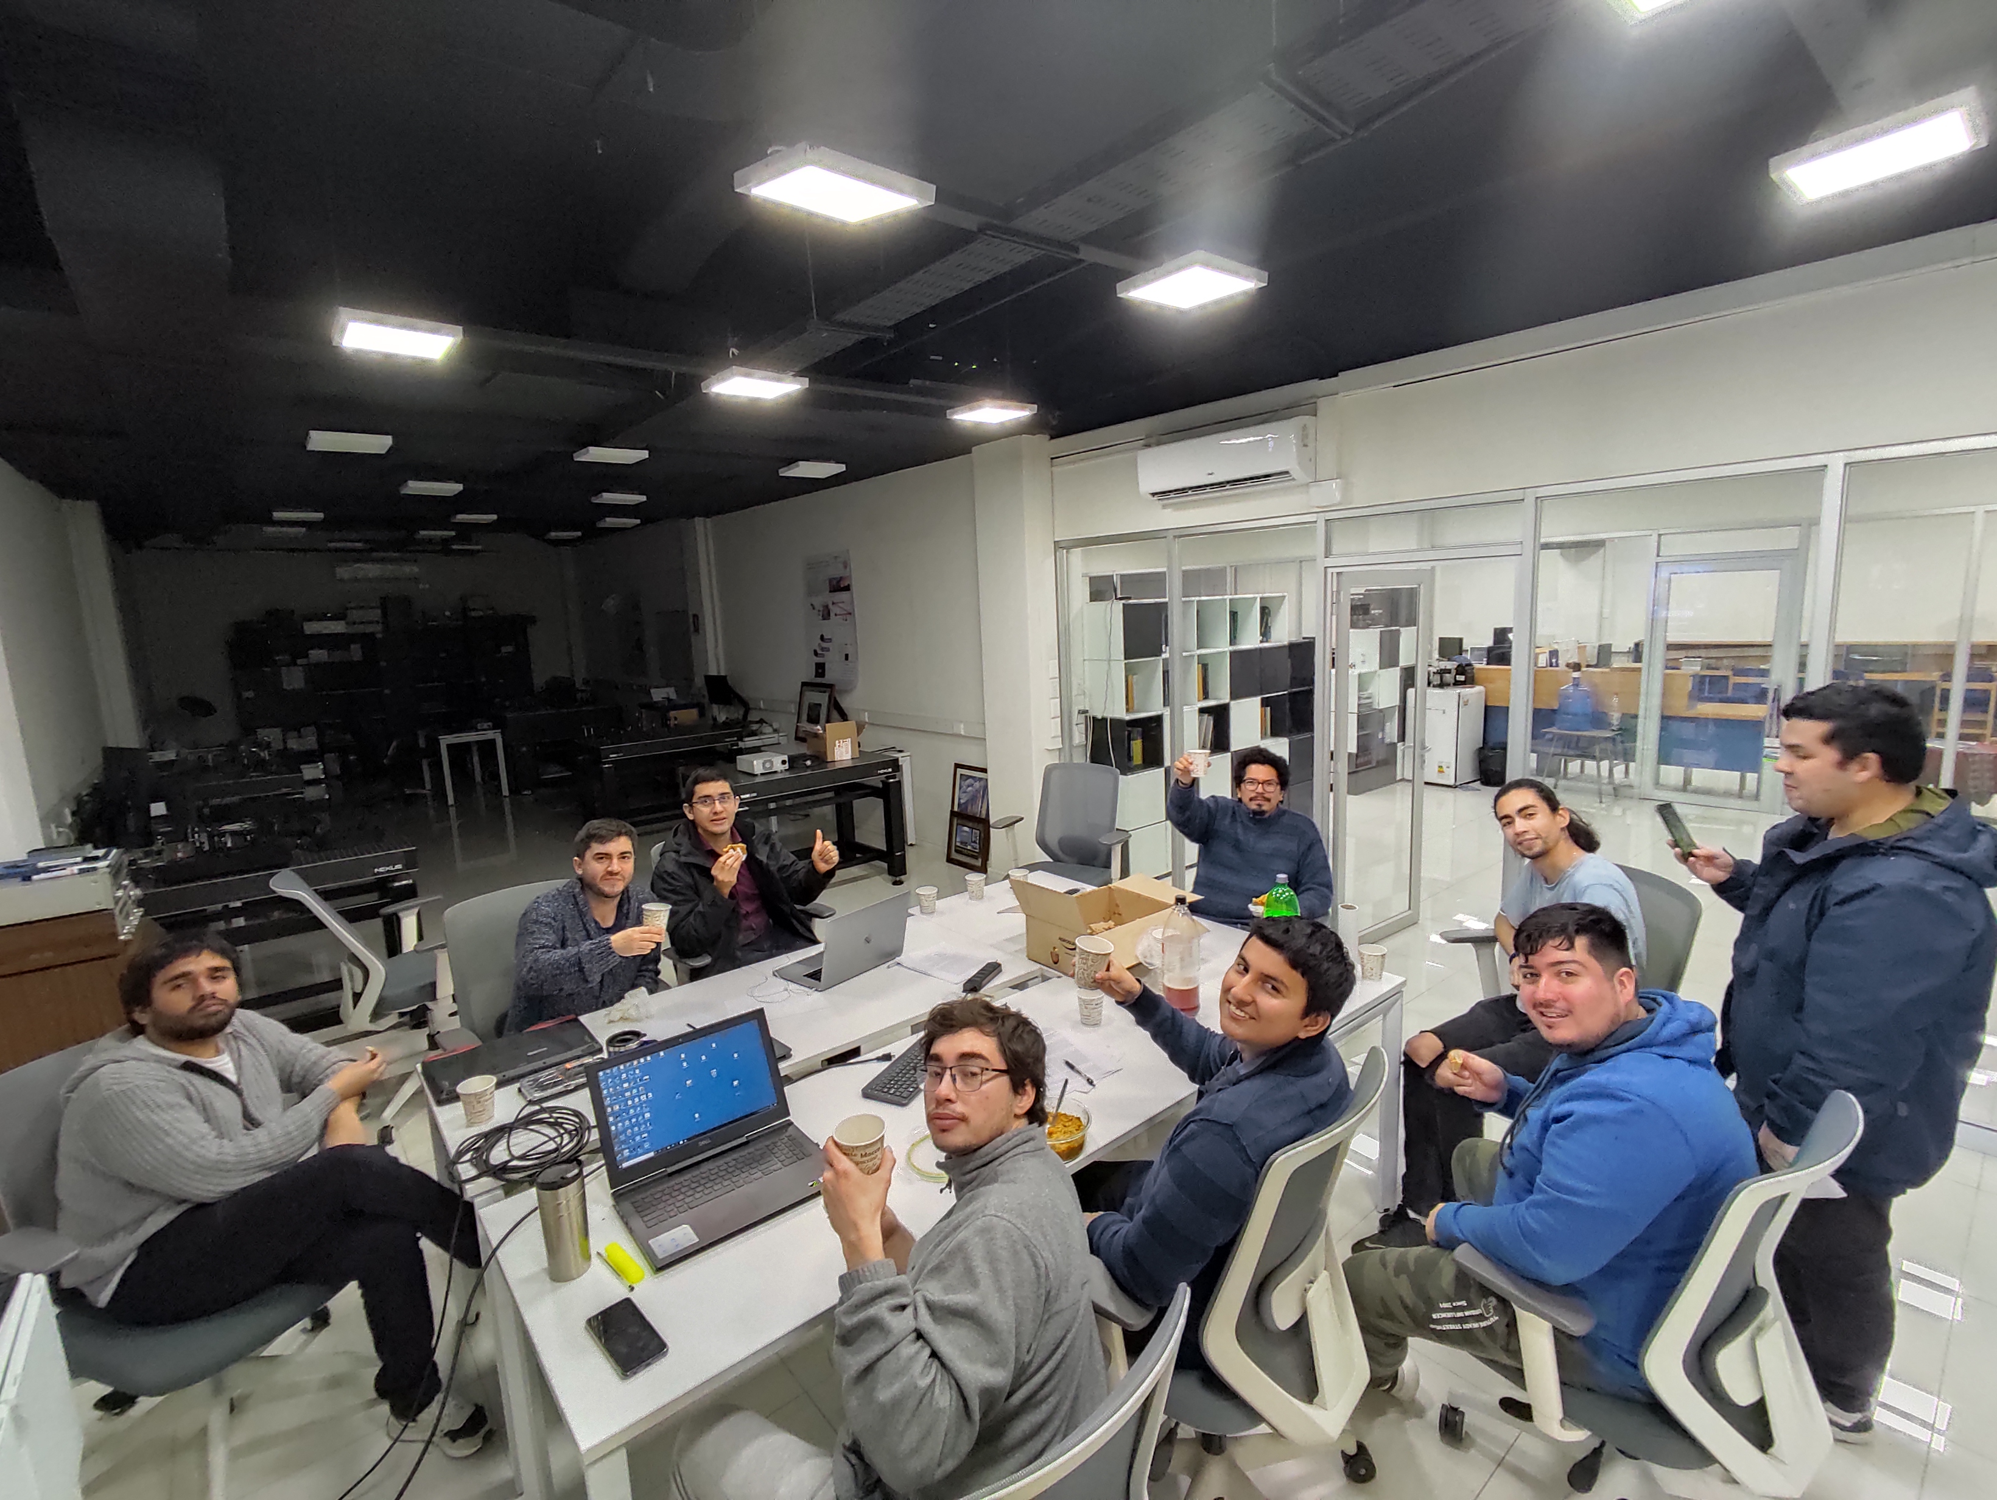
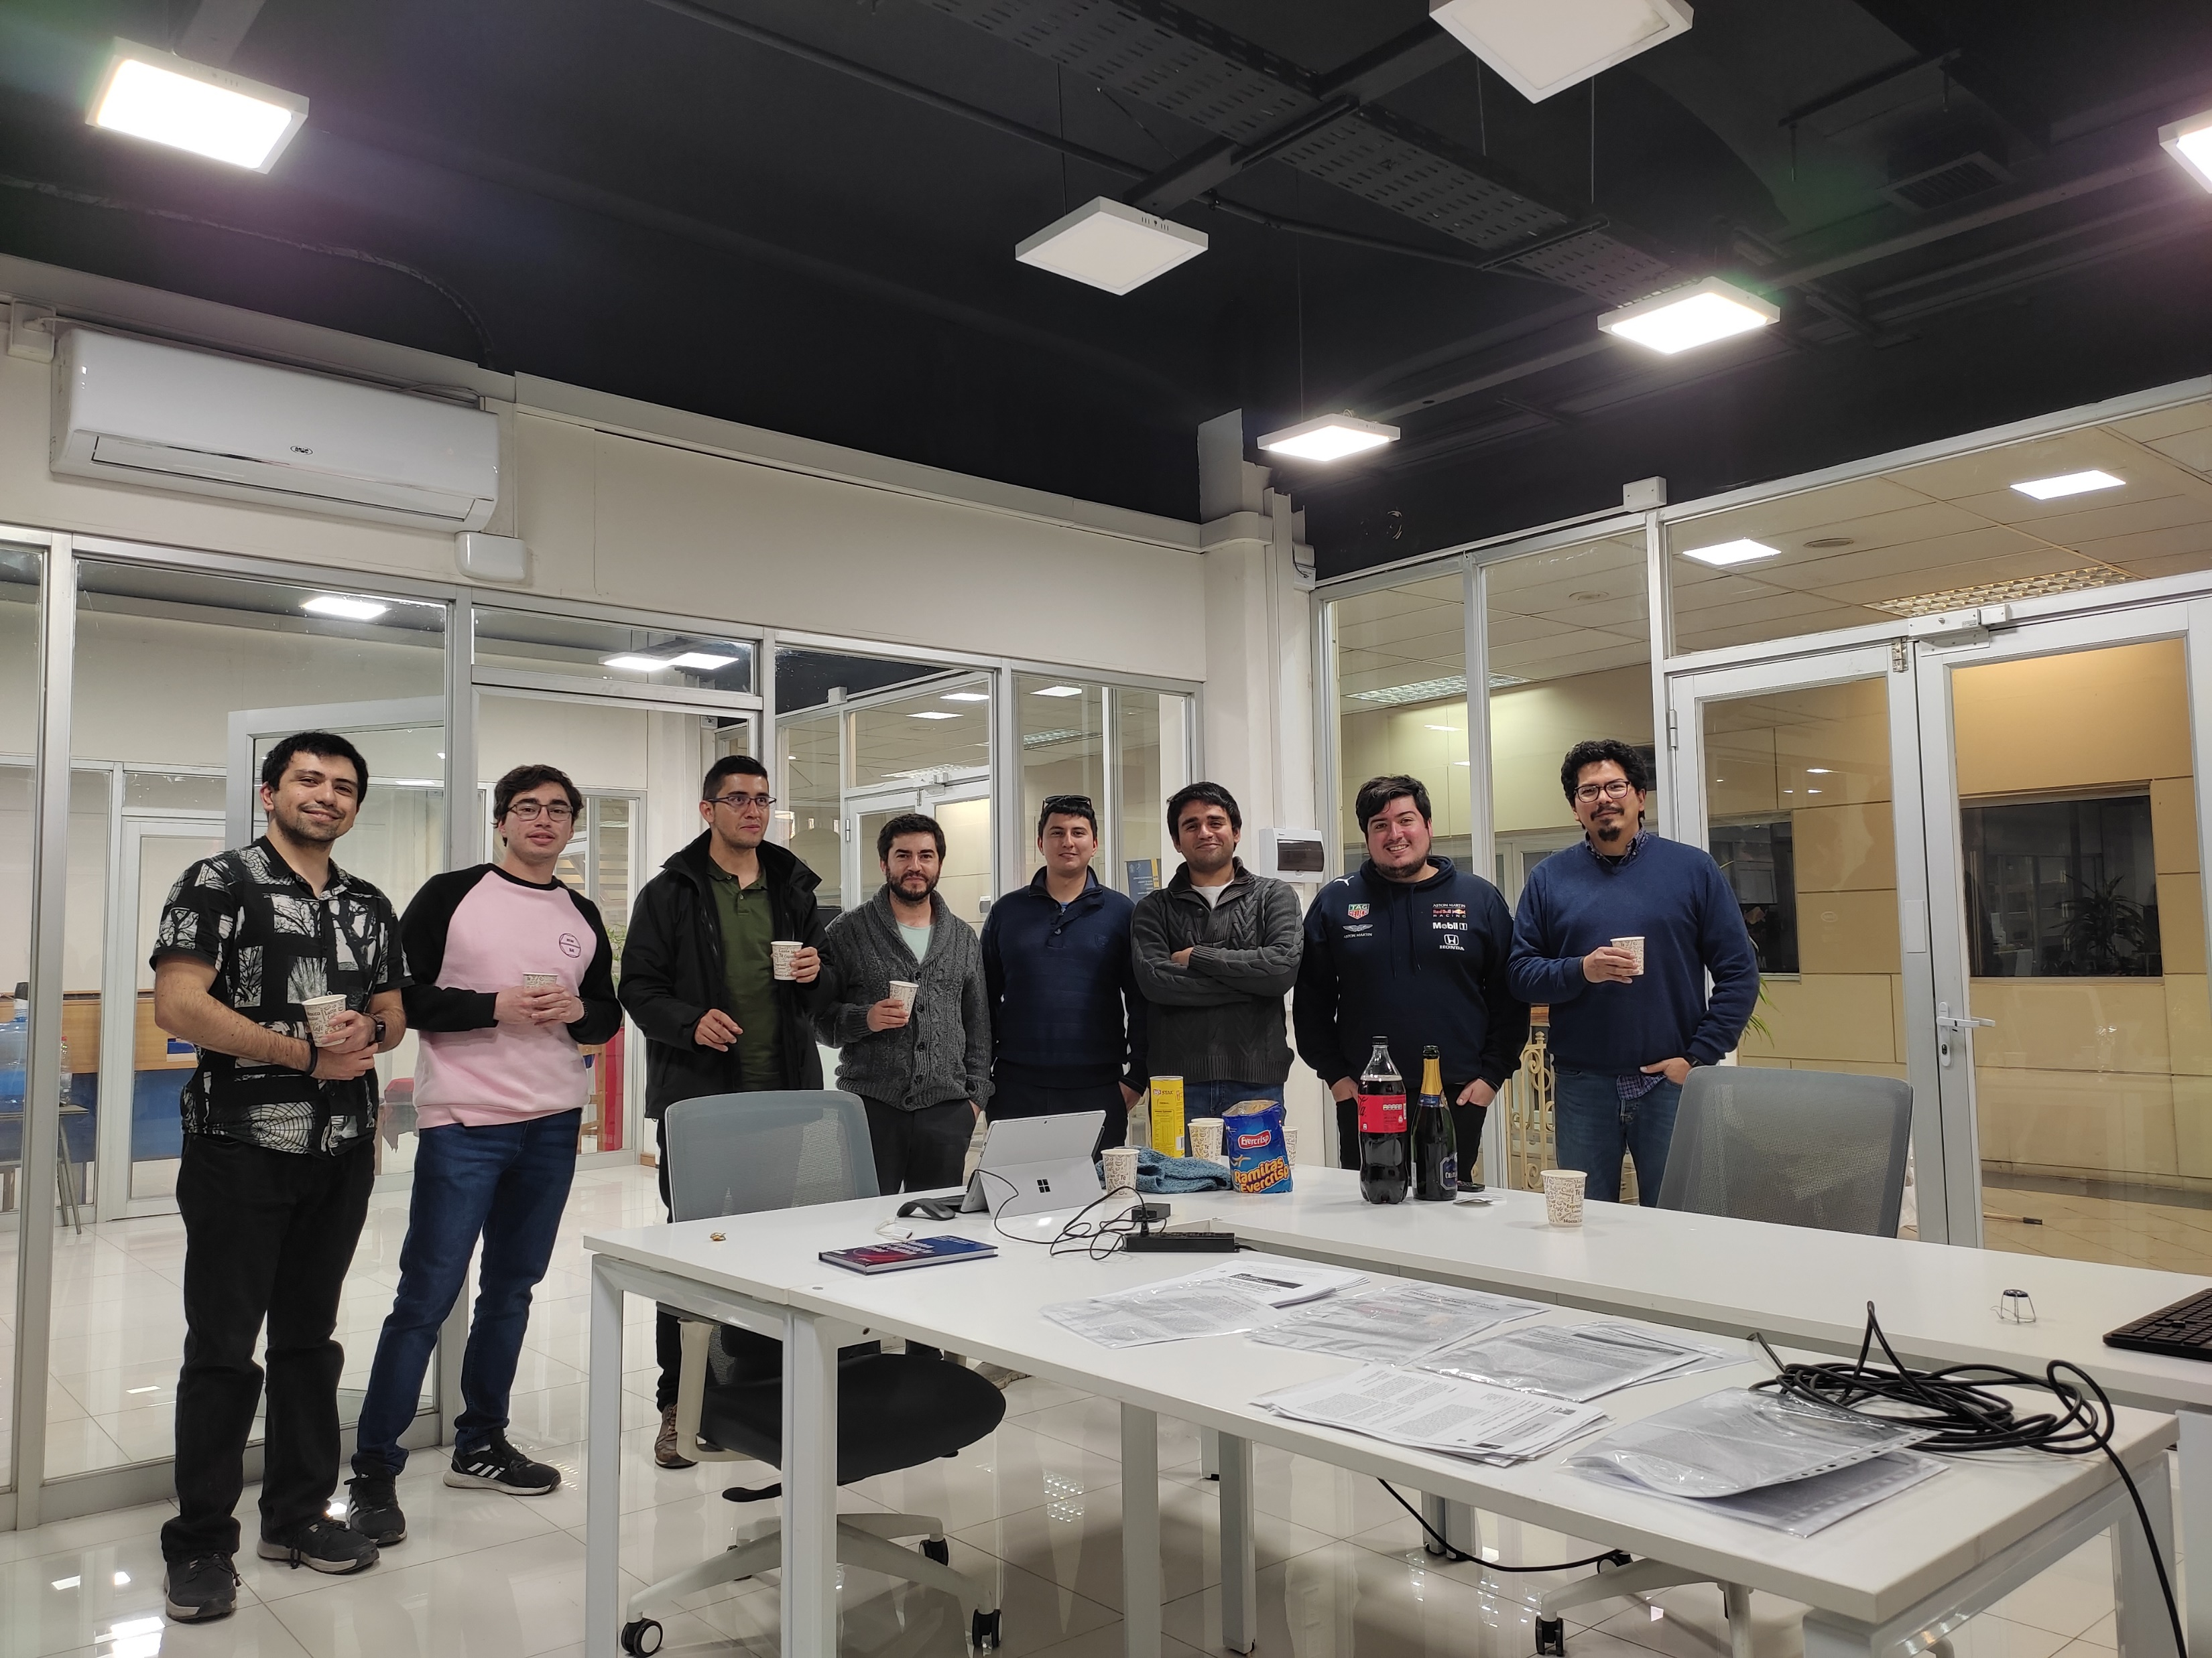
OptoLAB - PUCV

Slide 33



CALL FOR PAPERS
Optics in South America: Joint Feature Issue
Submission window: 1 October 2023 – 1 November 2023
Guest Editors
Gustavo Wiederhecker, University of Campinas, Brazil (Lead Editor)
JOSA A
Solange Cavalcanti, Universidade Federal de Alagoas, Brazil Adriana Fontes, Universidade Federal de Pernambuco, Brazil Jorge Garcia-Sucerquia, Colombia Sede Medellin, Colombia Dario Perez, Pontifica Universidad Catolica de Valparaiso, Chile Esteban Vera, Pontifica Universidad Catolica de Valparaiso, Chile
JOSA B
Andrea Bragas, University of Buenos Aires (UBA), Argentina Christiano de Matos, Mackenzie Presbyterian University, Brazil Alejandro Fainstein, Centro Atómico Bariloche and Instituto Balseiro, Argentina Daniel Felinto, Universidade Federal de Pernambuco, Brazil Debora Milori, Embrapa, Brazil Stephen Walborn, Universidad de Concepción, Chile
Learn more at opg.optica.org/josaa and opg.optica.org/josab
click Feature Issues

Slide 34





Esteban Vera
School of Electrical Engineering
Center for Adaptive Optics of Valparaiso
PUCV, Valparaiso, Chile
esteban.vera@pucv.cl
ALMA ASTRO20-0088
ECOS C20E02
STIC-AMSUD 21-STIC-09
QUIMAL 190002
FONDECYT 1221883
AFOSR FA9550-19-1-0293

