Slide 1

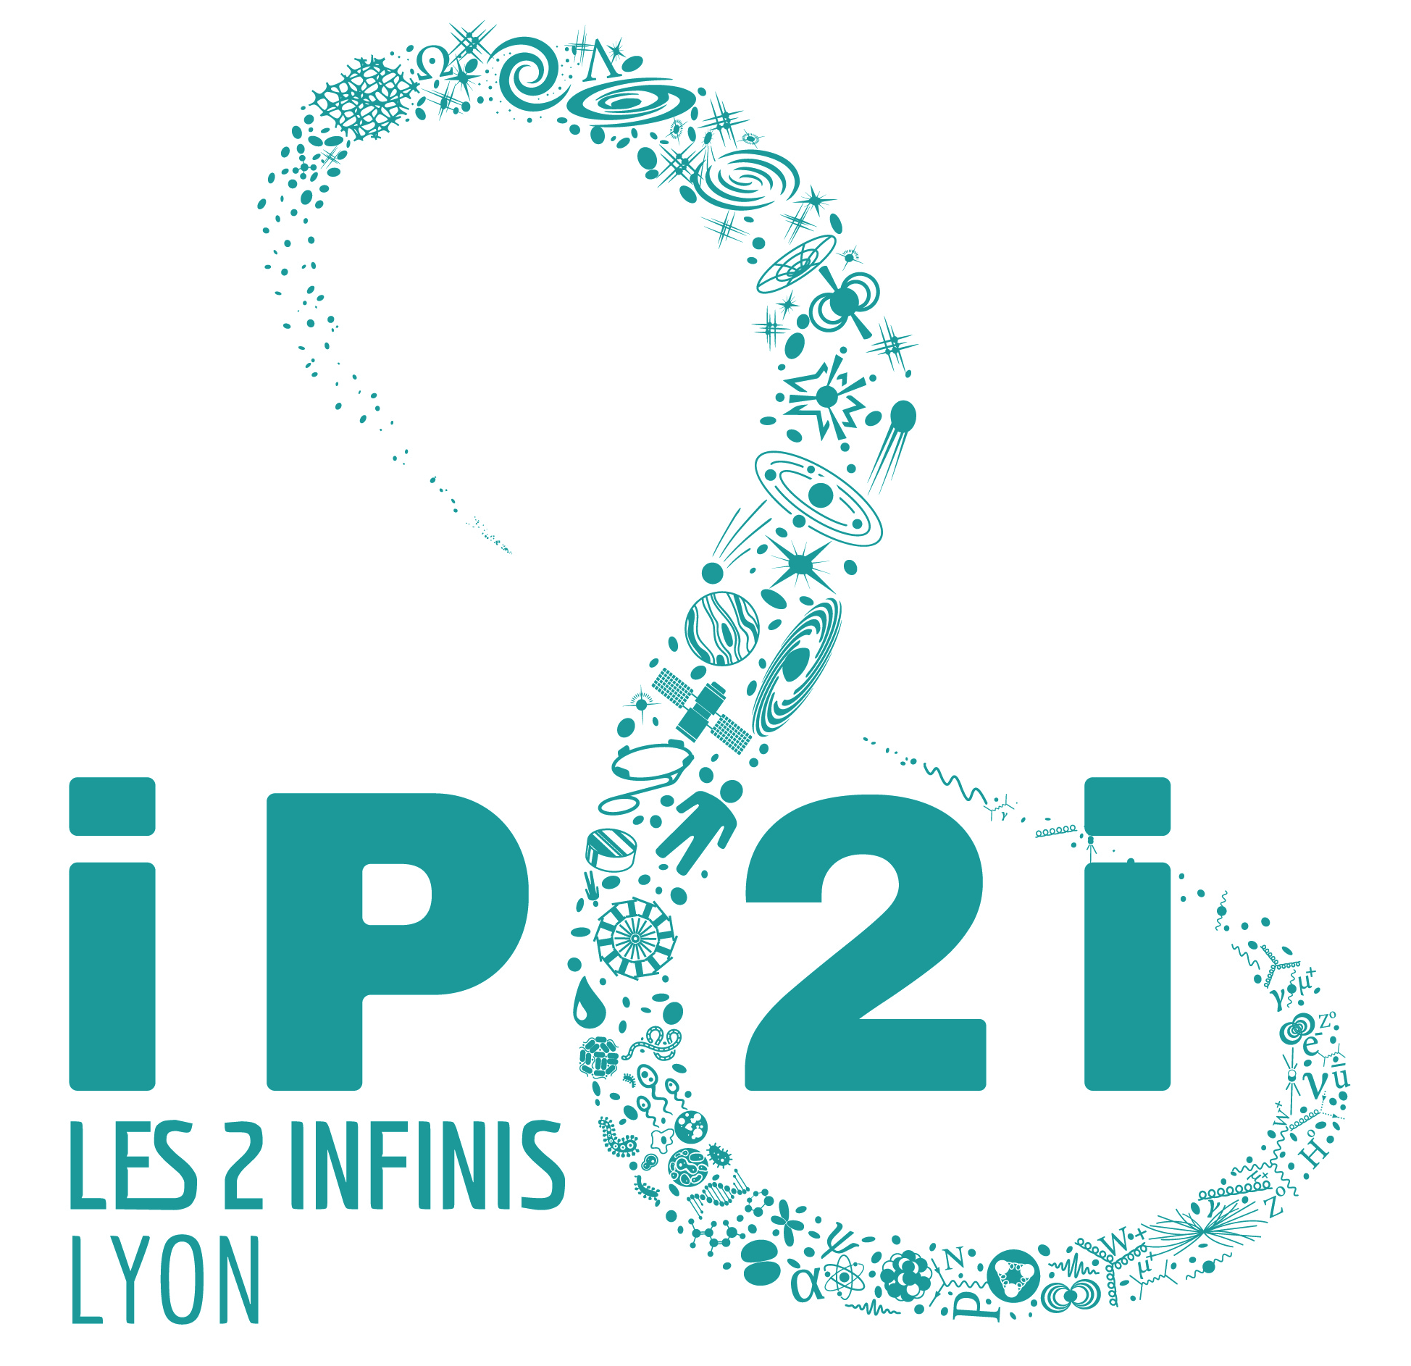
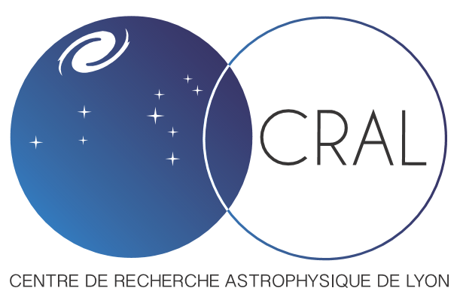
Integrated Mach-Zehnder (iMZ) wavefront sensor
Wavefront sensing at nanometric scale for XAO and high precision metrology
C. Graf ^{(a)}, M. Langlois ^{(a)}, M. Loupias ^{(a)}, E. Thiébaut ^{(a)}, M. Tallon ^{(a)}, J. Degallaix ^{(b)}
(a) Centre de Recherche Astrophysique de Lyon (CRAL), avenue Charles-André - Saint-Genis Laval
(b) Laboratoire des Matériaux Avancés (LMA), 7 Avenue Pierre de Coubertin 69622 - VILLEURBANNE Cedex
WFS Workshop in the VLT/ELT era
Porto, 19-21 October 2022

Slide 2
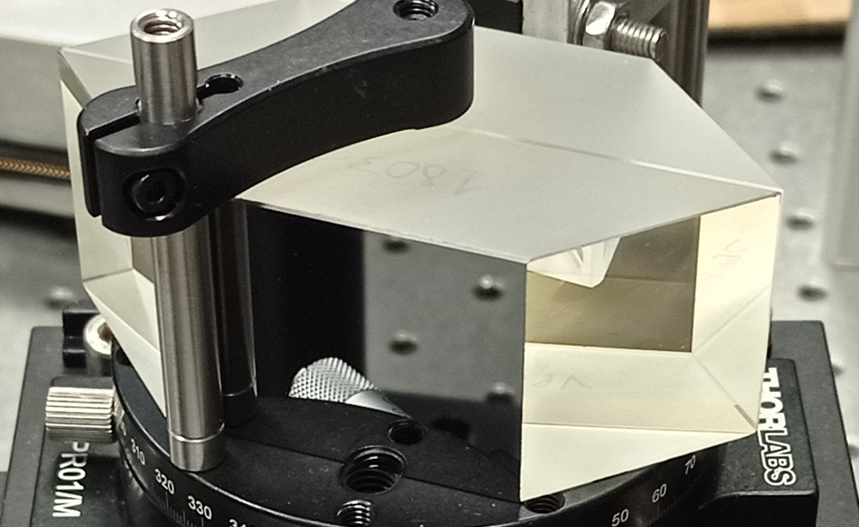
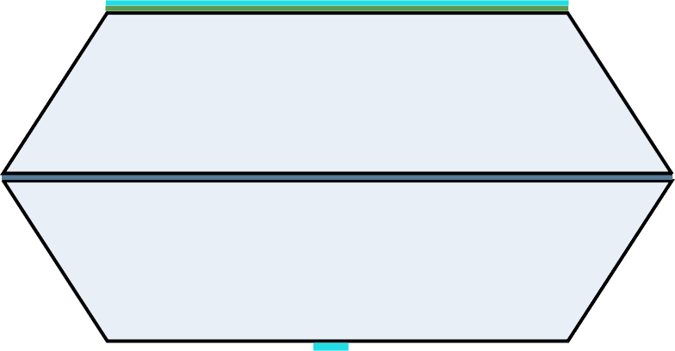







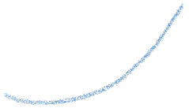

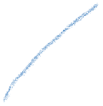


The iMZ :
integrated Mach-Zehnder
Mach-Zehnder interferometer with glass propagation
Fourier-filtering family of wavefront-sensor
2 glass plates of exact same width
λ/8
λ/4 beam splitter layer (r_{s}, t_{s})
λ/8 layer + reflective layer (r_{m})
reflective dot : pinhole ( ⌀ ≈ λ/D )
spatial filtering
Creation of the reference signal
iMZ = self-referenced interferometer
a ≈ λ/D
iMZ schematic representation
Notes:
-Dire au début que c'est un interferometre classique
operating range : 600 nm → 900 nm (new prototype → goes 850 um)
Ti305 beam splitter layer (lambda/4)
50 um diameter pinhole
lambda/8 OPD of SiO2
(OPTOPRIM)

Slide 3
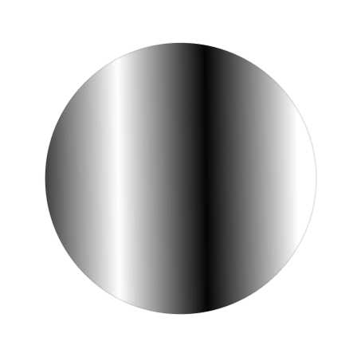
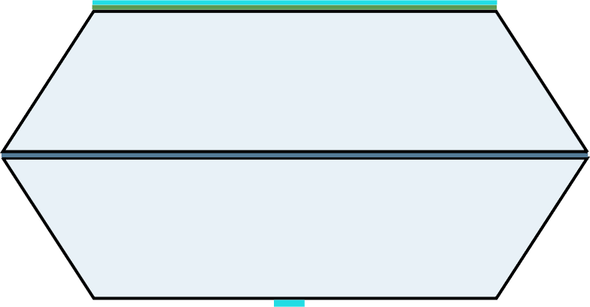
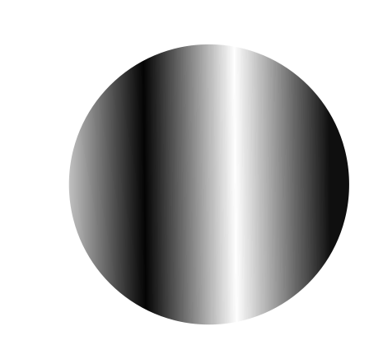
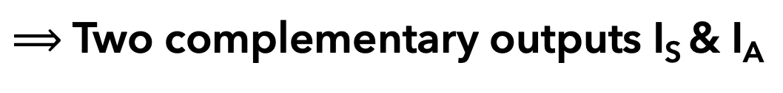



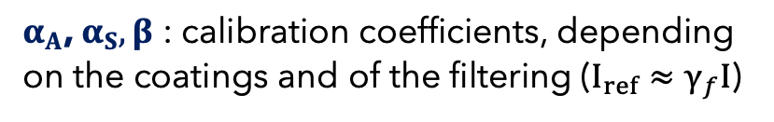
















The iMZ :
integrated Mach-Zehnder
$⟹$ Two complementary outputs I_{S} & I_{A}
Anti-symmetric output
I
λ/8
$$NF\left(α_{A}+\text{β}\text{sin}{(φ−φ_{ref}})\right)$$
I_{A}
$N$: incoming photon number
≈30 %
$F$: intensity distribution on the pupil
$φ$ : incoming phase
$$φ_{}$$
$φ_{ref}$ : reference phase
≈70 %
$$φ_{ref}$$
$α_{A}$, $α_{S},β$ : calibration coefficients, depending on the coatings and of the filtering ($I_{ref}≈γ_{f}I$)
I_{S}
$$NF\left(α_{S}−\text{β}\text{sin}{(φ−φ_{ref})}\right)$$
a ≈ λ/D
Symmetric output
iMZ schematic representation

Slide 4
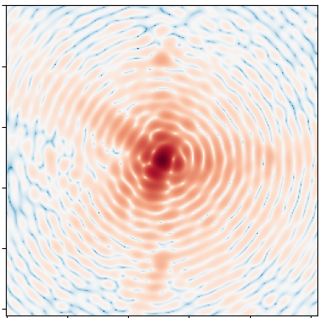
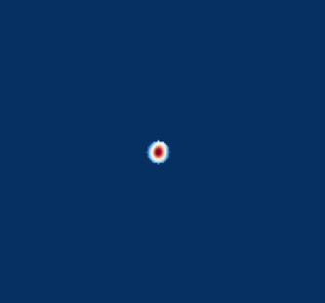
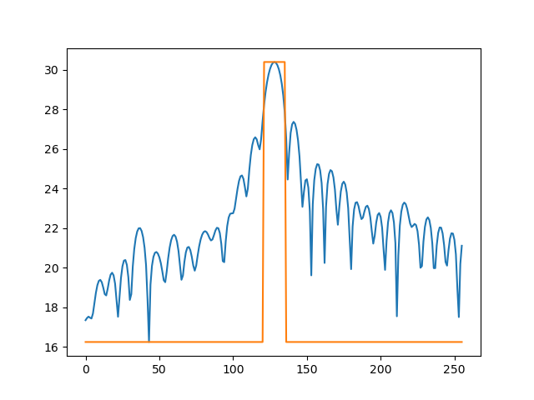


The iMZ :
integrated Mach-Zehnder
$⟹$ Two complementary outputs I_{S} & I_{A}
Anti-symmetric output
I
λ/8
$$NF\left(α_{A}+\text{β}\text{sin}{(φ−φ_{ref}})\right)$$
I_{A}
≈30 %
Complementary information
Sum of the 2 outputs : separate retrieval of phase and intensity
Signal linear with small phases
$$φ_{}$$
≈70 %
$$φ_{ref}$$
I_{S}
$$NF\left(α_{S}−\text{β}\text{sin}{(φ−φ_{ref})}\right)$$
a ≈ λ/D
Symmetric output
iMZ schematic representation

Slide 5
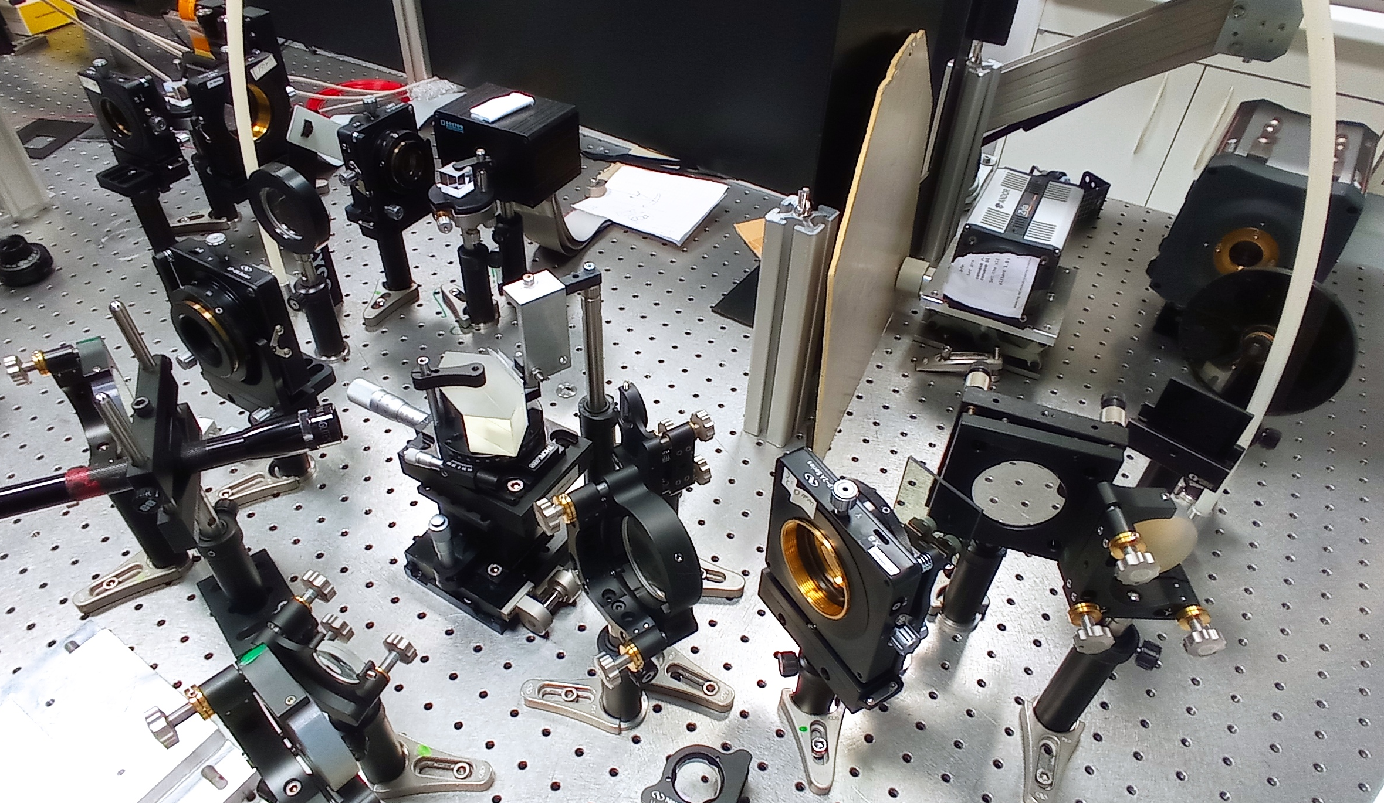
The XAO test bench at CRAL :
SLM
256x256 pixels
4 nm precision
DM
12x12 actuators
3.5 microns stroke
Camera Neo
Camera Zyla
iMZ

Slide 6
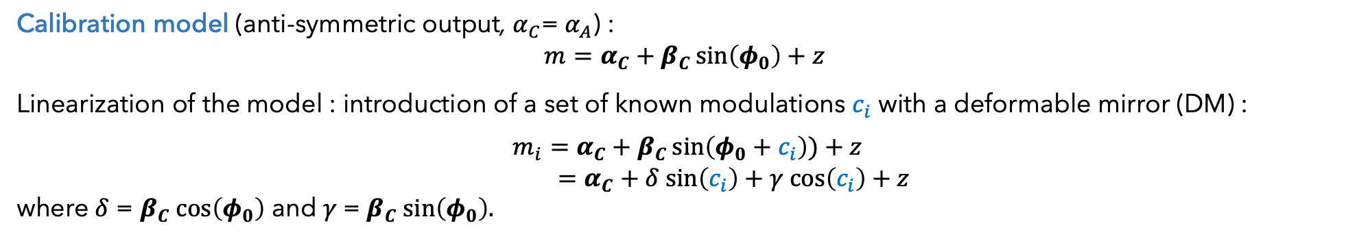
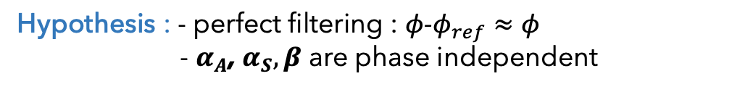
Calibration method :
Objective : extract the calibration phase $φ_{0}$ and the coefficient $α_{A}$, $α_{S},β$ from iMZ signal for each pixel of the pupil
Method : linear inverse problem resolution
Hypothesis : - perfect filtering : $φ$-$φ_{ref}≈φ$
- $α_{A}$, $α_{S},β$ are phase independent
Calibration model (anti-symmetric output, $α_{C}$= $α_{A}$) :
$$m=α_{C}+β_{C}\sin\left(φ_{0}\right)+z$$
Linearization of the model : introduction of a set of known modulations $c_{i}$ with a deformable mirror (DM) :
$$m_{i}=α_{C}+β_{C}\sin\left(φ_{0}+c_{i}\right))+z$$
$=α_{C}+δ sin\left(c_{i}\right)+γ cos\left(c_{i}\right)+z$
where $δ$ = $β_{C} cos\left(φ_{0}\right)$ and $γ \text{= }β_{C} sin\left(φ_{0}\right).$
Estimator (Least Mean Square Estimator) : $\hat{x}=arg\underset{x}{mi}n{ {\left\|d−Hx\right\|}_{W}^{2}}$
with $d$the data, $H$ the direct model matrix, $x=(α_{C} δ γ)$ the parameters vector and $W$ the noise matrix such as $W={cov(d)}^{−1}$
Independent calibration of the iMZ coefficients per subaperture using inverse approach
Optimized to accurately disentangle phase and intensity

Slide 7
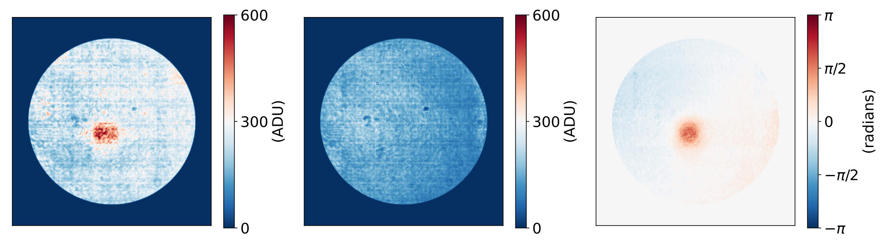
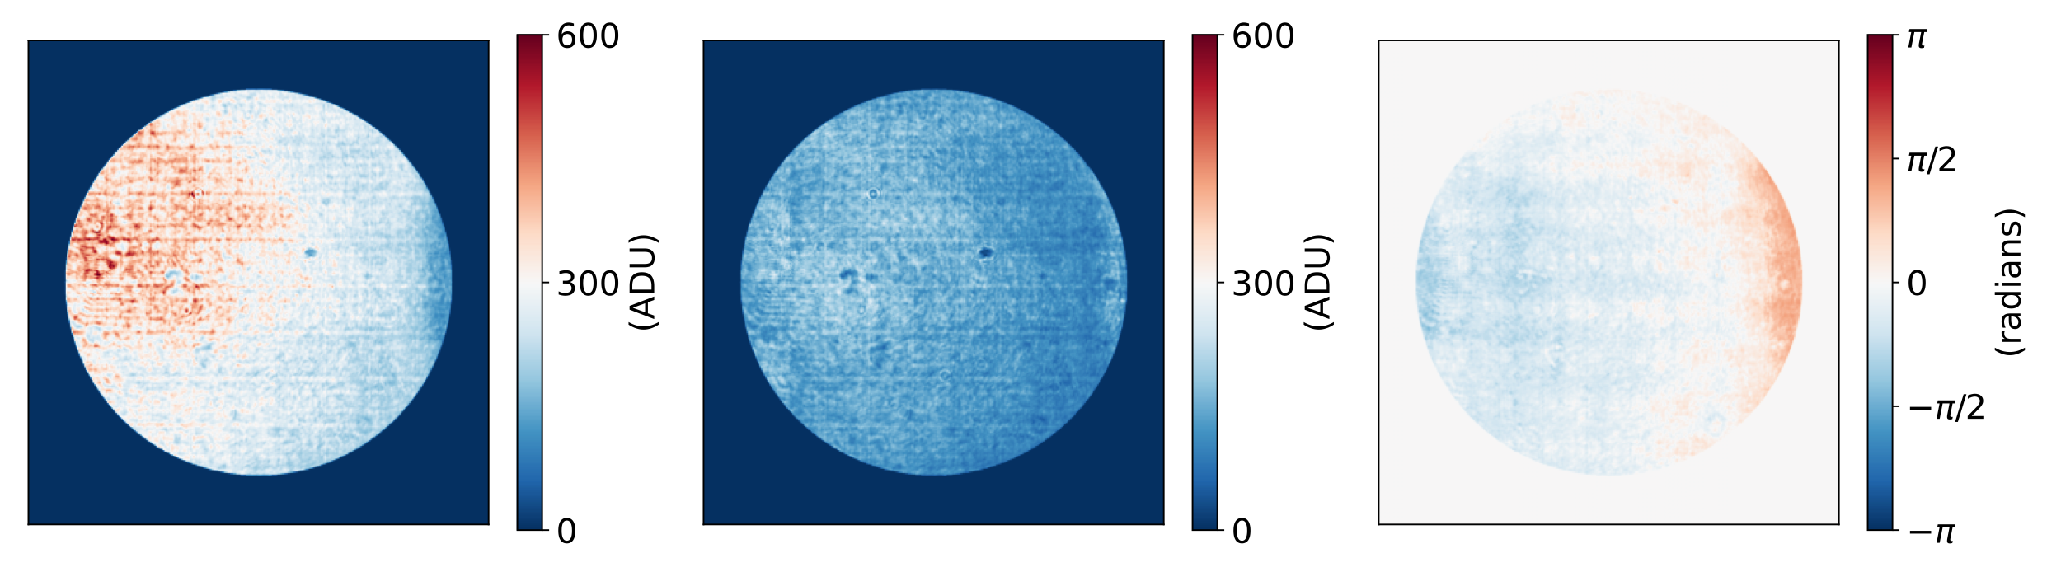









Phase extraction :
Extraction of the phase using the calibration coefficients and reversing the model :
$$d$$
$$α_{C}$$
$$φ$$
$$φ_{0}$$
$$−$$
$$=\sin^{−1}$$
$$−$$
Method captures non uniform pupil intensity
$$β_{C}$$
Non uniformity coming from the DM
Ratio $α_{C}/β_{C}$ ≈ $2$

Slide 8
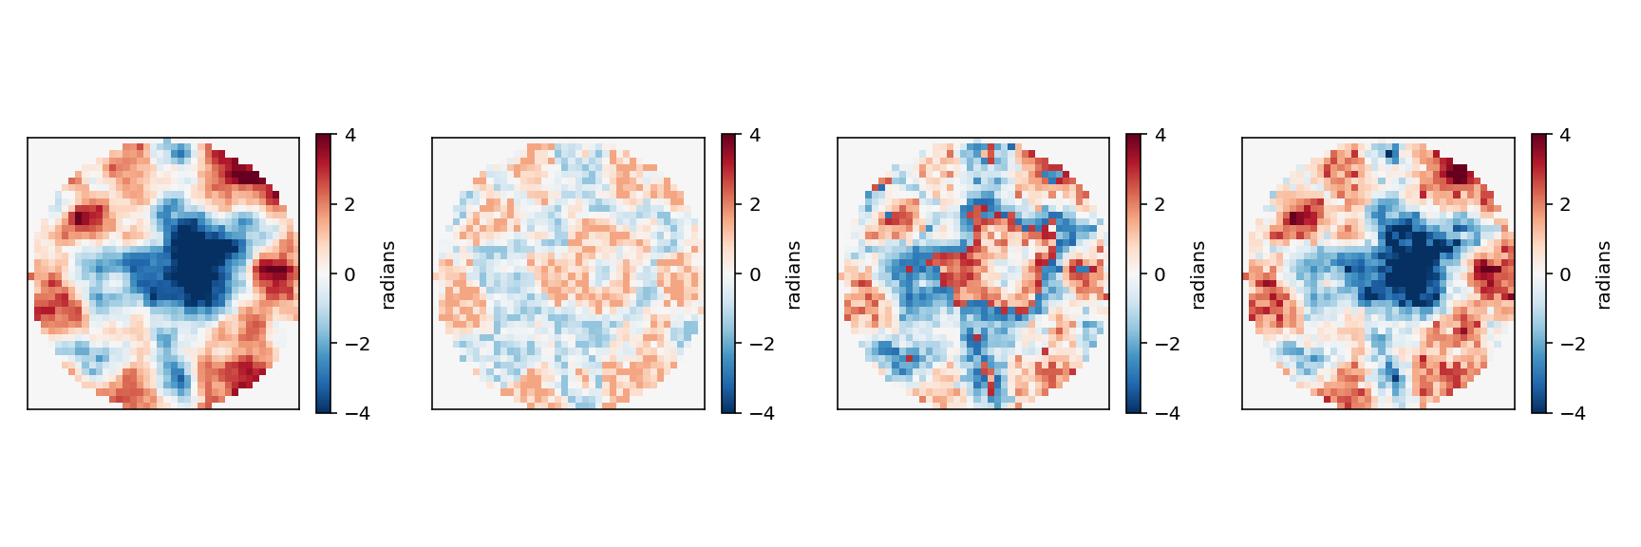
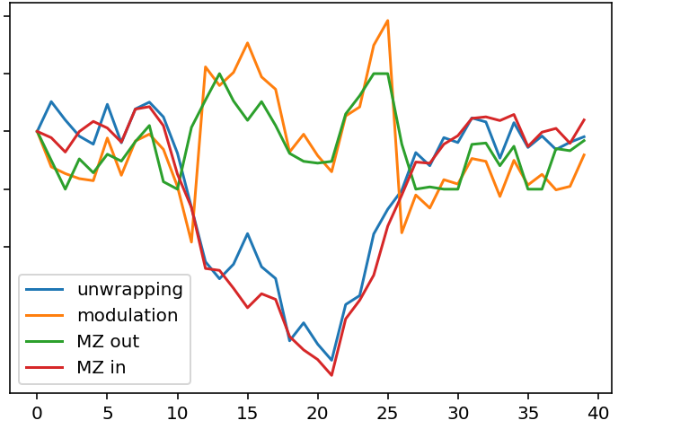
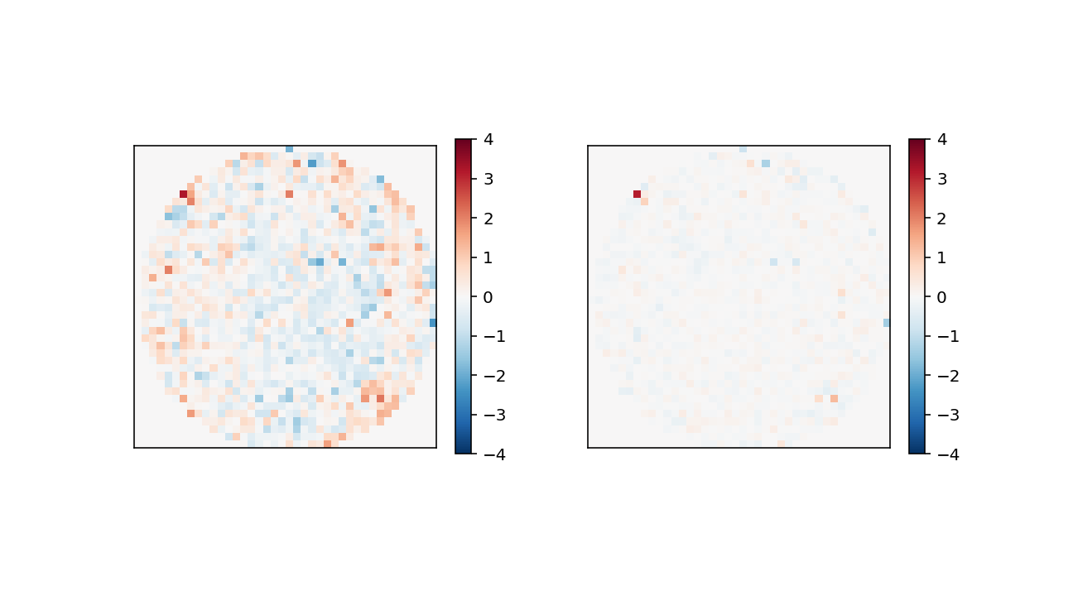






Simulation results : Increasing dynamic
iMZ signal$⟹ φ∈[\text{−}\frac{π}{2};\frac{π}{2} ]$ without unwrapping strategy
Modulation : introduction of a known phase step and its inverse $⟹ φ∈\left[\text{−}π;π\right]$
Unwrapping¹ on the modulated signal → $φ$up to several microns
MZ in
Unwrapping
$$π$$
$$\frac{π}{2}$$
Phase (radians)
$$−\frac{π}{2}$$
(radians)
$−π$
Residual 1st iteration
($σ^{2}≈0.3$rad²)
Residual 2st iteration
($σ^{2}≈0.03$rad²)
¹D. C. Ghiglia and L. A. Romero, “Robust two-dimensional weighted and unweighted phase unwrapping that uses fast transforms and iterative methods,” J. Opt. Soc. Am. A 11, pp. 107–117, Jan 1994.
M. J. Townson, O. J. D. Farley, G. O. de Xivry, J. Osborn, and A. P. Reeves, “AOtools: a python package for adaptive optics modelling and analysis,” Optics Express 27, p. 31316, oct 2019.

Slide 9
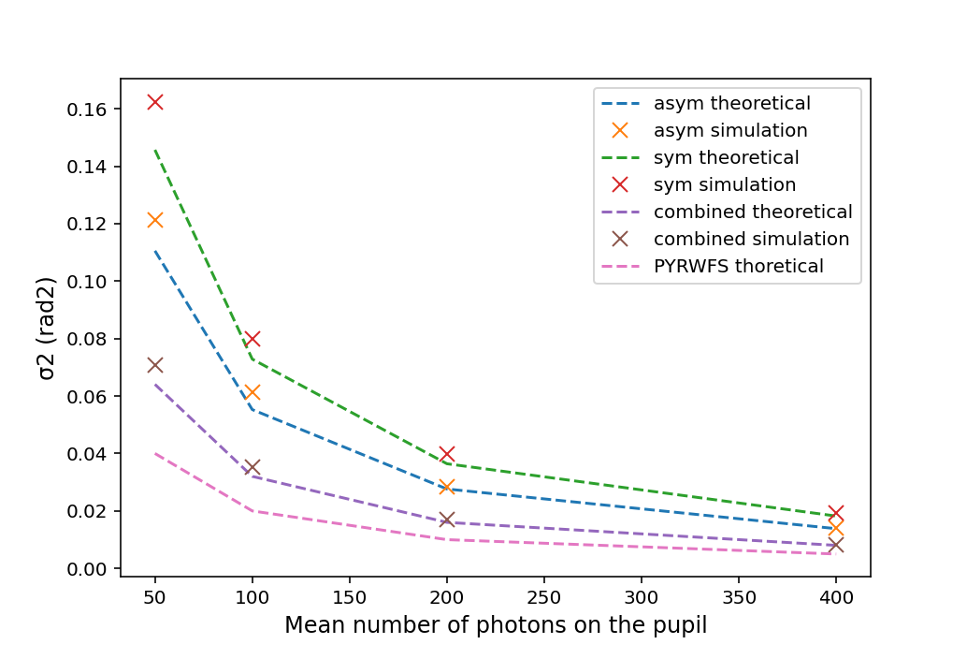
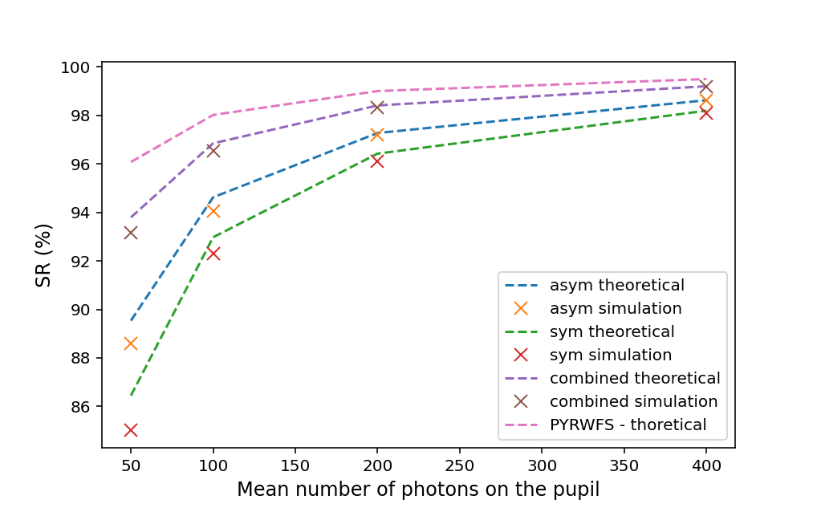
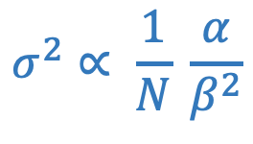
Noise propagation :
$$σ^{2}∝ \frac{1}{N} \frac{α}{β^{2}}$$
Theoretical limit :
(photon noise only)
Low noise propagation close to the theoretical limit of non modulated Pyramid WFS
O. Guyon, “Limits of adaptive optics for high-contrast imaging,” The Astrophysical Journal 629, pp. 592–614, aug 2005

Slide 10
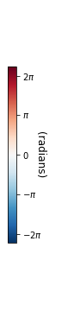
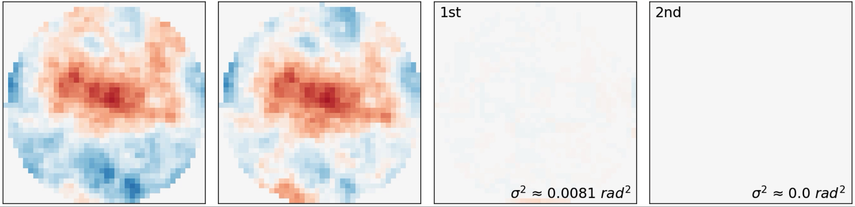

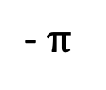
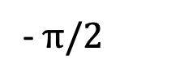


Simulation results : Wavefront reconstruction
Noise free simulation :
D = 8m, 40x40 subapertures, medium seeing
phase input
imZ phase output
residual 1st iteration
residual 2nd iteration
$$\overline{σ^{2}}≈0.09 {rad}^{2}$$
modulation + unwrapping
small phase regime
Accurate wavefront reconstruction in one iteration (SR > 90%)
Perfect wavefront reconstruction in the second iteration (SR > 99%)
$$π$$
$$π/2$$
-$π/2$
- $π$
Figure 2 : MZ phase reconstruction. In red entrance phase, in green iMZ output phase, in orange phase after modulation and in blue after unwrapping.

Slide 11
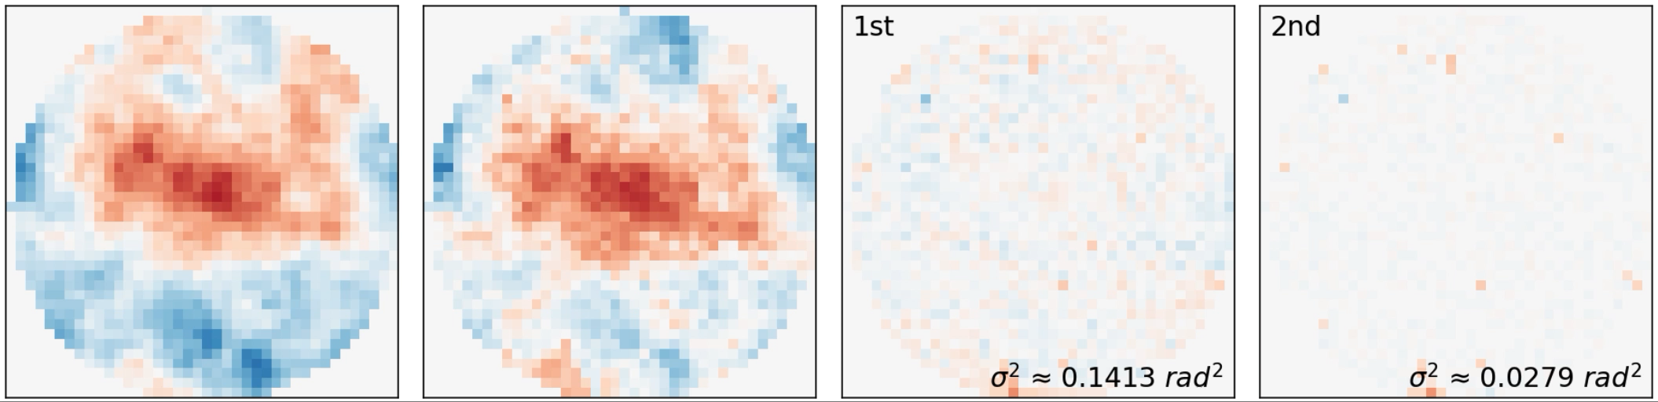


Simulation results : Wavefront reconstruction
Realistic flux simulation : m_{v} = 9, framerate = 500 Hz
D = 8m, 40x40 subapertures, medium seeing
phase input
imZ phase output
residual 1st iteration
residual 2nd iteration
$$\overline{σ^{2}}≈0.29 {rad}^{2}$$
$$\overline{σ^{2}} ≈0.04 {rad}^{2}$$
modulation + unwrapping
small phase regime
SR ≈ 75 % for bootstrapping (modulation + unwrapping)
SR ≈ 96 % for small phases reconstruction
$$π$$
$$π/2$$
-$π/2$
- $π$
Figure 2 : MZ phase reconstruction. In red entrance phase, in green iMZ output phase, in orange phase after modulation and in blue after unwrapping.

Slide 12
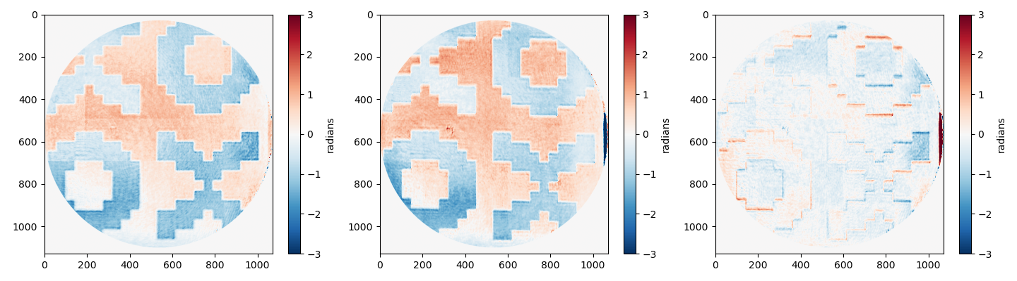

Experimental results :
Comparison of the phase from the two outputs :
Phase step introduced by a SLM (≈150 nm)
residual variance: $σ^{2}≈0.12$rad²
Anti-symmetric output
Symmetric output
Difference
iMZ high sensitivity to phase steps + measure of amplitude

Slide 13
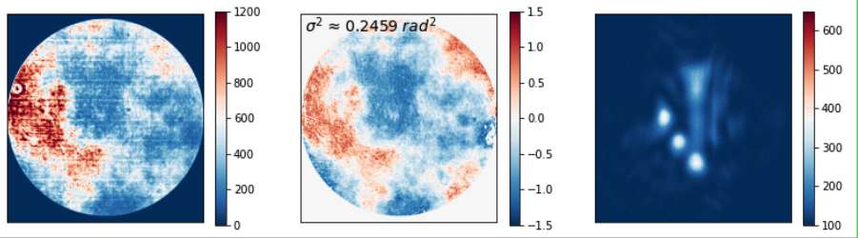
Experimental results :
Correction loop : phase screen on a 256x256 SLM correction with a 12x12 DM
raw pupil
phase pupil
image
ADU
radians
ADU
PSF on the coronographic path
(behind the pinhole)
Accurate measurement at 1st iteration
Strehl ratio > 90% after 2 iterations

Slide 14
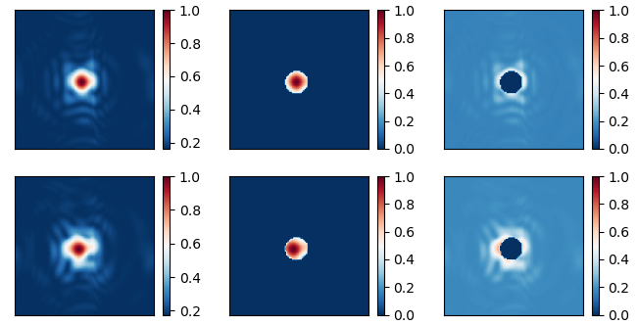
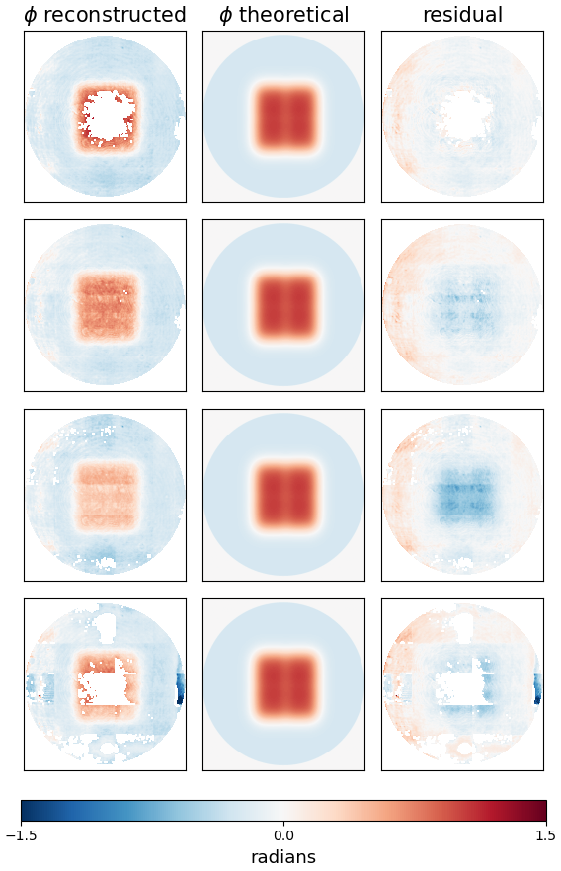
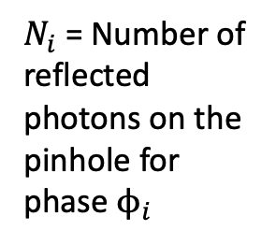
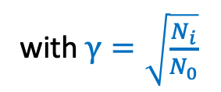
Experimental results :
Flux calibration : necessity to take into account the flux variation on the pinhole due to the phase diversity
PSF image behind the pinhole :
Refining the calibration model :
$I_{0}$ ($ϕ_{0}$reference phase)
with $γ=\sqrt{\frac{N_{i}}{N_{0}}}$
$$m=α_{C}+γβ_{C}\sin\left(φ_{0}\right)+z$$
without flux ajustement
$I_{i}$ ($ϕ_{i}$ random phase applied)
$N_{i}$ = Number of reflected photons on the pinhole for phase $ϕ_{i}$
with flux ajustement

Slide 15
Take-away :
Accurate measurement of both phase (at nanometer scale) and amplitude of the signal (scintillation)
Efficient calibration method to extract the phase from the iMZ signal which captures the non uniformity of the intensity in the pupil
Good sensitivity : low noise propagation
Simulation tool to realistically simulate the iMZ response to different phase : accurate phase reconstruction outside the iMZ linearity range thanks to modulation + unwrapping strategies
iMZ very efficient for XAO without first stage correction (except tip-tilt)

