Slide 1


Pyramid Wavefront Sensors for the detection of Small Phase discontinuities
D. Malone^{a,b}, P. Janoutª, R. Holzlöhnerª, S. Lévêqueª, B. Englerª, M. Kasperª
ªEuropean Southern Observatory, Karl-Schwarzschild-Str. 2, 85748, Garching, Germany,
^{b}Applied Optics Group, School of Physics, University of Galway, Ireland
19th October 2022
This work has been supported by the Irish Research Council under the Government of Ireland Postgraduate Scholarship Programme (Project ID GOIPG/2020/537) and the European Southern Observatory Studentship Programme.

Slide 2
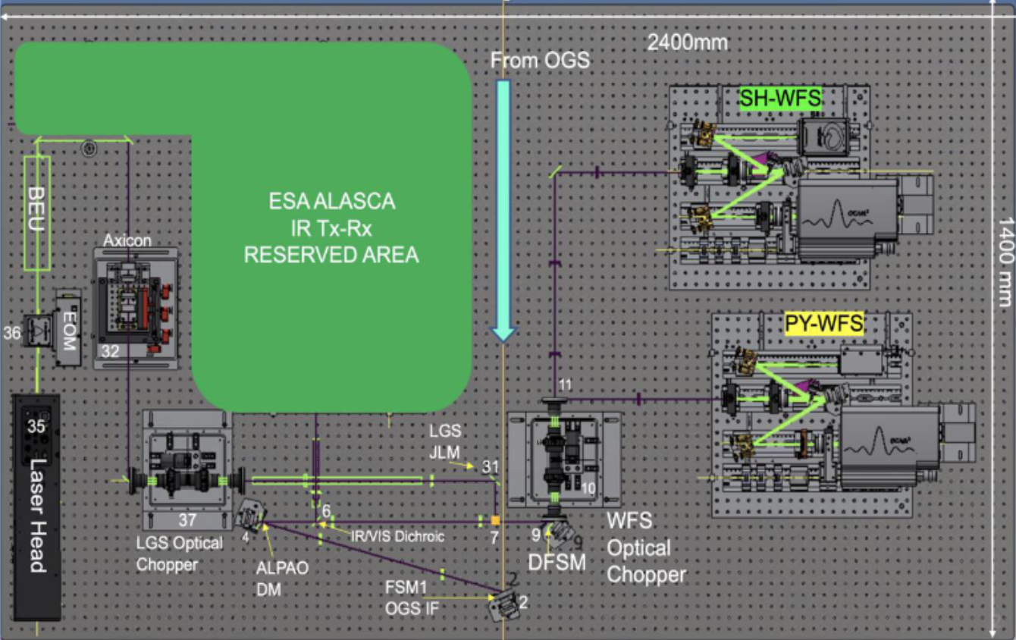
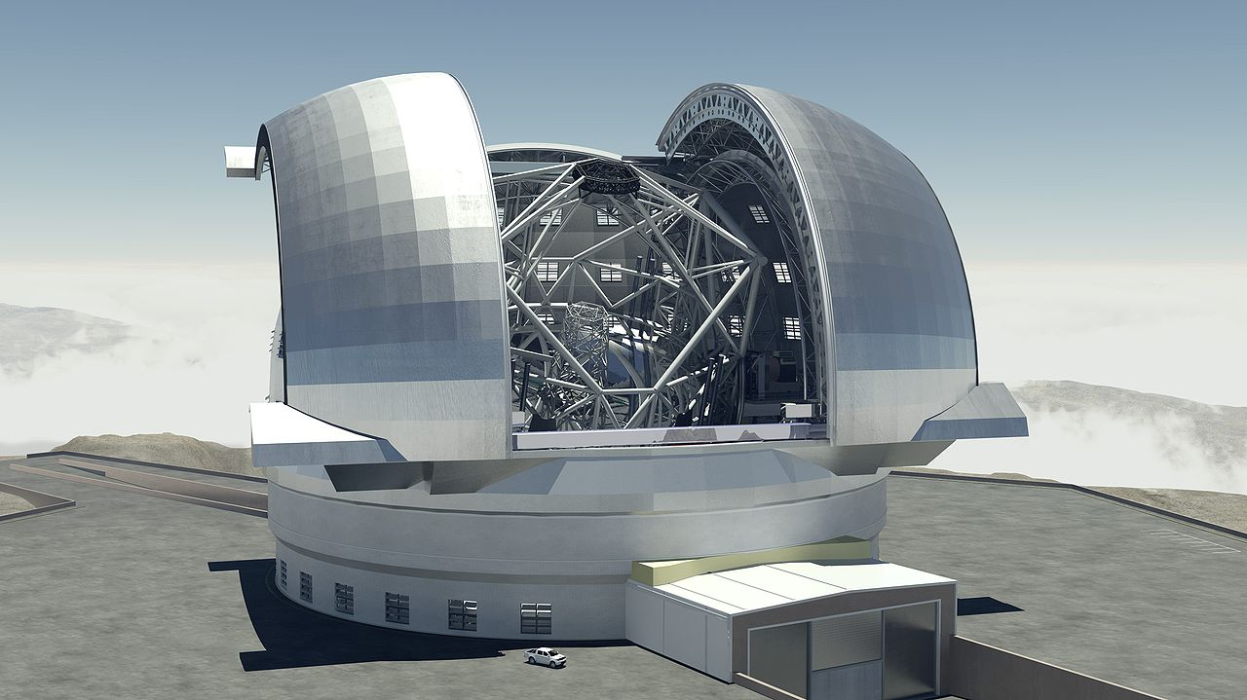
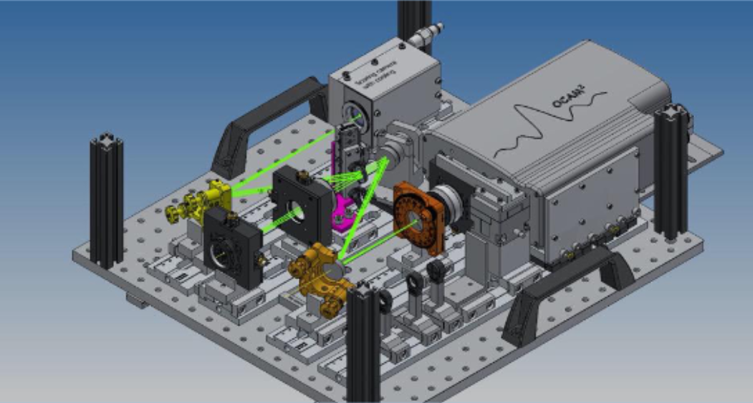

Background and Context
Simulation of Wavefront degrading effects with Spatial Light Modulators
CaNaPy - LGS-AO experimental facility for visible wavelengths
PhD topic: can you build a device which uses an SLM to calibrate and test an adaptive optics system.
Atmospheric Turbulence
Segmentation of the primary mirror
Petalling / Low Wind effect
Visible LGS-AO concept demonstrator.
Teide Observatory, Tenerife.
589 nm laser for LGS-AO
SH-WFS and PY-WFS arms for wavefront detection / correction.
Collaborating with PY-WFS group to calibrate / test PY-WFS before installation on CaNaPy
By Swinburne Astronomy Productions/ESO - ESO, CC BY 4.0

Slide 3
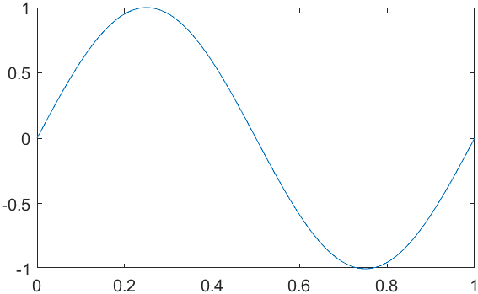
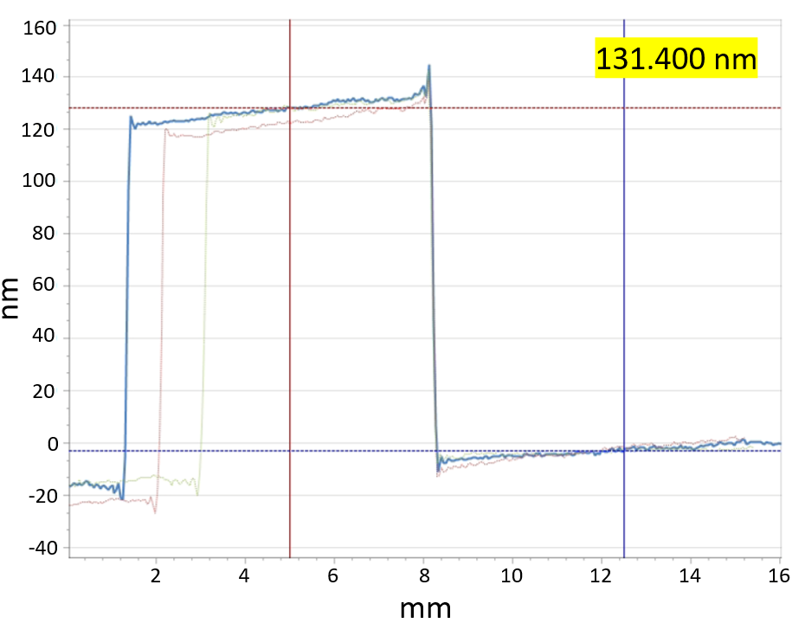

Method
Simple idea – Calibrate a PYWFS using an SLM which is simulating a segmented mirror with known phase steps.
Test the PYWFS on physical phase plates with precisely known phase discontinuities.
1) Simulate segmented mirrors with the SLM
2) Generate a calibration curve for the PYWFS.
3) Test the calibration curve by measuring physical phase plates with known phase steps

Slide 4
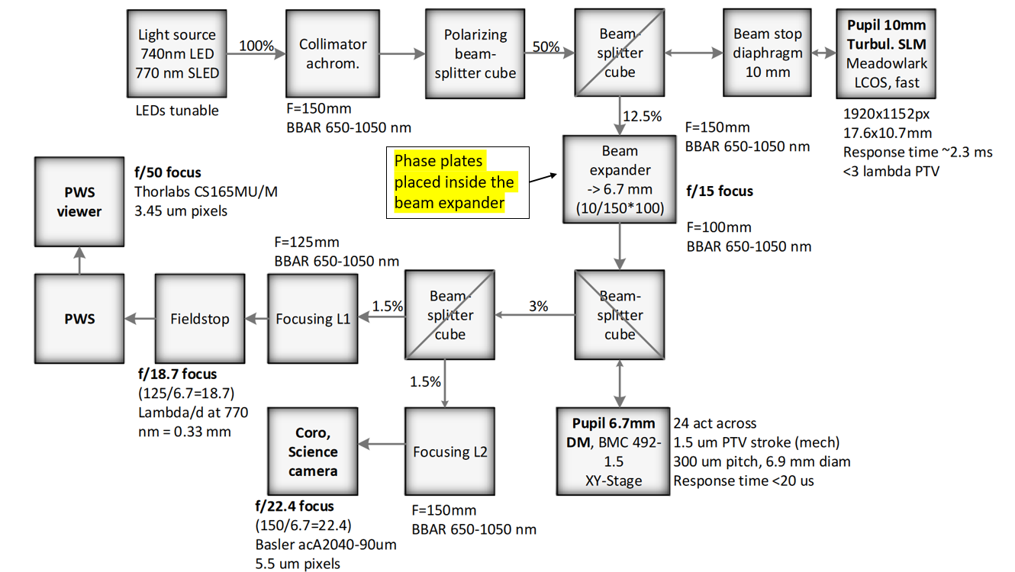
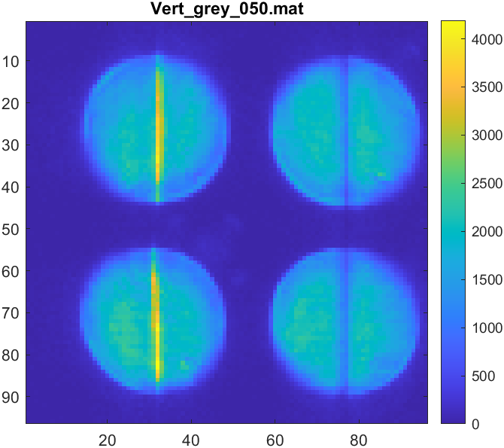
Test bench - GHOST
GHOST - GPU-based High-order adaptive OpticS Testbench.
770nm SLED as source.
Meadowlark LCOS SLM (1920 x 1152 px)
DM set to flat, not used.
Modulation radius of 3λ/D
050 denotes a grey level difference of 50 between the two sides.

Slide 5

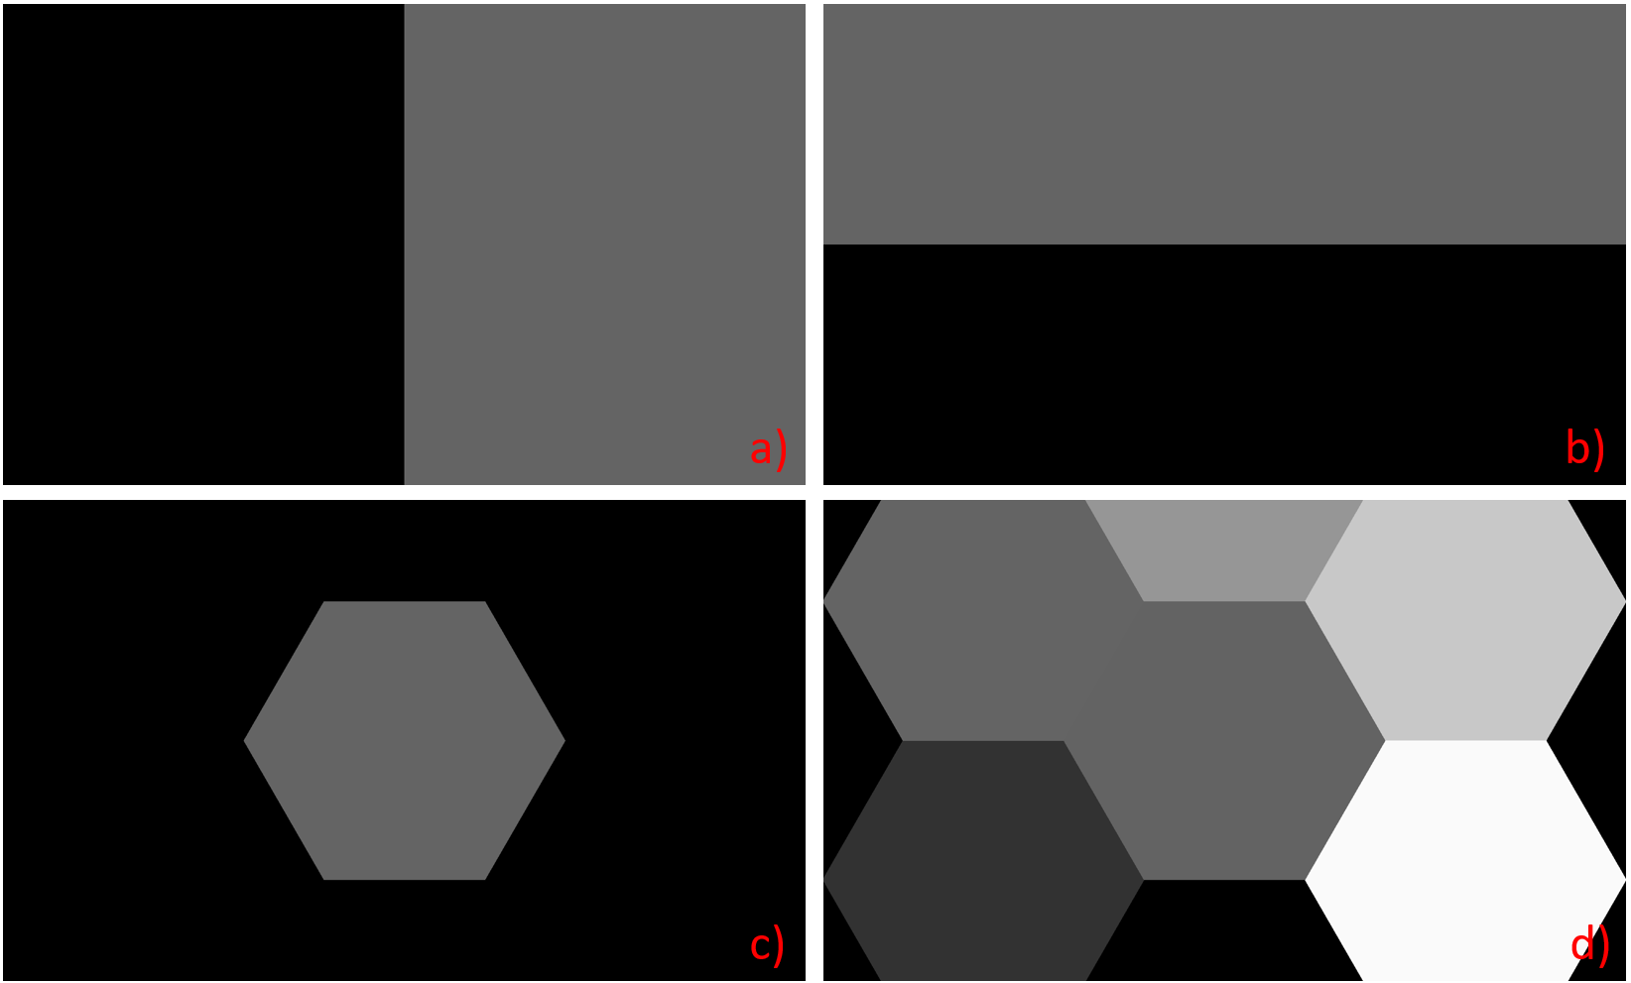
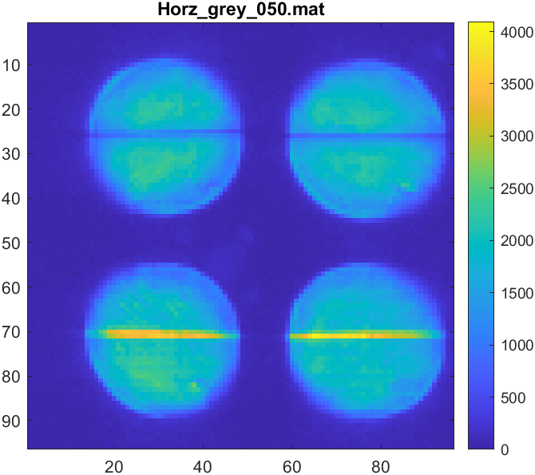

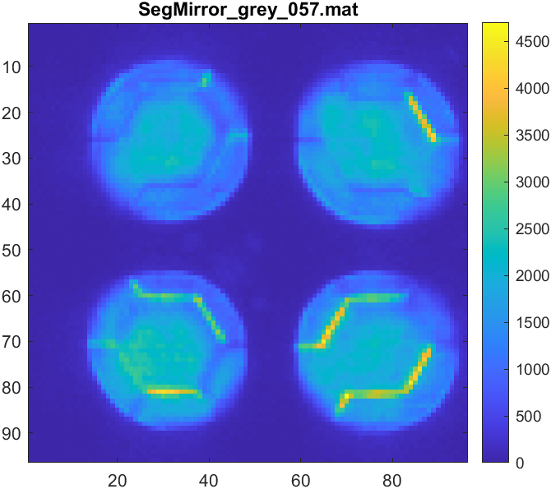
Phase Screens
Previously presented at:
4 types of phase screens
One part of the phase screen varies between grey levels 0-255, rest held at a fixed grey level.
X
0
X
0
150
100
200
0
X
X
50
250
0
X shows areas of phase screens in which grey level varies from 0 to 255.
Red highlighted numbers show set values.

Slide 6
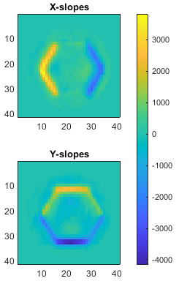
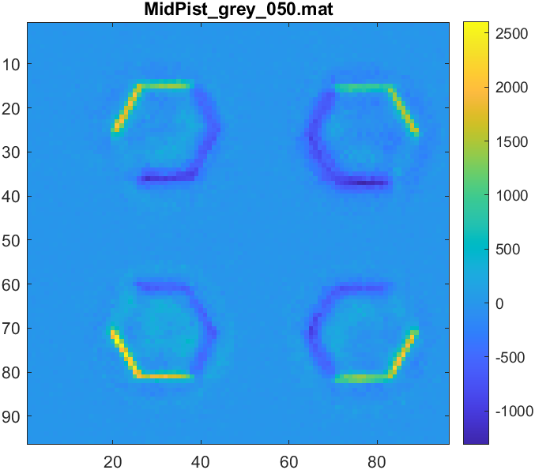
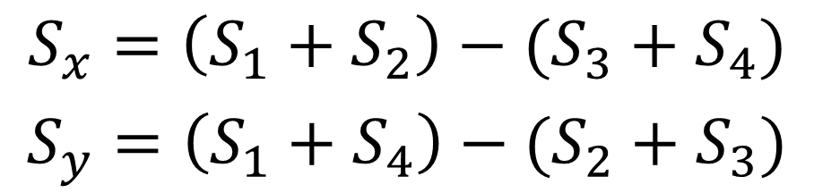
Data Reduction Method (Calibration Data)
Previously presented at:
S1
S2
S4
S3
1) Subtract the flat from the detector image (pixel by pixel subtraction)
2) Calculate the X and Y slopes from the subapertures
By calculating non-normalized slopes, the resulting sine wave will not be skewed.

Slide 7
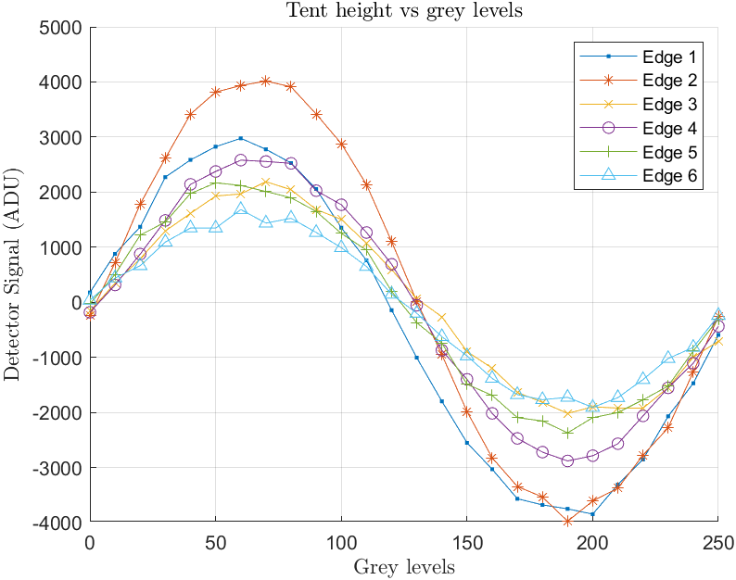
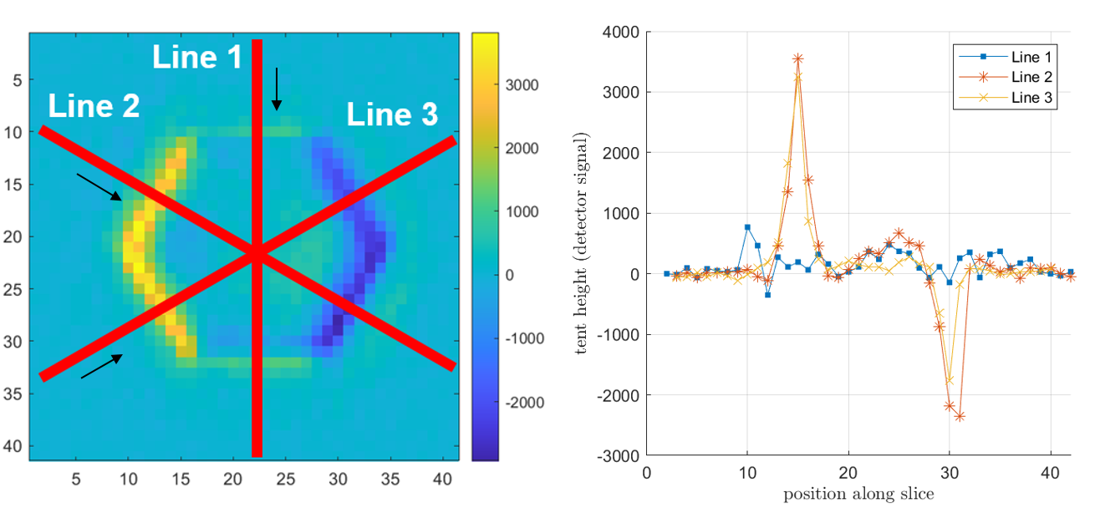
Data Reduction Method (Calibration Data)
Previously presented at:
X-slope image
1
3
6
Edge locations
5
4
2
3) Slices through the slopes images, perpendicular to each edge
4) Locate the edges along each slice
5) Plotting detector signal vs grey level should give a sinusoidal pattern

Slide 8
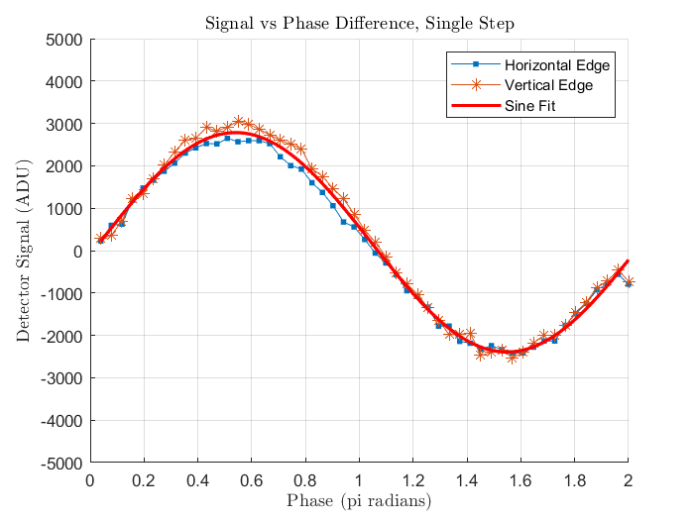
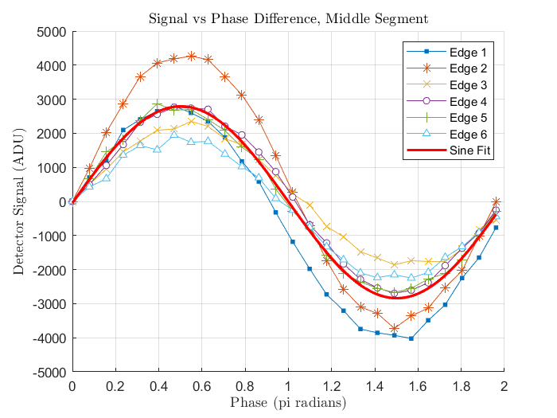
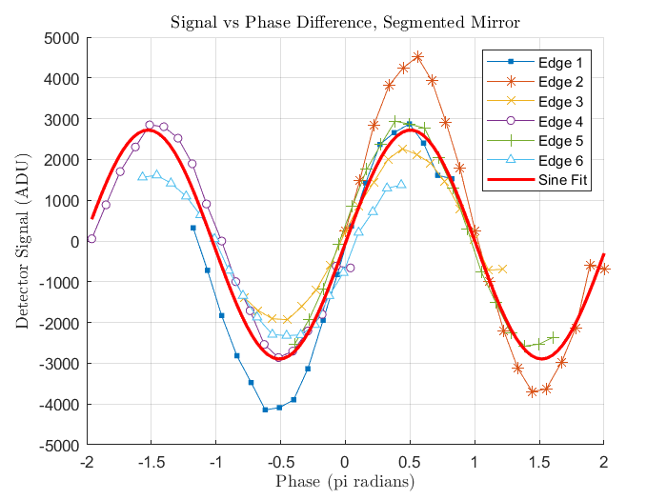



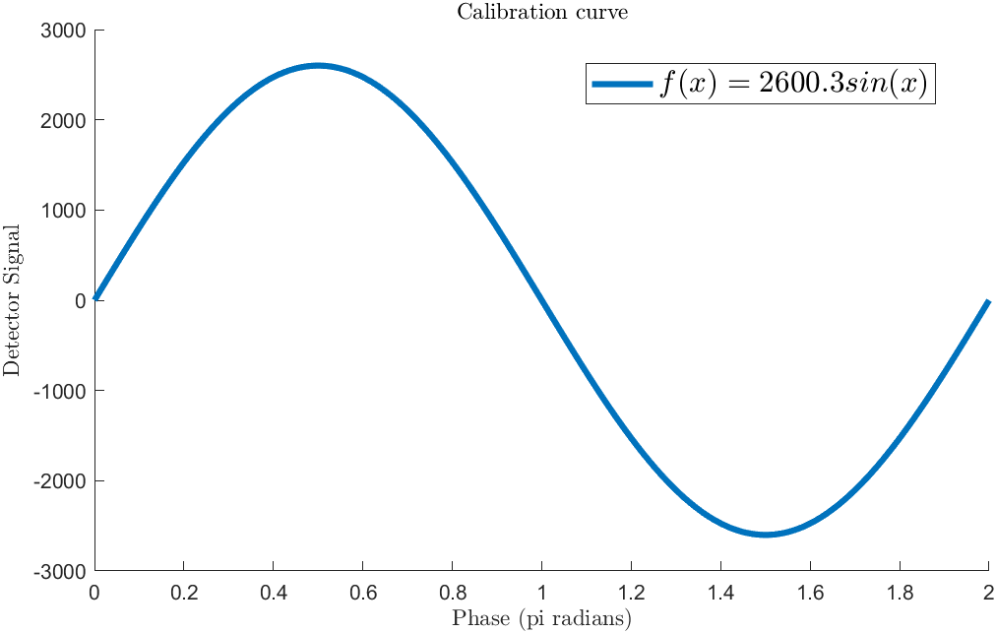
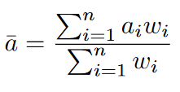

Resulting Calibration Curve
Previously presented at:
$$f\left(x\right)=2664\sin{(x)}$$
Calculated a “weighted average” for the amplitude of the calibration curve.
Amplitudes weighted by RMSE for each individual fit.
Notes:
Add phase screens

Slide 9
Measuring Physical Phase Plates
Previously presented at:
Could only use GHOST bench without modifying original set-up.
  Only place phase plates would fit was inside the beam expander section.
  Unable to place phase plates within a collimated beam.
Plate plates had a slight wedge shape.
  Source had to be adjusted to accommodate this
Introduction of plates introduced an additional defocus to the system
  Compensated using SLM.
  Could not eliminate entirely.

Slide 10
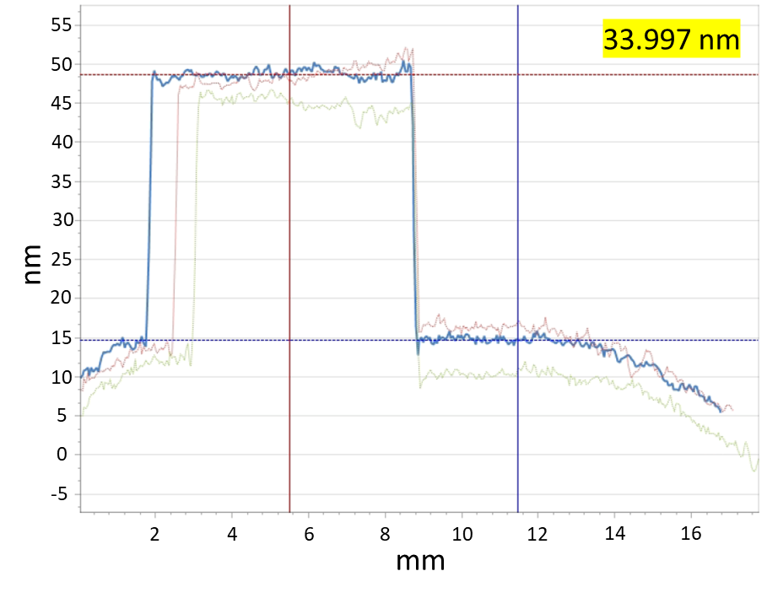
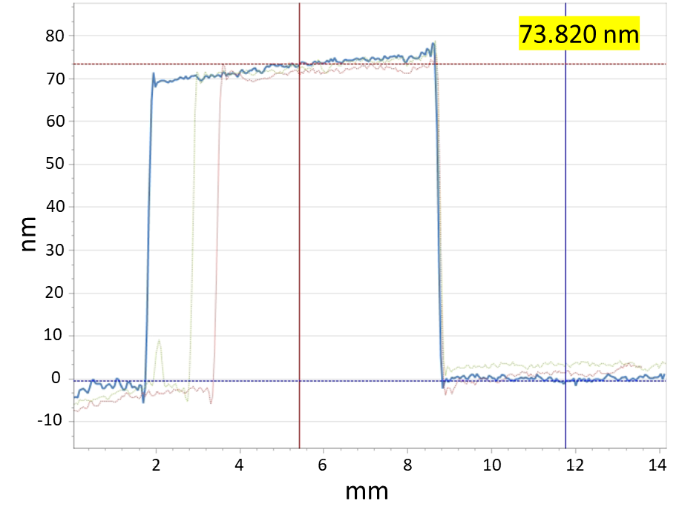
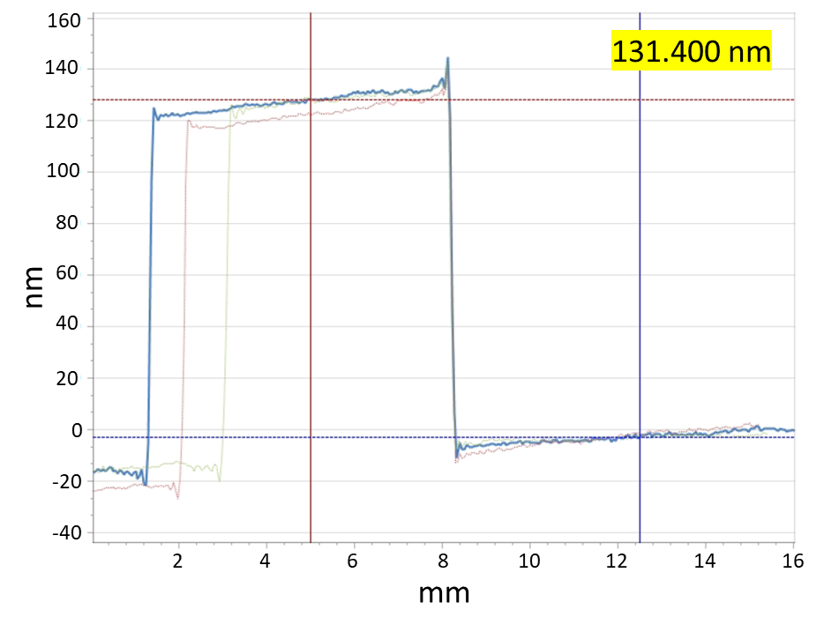
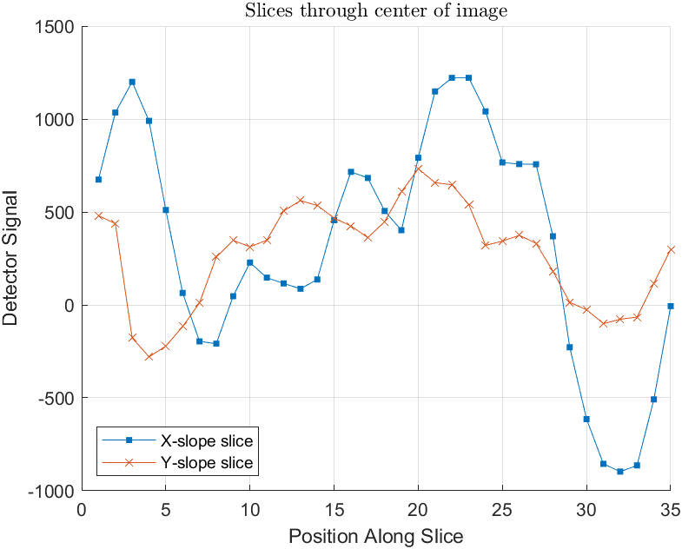
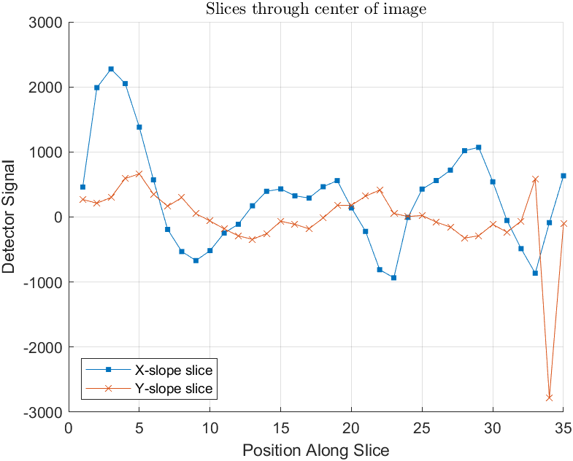
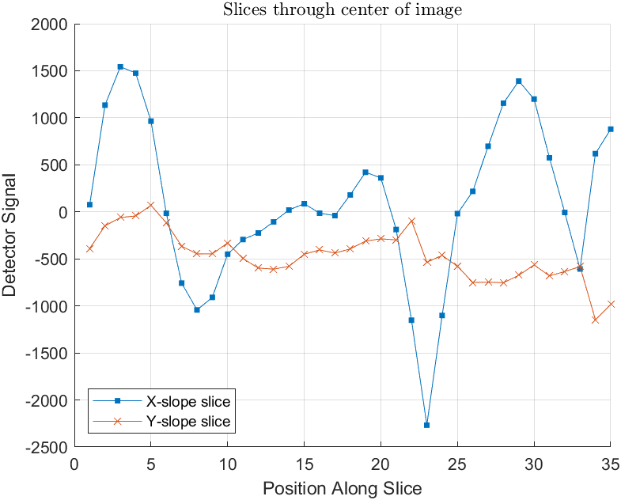
First Results
Previously presented at:
Phase plates data reduced in the same method as the calibration data.
Flat subtracted, slopes calculates, slices taken across the images. No normalization.
Manufacturer measurements of phase masks
Slices though X and Y slope images for each phase plate

Slide 11
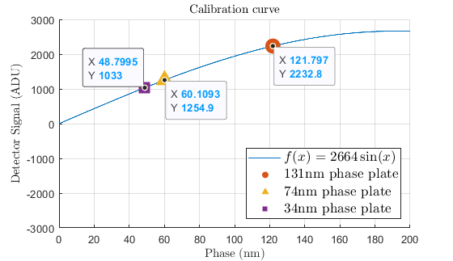
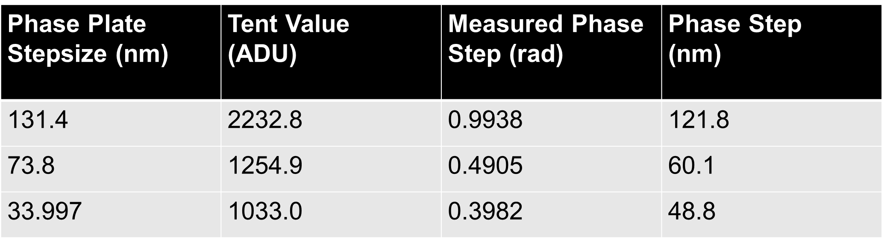
First Results
Previously presented at:
Height of tent taken as absolute value of tent over the average value for the image.
Then values interpolated to find position along calibration curve.
Deborah Malone, Petr Janout, Samuel Lévêque, Ronald Holzlöhner, Byron Engler, and Markus Kasper "Detection of discontinuous phase steps with a pyramid wavefront sensor", Proc. SPIE 12185, Adaptive Optics Systems VIII, 121855B (29 August 2022); https://doi.org/10.1117/12.2632347

Slide 12
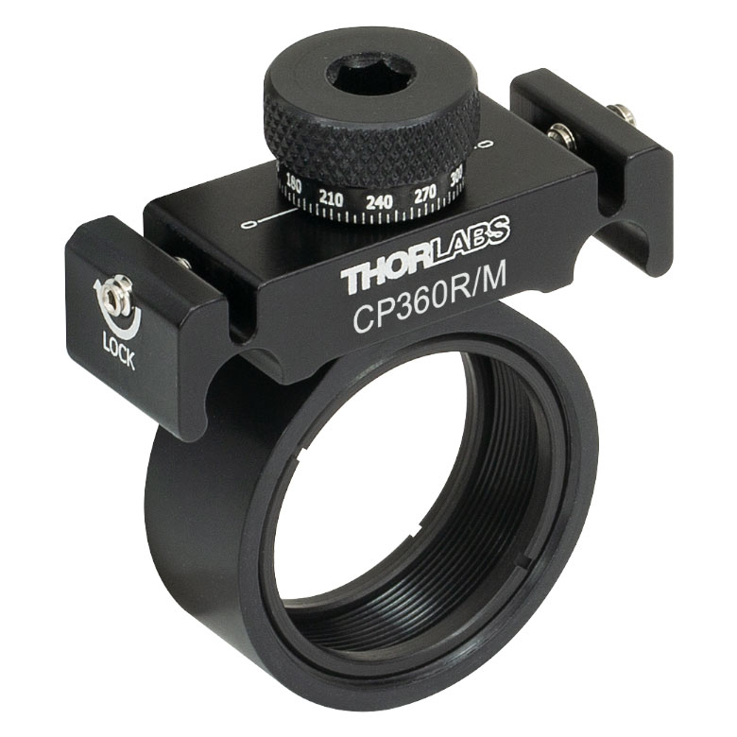
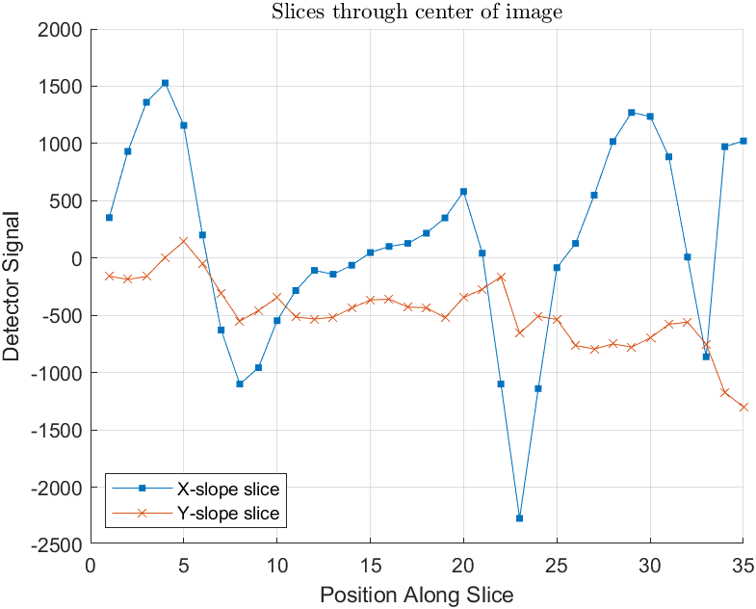
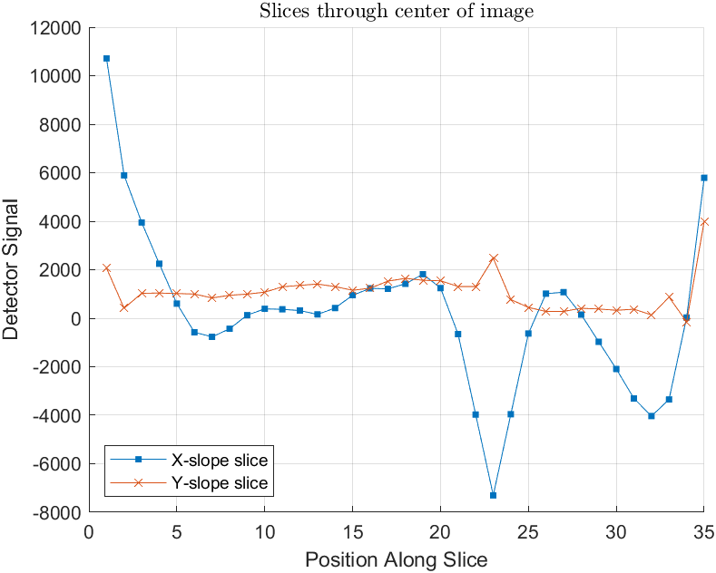
Second Dataset
Previously limited by wavefront aberrations from additional defocus term and off-axis aberrations introduced by re-alignment of source. Want to eliminate these
  Introduction of THORLABS mount to tilt phase plates and negate the need for source re-alignment showed an immediate improvement in measurement quality.
New dataset was taken with a different exposure time - > Required use of normalized calibration curve to compare both sets.
131nm step - Old data
131nm step - New data
Two data sets taken at different exposure times.
Old data – 4ms exposure
New data – 10ms exposure

Slide 13
Normalising the curve
What method would work best?
Dealing with flats
Normalisation
Dealing with tent values
in calibration data
No normalisation
Normalising by the sum of the flat subapertures
Normalising by the sum of the image subapertures
Single peak value across edge
Average across 2-3 pixels.
Subtracting a low-order flat
6 Different combinations, 2 Un-normalised, 4 Normalised

Slide 14
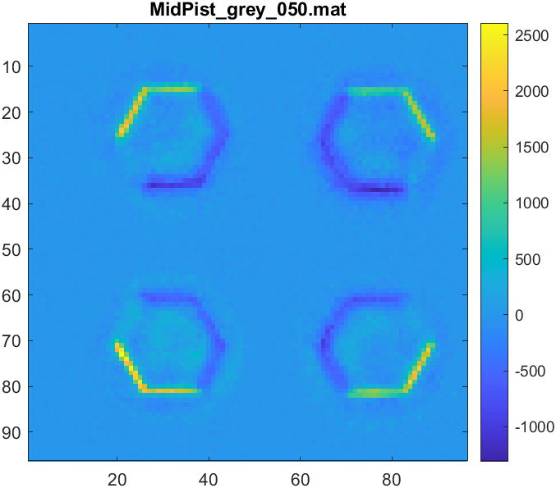
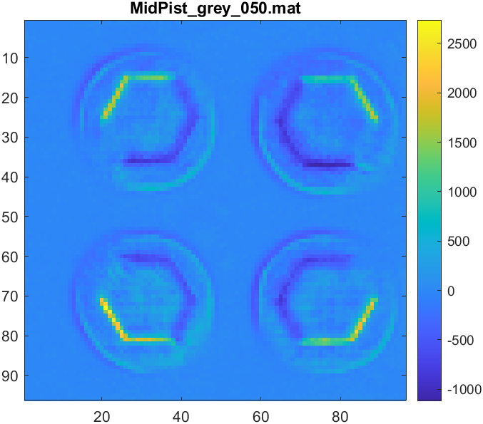
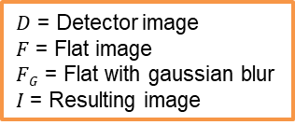


Subtracting Low-order flats
Pixel-by-pixel subtraction
New method
Low-order subtraction
If flats include any noise or high-order intensity variations, these will also be subtracted.
Flat is blurred (4-pixel Gaussian blur) and subtracted to only remove slowly varying background intensities.
$D$ = Detector image
$F$ = Flat image
$FG$ = Flat with gaussian blur
$I$ = Resulting image
$$I\left(x,y\right)=D\left(x,y\right)−F(x,y)$$
$$I\left(x,y\right)=D\left(x,y\right)−FG(x,y)$$

Slide 15
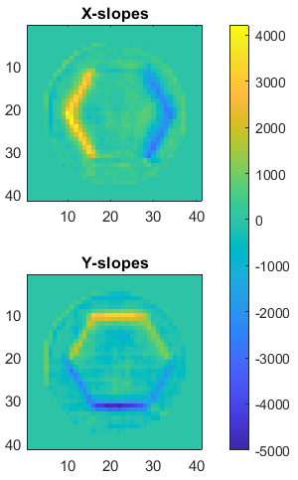
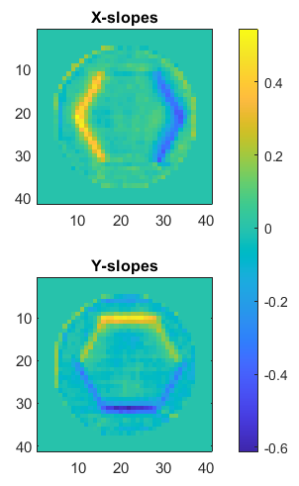
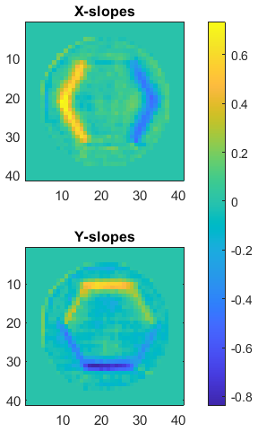






Normalization of the Slopes
No normalization
Flat normalization
Image normalization
All images have blurred flat subtracted
$$I\left(x,y\right)=D\left(x,y\right)−FG(x,y)$$
$Sn$ = Subaperture n of image $I$
$Sx/Sy$ = X slope / Y slope
$FGn$ = Subaperture n of flat image $FG$
$$Sx(x,y)=\left(S1\left(x,y\right)+S2\left(x,y\right)\right)−(S4\left(x,y\right)+S3\left(x,y\right))$$
$$Sx(x,y)=\frac{\left(S1\left(x,y\right)+S2\left(x,y\right)\right)−(S4\left(x,y\right)+S3\left(x,y\right)}{FG1\left(x,y\right)+FG2\left(x,y\right)+FG3\left(x,y\right)+FG4(x,y)}$$
$$Sx(x,y)=\frac{\left(S1\left(x,y\right)+S2\left(x,y\right)\right)−(S4\left(x,y\right)+S3\left(x,y\right)}{S1\left(x,y\right)+S2\left(x,y\right)+S3\left(x,y\right)+S4(x,y)}$$
$$Sy(x,y)=\left(S1\left(x,y\right)+S2\left(x,y\right)\right)−(S4\left(x,y\right)+S3\left(x,y\right))$$
$$Sy(x,y)=\frac{\left(S1\left(x,y\right)+S2\left(x,y\right)\right)−(S4\left(x,y\right)+S3\left(x,y\right)}{FG1\left(x,y\right)+FG2\left(x,y\right)+FG3\left(x,y\right)+FG4(x,y)}$$
$$Sy(x,y)=\frac{\left(S1\left(x,y\right)+S2\left(x,y\right)\right)−(S4\left(x,y\right)+S3\left(x,y\right)}{S1\left(x,y\right)+S2\left(x,y\right)+S3\left(x,y\right)+S4(x,y)}$$

Slide 16
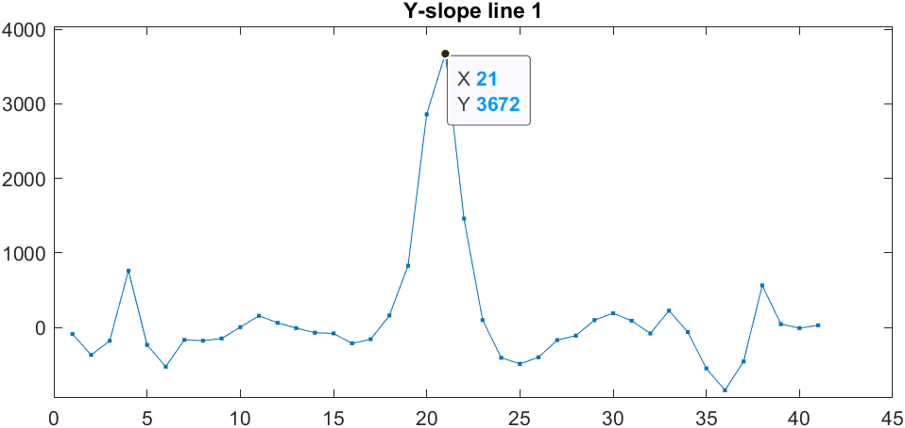
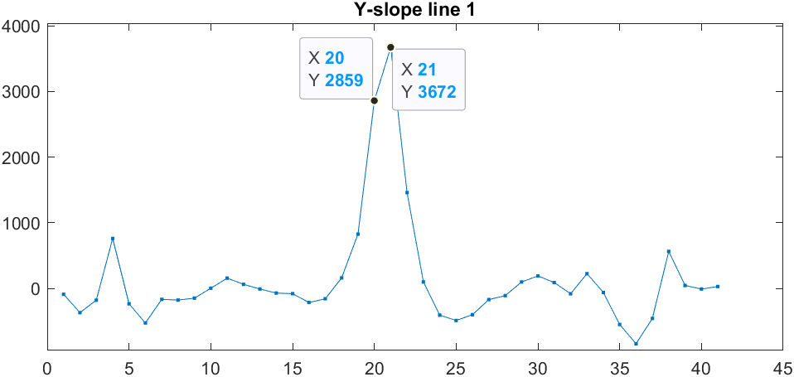
Calculating Tent values
Single value across edge
Average across edge
Picking the single highest value as the value of the tent function
Averaging across 2-3 pixels, results in a lower value for a given phase.
Horizontal Edge image, grey level 220
Horizontal Edge image, grey level 220
Highest point gives a value of 3672 for a grey level of 220.
Averaging the two pixels gives a value of 3266 for a grey level of 220.
In a turbulence scenario, edge is blurred, need to average over a few pixels to get the accurate value for the tent function.

Slide 17
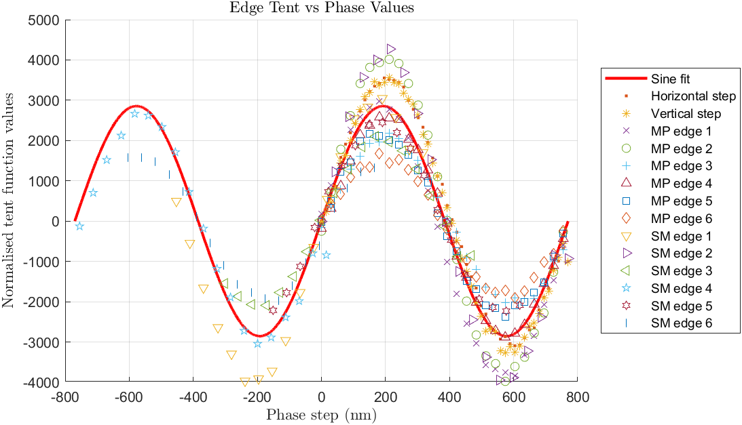
Calculating Calibration Curve – New Method
Instead of three different fits – all data points fitted together. One fit.
Flat subtracted, no normalization, averaging across the tent function

Slide 18
Before I show the graphs…
Flat subtraction
  Now subtracting a blurred flat.
Normalisation
  3 Methods,
    No normalisation.
    Normalisation using the flat.
    Normalisation using the image (common method).
Measuring the tent functions
  2 Methods
    Single highest value
    Averaging across 2-3 pixels.
Sine fit for all data points from all calibration screens.

Slide 19
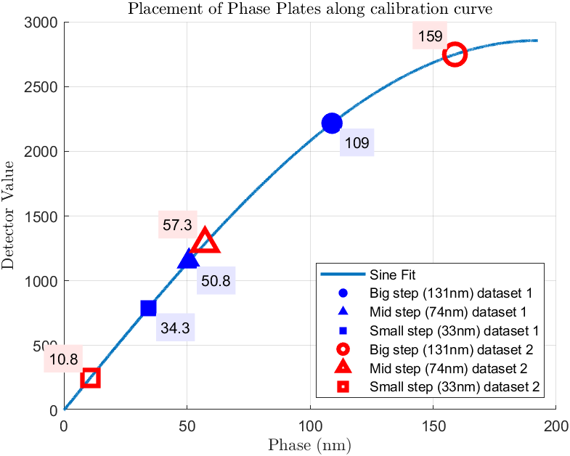
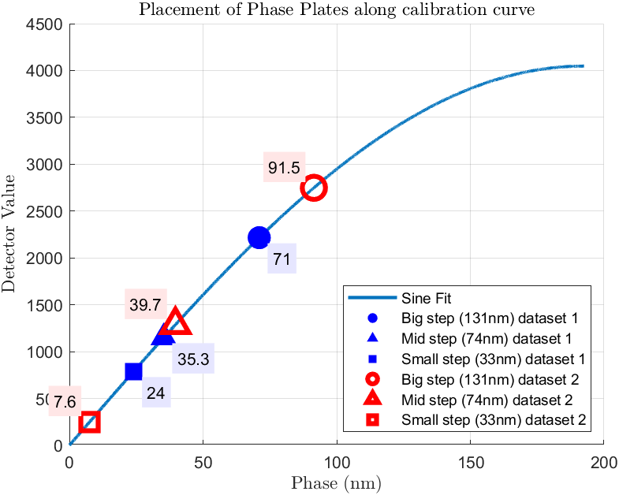


Method 1 – Flat subtracted, No normalisation
New data taken as 10ms exposure as opposed to 4ms, tried scaling the tent values by 4/10.
Nearest neighbour interpolation used to find where tent function of physical phase steps sit on the resulting calibration curve
Averaging tent values
Single tent values
$$f\left(x\right)=2855\sin{(x)}$$
$$f\left(x\right)=4047\sin{(x)}$$

Slide 20
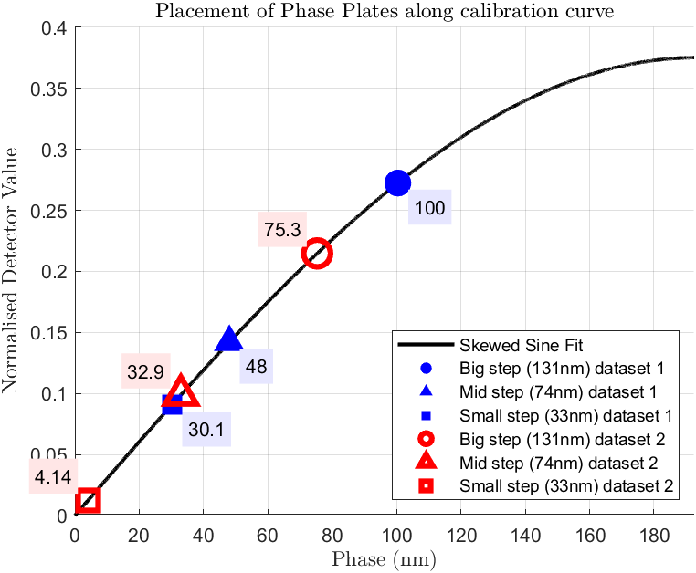
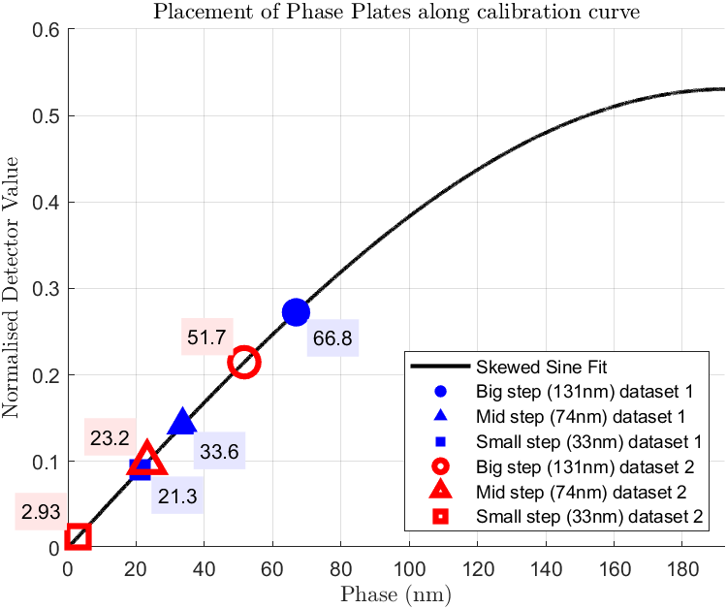


Method 2 – Flat subtracted, Normalised by flat
Subtracting a low order flat, and then using that same flat to normalise the slopes.
Averaging tent values
Single tent values
$$f\left(x\right)= \frac{0.3752\sin{(x)}}{1−(−0.009197)\cos{(x)}}$$
$$f\left(x\right)= \frac{0.5307\sin{(x)}}{1−(−0.01232)\cos{(x)}}$$
Notes:
When normalizing by the flat image, we see the same effect when averaging tent values and by using a single tent value. The measured phase is lower when using a single value as opposed to an averaged one. Worth noting here is that the skews are negative, meaning the curves lean to the right.

Slide 21
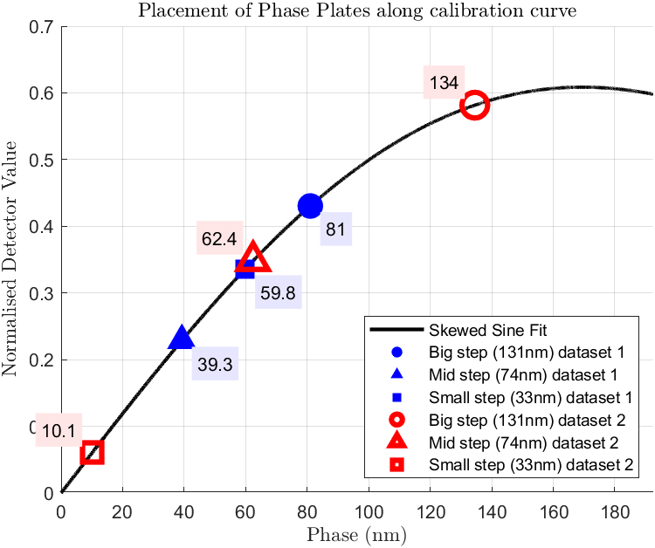
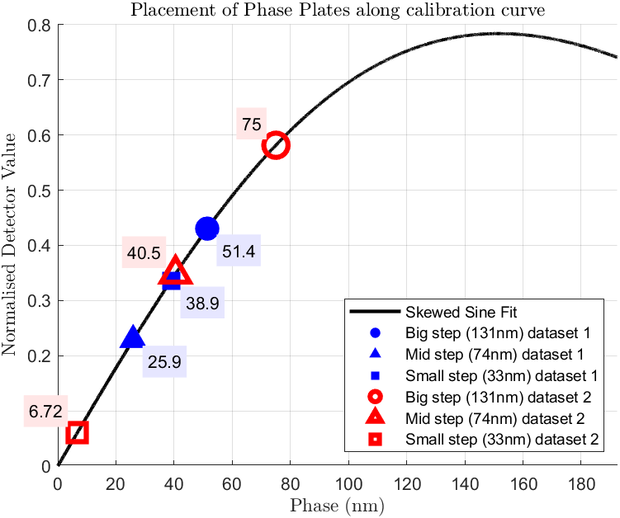


Method 3 – Subtracting flat, normalising by image subapertures
Subtracting a low order flat, and then using the sum of the resulting subapertures to normalise the result
Averaging tent values
Single tent values
$$f\left(x\right)= \frac{0.5978\sin{(x)}}{1−(0.1866)\cos{(x)}}$$
$$f\left(x\right)= \frac{0.7406\sin{(x)}}{1−(0.3278)\cos{(x)}}$$
Notes:
Similarly with final method, single tent produces much higher amplitude.
Notice how for the old set, the mid step and small step have “swapped places” on the curve? The small step is showing a higher step value for this method than the medium step. This is not the case with the new data.
Skew is positive in this fit, meaning curve leans to the left.

Slide 22
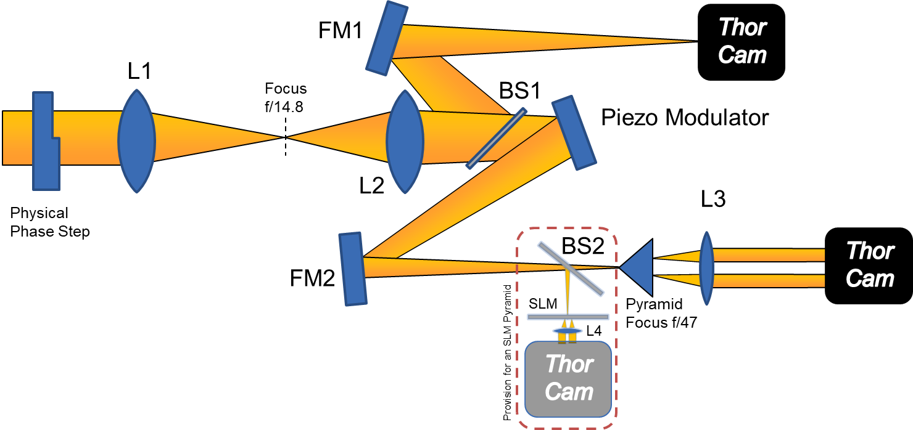
Future Measurements – Pyramid Piston Testbench
Want to be able to do similar measurements on a test bench which we understand and control all the individual components.
The Pyramid Piston Testbench is the prototype for the PyWFS arm from CaNaPy.

Slide 23
Conclusion
Previous results using non-normalized data reduction methods showed encouraging results.
Addition of rotating lens mount for phase plates improved the quality of images.
Different normalisation methods investigated.
  No normalisation, usable if all data taken with exact same parameters.
  Averaging across several pixels over the edge produced better results than using a single value.
  Normalisation by detector image with averaging over edge gave best results.
Future work planned
  Pyramid Piston Testbench at ESO.
  Plan to perform similar measurements and compare results.

