Slide 1


MKID-based pyramid wavefront sensor, wavelength sensitivity detector for tracking optical gain
Aurélie Magniez, Lisa Bardou, Charlotte Bond, Tim Morris, Kieran O’Brien
Notes:
PhD student at durham
Work on using MKID (just presented), as Pyr. WFS detector and see what we can do with it

Slide 2
Energy sensitive detector for PWFS?
Influence of λ?
Optical Gain : change with r₀ which change with λ
Corrected PSF diameter
Pupil dispersion
Atmospheric dispersion
Uses of using λ-signals?
Optical gain monitoring
Chromatic super resolution
Pupil dispersion : widening the useable bandpass
Without energy sensitive detector?
Multiple WFS/Camera
Complicates optics
Only for few wavelengths
What we have done?
PWFS module simulate energy sensitive detector
Impact of the pupil dispersion (SPIE 2022)
Initial parametric model to track optical gain (now)

Slide 3
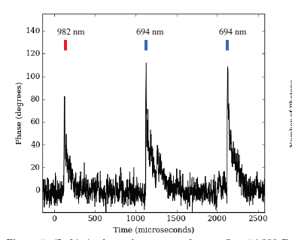
Microwave kinetic inductance detector (MKID) for XAO
OUTPUT
AO Requirements
Every pixel is read out at 1MHz independently in a continuous data stream
Match / exceed existing WFS detectors
Number of pixels
MEC array : 20k
Detection bandwidth demonstrated 400 nm to 1500¹ nm but no technical limits to go beyond
Additional features
Energy sensitivity
Resolving power : R = 30
Photon arrival time (to a microsecond)
PIXEL
ARRAY
Credit : Meeker et al. 2015
Mazin et al. 2019
Credit :Mazin et al. 2019
¹ De Visser et al., 2021, DOI : 10.1103/PhysRevApplied.16.034051

Slide 4
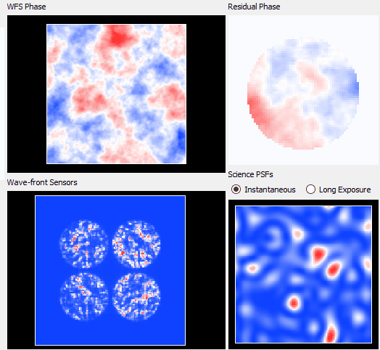
How to simulate an MKID-based PWFS?
Photon stream
Sample / simulate the atmosphere at higher temporal resolution than the AO system update rate
Modulation path can vary between frames
Work in progress
Wavelength sensitivity
Run simultaneously at different wavelength
Fixed modulation radius
Same atmosphere
Sampling according to the shortest wavelength
Soapy
AO end-to-end simulation
PWFS module update
Available on Github : https://github.com/AOtools/soapy
Increase computation complexity
Soapy’s
GUI

Slide 5
Motivation
Methods using energy sensitivity
Chromatic super resolution
Resolve pupil dispersion (SPIE)
Optical gain measurement
Questions:
What is the behaviour of the optical gain according to key parameters?
Can we use the λ-measures to track this behaviour?
SPHERE like parameters
Name | Value
Pixels across pupil | 40
Telescope Diameter | 8 m
Frame latency | 1
Frame rate | 1kHz
Controlled modes | 500

Slide 6
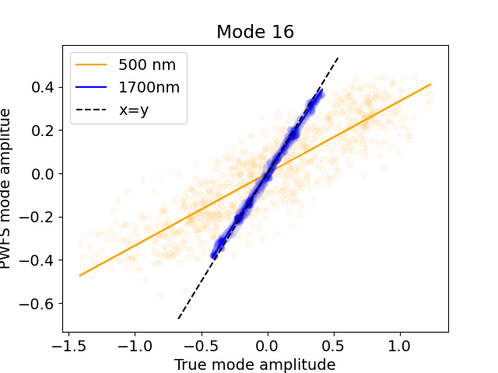
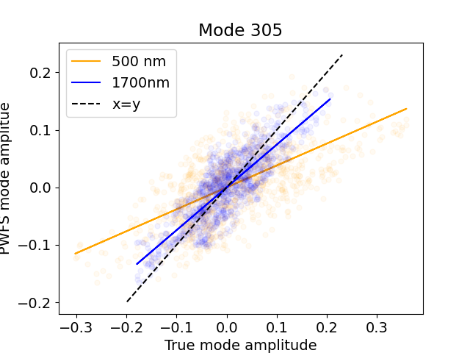
Measurement of optical gains (OG)
End-to-end simulation optical gain measure
Closed loop simulation
Decomposition of the PWFS input phase screen in KL modes
Plot amplitude measured vs true amplitude for each mode
Linear fitting : OG = slope coefficient
Work in progress: Compare with convolutional model

Slide 7
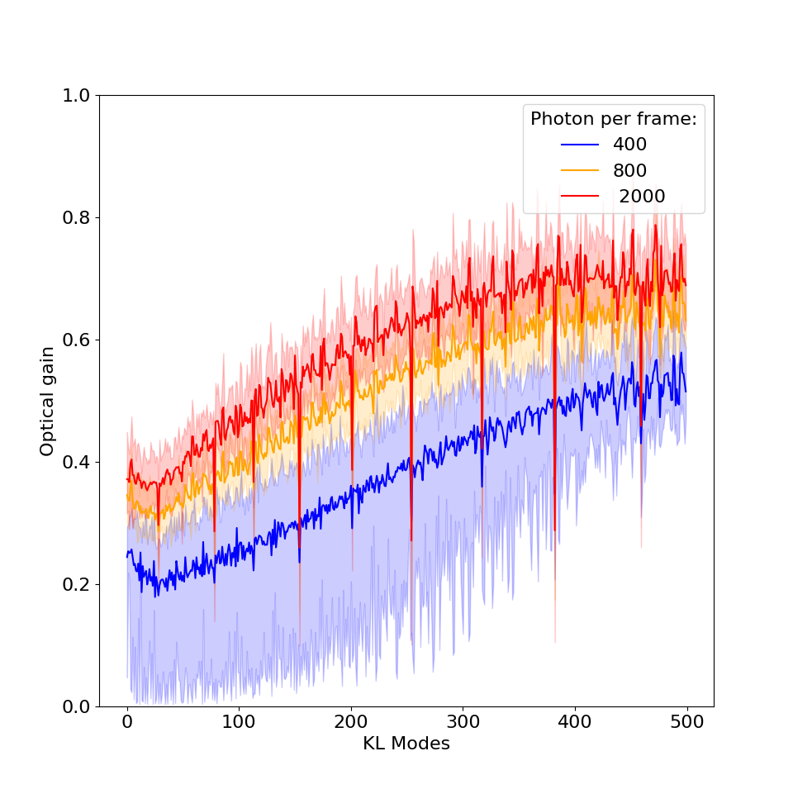
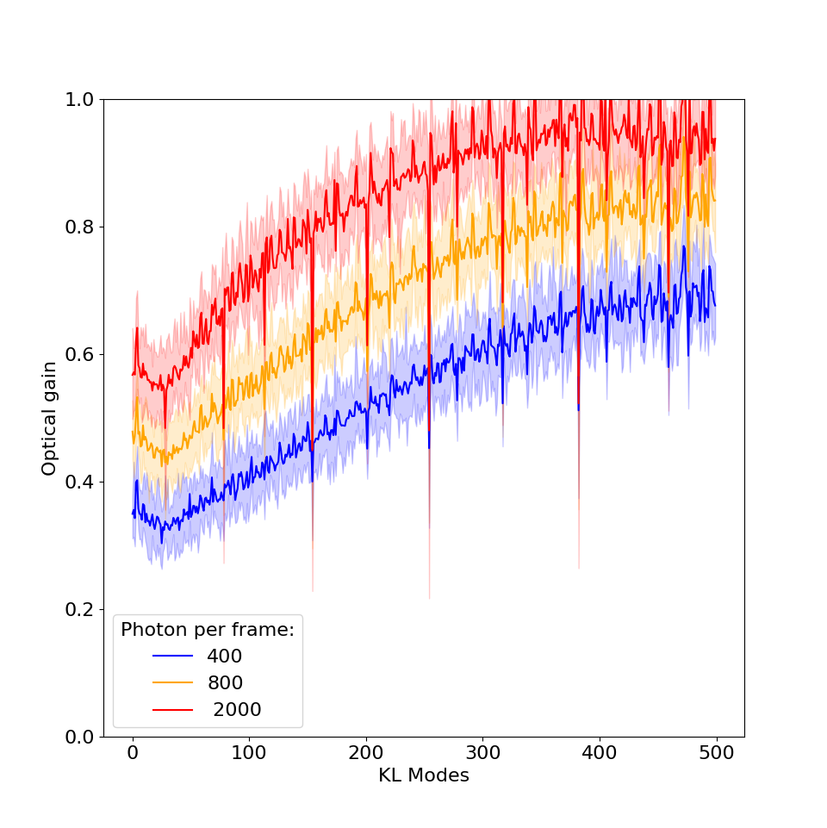
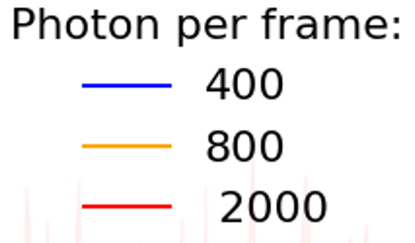
Optical gain behaviour : Photon noise and r₀
Loop at 500 nm
Optical gains increase with number of photons and r₀
r₀ = 12cm @ 500nm
r₀ = 20cm @ 500nm

Slide 8
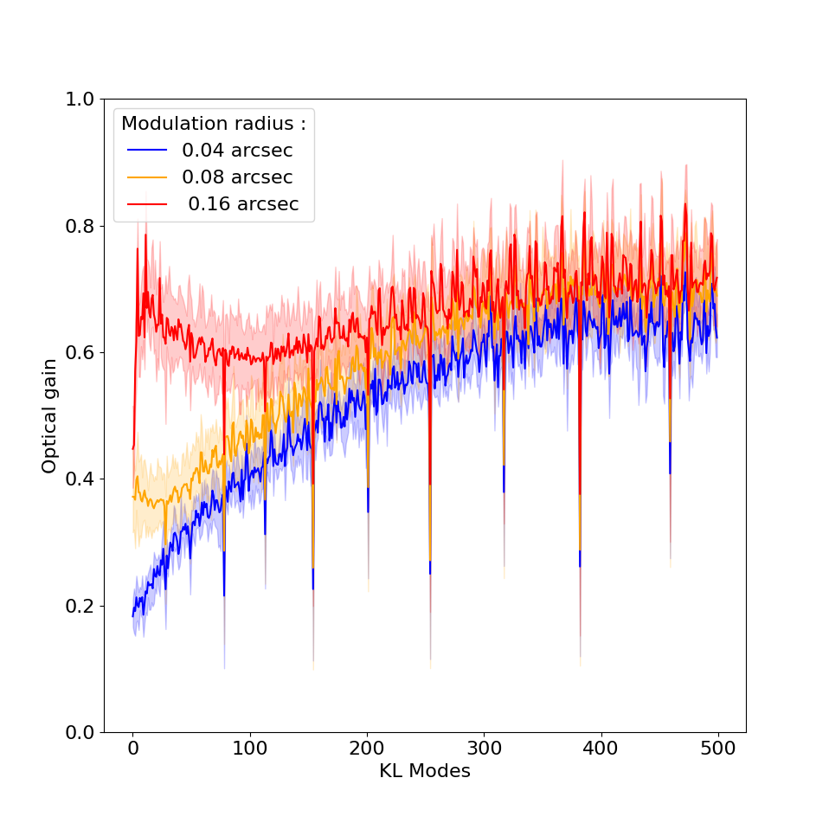
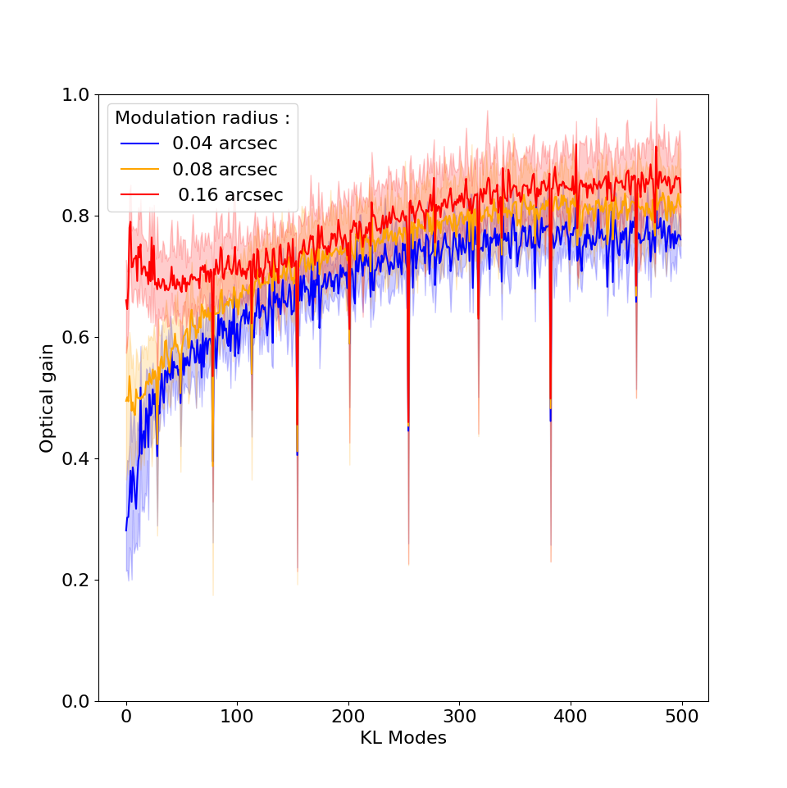
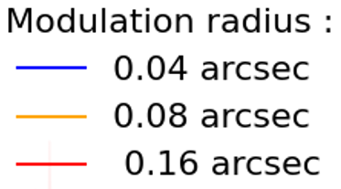
Optical gain behaviour : Modulation radius
Modulation radius change the dip in the mode space
Dip changed at different wavelength : dip influenced by λ/modulation radius
Loop at 500nm
Loop at 900nm

Slide 9
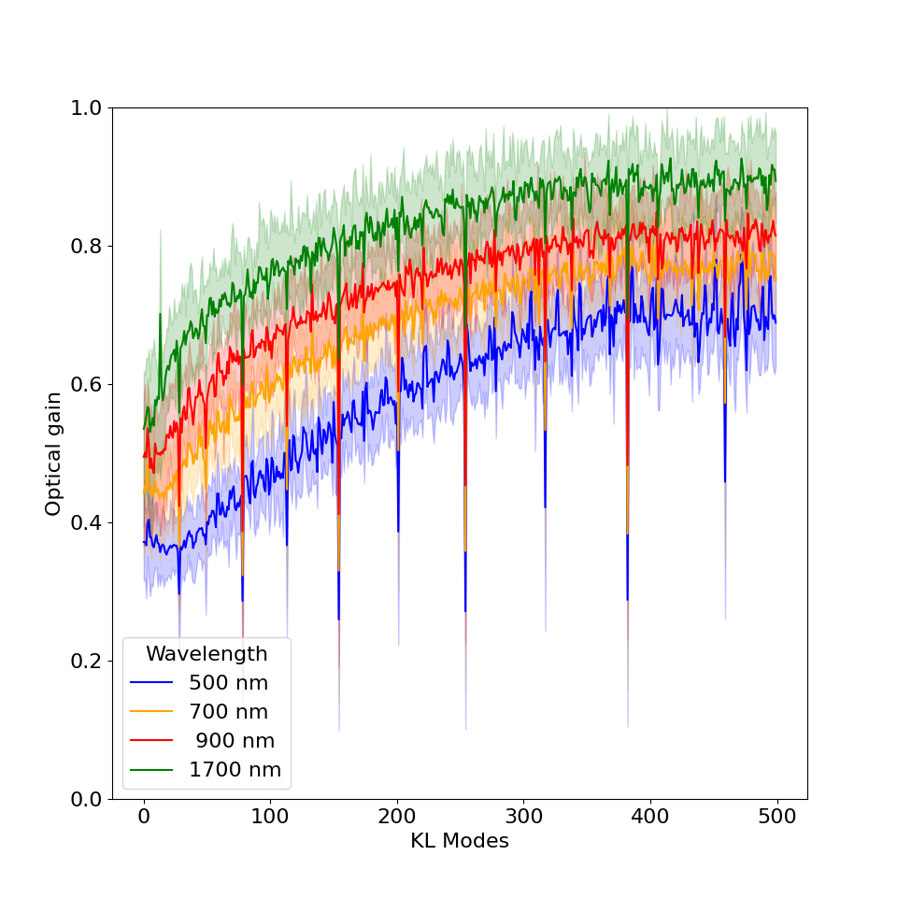
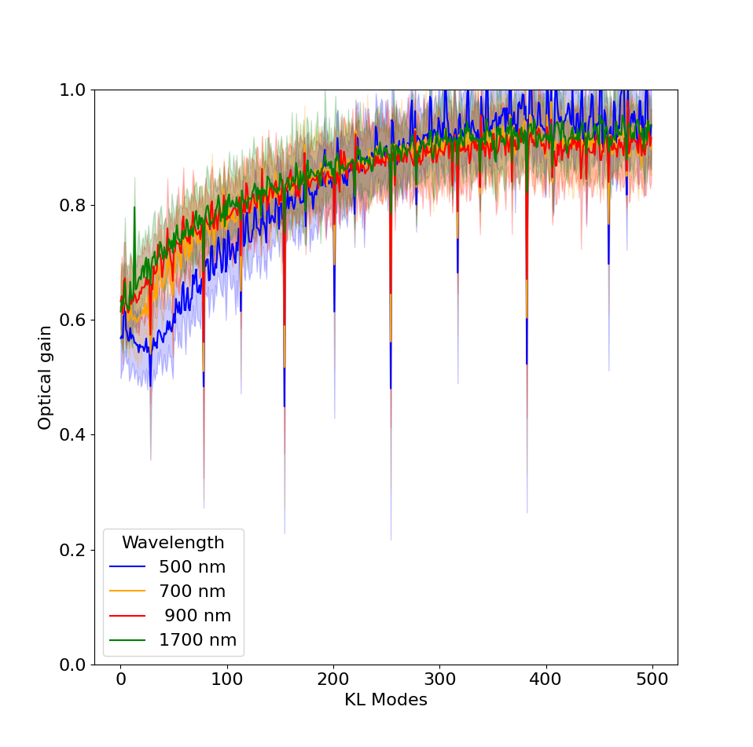
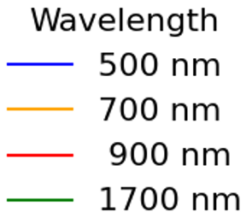
Optical gain behaviour : Wavelength
Change in the dip : influenced by the ratio wavelength / modulation radius
r₀ influences the ratio between OG at different
r₀ = 12cm @ 500nm
r₀ = 20cm @ 500nm

Slide 10
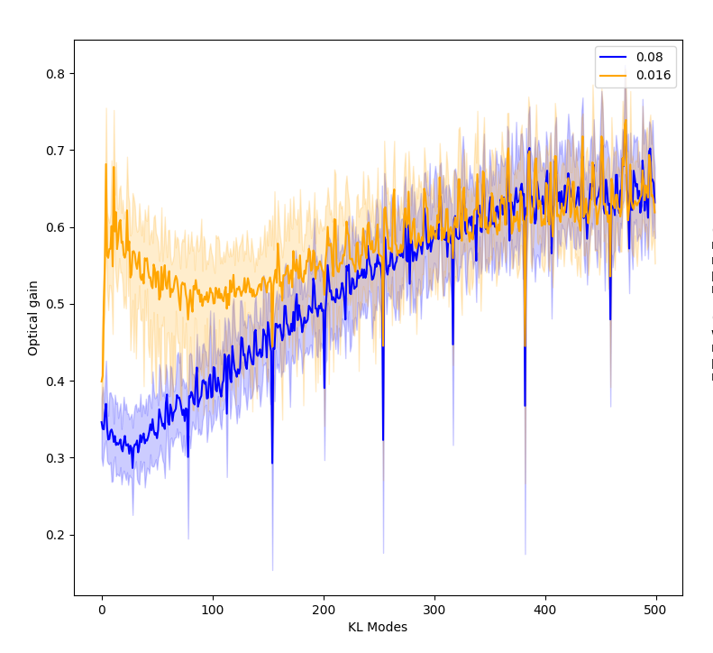
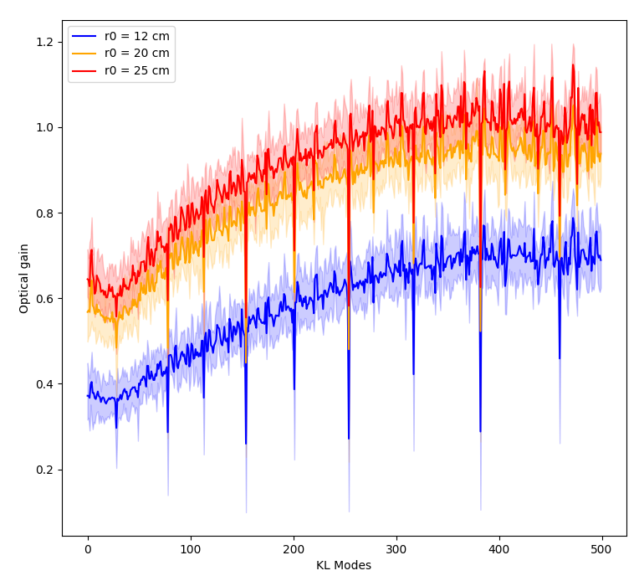
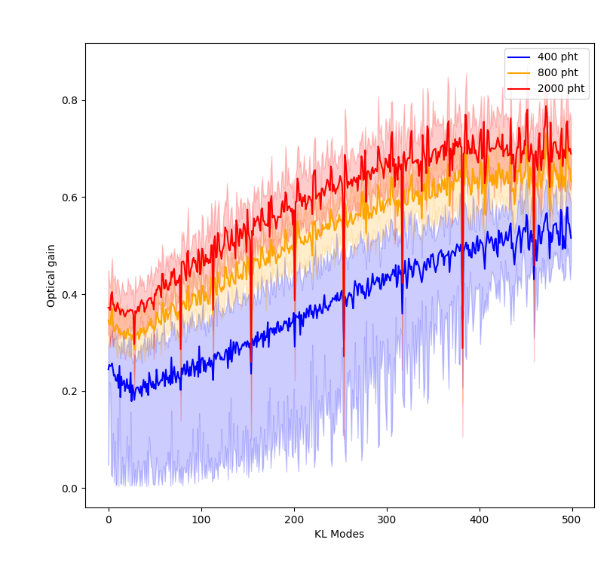
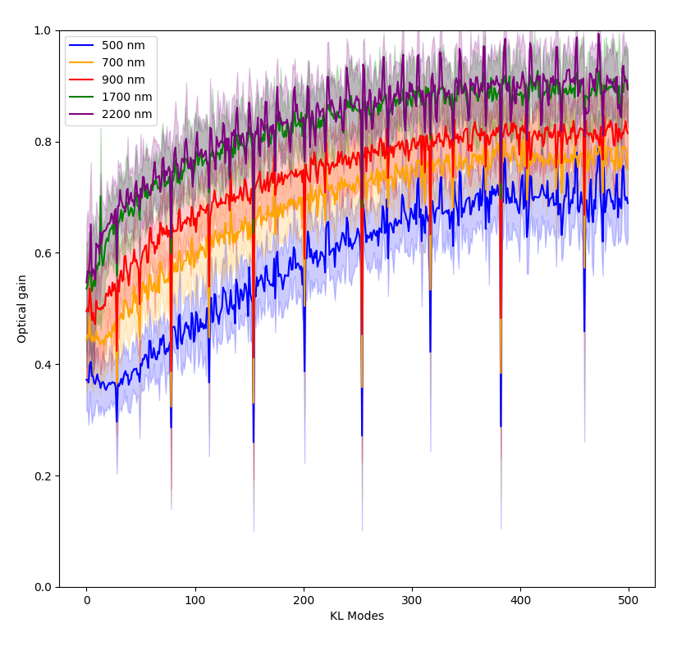
Optical gain : modelisation?
r₀
Modulation radius
UNKNOWN
KNOWN
Photon noise
Wavelength influence

Slide 11
We don’t have the OG…
… we have the KL decomposition of the wavefront at different λ
OG modelisation?
We need r₀ !
Ratio of the OG at different λ different for different r₀
Mod. radius
r₀
Photon noise
λ
Can the ratio of the PWFS measurements at different λ be linked to OG ratios?
Can we measure r₀ from these ratios to generate optical gain curves?

Slide 12
Simulation configuration
Data available
on sky
AO closed loop
Atm phase screen
DM
(KL modes)
KL mode coefficients λ₁
PWFS λ₁
Reconstructor λ₁
PWFS λ₂
Reconstructor λ₂
KL mode coefficients λ₂
PWFS λ₃
Reconstructor λ₃
KL mode coefficients λ₃
Work in progress:
Optimisation of the loop using ALL the measures

Slide 13
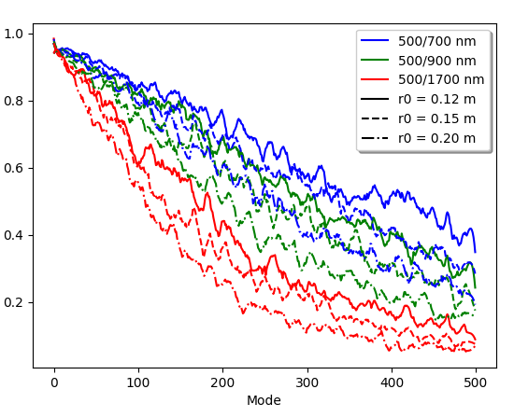
MKID output : let’s use it!
Loop closed at 500 nm
Pseudo open loop output (DM command + measure of the residuals by the PWFS) of the different PWFS
For different wavelength
At different r₀
Ratios
Work in progress:
Close the loop at higher wavelength
Understand more theoretically this behaviour.

Slide 14
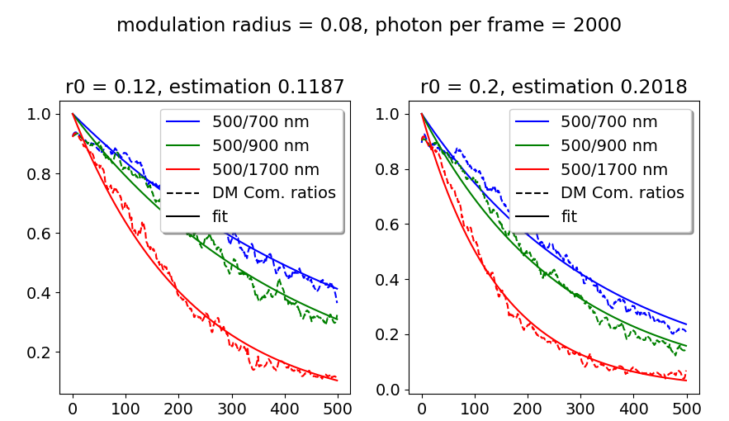
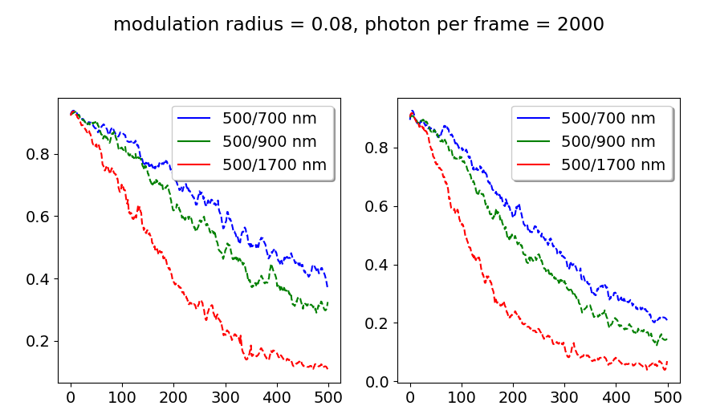


Parametric model : retrieve r₀
Separation of the curves per r₀
Fit of the curves
Determination of a
$$y= \frac{1}{\exp^{ax}}$$
r₀ | Measured r₀
0.12 | 0.1187
0.15 | 0.1507
0.2 | 0.2018
0.25 | 0.2486
$a= \frac{λ_{1}}{λ_{2}} ∗C1 ∗r_{0}+C2 ∗ r_{0}+C3∗\frac{λ_{1}}{λ_{2}}$ + C4
🥳

Slide 15
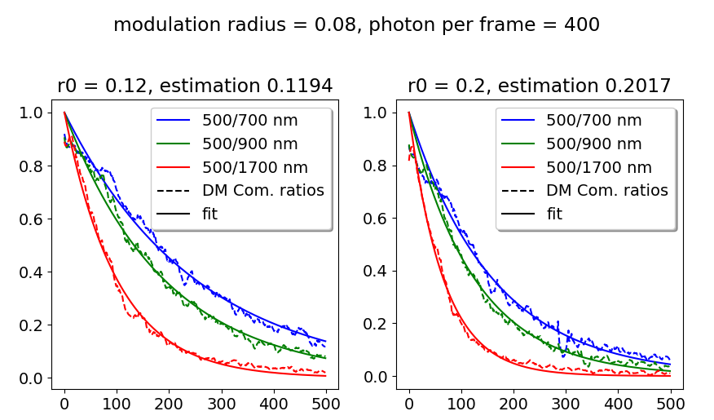
Parametric model : retrieve r₀
Separation of the curves per r₀
Fit of the curves
Determination of a
Works with fewer photons
$$y= \frac{1}{\exp^{ax}}$$
r₀ | Measured r₀ | Measured r₀ (less photons)
0.12 | 0.1187 | 0.1194
0.15 | 0.1507 | 0.1498
0.2 | 0.2018 | 0.2017
0.25 | 0.2486 | 0.2491
r₀ | Measured r₀
0.12 | 0.1187
0.15 | 0.1507
0.2 | 0.2018
0.25 | 0.2486
$a= \frac{λ_{1}}{λ_{2}} ∗C1 ∗r_{0}+C2 ∗ r_{0}+C3∗\frac{λ_{1}}{λ_{2}}$ + C4
🥳
Work in progress:
Change of the constants with the noise and other parameters: TBD
Sensitivity of the model?

Slide 16
Conclusion
End to end simulation shows parameters influence on OG
Unknown in our system : r₀
MKID : measure at different wavelength
Parametric model : estimation of r₀
MKID-based PWFS
Gives
Optical gain
Modal decomposition at different λ
Influenced
by
Retrieve
Parametric
model
Next:
Sensitivity of constants in the parametric model
Optical gain model
Optical gain compensation
Go to the lab!!
Mod. radius
r₀
r₀
Photon noise
λ

Slide 17
Thank you
aurelie.magniez@durham.ac.uk
Soapy :
https://github.com/AOtools/soapy

