Slide 1
LAser guide Star Sensor Integrated Extreme adaptive optics (LASSIE) Project
Dr. Lauren Schatz AFRL/RDSSE
Dr. Jeff Richey, Dr. Robert Johnson, Major Tod Laurvick, Dr. Colton Bigler,
Dr. Mala Mateen, Lt. Jeremiah Gaulding, Ian Kingsolver
Approved for public release; distribution is unlimited. Public Affairs release approval #AFRL-2022-4493

Slide 2
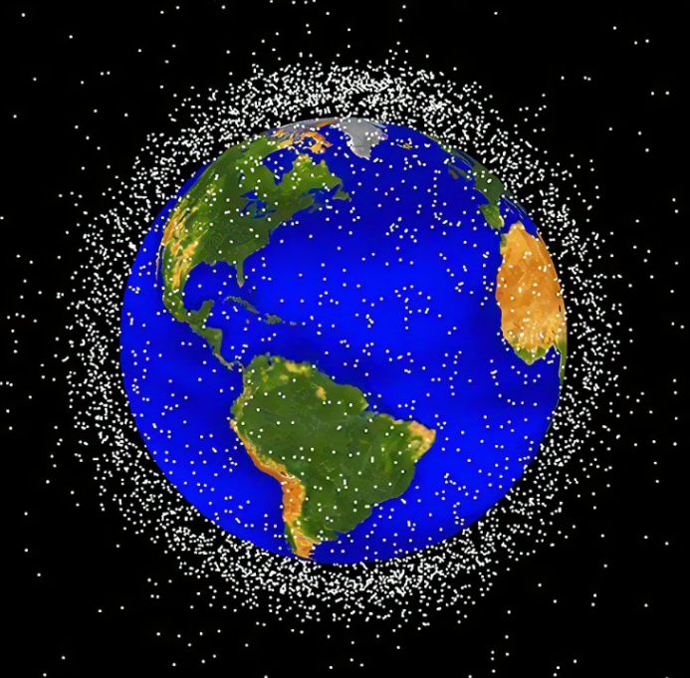
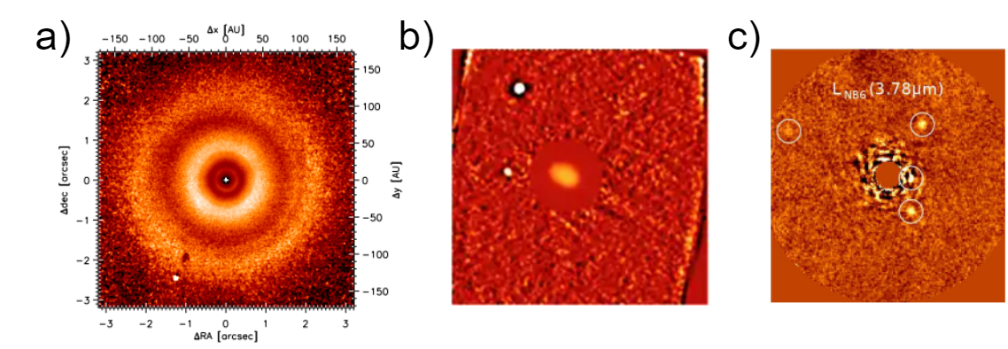
Motivation: High Contrast Imaging (HCI)
Imaging faint companions around bright objects
Closely Spaced Objects imaging at GEO similar to astronomical challenges
Real high contrast images taken in the infrared!
Circumstellar Disks
Asteroids + Moons
Exoplanets
Space Domain Awareness
Closely Space Objects (CSO) mission
Yang, B, et. al
Skemer, A
Van Boekel et. al
Approved for public release; distribution is unlimited. Public Affairs release approval #AFRL-2022-4493

Slide 3
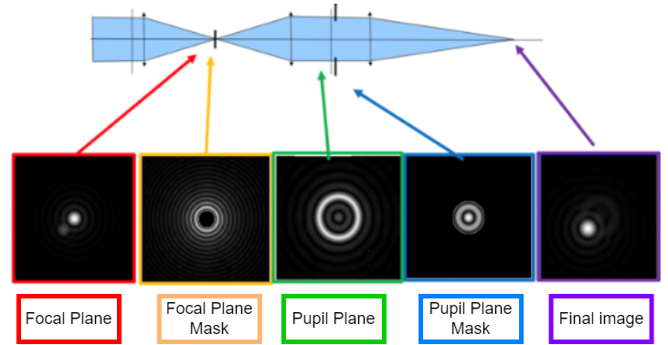
Problem One: Contrast
Lyot Coronagraph
Companions can be 10 billion times fainter than the star!
primary
Contrast
primary
secondary
secondary
Photo Credit:
NASA Hubble Space Telescope
“Lyot Stop”
Approved for public release; distribution is unlimited. Public Affairs release approval #AFRL-2022-4493

Slide 4
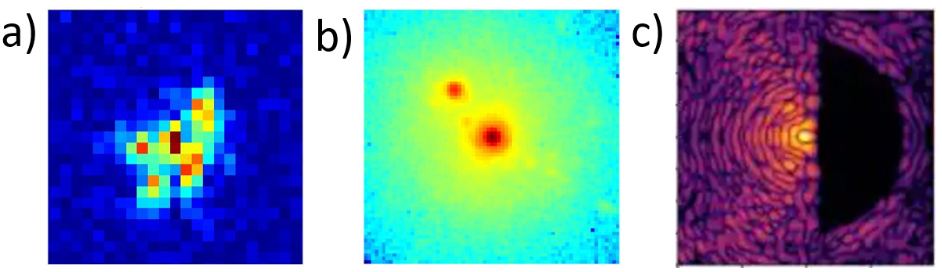
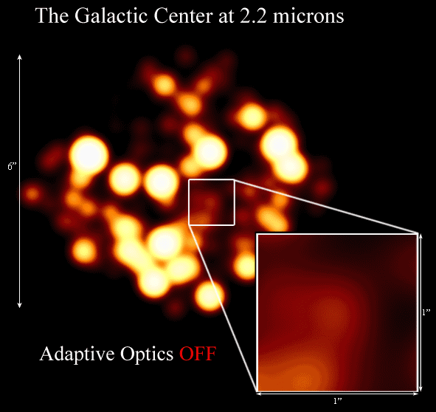
Problem Two: Atmospheric Turbulence
Binary Star System
Adaptive optics (AO) systems correct distortions of starlight wavefronts caused by atmospheric turbulence.
Adaptive Optics OFF
UCLA Galactic Center Group / W. M. Keck Observatory Laser Team
[4] Suárez-Gómez et al., 2017
Adaptive Optics ON
[5] Tavenner et al. (2021)
Approved for public release; distribution is unlimited. Public Affairs release approval #AFRL-2022-4493

Slide 5
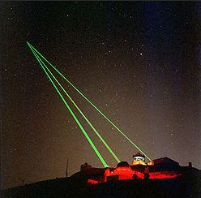
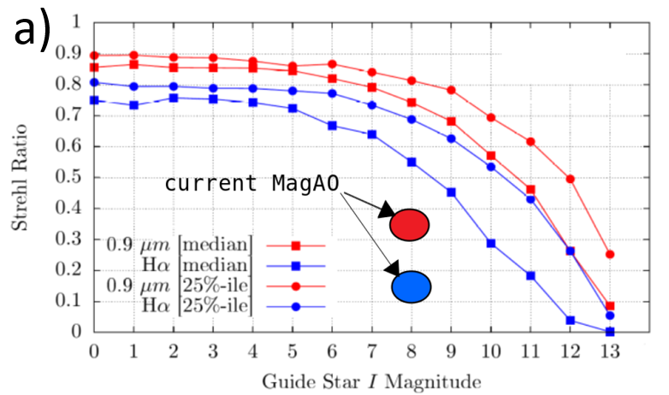
Problem Three: AO only works on bright stars
Results in about 1% sky-coverage for AO observations
Laser Guide Stars (LGS) are artificial beacons to allow AO systems to work if there are no bright guide stars
Extreme adaptive optics (ExAO) are systems optimized for coronagraphy and HCI
LGS has never been applied to ExAO systems
MagAO-X
Performance
But most stars are fainter!
Guide Star Magnitude
Laser Guide Stars
Approved for public release; distribution is unlimited. Public Affairs release approval #AFRL-2022-4493

Slide 6
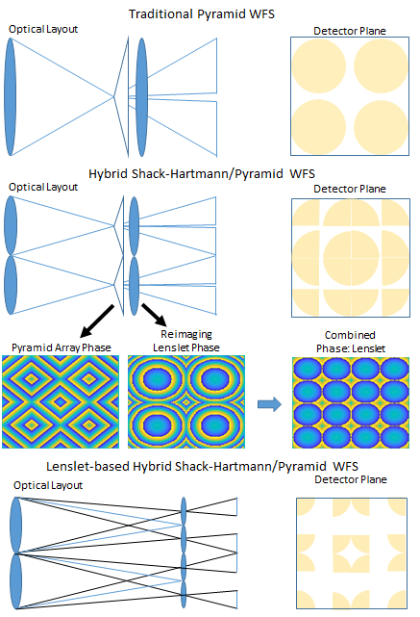
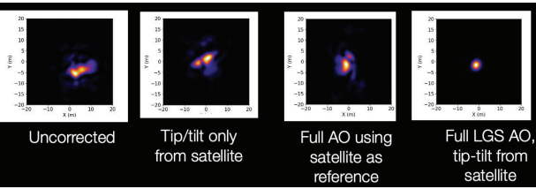

LAser guide Star Sensor Integrated Extreme adaptive optics (LASSIE) project
GEO satellites are very faint and therefore we need an LGS System
Explore advances in laser guide stars, wavefront sensors, and coronagraphy to build a new LGS ExAO
New uplink corrected Laser Guide Star Technology (Simulation). Calia et al. (2021)
New LGS Wavefront Sensor Developed at SOR
$$Uncorrected$$
Full LGS AO,
tip-tilt from satellite
Richey (2022)
Calia et al. (2021)
Approved for public release; distribution is unlimited. Public Affairs release approval #AFRL-2022-4493

Slide 7
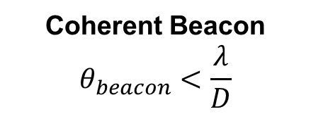
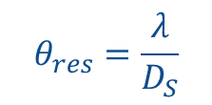
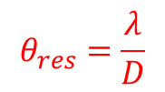
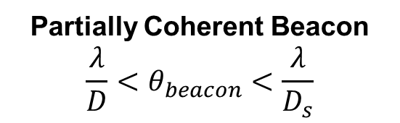
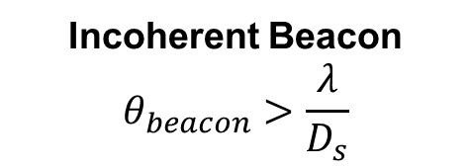
Partially Coherent Beacons
Richey (2022)
Coherent Beacon
$$θ_{beacon}<\frac{λ}{D}$$
Partially Coherent Beacon
$$\frac{λ}{D}<θ_{beacon}<\frac{λ}{D_{s}}$$
Incoherent Beacon
$$θ_{beacon}>\frac{λ}{D_{s}}$$
Uplink Corrected/Pulsed Sodium Beacon
Sodium Beacon
Star
$$θ_{res}=\frac{λ}{D}$$
$$θ_{res}=\frac{λ}{D_{S}}$$
SHWFS Subaperture Diameter: D_{S}
Telescope Diameter: D
Approved for public release; distribution is unlimited. Public Affairs release approval #: AFRL-2022-3112
Notes:
So now let’s define partially coherent beacons. As mentioned, the labels coherent and incoherent are simply useful approximations. The full calculation requires the mutual intensity which can be defined through the use of the complex degree of spatial coherence mu, the magnitude of which varies between 0 and 1. The coherent approximation assumes perfect intereference or a magnitude always equal to one, while the incoherent approximation assumes zero interference. The partially coherent applies when neither approximation is valid. For NGS and LGS sources, we can calculate the spatial coherence magnitude as shown, which simply states that the spatial coherence magnitude is the Fourier transform of the normalized source exitance, which means that the maximum distance between coherent points, the coherence area, is inversely proportional to the source size.
If the source angular extent is smaller than the angular resolution of our telescope aperture, the coherence area will be larger than the telescope diameter and we can apply the coherent approximation. Conversely if the beacon angular size is larger than the angular resolution of the smallest sampling aperture, or a SHWFS subaperture, the coherence area is small enough that adjacent sample points are not coherent, thus we refer to this as an incoherent beacon. A partially coherent beacon falls in-between these two extremes, but everything we develop to handle partial coherence can be applied to any beacon because it is a more rigorous calculation eschewing either approximation.

Slide 8
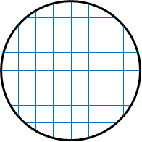
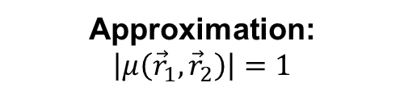
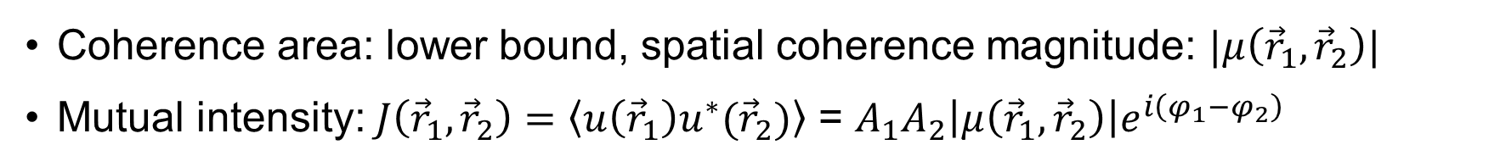
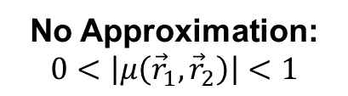
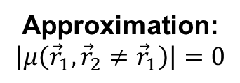
Partially Coherent Beacons
Richey (2022)
Coherent Beacon
$$θ_{beacon}<\frac{λ}{D}$$
Partially Coherent Beacon
$$\frac{λ}{D}<θ_{beacon}<\frac{λ}{D_{s}}$$
Incoherent Beacon
$$θ_{beacon}>\frac{λ}{D_{s}}$$
D
Coherence Area
D_{s}
Approximation:
$$\left|μ\left({\vec{r}}_{1},{\vec{r}}_{2}\right)\right|=1$$
No Approximation:
$$0<\left|μ\left({\vec{r}}_{1},{\vec{r}}_{2}\right)\right|<1$$
Approximation:
$$\left|μ\left({\vec{r}}_{1},{\vec{r}}_{2}≠{\vec{r}}_{1}\right)\right|=0$$
Coherence area: lower bound, spatial coherence magnitude: $|μ\left({\vec{r}}_{1},{\vec{r}}_{2}\right)|$
Mutual intensity: $J\left({\vec{r}}_{1},{\vec{r}}_{2}\right)=\left\langle u\left({\vec{r}}_{1}\right)u^{∗}({\vec{r}}_{2})\right\rangle$ = $A_{1}A_{2}\left|μ\left({\vec{r}}_{1},{\vec{r}}_{2}\right)\right|e^{i\left(φ_{1}−φ_{2}\right)}$
Approved for public release; distribution is unlimited. Public Affairs release approval #: AFRL-2022-3112
Notes:
So now let’s define partially coherent beacons. As mentioned, the labels coherent and incoherent are simply useful approximations. The full calculation requires the mutual intensity which can be defined through the use of the complex degree of spatial coherence mu, the magnitude of which varies between 0 and 1. The coherent approximation assumes perfect intereference or a magnitude always equal to one, while the incoherent approximation assumes zero interference. The partially coherent applies when neither approximation is valid. For NGS and LGS sources, we can calculate the spatial coherence magnitude as shown, which simply states that the spatial coherence magnitude is the Fourier transform of the normalized source exitance, which means that the maximum distance between coherent points, the coherence area, is inversely proportional to the source size. If the source angular extent is smaller than the angular resolution of our telescope aperture, the coherence area will be larger than the telescope diameter and we can apply the coherent approximation. Conversely if the beacon angular size is larger than the angular resolution of the smallest sampling aperture, or a SHWFS subaperture, the coherence area is small enough that adjacent sample points are not coherent, thus we refer to this as an incoherent beacon. A partially coherent beacon falls in-between these two extremes, but everything we develop to handle partial coherence can be applied to any beacon because it is a more rigorous calculation eschewing either approximation. Before we jump into the results of the work, we need to briefly discuss how we are going to define and measure WFS sensitivity

Slide 9
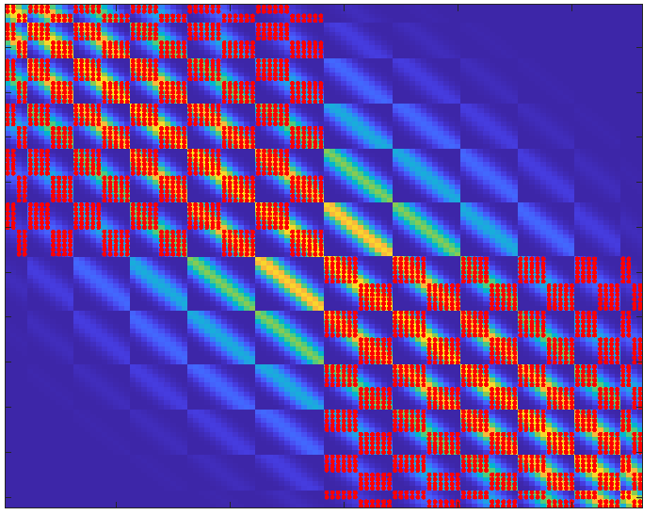
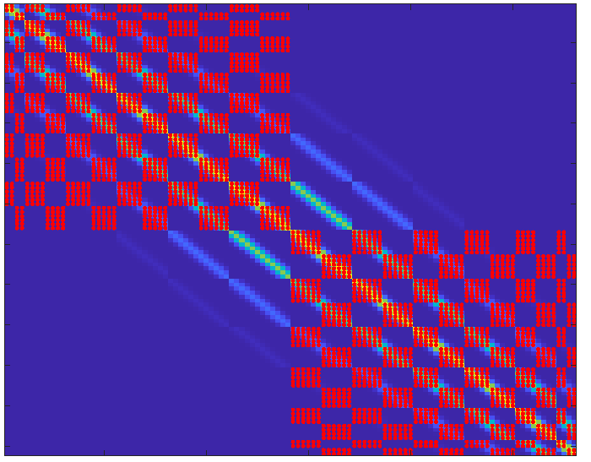
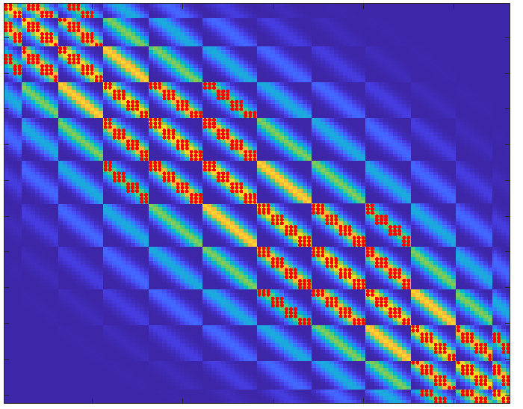
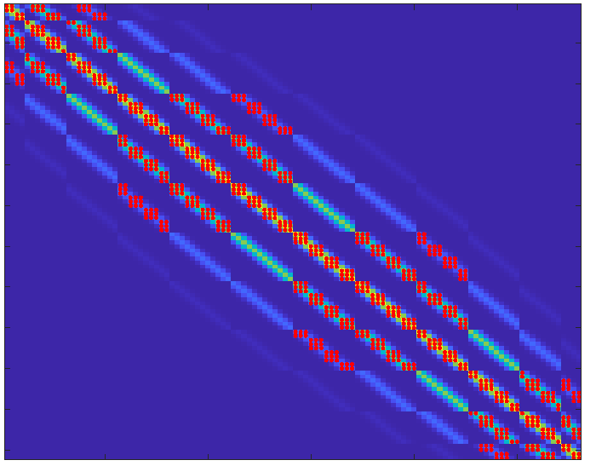

Optimizing WFS design for Partially Coherent Beacons
Pupil Segmentation – Hybrid WFS
Source: 2 λ/D
Source: 4 λ/D
2x2
$$|μ_{ab}|$$
4x4
Pupil Segmentation
Richey (2022)
Approved for public release; distribution is unlimited. Public Affairs release approval #: AFRL-2022-3112
Notes:
The objective is maximum the WFS sensitivity for a given coherence. We’ll do that through two approaches which are both based on the idea of minimizing the spread of light from a point in the pupil beyond the coherence area. The first approach is based on pupil segmentation, similar to the SHWFS we’ll divide the aperture into subapertures but now the division will be based on the coherence area and we’ll use a separate WFS technique to retrieve higher modes in each subaperture. While pupil segmentation can be applied to any WFS technique we’ll use it with a hybrid SH-Pyr WFS and compare its performance to a standard WFS. The second approach is based on what I call impulse response engineering, which just means we’ll try to modify the coherent impulse response of the WFS to limit its spread to the coherence area of the source. To demonstrate the concept we’ll use the spatial coherence matrix which simply a representation of the spatial coherence magnitude for each combination of points in the pupil. Rastering through the points on each axis, the diagonal is the self-coherence which is always equal to 1. Thus an incoherent source would look like an identity matrix while a coherent source would be 1 or approximately 1 everywhere. Let’s start by looking at how pupil segmentation works to achieve our basic approach.

Slide 10
LAser guide Star Sensor Integrated Extreme adaptive optics (LASSIE) project
GEO satellites are very faint and therefore we need an LGS System
Explore advances in laser guide stars, wavefront sensors, and coronagraphy to build a new LGS ExAO
New LGS Wavefront Sensor Developed at SOR
New uplink corrected Laser Guide Star Technology (Simulation)
Richey (2022)
Calia et al. (2021)
Approved for public release; distribution is unlimited. Public Affairs release approval #AFRL-2022-4493

Slide 11
Three Lab Tasks
Approved for public release; distribution is unlimited. Public Affairs release approval #AFRL-2022-4493

Slide 12
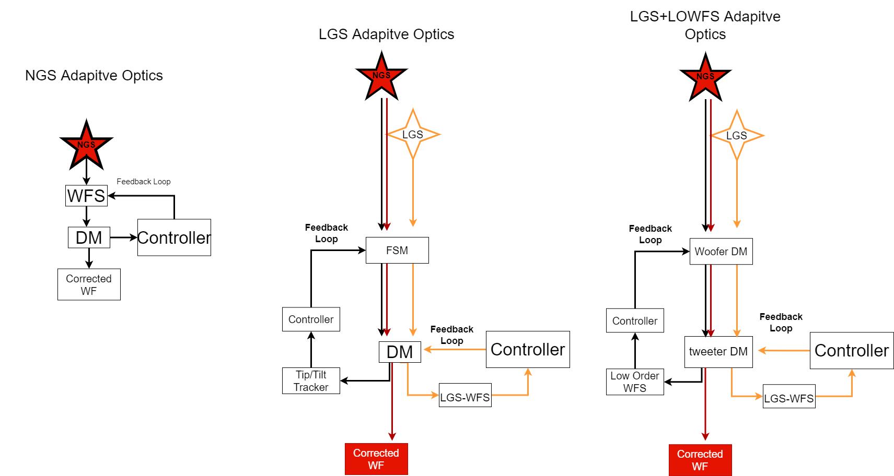
Task 1: Task One: Simulations and Optimization
End-to-end LGS ExAO System
Optimization of LGS wavefront sensor for ExAO application
Basic Lyot Coronagraph to measure expected contrast
Lyot Coronagraph
Secondary object now visible
To coronagraph
Approved for public release; distribution is unlimited. Public Affairs release approval #AFRL-2022-4493

Slide 13
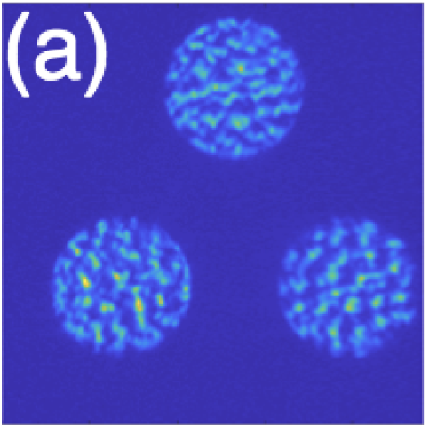
Task 2: Tip/Tilt Sensor Upgrade
Low order modes bad for coronagraphy, not well encoded by LGS
Leverage improvements to detectors
Replace tip/tilt sensor with a 3PWFS
Task 3: Lab demo of LGS Wavefront sensor + coronagraph at Starfire Advanced Optics Lab
Three-sided pyramid wavefront sensor
More photon efficient than a Shack-Hartmann or 4PWFS
Cheap and easy to make high quality pyramid optic
Can rebin detector for hybrid NGS-LGS system
coronagraph
Approved for public release; distribution is unlimited. Public Affairs release approval #AFRL-2022-4493

Slide 14
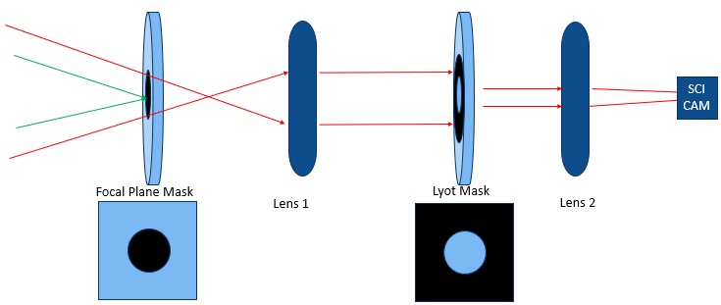
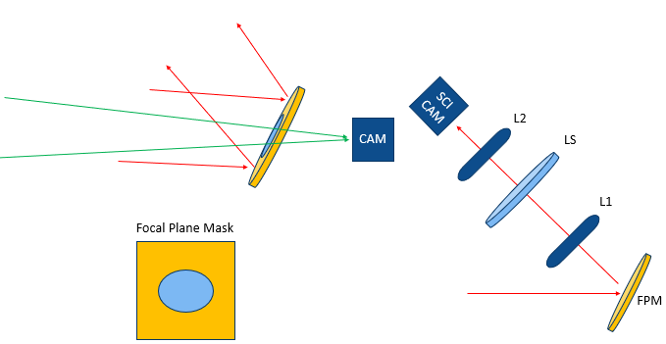
Coronagraph Preliminary Mask Designs
We plan to fabricate these masks in collaboration with the Air Force Institute of Technology (AFIT).
Metrics:
Surface quality,
Reflectivity/opacity
Ease of optical alignment
Chromaticity
Examine how the deposition process effects surface quality of mirrors and preexisting AR coatings.
Approved for public release; distribution is unlimited. Public Affairs release approval #AFRL-2022-4493

Slide 15
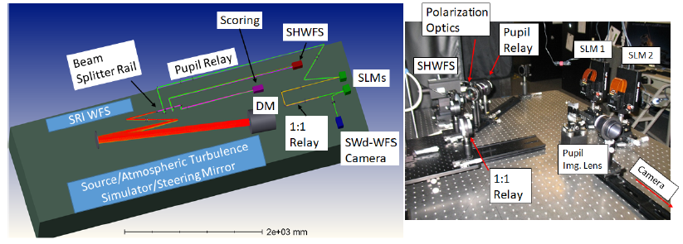
ASALT: Adaptive Optics Testbed at SOR
Approved for public release; distribution is unlimited. Public Affairs release approval #AFRL-2022-3096

Slide 16
Expected Impacts:
1. Apply and advance research by AFRL scientists:
LGS Wavefront Sensor- Jeff Richey
3PWFS- Lauren Schatz and Mala Mateen
LGS Beacon- Robert Johnson and Colton Bigler
2. Important for astronomical applications
Decadal Survey Priority Area: Pathways to Habitable World with the goal of trying to discover worlds that could resemble Earth and answer the fundamental question: “Are we alone?”
Pathfinding for next generation ExAO systems.
Pathfinding for ExAO+LGS System
MagAO-X
LGS+ExAO*
14
15
16
17
18
*Real performance to be determined
Approved for public release; distribution is unlimited. Public Affairs release approval #AFRL-2022-4493

Slide 17
References
Van Boekel, R., Henning, T., Menu, J., De Boer, J., Langlois, M., Muller, A., Avenhaus, H., Boccaletti, A., Schmid, H. M., Thalmann, C., et al., \Three radial gaps in the disk of tw hydrae imaged with sphere," The Astrophysical Journal 837(2), 132 (2017).
Yang, B., Wahhaj, Z., Beauvalet, L., Marchis, F., Dumas, C., Marsset, M., Nielsen, E., and Vachier, F., \Extreme ao observations of two triple asteroid systems with sphere, “The Astrophysical Journal Letters 820(2), L35 (2016).
Skemer, A. J., Marley, M. S., Hinz, P. M., Morzinski, K. M., Skrutskie, M. F., Leisenring, J. M., Close, L. M., Saumon, D., Bailey, V. P., Briguglio, R., et al., \Directly imaged lt transition exoplanets in the mid-infrared," The Astrophysical Journal 792(1), 17 (2014).
Suárez-Gómez, S. L., C. González-Gutiérrez, F. Sánchez-Lasheras, A. Basden, I Montilla, F. de Cos Juez, and M. Collados-Vera (2017). An approach using deep learning for tomographic reconstruction in solar observation. Proceedings of the Adaptive Optics for Extremely Large Telescopes, 5.
Tavenner, T., Drummond, J., Mateen, M., Wood, E., and Jenkins, O. R. E., \Speckle interferometry of binary stars with a 1m telescope, grounded with ao from a 1.5 m," (2021).
Schatz, Lauren, et al. "Three-sided pyramid wavefront sensor, part 1: simulations and analysis for astronomical adaptive optics." Journal of Astronomical Telescopes, Instruments, and Systems 7.4 (2021): 049001.
A. Tokovinin, “AO tutorial at CTIO” (2001).
Dalcanton, Julianne, et al. "From cosmic birth to living earths: the future of UVOIR space astronomy." arXiv preprint arXiv:1507.04779 (2015).
Richey, Jeff, and Michael Hart. "Hybrid wave front sensor for partially coherent beacons." Adaptive Optics Systems VII. Vol. 11448. SPIE, 2020.
Calia, D. Bonaccini, et al. "CaNaPy: SatComm LGS-AO experimental platform with laser uplink pre-compensation." International Conference on Space Optics—ICSO 2020. Vol. 11852. SPIE, 2021.
Approved for public release; distribution is unlimited. Public Affairs release approval #AFRL-2022-4493

Slide 18
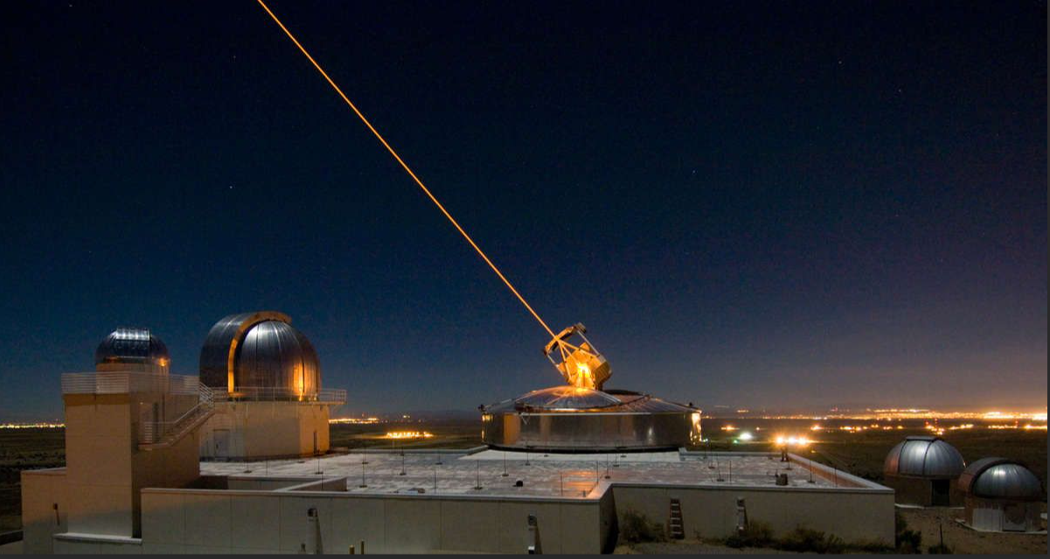
QUESTIONS?
Approved for public release; distribution is unlimited. Public Affairs release approval #AFRL-2022-4493

Slide 19
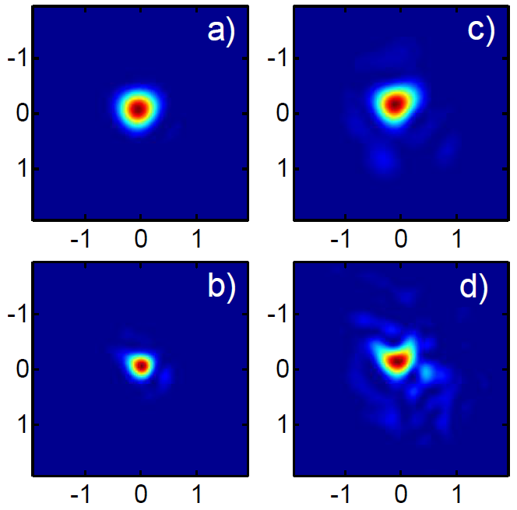




Partially Coherent Laser Beacon
Correct atmospheric turbulence on laser launch telescope
Uplink correction on 1st LGS AO system
Limited research into benefits:
Focus on SHWFS [4]
Limited aperture sizes [4]
Benefits of uplink correction
WFS sensitivity vs. spatial coherence
Optimal WFS design vs. spatial coherence
Sodium Beacon Irradiance Profile
$$r_{0}=17cm$$
$$r_{0}=7cm$$
$$D_{L}=30cm$$
$$D_{L}=50cm$$
(Holzlöhner, et al., 2008)
Approved for public release; distribution is unlimited. Public Affairs release approval #: AFRL-2022-3112
Notes:
The size of the LGS beacon is limited by the launch aperture diameter and the same atmospheric turbulence that we are trying to correct. As shown in the images, a larger aperture can yield a smaller spot if the turbulence is mild but the atmospheric coherence length r0 acts as a limiting aperture, such that for stronger turbulence the larger aperture yields more speckle rather than a smaller spot, at least for long-integration. However, we can apply the same AO techniques to mitigate the effects of turbulence. In fact the first ever Rayleigh LGS AO system included uplink correction, though it was done primarily to mitigate the poor beam quality of their copper-vapor Rayleigh laser. Correcting the laser uplink is not commonly used in astronomical AO systems, and research on the benefits of uplink correction is limited. To really understand the potential benefits of uplink correction we need to understand the interaction between spatial coherence and WFS sensitivity and develop methods for optimizing the WFS design for a given spatial coherence. This requires us to move beyond the standard coherent or incoherent approximation and instead examine wavefront sensing in the partially coherent regime.

Slide 20
Focal Plane Mask Designs
Opaque on glass
Opaque on Mirror
Hole Drilled in Mirror
Pros:
Surface quality should be good
Cons:
Not chromatic
Pros:
Chromatic
Cons:
Unclear if coating process will effect surface quality
Pros:
Enables Focal Plane WFS
Chromatic
Cons:
Custom optic (could be expensive)
Coring could cause surface defects
Mirror on Glass v2
Pros:
Enables Focal Plane WFS
Easiest alignment
Cons:
Not fully chromatic
Unclear surface quality of mirror deposition
Mirror on glass v1
Pros:
Enables Focal Plane WFS
Cons:
Not fully chromatic
Unclear surface quality of mirror depsition
Approved for public release; distribution is unlimited. Public Affairs release approval #AFRL-2022-4493

Slide 21
Lyot Stop Designs
Opaque on Glass
Mirror on Glass
Pros:
Enables Pupil plane WFS
Cons:
Not fully chromatic
Unclear surface quality of mirror deposition
Pros:
Surface quality should be good
Cons:
Not chromatic
Opaque on Mirror
Hole in Mirror
Pros:
Chromatic
Cons:
Unclear if coating process will effect surface quality
Pros:
Enables Pupil plane WFS
Fully chromatic
Cons:
Unclear surface quality
Will we need complex mask shapes when considering spiders?
Approved for public release; distribution is unlimited. Public Affairs release approval #AFRL-2022-4493

