Slide 1


Two-wavelength focal-plane piston sensing: first experimental results with LIFT
Cédric Plantet, A.- L. Cheffot, S. Lombardi, M. Bonaglia, A. Puglisi, C. Selmi, L. Busoni, E. Pinna, S. Esposito
WFS workshop, October 2022

Slide 2
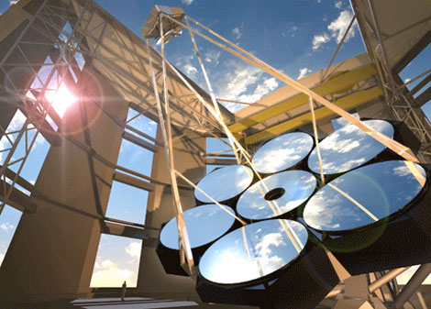
Context
Design of Giant Magellan Telescope’s Natural Guide star Wavefront Sensor
GMT = segmented telescope
Among the degrees of freedom, there is the differential piston between segments

Slide 3
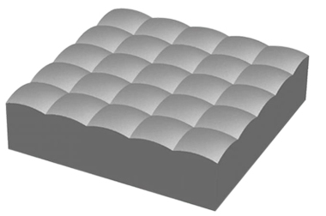
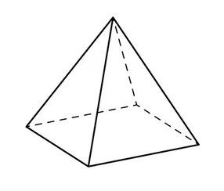
Wavefront sensor vs differential piston
Difference between these wavefront steps?
Sensor @ λ
Step? What step?
1)
200 nm
What difference? Both are 200 nm!
Credit: Thorlabs
2)
200 nm + λ

Slide 4
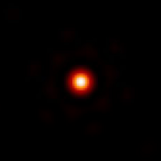

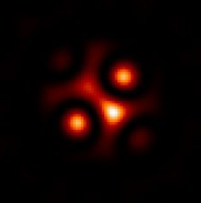
AO vs Science path
GMT’s Single-Conjugated Adaptive Optics done with pyramid sensor @ λ_{c} = 750 nm
Input wavefront
PSF @ 750 nm
AO path: “All fine!”
+750 nm
→ Need for another sensor and/or wavelength to identify ejections
H band PSF
-750 nm
Science path:
“What the…!”
Single sensor @ λ
→ segments converge at a multiple of λ

Slide 5
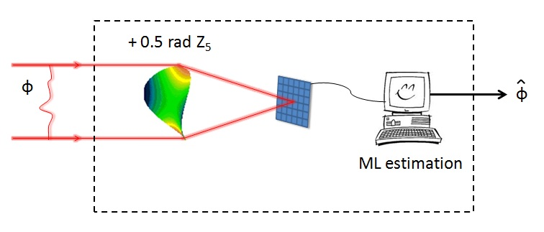
LIFT: principle
LInearized Focal-plane Technique
Phase diversity with single image
Relies on diffractive image formation model
Original goal: sense tip/tilt and focus on a faint NGS (with astigmatism phase offset)
Model-based → can be extended to piston estimation

Slide 6
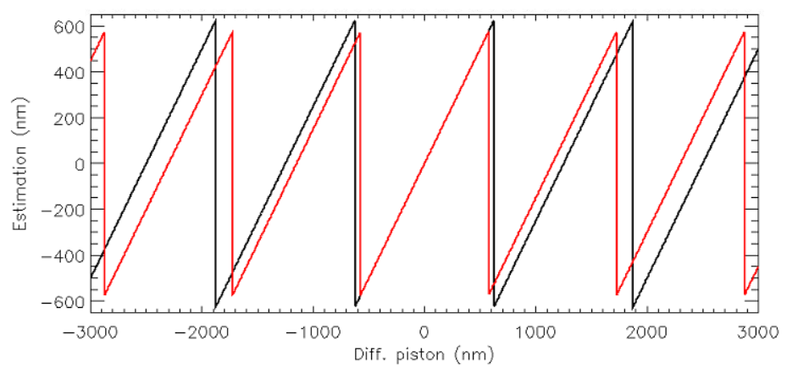
Double-wavelength LIFT: principle
Need for a large capture range > λ → minimum 2 sensing wavelengths
Astigmatism offset → focus offset (easier implementation)
Simple algorithm to match estimation couple – piston amplitude
1150 nm
1250 nm

Slide 7
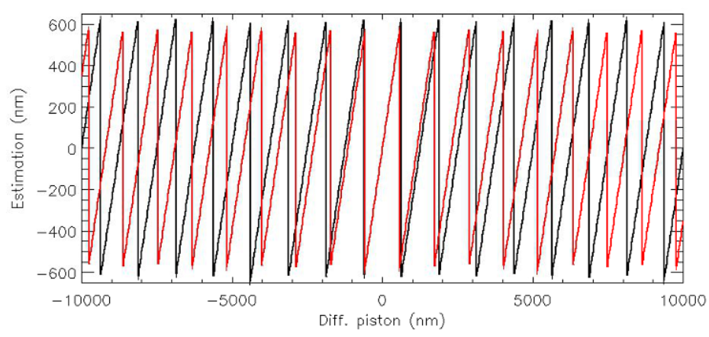
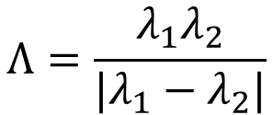
Double-wavelength LIFT: which wavelengths?
Capture range limited by synthetic wavelength (beating frequency):
Capture range → longer wavelengths, close to each other
AO correction → longer wavelengths
Good SNR → wavelengths as far as possible from a multiple of main AO’s wavelength
$$Λ=\frac{λ_{1}λ_{2}}{|λ_{1}−λ_{2}|}$$

Slide 8
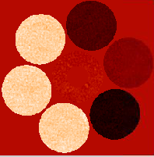
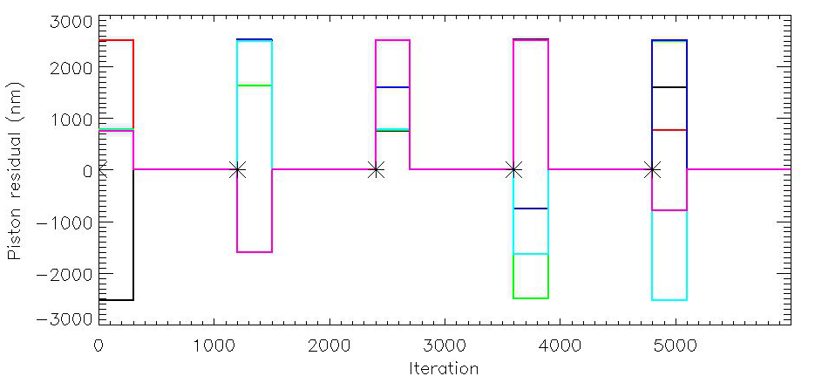
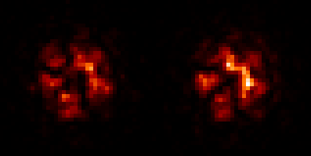
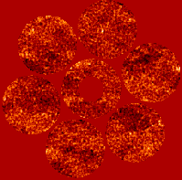
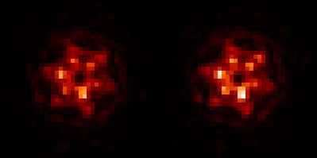
Example in simulations
LIFT in double J band
R = 12, r0 = 12.8 cm
AO residual series for mag R = 12 and r0 = 12.8 cm
Telescope regularly “scrambled” with differential pistons up to 2.5 um
J1
J2
J1
J2

Slide 9
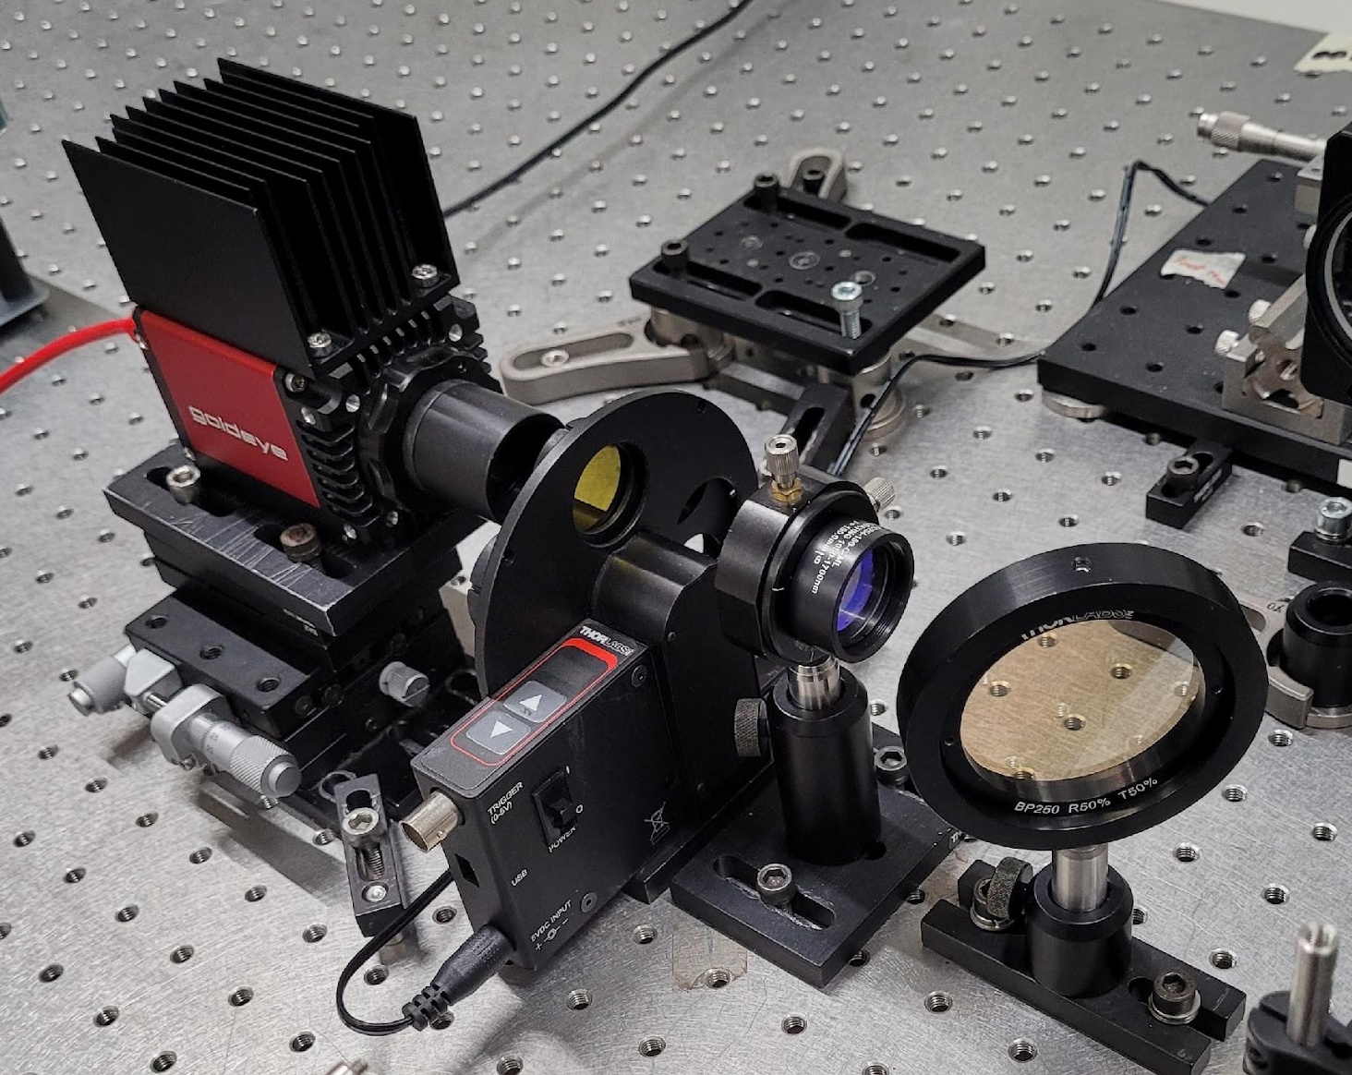
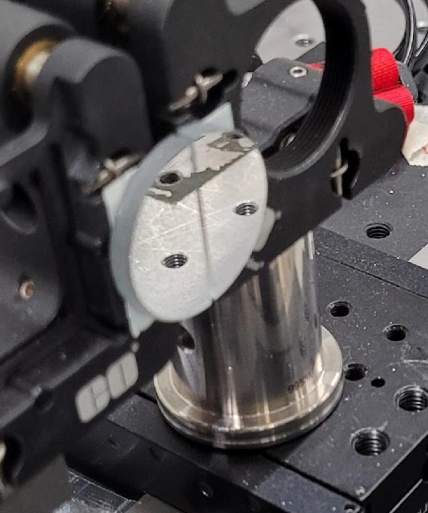
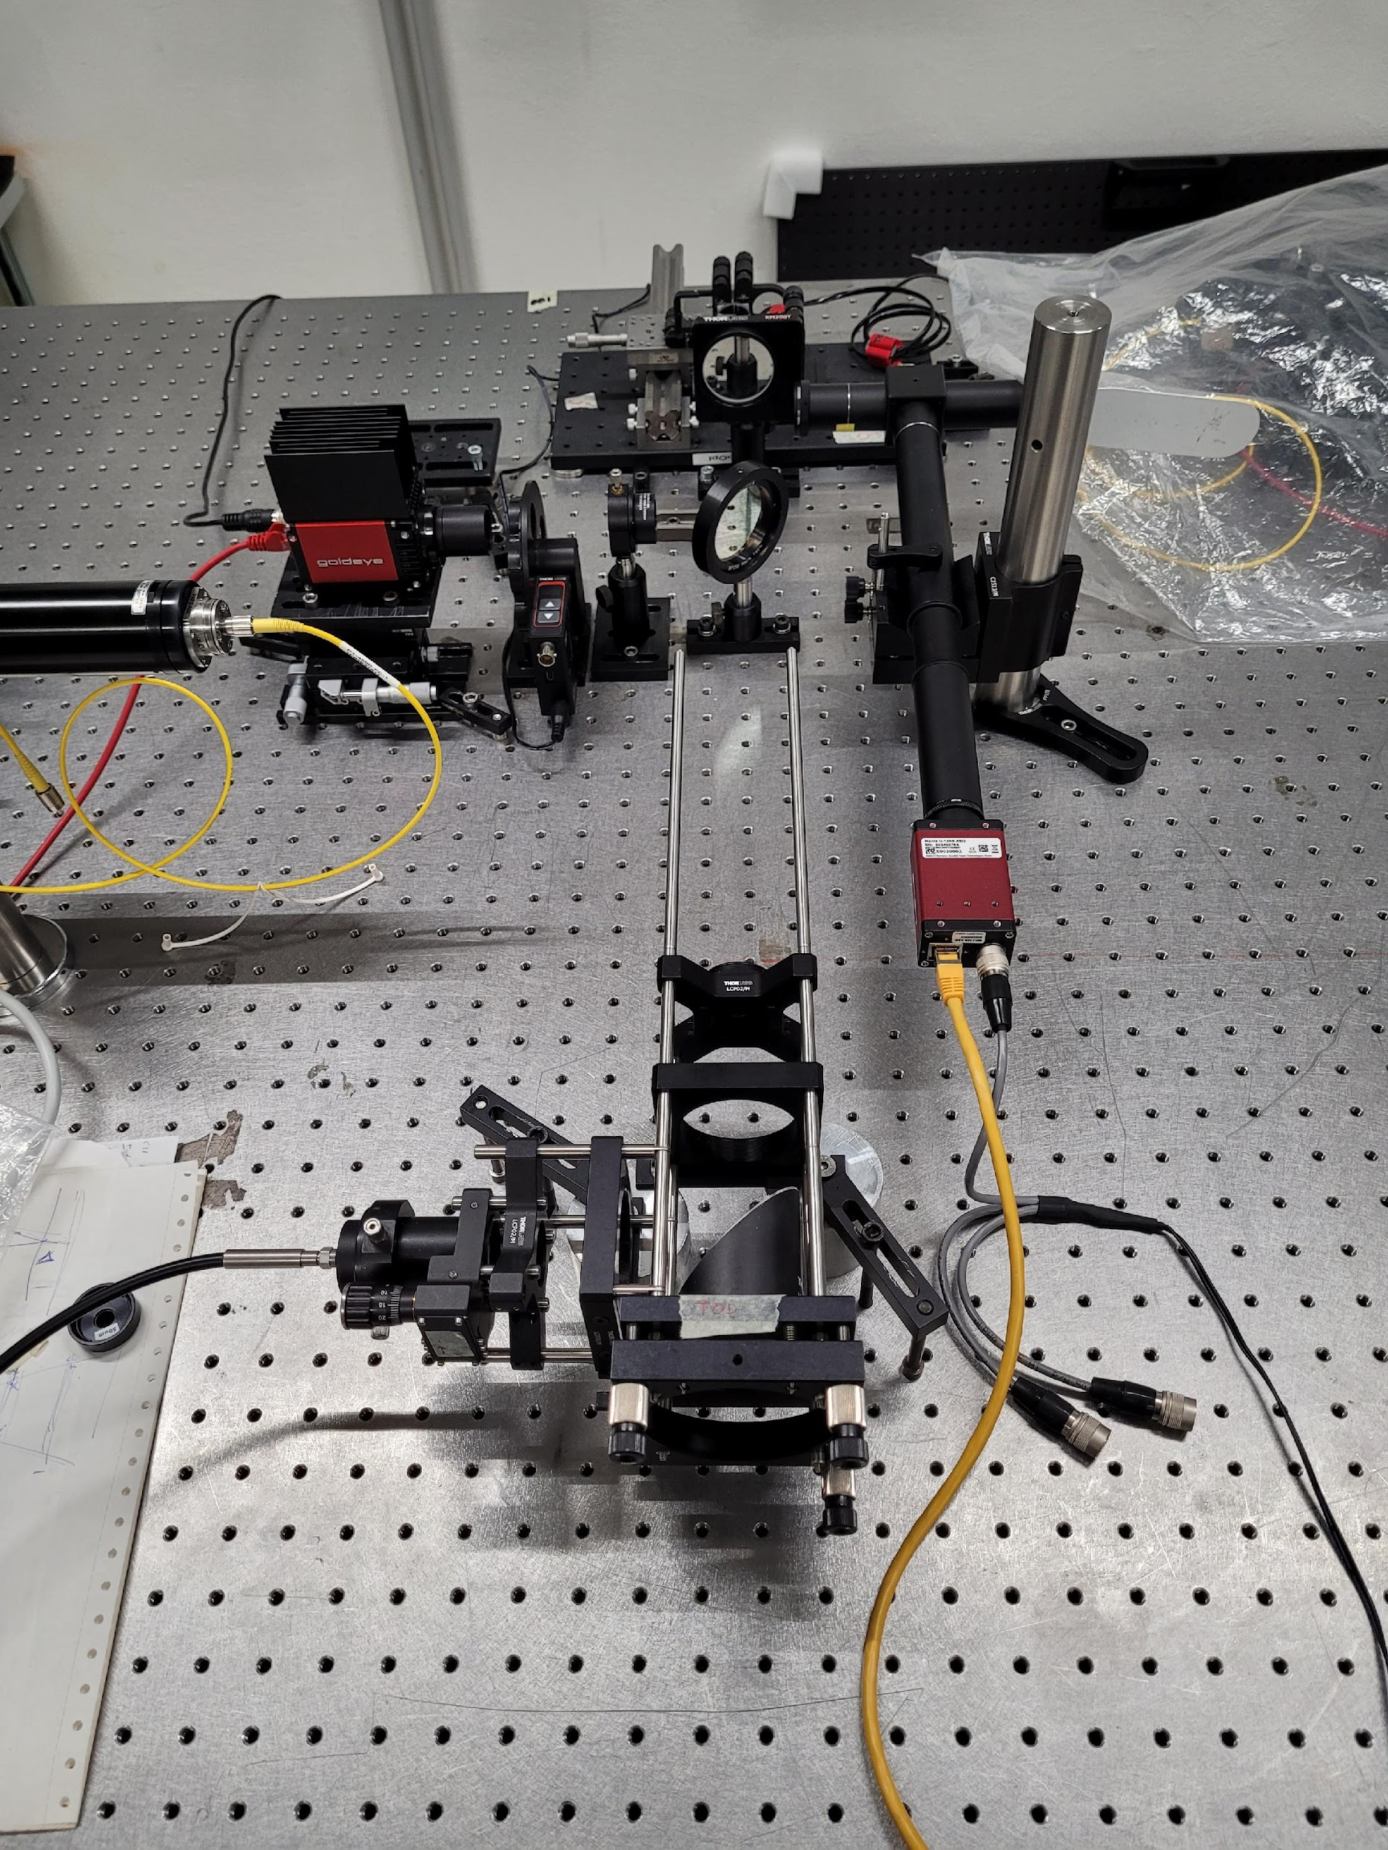
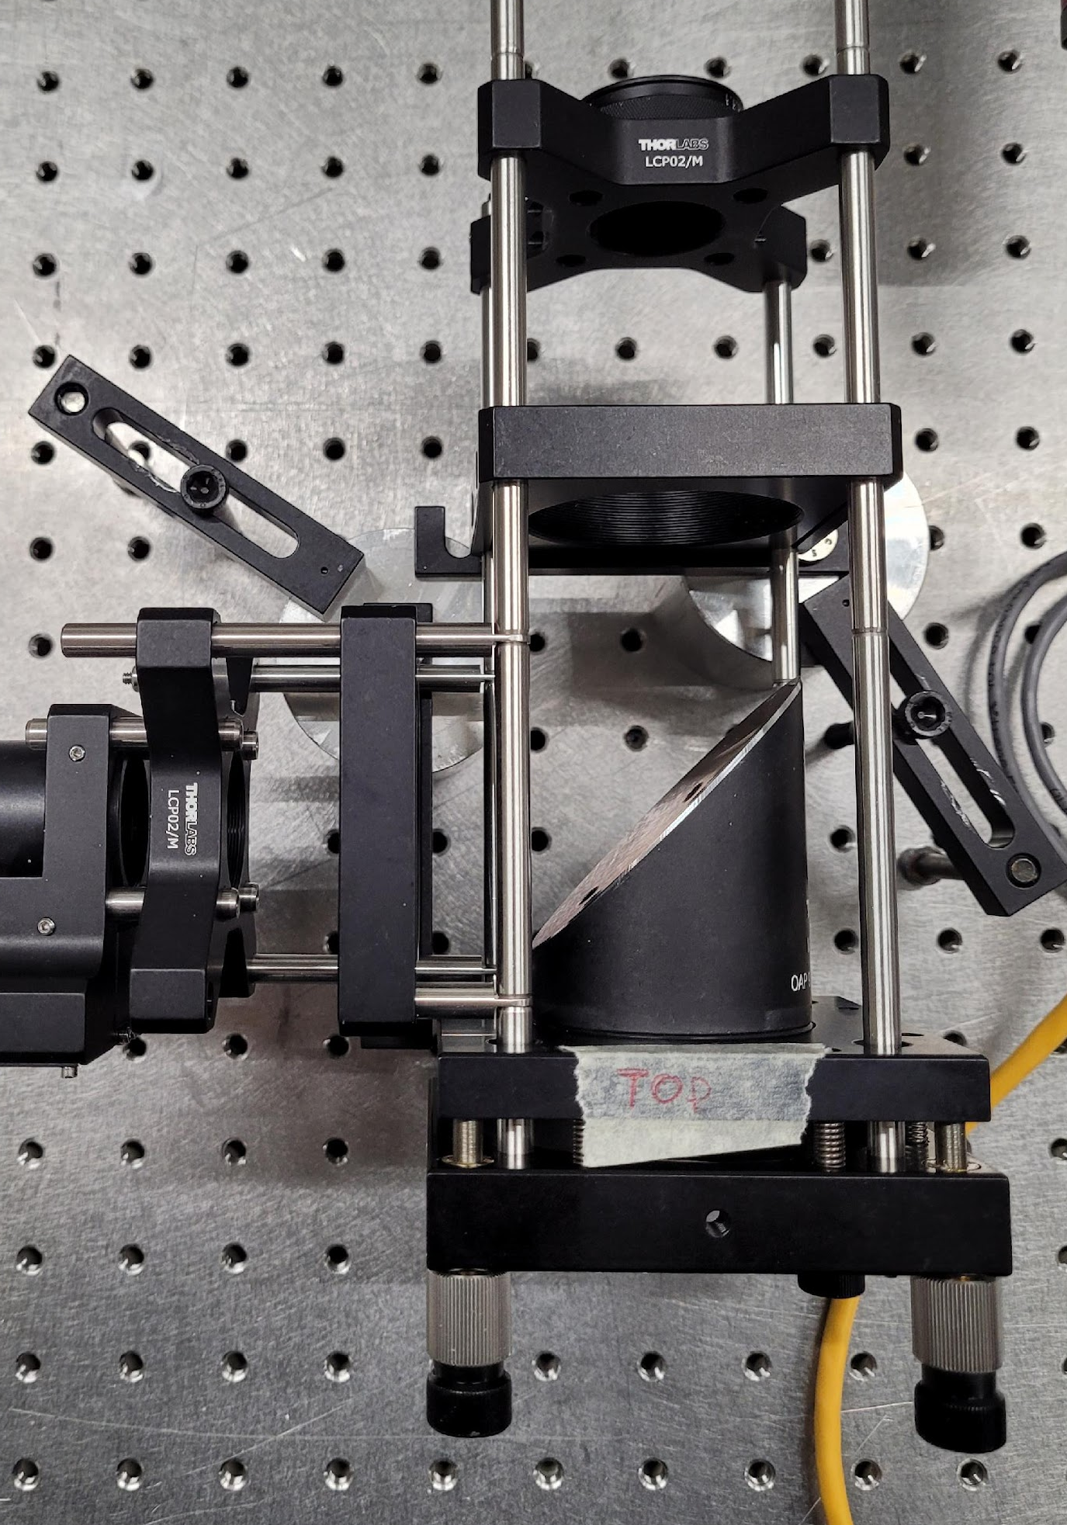
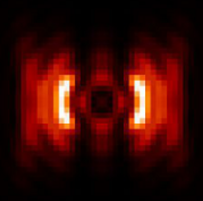
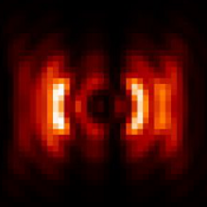
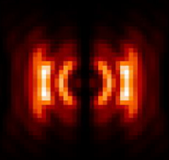
LIFT test bench
LIFT camera
with filter wheel
Diff. piston generator
(flat mirror cut in half)
Encoder on Z translation
Fiber output + parabolic mirror for collimation
pist = 0
pist = λ/5
pist = λ/2

Slide 10
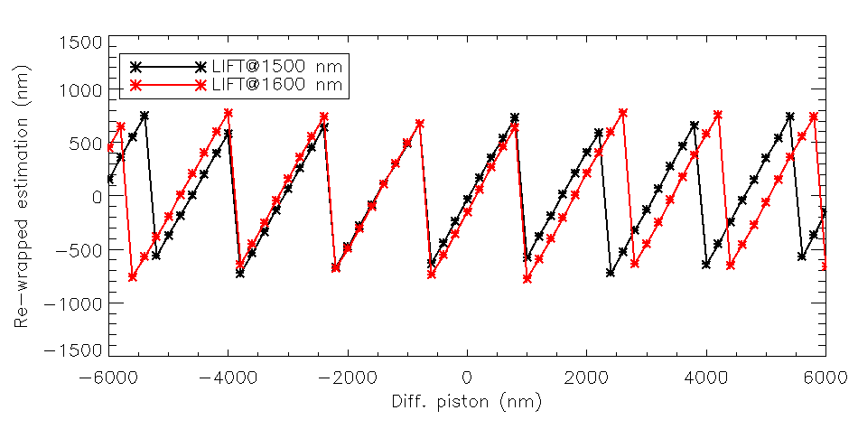
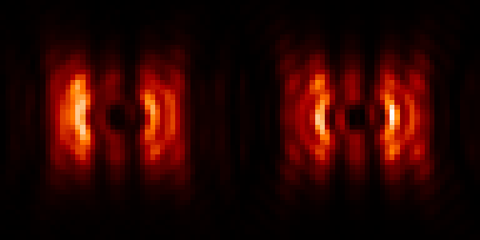
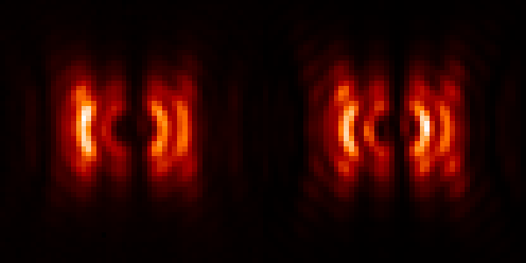
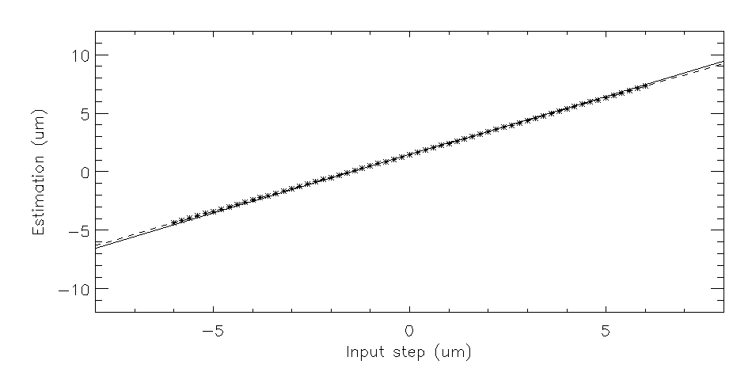
Results
Data
Rec
1500 nm
1600 nm
Successful estimation in double H band (1500 + 1600 nm) on 12 um range
RMS w.r.t. fit: 16 nm
Fit: y = 0.97 x

Slide 11
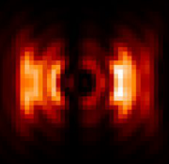
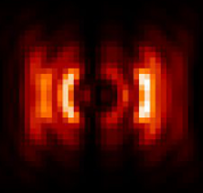
Limits
Diff. tip/tilt → bias on the estimation
Ok if bias << λ/2 on main channel
Model-based → sensitive to model errors
Pupil apodization
Uncalibrated NCPAs
…
Tip 50” on one segment (no piston)
Diff. piston -360 nm

Slide 12
Conclusion & perspectives
First experimental demonstration of differential piston sensing with LIFT!
Next:
Setup improvement
Tests in presence of simulated residuals
On sky?

Slide 13




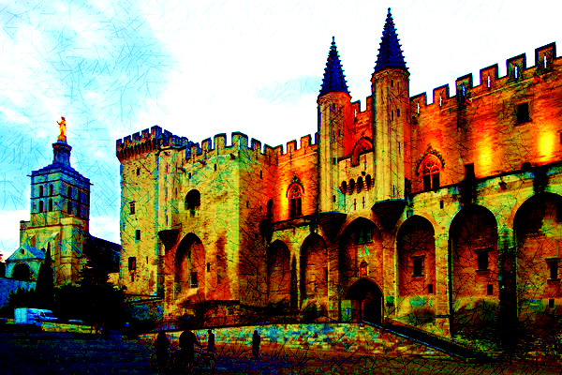









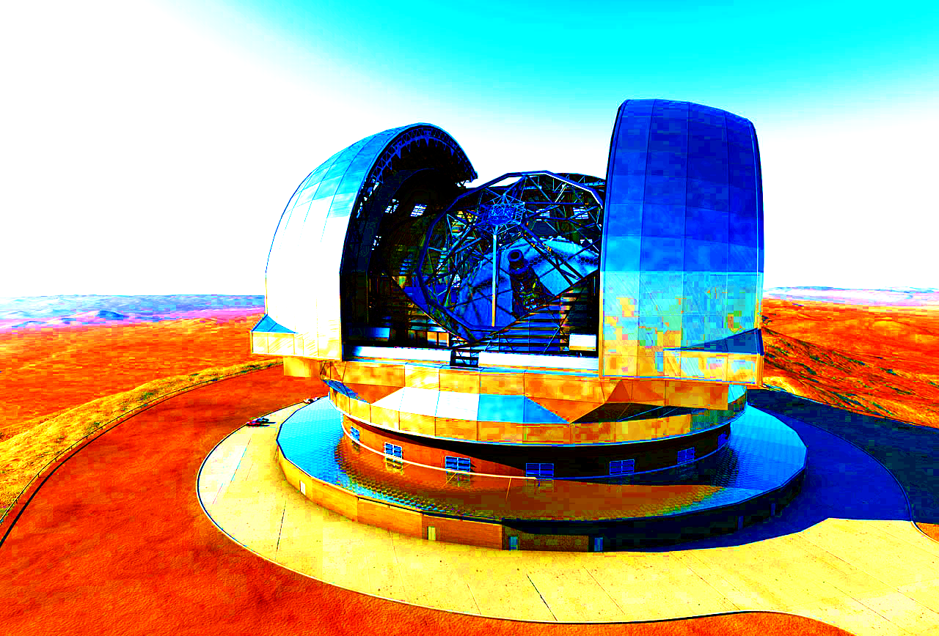
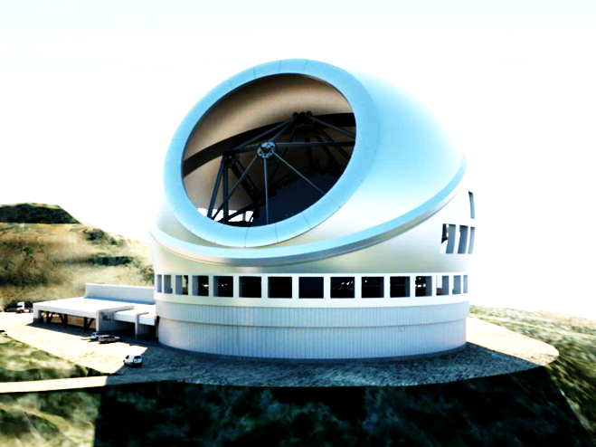
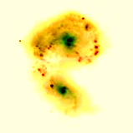
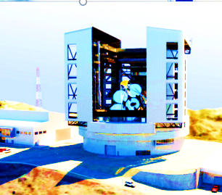
AO 4 ELT - 7th Edition 25 to 30 ^{th} June 2023 Palais des Papes, Avignon, France
Web site : ao4elt7.sciencesconf.org
More information: Thierry.Fusco@onera.fr, Benoit.Neichel@lam.fr

Slide 14
Thank you for your attention!
Questions?

